Slide 1
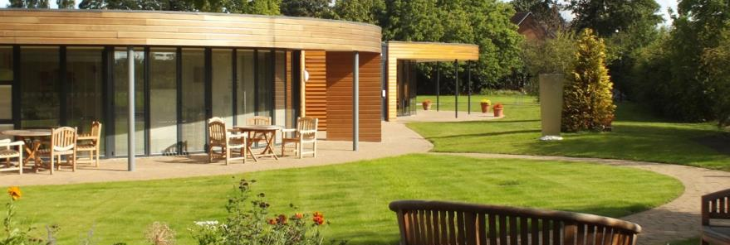
Improving information sharing whilst ensuring patient confidentiality at end of life.
Paula Powell
Medical Director Willowbrook Hospice

Slide 2
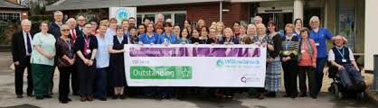
Who are we?

Slide 3
Who are we?
12 bed In Patient Unit providing Specialist Palliative Care
Over 100 staff and 500 Volunteers
Medical Director (Caldicott Guardian), Corporate Director (SIRO) Clinical Director (Registered Manager CQC)
Many thousands of interactions with patients and families every year

Slide 4
My experience as a Caldicott Guardian in end of life care
What issues do I see as a Caldicott Guardian – examples in practice
Caldicott decision making: improving practice and supporting frontline staff
Information sharing after death

Slide 5
Caldicott Principles
5 – Everyone with access to personal confidential data should be aware of their responsibilities
7 – The duty to share information can be as important as the duty to protect patient confidentiality

Slide 6
Key Challenges
Creating a ‘culture of confidentiality’ that supports patients and loved ones.
Sharing information when patient lacks capacity
Confidentiality after death

Slide 7
Culture of Compassion and Courage
It is our duty to protect the information we hold about people and the intimate confidences that can be shared at the end of people’s lives.
We protect it but we do not own it

Slide 8
It’s the small things day to day
Consider your ‘Touch Points’ – walk through the interactions you have with patient and carer data.
Signing in sheets
Ward ‘at a glance board’
Daily MDT
Patient records
Making appointments
Faxing
Education

Slide 9
Find the right way to share
“Paula – we need your advice”
Mr As son (doctor) has asked to see his Dad’s scans before he goes with him to his oncology appointment next week.
Can we do that?
Can we do that?
What do you need to know?
How might you manage this?

Slide 10
Find the right way to share
Has the patient got capacity?
Is the patient aware of the request?
Has he consented?
Is he aware of the results of his scans?

Slide 11
Encourage learning from breaches
Patients A and B attended the hospice with their district nursing notes.
At the end of the day Patient A went home with Patient B’s notes
Husband reported the error the next day
He dropped them off at the front desk with a volunteer unsealed.
Breach reported the following week

Slide 12
Issues?
Clear breach of confidential information
Potential for second breach when notes returned
Delay in reporting breach
Outcome?

Slide 13
Sharing information about those without capacity
Presume in favour of sharing.
This doesn’t mean all the information you have.
Share what is immediately relevant e.g. the scans show progression, we think what we are seeing is dying.
Its not about sharing other people’s information.

Slide 14
Confidentiality after death
Pay attention to the legislation – Access to Health Records Act1990
Right to confidentiality persists
Access for personal representative and those who may have a claim arising from the death

Slide 15
‘Real Life’ case
Patient died in our care. During admission had variable capacity
During admission made a will benefiting solely his 2 young adult children. Ex wife executor. Will witnessed by 2 friends. No solicitor present. Hospice not aware and had not been asked to make a capacity assessment.
NOK sister – raised immediate concerns that will made when he did not have capacity. Did not wish to discuss with him. Patient had given consent to share any information with his immediate family. Sister requested that her concerns were documented in his notes that the will may not be valid.

Slide 16

After death we received 2 SARs – from nominated NOK and Executor of the will.
Neither request initially stated why access was desired or to what information

Slide 17
Appropriate response?
Has the patient indicated that he did not wish to have information shared?
Seek assurances e.g. evidence of Executor, passport and signature.
What does the request relate to? What information is sought?
What information do we hold? Is there third party information that should be redacted?

Slide 18
Outcome
The NOK wished to see the notes from the time the will was made to ascertain if he had capacity in order to contest it.
Advised that seeking legal advice may be a good next step. Nil further contact.
The Executor (ex wife) wanted the notes so she could understand what had happened with the patient’s illness and explain this to her children.
Offer made to meet and discuss the medical care and explain the medical notes – notes given were redacted to exclude conversations with third parties.

Slide 19

Golden Nuggets
Be an ‘everyday’ Caldicott Guardian
Instill protecting information and sharing well in staff
Learn from incidents
Know the law
Find a Buddy

