Slide 1
Controlled Drugs Manager
High-Level Overview
Daniel Hinchley – International Business Development Manager

Slide 2
Product Vision
To provide an innovative, hospital-wide controlled drug management platform that...
Assists in controlled drug compliance, governance and reduction of drug diversion
Vastly improves hospital-wide controlled drug management efficiencies
Increases controlled drug register accuracy
Is adaptable to your hospital’s unique logistical and technical environment and controlled drug register process
Is intuitive and easy to use and learn

Slide 3
Value Proposition

Slide 4
Governance & Compliance
Capabilities
Real time alerting
Reporting
Audit tracking
Enforcement of precise and consistent procedures
Outcomes
Reduce potential for fraudulent behavior
Improve investigative processes
Increased visibility
Improved safety

Slide 5
Operational Efficiencies
Paperless solution
Integrated
Automated inventory control
Fast access to data

Slide 6
Register Accuracy
Easier legibility of register entries (no more paper register legibility issues)
Elimination of incorrect manual additions/subtractions
Filtered, customised reporting allows potential human errors to be quickly identified

Slide 7
Key Features

Slide 8
Functional Capabilities
Designed for use for all areas within hospital where controlled drugs are stored/used
Location-specific functionality
POD management
Alerting and alert management
Flexible reporting (print/save/filter)
Integrations – PAS (HL7), Pharmacy and EPMA/EPR systems available
Inventory management
Customisation and configuration
Workflows
Authentication and authorisation

Slide 9
Technical Overview
Integrates with dispense, inventory and other systems
On-premise, hybrid-cloud or full cloud hosting options
Offline capability in case of system outages
Optimised for PC and Windows tablets
Supports Citrix environments

Slide 10
Implementation, Training and Support

Slide 11
Implementation, Training and Support
Implementation process aligned to hospital IT and clinical standards and processes
Multi-staged rollout recommended: Pharmacy ⇾ A few wards ⇾ full hospital
WellSky provide all Training materials and documentation necessary.
WellSky provides exceptional support governed by SLA response and resolution targets.

Slide 12
Workflow Driven User Interface

Slide 13
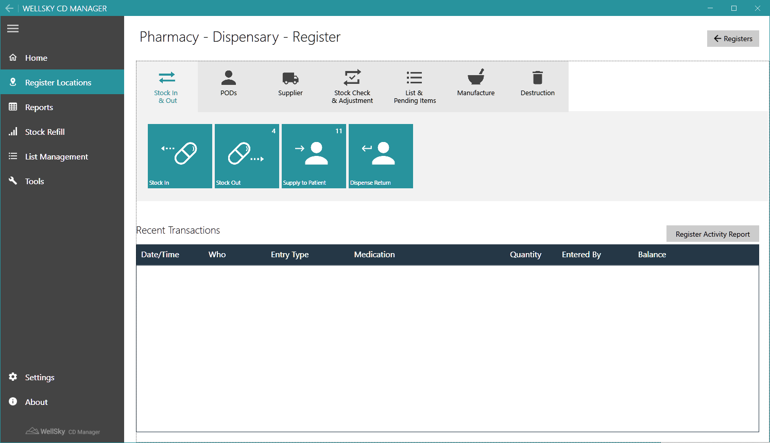
Pharmacy Registers

Slide 14
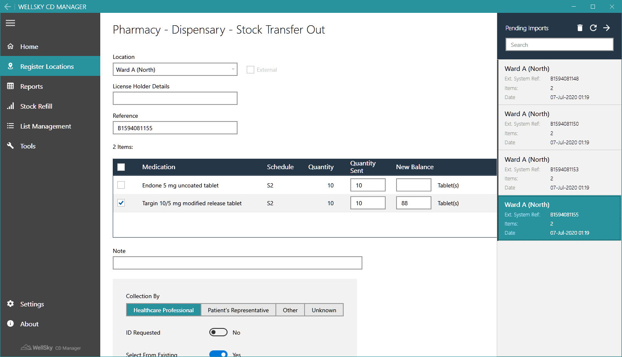
Pharmacy Registers – Supply to Ward Wards or Sale

Slide 15
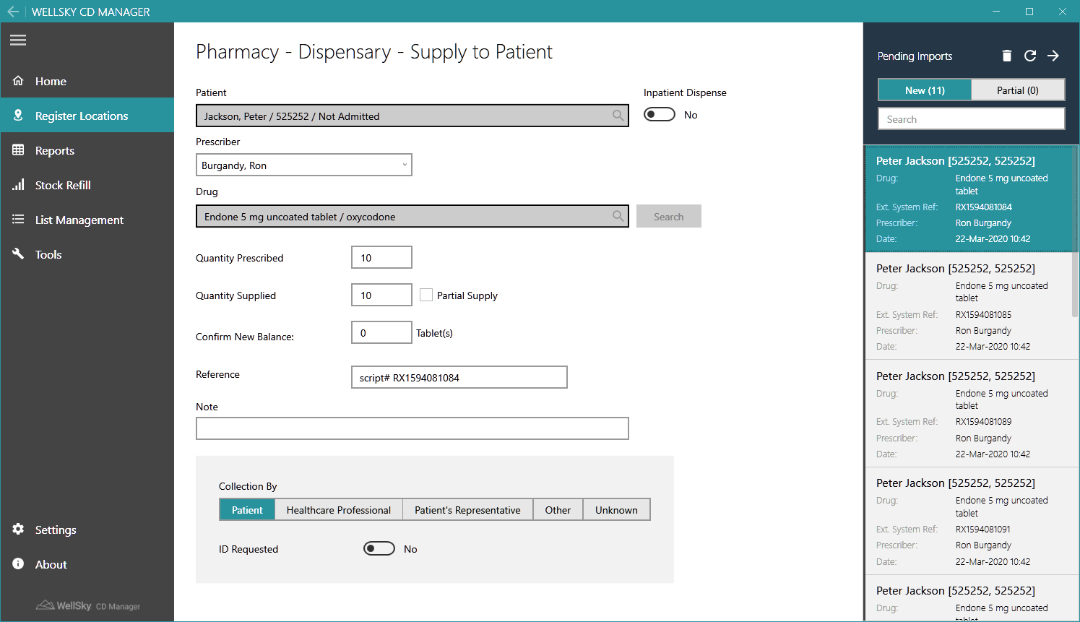
Pharmacy Registers – Supply to Patients

Slide 16
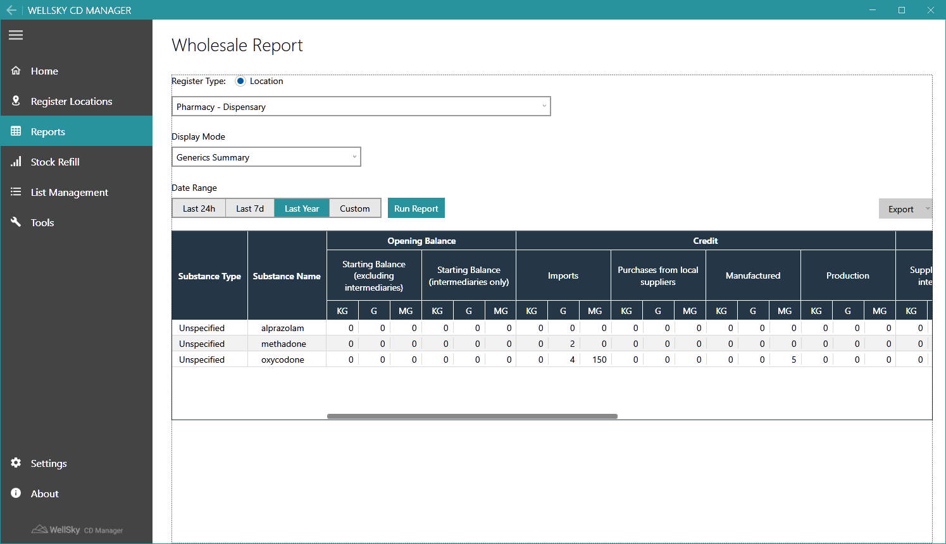
Built-in Home Office Report

Slide 17
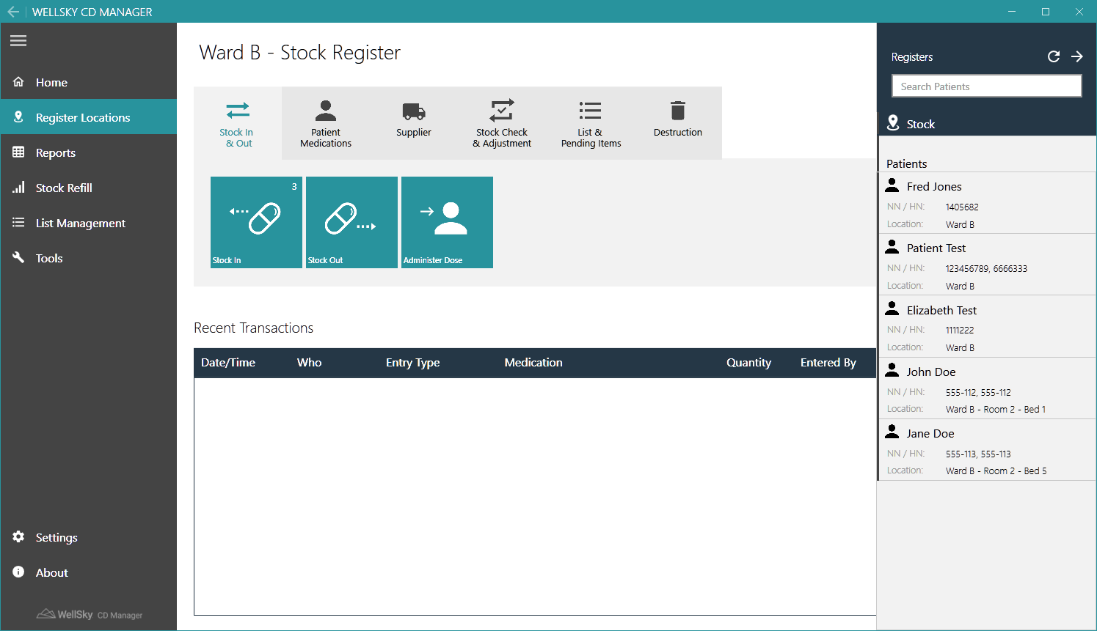
Ward-Based Registers

Slide 18
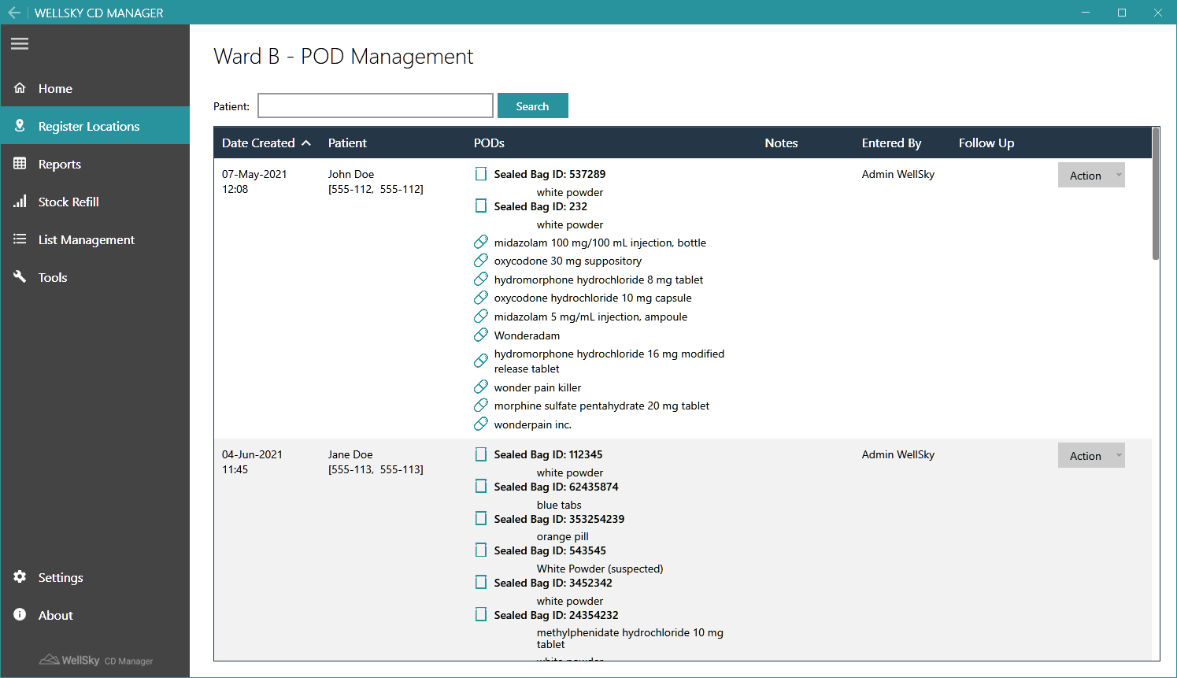
Comprehensive CD POD Management

Slide 19
Thank You
For more information contact wsisales@wellsky.com
01268 416348
www.wellsky.org

