Slide 1
Legal Supply Chain Issues Controlled Drugs / Stolen Drugs
Grant Powell
Legal Supply Chain Team
MHRA Enforcement Group

Slide 2
LEGAL SUPPLY CHAIN TEAM
Established in 2016 in reaction to increase in referrals to the MHRA.
Noted increase in unlawful websites advertising UK Supply Chain controlled drugs ‘for sale’ - without prescription - at enormously inflated prices.
Websites operated by Organised Crime Groups.
Where are they sourcing the controlled drugs from?
Notes:
There were also increased reported seizures of UK supply Chain controlled drugs by police up and down the country.
Huge quantities of UK supply chain controlled drugs seized in Northern Ireland and Scotland. Enquiries with manufacturers and major wholesalers identified inflated purchasing.

Slide 3
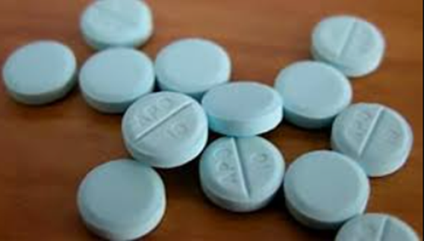
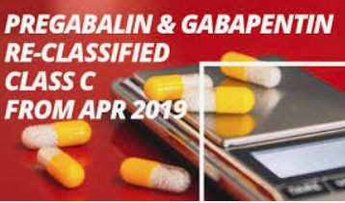
Watchlist Products
Diazepam
Nitrazepam
Zopiclone
Zolpidem
Temazepam
Tramadol
Codeine based products
Pregabalin
Gabapentin
Notes:
Why these products? Because that’s what is being commonly advertised on the Unlawful websites. Not exclusive though. Open to identifying new trends.

Slide 4
Benzodiazepines Opioids and Z Drugs
Controlled Drugs - as defined by the Misuse of Drugs Regulations 2001 and the Misuse of Drugs Act 1971
Licensed for short term usage on prescription.
All carry potential for misuse and dependence.
Dependent users gradually increase dose.
The prescribed dose is normally 1 tablet per day for 28 days.
Notes:
Usually the lowest dose is prescribed. Doctors are encouraged not to re-prescribe / continuously prescribe due to addictive nature of the drugs.
Higher doses usually administered at nursing homes / hospitals. However it is exactly this that drives the demand.
Users become dependant on the product and then find the same product advertised on –line – UK Supply chain so they buy with confidence.

Slide 5
Fatalities involving Benzodiazepines – England, Wales and Scotland
Risk to Public Health?
Year | 2015 | 2016 | 2017 | 2018
Benzodiazepines | 867 (366 Eng & Wales / 501 Scotland) | 1038 (406 Eng & Wales / 632 Scotland) | 1102 (391 (Eng & Wales / 711 Scotland) | 1340 (420 Eng & Wales / 920 Scotland)
“The number of deaths involving zopiclone or zolpidem has steadily increased”
Sources:
ONS, Deaths Related to Drug Poisoning in England and Wales
NRS, Drug-related deaths in Scotland
Notes:
There are many deaths linked to benzodiazepine and Z drug use / misuse. The figures quoted above are just benzodiazepines. The data for 2019 is not yet published by the Office for National Statistics but you can see the year on year increase.
Frequently contacted by Police from throughout the UK to assist where drugs are found at the scene of death and found to have been purchased unlawfully.

Slide 6
So what’s the issue?
GENUINE products intended for supply within the United Kingdom.
Unlawfully diverted from the legitimate supply chain.
In the majority of cases these are not stolen products.
Some wholesale dealers are wilfully neglecting their responsibilities / not completing adequate due diligence / permitting excessive purchase.
The medication is then being sold onward unlawfully to feed / supply illegally trading websites.
Notes:
Recap – Genuine UK Supply Chain products being offered for sale without prescription at vastly inflated prices. How are the products being sourced if they’re not diverted.

Slide 7
Example of an Investigation from 2016
27,000 packets (28 tablets per packet) of Diazepam on three pallets were recovered from a hired van by Police in Scotland.
Original manufacturers packaging.
Order traced as part of a 50,000 packet order fulfilled by a London based wholesaler (1.4 million individual doses).
Order made via a personal e-mail account.
Payment made via a personal bank account.
Collected in person from the wholesaler.
Pharmacy that the purchaser claimed connection to does not hold a WDA(H).
Poor quality counterfeit WDA(H) was produced to the wholesaler.
No Home Office Controlled Drugs License held.
Notes:
Obviously the order should not have been made from a personal e-mail account – and that should have created suspicion.
Even more suspicion should have been created by the purchase from a personal bank account.
Collected in person – alarm bells? Purchaser claimed to be connected to a pharmacy.
No due diligence enquiries made. If they had they’d have found the pharmacy doesn’t hold a WDA(H).
A poor quality counterfeit WDA(H) was presented at the point of collection. No HOCDL either.

Slide 8
Legitimate Distribution Methods
The only legitimate methods of distribution by a pharmacist are:
Against prescription –
By authorised wholesale dealing.
To wholesale deal TWO licences are required:
A Wholesale Dealers Authorisation (WDA(H)) including endorsements for Narcotics & Psychotropics.
A Home Office Controlled Drugs License (including export authority if export is intended).
Notes:
Only Legitimate distribution is against prescription. Or licensed wholesale dealing.
In each investigation the wholesaler diverting does not have a WDA(H) including the endorsement of Narcotics and Psychotropics.
Nor have they had a HOCDL. More due diligence is needed. Why is a pharmacist ordering thousands of packets? Have you checked If the wholesaler ordering has the requisite endorsements ?
Yes – a pharmacist can purchase using his / her pharmacy licence but only for dispensing against prescription.

Slide 9
How much is dispensed?
An average High Street pharmacy will dispense around 10-15 packets a week against prescription (all strengths of product combined).
Usually prescribed at its lowest strength.
Higher strengths are normally used in hospitals and nursing homes.
Re-ordered following dispensing – not stockpiled.
Relatively low purchase price. Easily re-ordered – no need to stockpile.
Notes:
Very small quantities are dispensed. Generally patients don’t get repeat prescriptions. Easily re-stocked and low value at wholesale levels.

Slide 10
How much is being purchased?
Then….
In 2016 instances of 20,000 packets of Diazepam at 10mg strength regularly being delivered to community pharmacies.
No WDA(H) held / no endorsement for Narcotics & Psychotropics.
No Home Office Controlled Drugs Licence held.
Some wholesalers not conducting effective due diligence.
Now….
Advisory cap of 100 packets maximum order.
Greater due diligence surrounding the correct licences being in place.
Notes:
MHRA encouraged wholesalers to put a 100 box cap on purchases without questions being asked.
Encouraged due diligence to be conducted.
YOU have a legal duty to ensure that the product is being sold properly.
These are CONTROLLED DRUGS. They have been legislated as such for a reason. They are dangerous in the wrong hands.
The market has been fuelled by the ease that the product was able to be purchased. The users – who often are not ‘drug addicts’ in the sense of how the media portrays addicts – are frequently in debt from the inflated pricing of the products.

Slide 11
One Pallet containing 13,440 packs of Diazepam
Notes:
To give you an idea. This is a pallet of 13,440 packs of diazepam. It is for illustrative purposes only.
When I speak about a pharmacy regularly taking delivery of 20,000 packs they were delivered on two pallets.
The delivery was allegedly made to a premises where that quantity of diazepam would not physically fit.
When you drill down to the delivery you find that the driver was asked to deliver to a small lock up nearby / or to the back of another van.

Slide 12
So what has happened since 2016……?
Over 40 investigations commenced.
Over 90 persons arrested / interviewed under caution
11 Pharmacists suspended by GPhC
Multiple Websites taken down.
Two Data trawls completed.
Numerous prosecutions undertaken.
Several convictions of persons responsible for diverting the drugs.
Notes:
You may have been involved in the data trawls. Thank you for the data you have provided.
It was analysed / graded and where appropriate action has been taken.
It helped to identify where some offenders purchased from multiple wholesale dealers and kept below the 100 packet purchase cap so as not to rouse suspicion. You need to be aware of that.
There are also prosecutions pending against those who were running several unlawful websites. It’s only a matter of time before the finger is pointed back at the wholesalers responsible.

Slide 13
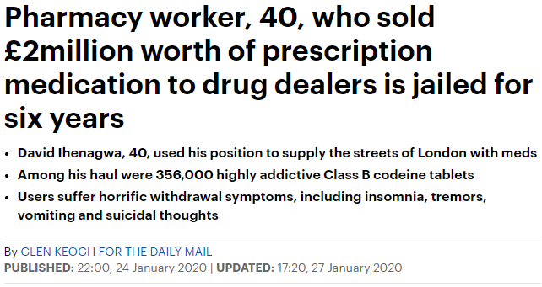
Notes:
Some examples of recent prosecutions. It is interesting that on each occasion the person responsible has pleaded Guilty due to the weight of evidence against them.
Some have sought to mitigate their wrongdoing by referencing the lack of restrictions upon purchase.
Many more prosecutions now coming before the courts.
Including persons not connected with the industry but that were running the websites.

Slide 14
Penalties
As a Pharmacist / Wholesale Licence Holder:
Loss of Pharmacist registration.
Loss of Wholesale Licence.
Criminal prosecution under the Human Medicines Regulations 2012 –
2 years imprisonment / unlimited fine.
Criminal prosecution under the Misuse of Drugs Act 1971.
14 years imprisonment / unlimited fine.
Notes:
Reputational damage / loss of business. Loss of livelihood. Criminal conviction . But it doesn't affect you does it? You haven’t sold to the end user. You’re not a drugs dealer…..Think again.

Slide 15
Section 21 of the Misuse of Drugs Act 1971 – Unlawful Supply of Controlled Drugs
Offences by Corporations
‘Where any offence under this Act is committed by a body corporate, is proved to have been committed with the consent or connivance of, or to be attributable to any neglect on the part of, any director, manager, secretary or other similar officer of the body corporate, or any person purporting to act in any such capacity, he as well as the body corporate shall be guilty of that offence and shall be liable to be proceeded against accordingly.’
The penalty is the same as for the substantive offence –
Upon indictment - 14 years imprisonment / unlimited fine.
Notes:
That’s YOU. I mentioned deaths earlier and the Police making enquiries on behalf of the Coroner. Websites identified as having sold to the deceased. Imagine if the product was traced back to your ‘Body Corporate’

Slide 16
Some Good News
Greatly Reduced over-purchasing without the requisite licences.
Greater vigilance by wholesalers.
Many websites no longer offering UK Supply Chain products.
-73% reduction in wholesale of 10mg Diazepam between 2016 – 2017.
Some Bad News
Increased reporting of Burglaries / Theft from motor vehicles (lorries).
Issue not eradicated – there are still individuals determined to divert product.
Notes:
But – good news. Much less UK supply chain product is being sold unlawfully.
The industry has tightened up its act. Huge reduction in the trading of the watchlist products.
-73% for Diazepam 10mg in one year 2016 - 2017. Similar reductions in other watchlist products. This data is taken from the data trawls conducted and that is why it is historic. A new data trawl would give current trading ratios.
Can’t quantify Pregabalin / gabapentin as it was only made a class C drug in April 2019.
However there's always a taint. Theft is becoming more prevalent. Make sure you have suitable safeguards in place.

Slide 17
Ongoing Issues………
Still not enough Due Diligence being undertaken in some instances.
Still have examples where Wholesale Dealers without the endorsement of Narcotics & Psychotropics on their WDA(H) have managed to purchase large quantities of controlled drugs – from several wholesalers.
Recent case of very high value hospital line pharmaceuticals being stolen.
Then re-introduced to the supply chain by a ‘Wholesale Dealer’ – No WDA(H) held.
Insufficient checks made by the purchasing wholesale dealer to confirm that the vendor is authorised to sell the products.
Notes:
It is still going on though. Still insufficient due diligence in some cases.
Other issues have included the systematic theft of extremely valuable cancer drugs and other high valued drugs over a period of time.
The thefts were from a hospital pharmacy. The drugs were then sold back in to the supply chain by ‘wholesale dealer’ with no track record or licences of any kind. The drugs were purchased by a second licenced wholesale dealer who then sold them on again.
MHRA have quarantined the stock that can be traced – it had left the supply chain and is not able to be vouched for. Much of it should have been temperature controlled. It is now classified as a ‘falsified medicine.

Slide 18
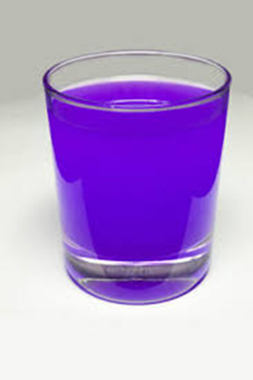
Emerging Problems
‘Purple Drank / LEAN is a recreational drug, created by combining prescription-grade cough syrup with a soft drink and hard candy. The concoction originated in Houston, Texas and is popular among those who belong to the hip hop subculture – Wikipedia’
Regular overordering of Codeine Linctus (Cough Medication) and Promethazine Hydrochloride (Phenergan Elixir) used to treat allergies / travel sickness / sleeping difficulties.
More frequent fraudulent purchasing attempts by ‘ghost purchasers’ claiming to be pharmacists.
Causes euphoria, motor-skill impairment, lethargy, drowsiness, and a dissociative feeling from all other parts of the body.
Notes:
Lastly – there is an ongoing problem with these two products. Both are pharmacy only medicines and are not restricted by the Misuse of Drugs regulation / Misuse of Drugs Act. Again some smaller wholesale dealers are purchasing in large quantities 500 – 2000 bottles. Why would any pharmacy want that quantity? It is in high demand. Please be vigilant.

Slide 19
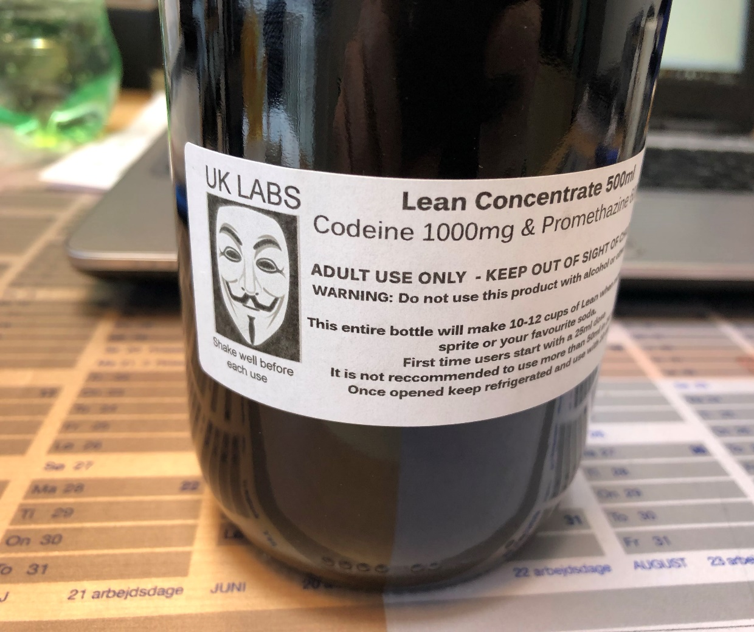
Recent Seizures of Purple Drank / LEAN
Recently there have been seizures made of a premixed concoction of Purple Drank / Lean.
Please be vigilant when selling the products described.

Slide 20
Thank You for your attention…………….
If you have any information please report to the MHRA:
casereferrals@mhra.gov.uk
YellowCard via mhra website
whistleblower@mhra.gov.uk 020 3080 6447
Grant Powell
Supply Chain Team
MHRA Enforcement Group

