Slide 1
Leadership for Improvement Developing and fine tuning your leadership skills
Effective Medical Directors
Virtual Conference Portal
Friday 18th June 2021
Alan Nobbs, Head of Design and Development
@Alannobbs

Slide 2
Thinking of my ideal self, who do I really want to be and what do I want out of my life and work?
From: Goleman, D., Boyatzis, R. E., & McKee, A. (2002)
The New Leaders – Transforming the art of leadership into the science of results

Slide 3
You can’t impose anything on anyone and expect them to be committed to it.
Source: Edgar Schein
Professor Emeritus, MIT Sloan School

Slide 4
Knowing
Doing
Being
Notes:
Show video of Asch Experiment behaviours
The good and bad news; people will conform to the norms of the group

Slide 5
ATTENDING
Being fully present & listening with fascination
EMPATHISING
With different views and mindsets
Compassionate Leadership
UNDERSTANDING
Sharing an understanding of what they face
HELPING
Taking intelligent action to support or help
Michael West
Professor of Organisational Psychology, Lancaster University Management School

Slide 6
CONTENT
TASK
PROCEDURE
INTERACTION
PROCESS
EMOTION
Notes:
This helps me bring a little sharper clarity to the attention of participants – building upon the notions of ‘being’ and ‘doing’; this helps me focus people’s minds as to where ‘most of their effort’ is often focussed whilst challenging them to consider where ‘most of the risk’ to their endeavours really lies.

Slide 7
SELF
SOCIAL
SELF-AWARENESS
Emotional Self-awareness
Accurate Self-assessment
Self-confidence
SOCIAL AWARENESS
Empathy
Organisational Awareness
Service Orientation
RECOGNITION
SELF-MANAGEMENT
Self-control
Transparency
Adaptability
Achievement Drive
Initiative
RELATIONSHIP MANAGEMENT
Inspirational Leadership
Developing Others
Influence
Change Catalyst
Conflict Management
Building Bonds
Teamwork & Collaboration
REGULATION
Emotional Intelligence Model: Daniel Goleman (2002)

Slide 8
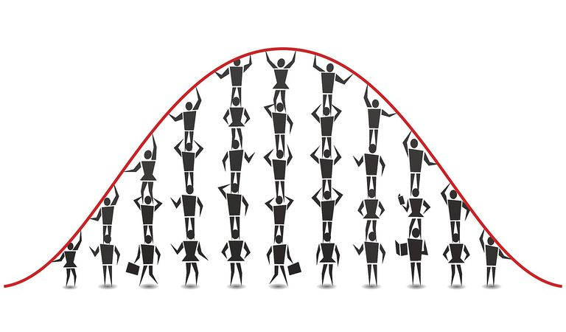

Slide 9
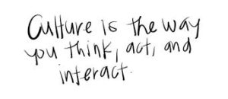

Slide 10
‘Every interaction by every leader at every level shapes the emerging culture of an organisation’
Michael West
Professor of Organisational Psychology
Lancaster University Management School

Slide 12
1. My Ideal Self:
Who do I want to be?
What do I want out of life and work?
4. Practicing…
…the new behaviour, building new neural pathways through to ‘mastery’
2. My Real Self:
How do I act?
5. Developing…
…trusting relationships, like coaches, that help, support & encourage me in each step
2. My Strengths:
Where my ‘ideal’ and ‘real’ self overlap
4. Experimenting…
…with new behaviour, thoughts and feelings
2. My Gaps:
Where my ‘ideal’ and ‘real’ self differ
3. My Learning Agenda
Building on my strengths whilst reducing my gaps
Goleman, D., Boyatzis, R. E., & McKee, A. (2002)
The New Leaders – Transforming the art of leadership into the science of results

Slide 13
Thinking of my ideal self, who do I really want to be and what do I want out of my life and work?
From: Goleman, D., Boyatzis, R. E., & McKee, A. (2002)
The New Leaders – Transforming the art of leadership into the science of results

Slide 14
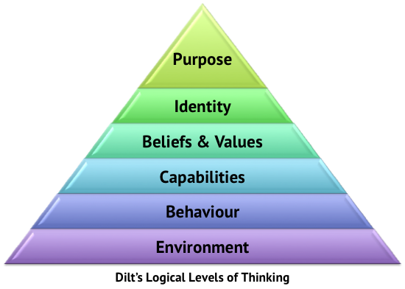
Source: Robert Dilts
Logical Levels of Thinking – Neuro Linguistic Programming
Source: Robert Dilts
Logical Levels of Thinking – Neuro Linguistic Programming

Slide 17
Thank you

