Slide 1
How the UroLift System can play a critical role in treating patients with BPH in ambulatory settings
MCI-2021-0361 (MAC01988-01 Rev A)
Ananda Kumar Dhanasekaran
Consultant Urologist, Sandwell & West Birmingham NHS Trust
Mr. Ananda Dhanasekaran is a paid consultant of NeoTract | Teleflex Interventional Urology MAC01988-01 Rev A : A Dhanasekaran BADS meeting

Slide 2
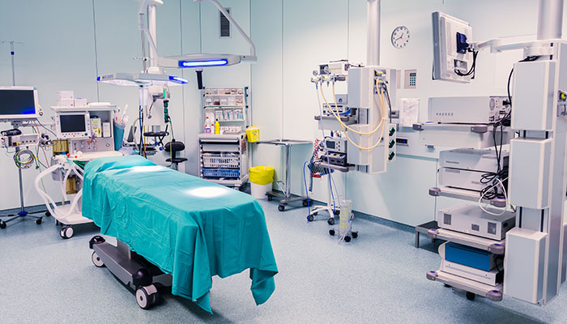
Day case surgery – Developing best practice pathways
Across all surgical admissions in England, use of day case surgery is increasing
66% of all surgical admissions are now undertaken as day cases.¹
Despite advances in surgery for benign prostatic enlargement (BPE):
Only 14% of BPH surgeries are carried out as day case²
TURP is one of the elective procedures identified by BADS/GIRFT for development of a day surgery pathway¹
Yet only 5% of TURP is carried out as day case (2019/20)²
Opportunity remains to increase and broaden day case surgery across England,¹ particularly in BPH
GIRFT, CPOC, and BADS (2020). Report: National Day Surgery Delivery Pack
Hospital Episode Statistics, NHS Digital, 2019

Slide 3
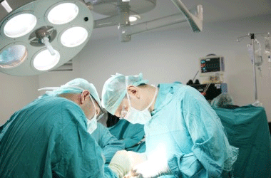
Transurethral resection of the prostate (TURP) – Current standard of care for LUTS from BPE
18,000+ TURP procedures performed each year (England)¹
Despite advances, only 5% of TURP performed as day case¹
Involves removing prostate tissue
Length of stay = 2 days¹
General anaesthetic^{2,3}
Theatre time = 60-90 mins^{2,3}
Complex and persistent complications, including:⁴
Bleeding
Infection
Incontinence
Permanent sexual dysfunction (erectile and ejaculatory)
Prolong length of stay and place further burden on the NHS
1. Hospital Episode Statistics, NHS Digital, 2019.; 2. NICE Shared Learning Case Study. Urolift – a community-based alternative treatment for Benign Prostatic Obstruction (BPO). Royal Devon & Exeter NHS Trust. Nov 2019. 3. NICE Shared Learning Case Study. Urolift – Adoption of UroLift procedure, an ambulatory pathway for patients suffering from Lower Urinary Tract Symptoms of Benign Prostatic Hyperplasia. Norfolk & Norwich University Hospitals NHS Trust. Nov 2016.; 4. Gravas, S. et al. (2021). EAU Guidelines on Management of Non-Neurogenic Male Lower Urinary Tract Symptoms (LUTS), incl. Benign Prostatic Obstruction (BPO).

Slide 4
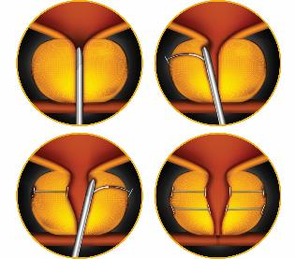
UroLift System – Prostatic Urethral Lift
The UroLift System uses adjustable, permanent implants to retract the prostatic lateral and median lobes and reduce urethral obstruction so that it does not narrow or block the urethra.
The UroLift System device is designed to relieve symptoms of urinary outflow obstruction without cutting or removing tissue.

Slide 5
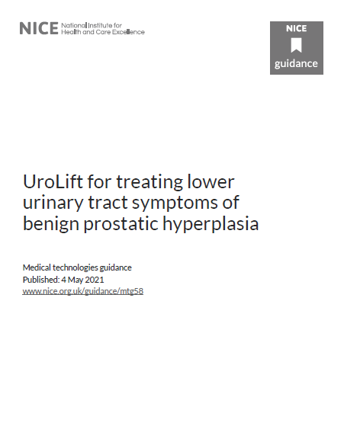
UroLift System – A minimally invasive procedure, which should be considered as an alternative to TURP and HoLEP
A quick procedure that can be done as a day-case or outpatient procedure
Local anaesthesia with or without sedation
Minimal risk to sexual function*
Improves quality of life
Sustained clinical benefit
Effective for treating obstructive median lobe
Cost savings arising from reduced length of stay and procedure time
NICE Guidance Update – May 2021¹
*No instances of new, sustained erectile or ejaculatory dysfunction in the L.I.F.T. pivotal study²
1. NICE. (2021). UroLift for treating lower urinary tract symptoms of benign prostatic hyperplasia. Medical Technologies Guidance, 4 May 2021.; 2. Roehrborn CG et al. Five year results of the prospective randomized controlled prostatic urethral L.I.F.T. study. Can J Urol 2017; 24(3); 8802-8813.

Slide 6
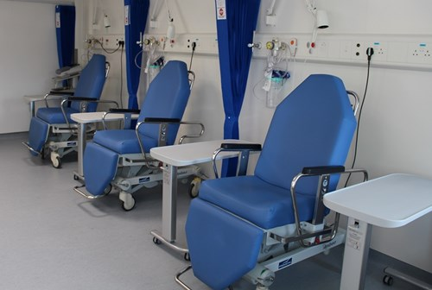
Key Procedures to move from day surgery to the outpatient setting
“It is important that appropriate outpatient minor procedures facilities exist to enable the change in care setting.”
UroLift System:
“Procedure where the focus should be to develop an outpatient rather than day surgery pathway”
BADS, GIRFT, CPOC. National Day Surgery delivery Pack 2020
GIRFT, CPOC, and BADS (2020). Report: National Day Surgery Delivery Pack

Slide 7
Introducing UroLift System at Birmingham City Hospital
Objectives:
Follow NICE guidance to introduce a minimally-invasive treatment option for men with BPE
Develop an ambulatory day-case protocol for treating BPE
Explore the use of advanced UroLift System techniques to treat BPE in men with more challenging prostate anatomies such as obstructing median lobe (OML) or high bladder neck.
Improve the patient experience
Improve efficiency within the surgical pathway for men with BPE
Increase inpatient bed capacity
Increase theatre capacity

Slide 8
Developing the local anaesthesia protocol
We developed a protocol to perform the UroLift System completely under local anaesthesia without sedation.
Key elements of this protocol are:
Hypothermic lignocaine (kept in the fridge overnight at 4ºC)
Verbal anaesthesia
These are the treating physician/institution’s protocol and not those of Teleflex. The practice of medicine, including anesthesia, is the responsibility of the treating physician.

Slide 9
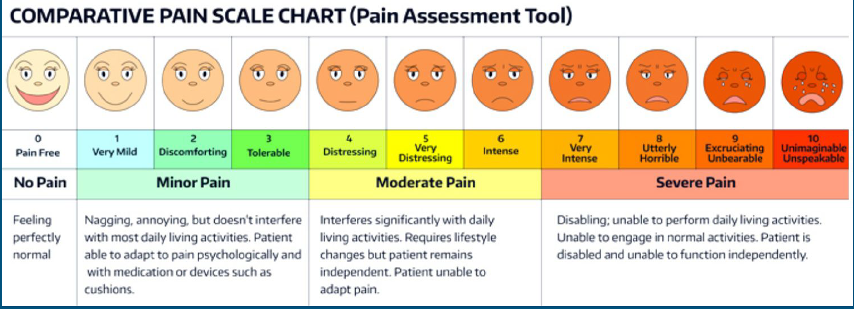
Randomised Single-Blind Study to compare hypothermic and normothermic lignocaine in flexible cystoscopy procedures
Comparing local anaesthesia achieved using:
Normothermic (room temp) lignocaine gel
Hypothermic lignocaine gel from the fridge at approx 4ºC
Outcomes:
Pain scores using Visual Analogue Scale (VAS) during flexible cystoscopy
Results:
Mean VAS (p<0.01)
Hypothermic Lignocaine: 4.2
Normothermic Lignocaine: 6.3
Ehsanullah, S. and Dhanasekaran, A. (2019). Is hypothermic lignocaine better than normothermic lignocaine for flexible cystoscopy procedures? Prospective Single Blinded Randomised Study. JELEU, 2 (Special Issue 1), pp. e4–e5.

Slide 10
Protocol for UroLift ® System procedure completely under Local Anaesthesia at Birmingham City Hospital
Local anaesthesia achieved
Patient positioning
Bladder irrigation
Bladder emptied between implants
20 mins before the start of the procedure
local anaesthesia is achieved with 20 ml cold lignocaine (kept in the fridge
overnight at 4ºC)
Patients are positioned
with the gluteus at the edge of the operating table
Warm normal saline used for irrigation to maximise
visualisation without bladder
overdistension
Between placement
of each UroLift implant, the bladder is emptied as we change the implant equipment
Dedicated theatre staff engage with the patient throughout the procedure to ensure his comfort.

Slide 11
Initial pathway for the UroLift System at Birmingham City Hospital
Clinical assessment
TRUS/MRI prostate volume
Flexible cystocopy
Flow rate and bladder scan
Pre-op clinic
Anaesthetic assessment if needed
UroLift performed under LA* and, rarely, IVSed** or LMA/GA***
Outpatient follow-up
LA = local anaesthetic; IVSed = IV sedation; LMA/GA = Short laryngeal mask airway / general anaesthetic

Slide 12
One-Stop LUTS Clinic
One-Stop LUTS Clinic
IPSS
Flow rate
Bladder scan
Flexible cystocopy (if needed)
Patient counselling about treatment options

Slide 13
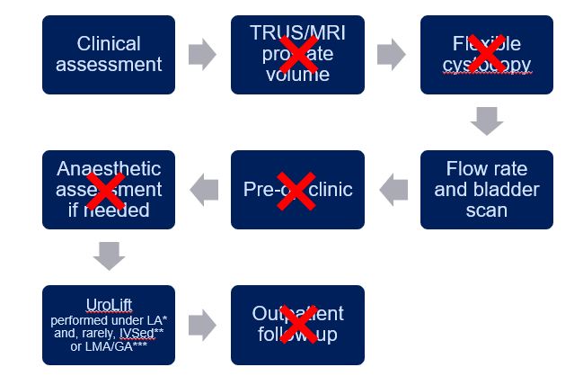
Simplified pathway for the UroLift System at Birmingham City Hospital
?
How could we modify and simplify the patient pathway to further improve the patient experience, create further capacity in the system, help to reduce waiting times and overall cost?
Key changes that we made to simplify the pathway were:
Removal of the pre-op flexible cystoscopy
Removal of the pre-op assessment, including the pre-op anaesthetic assessment
Removal of the prostate volume measurement (other than digital rectal examination – DRE where indicated)
Follow-up by telephone instead of in outpatient clinic
Changes supported by the establishment of the One-Stop LUTS Clinic, which negated the need for multiple separate appointments for assessment

Slide 14
Local audit
Over a 12-month period, we audited 39 consecutive patients who underwent a UroLift System procedure
Cohort included 14 men with complex prostate anatomies – obstructive median lobe or high bladder neck
Cohort included 8 men who had urinary retention at presentation – 3 chronic and 5 acute retention
Mean prostate size: 81.9 mL (SD 17.6, range 50–100)
Mean number of UroLift implants: 2.9 (SD 1.0, range 2–5).
All procedures performed under local anaesthetic, except the first, which was performed under general anaesthesia as part of the training for the theatre team
Cohort included patients with complex prostate anatomies
&
urinary retention

Slide 15
Local audit results
The protocol was well tolerated by all patients, and no patient had complications.
One patient required intravenous midazolam sedation due to anxiety and a language barrier.
At 3 months post-surgery we observed:
Quality of Recovery Visual Analogue Scale (QoR-VAS) mean score of 88.1%
Pain tolerability Visual Analogue Scale mean score of 3.5
International Prostate Symptom Scores (IPSS) mean improvement of 24.2 points
Quality of Life (QoL) scores mean improvement of 4.7 points
Patients in urinary retention
All 8 patients with urinary retention had a successful TWOC (trial without catheter) 3-5 days after the UroLift System procedure.
Before the UroLift System procedure, mean QoL scores were similar for patients with and without retention, and improved similarly after UroLift.
After UroLift System, IPSS, QoR-VAS, and pain tolerability (VAS) were similar between those who were in retention and those who were not.

Slide 16
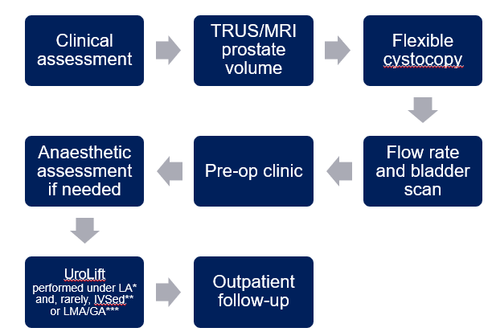
Initial vs. Simplified UroLift System pathways compared
Simplified pathway associated with shorter waiting times for a UroLift System procedure
Mean outcomes (QoR-VAS, IPSS, QoL and pain tolerability scores) at 3 months were comparable
Average number of implants was also comparable
Overall expenditure was reduced in the Simplified pathway due to less need for preoperative investigations and no outpatient follow-up in clinic

Slide 17
Benefits of performing UroLift System procedure with a Simplified Pathway under Local Anaesthetic
Minimally invasive treatment option for most types of prostates
Treat most types of prostates, including:
High bladder neck
Obstructive median lobe
Urinary retention
Improves theatre efficiency
UroLift System is a quick procedure under local anaesthetic
More UroLift System procedures can be performed in a theatre list compared with standard surgery for BPE
Release inpatient bed days
Patients discharged after a few hours compared with TURP where patients stay for 2-3 days
Improves outpatient efficiency
Patients are generally not required to return to hospital for post-op outpatient visit or TWOC
Cost saving
Estimated to save £981-£1,242 per patient compared with TURP¹
NICE. (2021). UroLift for treating lower urinary tract symptoms of benign prostatic hyperplasia. Medical Technologies Guidance, 4 May 2021.

Slide 18
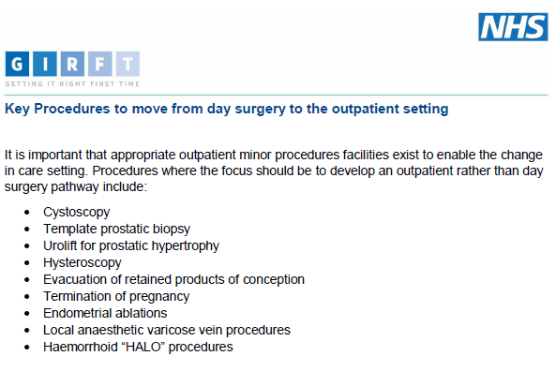
Looking to the future – Moving from day surgery to outpatient setting
Recommendations by BADS, GIRFT and CPOC:
UroLift System – a key procedure where “the focus should be to develop an outpatient rather than day surgery pathway”¹
This recommendation is being followed by some NHS Trusts, who are moving the UroLift System procedure to outpatients.
At Birmingham City Hospital, in the short-term, competing clinical priorities associated with the COVID-19 recovery mean there is currently no capacity in the outpatient setting for UroLift procedures.
Instead, we look towards 2022, when we hope to move the service to an ambulatory setting.
GIRFT, CPOC, and BADS (2020). Report: National Day Surgery Delivery Pack

Slide 19
References
Ehsanullah, S. and Dhanasekaran, A. (2019). Is hypothermic lignocaine better than normothermic lignocaine for flexible cystoscopy procedures? Prospective Single Blinded Randomised Study. JELEU, 2 (Special Issue 1), pp. e4–e5.
GIRFT, CPOC, and BADS (2020). Report: National Day Surgery Delivery Pack
Gravas, S. et al. (2021). EAU Guidelines on Management of Non-Neurogenic Male Lower Urinary Tract Symptoms (LUTS), incl. Benign Prostatic Obstruction (BPO)
Hospital Episode Statistics, NHS Digital, 2019
NICE. (2021). UroLift for treating lower urinary tract symptoms of benign prostatic hyperplasia. Medical Technologies Guidance, 4 May 2021.
NICE Shared Learning Case Study. Urolift – a community-based alternative treatment for Benign Prostatic Obstruction (BPO). Royal Devon & Exeter NHS Trust. Nov 2019.
NICE Shared Learning Case Study. Urolift – Adoption of UroLift procedure, an ambulatory pathway for patients suffering from Lower Urinary Tract Symptoms of Benign Prostatic Hyperplasia. Norfolk & Norwich University Hospitals NHS Trust. Nov 2016.
Roehrborn CG et al. Five year results of the prospective randomized controlled prostatic urethral L.I.F.T. study. Can J Urol 2017; 24(3); 8802-8813.

Slide 20
Disclaimers
Mr. Ananda Dhanasekaran is a paid consultant of NeoTract | Teleflex Interventional Urology.
This information is presented in conjunction with the named urologists. Surgical technique, medication and anaesthesia regimens are based on their experience with the UroLift System. Medical practice is solely the responsibility of the treating physician and not the named physicians or Teleflex Incorporated and its affiliates.
UroLift, the UroLift logos, NeoTract, the NeoTract logo, Teleflex, and the Teleflex logo are trademarks or registered trademarks of Teleflex Incorporated or its affiliates, in the U.S. and/or other countries.
Indicated for the treatment of symptoms of an enlarged prostate up to 100cc in men 50 years or older. As with any medical procedure, individual results may vary. Most common side effects are temporary and include hematuria, dysuria, micturition urgency, pelvic pain, and urge incontinence.¹ Rare side effects, including bleeding and infection, may lead to a serious outcome and may require intervention. Consult the Instructions for Use (IFU) for more information 1. Roehrborn, J Urology 2013.
© 2021 Teleflex Incorporated. All rights reserved. MCI-2021-0361

