Slide 1
Elective recovery and daycase pathways
John McGrath, Joint Clinical Lead (GIRFT)

Slide 2
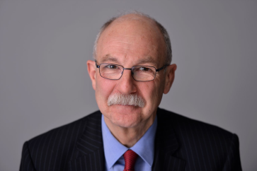
Overview
Scale of the problem
The opportunities
Principles of recovery
GIRFT alignment
GIRFT methodology
GIRFT Academy

Slide 3
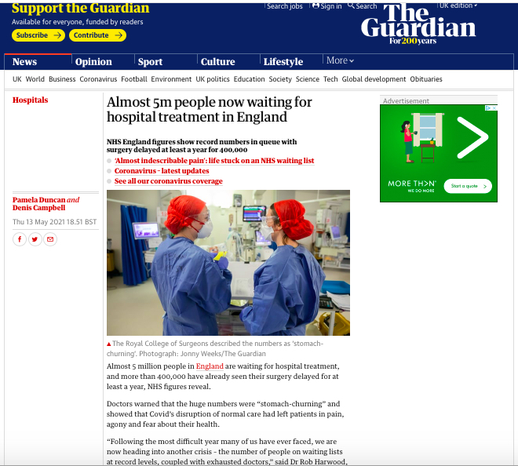
Notes:
Not revisit how we got here

Slide 4
Position across England

Slide 5
By region – all procedures

Slide 6
Position for Urology

Slide 7
By region - urology

Slide 10
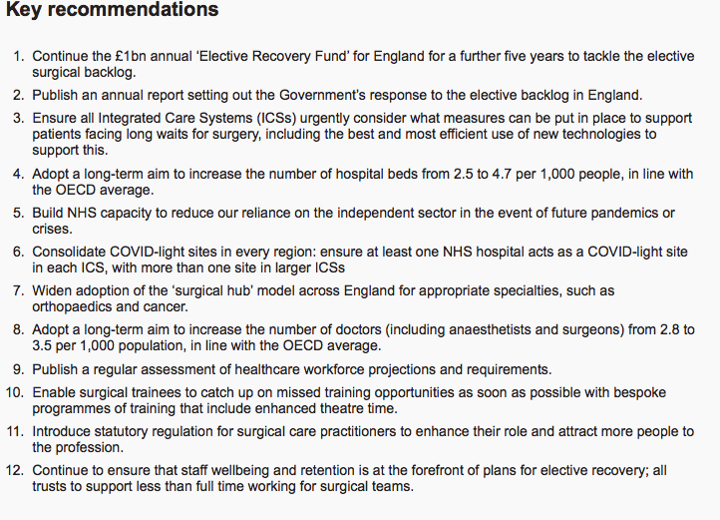

Slide 11
Principles of recovery
COVID protected and COVID resilient
Daycase / non-admitted
Minimally-invasive
COVID testing
Vaccination
Reduced OP attendances
Avoid over-crowding
Clinical prioritisation
Notes:
Duncan to cover CP

Slide 12
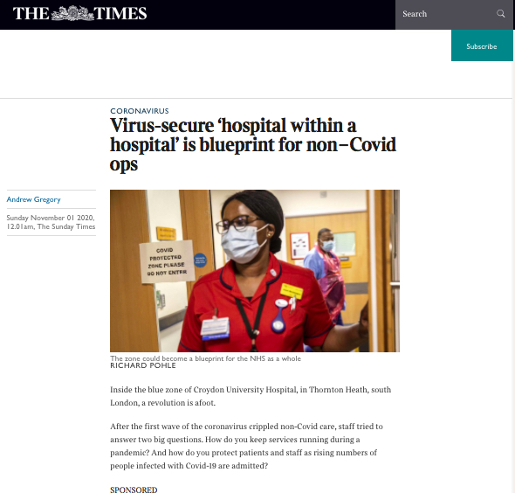

Slide 13
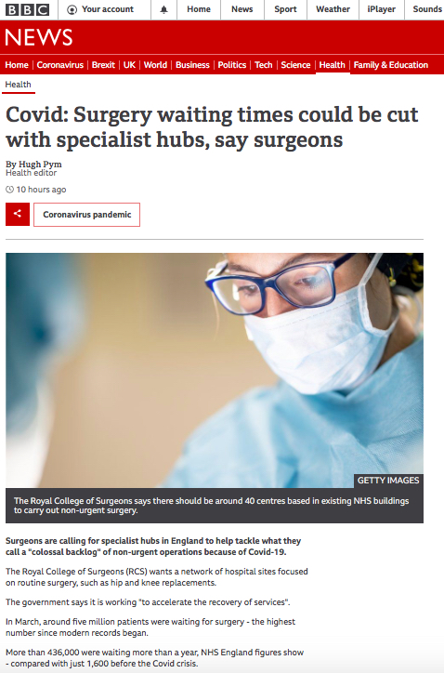

Slide 15
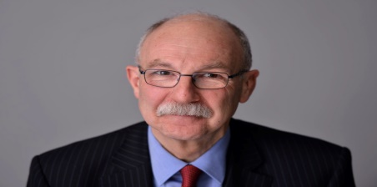

Slide 17
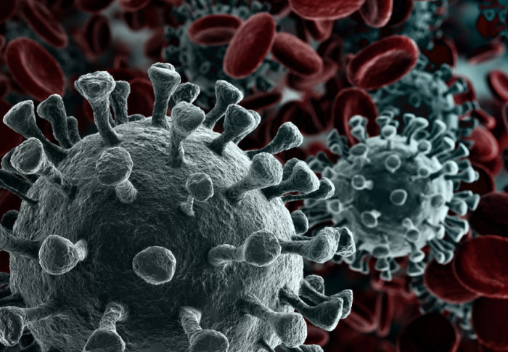
London programme
Emergency in elective care
System-based recovery
Green pathways
Locking in positive pathway changes

Slide 18
Notes:
Endorsed many of the prior changes – UIU, UANs, daycase etc.

Slide 19
Framework for recovery

Slide 20
Sentinel metrics

Slide 21
London Programme
Across the 5 ICS’s
‘Gateway’ visits
High-volume low complexity hubs
Pathway development
Passporting
Identifying and sharing best practice

Slide 23
Re-establish key priorities
UANs
Urology investigation units
Workforce
Daycase pathways
Out-patient transformation
Emergency care

Slide 24
TURBT pathway

Slide 25
BOO surgery pathway

Slide 26
URS pathway

Slide 27
OP transformation

Slide 28
GIRFT Academy Collaborative

Slide 30
Mechanism
Focused working groups – 4 areas initially
Chair
BAUS Sections
Relevant stakeholders
Virtual working
High level guidance
Sign-posting / collation of existing material

Slide 31
Outputs

Slide 32
Principles
Upper decile performance
Innovative practice
Key stakeholders
BAUS BAUN
BADS
NHSE/I
Task and finish working group
Implementation, measurement and QI

Slide 33
GIRFT ‘deep dives’
Re-establish visits
Dissemination of data pack / letters
Gateway document
Pre-visit questionnaire
Provider level
UAN level

Slide 34
Deep dive
Recovery situation
Networking arrangements
Provision of UIUs at diagnostic end
Consideration of HVLC (cold) sites
System opportunities / differences
Operational support
Workforce

Slide 35
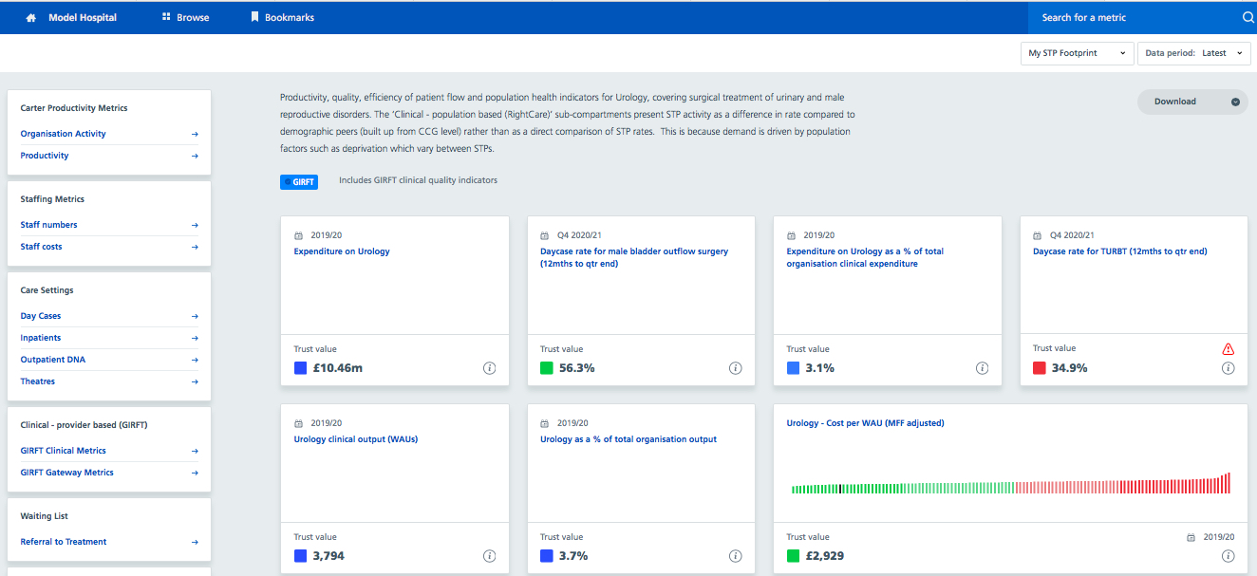

Slide 36
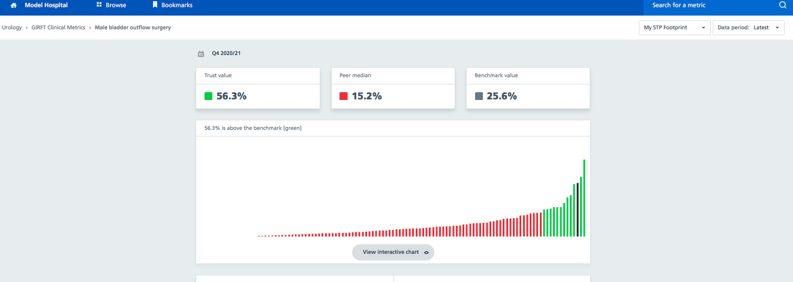

Slide 37
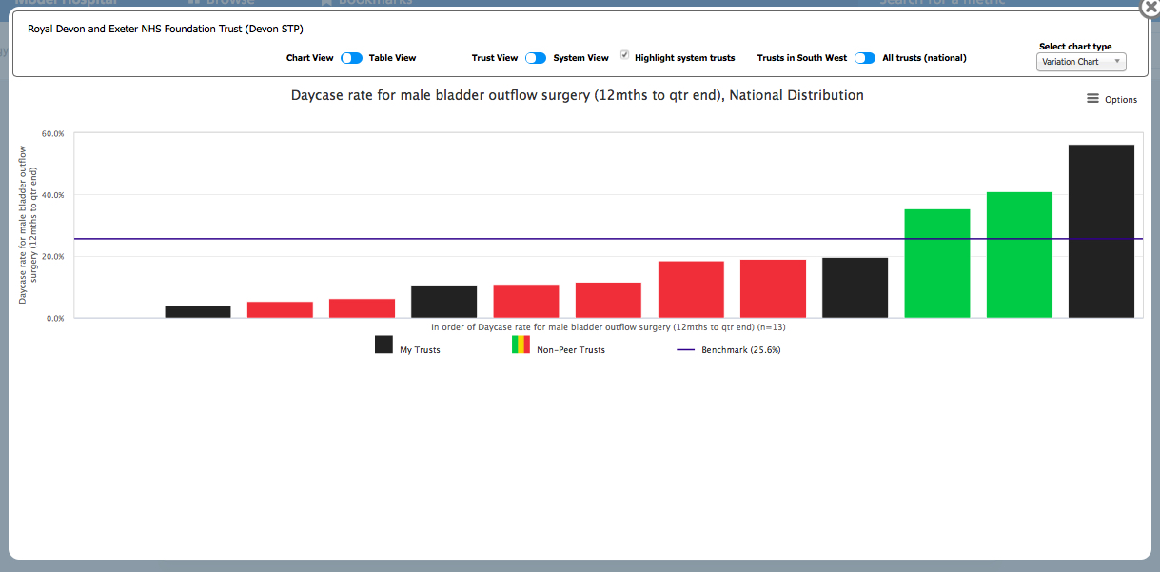

Slide 38
Outstanding challenges
Capacity
Low clinical priority procedures
Training
Future-proofing
Workforce
Health and well-being

Slide 39
Questions and comments

