Slide 1
Spinal Anaesthesia in Urology Day Case Surgery
Robbie Erskine Derby UK
BADS/HCUK 8th July 2021

Slide 2
Case studies: Pros and Cons
History
What’s available
Decision making
Where we are across the board
Our experience in Urology DCU
Targeting your spinal to the procedure

Slide 3
4pm in Urology DCU
Male 36 yrs for Cystoscopy
BMI 37, acid reflux, smoker
“Only a ‘scope ..he can have a quick GA”
LMA or ETT??

Slide 4
4pm in Urology DCU
Spinal option?
Bupivacaine 0.5%..low dose plus fentanyl
32% chance of overnight admission
12% urinary retention
Safe but unsatisfactory

Slide 5
2pm in Urology DCU
Male 75 yrs for repeat ureteroscopy and stent
BMI 38, COPD, CABG 5 yrs ago, multiple meds
Previous similar with spinal anaesthesia
Safe experience BUT admitted due to poor mobilisation

Slide 6
2pm in Urology DCU
Spinal is a safe, effective option
High dermatomal block required
Bupivacaine => delayed discharge and catheter
What are the options?

Slide 7
Day case spinals
Benefits
↓PONV
↑ Maximum BMI /comorbid patients
↓ Pain
↓Risk of aspiration
↑Throughput (overlapping procedures)
Short first stage recovery
Surgeon preference??
Cost

Slide 8
Problems
PDPH
Pruritis
POUR
Nerve injury
Failure
Delayed recovery
Awake patient
Atraumatic needles
Opioids
Bupivacaine
1:160,000 (NAP3 2009)
Repeat/alter plan
Bupivacaine
Awake v. Asleep

Slide 9
Principle aims
Maximise the benefits
Minimise the problems
Catheterisation/admission only for surgical reasons

Slide 10
How to do it ?
Low-dose bupivacaine +/- opioid
Hyperbaric 2% Prilocaine
Isobaric 1% 2-chloroprocaine

Slide 11
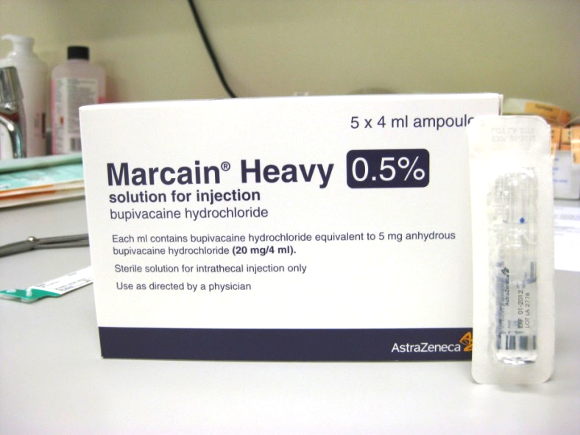
How to do it ?
Bupivacaine may be too much?
Heavy legs
Retention is a significant risk
Opioids cause pruritis
Delayed discharge
Avoid if possible for procedures < 120 mins
Spinal wears off later on the ward

Slide 12
Principle of short-acting spinals
IF
A 3hr GA is too long for a 60min procedure
THEN
A 3hr Spinal is too long for a 60min procedure

Slide 13
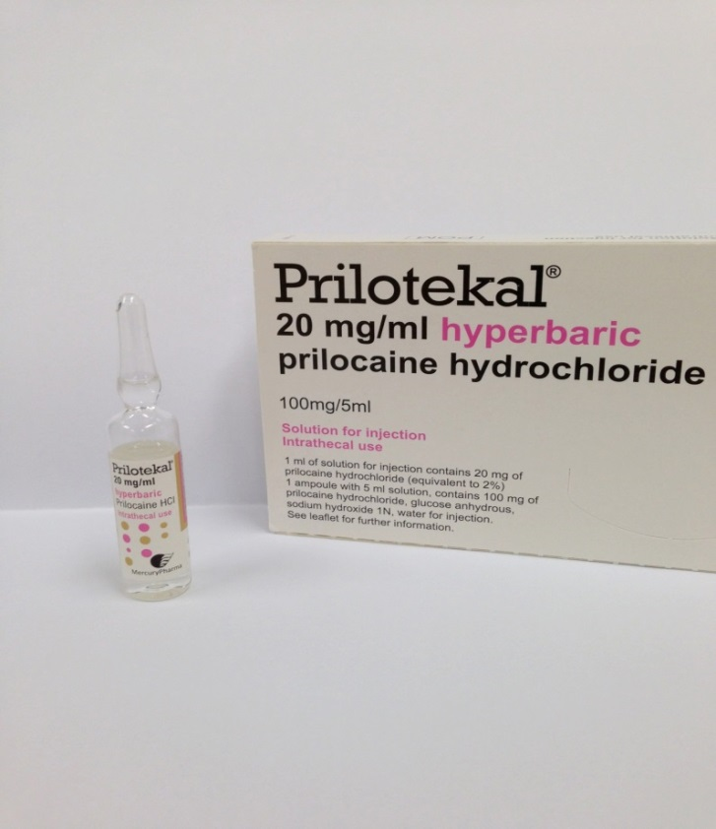
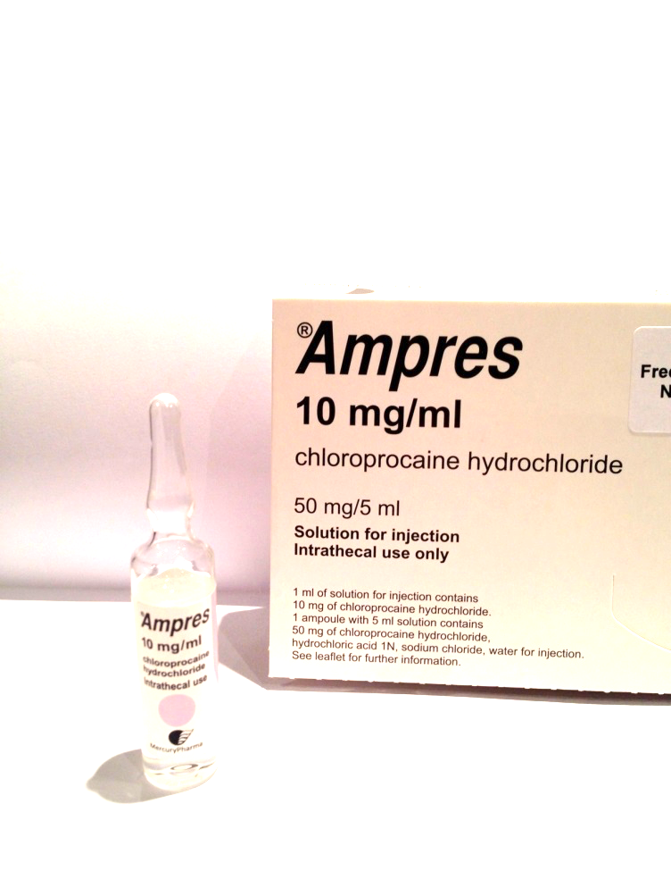
Prilocaine
2-chloroprocaine
GAMECHANGERS

Slide 14
Heavy Prilocaine 2%
Widely used in Europe >10 years, NOT in US or Australasia
“Intermediate” spinal duration
Licenced for 90 minutes of surgical time
Up to 120 minutes can be achieved for knee surgery
Hyperbaric property allows for manipulation of height of block
There’s increased CV stability compared with Bupivacaine
Fills “gap” between Bupivacaine and Chloroprocaine
Allows day case surgery WITHOUT the need for intrathecal opioid

Slide 15
Isobaric 2-chloroprocaine 1%
UK since 2013
Licenced in US too since 2018
“Short” duration
Licenced for 40 minutes of surgical time
60-80 minutes can be achieved for knee surgery
Less easy to manipulate height ..rarely above T10 for long
No case reports of urinary retention
Patients very confident to mobilise sooner

Slide 16
Targeting spinals to the procedure
Pragmatic approach to decision making
3 questions:
Saddle block only?
High block required?
Short or intermediate procedure?
No opioid required
“Per-Operative Analgesic Spinal”
Follow-on regional block and multimodal analgesia

Slide 18
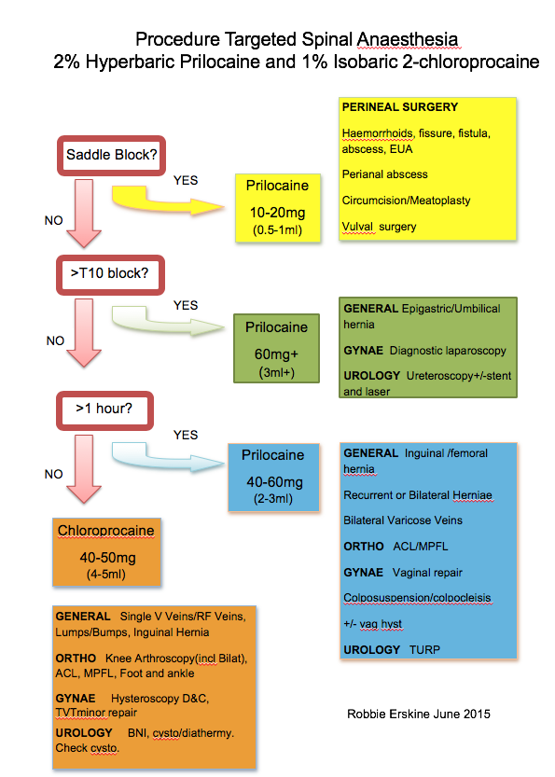
Prilocaine/Chloroprocaine in Urology
TURP
TURBT
Cystoscopy
Uretroscopy/otomy
Ureteroscopy
Perineal field procedures

Slide 19
Circumcision
Meatoplasty
Vulval/periurethral surgery
Scrotal surgery
Urolift

Slide 20
Ureteroscopy
+/- Stent/laser
Stone retrieval
Testicular surgery

Slide 21
TURP
Therapeutic Cystoscopy
Minor testicular surgery
BNI
Cystodiathermy
Check cysto
Urolift
Suprapubic catheter

Slide 22
How does this translate to a typical theatre session?

Slide 23
Low dose bupivacaine +opioid
Traditional Approach
Urethrotomy bupivacaine
Circumcision Bupivacaine
Cystoscopy Bupivacaine
TURP Bupivacaine
TURP Bupivacaine
Ureteric laser/stent Bupivacaine

Slide 24
Targeted Approach
Urethrotomy Chloroprocaine
Circumcision Chloroprocaine
Cystoscopy Chloroprocaine
TURP Prilocaine
Ureteric laser/stent Bupiv
Or Prilocaine

Slide 25
Urology Day Case
Approx 50% TURBTs go home
Only those bleeding needing irrigation stay in
Surgical decision to keep in
Some have catheter ‘til mobile then out and home
NO LONGER is it: spinal =catheter=admit
BNI/Urethrotomy: catheter and home
TURPs stay in
Ureteric stents: 70% go home

Slide 26
First Time Users
Follow the guidelines on the decision making chart
BE GENEROUS…remember these are:
NOT low dose BUT short acting
DON’T use opioids…not licenced and not necessary
Know your surgery/surgeon
Expand your use as you become more confident
Try PRILOCAINE first if unsure

Slide 27
Why choose day case spinal?
No AGP… increased safety…time saving……low cost
Offer sedation(if appropriate) and allow patient to change their mind (make them part of the team)
Match your spinal to the procedure
Keep dentures in!
Free clear fluids
Patient may observe procedure or discuss treatment with surgeon ?Follow up visit
No “wake up” or airway removal time in theatre
Safer for recovery/PACU staff (AGP)
Shorter recovery stay
Rapid mobilisation and discharge

Slide 28
Organisation
Surgeons
Patients
Preop staff
Patient information and choice
Day case staff
To PU or Not
Discharge info

Slide 29
BADS latest guide

Slide 30
Sintetica publication
Up to date practical guide

Slide 31
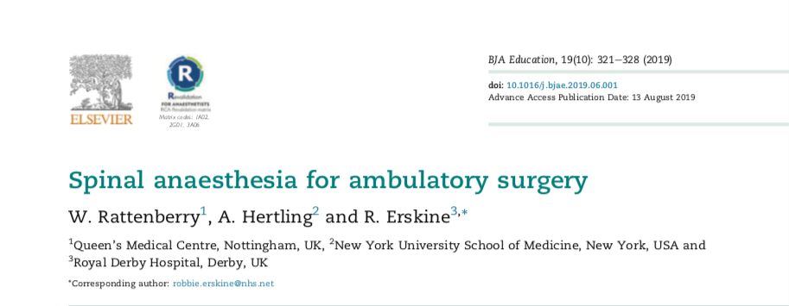
BJA education 2019

