Slide 1
Ethical decision-making: principles and practice
Dr Giles Birchley
Research Fellow, Centre for Ethics in Medicine
Trustee (2018-2021), UK Clinical Ethics Network,
The Caldicott Guardian & Ethical Decision Making
Tuesday, 13th July 2021

Slide 2
Ethical decision-making: principles and practice
Ethics in theory:
1. What is ethics and can we be experts
2. Moral decision making: ethical theories
Ethics in practice:
1. Principles and frameworks
2. Making difficult ethical decisions
3. Clinical ethics and clinical decision making

Slide 3
Ethics in Theory: 1. What is ethics and can we be experts?

Slide 4
What is ethics? (and how could it help?)
Ethics or ‘moral philosophy’ is the study of good (and bad), right (and wrong)
“Normative” ethics is the study of what the right thing to do is
The downside of ethics -
Ethics are “aporetic” – often the ‘good thing’ is in doubt or contradicts other good things
Ethics is not a science and cannot tell us how to definitively deal with these contradictions
The upside of ethics –
Ethics can offer language to help describe the intuitions we feel about situations to others
Ethical ideas can be heuristics to help us through crises
Ethics might help us to make sense of an apparently senseless world

Slide 5
What is bioethics?
Bioethics is the application of moral philosophy to the human sciences (including healthcare)
Interest in bioethics arose at a particular place and time
Retrenchment of welfare states from late 1970s
Less restrictive social norms, less support for private interests
Environment is generally one of interests and rights against state interference, any positive interests are against other individuals
Mirrors private law – responsibility and compensation for error
Legal changes (LAPSO) mean less access to funds to resolve disputes about interests through the law
Emphasis on negotiation – mediation, clinical ethics
Bioethics occupies space left by state guarantee of private interests: focus of ethical debate is on what individuals owe one another
Who arbitrates? Can we become ‘ethics experts’?

Slide 6
What is ethical expertise
What does it mean to gain ethics expertise?
Singer: ethicists should be able to reach right or soundly based decision by finding, understanding and isolating relevant evidence, being familiar with moral concepts, logic or moral argument; being more aware of bias; having more time to think
Archard: ethicists have skills of systemization, clarify, disambiguation and (perhaps) modification of common-sense morality
Rasmussen – expertise is ability to give non-binding opinions based on ethos and practice of a context, aiding others to understand supporting and opposing arguments
However, “to claim that those who know better ought to rule requires a justification that goes beyond … the individual’s expertise: it requires an account of legitimate political authority” (Estlund)
Moreover, ethical expertise may just lie in giving good arguments, not in giving the ‘right’ ethical answer … questionable whether anyone can be an expert in this way

Slide 7
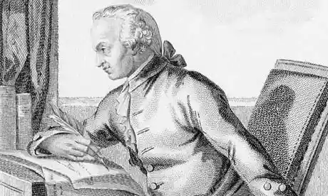
The limits of ‘ethical expertise’
Immanuel Kant: Free-will is the basis of moral understanding and behaviour of every self-conscious being
Kant does not tell us the moral law but gives grounds by which an ordinary mind already knows her moral obligations
Ethical expertise is thus innately limited – it is expertise in knowing our own duty, not that of others
Indeed, following an ‘ethics expert’ would be a dereliction of your moral duty per se
…more on Kant later…
“when common understanding excludes all [sensuous] incentives from practical laws ... it can even have as good hope of hitting the mark as any ... Philosopher” Groundwork (4: 404)

Slide 8
Ethics in theory 2. Moral decision making and ethical theories

Slide 9
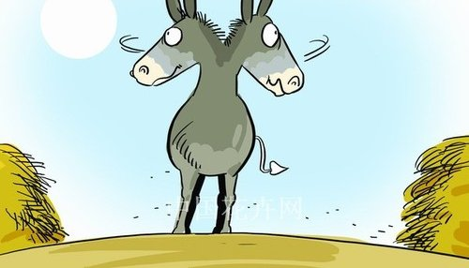
What is moral decision making?
A moral (ethical) decision is making an evaluation that one of two materially equal choices is better
We can illustrate this with ‘Buridan’s ass’, who has to choose between two identical piles of hay: what motivates any choice (in the absence of necessity) are values
Conventionally, a moral decision is a decision shorn of facts, one based on a rational discourse about ‘values’ alone
In the real world, facts and values are intimately linked (we often justify value choices on the basis of facts, and vice versa)
E.g. arguments about abortion will refer to facts about the risks of driving abortion underground or the foetal ability to feel pain as well as arguments about freedom of choice and the sanctity of life
Moral theory aspires to be transparent, rational and consistent… but there are certain caveats to keep in mind before considering theory

Slide 10
What is moral decision making?
Experimental psychology suggests that some assumptions made in philosophy about moral decision-making are questionable:
Moral reasoning appears to be post-hoc
“Moral dumbfoundment” (Haidt, 2001)
Moral judgements dominated by affective systems…
Link to bad smells (Schnall et al., 2008) and sweet tastes (Eskine et al., 2011)
…although rationality can inhibit affective responses
Implicit bias becomes worse after drinking alcohol (Bartholow et al., 2006)
We have little insight into our own motivations or biases
Bystander behaviour at emergencies: inaction not attributed to number of bystanders despite reliable correlation (Latane and Nida, 1981)
This does do mean we should not make moral judgements (we have to), but we should be aware of our limitations when doing so… moral theories may still give us starting points from which to think

Slide 11
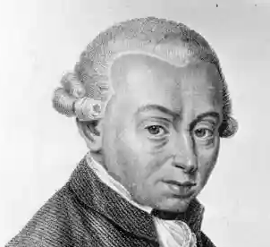
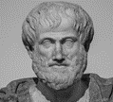
Moral theories and moral principles
Major moral theories in bioethics: Deontology (Kant); Utilitarianism (Bentham); Virtue Ethics (Aristotle)
Major philosopher | Major philosopher | Maxim | Method
 | Kant (1724-1804) | Obey the moral law | Rules based
 | Bentham (1748-1832) | Maximise the good | Consequence based
 | Aristotle (384-322 BCE) | Personal excellence | Person based

Slide 12
Kant: Deontology
I have already introduced you to Kant and his idea of free-will and moral choice
Kant’s fundamental idea is that we have “transcendental freedom”: we have freedom to intiate a chain of causation – we have free-will
All self-conscious reasoners know what feels like to be compelled to act by duty
Kant argues that duty is the based in the moral law: because that feeling of duty is universal, we all have access to the moral law
Kant sets out the grounds on which any ordinary mind already knows her duty: “the categorical imperative”, of which he gives three formulations
A moral duty must be a universal rule that applies to all equally and results in a rational world
We must respect other people as free agents (“treat people as an end in themselves”)
Respecting one another’s free-will and rationality will bring about a world of universal equality and reason

Slide 13
Kant: Deontology
Moral laws are universal rules. They tell us the right thing to do, regardless of what may appear best at a particular time… this may entail acting to very high standards indeed:
For example: A murder comes to my house and asks me where a friend, who has taken refuge in my home, is located. Should I lie?
Kant says we should not lie – it is our moral duty to tell the truth
To lie would imply contradiction – if everyone lied when they saw an advantage, it we would undermine the very basis of truth, there would be no difference between truth and lies
Instead we must tell the truth: we must rely on the murderer’s own sense of moral duty to prevent him going through with the murder
Kant tells us that by treating morality as dutiful following of reasoned laws (rather than picking and choosing what we do based on our immediate feelings) we can avoid selfishness and bring about a better world.

Slide 14
Bentham: Utilitarianism
Utilitarianism says that the good is always that which produces most utility: ‘The greatest good for the greatest number’
“Utility” can be defined in different ways, but is always the only source of intrinsic value
In Bentham’s terms utility = happiness: “Nature has placed mankind under the governance of two sovereign masters, pain and pleasure. It is for them alone to point out what we ought to do, as well as to determine what we shall do.”
All pleasures are equal: “Quantity of pleasure being equal, pushpin [a game of darts] is as good as poetry.”
Utilitarianism is anti-individualist: there should be no individual advantage (even for family or friends): "everybody to count for one, nobody for more than one“
What is good is separate from what we might think of as right or wrong
Where a law or custom is in conflict with an act that will maximise happiness, not only is the custom is wrong, but we are obliged to break it.

Slide 15
Bentham: Utilitarianism
In utilitarianism, only the consequence of our decision is important …
For example: Suppose I am suspicious that a prisoner knows the location of a hundred people who are suffering torture. Should I therefore torture the prisoner to get this information, and stop the suffering of a hundred people?
Bentham says we should torture the prisoner: “could any pretence be made so much as to the praise of blind and vulgar humanity, by the man who to save one criminal, should determine to abandon a 100 innocent persons to the same fate?”
We should set aside our qualms and realise we are morally obliged to torture the prisoner
Utilitarianism tells us that we should always do what produces the most good, without prejudice or favour. By acting on our rational instincts according to a governing principle, we can increase the total good in society.

Slide 16
Aristotle: Virtue ethics
‘Virtue ethics’ is based on three underlying concepts from Aristotle’s “Nichomachean Ethics”
Virtue (Arete); Practical Wisdom (Phronesis); Flourishing (Eudaimonia)
Virtue: All people and things have a fundamental purpose, encompassed in ‘virtues’
E.g. a good knife should have the virtue of “sharpness”
In people, virtues relate to the regulation of the human desires
Moral virtues are expressed as enduring ‘character’ traits
We recognise moral virtues because they are the mean between two vices
E.g. Courage is a virtue between the opposing vices of cowardice and rashness
Practical wisdom: We must understand our purpose in life and gain experience to better recognise virtue, virtuous response to any situation is one that follows this purpose in life
Flourishing: Having virtuous characteristics allows people to ‘flourish’ - to reach our purpose in life i.e. to exercise of the most “divine element” of humanity
Virtue ethics is based on the notion that character, rather than actions, is the source of morality, asking “Who should I be?”, not “What should I do?”

Slide 17
Aristotle: Virtue ethics
In virtue ethics there are no rules or principles that govern behaviour- actions are virtuous because we make the right decision at the right time
Actions that may be vices in one situation may be virtuous in another
For example: A Jewish doctor is caring for several sick patients in the Warsaw ghetto during the second world war. The population of the ghetto is being sent to concentration camps. The patients will die in abject circumstances during the journey. Should the doctor euthanise his patients without their consent?
While only this doctor can decide, virtue ethicists would look to the circumstances and the character of the doctor: euthanasia may be the action of a virtuous doctor in such a terrible situation
Virtue ethics says that character, rather than actions, are the source of morality. It recognises that the world is complex and sometimes involves terrible choices that can only be solved by asking “Who should I be?”, not “What should I do?”

Slide 18
Ethics in Practice 1. Principles and Frameworks

Slide 19
Moral theories and moral principles
Each ethical theory is complex (the discussions here are purposely simplified)
Ethical theories also contain numerous strengths and defects: indeed, most seem best at allowing us to understand the defects of the other
E.g. untenable outcomes of non-discretionary rules in deontology, complete discretion in consequentialism, lack of clarity over the right action in virtue ethics
Some have sought to both simplify ethical theory and aid ethical decision-making by deriving ‘principles’ from different theories that can be better used to aid thinking
These principles have been used to develop different frameworks for decision-making
These can be either:
Moral frameworks e.g. Beauchamp and Childress’ “The four principles approach”
Or
Procedural frameworks e.g. Jonsen’s “Four quadrants”

Slide 20
Moral Frameworks: Four Principles
Allow people to make their own choices
Maximise good outcomes
Respect for Autonomy: Respect people’s decisions about their lives, based on their values. Avoid paternalism. Give full information.
Beneficence: Promote the patient’s welfare, even if it is inconveniences or burdens us.
Non-maleficence: Do not intentionally cause harm and avoid it where possible.
Justice: Treat people fairly and without discrimination e.g. treat like as like
Beauchamp and Childress (1985+)
Beneficence
Respect for autonomy
Justice
Non-maleficence
Avoid actions that harm
Share scarce resources fairly

Slide 21
Procedural Frameworks: Four Quadrants
Medical Indications P’s condition, prognosis Treatment options (risks/harms v benefits) Probable outcomes of treatment | Contextual Features Impact of/on family and relatives Impact on hospital staff Financial/resource issues Insurance issues Legal issues
Patient Preferences What are P’s goals? Does P have sufficient information? Does P comprehend? Is P consenting voluntarily? Has P been coerced? If P lacks capacity, who has authority to decide? | Quality of Life (QoL) What does QoL mean (generally and here, incl. with/out treatment)? Can P determine his/her own QoL? If not, who should decide? How do others perceive P’s QoL? What is the relevance of QoL to ethical judgement?
Jonsen et al (2006)

Slide 22
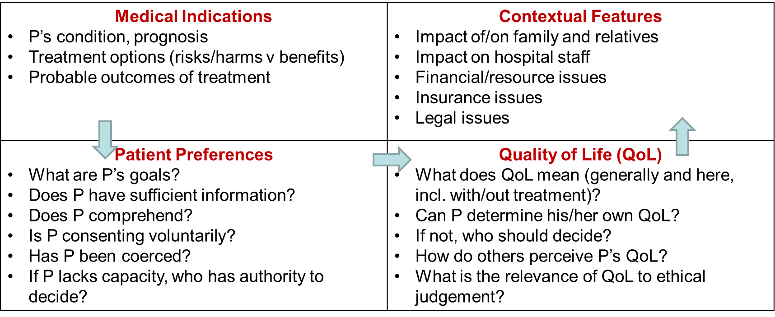
Moral theories and moral principles
Beneficence
Respect for autonomy
Justice
Non-maleficence
While it is clear that frameworks can be useful tools to discuss moral cases, all contain the potential for conflicts between the principles or stages they espouse…

Slide 23
Ethics in Practice 2. Making difficult ethical decisions

Slide 24
Conflict between moral principles
When we find that moral principles conflict, it reminds us that ethics is aporetic
Aporetic means irresolvable, or always open to doubt
There is a danger that ethical frameworks can make us misunderstand moral philosophy.
Ethics is not a science, we cannot produce answers that are true in every case
Solutions that are ethically ‘neat’ are likely to be so because we are failing to consider every factor
Ethics, properly done, should invite constant re-examination of our theoretical positions, as well as our own beliefs and understandings
Such a process has been described by the philosopher John Rawls as “Reflective Equilibrium”

Slide 25
Conflict between moral principles
Personal intuitions
Actions in Practical cases
COHERENCE
Moral theories and beliefs
Reflective equilibrium
Constant process of revision to bring theories, intuitions and practical cases into coherence
Radical epistemic equality: no element is beyond revision
Discard beliefs or activites that cannot be revised to cohere with the whole
Consider this in relation to the “murder at the door” or “torture” examples

Slide 26
Conflict between moral principles
Revision is a constant process – we make moral decisions when we have to, but we must always be ready to revise our view in the light of new understandings
How do we avoid our judgements becoming hopelessly unpredictable and contradictory?
One way to do this is to involve others in moral decision-making…

Slide 27
Ethics in Practice 3. Clinical ethics and clinical decision-making

Slide 28
Clinical ethics and clinical decision-making
Different views on the purpose of ethics have been characterised as Socratic or Pythagorean
Socratic view: the purpose of ethics is to find underlying truths
Pythagorean view: truths have been discovered - the task of ethics is to keep people on right path
If we take the Socratic view, a conflict between principles should invite us to question the principles we have chosen: are they the right ones? have we understood them properly? are our standards achievable in practice?
If we take the Pythagorean view we should question whether people understand what is demanded of them? how we can help people to better achieve the standards that we set?
Both views are useful in clinical ethics:
we must encourage people to adhere to the standards that are set in ethical codes and in the law, but;
we must also realise that these standards need translation at the bedside, and this requires us to be ready to revise our positions in line with the challenges of practice, and potentially, to agitate for change
How might we support clinical ethics?

Slide 29
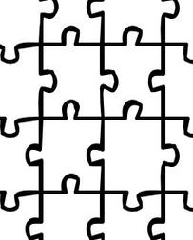
Clinical ethics support
Nuffield Council on Bioethics (national committee) established in 1991 to report on ethical issues
Clinical ethics support is based on a non-statutory, ‘enthusiast’ model
Ethics support usually follows committee model (plus a few lone ethicists)
UK Clinical Ethics Network (http://www.ukcen.net/) exists to support establishment of ethics committees
55 CECs are registered with UKCEN
84% (43/51) CECs received 1-10 consultations annually (Slowther et al., 2012)

Slide 30
Clinical ethics support
Committees usually have 10-20 members, usually includes clinical disciplines, chaplaincy, legal advisors, academic ethicists, lay members
Queries about patient involvement: often resisted, recent legal critique: X (A Child) [2020]
Benefits of diverse opinions:
Pervasiveness of bias, becomes more extreme among like minded individuals
Registering dissent in a homogenous group is at the cost of emotional distress
A diverse group gives access to dissenting opinions, and this reduces or eliminates these negative effects
Notes:
Pervasiveness of bias and groupthink: Sunstein CR. Going to extremes: how like minds unite and divide. Oxford: Oxford University Press, 2009:1–6.
Emotional distress in nonconformity via amygdala: Berns GS, Chappelow J, Zink CF, et al. Neurobiological correlates of social conformity and independence during mental rotation. Biol Psychiatry 2005;58:245–53.
Dissenting opinion reduces bias: Nemeth C, Mayseless O, Sherman J, et al. Exposure to dissent and recall of information. J Pers Soc Psychol 1990;58:429–37.

Slide 31
Clinical ethics and clinical decision-making
A key factor in reducing staff attrition, poor mental health and burnout is through the organisational structure and working environment (despite current emphasis on resilience)
Note that a wide variety of support structures are needed: e.g.:
Access to legal support
Access to mediation
Access to counselling
Mentoring, supervision and peer support
Schwartz rounds
Ethics committees and/or ethics consultants
Ethics support is stronger when it is part of a supportive institutional culture
Awareness of ethics is part of the solution, but only if we are also aware of its limitations, as well as its strengths

Slide 32
Conclusion
Medical ethics offers particular answers but may help us make decisions and live with decisions
We can become ‘expert’ in the ideas expressed in ethical theory, but all who are reflective and open minded have an ethical sense - we should be wary of claims of ethical expertise
We can approach ethical decision-making with a number of theoretical lenses, or with set of principles drawn from these theories. We should be aware that the psychology of moral decision making suggests that decision making is a complex tension between emotion and reason
Moral decisions usually involve conflict between apparently equally compelling considerations. We should be aware no theory is perfectly suited to practice, nor perfectly applied. These conflicts should be addressed through a constant and reflective process of revision and adaption
We may gain more consistency in our ethical decisions, by making them together, actively seeking and listening to other opinions and considering all the potential impacts and consequences
This sort of approach should be applied in practice as part of a supportive environment

Slide 33
Bibliography
Archard, D. (2011) Why Moral Philosophers Are Not and Should Not Be Moral Experts. Bioethics. 25(3):119–127
Aristotle (1999) Nicomachean Ethics (Translated by Irwin, T., Second Edition). Hackett.
Barela, S. J. (2020) “Reclaiming Bentham on Torture, in Interrogation and Torture” In Integrating Efficacy with Law and Morality, Steven J. Barela, Mark Fallon, Gloria Gaggioli, and Jens David Ohlin (eds) Oxford University Press
Bartholow, B. D., C.L. Dickter and M. A. Sestir (2006) ‘‘Stereotype Activation and Control of Race Bias: Cognitive Control of Inhibition and Its Impairment by Alcohol.’’ Journal of Personality and Social Psychology, 90: 272–287.
Beauchamp, T. L. and J. F. Childress (2009). Principles of Biomedical Ethics, 7th Edition. Oxford University Press.
Bentham J. (2012) An Introduction to the Principles of Morals and Legislation. Dover Publications.
Bentham, J. (1843-1859) “Rationale of Reward” In: The Works of Jeremy Bentham. Simpkin, Marshall.
Eskine K, Kacinic N, Prinz J. 2011. “A Bad Taste in the Mouth: Gustatory Influences on Moral Judgment.” Psychological Science 22:295–99.
Estlund, D. (2008) Democratic Authority: A Philosophical Framework. Princeton University Press
Haidt, J. (2001). “The emotional dog and its rational tail.” Psychological Review, 108: 814–834.
Jonsen, A., M. Siegler & W Winslade (2006) Clinical ethics 6th edition. McGraw-Hill
Kant, I (1997) Groundwork of the Metaphysics of Morals. Cambridge University Press.

Slide 34
Bibliography
Latane, B. and S. Nida (1981) ‘‘Ten Years of Research on Group Size and Helping.’’ Psychological Bulletin 89: 308–324.
Mill, J. S. (2003) Utilitarianism and On Liberty 2nd Edition, Mary Warnock (ed) Blackwell
Rawls J. A. (1999) Theory of Justice (Revised Edition) Harvard University Press
Rasmussen, L. (2011). An Ethics Expertise for Clinical Ethics Consultation. Journal of Law, Medicine and Ethics. 39(4):649–661
Singer, P. 1972. Moral Experts. Analysis. 32(4):115–117Schnall et al., 2008
Slowther, A. M., L. McClimans and C. Price (2012). "Development of clinical ethics services in the UK: a national survey." J Med Ethics 38(4): 210-214.
Schnall, S., J. Haidt, G. L. Clore, and A.H. Jordan (2008). Disgust as embodied moral judgment. Personality and Social Psychology Bulletin, 34: 1096–1109
Schneewind, J. B. (1998), The Invention of Autonomy: A History of Modern Moral Philosophy. Cambridge University Press.
UK Clinical Ethics Network (http://www.ukcen.net/)
Varden, H. (2010) “Kant and Lying to the Murderer at the Door... One More Time: Kant’s Legal Philosophy and Lies to Murderers and Nazis” Journal of Social Philosophy 41(4): 403–421.
X (A Child) [2020] EWHC 1958

