Slide 1
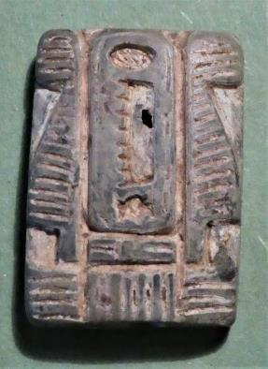
CALDICOTT GUARDIAN & Ethical Decision Making Conference Chairs introduction & Welcome National Update
Feathers of Justice (Goddess MAAT)
“Kingdom founded in Justice” - (1500 BC )
Cartouche Seal of King Tuthmoses
Christopher Fincken

Slide 2
The Greek Philosophers
“The unconsidered life is not worth living”
Socrates - (469 BC - 399 BC)
Why didn’t Socrates write things down?

Slide 3
DIFFERENCE BETWEEN CALDICOTT AND IG
IG = Can you do it legally and how
Caldicott = Should you do it?

Slide 4
“What is legal, is not necessarily the same thing as what is right.”
Christopher Fincken
Law codifies the values of society at any given time in history

Slide 5
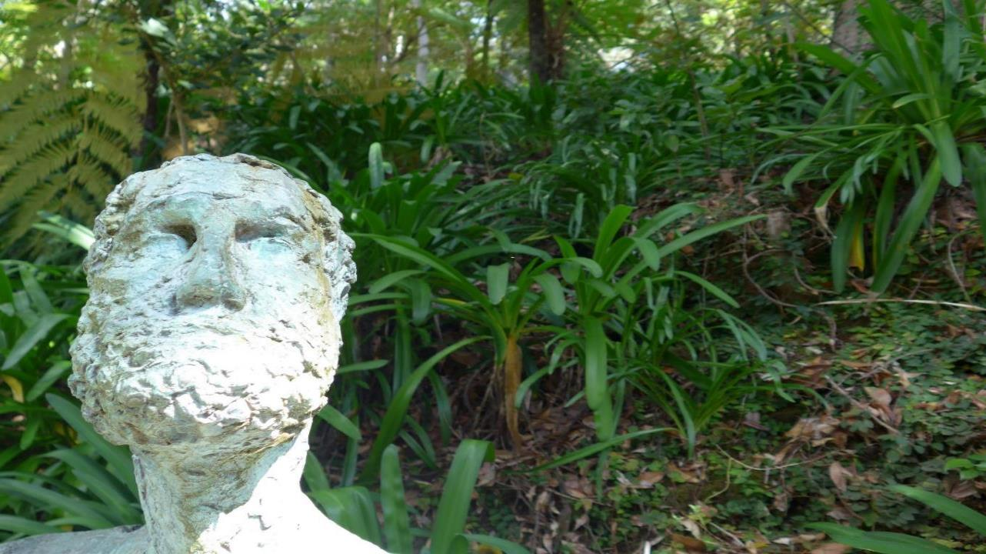
Caldicott Guardians
bring to bear ethical as well as legal considerations, making fine judgements about human situations that are rarely codified and could not be done by a machine.

Slide 6
CALDICOTT GUARDIANS
GATEKEEPERS
CONSCIENCE OF THE ORGANISATION
APPLY CALDICOTT PRINCIPLES IN REAL LIFE
Provide Evidence!!
NEED:
COMMON SENSE
COMPASSION
UNDERSTANDING LEGAL FRAMEWORK
MORAL COMPASS
WISDOM
COURAGE!

Slide 7
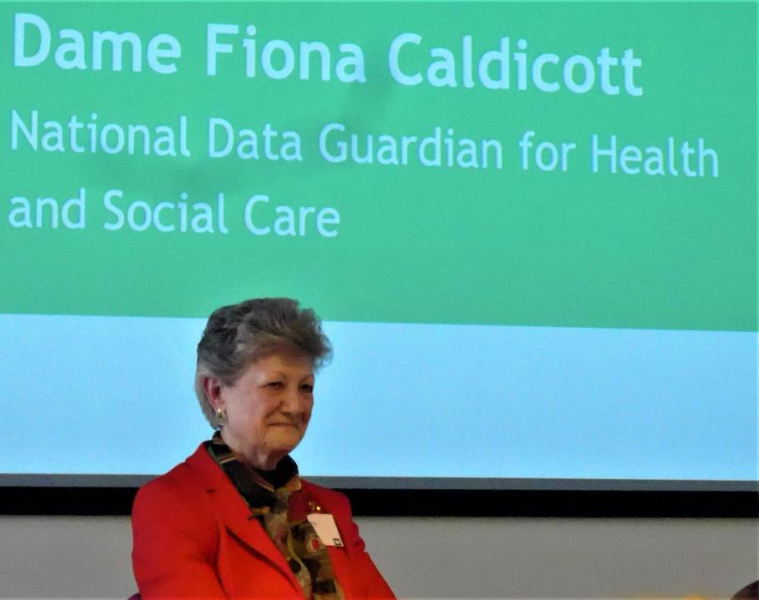
Dame Fiona CALDICOTT
1941 -2021
Dr Nicola Byrne
2nd National Data Guardian for Health and Social Care
(England!)

Slide 8
The Eight Caldicott Principles 2021
Update of Caldicott Principles
1: Justify the purpose(s) for using confidential information
2: Use confidential information only when it is necessary.
3: Use the minimum necessary confidential information
4: Access to confidential information should be on a strict need-to-know basis
5: Everyone with access to confidential information should be aware of their responsibilities .
6: Comply with the law
7: The duty to share information for individual care is as important as the duty to protect patient confidentiality
8: Inform patients and service users about how their confidential information is used

Slide 9
New Caldicott Principle 8 (DECEMBER 2020)
Inform patients and service users about how their confidential information is used.
A range of steps should be taken to ensure no surprises for patients and service users, so they can have clear expectations about how and why their confidential information is used, and what choices they have about this. These steps will vary depending on the use: as a minimum, this should include providing accessible, relevant and appropriate information - in some cases, greater engagement will be required.

Slide 10
The Role of the Caldicott Guardian – Oversight?
Data Protection Principle 1
Personal Data Shall be :
processed lawfully, fairly and in a transparent manner in relation to individuals (‘lawfulness, fairness and transparency’);
Evolution not Revolution! The most significant addition is the accountability principle. The GDPR requires you to show how you comply with the principles – for example by documenting the decisions you take about a processing activity.

Slide 11
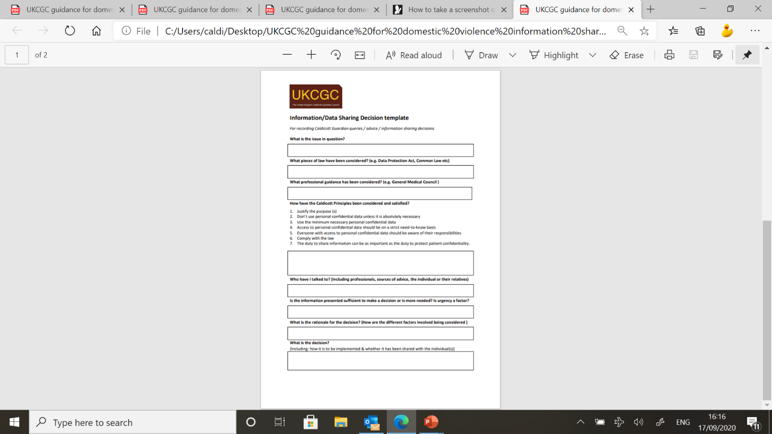
Caldicott Guardian Accountability

Slide 12
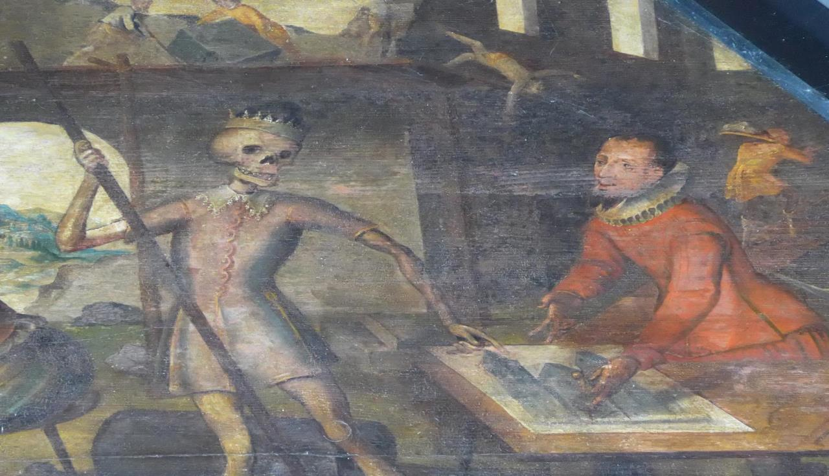
IG & CALDICOTT
in a time of Covid 19
I want to use Zoom for training and communicating
You can’t use ZOOM because of IG
Are you sure? Who says so?

Slide 13
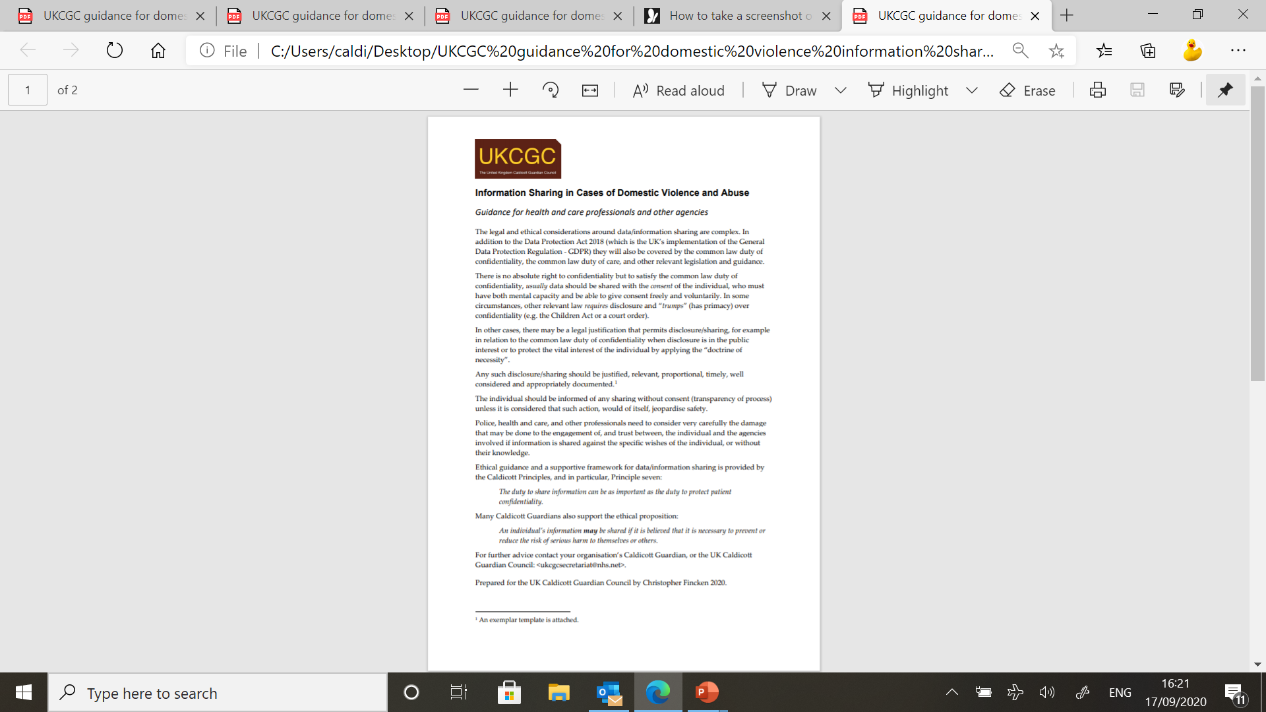
New Guidance on Domestic Violence and Abuse
“An individual’s information may be shared if it is believed that it is necessary to prevent or reduce the risk of serious harm to themselves or others.”

Slide 14
“You can share information in the Public Interest”
How do you decide
What is in the public interest?
Developing a public interest test.

