Slide 1
Best Practice Management of End Stage Heart Failure Dr Sharon Chadwick FRCP Consultant in Palliative Medicine

Slide 2
Objectives
By the end of this session you will:
Feel more confident to manage end stage heart failure
Understand the complexities of managing advanced heart failure
Feel able to address symptom control needs
Be more pro-active in discussing advance care planning
Be aware of the ethical dilemmas that might arise
Consider what is right for the individual patient and family
Consider how best to foster relationships locally to provide the best care for patients and families
Know who to ask for help

Slide 3
The Facts
‘A burgeoning clinical cohort with left ventricular systolic dysfunction’
Approx 900 000 people affected in the UK
60 000 new cases per year
Many with multiple comorbidities
A progressive, incurable and ultimately fatal long term condition
End of Life Care in Heart Failure: A Framework for Implementation.
NHS End of Life Care Programme 2014

Slide 4
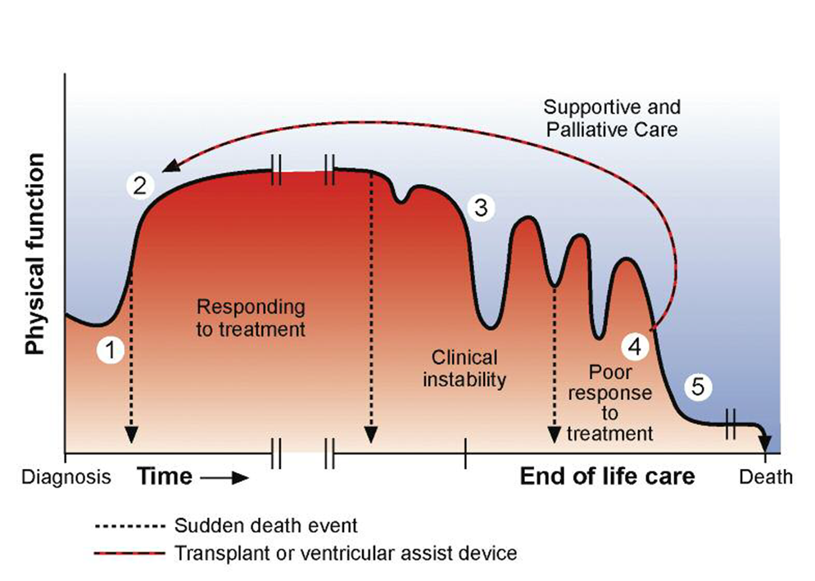
Typical course of heart failure

Slide 5
poor prognosis
Increasing age
Dependent for more than 3 activities of daily living
Cardiac cachexia
Resistant hyponatraemia
Serum albumin less than 25g/l
BNP ≥ 400 pg/ml
Multiple shocks from ICD
Comorbidities especially cancer
End of Life Care in Heart Failure: A Framework for Implementation. NHS End of Life Care Programme 2014

Slide 6
considerations
Patients with advanced heart failure are likely to have multiple hospital admissions in the last year of their life
Patients are walking a tightrope between renal impairment and fluid overload
Prognosis is more difficult to predict in heart failure than in any other life limiting illness

Slide 7
Prognostic Paralysis
Fears of HCPs around introducing about palliative care too early mean
People dying unprepared
Indaequate symptom control
No advance care planning = no choice

Slide 8
Potential problems for the individual patient
Multiple comorbidities
LVF
Angina
Atrial fibrillation
COPD
Peripheral vascular disease
Impaired renal function
Diabetes mellitus
Cerebrovasular disease
Osteoarthritis
Depression
Falls
Polypharmacy

Slide 9
Potential problems for the individual patient
Multiple symptoms
Dizziness
Breathlessness
Peripheral oedema
Nausea
Constipation
Immobility
Constipation
Pain
Low mood
Fatigue
Social isolation

Slide 10
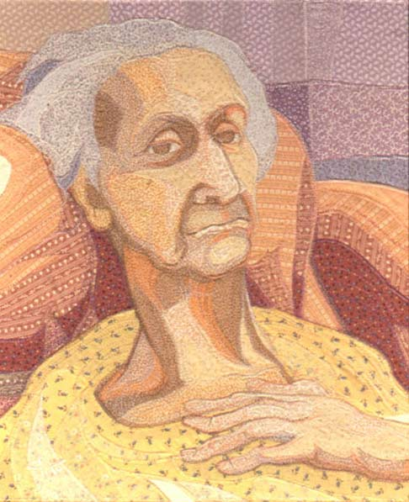
End stage heart failure- what is it like for the patient
Breathlessness
‘I feel old’
‘I feel depressed and unwell’
‘I’m not sleeping’
‘I’m spending too much time in hospital’
‘Too many tablets’
‘Can’t talk to my family -I don’t want to burden them’
‘I just can’t get my head round it all’

Slide 11
Palliative Care in Heart Failure
Whatever the aetiology there is a high symptom burden (O’Leary N et al 2009)
Quality of life can be poor for both patients and carers (Squire I et al 2017)
Often multiple comorbidities
Inevitable deterioration
Life limiting illness with increasing hospital admissions due to either fluid overload or acute on chronic renal failure in the final stages of the disease (Brännström M, et al 2014)

Slide 12
Palliative Care in Heart Failure Symptom control (physical)

Slide 13
SYMPTOM CONTROL
Breathlessness
- non pharmacological measures (fan, pacing)
- opioids, start low go slow. Morphine liquid 1 -2ml
(2 to 4mg) twice or three times daily or
oxycodone 1 to 2 ml twice daily
Leg swelling
- elevation, light compression stockings. Whose problem?
Increase diuretics?
Difficulty sleeping
- why? Sleep hygiene, reduce fluid intake during evening, screen
for depression
Swollen abdomen
- is this constipation, is it ascites
Confusion
- check electrolytes, check drugs, possibly vascular dementia,
always screen for infection

Slide 14
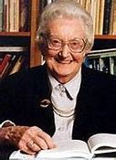
Palliative Care in Heart Failure Symptom control (psychological and existential)
Depression and anxiety – consider CBT as well as drugs
Adjustment reactions
Guilt
Fear of being a burden
Fear of dying and fear of being dead
Why me?
Legacy

Slide 15
Palliative Care in Heart Failure The Calman Gap
Calman K 1984

Slide 16
Potential problems for the individual clinician
Too many symptoms
Too many drugs
Devices that we are unfamiliar with
Don’t know where to start
Not enough knowledge
Fear of making things worse
Reluctant to stop drugs colleagues have started
New drugs, new interventions, difficult to keep up

Slide 17
New developments in heart failure
So many!!!
Entresto – sacubitril/valsartan – reduces death and hospitalisations form HF
Ivabradine- direct action on SA node
Iron infusions- improve exercise capacity, reduce hospitalisations and improve renal function
SGLT2 inhibitors – improve cardiovascular and renal outcomes even in those without type 2 DM
CRT-Ds

Slide 18
Don’t panic!!
Help is at hand
Community heart failure team –previously only for those with LVSD. Now able to help with valvular HF, HF-PEF, RV failure.
Palliative care – variable experience and knowledge.
But…. will work together with the HF team to help with symptom control

Slide 19
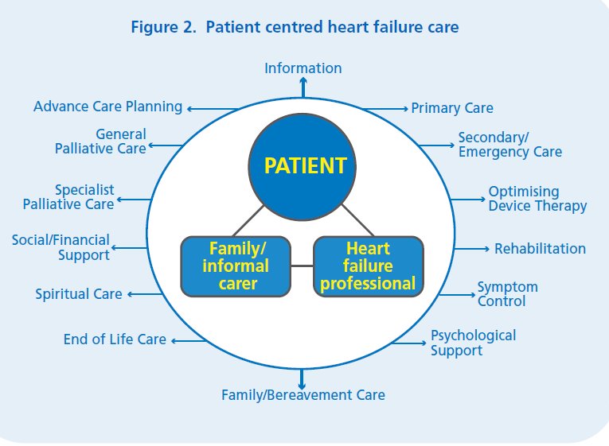

Slide 20
Top tips
Let the patient set the agenda for the consultation
Beware oxygen for breathlessness in heart failure
Remember non-pharmacological management of breathlessness
Fatigue is often a key symptom-check for reversible causes including anaemia, low potassium, hypotension
Always check pulse, blood pressure, heart rate and renal function before making any changes
Review medication but don’t rush this and whenever possible consult with the heart failure nurse specialist. Deprescribing is as important as prescribing.

Slide 21
Medication review-key points
Remember that in heart failure, beta blockers, ACE inhibitors and diuretics and spironolactone improve prognosis and symptom control
Be wary about stopping anti-anginals too quickly ESPECIALLY if there is any suggestion that the patient has had recent chest pain
Be very cautious about stopping beta blockers and if you do plan to stop them, do this gradually
Stop the statin, the calcium and vitamin D supplements, the bisphosphonates, the iron, folate and vitamin supplements

Slide 22
Atrial fibrillation
Focus on rate control (beta blocker, rate limiting calcium channel blocker-diltiazem, verapamil, or digoxin)
Risk calculated according to CHADS-Vasc score
Score of 6 = 18.2% risk of CVA
Score of ≥ 2 give anticoagulation
Options are: warfarin, apixaban, dabigatran etexilate, rivaroxaban.

Slide 23
Chads2-vasc
Age in Years
Sex
Congestive Heart Failure
Hypertension
CVA/TIA/Thromboembolism
Vascular Disease
Diabetes Mellitus
<65yrs=0, 65-74yrs=+1, ≥75yrs=+2
M=0, F=+1
Yes=+1, No=0
Yes=+1, No=0
Yes=+2, No=0
Yes=+1, No=0
Yes=+1, No=0
Score 0-9
Score ≥2 is high risk
Atrial fibrillation: diagnosis and management NICE guideline Published: 27 April 2021 www.nice.org.uk/guidance/NG196
1.2.2 Use the ORBIT bleeding risk score because evidence shows that it has a higher accuracy in predicting absolute bleeding risk than other bleeding risk tools. Accurate knowledge of bleeding risk supports shared decision making and has practical benefits, for example, increasing patient confidence and willingness to accept treatment when risk is low and prompting discussion of risk reduction when risk is high.

Slide 24
ORBIT Bleeding Risk Score for Atrial Fibrillation Predicts bleeding risk in patients on anticoagulation for AF.
Sex Male Female
Age >74 years No 0 Yes+1
Bleeding history
Any history of GI bleeding, intracranial bleeding, or hemorrhagic stroke
No 0 Yes+2
GFR <60 mL/min/1.73 m2
No 0 Yes+1
Treatment with antiplatelet agents
No 0 Yes +1
Score:
2 points= low bleeding risk. 2.4 bleeds per 100 patient years
3 points= medium bleeding risk. 4.7.bleeds per 100 patient years
4 points =high bleeding risk 8.1 bleed per 100 patient years

Slide 25
Devices (ICDs & PPMs)
Its complicated!
PPMs-for heart block
CRTDs- for heart failure with LBBB at risk of VF or VT
CRT-P for those with HF and LBBB for whom defibrillation would not be appropriate
ICDs for those at high risk of persistent VT or previous VF.
20% patients dying with an active ICD in situ receive shock(s) as they are dying

Slide 26
AN ILLUSTRATION

Slide 27
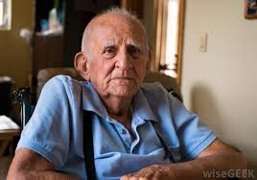
Mr PW
84 years old. Severe heart failure, EF 23%. CRT-D, atrial fibrillation, COPD, NIDDM, renal impairment, gout, peripheral vascular disease, previous CVA
3 admissions in last 6 months. 2 for decompensated heart failure, 1 with infective exacerbation of COPD.
General significant decline in last 6 months
Some cognitive impairment
CRT-D has never fired

Slide 28
MR PW
Current medication
Bisoprolol 7.5 mg twice daily Allopurinol 100 mg daily Lansoprazole 30 mg at night Ultibro Breezhaler one puff daily Ezetimibe 10 mg daily Bumetanide 1 mg daily Sodium chloride nebulisers Metformin 500mg twice daily
Entresto 97/103 1 tablet twice daily
Salbutamol inhaler used if needed
Prednisolone 15 mg daily (reduced from 40 mg daily, to be further reduced by 5 mg every three days for gout)
Ferrous sulphate 200mg three times daily
Movicol 2 sachets twice daily

Slide 29
Current issues:
Nausea
Fatigue
Aching in legs
Constipation/diarrhoea
Breathlessness on exertion
Too may drugs
Too many hospital appointments
Frustrated in not being able to do the things that he wants to do

Slide 30
On examination
Pulse 48 regular, BP 95/55. Chest clear. No ankle swelling.
Blood results
Na 136, K 4.5, Ur 14 Cr 142 eGFR 50
LFTs –mildly deranged in keeping with hepatic congestion
BNP 1435
BMs 4 to 6

Slide 31
Hospital Appointments
Cardiology- 3 hospital consultants and a heart failure nurse
Respiratory- 2 hospital consultants with associated CT chest booked and PFTs and an arms length respiratory nurse specialist
Rheumatology-investigations and F/U clinics (for gout)
Vascular-Investigations and followup clinics
Diabetes specialist clinic
Nephrology- initial appointment and associated investigations

Slide 32
Plan
Rationalise medication
Reduce Bisoprolol
Stop ezetimibe
Consider need to restart edoxaban
Titrate up allopurinol according to renal function
Try reducing/stopping lansoprazole once prednisolone has stopped
Stop Movicol and start sodium picosulphate
Rationalise hospital appointments
Check ECG, check bloods
ACP discussion
Consider deactivating ICD
Following chest CT and PF

Slide 33
Key moral/ethical considerations
Stopping drugs that improve prognosis to achieve better quality of life
To anti-coagulate of not to anti-coagulate in AF
Deactivation of ICDs
Has the device recently fired or fired at all
Need to explain that deactivation does not mean certain or imminent death
Risk of VF less as disease progresses
DNACPR in those with an active ICD
Would prevent CPR in the event of an irreversible asystolic arrest or PEA

Slide 34
A Plea from me
Please, in your daily work
Consider referral to palliative care for deteriorating symptomatic patients both those with cancer and non-cancer (including frailty)
Consider if you would be surprised if your patient dies in the next year
If you would not be surprised, address advance care planning including preferred place of care, preferred place of death, if they want to go to hospital if they deteriorate, DNACPR, prescription of JIC medicines. Make sure that you discuss this with family members too.
If you can do this, it will make life so much easier for you and your colleagues and will improve the way that people die

Slide 35
Advance Care Planning What is it?
An opportunity!
To help patients understand that they may have a poor prognosis
To explain choices that individuals may or may not have
To start conversations in families about what might lie ahead
To help people to understand that they are not going to live forever!

Slide 36
Advance Care Planning
Preferred place of care
DNACPR
‘Just in Case’ drugs
List of contact numbers
Power of Attorney
Resuscitation
Discussion about wills and funerals
Planning for the worst, hoping for the best’

Slide 37
Just in case drugs
Morphine 2.5 to 5mg s/c prn or if eGFR <30ml/min, oxycodone 1.25 to 2.5mg s/c prn.
For pain or breathlessness
Midazolam 2.5 to 5mg s/c prn
For breathlessness or agitation
Haloperidol 1.5mg to 3mg
For nausea or hallucinations
Glycopyrronium 200 to 400mcg s/c
For excess secretions
Furosemide 40mg s/c prn (2 x 20mg/2ml)
For peripheral or pulmonary oedema

Slide 38
When should we do it?
Following a change in circumstance
New diagnosis
Deterioration in condition
Hospital admission
Admission to a care home
If given a relevant cue by a patient
Use of the GSF (Gold Standard Framework) Prognostic Indicator Guide or SPICT (Supportive and Palliative Care Indicators Tool)

Slide 39
Remember…….
Always know the indication for each individual drug
Beta blockers for heart failure, angina, rate control
Warfarin for AF or metallic valve
Always consult with the heart failure nurse or if not known to them consult with GP
Verapamil & diltiazem should be avoided
Make sure you know about other PMH including TIAs, CVAs, bleeds etc
Gradually wean off medicines and check pulse, BP and bloods regularly during periods of change

Slide 40
And finally…….
For patients with a pacemaker/ICD be even more cautious about discontinuing drugs with a potential rate controlling or anti-arrhythmic effect
Always discuss with a cardiologist
Be very clear about what you are trying to achieve when adjusting medication and explain clearly to patients and when appropriate, their families
Think carefully about DNACPR discussions with those who have an active ICD

