Slide 1
Integrating Human Factors into Health and Social Care
Emma Crumpton
Ergonomist

Slide 2
What is Human Factors/Ergonomics?
“the scientific discipline concerned with the understanding of interactions among humans and other elements of a system, and the profession that applies theory, principles, data, and other methods to design in order to optimize human well-being and overall system performance” (International Ergonomics Association, 2000)

Slide 3
Integration of what?
Safety for Clinical Practice AND Safety for Health & Social Care systems
Integrating safety for micro systems (work as done)
Improve the work environment and technologies to care for patients safely and effectively
Integrating safety across macro systems
Investigation of patient safety incidents
Design protocols and guidelines (work as imagined)
Integrating HFE and Quality Improvement

Slide 4
How Human Factors / Ergonomics could, and should, be implemented in Health & Social Care
CIEHF White Paper (2018)
Authoritative guide for HFE in Health & Social Care
Clarifies HFE competence and experience:
Training & Education provision
Professional practice/support

Slide 5
use Human Factors
Understanding how to use Human Factors
To investigate incidents
HFE approach takes a wider view to encompass root causes such as poor product design
To think about systems
HFE may focus on optimisation of a micro-system, but there will be clear mapping of the relationships within the larger (macros) systems
To think about design
HFE is relevant to all stages of the life-cycle from early stages of planning and design, right through to implementation and evaluation

Slide 6
ment could include…
HFE assessment could include…
From micro…..
Working space
Tasks
Cognitive interfaces (workload, information processing etc.)
Physical interfaces with equipment etc. (e.g. furniture, medical devices)
Physical activity, lifting and carrying
Environment (e.g. lighting, thermal, acoustic)
Systems (e.g. job, team work, organisation)
…..to macro.

Slide 7
Integration of what?
Safety for Clinical Practice AND Safety for Health & Social Care systems
Integrating safety for micro systems (work as done)
Improve the work environment and technologies to care for patients safely and effectively
Integrating safety across macro systems
Investigation of patient safety incidents
Design protocols and guidelines (work as imagined)
Integrating HFE and Quality Improvement

Slide 8
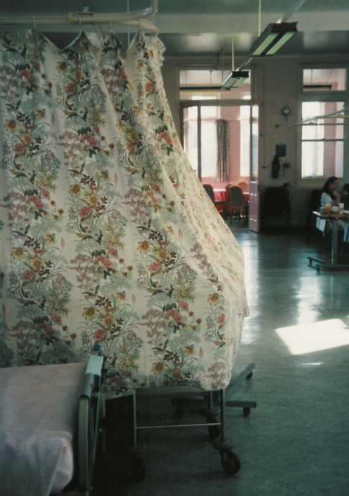
Space to care and work :Task Analysis
Working space
Tasks
Cognitive interfaces (workload, information processing etc.)
Physical interfaces with equipment and other objects (e.g. furniture, medical devices)
Physical activity, lifting and carrying
Environment (e.g. lighting, thermal, acoustic)
Systems (e.g. operating procedures, guidance and instructions)

Slide 9
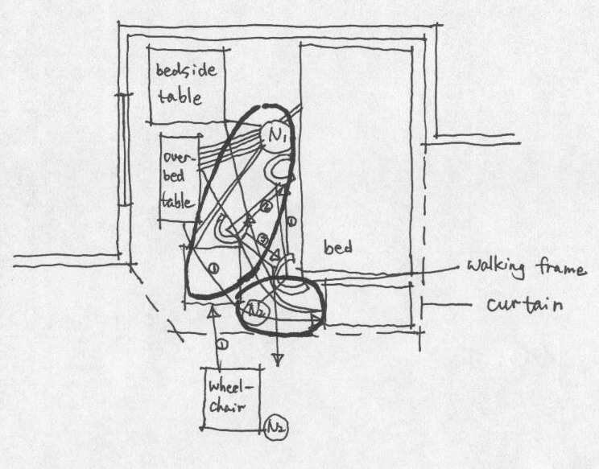
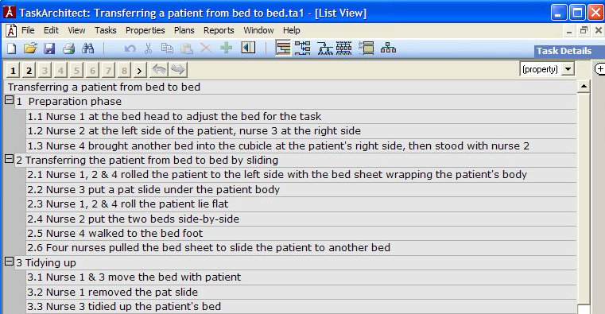
Space to care and work: Task Analysis
Observations in general medical and surgical wards, toilet/shower facilities and Intensive Care Units
Link Analysis: Transferring a patient from bed to wheelchair

Slide 10
Space to care and work
Acute medical/surgical ward bed space = 10.84m² (Ave. width 3.41m x length 3.18m)
Hignett, S. Lu, J. (2008) Ensuring bed space is right first time. Health Estate Journal, February. 29-31
Toilet/shower = 5.03m² (Ave. width 2.6m x length 2.01m)
Hignett, S. Lu, J. (2008) Ensuring bed space is right first time. Health Estate Journal, February. 29-31
ICU bed space = 22.83m² (Ave. width 4.68m x length 4.71m)
Hignett, S. Lu, J. (2007). Minimum Space Requirements to Prevent Injuries in Critical Care Nurses: An Evaluation of Three High Risk Tasks Critical Care Clinics of North America 19, 167-175
Neonatal Intensive Care cot space = 13.5m² (Ave. width 4.13m x length 3.27m)
Neonatal Health Building Note. Department of Health, Estates and Facilities Management Directorate
Bariatric bed space = 16.61m² (Ave. width 3.93m x length 4.23m)
Hignett, S. Griffiths, P., Chipchase, S., Tetley, A. (2007). Risk assessment and process planning for bariatric patient handling pathways. Health and Safety Executive Research Report RR573 http://www.hse.gov.uk/research/rrhtm/rr573.htm Accessed 17th July 2007
Prof. Sue Hignett S.M.Hignett@lboro.ac.uk

Slide 11
HFE approach to safety
Most effective
Eliminate – the hazard through DESIGN
Forced function e.g. the easiest option is the safest
Barriers – between the hazard and the user
Child resistant containers, controlled drug cupboards
Mitigate – the consequences of the hazard
Antidote drugs, limited dose infusions
4. Educate – to change behaviour Rely on (hope) users to prevent or avoid the hazard
Least effective
(adapted by Pickup (2018) from Hale and Glendon, 1987)

Slide 12
Integration of what?
Safety for Clinical Practice AND Safety for Health & Social Care systems
Integrating safety for micro systems (work as done)
Improve the work environment and technologies to care for patients safely and effectively
Integrating safety across macro systems
Investigation of patient safety incidents
Design protocols and guidelines (work as imagined)
Integrating HFE and Quality Improvement

Slide 13
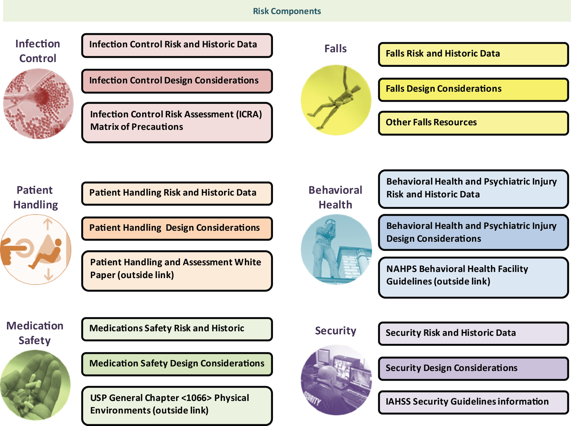
HFE Integration of Safety Risk Assessment Components (reproduced with permission of The Center for Health Design)
Building Design
Use at different phases of design process:
Pre-design
Design (schematic)
construction
Occupancy
Post-occupancy

Slide 14
Integration of what?
Safety for Clinical Practice AND Safety for Health & Social Care systems
Integrating safety for micro systems (work as done)
Improve the work environment and technologies to care for patients safely and effectively
Integrating safety across macro systems
Investigation of patient safety incidents
Design protocols and guidelines (work as imagined)
Integrating HFE and Quality Improvement

Slide 15
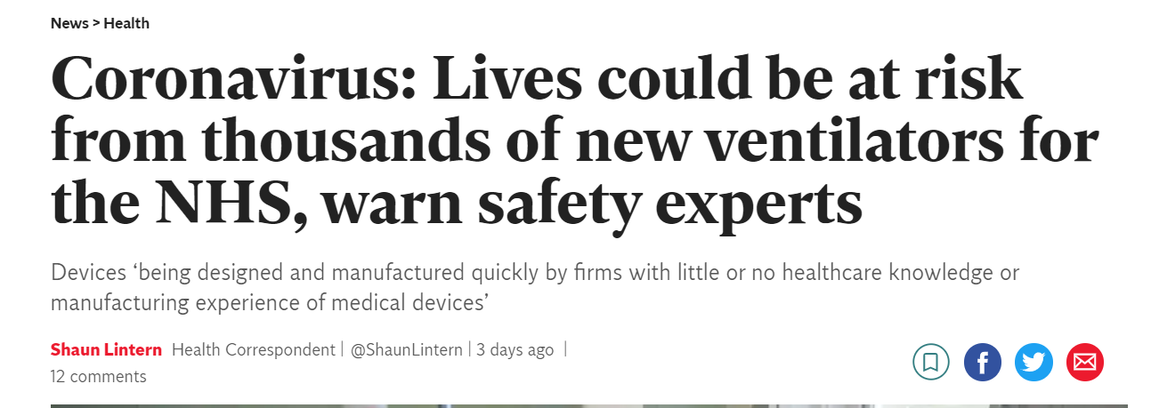
Rapidly Manufactured Ventilators for COVID-19

Slide 16
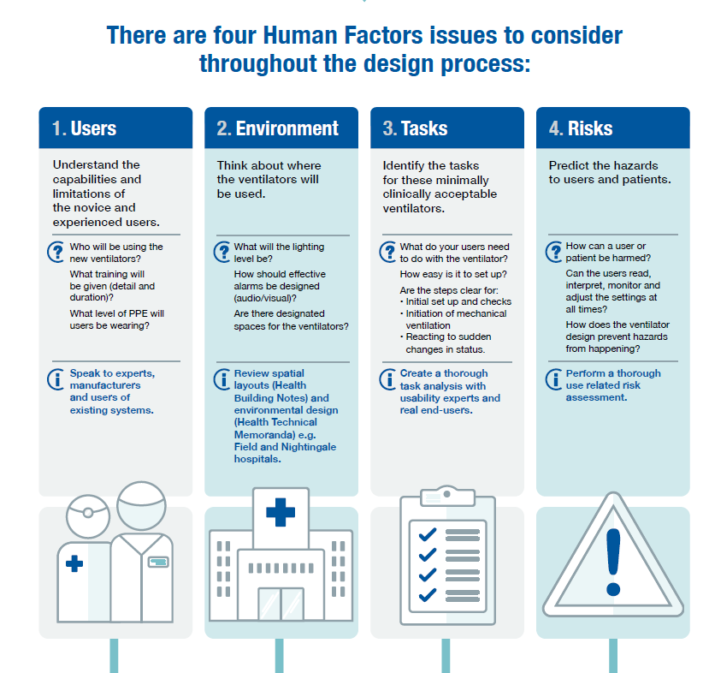
Human Factors for Rapidly Manufactured Ventilators

Slide 17
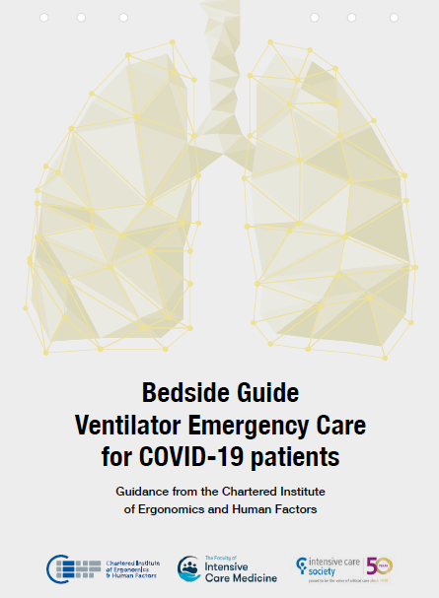
Human Factors/Ergonomics guidance
https://covid19.ergonomics.org.uk/

Slide 18
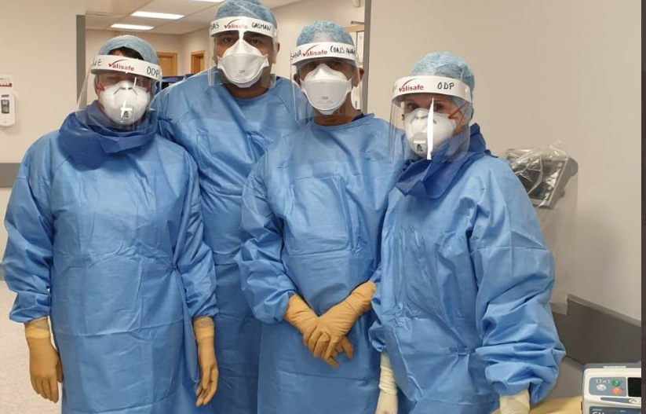
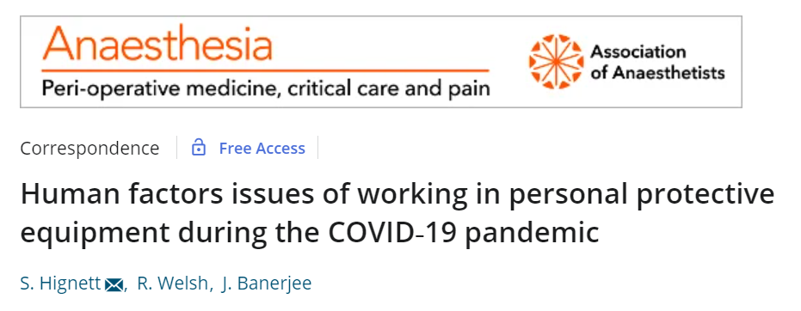
Personal Protective Equipment (PPE)
Online survey between 4 April and 8 May 2020
33,173 excess deaths recorded
Over 300 health & social care staff died (over 600 now)
Prof Jay Banerjee
Visiting Chair and A&E Consultant

Slide 19
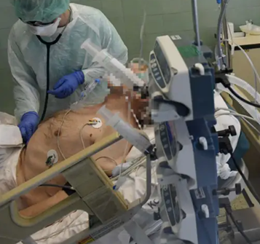
What did we ask about?
Face cover: safety glasses +/- specs, safety goggles, surgical mask, FFP3 mask, visor
Body cover: plastic apron, surgical gown with sleeves, one piece coverall
Gloves: disposable, viral protection
Human Factor/Ergonomics issues
Fit and comfort
Reading and operating equipment
Hearing and communicating
Reaching and moving
Dexterity to use touch screens, press buttons, open vials/taps, use syringes

Slide 20
HFE Integration
for Patients AND Staff (and other humans in the system)
across all safety risks in micro, meso and macro systems
‘bird’s eye (global) view of implementation by building on existing systems and structures
Step change over the next 30 years to reach out into all areas of clinical practice
Hignett, S. (2015) Plenary: Healthcare Ergonomics: Reaching out into all areas of Clinical Practice or ‘Touching and Analysing the Elephant’ Proceedings of the 19th Triennial Conference of the International Ergonomics Association. Melbourne, Australia, 11-15 August.

Slide 21
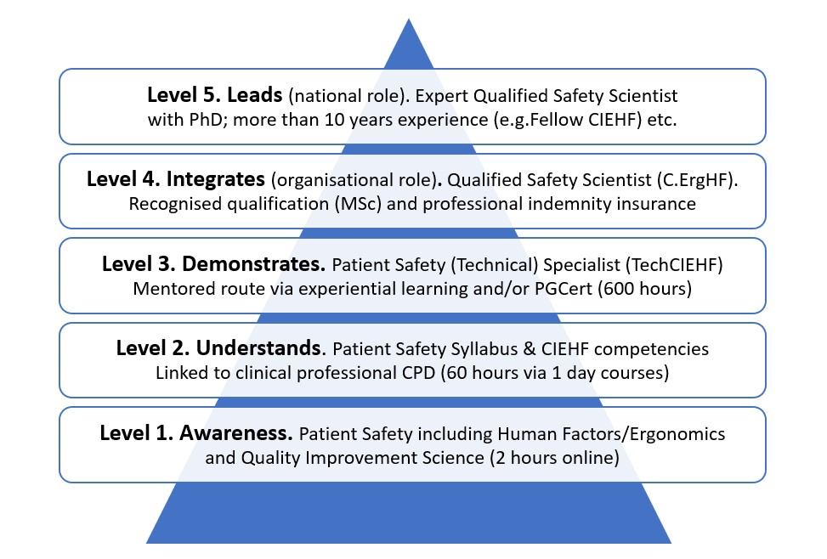
Professional Approach to Patient Safety
Proposed Learning Pathway
for COVID-19 and beyond….

Slide 22
Thank you!
E: d.s.hfehub@lboro.ac.uk
www.lboro.ac.uk/design/hfehub

