Slide 1

Educating and Training Staff in Human Factors
Dr Sarah Noble BM MRCS FRCEM @DrSarahNoble
Consultant in Emergency Medicine, Hampshire Hospitals
Programme Director, Patient Safety First, HEE Wessex
ED Clinical Governance Lead, Hampshire Hospitals
Associate Medical Director, QI, Hampshire Hospitals

Slide 2
Educating and Training Frontline staff in Human Factors
What & Why
How:
  Regional example
  Workplace Example
  Workplace Wide Example
Where & when
@DrSarahNoble

Slide 3
What……is Human Factors?
~10% patients harmed in healthcare systems
45% patients don’t receive gold standard care*
80% error caused by human factors rather than technical skills
*McGlynn et al., NEJM, 2003
@DrSarahNoble

Slide 4
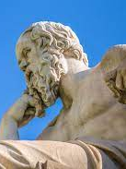
Why?
To spark improvements to keep our patients safe & deliver best care
Medicine is complex requiring complex team working and communication
“You can’t hold all the information in your head any longer, and you can’t master all the skills. No one person can work up a patient’s back pain
  run the immunoassay
  do the physical therapy
  protocol the MRI
  direct the treatment of the unexpected cancer found growing in the spine.”
      Atul Gawande
Workplaces are complex with huge variation across the NHS in processes/systems and equipment
Humans are complex
“To know thyself is the beginning of wisdom” Socrates
@DrSarahNoble

Slide 5
How?
Regional example
Work area example
Work Wide examples
@DrSarahNoble

Slide 6
Educating and Training staff in Human Factors
Regional Programme Example:
Patient Safety First
Since 2009
Clinical Human Factors Group Resources
3243 delegates
All CT1s in all specialties, more recently nursing (paed and neonatal) preceptees and newly qualified pharmacists
Blend of Patient Safety, Human Factors and Quality Improvement
@DrSarahNoble

Slide 7
Regional Programme Example:
Patient Safety First Programme
Training day
Patient Safety Project
Conference
@DrSarahNoble

Slide 8
Training day
  Patient safety, error, risk – high profile cases
  Human factors
    Based on “Human factors in Healthcare” principles
    PERSONAL CLINICAL EXAMPLES = Credibility
    Examples from industry (Piper Alpha) as well as clinical (Bawa Garba case)
    Relevant national/local campaigns e.g. Civility Saves Lives
  Introduction to Quality Improvement
  Specialty groups with specialty facilitators to discuss specialty specific risks and patient safety projects
@DrSarahNoble

Slide 9
Training day: Human Factors – problems and solutions
Systems:
  Violations e.g. drug rounds, bloods in babies, slide sheets
Human Interactions:
  Pseudo-teams
  Error risks (e.g. Conformity, Assumptions)
  Portable Skills – e.g. sharing mental model, respectful challenge, closed loop comms, SBAR, role modelling
Equipment:
  Awareness
  Checks
  Reporting
  Solving e.g. design/labelling
Environment:
  Distractions e.g. sterile cockpit, Stop moments
Personal
  Slips/lapses vs mistakes
  Cognitive overload
  Situational awareness and biases
@DrSarahNoble

Slide 10
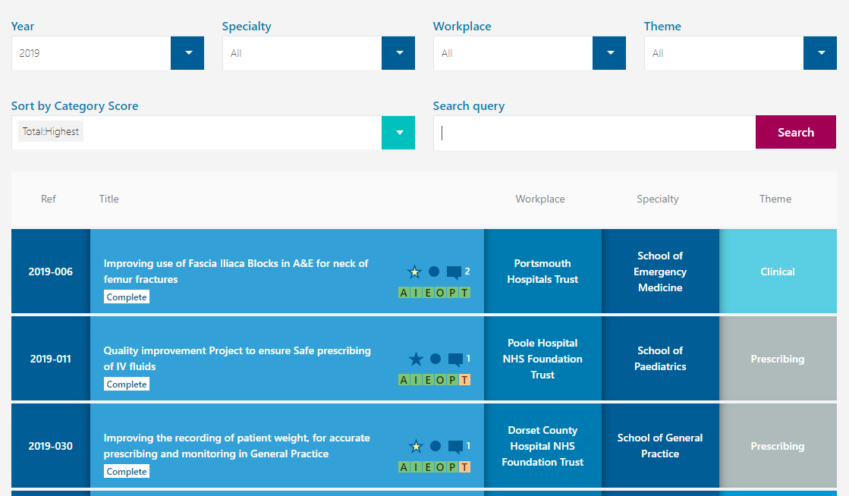
Patient Safety Project
  1434 so far
  In place of work
  Themes fed back to specialty schools and workplaces
  www.healtheducationwessexprojects.org.uk
@DrSarahNoble

Slide 11
Conference
  Project Presentation
    learning
    sharing
  Inspirational Speakers
  Ideas for next steps
@DrSarahNoble

Slide 12
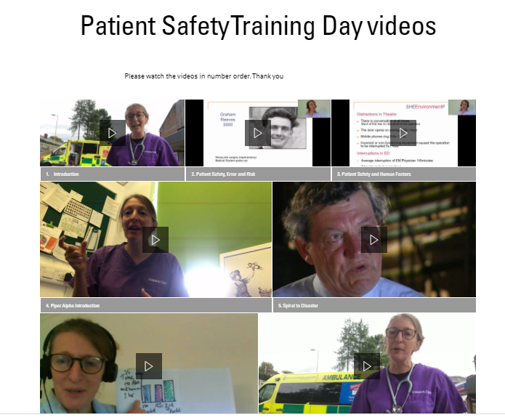
Taking Patient Safety First Online
@DrSarahNoble

Slide 13
Feedback
“Many thanks to the facilitators, as the content is compelling and engaging in delivery. Concise and easy to apply to developing a specialty specific QIP”
“a great opportunity to learn and attain how important patient safety is first and relevant application in our clinical practice”
“very informative, supportive and approachable”
“everything was perfect, content was appropriate, it was nicely delivered”
@DrSarahNoble

Slide 14
Pros/cons
Great feedback in terms of changing attitude and practice
Great patient centred grass root projects
Holistic approach to delivering quality care
Hard to measure
Challenging workplace engagement
Doctor heavy
Potential for reporting significant information on themes of risks from delegates (discussions and projects) for specialty schools and workplaces to inform education and improvement which is not entirely tapped yet
@DrSarahNoble

Slide 15
Future Considerations
Evolution of content to keep pace with context:
Patient Safety, Human Factors, QI
Patient Safety Syllabus
Feedback to specialty schools and workplaces
MDT
Place in context of journey of training/career development
Faculty development/acknowledgement
Locally relevant: Currently deanery based but trial of delivery to ED MDT in situ with relevant local information reaped significant reward for safety culture
@DrSarahNoble

Slide 16
Questions and sharing of regional examples
@DrSarahNoble

Slide 17
Educating and Training staff in Human Factors
Workplace Example: Using the Governance Process
Boards
Governance Teams
Governance Data
Staff
@DrSarahNoble

Slide 18
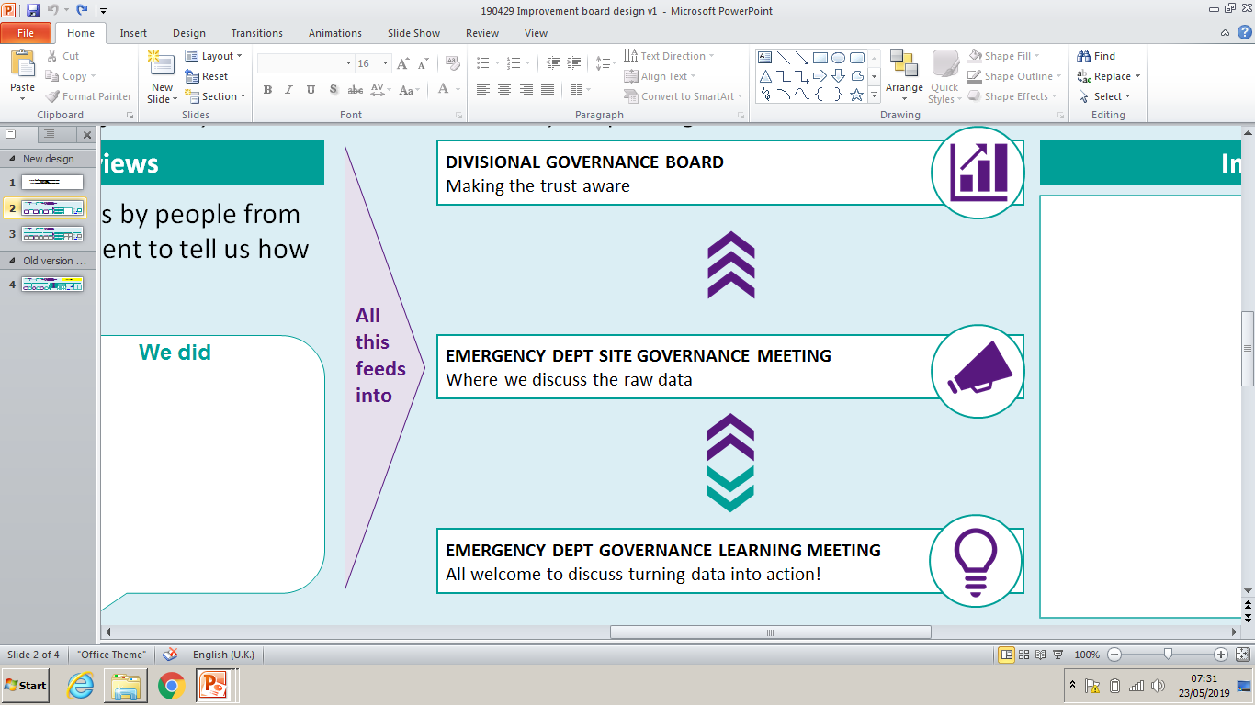
GOVERNANCE DATA
Matters Arising
COVID
Build risks
Improving patient care and Safety
Infection Control
Datixes
Risk Register
Improving Experience of Patients
Complaints, Compliments
Patient Survey
Peer Review
Valuing Staff and Partners
Training
Ensuring Clinical Excellence
New interventional Procedures
New SOPs and Guidelines
Unexpected deaths
Reattendance within 7 days
Improvement Projects
Research
Other
Staffing
Other ways we learn and improve from this:
Clinical Educator Updates for teaching in dept
Top Ten Tips
Safety bulletins
Improvement Projects
@DrSarahNoble

Slide 19
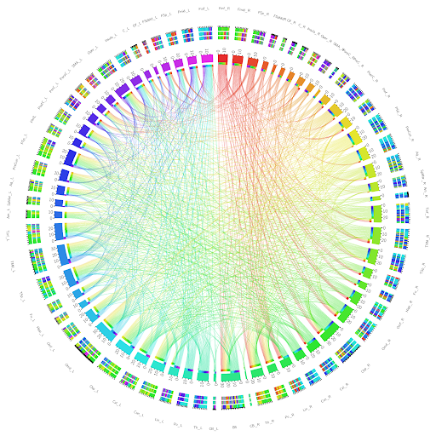
Every Patient
Governance is about making sure we are always
learning and improving
creating an environment where we can provide
EXCELLENT PATIENT CARE!!
Everyone
Every day

Slide 20
Risk in our Emergency Departments

Slide 21
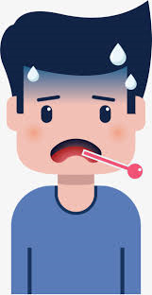
What our cases say:
@DrSarahNoble
Notes:
This is mostly the M&M presentation from Gareth Davies/Alex Van Heerden which needs to include any SIRIs that Mel has sent over. We should also aim to include a summary of all the ‘Datix Learning’ e mails that have been sent out by Mel.

Slide 22
GOVERNANCE STRATEGY
Governance Aim Statement Always learning and improving, creating an environment which supports delivery of patient centred, quality, timely care. | Drivers | Strategy
 | Understanding the Data | Weekly (alternate sites) Site meetings to review data:
 | Taking action in response to data | Rapid response to urgent datixes: 48hr panel, 72hr report Data driven improvement projects carried out by staff, mentored by improvement lead Engagement with organisational improvement projects
 | Communicating the data and response | Monthly Governance Learning Meetings Training: Clinical Educator Summaries for shop floor teaching; SHO/Registrar teaching specific sessions for governance learning (often sim) Top ten tips and One Minute Wonder board Governance Learning Boards; weekly stand up/comms cell.
 | Enabling and Empowering Workforce to engage and lead on improvements | Individual QI training to optimise specific projects Group Training in QI: SHOs, ENPs, Consultants, Nursing teams Broad Patient Safety and Human factors training for all Sign posting to Trust QI academy for development of champions/mentors. Building a culture of improvement, inclusive of all roles and supported by senior team.

Slide 23
AND PUT SIMPLY?...........
Defining the gold standard
Patient Journey
from Governance Data
Quality Commitment
Patient Centred, Quality, Timely Care
For every patient, by everyone, every time
@DrSarahNoble

Slide 24
Questions
Sharing of workplace examples
Personal pledges
@DrSarahNoble

Slide 25
Educating and Training staff in Human Factors
Workplace Wide Example:
Improving Human Factors for Patient Safety - iHuPS
System Dependent
Widely inclusive
  Culture
  Patient Safety & Governance
  Innovation
  Improvement
  Clinical Strategy
  Organisational Development
Multi disciplinary teams
Faculty/Champions
Support from workplace for time/training
@DrSarahNoble

Slide 26
Questions
Identification of potential collaborators in workplace

Slide 27
Break Out Groups: Next Steps
Within your gift
  Role Modelling
  Handover
  Notice boards
  TEAMS
  Projects
  Datix/AER/M&M meetings
Big picture thinking
  Know your aim, know your stakeholders
  Start with something where you can and worry about the rest later
1. What is in your region, widespread workplace or work area?
2. Which teams or people would be useful to engage with?
3. What can you do to deliver training when you leave the conference?

Slide 28
Sharing next steps
Final Questions?

