Slide 2
In the UK
1 IN 4
1 IN 20
Experience a mental health condition
Have a Personality disorder diagnosis

Slide 3
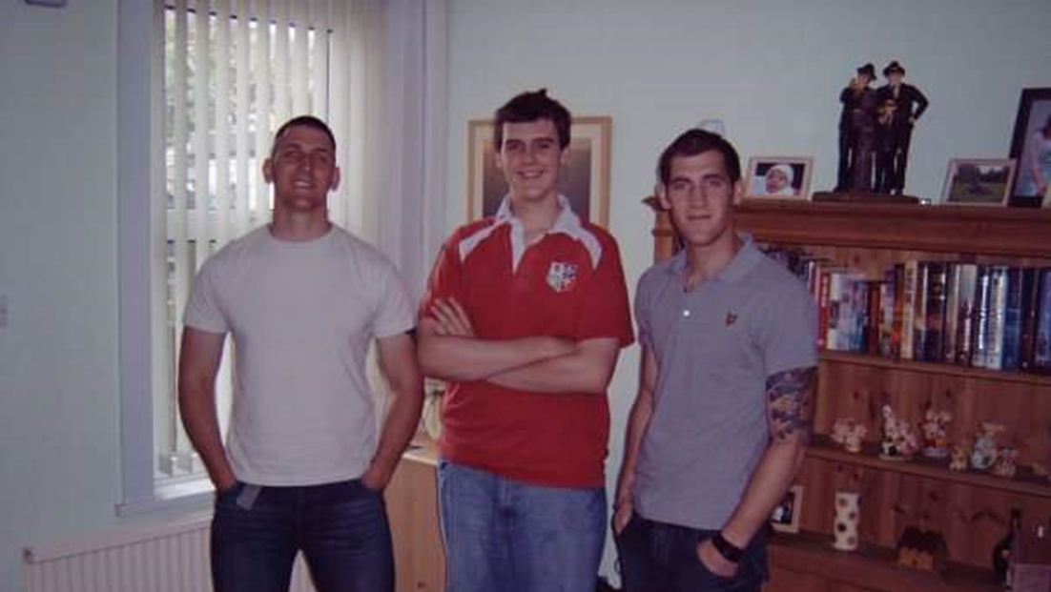

Slide 4
LCpl William Bonner
1984 - 2009

Slide 5
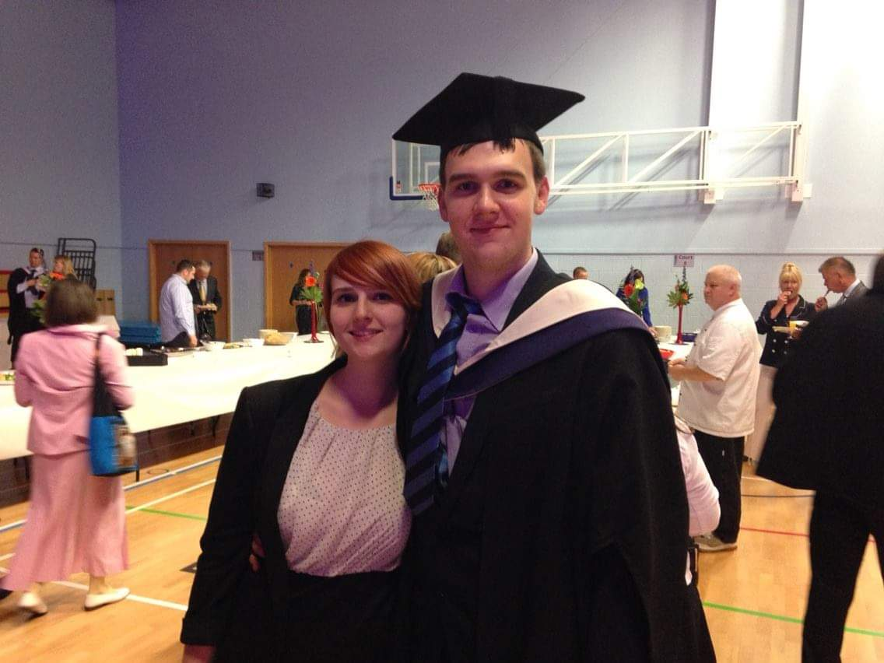

Slide 6
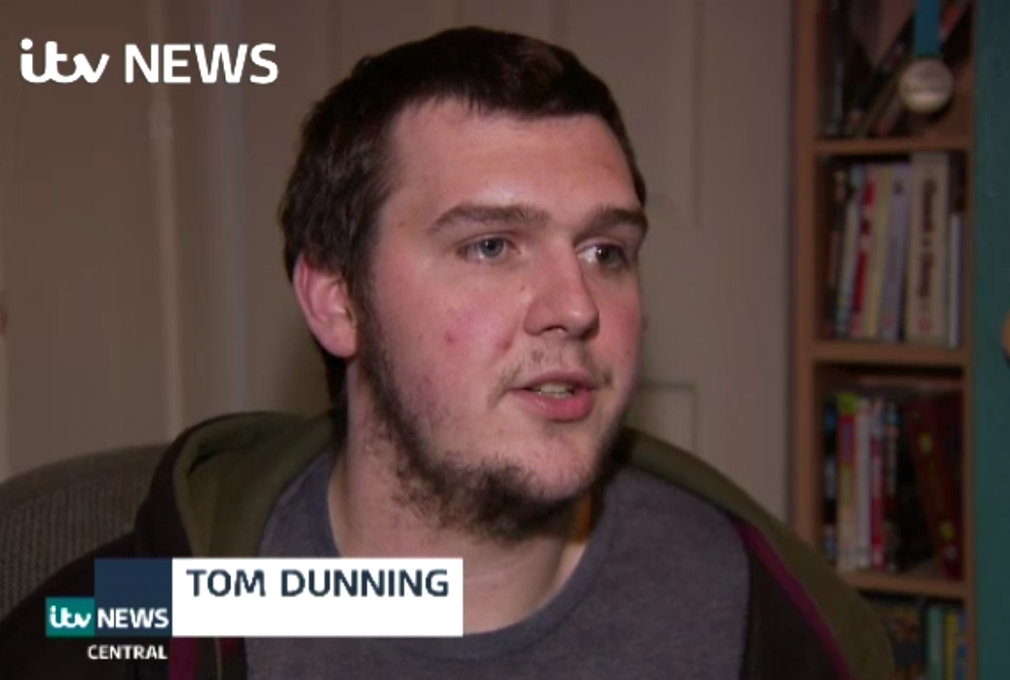

Slide 7
OVER
6500
SUICIDES
IN THE UK IN 2018

Slide 8
Before the Turning point – The Diagnosis
Not unwell enough for one service, Too unwell for another.
“Treatment Quagmire” Feeling: Alone, not wanted and no hope.
¾ of a year until seen psychologist and diagnosis given: Borderline Personality Disorder – PTSD – Social Anxiety Disorder
Crisis team Quotes : “We don’t need you in here [to Amber/Carer+partner]”
“I see you have gobbled up those tablets then” “What do you want me to do about it?”

Slide 9
The Turning Point
Carers Sessions:
Once a week
“Respite” from caring for sufferer
Open invite to carers and the people they care for.
Met people in a safe chatty environment with same diagnosis.

Slide 11
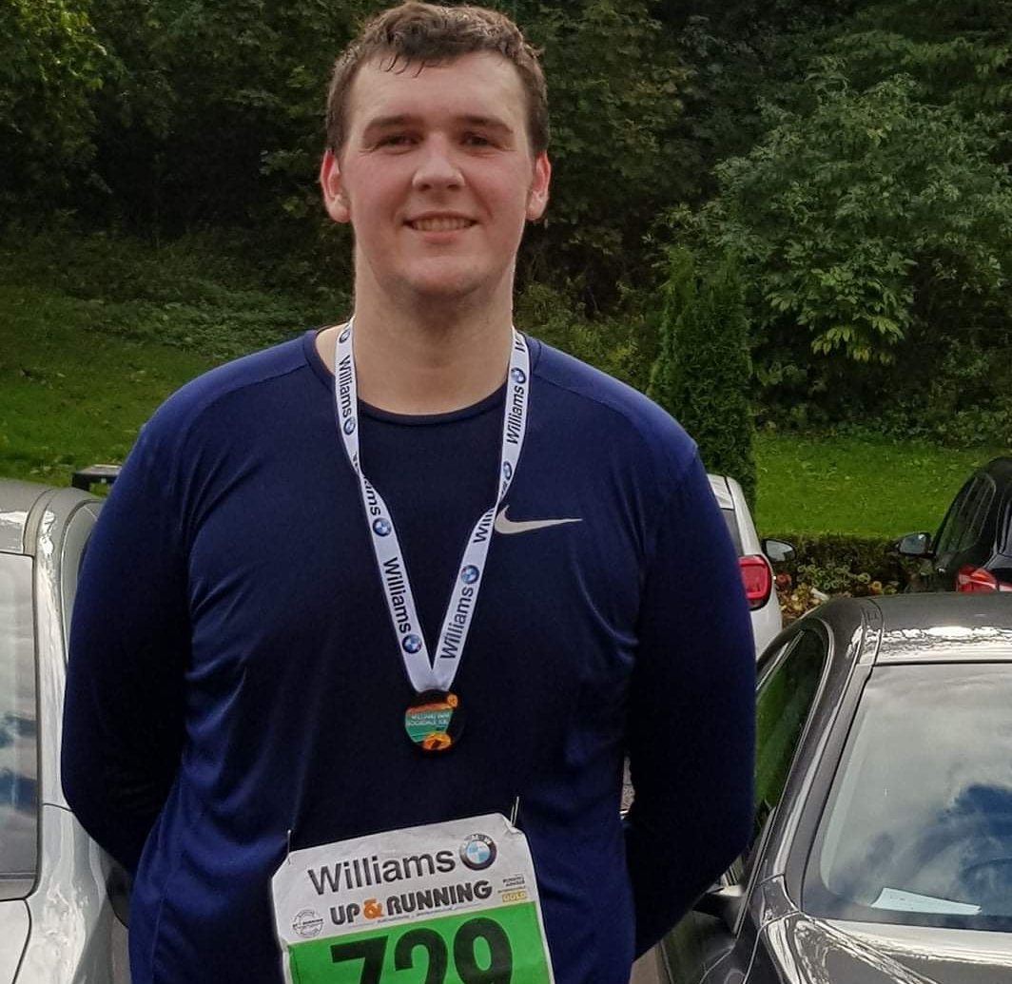
START WEIGHT 23 Stone 6.4 Lb

Slide 12
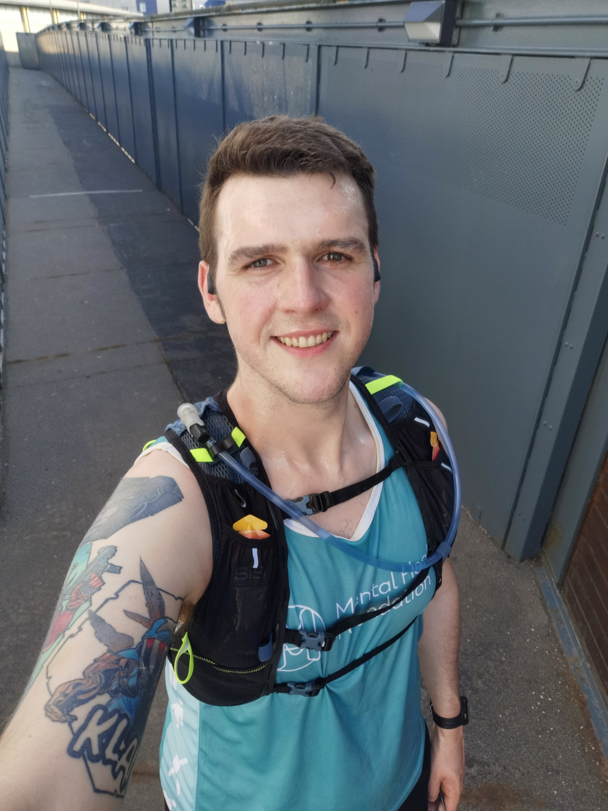
CURRENT WEIGHT 16 Stone 4.2 Lb

Slide 14
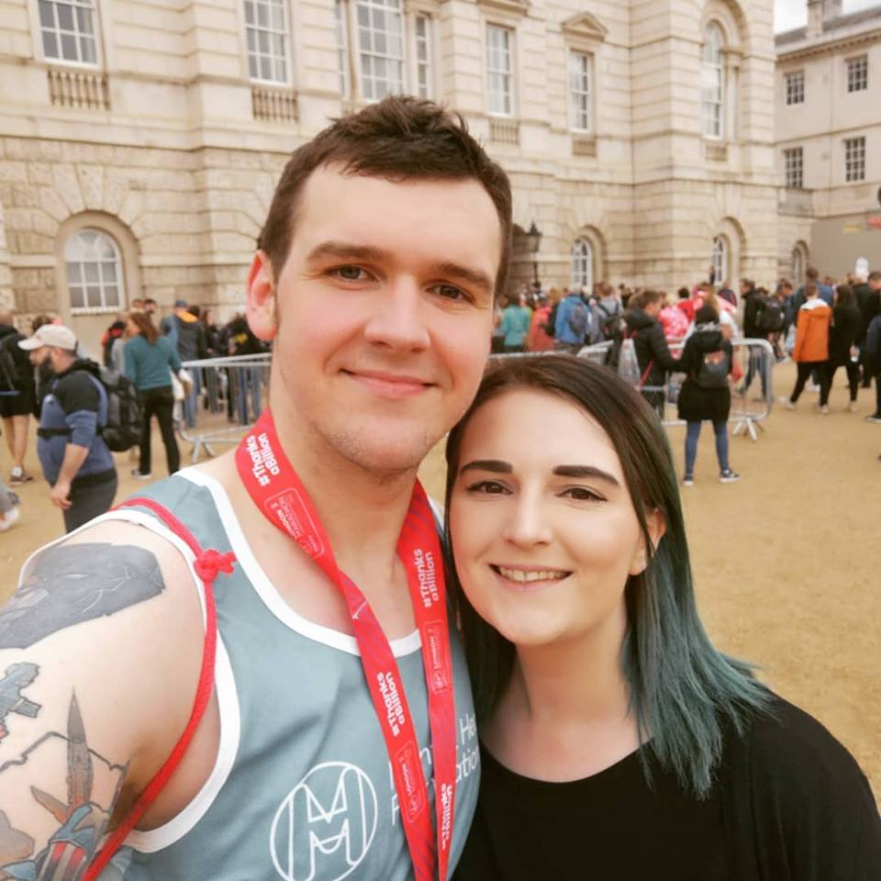

Slide 16
ARE
YOU
OK?

