Slide 1
Developing and ensuring competence in practice for Nursing Associates
Kathryn Draper
Senior Nurse Lecturer
Course Lead of the Nursing Associate Programme

Slide 2
Aims of the session to discuss and explore:
How training and education can be rooted in clinical practice
Developing and ensuring competence in practice: maintaining the standards of proficiency
Supervision and accountability in practice
The development of expanded practice and additional competencies
Ensuring Nursing Associates stay within their competence and scope of practice
Our expereince at NTU and how the programme has developed since our first cohort
www.ntu.ac.uk

Slide 3
Main themes
Communication
Flexible
Empowerment
Challenge
Innovation
Notes:
To address the outcomes of the presentation the same themes kept occurring so rather than repeating myself I have decided to break the points into the following themes ….. I think you would all agree these are key themes of being a nurse, nursing associate and educator

Slide 4
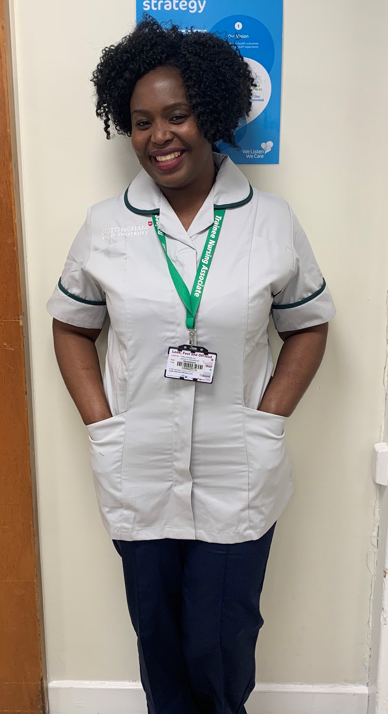
Our journey so far…..
2018 Nursing Associate programme was collaboratively developed with practice partners and people with expereince
Summer 2019 Nursing Associate programme validated by the NMC
January 2020 First cohort of 29 Nursing Associate Apprentices commenced
October 2020 Second cohort of 18 Nursing Associate Apprentices commenced
January 2021 Third cohort of 38 Nursing Associate Apprentices commenced
Working with a number of different employers including:
Large acute teaching hospitals
Child and Adolescent Mental Health Service (CAMHS)
Medium and High Secure Forensic Mental Health Services
General Practice
Social Care
www.ntu.ac.uk
Notes:
Model of a weeks induction at the beginning of each year of the programme, then a day release after this for the rest of their programme
Will be focusing on apprentcieship route as I have no expereince of supporting direct entry learners.

Slide 5
Communication
With who …..
Trainee Nursing Associate
Practice Partners
NTU Community Group
Other colleagues
Regional and National Groups
How we have achieved this ……
Setting expectations of being an accountable professional
Investment and valuing of practice relationships
Regular meetings with practice
Facilitate shared learning
Tripartite reviews
This Photo by Unknown Author is licensed under CC BY-SA

Slide 6
Flexibility
Nursing Associate role is ever evolving and developing
Learning outcomes and content relates to local policies and procedures
Responding to the development of care provision across all areas of care in health and social care
How we have achieved this …
Learning about the different care settings the apprentices are based in
Acknowledge the differences in practice across the different clinical settings and experiences
Regular content review
Communication with practice and TNA’s ensures correct application to practice
Keep up to date with developments of the Nursing Associate role
This Photo by Unknown Author is licensed under CC BY-NC

Slide 7
Empowerment
TNA’s to have the confidence and knowledge to be actively involved in quality improvement
Practice partners to incorporate role and competencies into governance & workforce plan
Facilitate shared learning
Make a positive impact on the local community and employer
Preceptorship programme
How we have achieved this …..
Discuss accountability and responsibilities of being a registered healthcare professional
Quality Improvement is key learning outcome of the programme
Regular communication and advice with practice
Regular meeting with practice to encourage shared learning
Discussions with TNA’s during taught sessions, workplace reviews and course development meetings to encourage discussions in practice and for future competency development
This Photo by Unknown Author is licensed under CC BY-SA-NC

Slide 8
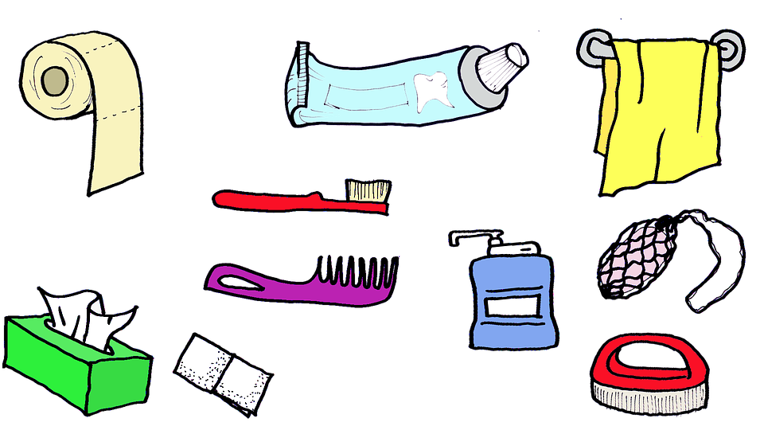
Peer support – providing personal hygiene
Communication – between peer groups
Flexibility – encouraging apprentices to learn in different ways
Empower – apprentices with knowledge and experience to support peers and teach them how to provide personal hygiene
Challenge – the evidence base and ‘this is how we have always done it’
Innovation – peer to peer learning and support
www.ntu.ac.uk

Slide 9
Challenge
Self
Trainee Nursing Associates on the programme with appropriate assessments
Inclusion of four fields of nursing
Practice Partners to continually review and develop role and areas of competence
Tripartite reviews
Curriculum
How we have achieved this …..
Accepting and responding to feedback
Embracing and accepting the challenges
Maintaining a positive outlook
Active listening
Avoiding the thought ‘I know best’
Being open and transparent and encouraging everyone else to be

Slide 10
Case study – General Practice
Innovation and Empowerment
Developing role of the TNA in primary care
Undertaking Long Term Condition reviews whilst incorporating a discussion about mental health to provide person centered care
The Trainee Nursing Associate reflected on thier experience …
‘There is a clear correlation between depression and Long Term Conditions (LTCs), therefore I feel the need to routinely address the psychological impact living with multimorbidity has on the patients I care for. After learning about the prevalence of mental health for those with LTCs I feel frustrated and disappointed about this subject being optional (within the LTC templates). I can now provide evidence-based feedback on how templates can be improved not only to make them more efficient for clinicians but to ensure care is personalised and engaging for the patient.’
This Photo by Unknown Author is licensed under CC BY-NC-ND

Slide 11
Innovation
Competence relates to providing innovative person-centered care not just ‘clinical skills’
Shared learning
Interprofessional Education
Leadership
Four fields of nursing
How we are achieving this …..
Challenging the ‘norm’
Empowering leaders to lead
Utilising technology
Recognising with the Nursing Associate role we are all on a journey and no one is an expert
This Photo by Unknown Author is licensed under CC BY-SA-NC

Slide 12
Introducing the Nursing Associate role into a new care setting
Communication and Flexibility
Utilising shared learning in similar settings
Monthly communication to ensure the role is being embedded and appropriately supported
Discussions to ensure content and expectations of TNA are appropriate and relevant to practice
Workplace reviews ensure support in practice and accountability is appropriate
Discuss with TNA’s about their experiences and application to practice
Ensuring module leads, scenarios and case studies reflect the new setting and application to practice
Enquiring if the role is being future proofed by policies, governance, roles and responsibilities, communication with the MDT and identification of future care provision
This Photo by Unknown Author is licensed under CC BY-ND

Slide 13
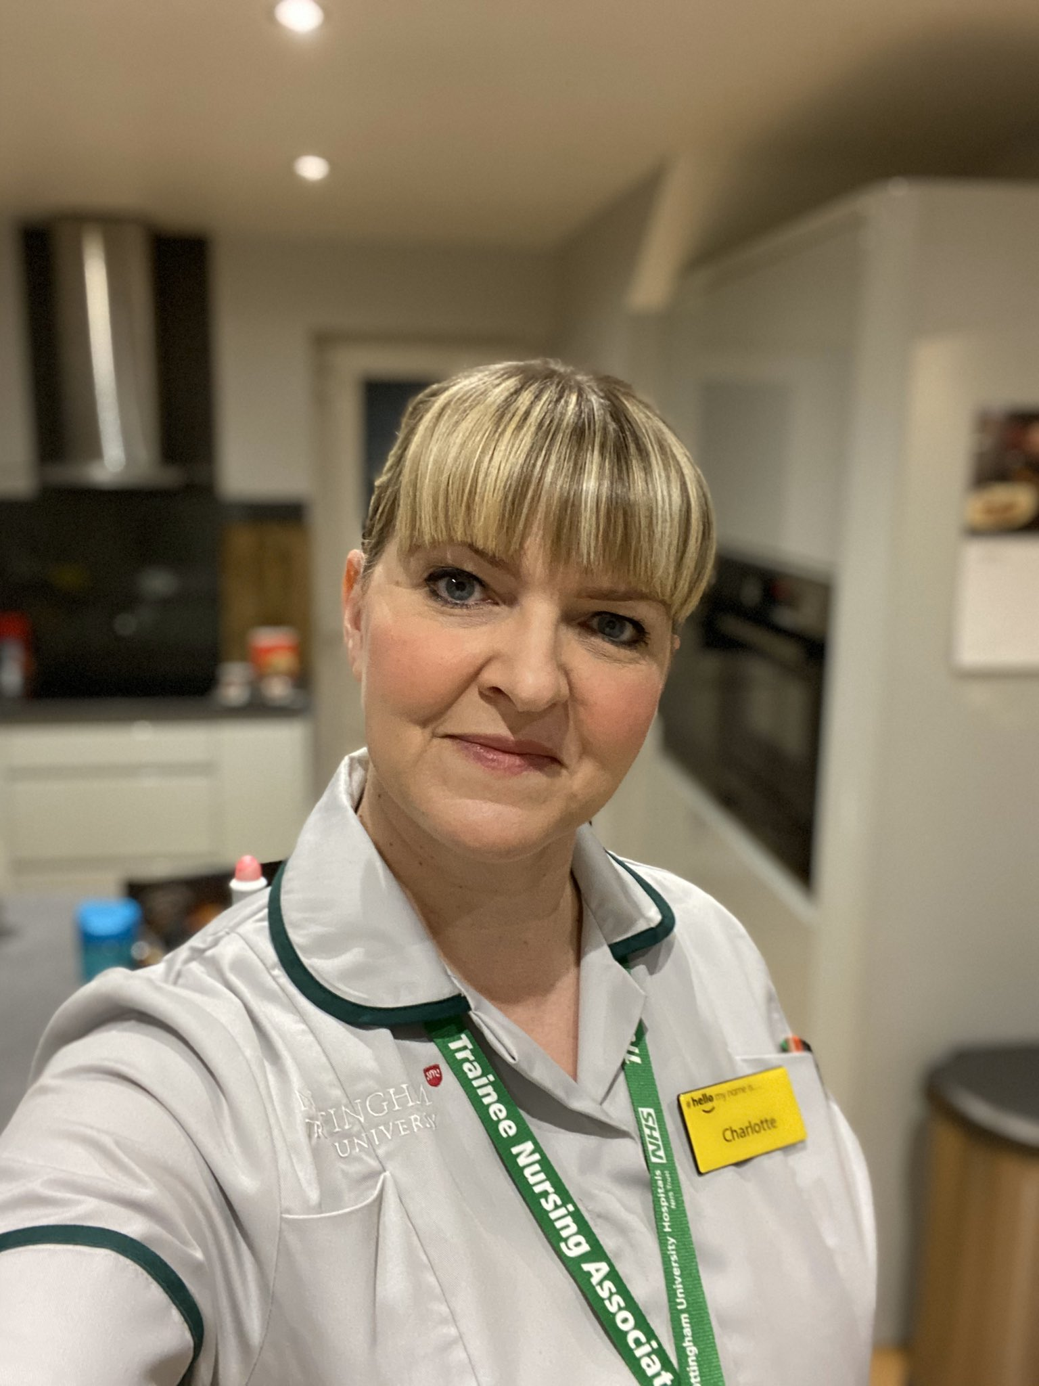
Our expereince and how the programme has developed since our first cohort
Maintaining the focus and motivation
Continuing to develop communication processes with practice partners, student reps to develop content and delivery
Incorporation of any national or local developments into programme
Utilising the knowledge of new members to the team at NTU
Utilising members of the NTU Community Group
www.ntu.ac.uk

Slide 14
This presentation has discussed and explored:
How training and education can be rooted in clinical practice
Developing and ensuring competence in practice: maintaining the standards of proficiency
Supervision and accountability in practice
The development of expanded practice and additional competencies
Ensuring Nursing Associates stay within their competence and scope of practice
Our expereince at NTU and how the programme has developed since our first cohort
www.ntu.ac.uk

