Slide 1
The future of the PA profession in the UK
Kate Straughton, President, FPA

Slide 2
A bit of history…
First US-trained PAs came to work in the UK
First permanent courses started training
Name changed to Physician Associate
2002
2008
2013
2004
2010
2015
Pilot schemes in West Midlands ¹ & Scotland ²
Managed Voluntary Register
Professional organisation moved to FPA@RCP
1. Woodin J, McLeod H, McManus R. Evaluation of US-trained physician assistants working in the NHS in England: Interim Report: The introduction of US-trained physician assistants to primary care in Tipton: First impressions
2. Buchan J, O'May F, Ball J. New Role, New Country: introducing US physician assistants to Scotland. Human Resources for Health. 2007;5(1).

Slide 3
PA training
1,600 hours of clinical placements
National Curriculum and Exam
2 year post-graduate course
Approx. 2,000 PA students
35 Courses across the UK

Slide 4
PA training
New curriculum currently being written by FPA, RCP, PA Schools Council (PASC) and GMC
This will be a capabilities based, rather than current competency based curriculum
HEIs will then either independently, or collaboratively design a syllabus to sit alongside
Consultation Autumn 2021
Working towards publishing July 2022

Slide 5
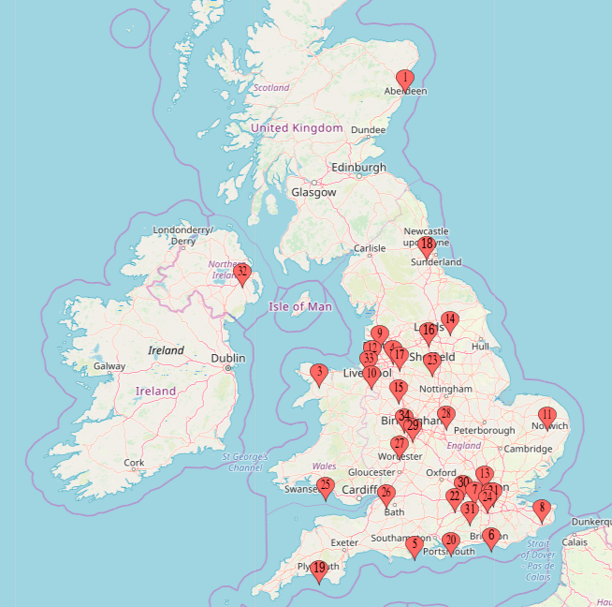
PA Training – Where does it happen?

Slide 6
PAs in the UK
Approx. 2,700 qualified PAs working across England, Wales, Scotland and Northern Ireland
Take written recertification exam every 6 years (currently)
Currently not regulated but have a Managed Voluntary Register – Code of Conduct; Scope of Practice; CPD; FTP
Generalist role across many different specialties of medicine and surgery

Slide 7
PAs in the UK

Slide 8
PAs in the UK: 2020 Census
Generalist Settings
9% | Emergency Medicine
30% | General Practice
13% | Acute Medicine
1% | Community Medicine
Adult Medical Settings
2% | Cardiology
5% | Care of the Elderly
0.4% | Dermatology
1.8% | Endocrinology
3% | Gastroenterology
2% | General Internal Medicine
<1% | Genitourinary Medicine/ Sexual Health
2% | Haematology
<1% | Nephrology
3% | Neurology / Stroke
2.3% | Oncology
3% | Respiratory Medicine
Surgical Settings
<1% | Cardiothoracic Surgery
<1% | ENT
5% | General Surgery
<1% | Neurosurgery
1% | Obstetrics & Gynaecology
<1% | Plastic Surgery
<1% | Transplant Surgery
3% | Trauma & Orthopaedics
1% | Urology
<1% | Vascular Surgery
Paediatric Settings
1% | General Paediatrics
<1% | Neonatology
<1% | Paediatric Psychiatry
1% | Paediatric Surgery
Psychiatry Settings
2% | Psychiatry
Further census findings available at fparcp.co.uk

Slide 9
What do PAs do?
Take Medical Histories from patients
Carry out Physical Examinations
See patients with undifferentiated diagnoses
See patients with long term chronic conditions
Formulate differential diagnoses and management plans
Perform diagnostic and therapeutic procedures
Develop and deliver appropriate treatment and management plans
Request and interpret diagnostic studies
Provide health promotion and disease prevention advice for patients
Taken from the Competence and Curriculum Framework, DOH 2012

Slide 10
But what impact does that have?
Add continuity
Act as additional resource for other staff members, patients, relatives…
Can help to free up junior doctors to get to teaching or clinics
More experienced PAs can support junior doctors in clinical setting, teach them, provide stability
Concern re ‘stealing teaching opportunities’, ‘cherry picking jobs’
Evidence shows junior doctor training is not negatively impacted by having a PA ⁴
4. Roberts S et al. Experience of the impact of physician associates on postgraduate medical training: A mixed methods exploratory study . Clinical Medicine 2019 Vol 19, No 1: 4–10

Slide 11
Public consultation closed June– Regulation reform but specific section (section 5) around bringing PA regulation in under GMC
Regulation will bring protected title, QA for PA courses, as well as potential for other opportunities such as prescribing
Regulation
Current timeframe shows statutory regulation coming into play for PAs in the “latter half of 2022”

Slide 12
Career Progression
“Lack of Progression” for PA profession
Career Framework in development
National Job Profiles
Portfolio or equivalent
Additional avenues – research, education, management, leadership, national representation

Slide 13
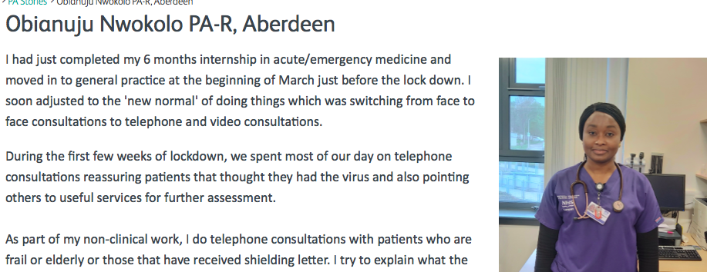
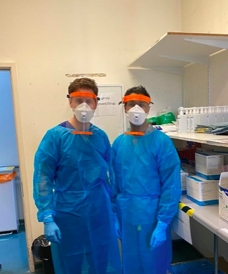
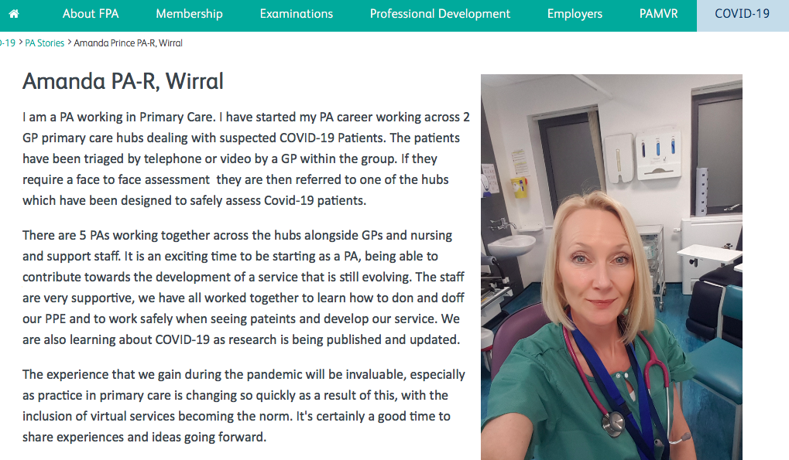
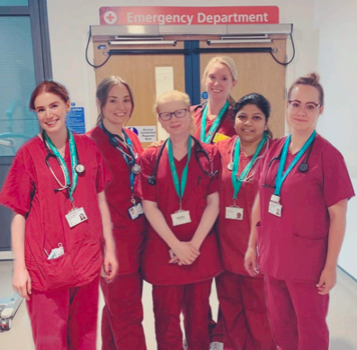
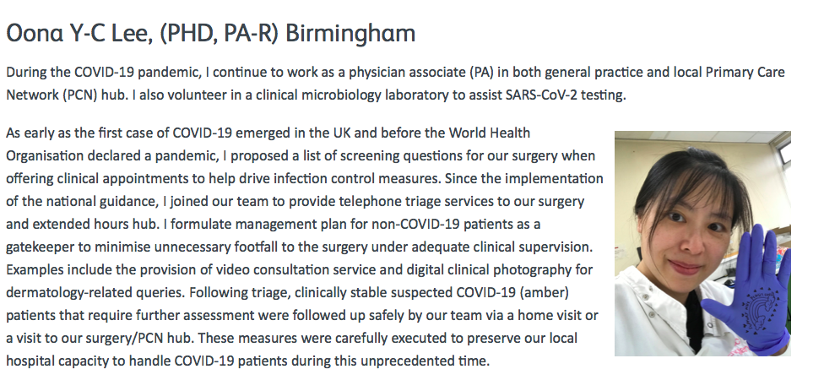
COVID-19
Flexible generalist medical workforce
Institutional continuity
https://www.fparcp.co.uk/covid-19

Slide 14
COVID-19
https://www.fparcp.co.uk/covid-19

Slide 15
Moving Forward
1
8
Statutory Regulation with GMC
International recognition
2
7
Career Framework to support progression
Ensuring patients are informed of the PA role
3
6
Work towards prescribing rights
Increased research about the UK PA role and working as part of the team
4
5
More regional representation for members
E-portfolio and other resources to support education and development

Slide 16
Thank you!
kate.straughton@rcplondon.ac.uk
@KateStraughton
fpa@rcp.ac.uk
@FPARCP

