Slide 1
The Future of the Digital Professional
James Freed, CDIO, Health Education England, Deputy SRO, Building a Digital Ready Workforce
@jamesfreed5

Slide 2
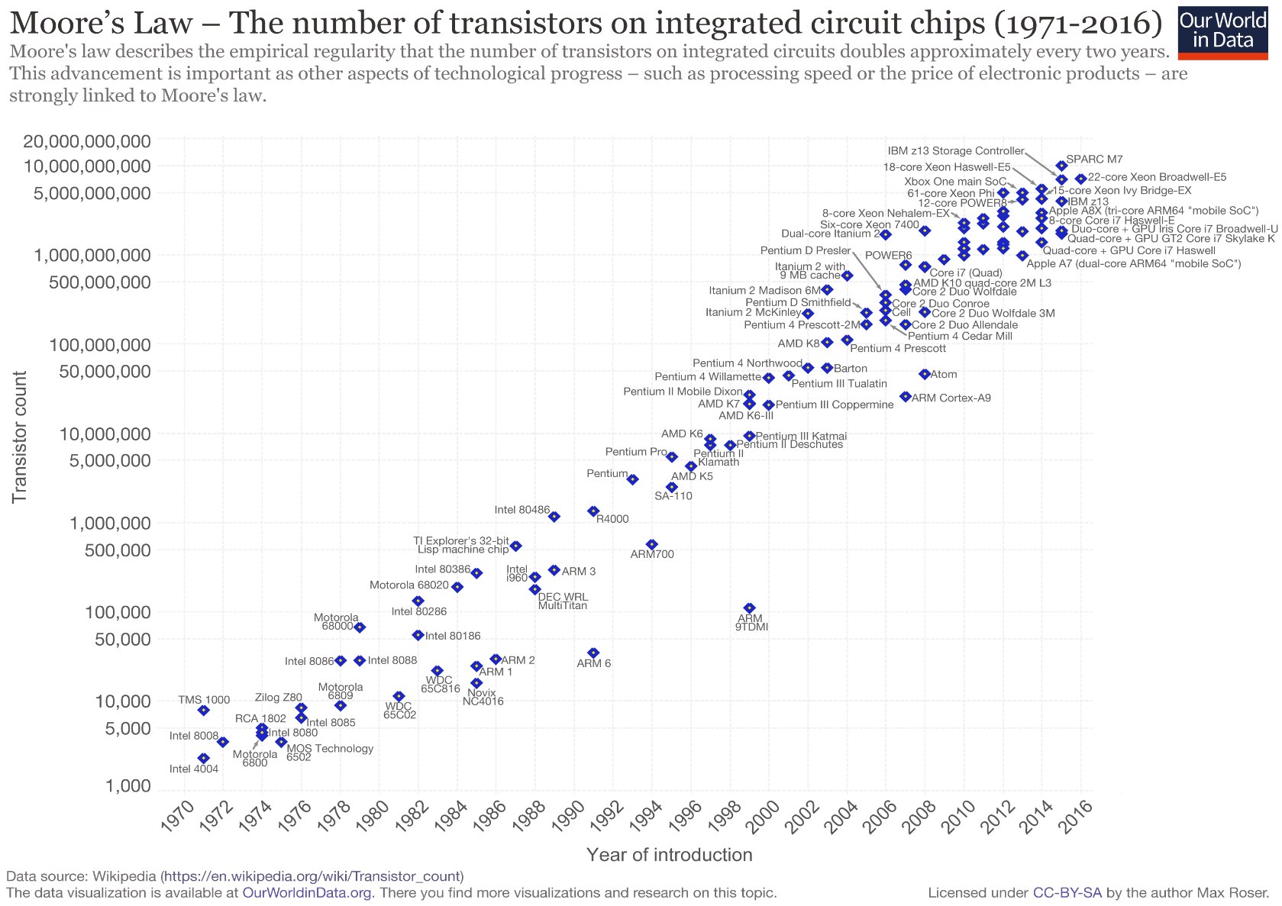

Slide 3
Learn faster
Govern smarter
rate of change
Human adaptability
Technology
time

Slide 4
Conclusion 1: Everyone has a role to play in delivering a digital future
Digital ready
Digitally willing
Individual attitudes
Culture
Digitally able
Individual Skills
Data and Technology
Organisation leaders
Everyone
Everyone
Digital professionals
@NHS_HealthEdEng @jamesfreed5 #DigitalReady
Notes:
JF.
How is BDRW delivering adaptability? Through digital readiness for all, culture change in organisations and a move to ensure all digital experts, who help us make decisions right now, are good enough, both in skill and in attitude.

Slide 5
Conclusion 2
The future digital professional creates an environment
conducive for rapid and safe change
People
1: Does the organisation understand the changes being brought about by the use of digital in healthcare?
2: Does the organisation have a culture of open discussion & experimentation led by visible leaders?
3: Does everyone understand users’ needs and are they empowered to act to improve them?
4: Does the organisation have a suitably skilled and empowered workforce?
Process
5: Is the organisation supportive of cross-functional, non-hierarchical structures?
6: Are organisational processes fast, integrated and light and do they meet users’ needs?
7: Are digital risks understood, weighed against benefits and is appropriate assurance is available?
8: Is technology scalable, interoperable, flexible, fixable, resilient and fit-for-purpose and does the organisation understand how to assure themselves of this?
Technology

Slide 6
Conclusion 3 (a)
The future digital profession will include more specialities…
Nine areas of work*
Clinical coding
Health records
Information management
Information and communications technology
Clinical informatics
Knowledge management
IT programme and project management
IT strategy and development
IT education and training
Job roles and skills within each area of work mapped to:
Roles and skills frameworks
Government Digital Service (GDS) - Digital, Data and Technology (DDaT) Framework (39 roles)
Digital Health and Care Institute – Occupational Category Framework
Digital Health and Care Institute – 21st Century Skills Plus Framework
FEDIP – Professional Standards Framework
*Categories defined by NHS Digital
Guidance on Informatics and used in ESR

Slide 7
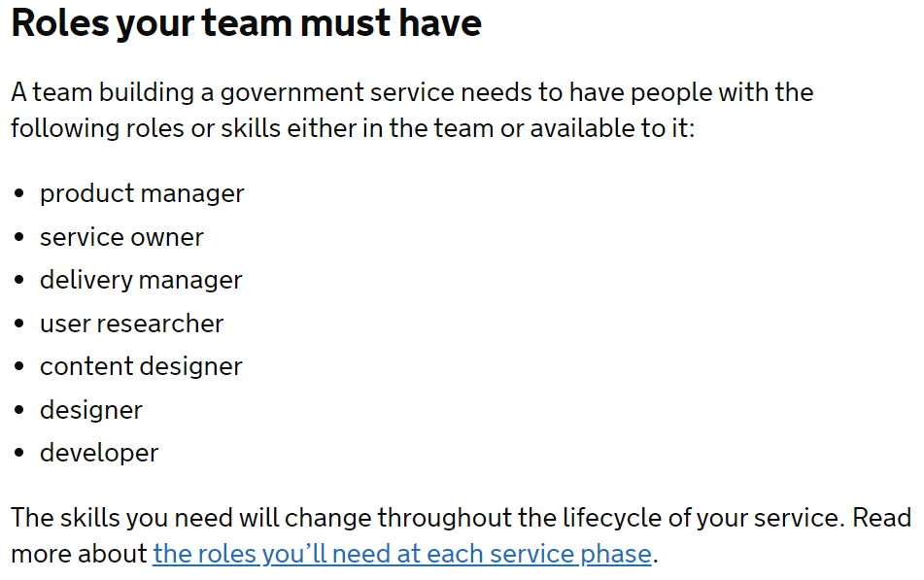
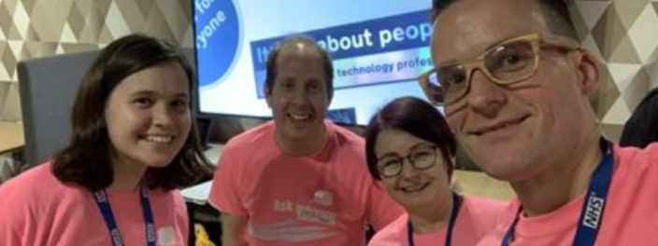
Conclusion 3 (b)
…with greater cohesion as an MDT designing, delivering and improving services

Slide 8
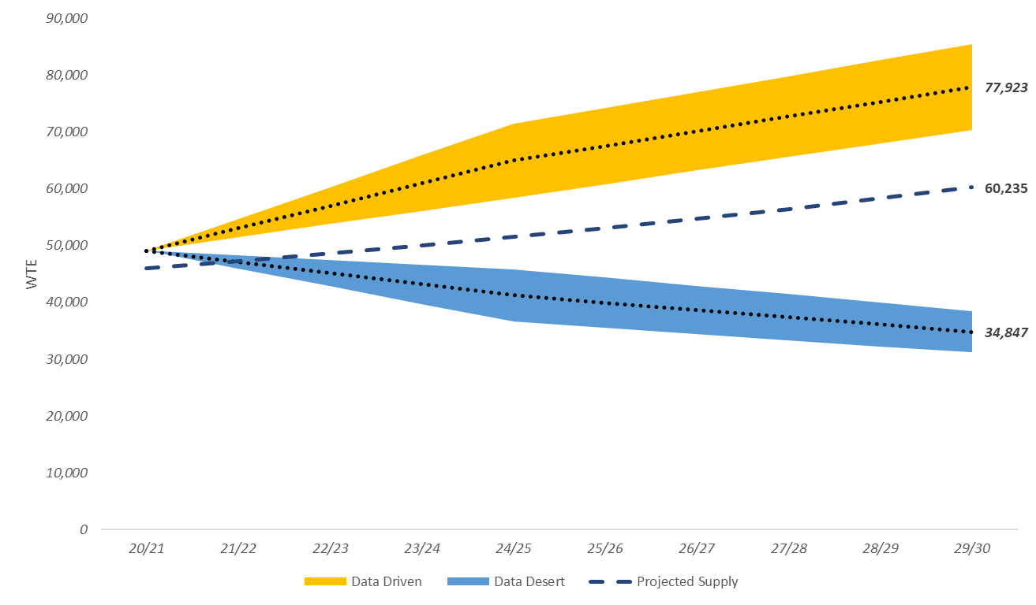
Conclusion 4 (a)
The profession will grow…
Data Driven Future
Gap between current workforce size in 2020 and projected demand in 2030:
32,000 FTEs or +69% increase required between 2020-30
Current 2020 workforce size (supply): 46,000 FTEs
Estimated demand by 2030: 78,000 FTEs
Gap between projected supply and projected demand in 2030
17,700 FTEs shortfall
Even though supply has increased by 31% from 46,000 FTEs to 60,250 FTEs between 2020-30

Slide 9
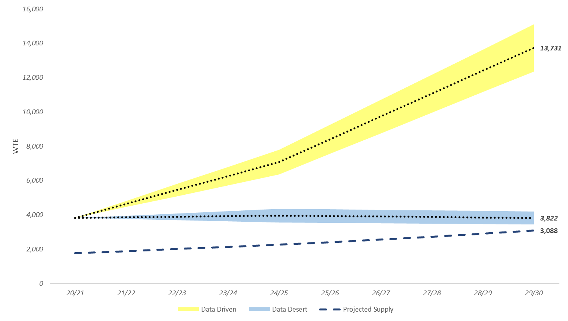
Conclusion 4 (b)
…and clinical informatics will grow the most
Data Driven Future
Significant increase in demand and stagnating supply
Shortfall of 10,650 FTEs by 2030
Increases required in all job levels particularly professional, managerial staff and senior leaders to meet demand.
Changes in staffing by job levels in a Data Driven Future

Slide 10
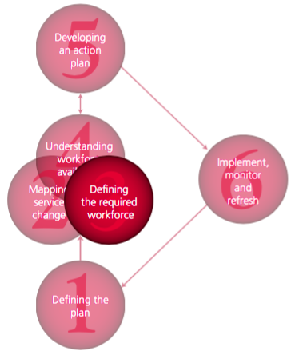
Six Steps Methodology to Integrated Workforce Planning
Define the plan
Map service change
Define the required workforce – up to 2030
Understand workforce availability – up to 2030
Develop action plan
Implement, monitor and revise
Notes:
Welcome to Delegates; Remind of agenda; Purpose
Rules – reiterate those on ‘landing slide’ e.g. all on mute unless asked to speak; use chat to ask questions / tech issues etc
We have invited you here as experts in your own right and we want YOUR views based on your expertise.
Don’t feel the need to defend a ‘position’ or an organisation.
The discussions will be conducted under a form of ‘Chatham House’ rules, i.e. we will report on the groups’ considerations but not on individual responses.
At end, hand over to David Farrell

Slide 11
The future is bright
Support for Digital Experts
Who: The professional bodies
Co-ordinated by: FEDIP/ HoPs
What will we solve?
Describe who digital staff are
Create a common language for capabilities across professions
Set a bar for digital roles
Provide a route to assess digital staff against that bar
Create career routes
Who: Learning providers
Co-ordinated by: NHS Digital Academy
What will we solve?
Identify learning offers for professional groups at all levels
Create a way to accredit learning through professional bodies
Delivery of core learning and signposting to additional learning
Who: Communities and networks
Co-ordinated by: FEDIP/ ISDNs
What will we solve?
Help signpost and maintain diversity of communities, particularly for less well served groups
Help organisations understand how to use the NHS Digital Academy and the FEDIP professional bodies to support all digital staff to develop
Am I good enough?
What learning do I need?
Who can help me?

Slide 12
Thank you
James Freed
james.freed@hee.nhs.uk
@jamesfreed5

