Slide 1


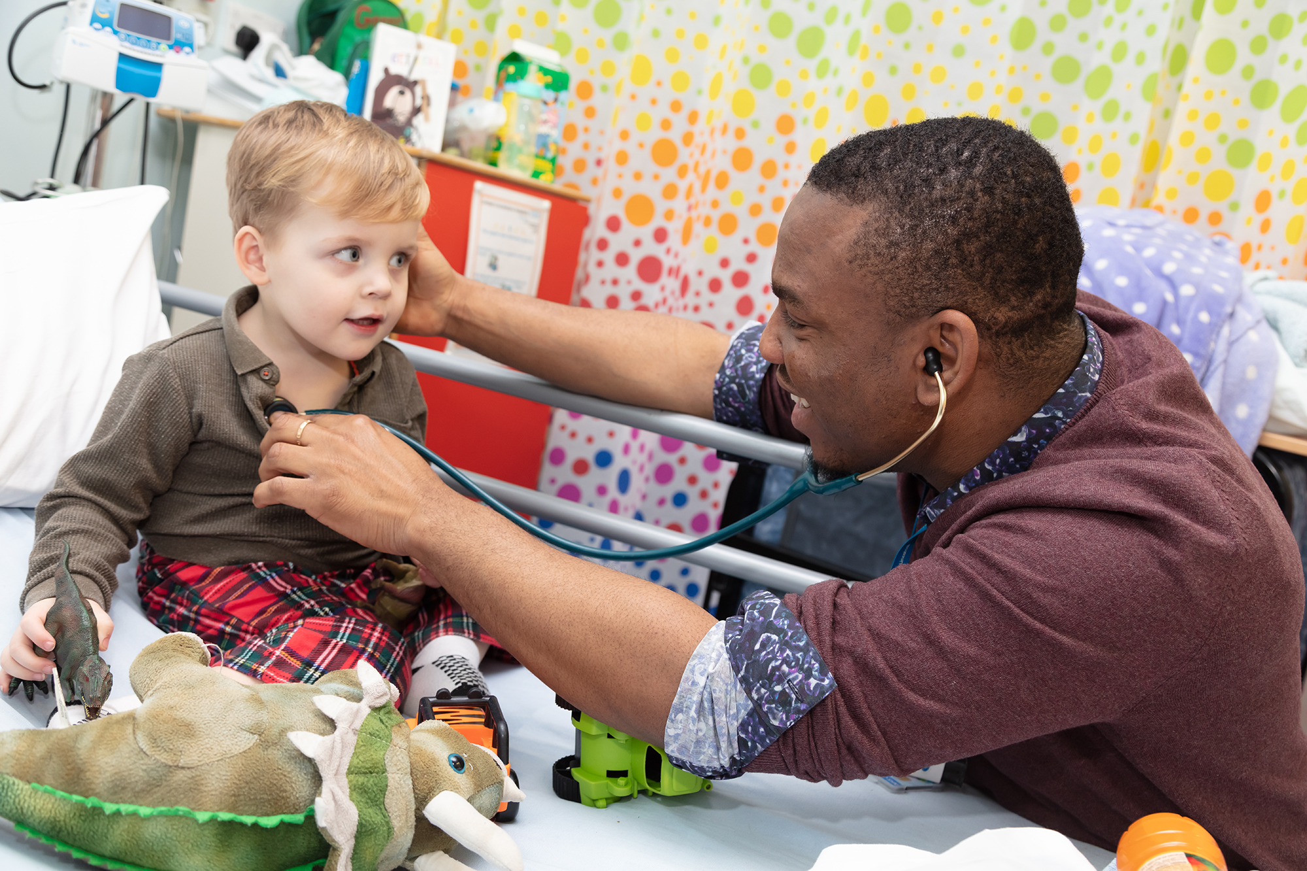
Sepsis Education and Training
Dr Gary Wares
Post Graduate Dean, Health Education England
15 July 2021

Slide 2
Outline
HEE’s role in educating the workforce
HEE sepsis scoping work
Available educational materials

Slide 3
What does HEE do?
Health Education England (HEE) exists to support the delivery of excellent healthcare and health improvement to the patients and public of England by ensuring that the workforce of today and tomorrow has the right numbers, skills, values and behaviours, at the right time and in the right place.

Slide 4




HEE Mandate
All healthcare staff are competent in the recognition of, and response to, sepsis
2015-2016: Take steps to ensure that training is also available so that healthcare staff are competent in the recognition of, and response to, acute illness such as sepsis as a key factor in preventable mortality.
2016-2017: Build on work started in 2015, including making available, by August 2016, a specific training module for sepsis. HEE will also make recommendations on any new materials identified as necessary from wider scoping work.
2019-2020: Increase awareness of sepsis among health and care workers including pharmacists working in primary and community settings, health visitors, community nurses, and domiciliary and care home workers. HEE will also commission projects to fulfil specific education and training gaps in antimicrobial resistance and sepsis.

Slide 5
Scoping work
Highlights numerous examples of good practice in relation to sepsis education and training.
Identifies clear gaps in the provision of sepsis education and training, particularly for:
    - healthcare staff working in community and primary care settings.
    - management and executive staff within healthcare providers.
    - staff in permanent and non-training roles.

Slide 6
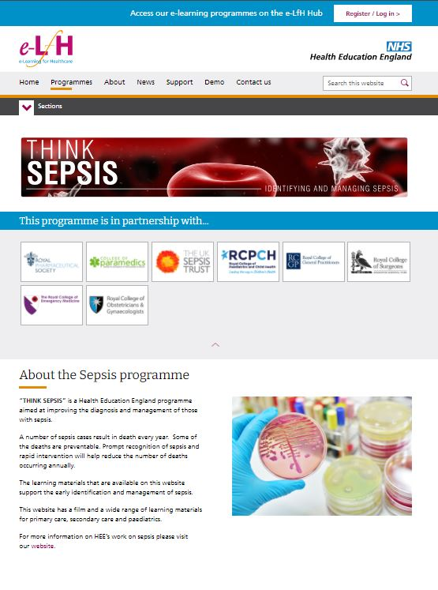
Sepsis educational resources
THINK SEPSIS
We worked with a wide range of partners and stakeholders to develop the THINK SEPSIS programme to help improve patients’ outcomes and reduce the number of avoidable deaths occurring every year.
This programme offers training to support primary care, secondary care and paediatrics staff in the prompt recognition of sepsis and rapid intervention.

Slide 7
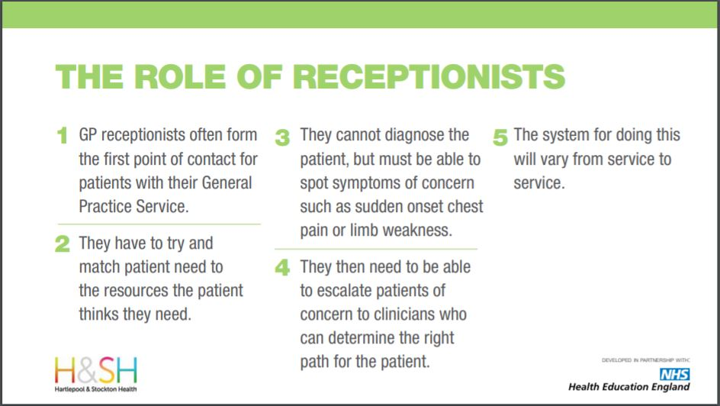
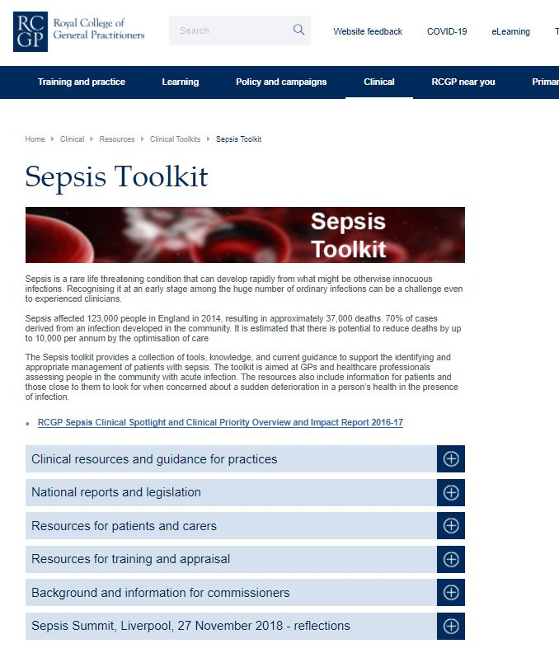
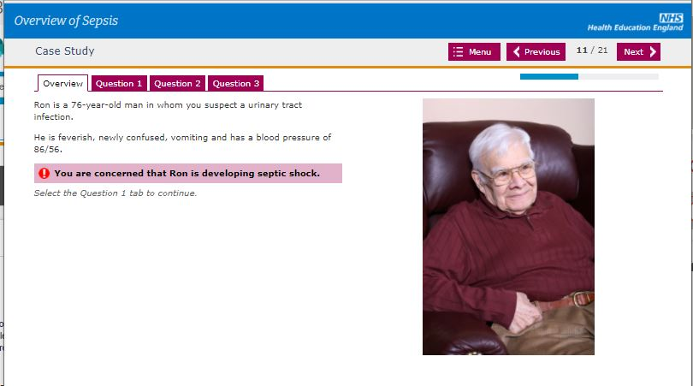
Sepsis educational resources
Primary Care
Sepsis in Primary Care
E-learning package to support clinical staff in primary care settings in the identification and management of sepsis in adults, children, elderly, and complex issues such as maternity and neutropenia.
GP Reception Learning Toolkit
E-Learning course to support receptionists in recognising specific symptoms that may indicate a deteriorating patient, including sepsis, and how they would consider escalating this to a clinician within the service/practice in which they operate.
RCGP Toolkit
Online toolkit linked to all learning resources available through a designated RCGP portal.

Slide 8
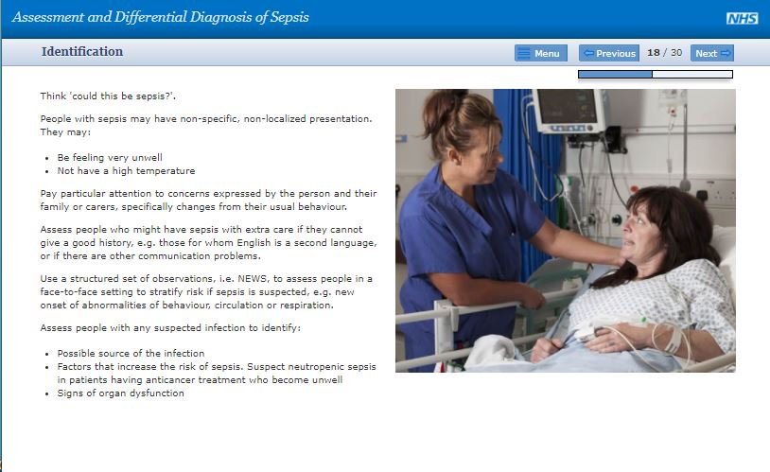
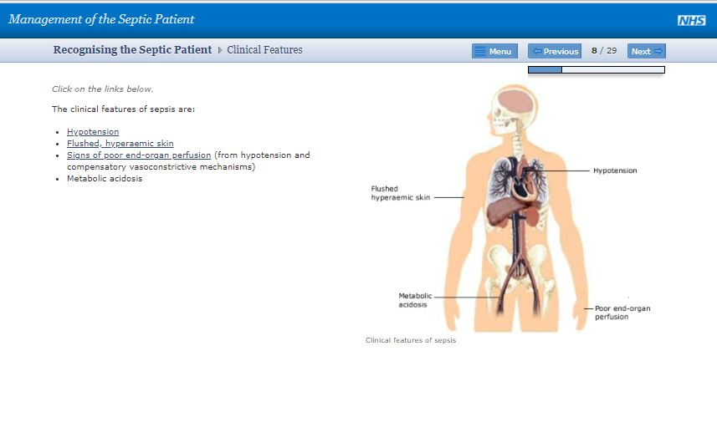
Sepsis educational resources
Secondary Care
Assessment and Differential Diagnosis of Sepsis
How to assess a patient with suspected sepsis in terms of history, clinical examination and investigations and recognize the differential diagnoses in suspected sepsis both on admission to hospital and in hospital.
Management of the Septic Patient
This session focuses on the sepsis resuscitation care bundle and summarises the evidence regarding specific management strategies.

Slide 9
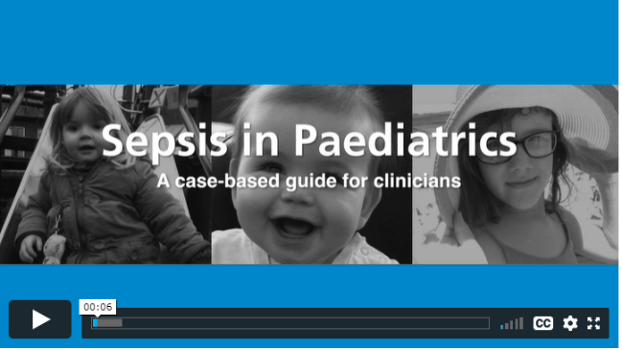
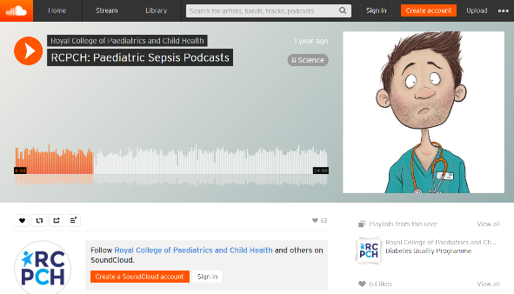
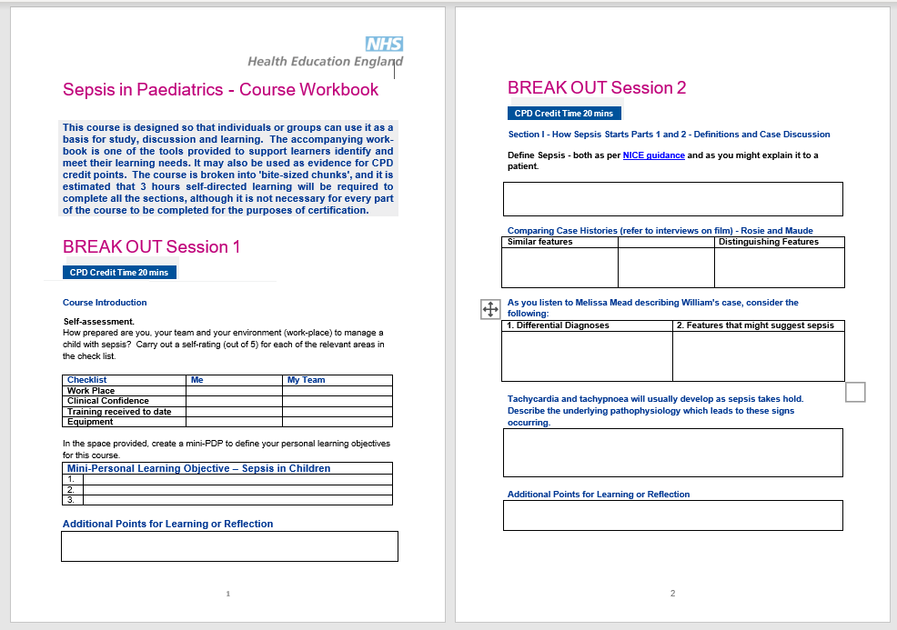
Sepsis educational resources
Paediatric settings
Sepsis in Paediatrics e-learning
Case based guide aimed at supporting clinicians in the recognition and treatment of sepsis in children and involves the stories of three children, their assessment, experiences and treatment
Paediatric sepsis podcasts
They explore what sepsis is, the complexities of how to recognise and manage sepsis, what is different about sepsis in children with complex health conditions and offers real-world advice and guidance on how to manage paediatric sepsis.

Slide 10
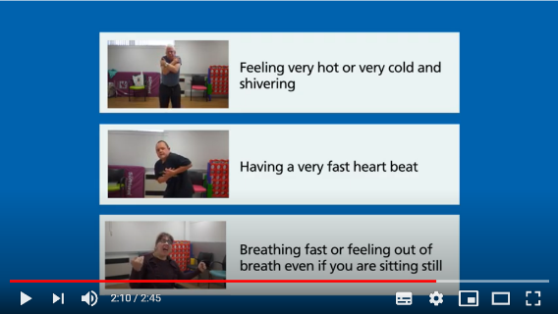

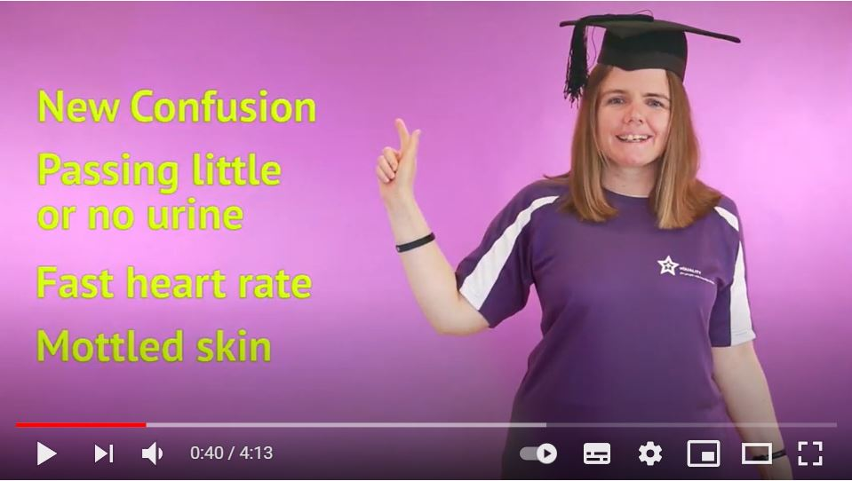
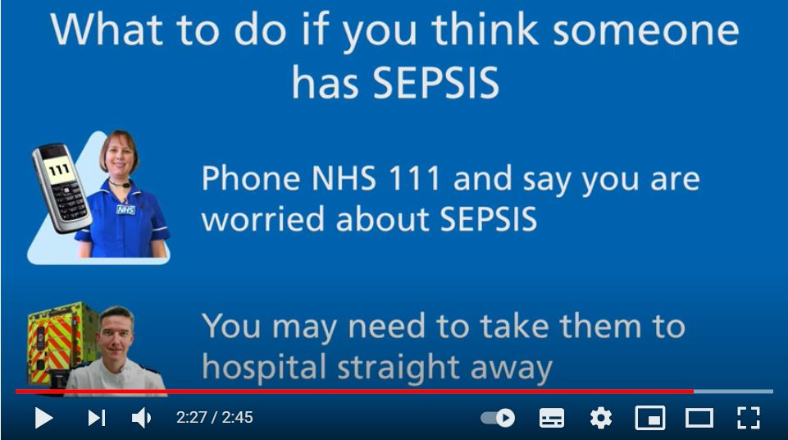
Sepsis educational resources
Learning Disabilities
Resources for healthcare professionals and carers
A training film that supports healthcare professionals and carers in spotting the softer signs of deterioration in people with a learning disability.
Resources for people with a learning disability
A song to raise awareness and improve vigilance to the signs of sepsis.
A Film aimed at people with a learning disability who may not be able to communicate or verbalise how they are feeling.

Slide 11
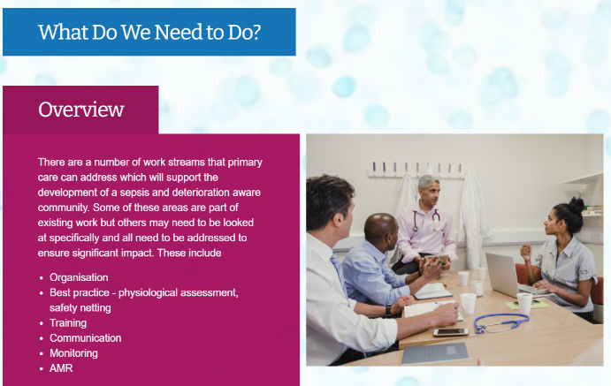
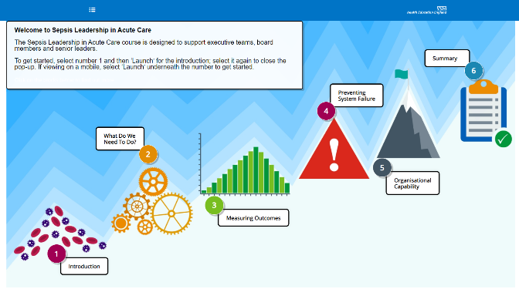
Sepsis Leadership
Sepsis educational resources
Leadership in Primary Care
Designed for clinical and non-clinical leaders to ensure best practice in identifying and managing acute deterioration and sepsis.
Leadership in Acute Care
Provides specific context for boards to understand the clinical priorities within healthcare and how executive, non-executive and clinical leaders can work together to maintain good standards on the quick recognition, management and treatment of sepsis.
Notes:
My initial comments are that the details and quality of information is exceptionally high and very credible for the purpose and background of your intentions.
The requirements of an executive/senior leadership team for an “top tips/key messages” will be very very different to the requirement of clinical and medical colleagues who may need more of this detail. I am not sure that this presentation can be blended for different audiences in its current format as it is very detailed. I don’t want my feedback to sound or be unhelpful so let me know if I am off the mark with this.
My questions for you to consider remain the same as on the call mainly:-
What is your intended audience and what do you need them to know?
What is the language and terminology they understand?
What do you want them to do, say, think after they have seen these slides?
Executive teams consider the following:-
If I have 100+ pages of board papers to review how likely and easily am I to pick up or hear the slides you have developed?
What I need to know as an exec
What is the quality, safety, cost and experiences of the care for Sepsis in my organisation
What can you share with me to allow me to focus on these things and still align to your sepsis and AMR guidelines
What data/intelligence do we have that will help me get this right and have you any templates or guidance that I can use now to find this out?
Where can I go for more help?
Who in my organisation should/could be leading this for us?
You may be able to present me with 3-5 things I need to focus on to get this right.
If this is an e-learning package again clarify who for
Currently this is very heavily medically based with levels of information that although relevant do not translate well for non-clinical audiences with little time to spare
What can you say quicker and easier for more generic audiences.
How do I assess my learning if I do this?
If you define what you need and really think are the key messages for everyone to get you can then define a set of questions that map this.
You can focus your information and presentation on ensuring that people can answer these questions at the end of the session.
Ultimately ask “so what” If you give people information “so what will or can they do differently as a result of it?”
I feel you want to drive actions and improvements so the knowledge needs to make it easy to do this.
Use hooks like quality, cost, impact etc and then tie these messages into the solution you want people to do as a result.
Walk them very quickly down the path of “tell me what the issue is and show me how to improve it!” One slide with visually displayed key facts is worth more than 5 slides with detail that doesn’t immediately state the purpose for which you are sharing it.
I hope this isn’t teaching you to suck eggs and I am really happy to work with you in more detail if you feel my contributions can help. I do think you are on to a good concept about this and am happy to help you refine and test it as it develops. However I also realise that this is just my understanding of your intended audiences and I may be way off the mark in terms of your aims. Please don’t worry about letting me know if I have gone about this the wrong way for you.

Slide 12
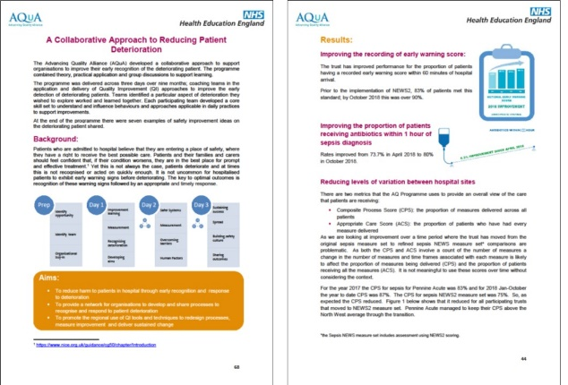
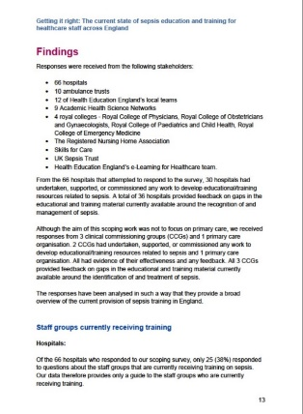
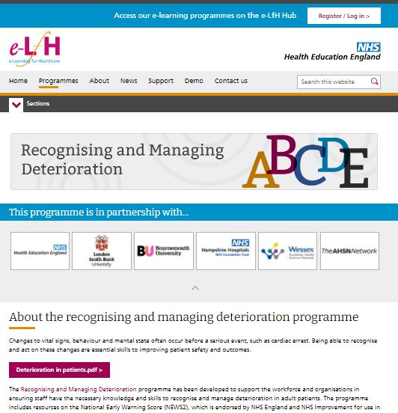

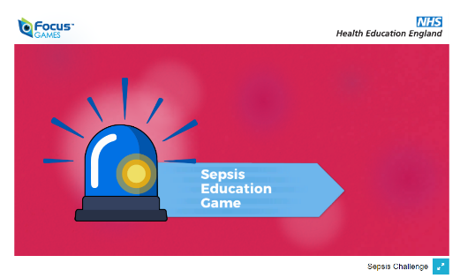
Sepsis educational resources
Other
Case studies and reports
Sepsis educational game
Blood culture pathway films
Antibiotic Prescribing films
Deterioration, NEWS and sepsis in care homes e-learning

Slide 13

Deterioration
Recognising and managing deterioration e-learning for health and social care professionals
Signs of Life - Educational Game
NEWS in Primary Care e-learning, including a Train the Trainer package
NEWS in Secondary Care e-learning and case studies
NEWS and Deteroration in Care Homes
Coming Soon - NEWS in Mental Health and NEWS in Ambulance services e-learning and case studies
Notes:
We also developed resources on recognising and managing deteroration.
Future Initiatives include developing further e-learning resources on deteroration (NEWS, PEWS and MEWS).

Slide 14
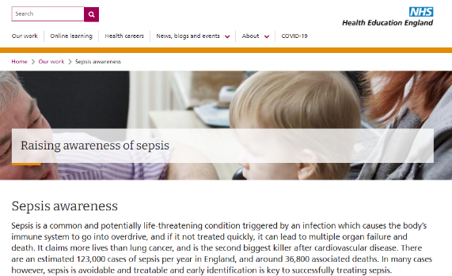
Where to find HEE resources
The THINK SEPSIS programme is freely available via the e-Learning for Healthcare Hub
https://www.e-lfh.org.uk/programmes/sepsis.
For more information on HEE’s work on sepsis, please visit our website: https://www.hee.nhs.uk/our-work/sepsis-awareness

