Slide 1
The Parliamentary and Health Service Ombudsman Good local complaint handling
The new Complaint Standards
Jo Power – Liaison Officer 18 August 2021

Slide 2
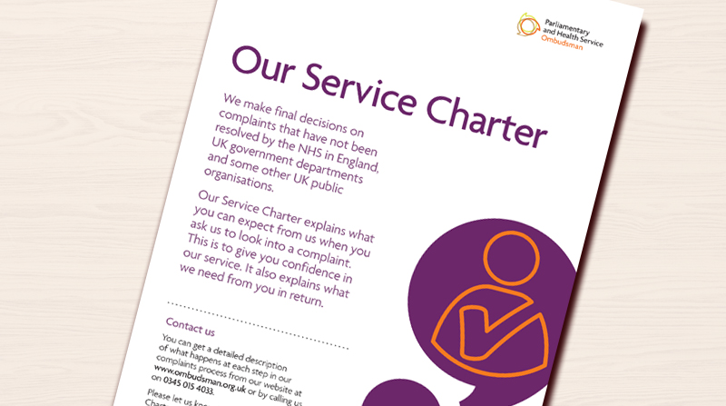
Overview
The Ombudsman – a reminder
How the Ombudsman works and makes decisions
What do people want when they complain and how to get this right first time
The NHS Complaint Standards

Slide 3
Our role
Parliamentary Commissioner Act 1967
Health Service Commissioners Act 1993
18%
82%
Complaints about UK government departments and public organisations
Complaints about the NHS in England

Slide 4
NHS complaints second and final stage - Ombudsman
Under Regulation 14(2)(c) and Regulation 14(2)(d), the local response must tell the complainant of their right to take the complaint to the Ombudsman
The Local Authority Social Services and National Health Service Complaints (England) Regulations 2009

Slide 5
Our casework process Investigation
Our approach
We look to see if what happened was in keeping with relevant regulations, standards, policies and published guidance.
Our decision
If it wasn’t, we look to see how significant the shortfall is and what impact it has had and, if it has caused hardship or injustice, has that already been remedied by the organisation.

Slide 6
The local investigation Getting it right the first time
What people want in decision making
Where possible, a swift outcome
A real opportunity to be heard and to input into the process before decisions are made
To see how decisions are made via clear, understandable and transparent rules
For complaint handlers to show they’re acting sensitively and impartially – by basing decisions on objective information and appropriate criteria.

Slide 7
Sharing learning Good local response
If failings have caused injustice or hardship – suitable apology and redress
If appropriate, explain how it will be put right for other service users
Explain how the complainant will be updated/involved in the changes
Make it clear that it is your final response and signpost to the Ombudsman service

Slide 8
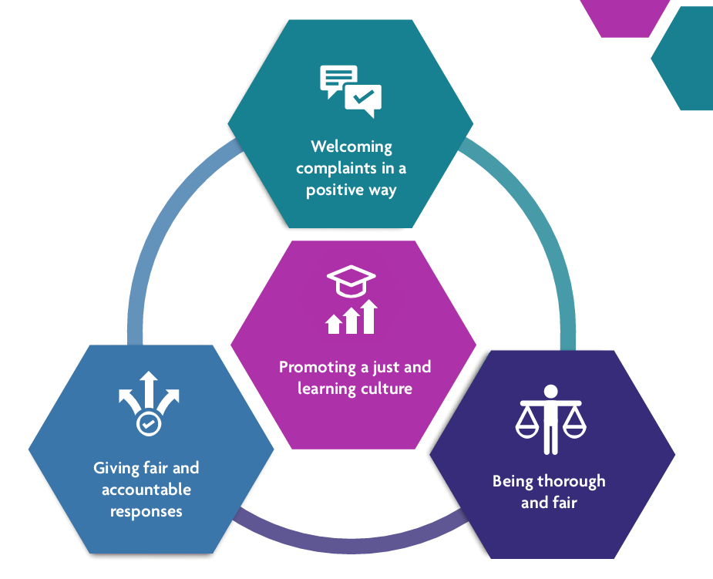
The NHS Complaint Standards

Slide 9
The Background
Objective 3:
Working in partnership to strengthen and support frontline complaint handling.
Developing new Complaint Standards for the NHS in England
Developing supporting guidance, training and professional accreditation for complaint handlers

Slide 10
What complaints staff told us
We need a single vision of what good complaints handling looks like
Notes:
Option 1 – For awareness raising
First we were told that there was a lot of good practice and guidance out there but it would be much easier for them if there was one single vision or Standard for everyone to follow regardless of where they worked and what they did.
Option 2 – For more interactive session can insert slide that asks attendees what it is they think Complaint Staff said they wanted/needed to help them do their job to lead them into seeing that we have (hopefully) produced that.. Then progress through this slide and next 2 slides

Slide 11
What complaints staff told us
We need centralised, standardised training
Notes:
Secondly they shared their experiences of training and these were very different and varied – some good and some bad.
They said that what they needed was good quality complaints handling training that is available to everyone and that is standardised and centrally led so that everyone is trained in the same way to the same high standard

Slide 12
What complaints staff told us
We want to be supported and recognised for the professionals we are
Notes:
And finally they told us about the support they received, particularly from senior leaders, for the work they do and again this varied dramatically.
They said that senior leaders needed a clear understanding of how to support their complaints staff and create a culture that is open and honest, just and fair and most importantly focused on learning from complaints to improve services.
They also said that it was time that they were recognised for the professionals they are and supported in that by the creation of a formal qualification for complaint managers and investigators.

Slide 13
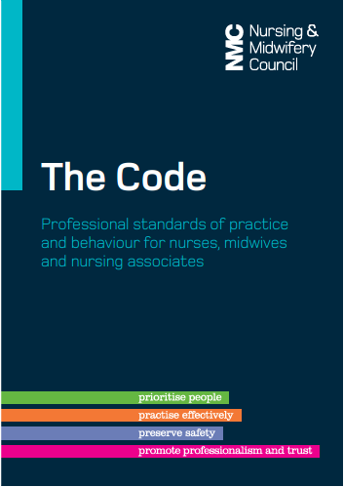
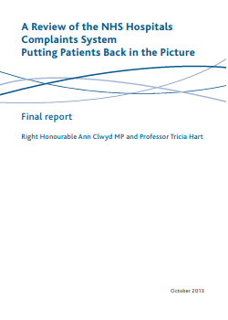
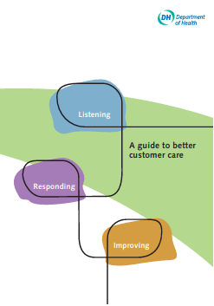
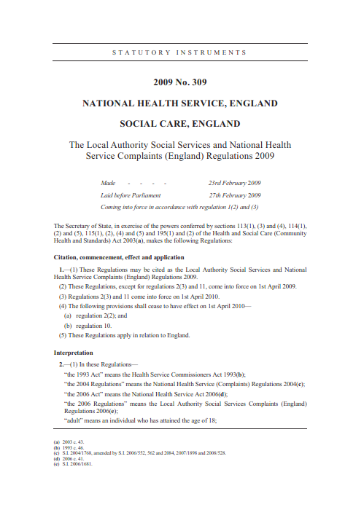
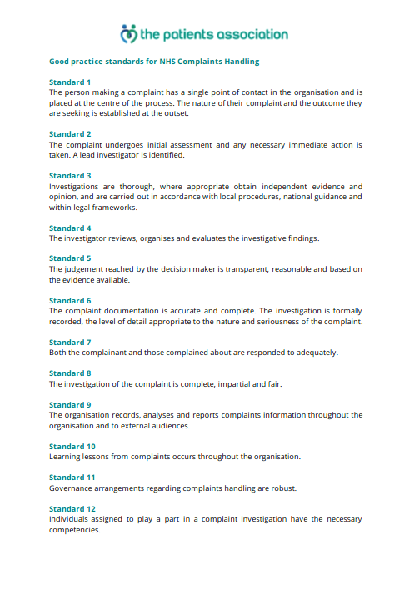
Existing good practice
.

Slide 14
Why create Complaint Standards?
There are lots of ideas about good complaint handling, but no single view of what ‘good’ means
Training is different in different parts of the NHS, leading to an inconsistent approach
Complaints staff feel undervalued because some organisations do not take complaints seriously or learn from them.

Slide 15
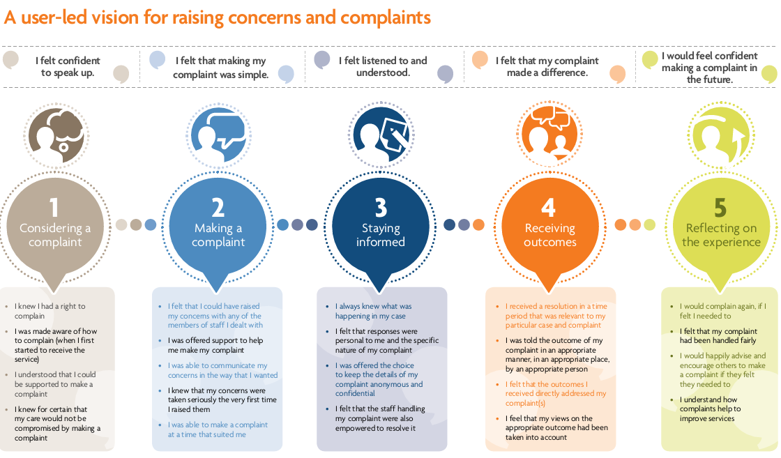
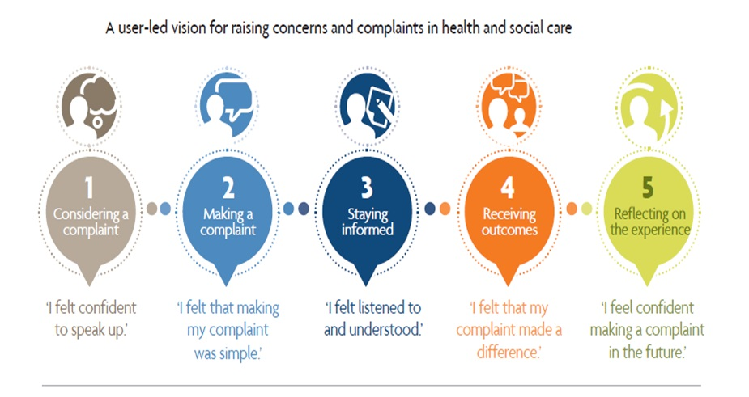
My Expectations

Slide 16
The Complaint Standards:
Set out a single set of expectations for NHS staff to follow when they handle a complaint
Support staff to deliver what people expect when they raise a concern or complaint or give feedback
Describe how NHS organisations can be ‘just and learning’ cultures by:
- taking responsibility when things go wrong
- celebrating positive feedback

Slide 17
The Complaint Standards

Slide 18
Public consultation
Last year, we ran a public consultation to get people’s views on the draft NHS Complaint Standards
The consultation generated a lot of interest and feedback.
On 24 March 2021 we published a report that set out the responses we received and explained what we did and the changes we made in response to the feedback.

Slide 19
The Launch – 30 March

Slide 20
Pilot and Early Adopter phase

Slide 21
www.ombudsman.org.uk/complaint-standards

Slide 22
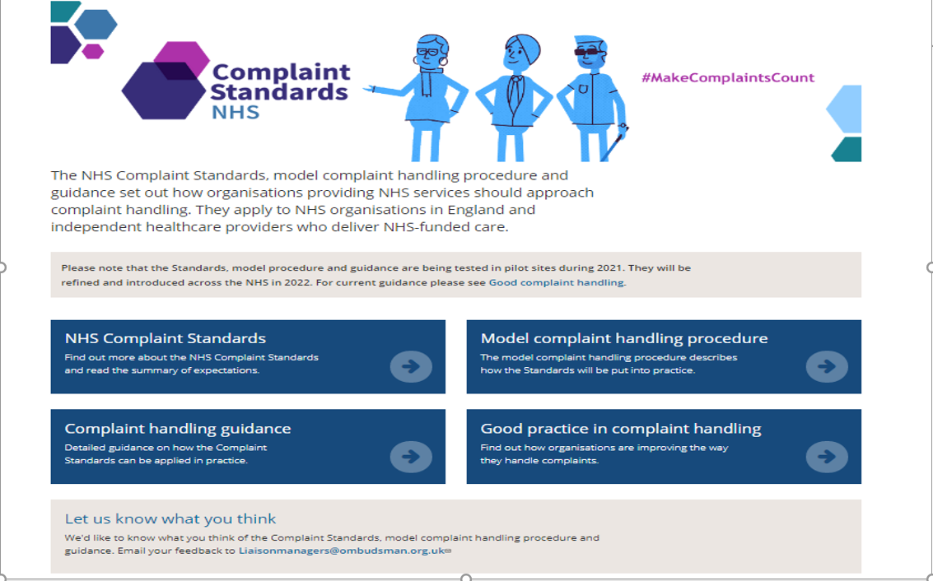

Slide 23
Thank you
Website
www.ombudsman.org.uk
@PHSOmbudsman
Helpline
0345 015 4033
8.30 - 5.00 Monday to Thursday
8:30 –12:00 Friday
Parliamentary and Health Service Ombudsman
Email
liaisonmanagers@ombudsman.org.uk
Radio Ombudsman Podcast

