Slide 1

Improving practice in early resolution
Michele Golden
Deputy Director of Safety and Learning
Notes:
Introduce ourselves
State Reason for choice of subject. – Sharing with your our experience of concerns during Covid-19
List the topics to be covered
Explain what that means for the audience in their terms/language not ours
Grant permission to participate in web chat questions? NB: Chat and comments will be visible to all.
Tell them how to use the platform/audio off when not speaking/ raise hand for questions etc
State how they can access/download the slides/product at the end of the webinar/ raise further questions and or receive a one to one

Slide 2
Our purpose is to provide expertise to the NHS on resolving concerns fairly, share learning for improvement and preserve resources for patient care

Slide 3
NHS Resolution
April 2017
we became NHS Resolution
  Claims Management: providing indemnity schemes to the NHS in England and resolving claims for compensation fairly.
  Practitioner Performance Advice (formerly NCAS): supporting the resolution of performance concerns of individual doctors, dentists and pharmacists.
  Primary Care Appeals (formerly FHSAU): ensuring the prompt and fair resolution of appeals and disputes between NHS England and primary care providers.
  Safety and Learning: helping to make the NHS a safer place by learning from harm and sharing best practice to reduce future risk.
July 2018
we updated our service names
Notes:
Our organisational rebrand provided an opportunity to build upon the combined strengths of each of our services and better reflect our five-year strategy - ‘Delivering fair resolution and learning from harm.’
https://resolution.nhs.uk/our-strategy/
All our services are delivered under the banner of NHS Resolution.
They are not sub-brands and do not have separate logos or branding
While people get used to the change, we will make reference to our ‘former’ service titles alongside the new names in all our communications until April 2019

Slide 4
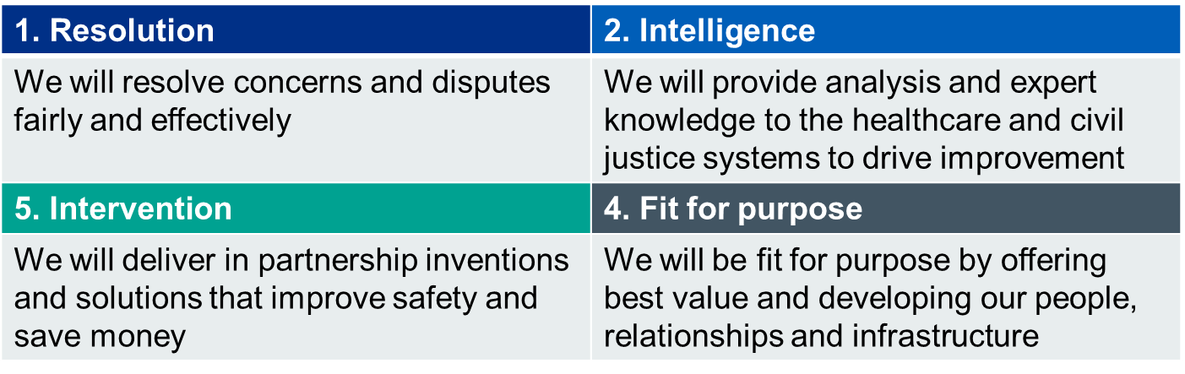
Our priorities
We have four priorities, which will drive our strategy for the next five years:

Slide 5
The environment we operate in…
Operating between the health service and civil justice systems - constant change, challenge and political interest, Covid-19.
Rising costs – limited resource, competition.
NHS structural changes – NHS Improvement and NHS England closer worker, health and social care integration.
Expectation of closer working and a collaborative approach.
An increased focus on safety and transparency – Francis Report, Duty of Candour, Gosport Enquiry.

Slide 6
The scale of the challenge
‘The cost of clinical negligence claims is rising at a faster rate year-on-year, than NHS funding’
National Audit Office (NAO) 2017
900 new clinical negligence claims a month
£2.4bn cash cost vs £9bn incurred cost
£83.4bn provision (up £6.4bn on 2017/18)

Slide 7
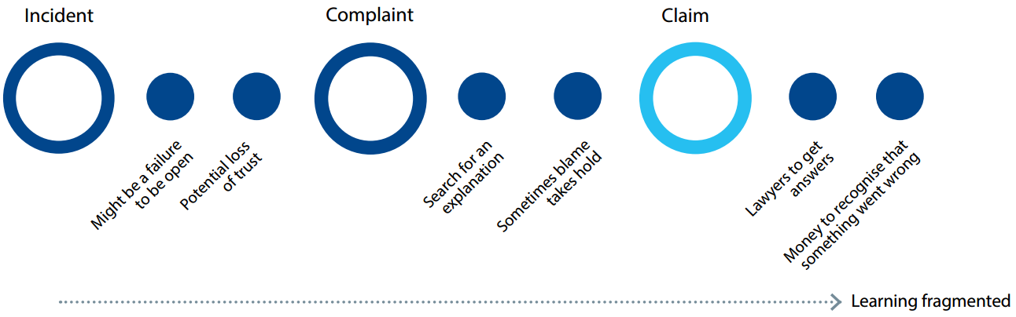
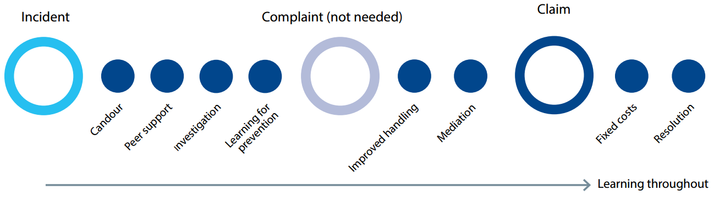
Our role – Moving upstream
Current (worst case scenario)
Future (best case scenario)

Slide 8
The Early Notification scheme
Since April 2017: trusts required to notify maternity incidents, which are likely to result in severe brain injury within 30 days of the incident. These relate to babies born at term, following labour, with a potentially severe brain injury diagnosed in the first seven days of life with the aims of:
Identifying learning and sharing at a national, regional and local level;
Improving the experience for both the families and staff affected; and
accelerating liability investigations, allowing contemporaneous collation of evidence and early admissions of liability.

Slide 9

The Early Notification scheme – progress so far
Year one:
760 cases reported (100% of expectation)
51 admissions of liability made
In all cases;
  apologies provided by the hospital
  offers of practical and financial support provided within months of the incident.
Support for families and staff:
  Training to support candour
  Early mediation
  Direct contact/advice.

Slide 10

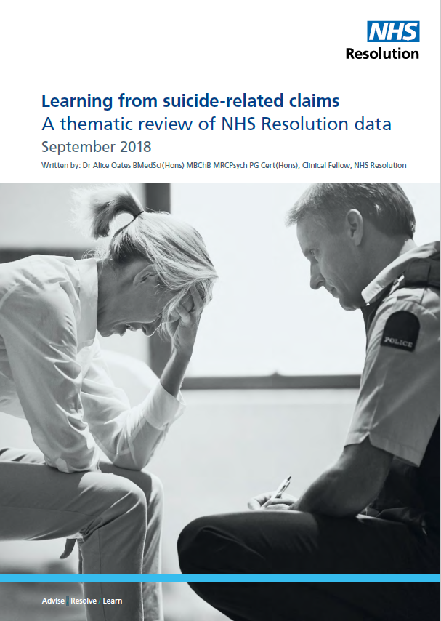


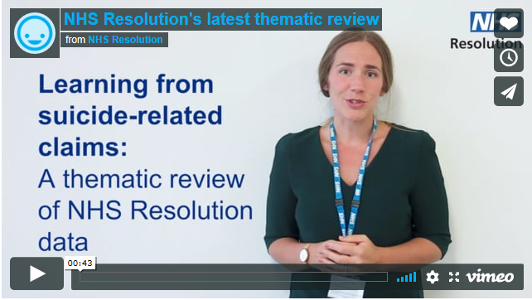
Clinical lens to claims data

Slide 11
The benefits of mediation
Mediation normally takes one day and is flexible in terms of when and where it can take place.
A party is free to leave the mediation if they wish and the mediation may end up with no settlement for other reasons.
About 75% of mediations result in a satisfactory outcome, often within a single day.

Slide 12
Cases suitable for mediation
Cases where the claimant is seeking a response other than a financial award
Cases involving highly emotional, complex or sensitive issues
Cases involving Litigants in Person
Cases where the costs significantly outweigh any potential award of damages
Cases can be agreed for mediation at any stage

Slide 13
Mediation costs
We pay mediation costs in the following cases:
where liability is admitted in full;
partial admissions have been made and/or it is the intention to settle the case;
the claimant is unrepresented;
in other cases the cost is split equally.
In the majority of cases, barristers are not required, which tends to lead to more open discussions;
It is very important that a member of staff from the trust attends. it seems to help the negotiations if the claimant can see that the trust has taken their case seriously.

Slide 14
Court action
Very few cases get to Trial. There are many reasons for this:
  Time - the claimant has three years from the date of the incident occurring or their date of knowledge of this, to settle the claim or issue court proceedings. This can be extended.
  Liability dispute - often at an early stage the experts cannot agree whether there was a breach of duty, and so both parties are advised that they have a strong case. If this cannot be resolved by negotiation, proceedings may follow, and it often won’t be until the experts have to meet (as ordered by the court) that some agreement is reached.

Slide 15
  Dispute as to the value of a claim – in the same way, it may be that each side has their own views on the extent of damage caused, which become entrenched. These are the cases that really should be mediated before court action.
The need for the court to approve an award for a child or an adult with a disability.
We are more than happy to take a case to trial, if we believe that we have a good prospect of success, or where we need to test an important point of law.

Slide 16
The way forward
We are currently looking at how many cases have court proceedings issued, and the reasons why.
It is hoped that we can create a reputation in the claimant lobby that when we indicate we will take a case to trial, we mean it.
To create this reputation, we also need to demonstrate that where a genuine claim is presented, we will make early admissions and settlement offers.

Slide 17
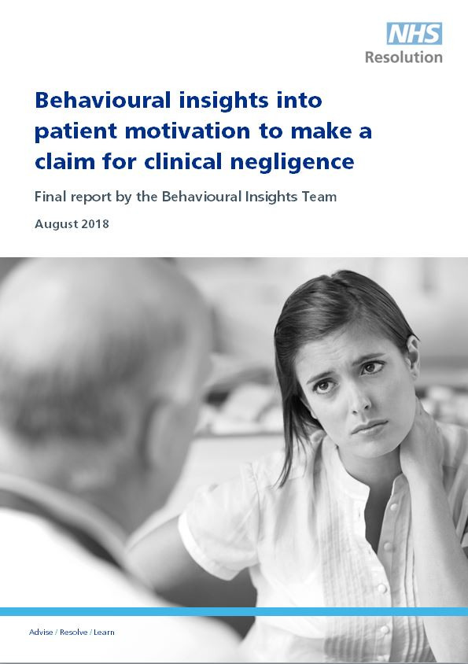
Drivers - why do people claim?
Key conclusions from surveying 728 past claimants include:
Reactions of NHS staff …were generally considered inadequate
The majority …were not satisfied with the NHS complaints’ handling process
A major external motivation to claim was suggestions from NHS staff
  External motivations e.g. suggestions from NHS staff.
  Personal or ‘intrinsic’ motivations
Notes:
External motivations e.g. suggestions from NHS staff.
Personal or ‘intrinsic’ motivations e.g. wanting to prevent similar things happening to others, wanting to receive an apology, wanting the clinicians involved to be held to account, and financial compensation. Also emotional response (e.g. frustration and anger) brought about by poor incident or complaint handling.

Slide 18
Thank you
Michele.golden@resolution.nhs.uk
solution.nhs.uk

