Slide 1
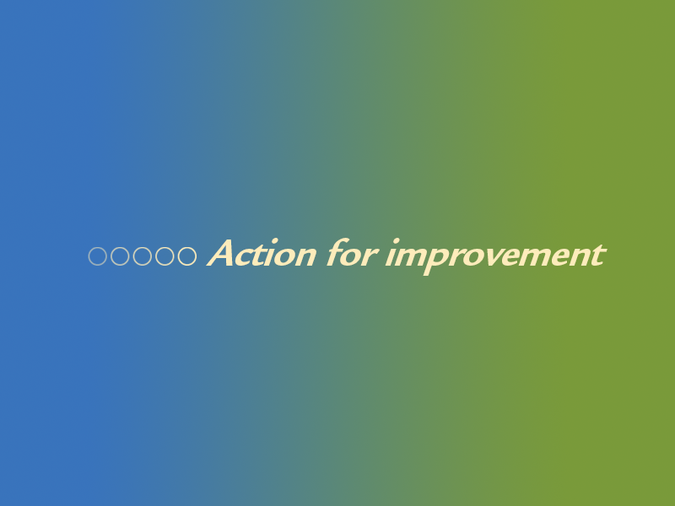
Copyright © Healthcare Quality Quest, 2021

Slide 2

How to use a model —
I–M–P–R–O–V–E–S
to plan achieving
an improvement

Slide 3

The challenges in achieving change
New evidence, best practices or new procedures don’t implement themselves
A change in practice is not automatically continued over time
The impact of change can be highly variable
Teams select ‘weak’ actions that depend on people’s memory and good will
Teams ‘take action’ rather than plan the change process

Slide 4
The even bigger challenges in sustaining change over time
What can happen —
The change intervention itself didn’t really work —
something else caused the improvement
The change intervention is changed from one setting to
another
The context affects the impact of change

Slide 5
Change

Slide 6
New thinking about implementing change in clinical settings
Complexity
science
Implementation
science
Social
science
Change in clinical settings

Slide 7
The sciences working together
Implementation Getting best practice done for all science patients
Complexity Working through organizational
science systems
Social Working through people and science groups

Slide 8

Theory of change for improvement defines exactly what will be achieved through a change process and how the process will work to produce the intended improvement. The ‘theory’ explains ‘what’ is to be changed and ‘how’ and ‘why’ it works and under what conditions, that is, ‘when’ and ‘where’

Slide 9

Theory asks —
Was the action the right action?
Was the right action implemented the right way?
Success depends on —
Is there a cause-and-effect relationship between
the action and the effect of action?
Choosing the right strategies
appropriate decision-making
Doing the right strategies the right way
effective implementation

Slide 10
I–M–P–R–O–V–E–S model
I
dentify the IMPROVEMENT
M
ould opinion to favour the improvement — and
overcome barriers
P
repare for a new way — strategies and tactics
R
edesign the way things work now
O
perate the new way — on a pilot basis
V
erify that the new way works
E
liminate unwanted variation in the new way
S
tabilize the new way

Slide 11
dentify the improvement
I
An improvement is the exact outcome to be achieved through the change process, preferably expressed in measurable terms
Number or percentage or ratio of time or patients the desired outcome will happen

Slide 12
How to figure out what’s needed
Problem
Causes
Improvement
Action
What do
we want to achieve — the level of patient care we want?
What do we have
to do to achieve it?
What isn’t
happening
now?
Why isn’t it happening?
the clinical audit findings
the findings of analysis
the result or outcome
the process of making change

Slide 13
Improvement and action
Improvement is the exact outcome you want to achieve —
the percentage of patients that get
the right care
Action is what has to happen to minimize the cause/s of the problem/s — the change process to get the improvement
Think about exactly what action will result
in the intended improvement

Slide 14
Example: Information for patients
33% of patients aren’t satisfied with the timeliness, nature of and the way information was given
Problem
95% of patients are satisfied with how information was given
Improvement
Staff members provide as much information as they can at one time
Staff lack confidence on how to pace giving
information to patients
Information package isn’t available
The organization’s policy and support is insufficient
Time isn’t allocated
Roles not clear
No allocated place
Causes

Slide 15
Factors involved — Who or what has to change?
Individual professionals — attitudes, beliefs, knowledge,
skills
Social interaction — communication, networking, team
work, leadership
Organizational — roles, staff, environment, policies,
procedures, processes, systems, culture
Financial or regulatory — funding, contracting, inspection

Slide 16
Individual professionals — Why don’t they do what we expect them to do

Slide 17
They don’t want to
It goes against
the grain
It’s not worth it
What’s in it for me
It’s more
work
I don’t see
the point
People don’t believe in the change

Slide 18
They can’t — the organizational factor
I don’t
know how
It doesn’t match
‘the system’
I don’t have
what I need
I don’t really know
what you want
My manager
says to ignore it
People don’t have what it takes to make the change

Slide 19
To increase the uptake and sustainability of change by individual professionals, they need —
Scientific evidence of what is the right or best way
Belief in the value of the evidence
A feasible way to implement the evidence

Slide 20
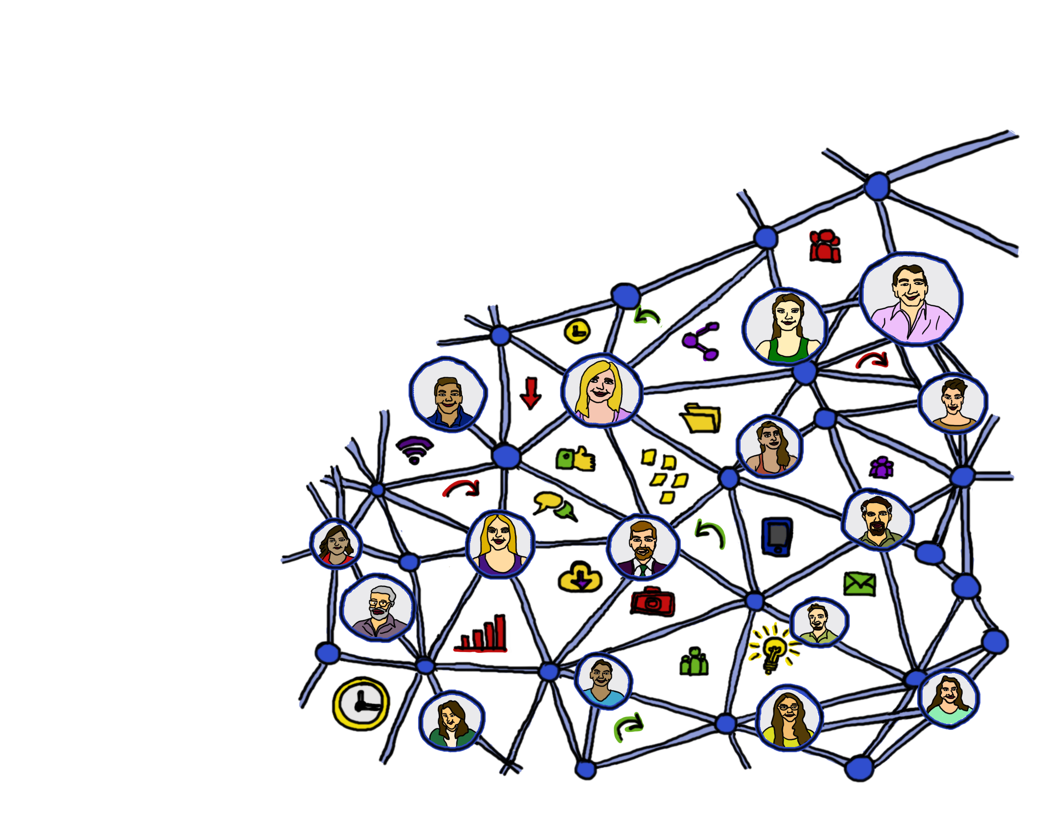
Social factors —
Information or communication from a credible source
Teams of professionals working together
Leadership
Professional bodies support as relevant

Slide 21
ould opinion
M
Are people ready?
Use discussion, focus groups, force field
analysis or an opinion leader
Find selling points and barriers
Pros …
Cons …

Slide 22
Organizational factors
Teams are enabled to change things on their own
Strategy, structure, culture, support
Process redesign and implementation
Systems approach
Continuous learning as an organization
The organization is active in supporting improvement

Slide 23
Financial factors
Pay-for-performance or other targets
Financial rewards or penalties
Contractual arrangements
Regulator influences

Slide 24
repare a strategy for change
P
Reaffirm or amend improvement
State benefits and barriers and investigate barriers
Reaffirm or amend who will be involved
Reaffirm or amend the types of changes needed

Slide 25
Types of contexts
Clear causes — Act on the causes
Simple
Complicated
Not so clear cause-and-effect relationships — Act on the causes
Complex
Learn the cause-and-effect relationships over time — Investigate causes and test actions for causes
Chaotic
Cause-and-effect links are unknown —
Try actions and learn

Slide 26
Possible strategies
Education
Consensus-building
Opinion leader
Audit and feedback
Use as many
strategies as
possible
Patient feedback
Reminder system
Marketing
Communication and media
Professional linkages
Role revision

Slide 27
Possible strategies
Skill mix changes
Clinical teams and processes
Reorganization of services
Continuity of care
Use as many
strategies as
possible
Workplace satisfaction
Changes in structure
IT systems
Financial incentives
Regulatory influences

Slide 28
Types of actions healthcare organizations can take
WEAK ACTIONS
STRONG ACTIONS
Raise staff awareness
Remind staff
Provide training
Write a new policy
Remove barriers to doing the work effectively
Redesigning the work
Monitor and feed back
Supervise
Use IT or technology
Hughes D. Root cause analysis: bridging the gap between ideas and execution. National Center for Patient Safety Topics in Patient Safety 2006;6(5):1–2

Slide 29
A practical hint — Setting priorities among
possible actions
Make a list of actions to address the shortcomings in
the quality of patient care
Use a 7–point scale to rate —
1
How effective will the action be in addressing the
cause of the shortcoming in quality
How strongly do you believe that the action can be
implemented in your organization
Multiply the ratings
2
Find and implement the priority actions (top priority = 49)
3

Slide 30
edesign current practice
R
are the attitudes, values, behaviours, processes or systems needed for the improvement?
What
is involved in the change?
is assuming responsibility for managing the change?
Who
will the attitudes, values, behaviours, processes or systems be changed?
How
will the attitudes, values, behaviour, process or system be changed?
When

Slide 31
How much change and for how long? — Dose of change intervention
Quantity
How many interventions
How ‘intense’ is the intervention to get the
outcome
Intensity
Reach
How many staff to be touched
Duration
How long
Scope
How many measures
Comprehensiveness
All of the above

Slide 32
Example: Information for patients
33% of patients aren’t satisfied with the timeliness, nature of and the way information was given
Problem
95% of patients are satisfied with the timeliness, nature of and the way information was given
Improvement
Staff members provide as much information as they can at one time
Staff lack confidence on how to pace giving information to patients
Information package isn’t available
The organization’s policy and support is insufficient
The organization is not aware of the problem
Time isn’t allocated
Roles not clear
No allocated place
Causes

Slide 33
Example: Information for patients
Establish a team and discuss the benefits
Learn about best practice on giving information to patients
Clarify roles
Review time and space allocations in the clinic
Clarify policy and resources to support staff
Participate in training on developing information packages
Develop and produce an information package
Prepare staff members to use the package
Measure patient satisfaction
Actions

Slide 34
perate the new way
O
Have a formal pilot —
Plan the change to achieve improvement
Act
Plan
Implement the change
Study
Do
Measure the effects of the change
Make adjustments as needed

Slide 35
V
erify that the new way works
Use data to evaluate —
Is the change working?
If not, why not?
If yes, is it working consistently?
Are there any unintended side effects?
Quick FEEDBACK to all those involved!

Slide 36
E
liminate unwanted variation
A run chart helps!
If there is variation shown in the data —
Decide on the type of variation — common or
special cause
Take actions accordingly
Continue to monitor

Slide 37
S
tabilize change
Plan full implementation
Continue measuring the effects
Provide feedback to all those involved
Continue to make adjustments as needed

Slide 38
I–M–P–R–O–V–E–S model
I
dentify the IMPROVEMENT
M
ould opinion to favour the improvement — and
overcome barriers
P
repare for a new way — strategies and tactics
R
edesign the way things work now
O
perate the new way — on a pilot basis
V
erify that the new way works
E
liminate unwanted variation in the new way
S
tabilize the new way

Slide 39
Nancy Dixon
Nancy.Dixon@hqq.co.uk
www.hqq.co.uk
@hqq_uk

