Slide 1
Motivating Clinical Staff to Change and Improve
Perbinder Grewal

Slide 2
Motivation
Motivations are closely related to emotions.
A motivation is a driving force that initiates and directs behaviour.

Slide 3
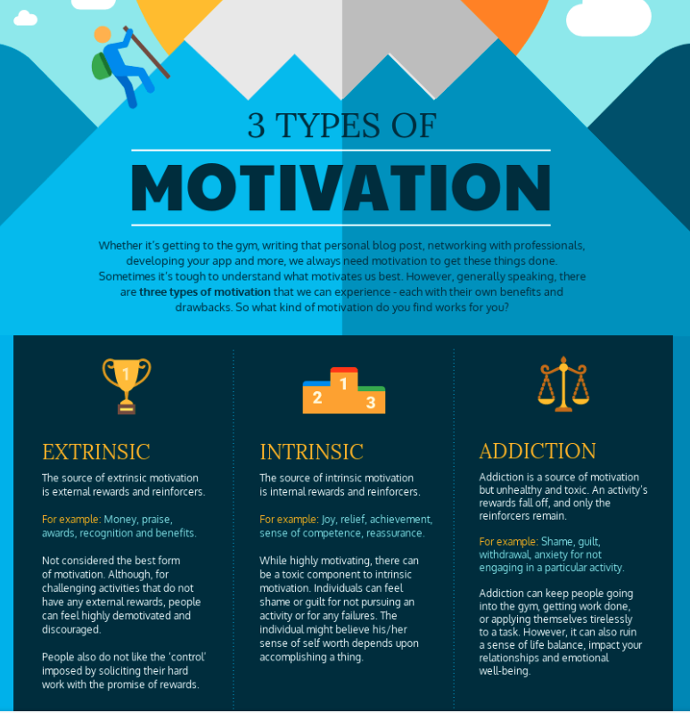

Slide 5
Motivational Profiles
Apathetic
Indifferent
Externally motivated
Very low levels of internal motivation
Typical
Largest number of managers
Seek external motivation but also have internal motivation
Mixed
Above average in all 4 motives
Internally Driven
High levels of internal motivation
Desire to maintain their self-image, pursue their values and engage in enjoyable work
Self-directed
Low external motivation
Do what is personally important or enjopyable
Externally motivated
Don’t work to enhance self-worth

Slide 6
Self-directed and internally driven profiles were the most favourable, meaning that employees feel good about their work and want to stay with the organization.
Managers who had these profiles were the most satisfied with their jobs and committed to their organizations.
They also expressed the lowest intent to leave their organizations.
They focused on fulfilling personally important goals and values and doing interesting and enjoyable work, and, in the case of the internally driven profile, maintaining a positive self-image through their work.

Slide 7
Managers who had the mixed profile also had relatively positive job attitudes.
However, their feelings about their jobs and organizations were not as positive as the self-directed and internally driven profiles.
Thus, managers who have a moderate amount of all four motives feel fairly good about their organizations and jobs.

Slide 8
The managers who had the lowest job satisfaction and organizational commitment, and the highest intent to turnover were those who had apathetic and indifferent profiles.
These managers were the least happy with their jobs and organizations and reported the highest likelihood of leaving.
Managers who had the apathetic profile were especially at risk for turnover. It appears that a lack of internal motivation is particularly problematic for managers’ well-being.
Managers who displayed the typical profile also had relatively unfavourable job attitudes, although their attitudes were less negative than those of the apathetic and indifferent profiles.

Slide 9
Managers need internal motivation to unlock productivity.
Being simultaneously internally and externally motived is related to more positive outcomes than solely being externally driven.

Slide 10
Three Levers to Unlock Internal Motivation
Bosses who provide support and encourage self-direction
Rewards systems that affirm, not manipulate
Minimize organizational politics and promote fairness

Slide 14
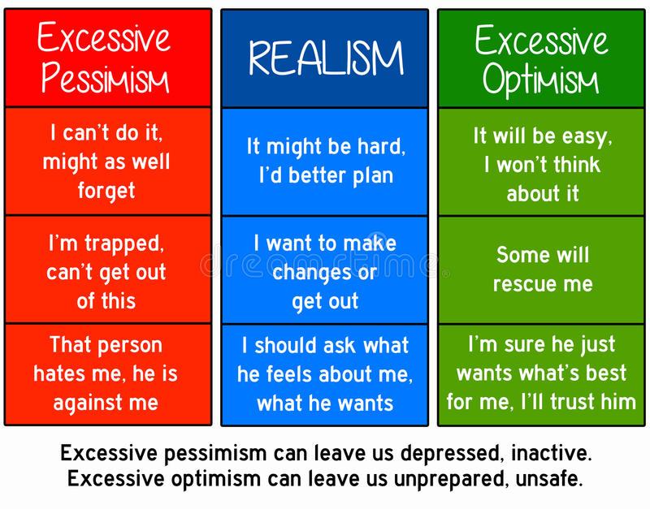

Slide 15
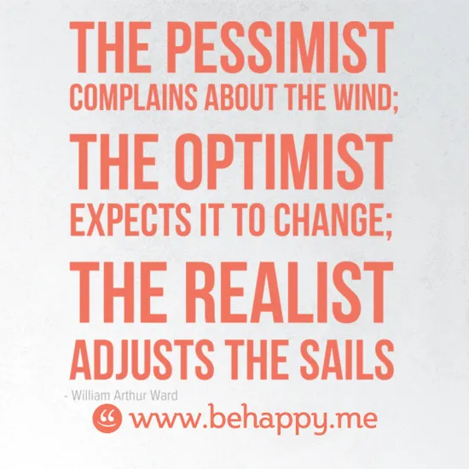

Slide 16
Setting your Sights
Rules for hitting the target
Know what the target is
Describe it in detail
See, hear and feel it
Make sure it excites people
Know what we need to do
DO IT!

Slide 17
5 Questions to stop procrastination/anxiety
What will it feel like when we achieve my goal?
What are the reasons we am doing this?
Who am we doing it for?
What is stopping us right now?
Is that the truth or just what we am telling ourselves?

Slide 19
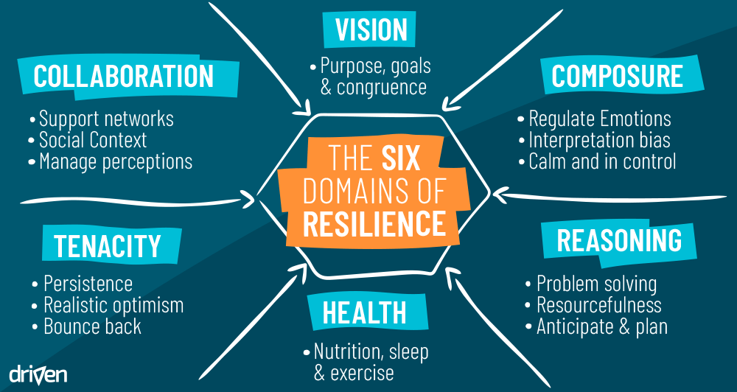

Slide 21
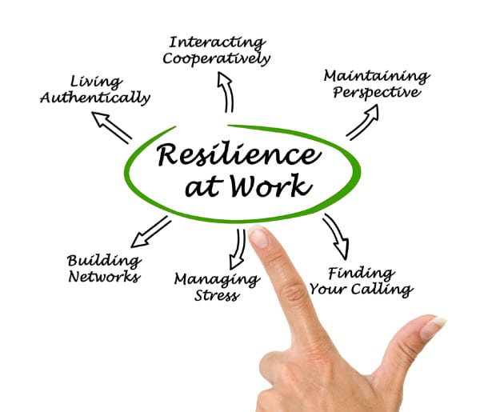

Slide 22
Improvement Planning
What is the motivation level on a consistent basis?
What are your resilience level like?

Slide 23
Improvement Planning
What areas need improvement?
What is stopping you in these areas?
What actions will you take to improve this?
What is the outcome you want to achieve?
When will you start?

Slide 25
Good Action Plan in response to a patient complaint (amended from The Parliamentary and Health Service Ombudsman, 2012)
Say what went wrong in the service provided, and identify the cause of the problem
Explain what action will be taken to stop it happening again and who will be responsible for ensuring this happens
Give timescales for when that action took place or will take place
Where possible, provide objective evidence of those actions
Explain how the organisation will check that these actions have been taken

Slide 27
Many times saying “sorry” is all that the patient wishes to hear along with an acknowledgement of their complaint.
Often staff do not apologise due to fear of accepting liability.

Slide 28
Section 2 of the Compensation Act 2006 states: “An apology, an offer of treatment or other redress, shall not of itself amount to an admission of negligence or breach of statutory duty.”
The lesson is that an early and genuine apology can do much good at no cost.
Thus a simple “I am sorry this happened to you …” may help settle the complaint.

Slide 29
Sources of Dissatisfaction
Failure to address all concerns
Incomplete/defensive/dismissive responses
Technical language / medical jargon
Unwillingness to take action if errors/mistakes found
Length of time for response
Lack of communication through process

Slide 30
Complaints are an opportunity to improve practice and avoid escalating issues.
By better communication with patients and managing expectations, many complaints will end.

Slide 32
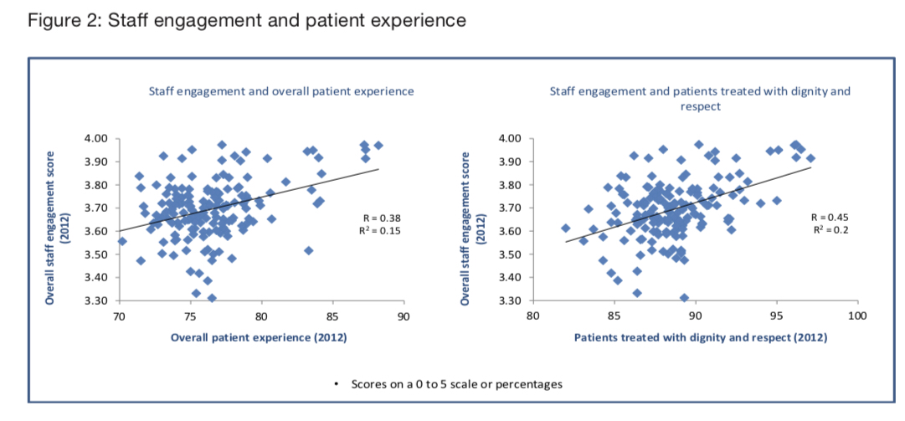

Slide 33
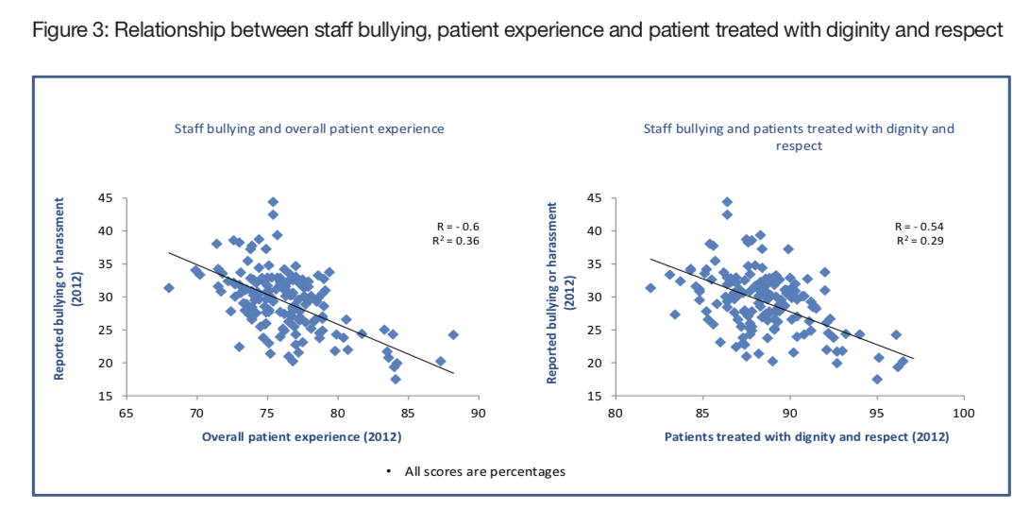

Slide 34
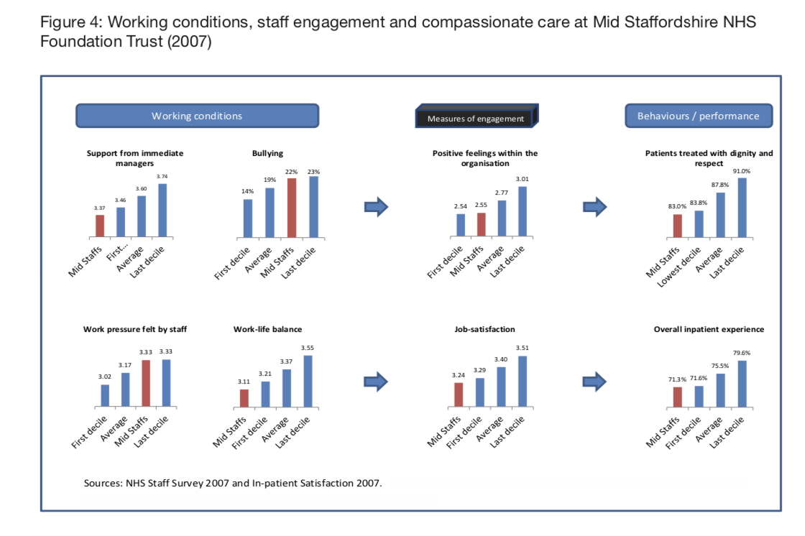

Slide 35
Causes of complaints
Communication - 15%
Patient Care - 12%
Values and Behaviours

Slide 36
Supporting Frontline Staff

Slide 39
Learning from Complaints
Important that the organisation learns from complaints not just the person/department complained about
Focus should be on improving services to ensure future patients do not have similar problems

Slide 40
Learning for individuals eg attitude / competency
Subspecialty or departmental changes
Capturing themes / triangulation of data
Sharing learning across a division / the Trust

Slide 41
Examples of learning
Divisional complaints officers to act as first point of contact for complaints and PALS
Newsletters regarding complaint learning shared with directorate and organisation
Revising policy
Development of clinical guidelines

Slide 42
Patient Involvement in Complaints Service
Involve patients in how to improve the service
Gives people a say in how we do things
It helps us to:
Ensure services meet patient needs
Identify areas for improvement
Connect better to patients
Monitor our progress
Fulfil our legal requirement!

Slide 43
Just culture
Staff are not punished for actions/omissions/decisions as long as there is no gross negligence, wilful violations and destructive acts
This accounts for the fact that humans will make mistakes and is a policy where honest mistakes can be reported without any fears of ramifications in the hope of improving safety.

Slide 44
However “justness” has to be balanced by both sides so dangerous acts of negligence also have to be dealt with accordingly through culpability agreements etc.
(Dekker, 2012)

Slide 45
Relationship between behaviour and response

Slide 46
Just Culture Options
Take no action
Warn against doing it again
Encourage different behaviour/coach
Discipline/punish
Does the outcome make a difference?

Slide 47
Managing System Reliability
Human Factors design to reduce error
Barriers to prevent failure
Capture failures before becoming critical
Redundancy to limit effects of failure

Slide 48
Managing Human Reliability
Information
Equipment
Design
Qualifications
Perception of risks
Organisational factors
Individual factors
Supervision
Communication

Slide 49
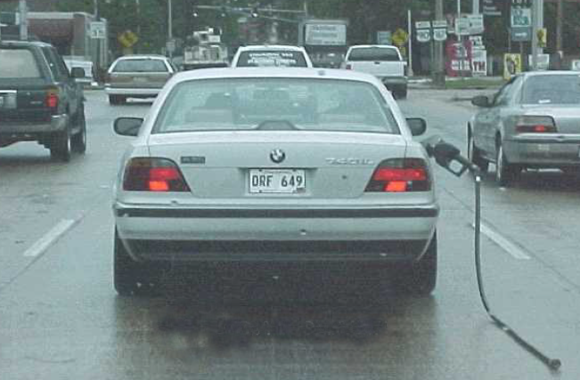
To Err is Human

Slide 50
Three Behaviours
Human Error
At-Risk Behaviour
Reckless Behaviour

Slide 51
Human Error
Coach
Learn

Slide 52
Reckless or Intentional Behaviour
Punish

Slide 56
