Slide 1
Clinical Audit for Improvement – NHSEI Update
Dawn Chamberlain
Director Clinical Improvement
NHSEI
2nd September 2021
System
Development
Social Care
Integration for
Improvement
Pathway
Improvement
Support
Futures
Platform
Notes:
The Clinical Improvement Group has three distinct focuses of work:
Beneficial Changes Network
RightCare
Clinical Audit (from June 2021)
The National Incident Response Board commissioned the Improvement Directorate to capture the innovation and new ways of working from the frontline happening in response to the pandemic and so the Beneficial Changes Network evolved in May 2020.
RightCare started out as the NHS England national commissioning improvement programme to reduce unwarranted variation by benchmarking CCGs and highlighting opportunities for improvement across commissioning care pathways. Various data packs are now provided at Primary Care Network level and also at ICS level for systems to use locally to inform the transformation of care pathways. In addition, patient scenarios and toolkits are developed by the team to support delivery.
Historically Clinical Audit has been seen as a clinical intervention, led by the Medical Directorate at national level, however the Clinical Improvement Director now co-chairs the national forum giving us an opportunity to bring the national recommendations from clinical audit into the integrated improvement work at National and Regional level.
In addition the Clinical Improvement Group leads on a number of Improvement Directorate-wide initiatives:
Coproduction
Social Care integration – first workshop in July 2021
Improvement Hub and repository on the NHS Futures site

Slide 2
An introduction to
Clinical Improvement
Beneficial Changes Network
RightCare
Clinical Improvement
Clinical Audit
Coproduction
System
Development
Health Inequalities
Improvement
Pathway
Improvement
Futures
Platform

Slide 3
Introducing the Clinical Improvement Group
The Clinical Improvement Group has three distinct focuses of work:
Beneficial Changes Network
RightCare
Clinical Audit (from June 2021)
The National Incident Response Board commissioned the Improvement Directorate to capture the innovation and new ways of working from the frontline happening in response to the pandemic and so the Beneficial Changes Network evolved in May 2020.
RightCare started out as the NHS England national commissioning improvement programme to reduce unwarranted variation by benchmarking CCGs and highlighting opportunities for improvement across commissioning care pathways. Various data packs are now provided at Primary Care Network level and also at ICS level for systems to use locally to inform the transformation of care pathways. In addition, patient scenarios and toolkits are developed by the team to support delivery.
Historically Clinical Audit has been seen as a clinical intervention, led by the Medical Directorate at national level, however the Clinical Improvement Director now co-chairs the national forum giving us an opportunity to bring the national recommendations from clinical audit into the integrated improvement work at National and Regional level.
In addition the Clinical Improvement Group leads on a number of Improvement Directorate-wide initiatives:
Coproduction
Social Care integration – first workshop in July 2021
Improvement Hub and repository on the NHS Futures site

Slide 4
BCN Shared Purpose
The Beneficial Changes Network has come together to build on the incredible ways in which people and systems have responded to COVID-19 through innovation and collaboration, whilst safeguarding effective health and care delivery
We are a collaborative group of health and social care stakeholders and people with lived experience who want to harness and capture the benefits, evaluate these changes, to share the knowledge and embed the learning across the entire health and care sector.
This encouraging and supportive alliance will help facilitate the cultural change to ensure these benefits are felt by all.
#beneficialchanges

Slide 5











Beneficial Changes Network
2020-21
Evidence Scans from over 60 online databases & sources produced every fortnight with thousands
of hits
Over 3000 stakeholder submissions, 700 headline changes and 250 documents reviewed
Futures Network with over 1000 members from 240+ stakeholder organisations across health and social care
Review published with AAC - key recommendations from 80+ stakeholder organisations on innovation, research and collaboration experienced during the pandemic
29 BCN case studies and 42 narratives and over 50 external case studies sharing best practice
Coproduced with 40+ people with lived experience and 20+ voluntary and community organisations
Influencing:
People Plan,
Bureaucracy Busting,
White Paper ‘Working together’ & Planning Guidance
Supporting:
National Recovery,
Productivity,
System Development,
Workforce
Network sharing events with hundreds of attendees and presented at over 60 external events
Regional Priorities agreed
Lunch and learns with over 500 attendees sharing learning across the Network

Slide 6
Clinical Audit at NHSEI

Slide 7
National Clinical Audit Patient Outcome Programme (NCAPOP)
The National Clinical Audit Patient Outcome Programme (NCAPOP) aims to improve patient outcomes by stimulating health improvement and policy development using high-quality data combined with strong clinical leadership to effect change in practice with a programme comprising 40 plus national clinical audits and outcome review programmes.
Commissioning is led by the NHSEI Medical Directorate, funded by a number of Directorates and delivered via the Healthcare Quality Improvement Programme (HQIP) who work in partnership with NHSEI clinical and policy teams to ensure each audit is supporting NHSEI’s strategic and clinical priorities.
NCAPOP topics are aligned to and support the delivery of Long-Term Plan clinical priorities in areas such as: diabetes, mental health, cardiac, stroke, obesity, cancer, maternity, children and young people.

Slide 8
National Clinical Audit Patient Outcome Programme (NCAPOP)
NCAPOP improves healthcare through a range of approaches including:
encouraging the use of robust data for quality improvement of care, promoting patient safety
measuring NHS compliance to National Institute for Health and Care Excellence (NICE) Guidance
supporting commissioners to tackle unwarranted variation
supporting payment mechanisms, for example Best Practice Tariff (BPT)
identifying and responding to serious national incidents or areas of concern
supporting commissioning of specialised services, e.g. specialised cardiac care
providing trusts with individual benchmarked reports on compliance and performance
Outlier management processes

Slide 9
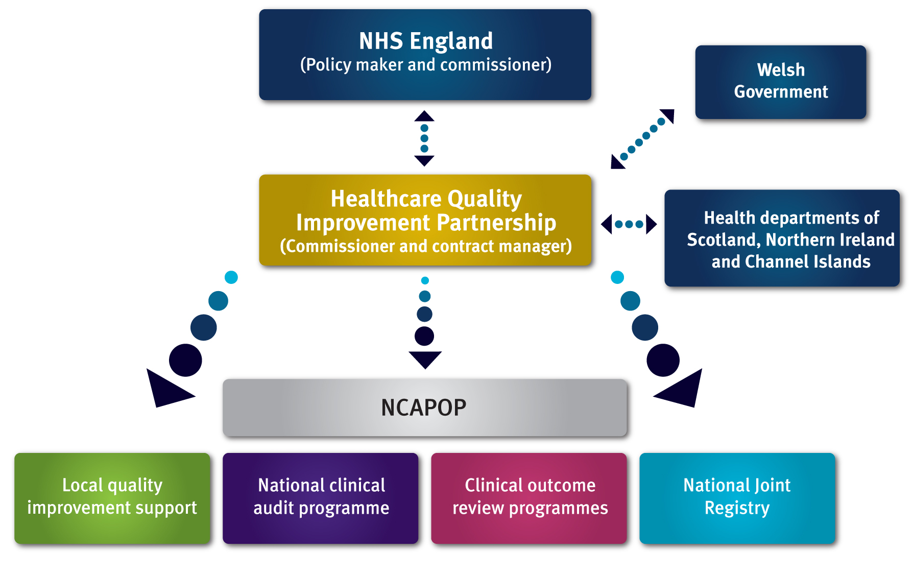
NCAPOP Commissioning Arrangements

Slide 10
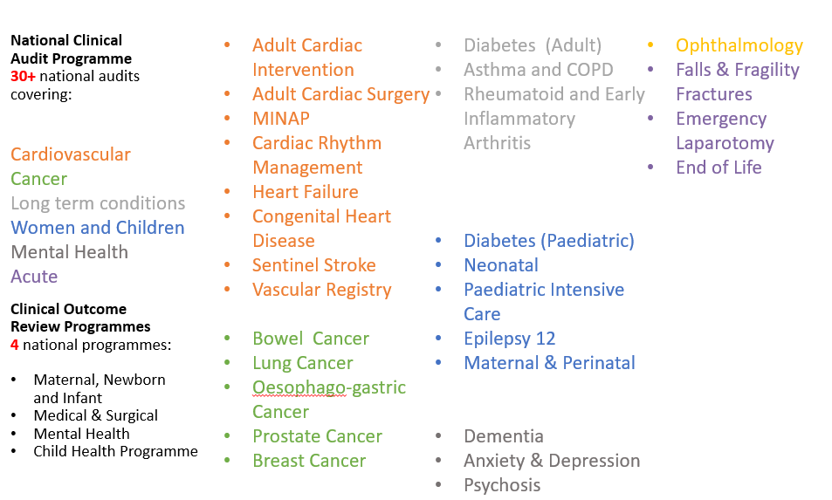
NCAPOP Topic areas

Slide 11
NCAPOP commissioning principles
National Clinical Audit
Effective clinical leadership
Minimal data burden /maximise linkage
Patient and public involvement and focus
Clear quality improvement intent
Value for money
Tailored outputs
Complete, high quality benchmarked data
Alignment with system and health priorities
Robust methodology
Notes:
These are the commissioning principles HQIP uses and they guide all areas of our work:
We are unique in our approach. We commission, manage and develop the most comprehensive, transparent programme in the world on behalf of NHS E and it is internationally admired
We commission for active clinical leadership and engagement in all our work to support implementation of findings i.e. improvement in patient care and outcomes
We have worked hard with our providers to ensure a high (95%+) participation of all those that provide care to NHS patients and to ensure high case ascertainment within each organisation
We ensure that commissioned outputs represent value for money for the public purse
We work to maximise the outputs from clinically relevant robust trustworthy data minimising as far as possible the activity required locally to collect it
We insist on meaningful patient involvement in everything we commission
We work collaboratively and proactively to support system alignment: NICE standards or other evidence-based standards used to underpin, supports other improvement initiatives (e.g. BPT, GRIFT, CQC)
Our work with the HQIP led and funded initiative of National Clinical Audit Benchmarking (NCAB – further detail later in presentation) delivers national QA and data for local QI and supports medical director and Trust Board engagement and hence service redesign.

Slide 12
Recent NCAPOP report examples
National Diabetes Audit, 2019-20 Type 1 Diabetes England and Wales 12 August 2021 | https://www.hqip.org.uk/wp-content/uploads/2021/08/REF228_NDA-Type1-Rep-2019-2020_FINAL-v20210806.pdf
National Diabetes Inpatient Audit (NaDIA) Harms, 2020 England 8 Jul 2021 Annual report | https://www.hqip.org.uk/wp-content/uploads/2021/07/REF227_NaDIA-Harms-Eng_Main-Report-v1.0_FINAL-20210705.pdf
National Paediatric Diabetes Audit Annual report 2019-20 Care processes and outcomes | https://www.hqip.org.uk/wp-content/uploads/2021/06/Ref.-261-NPDA-annual-core-Report-summary-FINAL.pdf
Hard to Swallow? A review of the quality of dysphagia care provided to patients with Parkinson’s disease aged 16 years and over who were admitted to hospital when acutely unwell | https://www.hqip.org.uk/wp-content/uploads/2021/08/Ref.-251-Med-Surg-Dysphagia-Full-report-FINAL.pdf
National Asthma and Chronic Obstructive Pulmonary Disease Audit Programme (NACAP) COPD clinical audit 2019/20 (people with COPD exacerbations discharged from acute hospitals) | https://www.hqip.org.uk/wp-content/uploads/2021/06/COPD_SC_data-and-methodology-report_2019-20_final.pdf
Suicide by middle-aged men. National Confidential Inquiry into Suicide and Safety in Mental Health. | https://www.hqip.org.uk/wp-content/uploads/2021/05/NCISH_2021-Suicide-by-middle-aged-men-report_HQIP_FINAL.pdf
Examples of near real time dynamic reporting / dashboards
National hip fracture database (NHFD) | https://www.nhfd.co.uk/charts
National Emergency Laparotomy Audit (NELA) | https://data.nela.org.uk/Documents/Hospital/88/Year6-2/88_Year6-2_QuarterlyReport-pdf.aspx
National Paediatric diabetes audit | https://npda-results.rcpch.ac.uk/default.aspx

Slide 13
Clinical Audit for Improvement

Slide 14

Draft Vision
Clinical Audit for Improvement is achieved by:
A prioritisation of recommendations, with patient safety at the top of the hierarchy.
Automated, real-time data for all clinical audits in the Model Health System, with benchmarking, dashboards, early warning systems and alerts available to all stakeholders.
A focus on quality improvement to embed recommendations at the front-line.
Clear communication and training, whereby everyone knows how and where to access clinical audit data and recommendations and understands what it means.
A central repository to facilitate easy access to the latest recommendations and best practice.
Supported by strong leadership across NHSEI Programmes as well as good engagement from the frontline.
Local needs assessment that informs system priorities.
Routine inclusion in education, on-going training & professional development, and job planning.
Appropriately resourced system wide, with recommendations feeding into appropriate policy & strategy.

Slide 15


Poll: Which are the top three vision statements that you want to see achieved?

Slide 16
Poll: In a single word, can you describe any gaps?

Slide 17

Patients
Clinical Audit
for Improvement
Stakeholders
Carers
CQC
Patients and Public
Regulators
Patient/Lived
Experience
teams
Clinicians
Caldicott
Guardians
National Directives
National Clinical
audit teams
NCDs
National
Quality
Boards
Patient
support
services
Government
(policy
documents)
Clinical
Senates
NHSEI
Transformation
Directorate
Regions
HEE
Interest Groups
Data/IT
HQIP
Medical
Directors
NICE
Providers
NHS Media/
communications
Strategic
Clinical
Networks
Systems
RightCare
National
Quality
Improvement
Network
Primary Care
ICSs
Royal
Colleges
Model
Hospital
NCEPOD
Cancer
Alliances
Clinical
Audit
Support
Centre
GPs
GIRFT
Trusts
Chief
Executives
PMO
AoMRC
ARCs
Trust Boards
Heads
of Nursing
System /
Condition
Specific
Analytical
teams
HR
Performance
AHSNs
Frontline
Staff –
Nursing and
AHPs
Improvement
Hubs
CCGs
Professional
bodies
(GMC, RCN,
etc.)
Quality
Improvement
/ performance
teams
National
Clinical Audit
Benchmarking
Equality,
Diversity and
Inclusion
HR
Operational
teams
Clinical
audit staff
Finance
Transformation
Leads
Commercial
organisations
Information
technology
Finance

Slide 18
Next steps
We are taking a paper to the Executive Quality Board Clinical Audit Sub-Group in September to set out recommendations for embedding Clinical Audit for Improvement
Share the outcome at the Clinical Audit Leadership Conference in November

Slide 19
An introduction to the development of a Coproduction Strategy for the Improvement Directorate for NHSEI

Slide 20
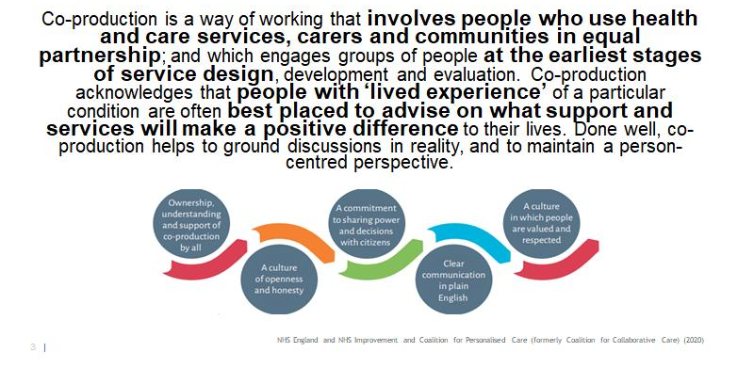
Putting the voice of people with lived experience at the heart of everything we do

Slide 21
BCN Rapid Review – Recommendation 1
Recommendation 1: Co-Production as Default – Led by Experience of Care Team, Nursing Directorate
Work with system partners to place co-production – including people with relevant lived experience – at the centre of how the health and care system learns and embeds change from the response to COVID-19.
Actions: In local services, in ICSs and nationally, we will transform our ways of working so that we are able to demonstrate that we: Always start from what matters most to people who use and work in services Work with people who have relevant lived experience (patients, service users, unpaid carers and people in paid lived experience roles) and with staff, in everything we do to directly connect with multiple and diverse voices Build equal and reciprocal partnerships with people who have relevant lived experience, and staff, including with those from disadvantaged and minority communities, from the very start of, and throughout, all our work.

Slide 22
Lived Experience Improvement Partners
The Lived Experience Partners will ensure the work of the Improvement Directorate is co-produced and based on what matters to people using our services and their carers. ​
​
The role of the Lived Experience Improvement Partner is to:​
Ensure that the Improvement Directorate as a whole, and across workstreams, considers and prioritises the person who uses our services and their carers.​
Ensure that relevant lived experience is central to the achievement of the Improvement Directorate principles.​
Co-produce the programme ensuring diverse voices are included from a wide range of people, communities and networks.​
Champion and advocate for increasing lived experience and public awareness of the outcomes and achievements of the Improvement Directorate. ​
Be an active team member

Slide 23
Next Steps on Coproduction
42 lived experience members of the BCN
Development of the Coproduction strategy for Improvement
Create networks of relevant lived experience per pathway
Learn from Best MSK who have a Lived Experience Board
Improve access and outcomes through co-design

Slide 24
How can we involve patients and the public in National Clinical Audit?
Please post your comments into the chat

Slide 25
How would you like the National Clinical Audit programme to continue to engage with you?
Please post your comments into the chat

Slide 26
Thank you
Join the Beneficial Changes Network - https://future.nhs.uk/BeneficialChangesCOVID19/
Follow us on Twitter - @NHSRightCareBCN
Email us at england.improvementsupporthubpmo@nhs.net

