Slide 1
Clinical Auditorium Patient Involvement in Clinical Audit
September 3rd 2021
Carol Munt

Slide 2
Who are HQIP- what do they do? They collect data. (clinical audits)

Slide 3
What’s the point in sharing data?
Using data from a range of hospitals and surgeons it is possible to standardise methods of undertaking operations based on best practice in operating theatres.

Slide 4
Using audit data for quality improvement will bring about better patient outcomes and patient experience.

Slide 5
HQIP’s SUN was established in 2009 It now comprises 40 patient and public representatives who
work alongside HQIP teams in helping to:
Develop public and patient involvement and our quality improvement work
Be an expert consultation group

Slide 6
The involvement of SUN and other patients and service users in our work is crucial. Acting on the patient voice is critical to the development of high-quality audit that measures the quality of care on issues that are important to patients.

Slide 7
Impact for patients and carers – why should we encourage participation
Informed choice
Patient perspective
Responsive to local need
Organisational buy-in
Project continuation
https://www.hqip.org.uk/resource/introduction-to-quality-improvement-for-patients-and-public/

Slide 9
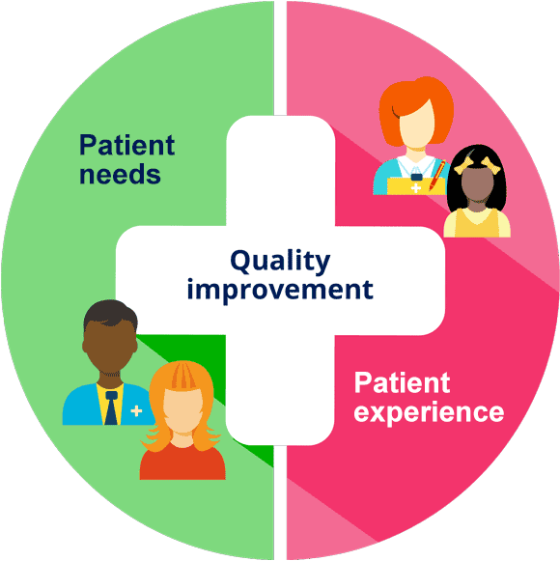

Slide 10
NCAPOP
We’re excited to announce that the Richard Driscoll Memorial Award 2021 is now open to entries!
This award celebrates excellence in patient and public involvement in the national clinical audit programme.
Find out more on our website: https://bit.ly/3Dwn0i4

Slide 11
All HQIP commissioned national programmes are eligible to submit an application that showcases how patients and carers influence the production of the patient-focused outputs of the audit.
This year we are focusing on the information the audits produce for patients and carers, highlighting the variety of formats and styles in which projects choose to share audit data, treatment options and recommendations for quality improvement in local services and patient outcomes.
This is an opportunity for the patient advocates involved in your programme to talk about their role and influence and share experiences about how the audit supports them.

Slide 12
Introduction to quality improvement for patients and public
This eLearning package replaces our previous online learning module ‘Understanding clinical audit for patients’, and seeks to support service users who wish to become involved in quality improvement work in healthcare.
It has been developed and tested through a series of consultations with HQIP’s own
Service User Network group.

Slide 13
“Most brilliance arises from ordinary people working together in extraordinary ways”

Slide 14
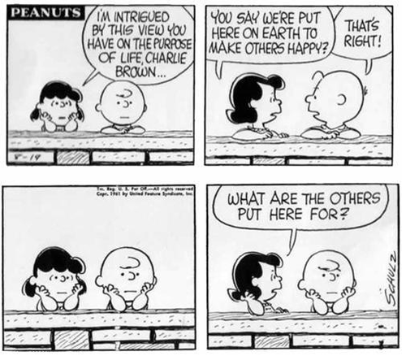

Slide 15
Thank you I hope you enjoyed it as much as I did.

Slide 16
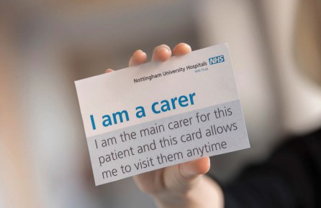
This should be national policy

Slide 17
Carol Munt
Patient Partner & Advocate
munt12@aol.com 07881911429
Hon. Lecturer & Doubleday Affiliate Manchester Medical School NHS Leadership Academy Experience of Care Partner
NHS Beneficial Changes Patient Flow Network
NHS Beneficial Changes Experience Based Co-Design
NHS Task & Finish Group Co-Production by Default
NHS Always Events National Advisory Group
National Steering Group Maximising Leadership Learning
NHS Horizons Project A Falls Collaborative
@muntma linkedin.com/in/carol-munt-5121721b

