Slide 1



Non-Medical Prescribing: National Update
29th September 2021
Dr Barry Quinn RN
Senior Lecturer, Cancer & Palliative Care
Queens University Belfast

Slide 2
Aims
National developments in nurse/non-medical prescribing
Developing confidence and competence in your ability to prescribe
Demonstrating compliance with the NMC Code for revalidation
Nurse/non-medical prescribing and compassionate care
NMP at the end of life & Covid-19

Slide 3

Background
“The dying know that we are not God, all they ask is that we do not desert them”
(Cassidy 1988)

Slide 4
Non medical prescribing
When prescribed and used effectively medicines have the potential to significantly improve the quality of lives and improve patient outcomes. However, the challenges associated with prescribing the right medicines and supporting patients to use them effectively should not be underestimated.
(Royal Pharmaceutical Society 2016)

Slide 5
National developments
Older population
Co-morbidities
Increased community focus
Integration of health and social care
Workforce - challenges and opportunities
New ways of working
Scope of practice
End of life care delivery
COVID-19

Slide 6
Nursing is changing
With more care being given in the community and patients presenting with a range of complex conditions. Nurses will need to be prepared with a different set of skills and competencies, including; high quality, cross-sector care, people management skills and public health promotion. (NMC 2016)

Slide 7
NMC Standards for Education and Training
Newly qualified nurses will have a higher level of proficiency in skills such as assessment , diagnostics, care planning and management, pharmacology and leadership. These are important skills for prescribers. (NMC 2019)

Slide 8

National developments
The competency framework for prescribers published (NICE 2012)
Royal Pharmaceutical Society (RPS) 2016 updated the competency framework in collaboration/endorsed by other prescribing professions (NMC January 2019)
RPS maintain and update competencies

Slide 9
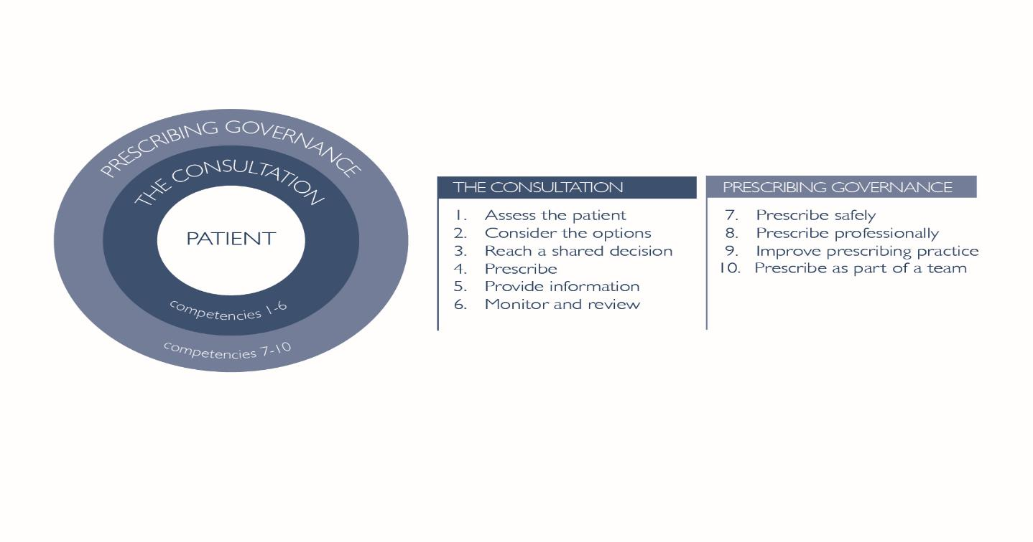
Prescribing competency framework
Ten competencies - two domains.
Within each of the ten competencies there are statements which describe the activity or outcomes prescribers should be able to demonstrate.

Slide 10
Consultation
Assessment: person-centred, physical, emotional, social and spiritual
Treatment/support options: non-pharmacological, pharmacological, co-morbidities, existing medication, impact on quality of life
Reach a shared decision: working with the patient/carer, consider diversity, values, beliefs and expectations
Prescribe: medicine/s with awareness of its actions, indications, dose, contraindications, interactions, cautions, and side effects, potential for misuse
Provide information: patient/carer’s understanding of plan, monitoring and follow-up, empower patient/carer (deterioration or no improvement)
Monitor and review: plan and adapts in response to monitoring, patient’s condition and preferences.
(Royal Pharmaceutical Society 2016)

Slide 11
Governance
Safety: scope of practice, Recognises limits of own knowledge and skill.
Professional: decisions based on the person
Competency: patient and peer review feedback, prescribing practice and audit
Teamwork: support and supervision for role as a prescriber, organisational policies and procedures
(Royal Pharmaceutical Society 2016)

Slide 12
NMP entry requirements
Old standards
Community prescriber V150 (min 2 years)
Independent prescriber V300 (min 3 years)
New standards
Skills including-
Clinical and health assessment
Diagnostics
Care management
Planning and evaluation of care

Slide 13
NMP and revalidation
Supervision
450 practice hours (prescribing in practice)
35 CPD hours (NMP annual training and updates)
Practice feedback (peer to peer audit and patient reviews)
Reflection and discussion (challenging situations, team working)

Slide 14

NMP and end of life
Illness not merely a breakdown of an objective body but a rupturing of the person’s ability to negotiate with the world
(Baron 1985)

Slide 15
Symptom management
what is seen
Physical
Social
Emotional
?
Spiritual
(Adapted: Mortally Wounded - Kearney 1996)

Slide 16

I am frightened
’Inside I am a frightened child, I am like that bird (referring to a dream she had), I am vulnerable, and I am trying to say to them, and nobody listens, for the way I feel inside’ (Nora)

Slide 17

A Modern Day Myth
“Today we live in the shadow of one of modernity’s most powerful myths, the belief that science and technology will cure all of humanities ills”
Mc Grath (2000)

Slide 18

Sharing the darkness

Slide 19
Jonathan
“Many of my friends wonder how I maintain a positive outlook and indeed suggestions have been made that I am in fact in a manic depressive state. I am happy during the day because I cry at night…….too put it simply, I’ll do my smiling during the day and I’ll leave the painful parts until dark”

Slide 20

Compassionate practice
Presence (listening with fascination)
Understanding Distress (yours and others)
Feelings Response (empathizing without being overwhelmed)
Impulse to Help (think back to our reasons)
*when nurses display these behaviours patients are more satisfied
West, M. & Chowla, R. (2017). Compassionate leadership for compassionate health care. In P. Gilbert (Ed.).Compassion: concepts, research and applications. London: Routledge, 237-57.

Slide 21

Prescribing in practice
Pay attention
See beyond the symptom
Skilled companion
Willingness to learn
(Managing Advanced Cancer Pain Together MACPT 2015)

Slide 22
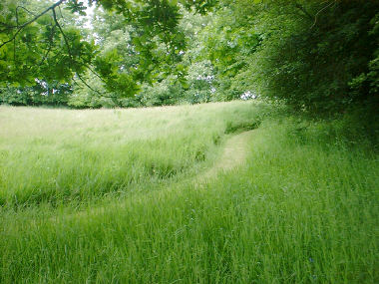
‘Skilled companionship’
“When we become true companions to ourselves, then we can also be companions to our patients and clients”
(Tschudin 1997)

Slide 23

End of life care
Move beyond a medical focus of care – personal meaning of symptoms
Person led care – important conversations and plans
Working with family, team and community partners
Bereavement support

Slide 24
Thank you
Barry.quinn@qub.ac.uk

