Slide 1
Caldicott Leadership during and beyond COVID-19
Professor Alison McCallum October 14, 2021

Slide 2
Caldicott leadership during and beyond COVID-19
What I was asked to cover:
Leading Caldicott and embedding the Caldicott principles
Current issues and dilemmas in practice
What I’ll cover
Approach – matters of life & death
History
Developments – dilemmas resolved
Dilemmas with fixes
Dilemmas emerging/remaining
Links & tips at the end

Slide 3
Values Scholarship Solutions Standards
The role should help:
good health as a global goal to be advanced
the right to health to be implemented;
individual and population level prevention, treatment and care to be transformed
without breaching confidentiality
Notes:
responsibilities: strategic, directorate individual • leadership qualities required for the role • Caldicott Guardian accountability

Slide 4
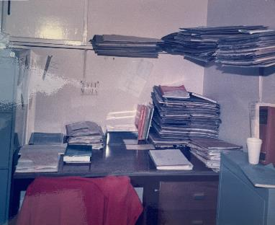
How do you protect personal data, and the lives that it describes, while being unable to measure quality or improve care without it?
Resolving the Caldicott Guardian’s dilemma
My first project
When the walled garden was enough
The basics
Mobile devices
Rapid transfer of data
Large datasets
Small populations
Help for exceptions
Safeguards: human, physical, technological, product
Learning from incidents – yours & other people’s
Notes:
The Caldicott Report
A review was commissioned in 1997 by the Chief Medical Officer of England "owing to increasing concern about the ways in which patient information is being used in the NHS in England and Wales and the need to ensure that confidentiality is not undermined. Such concern was largely due to the development of information technology in the service, and its capacity to disseminate information about patients rapidly and extensively".
A committee was established under the chairmanship of Dame Fiona Caldicott, Principal of Somerville College Oxford, and previously President of the Royal College of Psychiatrists. Its findings were published in December 1997.
The report highlighted six key principles, and made 16 specific recommendations.

Slide 5
Confidentiality
Imaging data
Data storage
http://www.sinapse.ac.uk/

Slide 6
Scholarship
Patient, public & collegiate engagement
Confidentiality research
Data linkage
Methods
Technical standards of privacy protection

Slide 7
Staff as patients in the time of COVID –separate roles, functions & reporting –all apply
Public health incident response
Occupational Health Record
Reporting
Risk assessment
Hazard identification
Surveillance -known & new
The individual clinical record in occupational health remains confidential
Notes:
There are specific constraints on sharing employer access to confidential health information from the clinical record but requirements for reporting to ensure that workplaces prevent, mitigate and manage known and emerging exposures to hazards

Slide 8
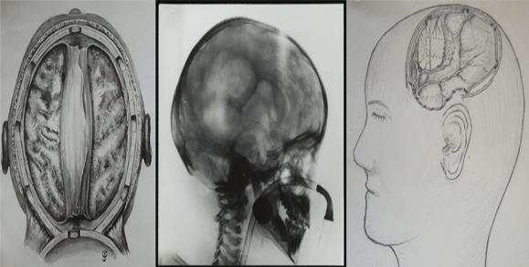
Matters of life and death
Public inquiries
Records of those left behind
Learning from archaeology
National Records of Scotland
Genomic blueprint of a relapsing fever
pathogen in 15th century Scandinavia

Slide 9
Matters of life and death: the team around the person 1585
‘The crew of William of Leith came down with the plague, and was kept on board off Inchcolm. Cleaners supervised ‘disinfection’ of the ship, cargo and crew..’
A register was kept of the sick, indigent and poor shut in their homes, and food and drink made available to them along with those on the moor. Children sleeping in the streets would be taken to the chapel at St Mary’s Wynd…
http://www.davidcforster.co.uk/

Slide 10
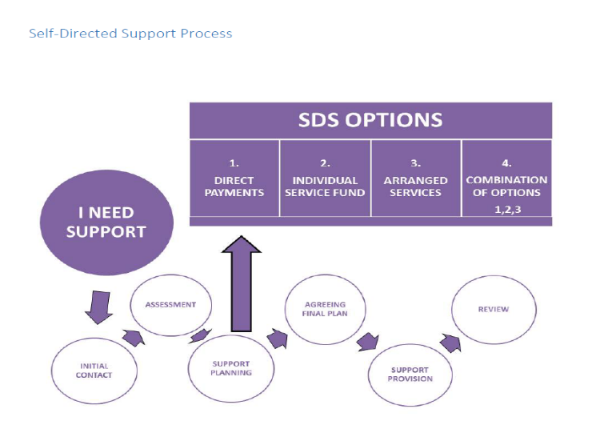
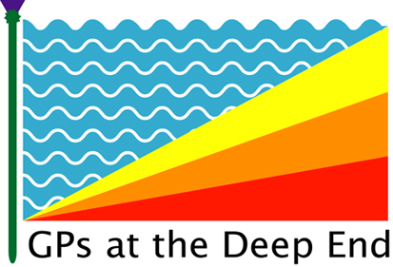
Multiagency support: services & volunteers the team around the person in a pandemic
Notes:
Maintain and develop relationships with a wide range of national and local stakeholders, including local authorities and health and social care partnerships, so we can help more people access our service, learn from best practice and prepare for the launch of other new benefits.
Develop a health and social care Division that will contribute expert advice to make sure decisions about disability benefits are consistent.
Providing care across borders
Calling people by their preferred name
Consistent descriptions of how safe people, safe projects, safe settings, safe outputs, safe data, standards will be met
Look for shared understanding

Slide 11
Dilemmas emerging (& re-emerging)
Clinical records held by the wider primary care team
New services & pathways
Missing people
Anonymous services
https://images-assets.nasa.gov/image/NHQ201708210205/NHQ201708210205~small.jpg
Notes:
Non-NHS dentists & urgent suspicion of cancer
Data detectives
https://images-assets.nasa.gov/image/NHQ201708210205/NHQ201708210205~small.jpg

Slide 12
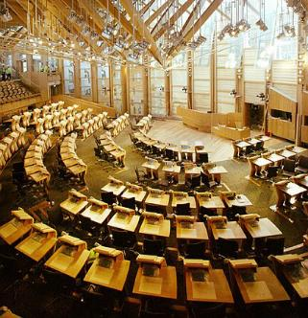
Values Scholarship Solutions Standards
Accountability
People & Parliament
Board
Health & Care Governance
Exceptions
Data quality
Information Governance
R&D
Evaluation
Audit
Linkage
Public
Inquiries
Fiona Buckle
Archive
Public Records
Public Protection
Data Sharing
FOI

Slide 13
Solutions
Understand the decision and dilemmas
1
Respond rapidly to questions that affect care
3
Be the conscience, take on, manage risk & report it
4
Delegate. Focus on risk mitigation & assurance
2

Slide 14
Thank you
Q&A
Professor Alison McCallum
Alison.mccallum@ed.ac.uk

Slide 15
Key features of the “safe haven” approach
clinical data never held attached to personal identifiers
Other data sources e.g. census data never held attached to personal identifiers
all linked data held in a secure environment
access only to named researchers /professionals
all outputs approved by disclosure committee before release
public panel discusses questions and how to tackle them
Must have Privacy protection: safe people, safe projects, safe settings, safe outputs, safe data
Must be Public Benefit
Notes:
15
Reflects findings of research

Slide 16
Prepare for action & find pals
Anonymising qualitative research and case studies
Good redaction practice
Make friends with the law and the lawyers
Know the role of the regulator
Find out which professionals (& managers) are the go to people when making difficult professionals & ethical decisions
Find out who the ‘go to’ people are for patient & public involvement
Talk to the complaints, critical incidents & FOI teams about what’s tricky
Find out how Finance handle information
Work with HR, trades unions & occupational health so that staff are staff, patients are patients and the Venn diagram is monitored
Healthcare scientists will have an expert on health technology assessment and challenges regarding MHRA/ licensing versus encrypting, deidentifying and anonymising data held in equipment and devices. In Local Authorities, you should have environmental health professionals with similar expertise
Healthcare illustration are also registered health professionals (Academy of Healthcare Science regulates professions not regulated by the Health and Care Professions Council https://www.ahcs.ac.uk/the-register/overview-the-register/) and sits under the Professional Standards Authority like regulators such as General Medical Council
Organise myth-busting sessions - it’s always been possible to do the right thing eventually

Slide 17
The role of the regulator
Transfer/sharing of certain data is a regulatory requirement e.g. to Steering Committee to protect participant/patient safety and respect their rights
Permitted under the law or a legal requirement
For health/research/statistical purposes
Includes monitoring of consent
Includes monitoring adequacy and compliance of privacy and confidentiality with protocol
Access or transfer of data for regulatory requirements must be set out in the Patient information (PIS) and consent form.
Clear audit trail required to ensure comprehensive reporting of adverse events.
Guidance for access to data by regulators should be followed
Regulator must agree formally that data will not be used for any other purpose.

Slide 18
Redaction and reconstruction
Make friends with an archivist
Case note cataloguing
http://www.lhsa.lib.ed.ac.uk/projects/UKAD2013_Poster_Button_Williams.pdf
https://collections.ed.ac.uk/lhsacasenotes
Know the Records Management Code of Practice
https://ico.org.uk/media/for-organisations/documents/2021/2619016/how-to-disclose-information-safely-20201224.pdf
https://www.nationalarchives.gov.uk/documents/information-management/redaction_toolkit.pdf
http://www.knowledge.scot.nhs.uk/media/CLT/ResourceUploads/4087083/cf6965c7-885f-4a24-b7e4-ce0f0cc7d65f.pdf
Victoria Hoyle, Elizabeth Shepherd, Andrew Flinn, Elizabeth Lomas, Child Social-Care Recording and the Information Rights of Care-Experienced People: A Recordkeeping Perspective, The British Journal of Social Work, Volume 49, Issue 7, October 2019, Pages 1856–1874, https://doi.org/10.1093/bjsw/bcy115
Infected Blood Inquiry
https://www.infectedbloodinquiry.org.uk/sites/default/files/2020-04/2020-04-14%20Re-Amended%20Statement%20of%20Approach%20-%20Anonymity%20and%20Redaction.pdf

Slide 19
Links and references
How we use data https://www.nhsinform.scot/care-support-and-rights/health-rights/confidentiality-and-data-protection/how-the-nhs-handles-your-personal-health-information
Understanding patient data https://understandingpatientdata.org.uk/ https://www.ed.ac.uk/usher/biomedicine-self-society/research https://www.ed.ac.uk/clinical-research-facility/patient-and-public-involvement/meet-the-team
Right to erasure does not apply https://ico.org.uk/for-organisations/guide-to-data-protection/guide-to-the-general-data-protection-regulation-gdpr/individual-rights/right-to-erasure/
Genetics toolkit for research expected late 21/22 https://www.ga4gh.org/how-we-work/2020-2021-roadmap/2020-2021-roadmap-part-ii/rews-2020-2021-roadmap/
Transfer of genomic data https://doi.org/10.1007/s00439-018-1917-9
Historical data and remains
McLennan W. The Eleven plagues of Edinburgh. Proc R Coll Physicians Edinb 2001; 31:256-261https://www.rcpe.ac.uk/journal/issue/vol31_no3/T_Eleven_Plagues.pdf
archives –https://www.nationalarchives.gov.uk/documents/records-collection-policy-2012.
https://www.forskningsetikk.no/en/about-us/our-committees-and-commission/skjelettutvalget/about-the-national-committee-for-research-ethics-on-human-remains/ https://www.forskningsetikk.no/en/resources/the-research-ethics-library/research-on-human-biological-material/human-remains/ https://www.ed.ac.uk/files/atoms/files/archaeology_ethics_statement_5_may_16.pdf
Primary care
https://www.gla.ac.uk/researchinstitutes/healthwellbeing/research/generalpractice/deepend
My first project
McCallum A, Eastwood MA, Smith AN, Fulton PM. Colonic diverticulosis in patients with colorectal cancer and in controls. Scand J Gastroenterol. 1988 Apr;23(3):284-6. doi: 10.3109/00365528809093866. PMID: 3387892.
Multiagency support
https://tfn.scot/news/providing-support-across-edinburgh
https://www.iriss.org.uk/resources/insights/self-directed-support-ten-years
https://www.socialsecurity.gov.scot/reporting/publications/business-plan-2021-2022
https://www.socialsecurity.gov.scot/asset-storage/production/downloads/Corporate-Plan-research-report-visual-summary-ISBN.pdf

Slide 20
Links and references II
Pregnancy loss – example of extended retention https://www.hta.gov.uk/faqs/disposal-pregnancy-remains https://www.gov.scot/publications/report-national-cremation-investigation-dame-elish-angiolini-dbe-qc/
Transfer of data to the US https://www.gibsondunn.com/us-cybersecurity-and-data-privacy-outlook-and-review-2021/#_Toc62718914
Privacy and electronic communications https://ico.org.uk/for-organisations/guide-to-pecr/what-are-pecr/#3
Clinical trial monitoring https://onlinelibrary.wiley.com/doi/epdf/10.1111/tmi.12781
Sharing minimal clinical data for second opinions etc https://ec.europa.eu/health/sites/health/files/ern/docs/cpms_ps_en.pdf
Sharing data between GPs and Dentists – problems with the urgent suspicion of cancer pathway Grafton-Clarke C, Wen Chen K, Wilcock J. Diagnosis and referral delays in primary care for oral squamous cell cancer: a systematic review. Ciaran. British Journal of General Practice 2019; 69 (679): e112-e126. DOI: 10.3399/bjgp18X700205
Non disclosure https://doi.org/10.1016/j.drugpo.2020.102873 https://doi.org/10.3122/jabfm.2018.01.170167
Digital strategy, ethical framework, equalities & fairer Scotland impact assessments https://www.gov.scot/publications/a-changing-nation-how-scotland-will-thrive-in-a-digital-world/pages/an-ethical-digital-nation/
Virtual clinical discussions https://ec.europa.eu/health/sites/health/files/ern/docs/cpms_ps_en.pdf
DPA/GDPR adequacy decision https://ec.europa.eu/info/sites/info/files/draft_decision_on_the_adequate_protection_of_personal_data_by_the_united_kingdom_-_general_data_protection_regulation_19_feb_2020.pdf
Occupational data https://www.hse.gov.uk/coronavirus/riddor/index.htm
Registers and data linkage Epidemiology of multimorbidity and implications for health care, research, and medical education: a cross-sectional study Barnett, Karen et al The Lancet, Volume 380, Issue 9836, 37 – 43 https://doi.org/10.1016/S0140-6736(12)60240-2

