Slide 1
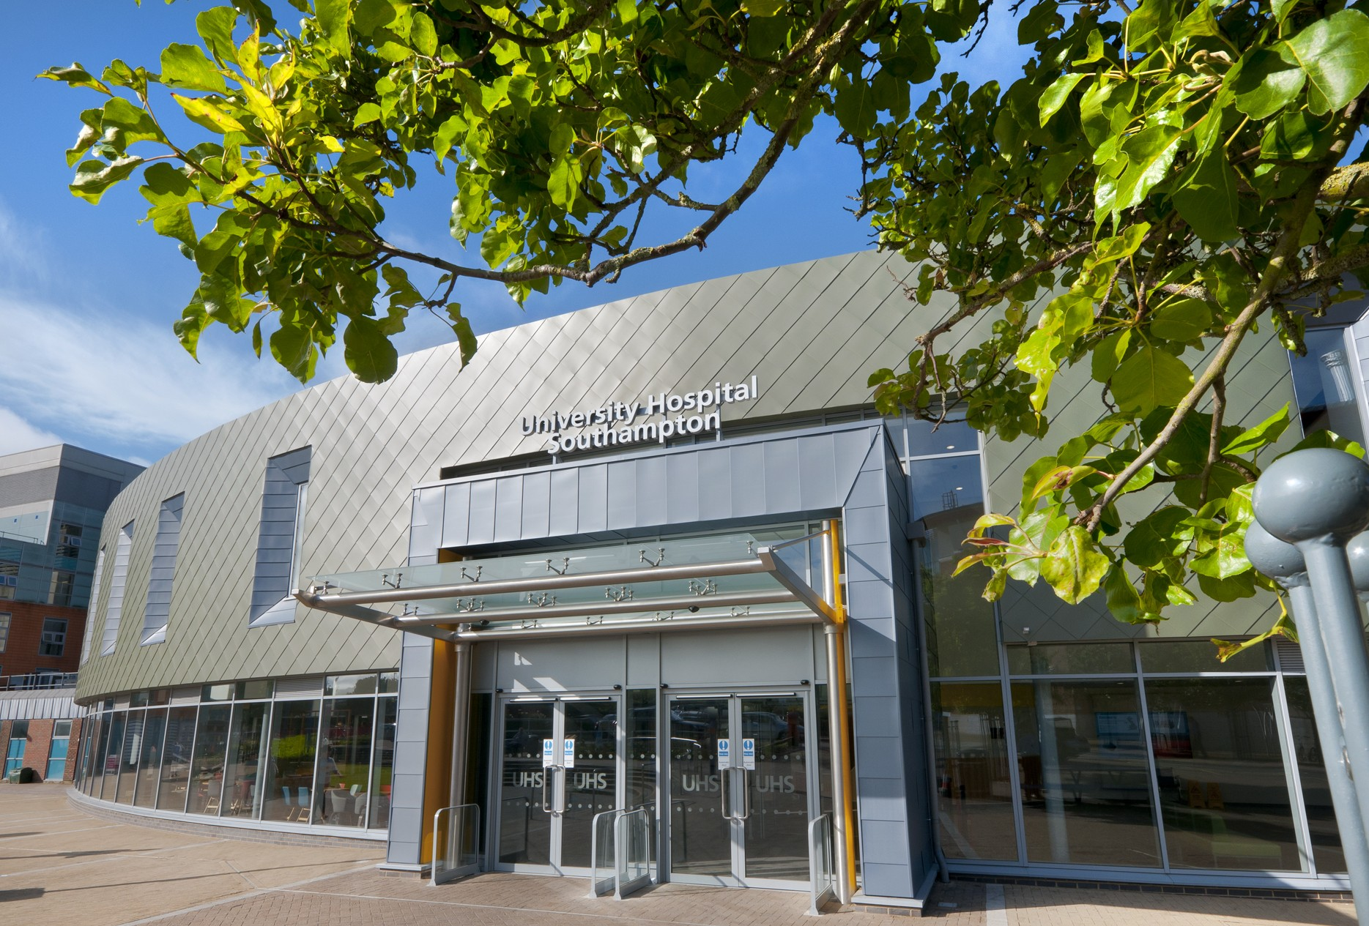

Out of Hours Care
& Seven Day Services Extended Session
Dr Juliane Kause
Chief Medical Officer, Anvil Group
Consultant Physician, University Hospital Southampton

Slide 2
Session Objectives
One
Two
Three
Overview over H@N, 7 Day Services, The 24/7 Hospital
Gap Analysis
Workforce models for clinical and support services
Four
Five
Six
Service Delivery Models
Service Development
Resources in 2021

Slide 3

What is
Hospital
at Night?
Hospital at Night (H@N) is a multiprofessional, multispecialty approach to delivering care at night and out of hours, with the aim of improving patient safety.
It involves members of medical and nursing staff coming together to form a team that manages patients across many disciplines in a hospital.

Slide 4

Before We Begin
We will send you the associated handout
Submit your questions anytime via the chat box.
Please complete the exit survey

Slide 5

Priority of the organisation
Resources required for improvement
Poorer clinical outcomes (admissions, emergency procedures, discharges)
Ongoing Issues
Inadequate clinical staffing
at night/out of hours
Inadequate consideration of human factors affecting shift workers in healthcare
Inadequate use of available resources
Electronic handover tools, rotas kind to circadian rhythms (systems)
Automation, communication tools (equipment)
All members of the Multiprofessional Team (people)

Slide 6


Insufficient senior decision makers
Insufficient workers
Why does it “feel” different to work out of hours?
Each department works in isolation
Lower staffing levels
Negative recruitment and retention impact
Reputational consequences

Slide 7
Why does it feel different to receive care out of hours?
2013 & 2015
Fewer staff visible
Visible staff “always busy with emergencies”
Less visible “hospital activity” - tests, treatments, therapy
Staff comments:
only dealing with emergencies
always understaffed at weekends

Slide 8

168 hours per week
40 hours are core hours
OOH services global facts and local problem
128 hours are out of hours: nights, weekends
Public holidays additional out of hours
Services designed for core hours
Staffing models designed for core hours
Key performance indicators designed to for core hours
Growing research evidence on unsafe patient care out of hours

Slide 9
Drivers and barriers for changes in OOH services
01
02
03
04
Enormous anecdotal evidence of overworked doctors and nurses
Healthcare professionals opting for roles with core working hours
Clinicians carry out administrative tasks that could be carried out by others
“too wicked a problem to solve”, “too complicated”

Slide 10

Historical Context (UK)
Suboptimal care out of hours identified, DoH introduces Hospital at Night
1990’s
Hospitals at Night implemented widely, further reports of human error documenting poorer outcomes out of hours
2000’s
Secondary care wide solutions implemented by DoH, NHSE 7 Day Services
2010’s
System wide changes needed to achieve sustainable change
2020’s

Slide 11
01
Patient safety and staff experience is key driver for positive change
02
Driver for H@N was reduction in doctors working hours, not patient safety
Learning from the last 25 years
03
Core hour working needs to change to positively impact on out of hours workload and practices
04
Emergencies are mainly “medical”. Staffing models need to reflect this
05
Sustainable solutions are system based

Slide 12
Audit 2003
107 English NHS hospitals
77 different models
Hospital at night audit; the early years
No clinical standard identified
Outcome indicators – reduction in junior doctor working hours from
56 hours per week to 48 hours (2009)

Slide 13
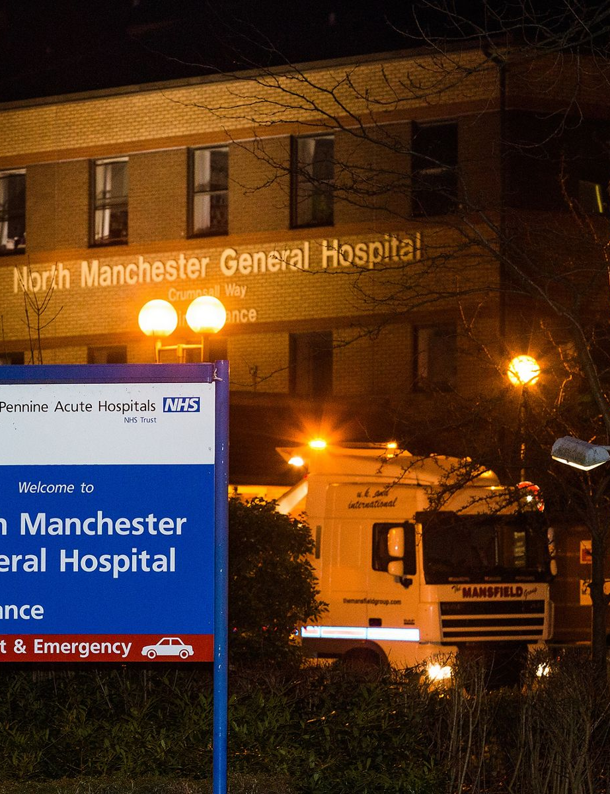

Seven Day Services
The provision of seven-day services is about ensuring that patients receive consistent high quality safe care every day of the week. There are three key elements:
{{
One
Two
Three
Routine general practice; access to GP appointments in the evenings and at weekends
Quality hospital care that will provide 100% of the population with access to the same level of consultant assessment and review, diagnostic tests and consultant-led interventions every day of the week by 2020
Urgent care; access to healthcare advice 24/7 via NHS 111
Page
13

Slide 14

Improving “Out of Hours” and weekend care
will have a positive impact in 4 key areas
01
02
03
04
Better Patient Experience
Improved Patient Flow
Patient Safety
Better clinical supervision across the week
Notes:
There are four key areas where improving out of hours and weekend staffing, access to investigations and interventions, will have the most impact.
To meet these standards, Trusts need to improve workforce planning and ways of working within and across clinical services and specialties. For instance, patients cannot get reviewed in accordance with the standards unless there are handover discussions or board rounds every day that review the condition of recently admitted patients and deteriorating patients.
Early decisions about patients will improve patient flows; patients will undergo investigations earlier and the Monday morning pressures on diagnostics and discharge processes will be eased. 7 day services will reduce readmission rates, lengths of stay and encourage the type of discussion about patients that improves clinical governance and have benefits in terms of patient safety and improved clinical effectiveness.
It should also improve patient experience by improving their perception of their safety at weekends and by creating more opportunities for information from patients and carers to be taken on board in the decisions that are made
Having more consultant working the weekends will also ensure that trainees and other juniors receive greater clinical supervision. This will enhance training and the working experiences for those in training, whilst increasing patient safety.

Slide 15
Improving “Out of Hours” and weekend care will have a positive impact in 4 key areas
01
02
03
04
Better Patient Experience
Improved Patient Flow
Patient Safety
Better clinical supervision across the week
Better staff experience
Improved training
Improved job satisfaction
Improved staff retention
Fewer vacancies
Notes:
There are four key areas where improving out of hours and weekend staffing, access to investigations and interventions, will have the most impact.
To meet these standards, Trusts need to improve workforce planning and ways of working within and across clinical services and specialties. For instance, patients cannot get reviewed in accordance with the standards unless there are handover discussions or board rounds every day that review the condition of recently admitted patients and deteriorating patients.
Early decisions about patients will improve patient flows; patients will undergo investigations earlier and the Monday morning pressures on diagnostics and discharge processes will be eased. 7 day services will reduce readmission rates, lengths of stay and encourage the type of discussion about patients that improves clinical governance and have benefits in terms of patient safety and improved clinical effectiveness.
It should also improve patient experience by improving their perception of their safety at weekends and by creating more opportunities for information from patients and carers to be taken on board in the decisions that are made
Having more consultant working the weekends will also ensure that trainees and other juniors receive greater clinical supervision. This will enhance training and the working experiences for those in training, whilst increasing patient safety.

Slide 16
Seven Day Services Key Findings
2016 to 2019
Patients who were discharged on a Friday, Saturday and Sunday had an increased likelihood of an emergency readmission within seven days of discharge compared to those who were discharged on a Wednesday.
Patients who were admitted at the weekend had an increased likelihood of mortality within 30 days of admission compared to those who were admitted midweek.
There are many possible explanations for this variation including differences in the case-mix of patients (over and above that accounted for in the analysis), patient behaviour and provision of services both in and outside of the hospital (including social care), but this analysis is unable to determine the causes of the observed variation.
https://digital.nhs.uk/data-and-information/publications/statistical/seven-day-services/oct-18-sep-19
Patients who were admitted in an emergency stayed slightly longer in hospital if they were admitted on a Saturday.

Slide 17
A set of clinical standards were identified
to support 7 day services in hospitals
PRIORITY CLINICAL STANDARDS
Standard 2: Time to consultant review
Standard 5: Diagnostics
Standard 6: Consultant directed interventions
Standard 8: On-going review in high dependency areas
Clinical standards which enable sustainable delivery
Standard 1: Patient Experience
Standard 3: MDT Review
Standard 4: Shift Handover
Standard 7: Mental Health
Standard 9: Transfer to primary, community & social care
Standard 10: Quality Improvement
The 10 clinical standards were developed by the NHS Services, Seven Days a Week Forum led by Professor Sir Bruce Keogh.
Priority standards are identified as the minimum set of clinical standards needed to tackle variation in mortality, patient flow and experience. Selection is supported by the Academy of Medical Royal Colleges.
Notes:
Originally ten standards were set to describe what ‘seven day services’ should mean for the NHS. These were developed by the clinically led NHS Seven Days a Week Forum in 2013, drawing on evidence from the Royal Colleges, subject matter experts and NICE. Four standards were prioritised as they were seen as most likely to improve patient flow, experience and mortality. This prioritisation was approved by the Academy of Medical Royal Colleges. It is still envisaged that all ten standards will be implemented but the focus is on the 4 priority standards initially. These standards should ensure that patients receive the same quality of assessment, diagnosis, treatment and review on any day of the week
NHS Improvement is committed to see these standards inform related improvement work and to secure steady progress against each. The seven day service clinical standards should have informed, or been embedded into, plans to deliver Urgent and Emergency Care Networks across England, and local sustainability and transformation plans (STPs).

Slide 18




https://www.england.nhs.uk/seven-day-hospital-services/
https://improvement.nhs.uk/resources/seven-day-services/
https://digital.nhs.uk/data-and-information/publications/statistical/seven-day-services
Implementation
Resources
for H@N/7DS

Slide 19
Case Study:
Out of Hours and Seven Day Services in Secondary Care
Page
19

Slide 20
Context
Every year our 11,500 staff:
Treat around 150,000 inpatients and day patients, including about 50,000 emergency admissions;
Provides services to some 1.9 million people living in Southampton and South Hampshire.
Provides specialist services to more than 3.7 million people in central southern England and Channel Islands.
See over 624,000 people at outpatient appointments; and
Major centre for teaching and research in association with University of Southampton and partners including the Medical Research Council and Wellcome Trust.
Deal with around 135,000 cases in our emergency department.
Providing these services costs £1.9 million a day.

Slide 21
The Problem
Out of hours means all 128 hours that are not core working hours (40)
Extended OOH nurse roles beyond “H@N”
Separation of bed management/ staffing from clinical role out of hours
Patient safety and patient flow are interrelated
More doctors/senior decision makers needed to ensure patient safety and patient flow
Not enough workers to meet demand for clerical/routine tasks OOH

Slide 22
Results of Gap Analysis
Day time working needs to change to make nights safer
Too many tasks done by clinicians that could be carried out by administrative staff
Too few doctors for number of patients and emergencies
Day time working needs to change to make nights safer
Too much spent on locum doctors and agency nurses
Most emergencies are medical – service needs to reflect this
Too many responsibilities for nurses on night duty

Slide 23
OOH/7Day Services plan
…always open, always ready…
3 year project plan (2013- 2016)
Local (departmental/directorate) solutions and overarching organisational plan
In house gap analysis by:
  Directorate/specialty
  Workforce
  Budget setting
  Discharges: non elective patients length of stay – weekday vs weekend
  Community links
Notes:
Originally ten standards were set to describe what ‘seven day services’ should mean for the NHS. These were developed by the clinically led NHS Seven Days a Week Forum in 2013, drawing on evidence from the Royal Colleges, subject matter experts and NICE. Four standards were prioritised as they were seen as most likely to improve patient flow, experience and mortality. This prioritisation was approved by the Academy of Medical Royal Colleges. It is still envisaged that all ten standards will be implemented but the focus is on the 4 priority standards initially. These standards should ensure that patients receive the same quality of assessment, diagnosis, treatment and review on any day of the week
NHS Improvement is committed to see these standards inform related improvement work and to secure steady progress against each. The seven day service clinical standards should have informed, or been embedded into, plans to deliver Urgent and Emergency Care Networks across England, and local sustainability and transformation plans (STPs).

Slide 24
Improvement strategy = workforce transformation
3-year plan
Increase staffing without “taking from existing pool of staff” | Achieving cost effective solutions | Increase use of IT solutions for handover | New posts for middle grade doctors - Acute Care Fellows (research SpRs) | Extended out of hours nurse roles to cover 128 hours

Slide 25
Improvement strategy = workforce transformation
3-year plan
Separation of bed management/staffing from clinical role out of hours | Out of hours therapists | Out of hours pharmacists | Extended job roles for admin/clerical staff - weekend and evening ward clerks until 10 p.m. | New job roles – Doctors’ administrators

Slide 26
Workforce
Transformation
Existing Roles:
Doctors
Nurses
Pharmacists
Therapists
Porters
Radiographers
Radiologists
New Roles:
Acute Care Fellows
Doctors Administrators
Expanded role of Medical Assistants
Band 4 Bed managers

Slide 27

Transformation from nurse coordinator/bed manager (Band6) to Advanced nurse practitioner (Band7)
Separation of bed management from clinical work
- Key to success
- Clear definition of roles
Transformation of nursing roles in medicine
Advanced nursing practice pathway (MSc)
H@N to OOH Advanced Nurse
practitioner
Development of MDT delivering OOH
care

Slide 28
New role for middle grade doctors: Acute Care Fellows
Time out of specialty training for clinical/scientific research leading to higher degree (PhD/MD)
Senior Registers (ST5 and above)
6 Acute Care Fellows
Breadth of specialty experience
Gastroenterology/Cardiology/ Respiratory/Endocrinology
Started 2014, programme remains successful

Slide 29
Benefits to the Acute Care Fellows
Develop management/ leadership/
GIM competencies
Supports out of programme research
Retain clinical skill set
Experienced clinicians are not “lost” to the NHS
Clinical training time credited, therefore qualify as consultants 6-12 months earlier

Slide 30
The impact of the OOO Advanced Nurse Practitioner
and the Acute Care Fellow Role
Broad range of specialty knowledge available collectively OOH
Reduces the overflow of ‘routine’ work to the night shift
Timely review & escalation of patients
Builds teams, supports individuals
Shared workload

Slide 31
Therapy Services Transformation
5-day services “stretched” to
seven days
Physiotherapy and occupational therapy combined
New Band 3 and Band 4 roles
One
Two
Three
Early successes:
- timely end of life care discharges
- equitable service for all patients
Challenges:
- culture change
- some staff were new to weekend working
Four
Service design based on clinical need
Six
Five

Slide 32

Pharmacy
2014
2016
Focus of service = discharges from AMU and medicine
Focus of service = to support discharges and therapeutic drug monitoring for the whole organisation
Weekdays: 09:00 to 17:00
Sat and Sun 09:00 to 12:00 AMU and Medical Wards only
No weekend service for rest of the organisation
No Public Holiday service
Dispensary open Saturday and Sunday from 09:00 to 12:00
Weekdays, weekends:
09:00 to 17:00, up to 19:00 in all acute admission areas
Weekends and Public Holidays:
reduced service for all 09:00 to 17:00 all areas (2017)
Dispensary open from 09:00 to 17:00, seven days a week
Page
32

Slide 33

Doctors Administrators (DA) “invented” at UHS in AMU in 2015 - now national, all specialties
The Problem: “busy Acute Admissions area”
56 bedded AMU
70-100 daily attendances/admissions
41% direct discharge rate – 30-40 electronic discharge summaries (EDS) per day
15 minutes to complete EDS excluding to take out medications (TTOs)
10 hours per day = time required by junior doctors to complete EDS
3 SHO grade doctors on “ward-based duties” each day, one SHO for admissions, 1-2 SpRs, 1 consultant 08:00-22:00, seven days a week
Median length of stay 20 hours
Junior doctors carry the administrative burden at the expense of direct patient care and education
European Working Time Rule considerations created additional pressures

Slide 34
Doctors Administrators (DA) “invented” at UHS in AMU in 2015 - now national, all specialties
The Solution: A Doctors Administrator “busy Acute Admissions area”
41% direct discharge rate – 30-40 electronic discharge summaries (EDS) per day
15 minutes to complete EDS excluding to take out medications (TTOs)
10 hours per day = time required by junior doctors to complete EDS
3 SHO grade doctors on “ward-based duties” each day, one SHO for admissions, 1-2 SpRs, 1 consultant 08:00-22:00, seven days a week

Slide 35
Recruitment of Doctors Administrators
Advertised on open market (avoid depleting health care support roles further)
Internal
and external recruitment
Competitive selection
process
Skills required
Dynamic
Attention to detail
Able to work well in acute environment
initiative
Page
35

Slide 36

Training of Doctors Adminstrators
{{
Six-week
training programme
Trust induction
Coding education session
Trust IT clinical applications course
Medical terminology course
Dummy discharge summaries
Competency framework
Medical model
Clinical supervisor
AMU consultant = mentor
Page
36

Slide 37
Placement/Utilisation
of Doctors Administrators
2 doctors administrators on duty each day (Mon to Fri) and one on Sat, Sun and public holidays
DAs join the morning ward round – checklist approach encouraged to include CQuIN items
DAs give patient information leaflets after the ward round
DAs liaise with junior doctors when results become available
DAs restock treatment room (checklist approach)
DAs conduct departmental audits
DAs write eDS, checked and signed by junior doctor
Notes:
Originally ten standards were set to describe what ‘seven day services’ should mean for the NHS. These were developed by the clinically led NHS Seven Days a Week Forum in 2013, drawing on evidence from the Royal Colleges, subject matter experts and NICE. Four standards were prioritised as they were seen as most likely to improve patient flow, experience and mortality. This prioritisation was approved by the Academy of Medical Royal Colleges. It is still envisaged that all ten standards will be implemented but the focus is on the 4 priority standards initially. These standards should ensure that patients receive the same quality of assessment, diagnosis, treatment and review on any day of the week
NHS Improvement is committed to see these standards inform related improvement work and to secure steady progress against each. The seven day service clinical standards should have informed, or been embedded into, plans to deliver Urgent and Emergency Care Networks across England, and local sustainability and transformation plans (STPs).

Slide 38
Accountability of Doctors Administrators
Overall clinical accountability
=
AMU consultant of the week
Accountability for each electronic document
=
signing clinician
Line management
=
administration manager for each department
Education
=
mentor consultant and clinical director emergency care
Page
38

Slide 39
Professional Networks of DAs within each Department/Organisation
Integrated valued members of the MDT within three month of introducing Doctors Administrators
Quality for income (cost improvement and transformation)
Coders
Ward Clerks
Nurses
Doctors

Slide 40
Impact on Clinical Service
Improved documentation of initial consultant review
Improved patient information
Improved quality, detail and narrative on EDS
More direct discharges from AMU
Reduced length of stay (median LOS 20 hours to 16 hours)
Improved patient flow to wards
Consistency throughout the week
Notes:
Originally ten standards were set to describe what ‘seven day services’ should mean for the NHS. These were developed by the clinically led NHS Seven Days a Week Forum in 2013, drawing on evidence from the Royal Colleges, subject matter experts and NICE. Four standards were prioritised as they were seen as most likely to improve patient flow, experience and mortality. This prioritisation was approved by the Academy of Medical Royal Colleges. It is still envisaged that all ten standards will be implemented but the focus is on the 4 priority standards initially. These standards should ensure that patients receive the same quality of assessment, diagnosis, treatment and review on any day of the week
NHS Improvement is committed to see these standards inform related improvement work and to secure steady progress against each. The seven day service clinical standards should have informed, or been embedded into, plans to deliver Urgent and Emergency Care Networks across England, and local sustainability and transformation plans (STPs).

Slide 41
Impact on Staff
Doctors have more time to treat patients
Time between AMU admission and AMU initial AMU doctor assessment has halved (now 1 hour)
Improved job satisfaction for doctors, nurses, pharmacists, social workers, H@H as we are better able to deal with acutely unwell patients and patients ready for discharge
Improved educational experience for staff in training
Fewer vacancies (other local initiatives have also contributed to this)
Notes:
Originally ten standards were set to describe what ‘seven day services’ should mean for the NHS. These were developed by the clinically led NHS Seven Days a Week Forum in 2013, drawing on evidence from the Royal Colleges, subject matter experts and NICE. Four standards were prioritised as they were seen as most likely to improve patient flow, experience and mortality. This prioritisation was approved by the Academy of Medical Royal Colleges. It is still envisaged that all ten standards will be implemented but the focus is on the 4 priority standards initially. These standards should ensure that patients receive the same quality of assessment, diagnosis, treatment and review on any day of the week
NHS Improvement is committed to see these standards inform related improvement work and to secure steady progress against each. The seven day service clinical standards should have informed, or been embedded into, plans to deliver Urgent and Emergency Care Networks across England, and local sustainability and transformation plans (STPs).

Slide 42
Value added
Financial
Value to patients and clinical staff
Service improvement initiatives
Patient information
CQUIN data completion
Post Evaluation
Integral part of Multiprofessional Team
Trusted colleagues
Electronic Discharge Summary audit shows DAs provide better documentation than junior doctors (N = 40)
Consistent quality

Slide 43
Out of Hours Models of Care: Pre-OOH Work Structure
SpR
SHO
FY1
Med. Asst.
Nurses and Patients

Slide 44
Out of Hours Models of Care: OOH/7 Day Services
OOH Team (ANPs/ACFs)
Pharmacist
Medical Assistants
Physio
Doctors Admin
Consultants
SHO
SpR
FY1
Nurses
Patients

Slide 45
Improvements Delivered through
Workforce Transformation
Extended
clinical service
Educational packages for nursing staff and junior doctors
Creation of new job roles - Acute Care Fellows, Medical Assistants and Doctors Administrators
Online task management and handover system (“one stop shop”) designed by us for us
Page
45

Slide 46
Sufficient senior decision makers
Sufficient workers
Impact on out of hours staffing in one large university hospital
Whole system approach
Safety in numbers
Positive recruitment and retention impact
Positive impact on reputation

Slide 47
New ways of working
On call replaced by shift work where required
Trust huddle at 11pm to discuss acuity and workflow
MDT works seven days a week and nights where required
Shift harmonisation of all professions working and MDT handover
Do all “outstanding” emergency work outstanding before midnight

Slide 48
New approaches to solving old problems
Super Sundays – MDT approach to clinical administration tasks
Doctors Administrators
Ward Clerks
Junior Doctors
Nurse Practitioners
Discharge summaries = income
Adding value and valuing staff

Slide 49
In
Conclusion
2012 Baseline:
378 beds (13 wards, including Respiratory HDU)
PATIENT FLOW AND SAFETY:
  Medical outliers – up to 100 in the winter
  PEA cardiac arrests - 45 per
  Length of stay – 8 days
Shift patterns between health care professions not coordinated
Medical assistant cover sporadic
No weekend pharmacy service
1/3rd SpR vacancies (8/27)
Out of hours staffing for 278 beds = 1SpR, 1 Core Speciality Trainee, 1 Foundation Doctor, intermittent Out of Hours Nurse Practitioner cover
Bed management function carried out by Out of Hours Nurse Practitioner
2015 - 2019
Bed footprint unchanged, RHDU increased in size
PATIENTS FLOW AND SAFETY:
  Medical outliers reduced by 75%
  PEA cardiac arrests reduced to < 10 for last 2 years
  Length of stay – 6 days (in 2015), 5.5 days in 2018
Shift pattens aligned (doctors, nurses, pharmacists, therapy team, adminstrators)
Consistent medical assistant provision 24/7
Weekend and public holiday pharmacy service
No SpR vacancies
Out of hours doctor staffing: 2-3 SpRs, 2 Core Trainees, 2 Foundation Doctors, 2 ANPs
Bed management function separated, with electronic tools supporting this function
FINANCIAL- Significant reduction in spending on bank nurses and locum doctors
NATIONAL RECOGNITION AND COLLABORATION- national leader in OOH care, patient and staff co-design of services, clinical academic profile, innovation

Slide 50
“In reality, when [staff] started doing it they said, this is brilliant, we don’t get managers bothering us, we don’t get emails, we can get hands on patients all day”.
Annette Purkis, Head of Therapies, University Hospital Southampton NHS FT
Page
50

Slide 51
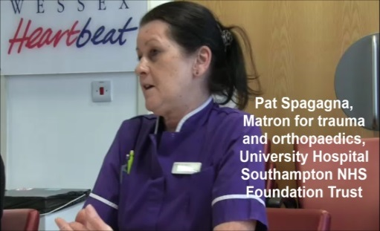
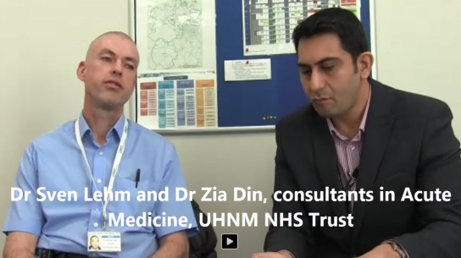

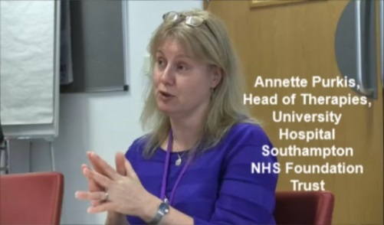
Spreading the Word
Video and written case studies of staff already implementing seven-day hospital services
https://improvement.nhs.uk/resources/seven-day-services/
Notes:
NHS Improvement is sharing good practice, case studies in written and video format via our Improvement Hub. We have created a comprehensive yet simple animation explaining what seven day services means for staff and patients and will continue to build this resource as the seven day service programme continues.
Visit the improvement at the website on screen for further information.

Slide 52
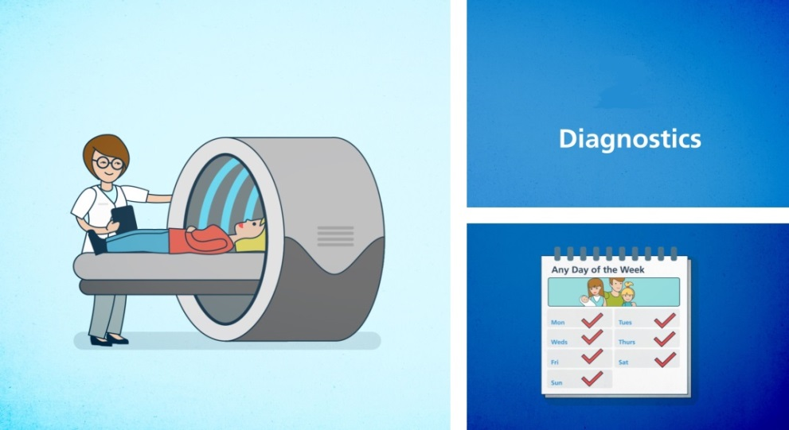

Animated film clarifying the four clinical standards and benefits to staff and patients

Slide 53
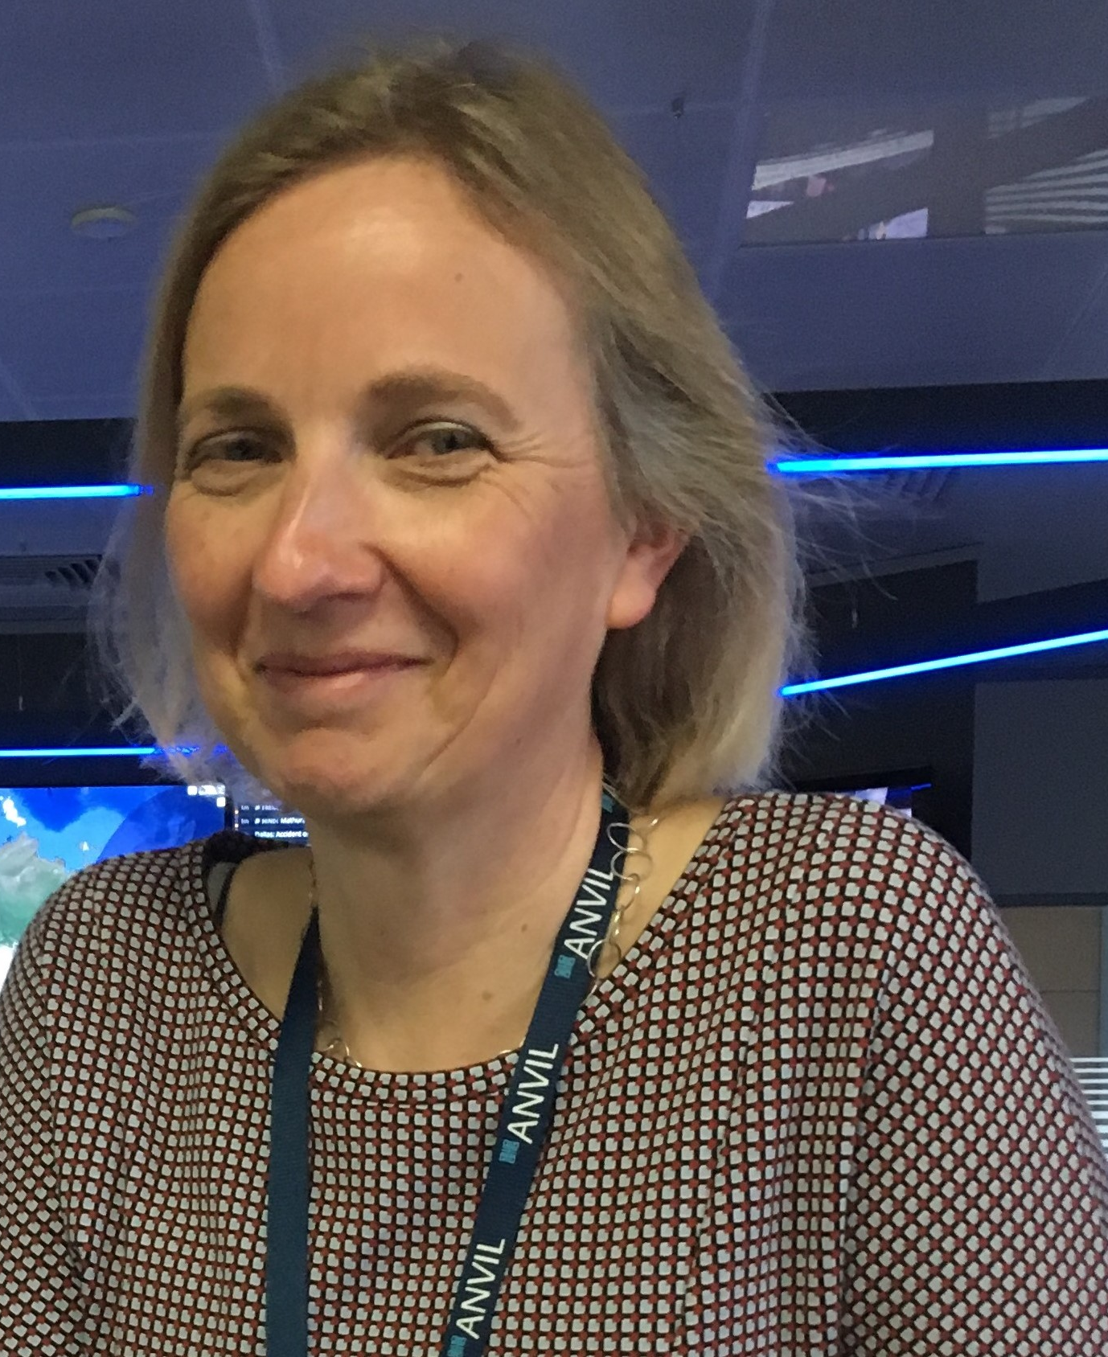
Would I do it again? Absolutely!
Thank you!
Questions! Unmute, use chatbox or email me:
j.kause@nhs.net or jkause@anvilgroup.com
Dr Juliane Kause

