Slide 1
Improving the Mental Health of People Seeking Asylum & Refugees
Renae Mann, Executive Director of Services

Slide 2
Presentation
The importance of our mental health services for people seeking asylum and refugees.
The Refugee Council – championing the rights of refugees.
Current key issues in mental health for people seeking asylum and refugees.

Slide 3
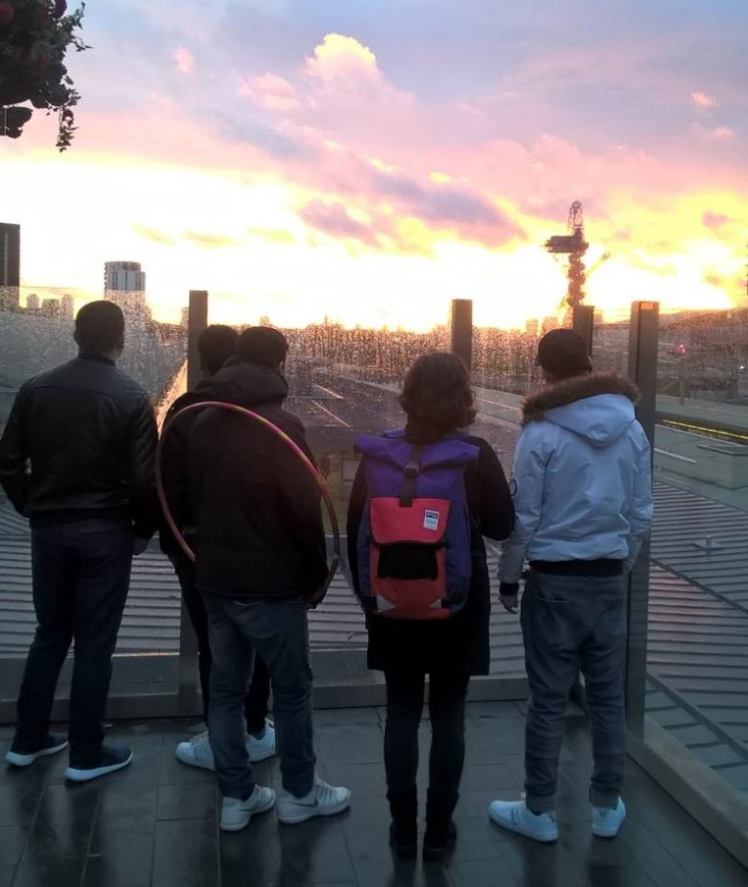
Refugee Protection – Legal Framework
Refugee is a person who “owing to well-founded fear of being persecuted for reasons of race, religion, nationality, membership of a particular social group or political opinion, is outside the country of his nationality and is unable or, owing to such fear, is unwilling to avail himself of the protection of that country; or who, not having a nationality and being outside the country of his former habitual residence as a result of such events, is unable or, owing to such fear, is unwilling to return to it.” Article 2 UN Convention Relating to the Status of Refugees
“Everyone has the right to seek and enjoy in other countries asylum from persecution.” Article 14, Universal Declaration of Human Rights 1948.
“Refugees have the right not to be punished for illegal entry into the territory of a contracting state.” Article 31, UN Convention Relating to the Status of Refugees
(The need for trauma-informed refugee reception services)

Slide 4
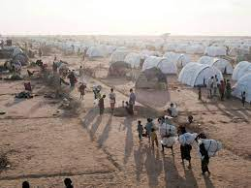
A perilous journey in search of protection

Slide 5
Multiple & Competing Stressors

Slide 6
Dehumanisation

Slide 7
The refugee experience and health impacts
“The first goal of trauma recovery should and must be to improve your quality of life on a daily basis” Herman 1994

Slide 8
Therapeutic Care Model: Trauma Informed Practice
Key strands:
Establishing safety
Trustworthiness and transparency
Peer support
Collaboration and mutuality
Agency, voice and choice
Respect and acknowledge

Slide 9
Where we operate
Remote
Dedicated My View therapist supporting children in locations across England where RC don’t have a presence – online/telephone
Sheffield/South Yorks
New Roots
Multiple projects in one location
Children and Family Wellbeing
Adults seeking asylum
Lancs
Leeds
My View – Separated Children
Hertfordshire
Sheffield
Herts Valleys
East and North Herts
Birmingham
New Roots– AMIF adults with status
Birmingham Regional Refugee Care
Essex
WW4RI – AMIF separated children and adults with status
My View
Peterborough
North East Essex
West Essex
Birmingham
Cambridge
Children and Family Wellbeing Project – resettled families
Luton
Stevenage
Harlow
Colchester
London
London
Kent
London Therapeutic (Men and Women)
Destitution
East Sussex
New Roots
My View

Slide 10
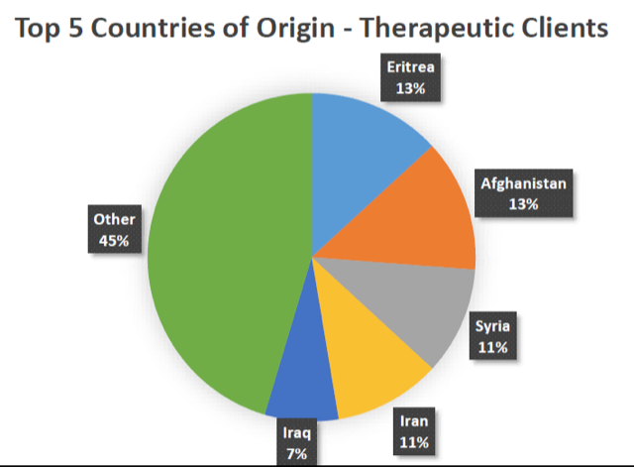
Our clients

Slide 11
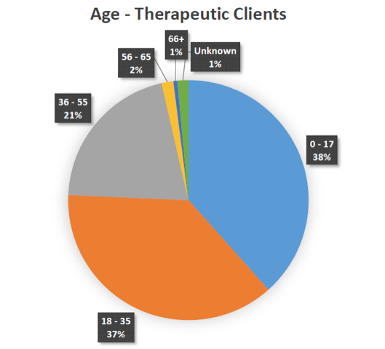
Our clients

Slide 12
Improving Health & Integration
In 2020/21 Therapeutic Services supported 950 named clients.
Outcomes were recorded for 325 of these clients, using clinically validated Clinical Outcomes in Routine Evaluation (CORE) outcome measures (CORE-10 for adults and young people CORE for children and young people).
RC Outcomes (derived from CORE)
90% Improved physical and mental wellbeing
81% Improved safety
80% Improved social inclusion
71% Improved ability to make informed choices

Slide 13
Context, Choice & Voice

Slide 14
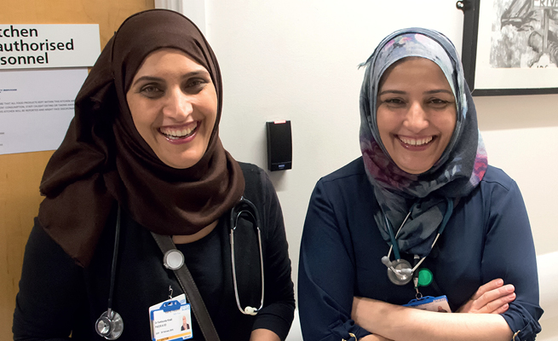
Contributors in our Society Crucial role since March 2020 Covid-19 Crisis
35 refugee doctors supported to gain their licence & joined the NHS.
9 requalifying doctors joined London NHS Trusts as NHS Medical Support Workers to reduce workforce pressure.
Refugee health professionals vaccination centre vaccinators or volunteers.
50 London based refugee doctors re-qualified, accessed employment & re-started their medical career.

Slide 15
Challenges Accessing Mental Health Services
Health access: interpreters, digital exclusion, voice/choice
Disjointed Experiences: NHS criteria & referral pathways
Clients voice/choice
Digital exclusion and lack of information
Covid-19 safeguarding alerts
Adversarial asylum system, chronic exclusion & poverty

Slide 16
Opportunities to Improve Access & Inclusion
Improve coordination with Home Office, Department of Health, local health trusts.
Increase CCG/LA investment.
Sector collaboration to strengthen voice & practice.
Increase employment pathways for refugee doctors/health practitioners.
Improve transcultural health competencies in the system.

Slide 17
Let’s continue the dialogue
For more information:
Our website: https://www.refugeecouncil.org.uk/our-work/mental-health-support-for-refugees-and-asylum-seekers/
Contact us:
Renae Mann Renae.Mann@refugeecouncil.org.uk
Angelina Jalonen, Head of Therapeutic Services, Angelina.Jalonen@refugeecouncil.org.uk

