Slide 1
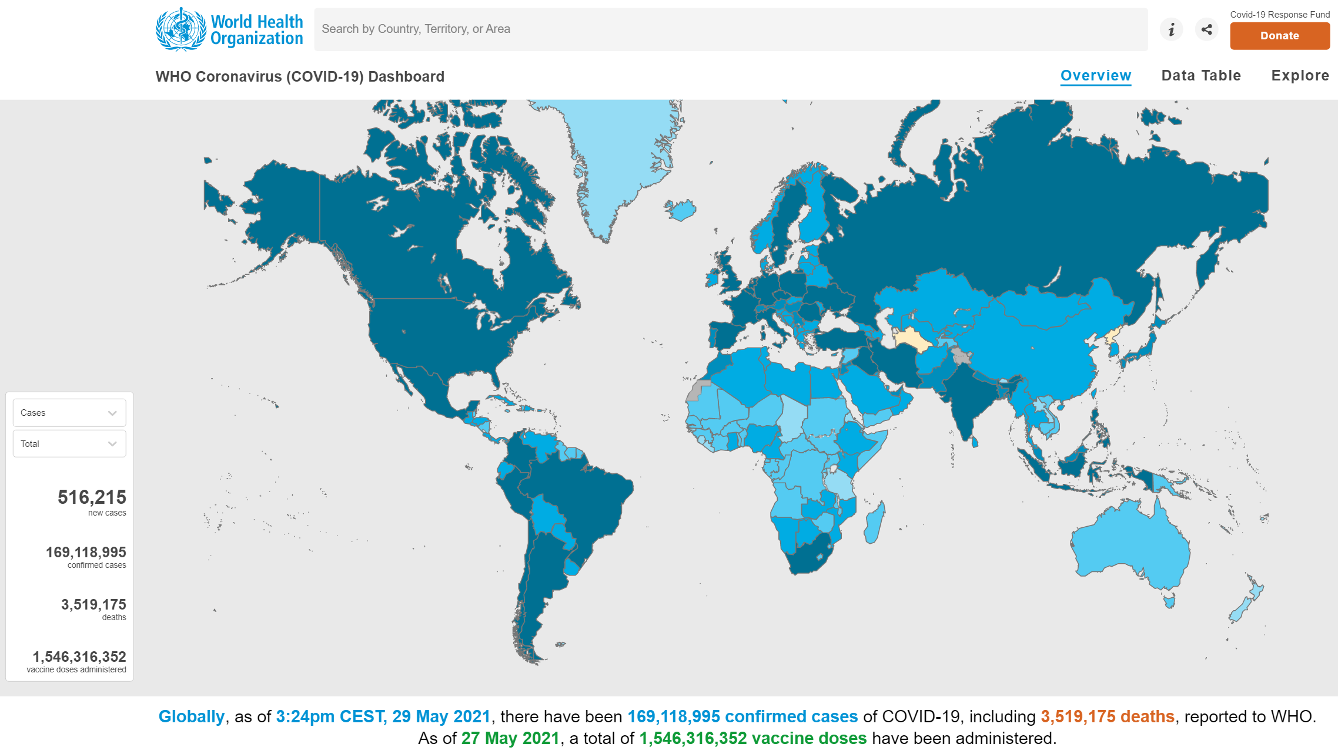
COVID-19 and its impact on surgery Outlook for day case major knee surgery
By:
Justin Kua
NIAA HSRC Clinical Research Fellow
MPhil/PhD Student at UCL

Slide 2
Conflicts of interest
None to declare.

Slide 3
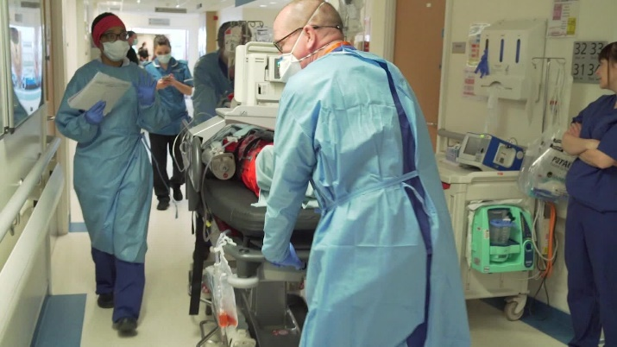
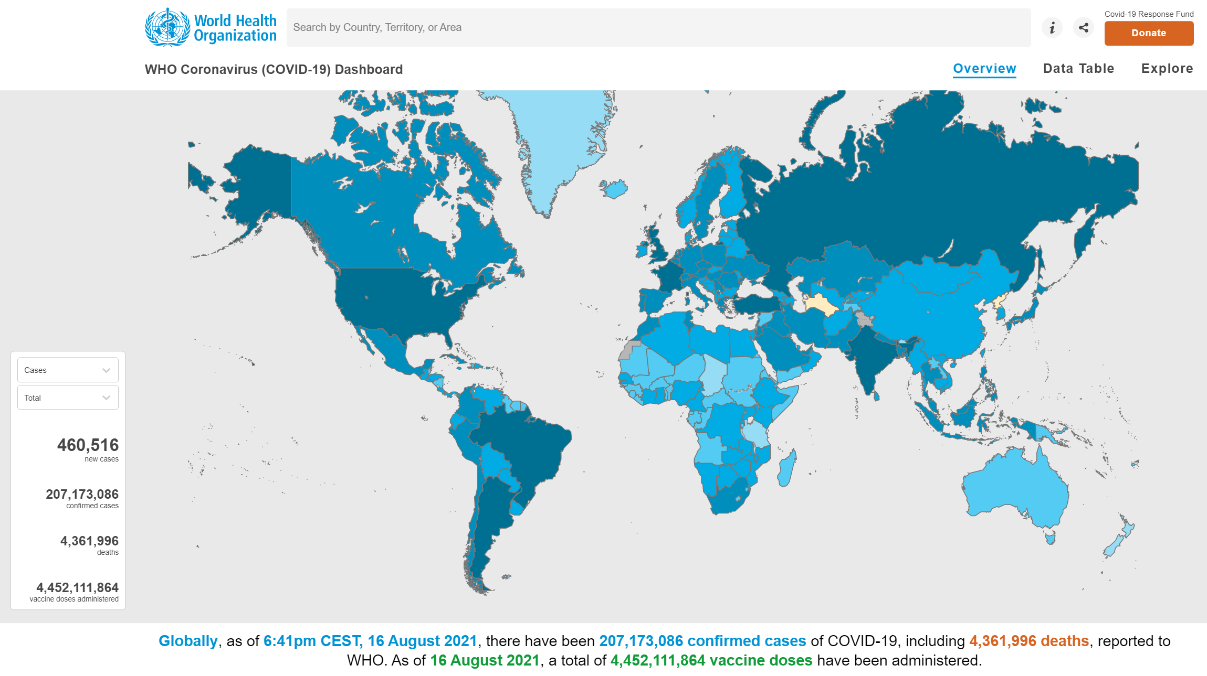
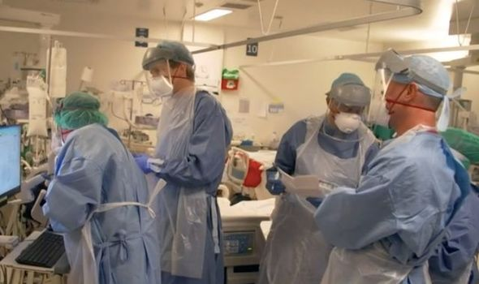

Slide 4
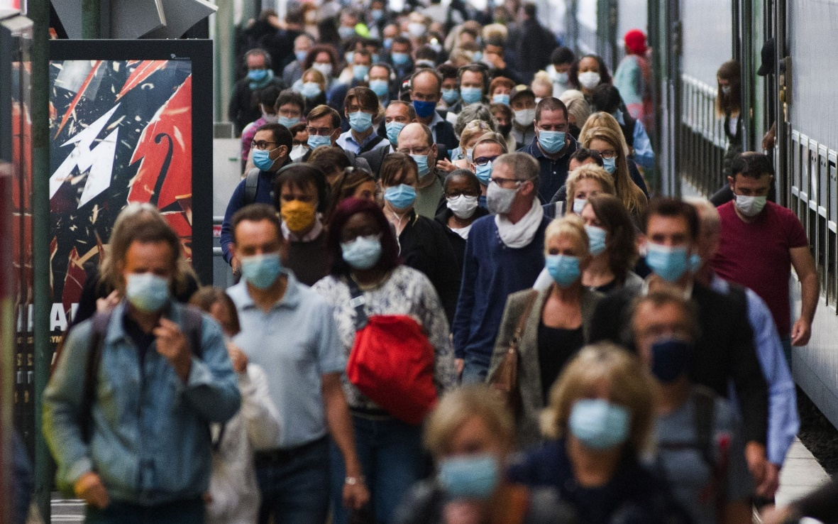

Slide 5
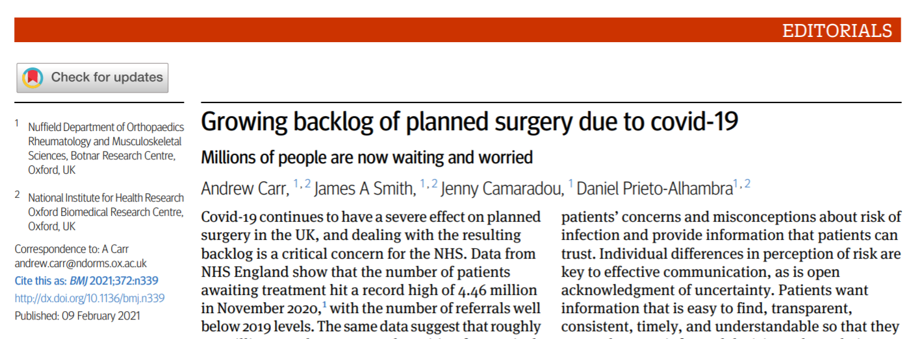
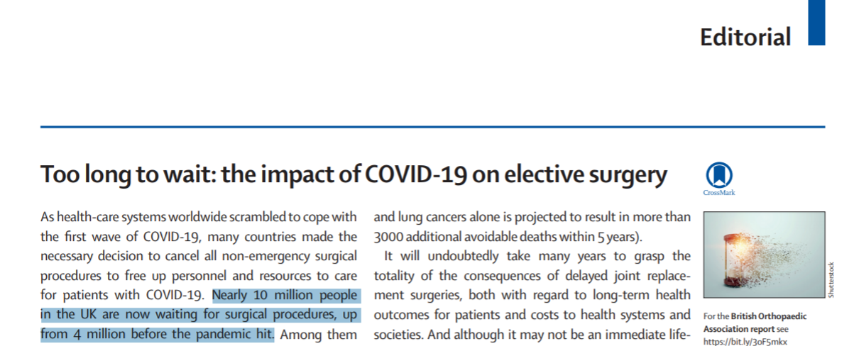

Slide 6
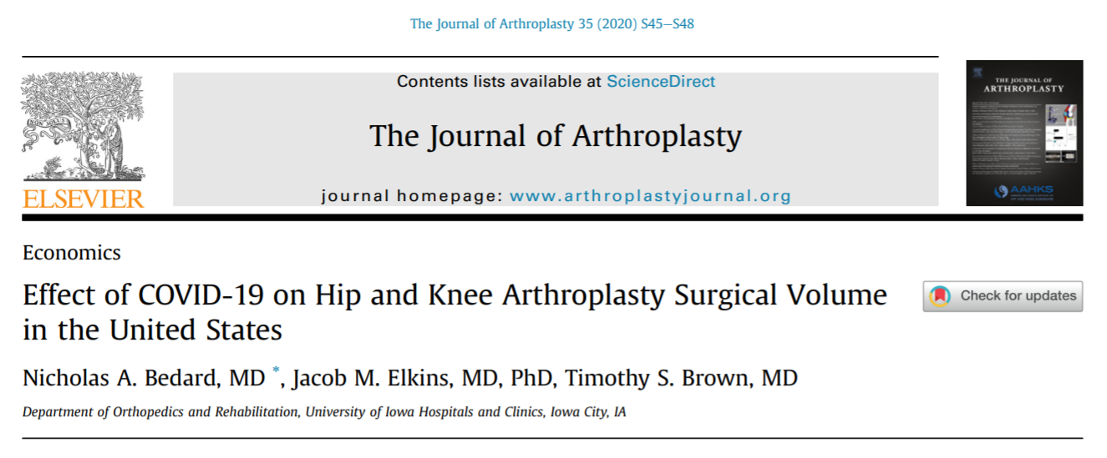
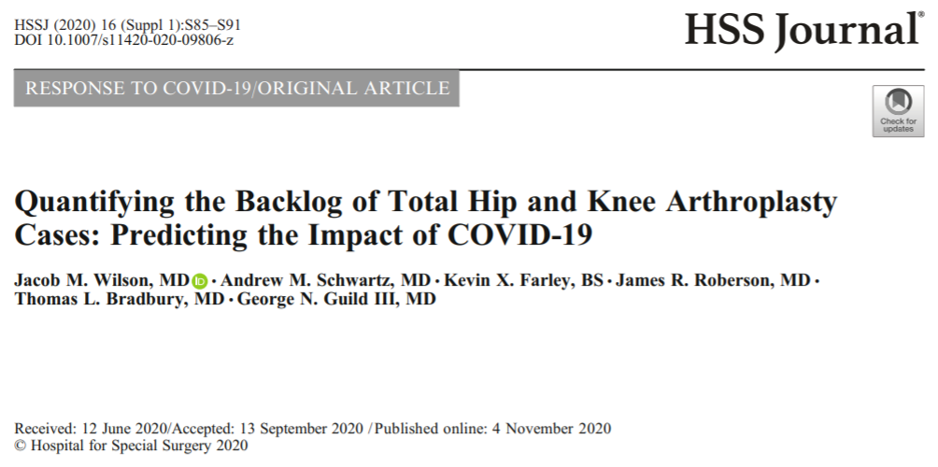

Slide 7
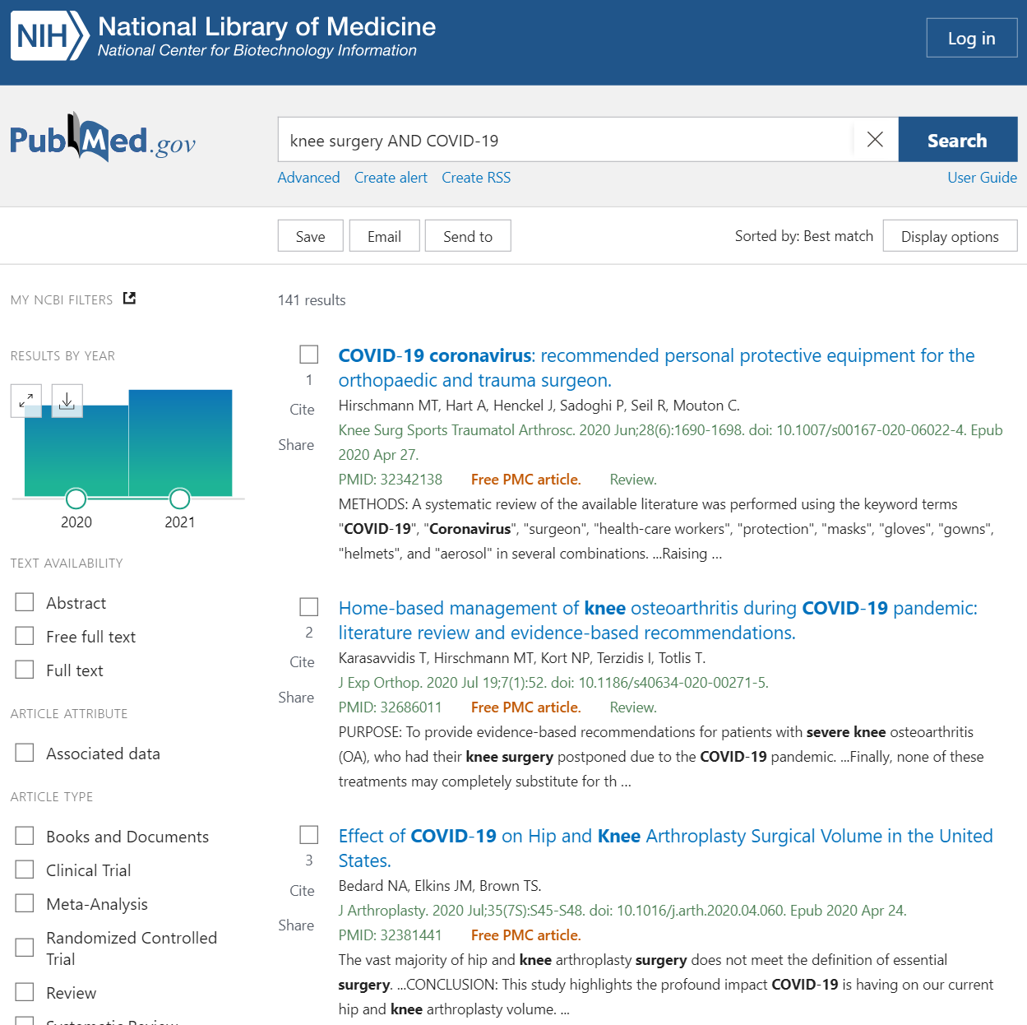

Slide 8
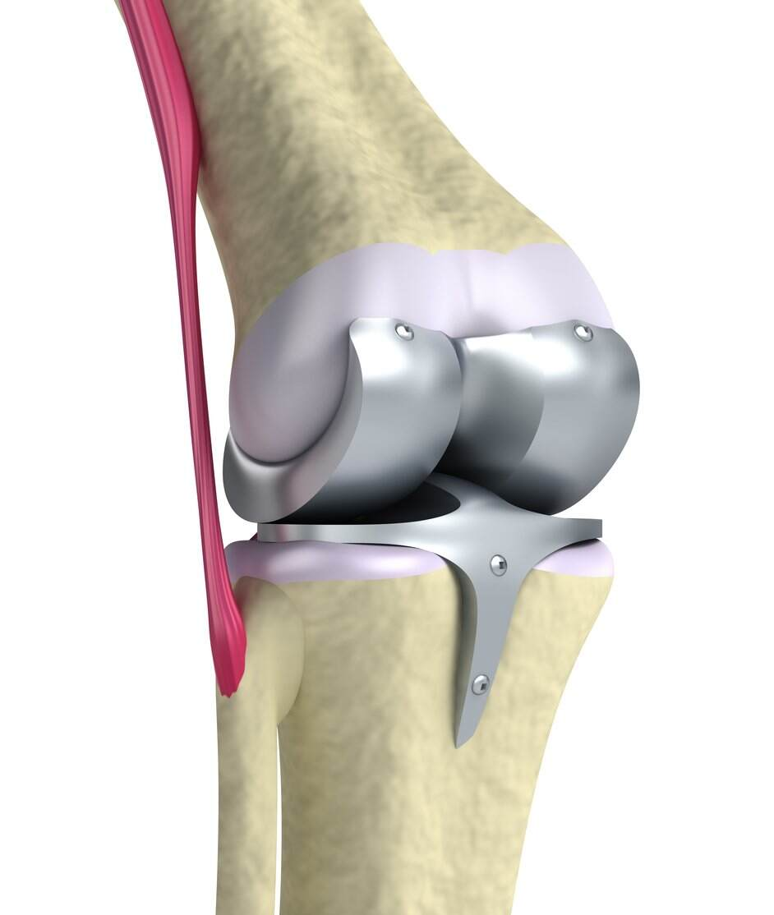

Slide 9
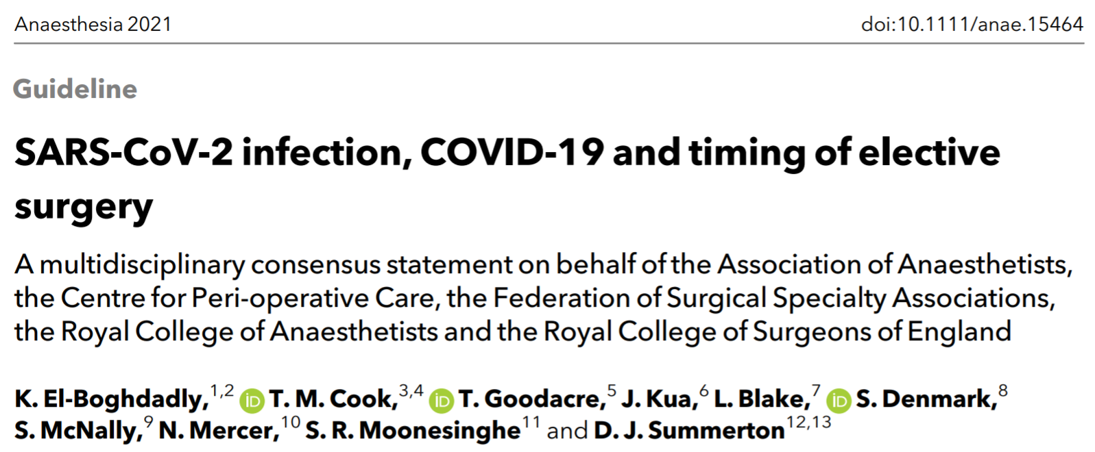

Slide 10
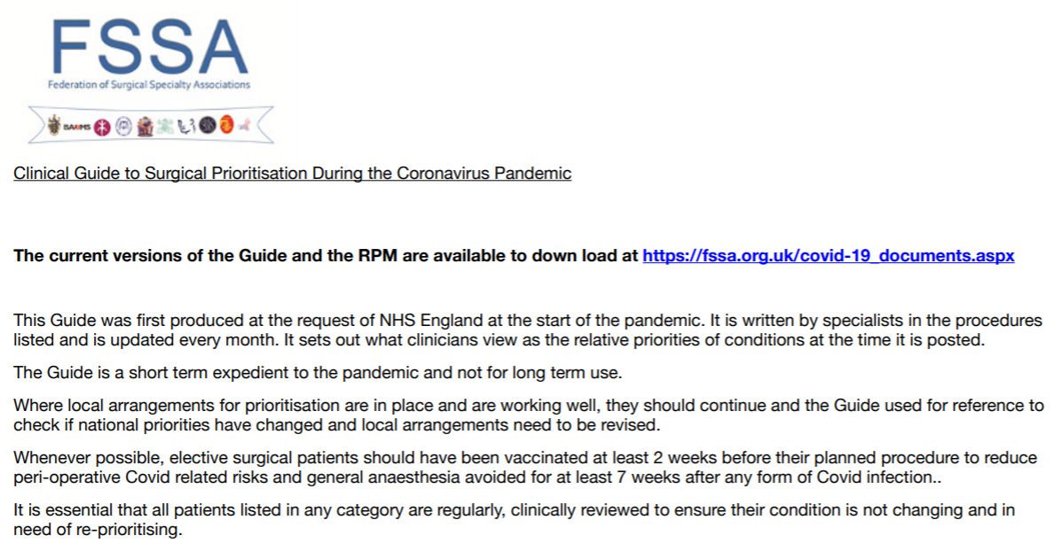

Slide 11
‘New Normal’
‘Acute COVID-19’
‘Post-COVID-19’

Slide 12
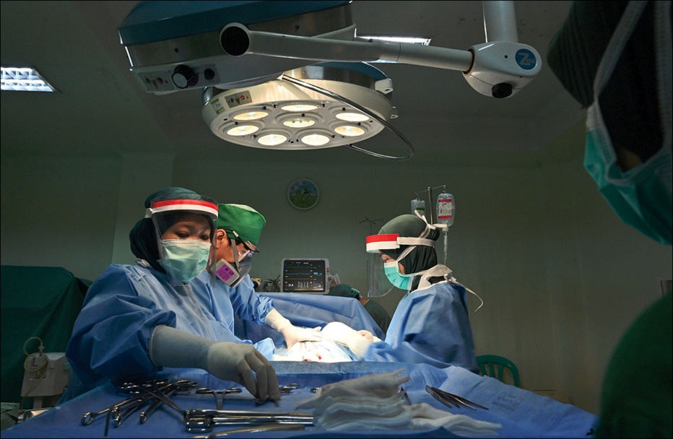
‘New Normal’
COVID-free
Vaccinated x1/x2
LOWEST risk

Slide 13
‘New Normal’
COVID-free
Vaccinated x1/x2
LOWEST risk

Slide 14
‘New Normal’
COVID-free
Vaccinated x1/x2
LOWEST risk
‘Acute COVID-19’
‘Post-COVID-19’

Slide 15
‘Acute COVID-19’
Positive for SARS-CoV-2 via RT-PCR or antigen testing
+/- Symptoms
HIGHEST risk

Slide 16
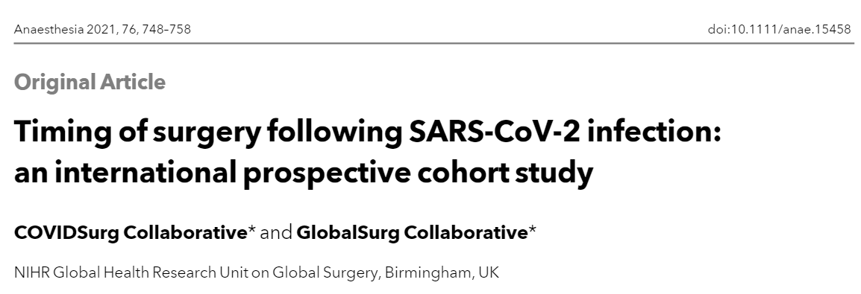
COVIDSurg Collaborative & GlobalSurg Collaborative, 2021

Slide 17
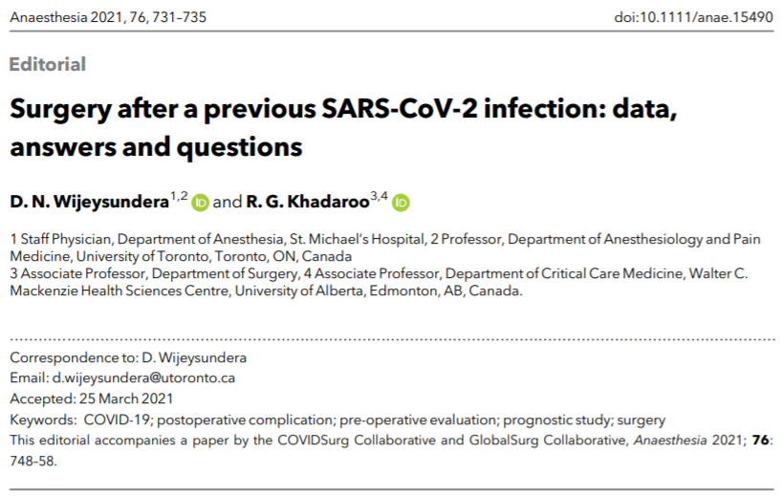
Wijeysundera & Khadaroo, 2021

Slide 18
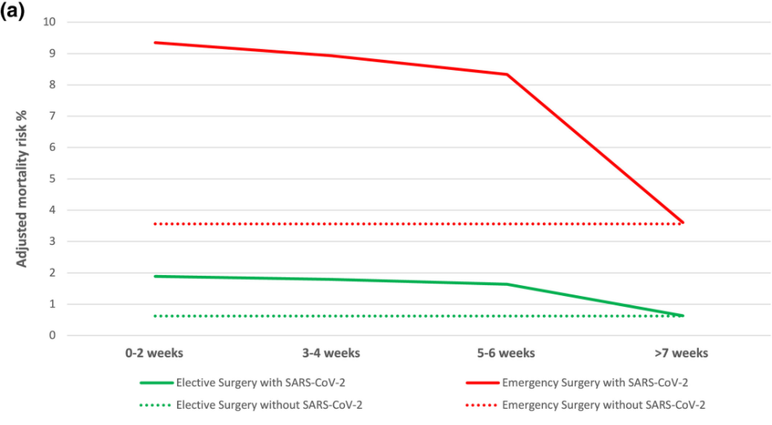
Wijeysundera & Khadaroo, 2021

Slide 19
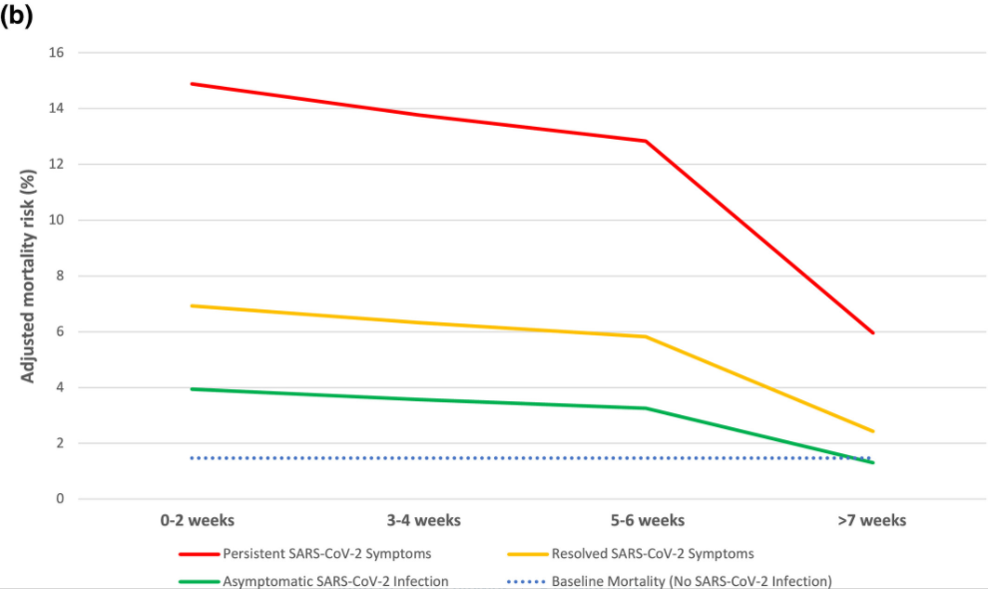
Persistent Symptoms
Resolved Symptoms
No Symptoms
Wijeysundera & Khadaroo, 2021

Slide 20
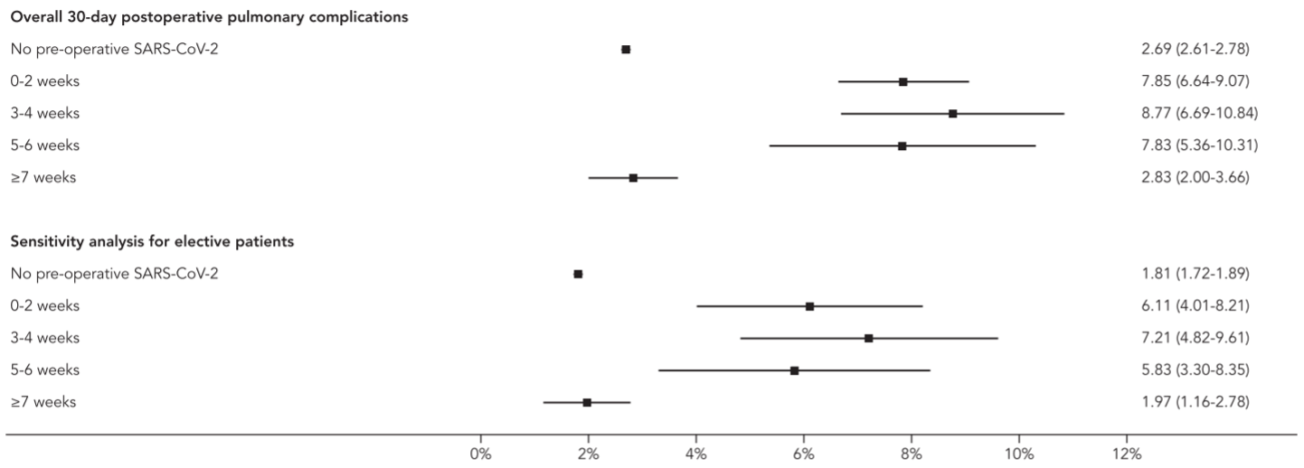
COVIDSurg Collaborative & GlobalSurg Collaborative, 2021

Slide 21
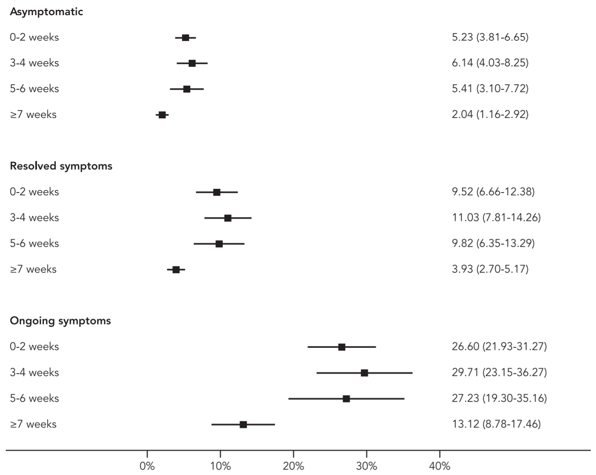
COVIDSurg Collaborative & GlobalSurg Collaborative, 2021

Slide 22
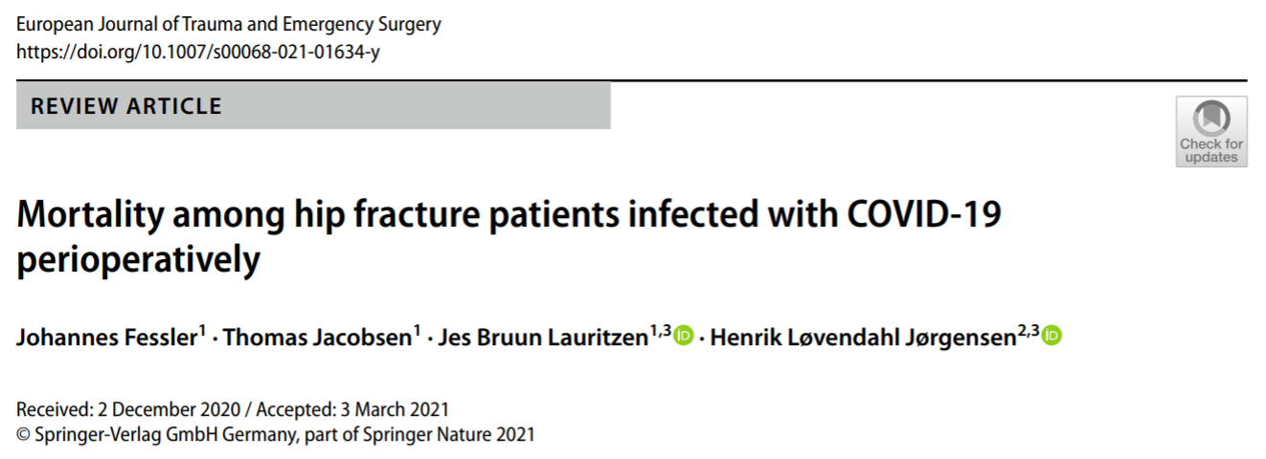
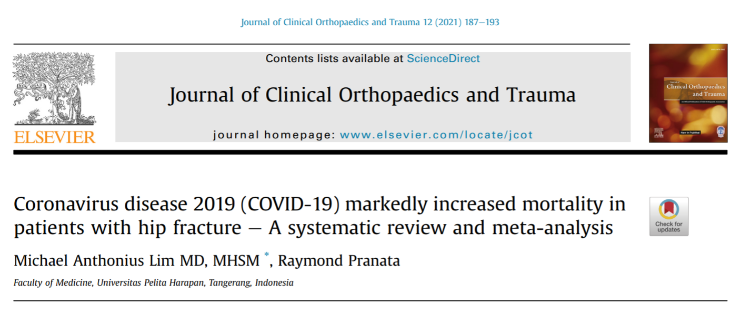

Slide 23
‘Acute COVID-19’
Positive for SARS-CoV-2 via RT-PCR or antigen testing
+/- Symptoms
HIGHEST risk

Slide 24
Recommendation 2:
Planned surgery should not be considered during the period that a patient may be infectious:
10 days after mild/moderate disease
15 – 20 days after severe disease

Slide 25
‘Acute COVID-19’
Positive for SARS-CoV-2 via RT-PCR or antigen testing
+/- Symptoms
HIGHEST risk

Slide 26
‘New Normal’
COVID-free
Vaccinated x1/x2
LOWEST risk
‘Acute COVID-19’
Positive for SARS-CoV-2 via RT-PCR or antigen testing
+/- Symptoms
HIGHEST risk
‘Post-COVID-19’

Slide 27
‘New Normal’
COVID-free
Vaccinated x1/x2
LOWEST risk
‘Post-COVID-19’
Previous COVID-19 infection
INTERMEDIATE risk

Slide 28
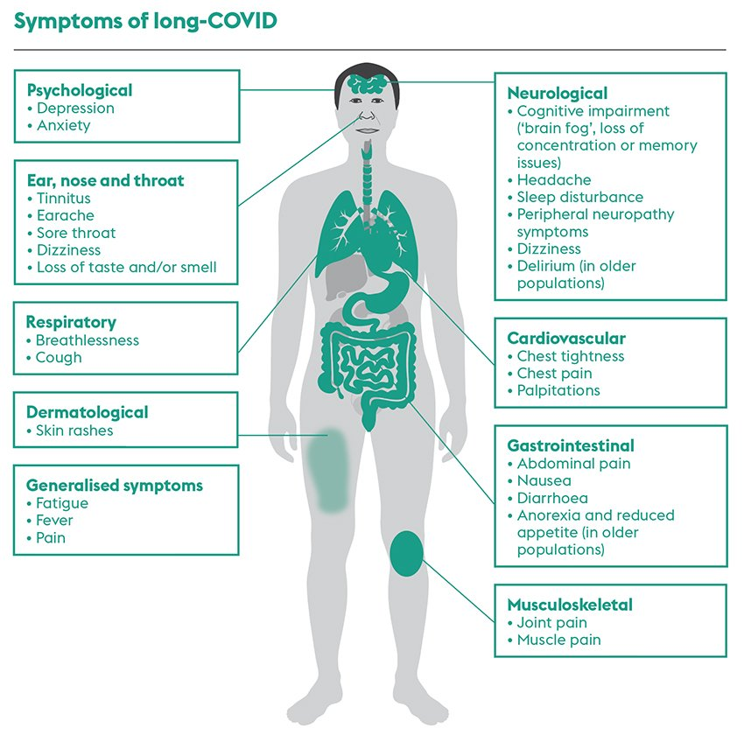
Evans, 2021

Slide 29
COVIDSurg Collaborative & GlobalSurg Collaborative, 2021

Slide 30
Wijeysundera & Khadaroo, 2021

Slide 31
Persistent Symptoms
Resolved Symptoms
No Symptoms
Wijeysundera & Khadaroo, 2021

Slide 32
COVIDSurg Collaborative & GlobalSurg Collaborative, 2021

Slide 33
Recommendation 3:
Surgery within 7 weeks of SARS-CoV-2 infection is
associated with increased morbidity and mortality.
Elective surgery should not be scheduled within
7 weeks of a diagnosis of SARS-CoV-2 infection, unless outweighed by the risk of deferring surgery such as disease progression or clinical priority.

Slide 35
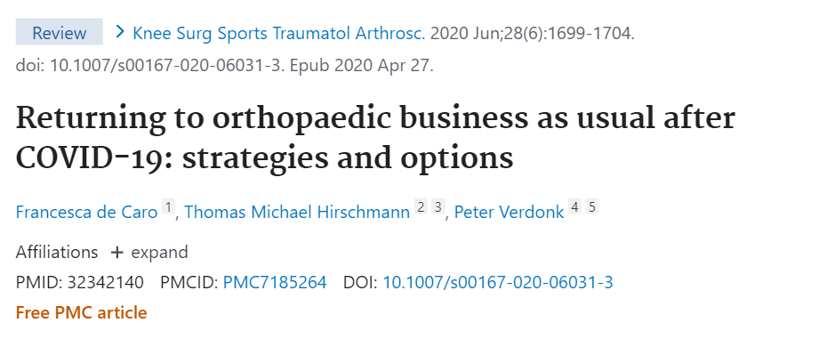
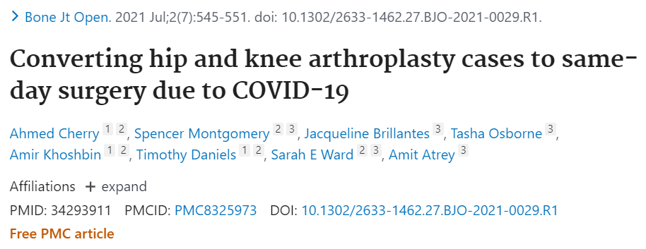

Slide 36
‘New Normal’
COVID-free
Vaccinated x1/x2
LOWEST risk
‘Post-COVID-19’
Previous COVID-19 infection
INTERMEDIATE risk

Slide 37
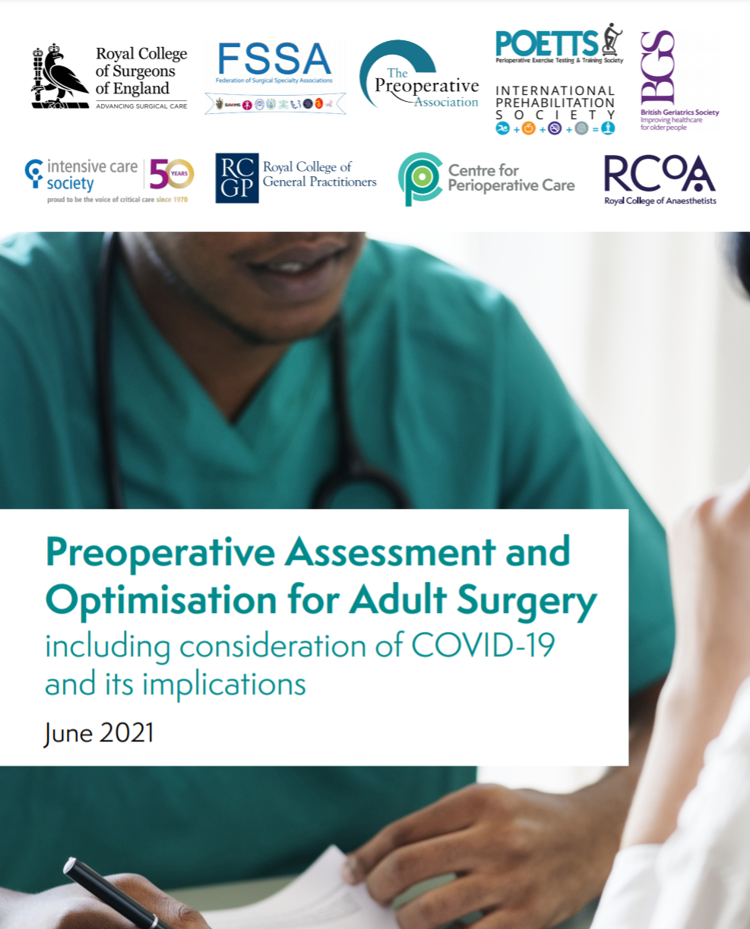

Slide 40
‘New Normal’
COVID-free
Vaccinated x1/x2
LOWEST risk
‘Acute COVID-19’
Positive for SARS-CoV-2 via RT-PCR or antigen testing
+/- Symptoms
HIGHEST risk
‘Post-COVID-19’
Previous COVID-19 infection
+/- Symptoms
INTERMEDIATE risk

Slide 41
The End
Thank you for your time!

Slide 42
References
COVIDSurg Collaborative. Delaying surgery for patients with a previous SARS-CoV-2 infection. Br J Surg. 2020 Nov;107(12):e601-e602. doi: 10.1002/bjs.12050.
COVIDSurg Collaborative, GlobalSurg Collaborative. Timing of surgery following SARS-CoV-2 infection: an international prospective cohort study. Anaesthesia. 2021 Jun;76(6):748-758. doi: 10.1111/anae.15458.
K El-Boghdadly, T M Cook, T Goodacre, J Kua, L Blake, S Denmark, S McNally, N Mercer, S R Moonesinghe, D J Summerton. SARS-CoV-2 infection, COVID-19 and timing of elective surgery: A multidisciplinary consensus statement on behalf of the Association of Anaesthetists, the Centre for Peri-operative Care, the Federation of Surgical Specialty Associations, the Royal College. Anaesthesia. 2021 Mar 18. doi: 10.1111/anae.15464.
Evans N. Long-COVID: the range of symptoms and how to help your patients. Nursing Standard. 2021. Available from: https://rcni.com/nursing-standard/newsroom/analysis/long-covid-range-of-symptoms-and-how-to-help-your-patients-172666 (accessed 15/08/2021)
Federation of Surgical Specialty Associations. Clinical guide to surgical prioritisation during the coronavirus pandemic. 2020. Available from: https://fssa.org.uk/_userfiles/pages/files/covid19/prioritisation_master_240720.pdf (accessed 15/08/2021).
DN Wijeysundera, RG Khadaroo. Surgery after a previous SARS-CoV-2 infection: data, answers and questions. Anaesthesia. 2021 Jun;76(6):731-735. doi: 10.1111/anae.15490.

