Slide 1
The patient pathway for day surgery
Dr Mary Stocker
Past-President British Association Day Surgery
Consultant Anaesthetist, Torbay

Slide 2
To be Covered
Day Surgery Pathway
Patient selection
Procedures
Measuring outcomes

Slide 3
What is Day Surgery?
Planned procedure
Intended management of day surgery
Patient admitted/operated upon/discharged on same calendar day

Slide 4
What is Day Surgery?
Planned procedure
Intended management of day surgery
Patient admitted/operated upon/discharged on same calendar day
Emergencies?

Slide 5
What is Day Surgery?
Planned procedure
Intended management of day surgery
Patient admitted/operated upon/discharged on same calendar day
If they are not planned as a day case they do not count as a day case

Slide 6
What is Day Surgery?
Planned procedure
Intended management of day surgery
Patient admitted/operated upon/discharged on same calendar day
This is NOT 23 hr stay!

Slide 7
Day Surgery Pathways
GP referral for procedure
Surgical OPA
Patient Selection
Booking
Pre op assessment
Admission
Surgery
Discharge
Recovery at home

Slide 8
Day Surgery Pathways
GP referral for procedure
Surgical OPA
Patient Selection
Booking
Pre op assessment
Admission
Surgery
Discharge
Recovery at home
All undertaken by dedicated day surgery team

Slide 9
Day Surgery Pathways
GP referral for procedure
Surgical OPA
Patient Selection
Pre op assessment
Admission
Surgery
Discharge
Recovery at home

Slide 10
GP Referral
Do our primary care colleagues know which procedures?
Do they know which patients are appropriate?
Do they ensure patients are “fit to refer”?
Do they start the day surgery message
Do we communicate well enough?

Slide 11
Day Surgery Pathways
GP referral for procedure
Surgical OPA
Patient Selection
Booking
Pre op assessment
Admission
Surgery
Discharge
Recovery at home

Slide 12
Surgical OPC
Do our surgical colleagues know which procedures?
Do they know which patients are appropriate?
Do they ensure patients are “fit to list”?
Do they start the day surgery message

Slide 13
Surgical OPA
Surgeon confirms day case management intention
  Default suitable procedures to day case intention
  Remember if not fit for day surgery probably not fit for elective surgery
  Communicate about stopping medications

Slide 14
Surgical Criteria
Which Procedures?

Slide 15

Audit Commission Basket of Procedures 2001
Cataract Extraction
Excision Breast Lump
Carpal Tunnel Decompression
Bat Ears
R/O Metalwork
Bunion Operations
Laparoscopy
Tonsillectomy
TURBT
Squint Correction
Orchidopexy
Anal Fissure
D&C / Hysteroscopy
Nasal Fractures
Myringotomy
Laparoscopic Cholecystectomy
Excision of Ganglion
Hernia Repair
Varicose Veins
Dupuytren’s Contracture
Haemorrhoidectomy
Circumcision
Arthroscopy
SMR
Termination of pregnancy
Notes:
15

Slide 16
Surgical Criteria
Can the patient be reasonably expected to manage oral nutrition post-operatively?
Can the pain of the procedure be managed by simple oral analgesia supplemented by regional anaesthetic techniques?

Slide 17
Surgical Criteria - 2
Is there a low risk of significant immediate post operative complications (eg catastrophic bleeding)?
Is the patient expected to mobilise with aid post-operatively?

Slide 18
Surgical Criteria - 3
Evaluate existing inpatient procedures with short(ish) LOS
What would you need to change to enable them to be day surgery?

Slide 19
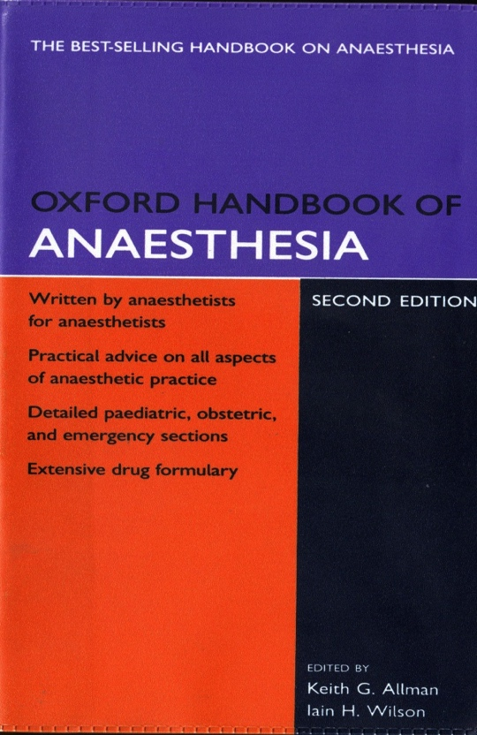
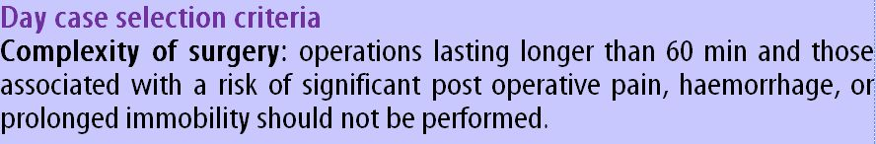
Long Operating Times?
Notes:
In the then current Oxford Handbook of Anaesthesia... ( I would hope the author of the day surgery chapter in the new edition has updated it... [Jackson!])

Slide 20
Long Operating Times
 | Admissions | Total | %
Ops < 60 min | 191 | 9553 | 2.00%
Ops > 60 min | 27 | 1116 | 2.42%
}χ²
p = 0.36
Skues MA, J One Day Surgery, 2011

Slide 21
Miller’s Anaesthesia 7th Edition 2010
‘The duration of surgery in the ambulatory setting was originally limited to procedures lasting less than 90 minutes...
... However, surgical procedures lasting 3 to 4 hours are now routinely performed on an ambulatory basis.’

Slide 22
Nearly ALL surgery should be
day or very short stay
lap nephrectomy
prostatectomy
lap hysterectomy
vaginal hysterectomy
thyroidectomy
mastectomy
shoulder surgery
anterior cruciate ligament
lumbar discectomy
abdominoplasty
some emergencies
Notes:
The DH vision for the CITECs

Slide 23
What next?
Craniotomy
Caesarean Section
Joint Replacements
Carotid Endarterectomy
Endovascular Aneurysm Repairs
Emergency Procedures

Slide 24
How far have we come?
Specialty | Procedures in 1990 | Procedures in 2019
Ophthalmology | Cateract Extraction | Vitrectomy
Gynaecology | Hysteroscopy | Hysterectomy
Orthopaedics | Arthroscopy | Uni-chondylar Knee Replacement/THR
Urology | Circumcision | Laparoscopic Nephrectomy
Head and Neck | Tonsillectomy | Thyroidectomy

Slide 25
Day Surgery Pathways
GP referral for procedure
Surgical OPA
Patient Selection
Booking
Pre op assessment
Admission
Surgery
Discharge
Recovery at home

Slide 26
Which Patients?
Are this patient’s risks increased in any way by treatment on a day stay basis?
Would management be different if he/she were admitted as an inpatient?

Slide 27
If the answer is ‘no’
The patient is probably suitable for day surgery

Slide 28
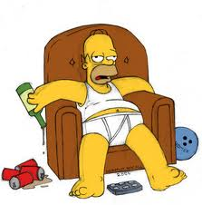
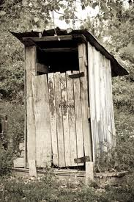
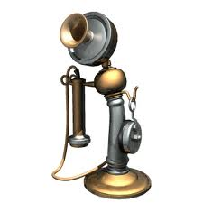
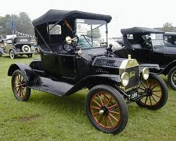
Social Factors
Responsible adult
Maximum 1 hours drive
Adequate housing
conditions
-inside toilet
-telephone access
-heating
-stairs

Slide 29
Patients who live alone
Who can provide this care?
Are all procedures equal – does everyone require a carer?

Slide 30
Possible Solutions
Torbay Model: provide carers into patients homes
Norwich Model: allow some patients home without carers after certain procedures
Escort vs 24 hour Care
Retief J, Morris R, Stocker M. The postoperative carer: A global view and local perspectives. Journal of One Day Surgery. March 2018.

Slide 31
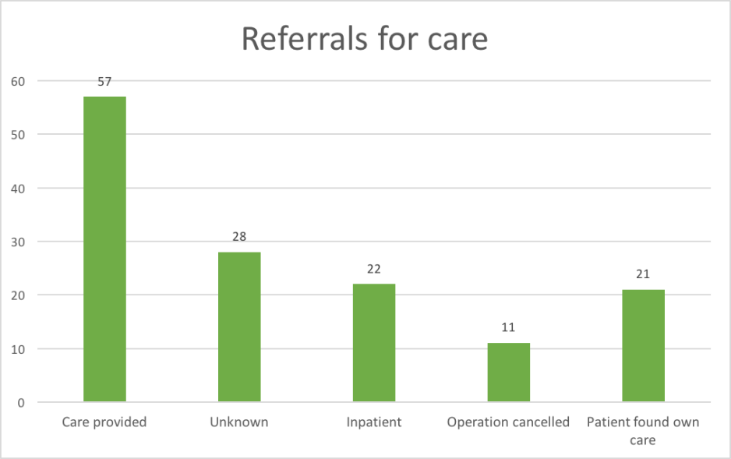
Who can Provide Care?
Torbay Carers

Slide 32
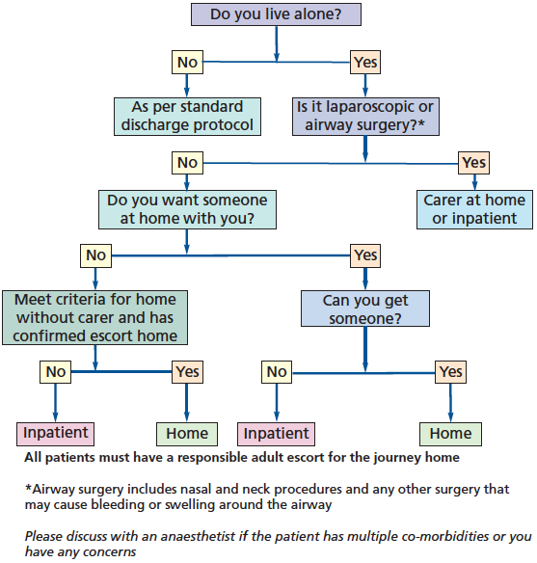
Norwich Home Alone Protocol

Slide 33
Both pathways have now been in place for a number of years
excellent patient satisfaction
no adverse outcomes

Slide 34
Distance from Hospital
Rarely a problem
Even in mid Wales/rural Devon
Remember it is 1 hour from a hospital that can treat the condition not necessarily the operating hospital

Slide 35
Social Factors
The vast majority of patients are socially appropriate for day surgery or can be enabled to be so with proactive management

Slide 36
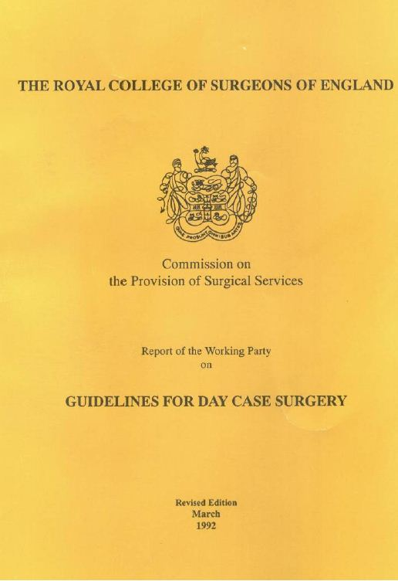

Medical Factors 1980’s
1985 & 1992
Royal College of Surgeons of England
Selection Criteria
Age limit 65-70 years
ASA I & II
BMI<30
Max 60 mins operating time

Slide 37
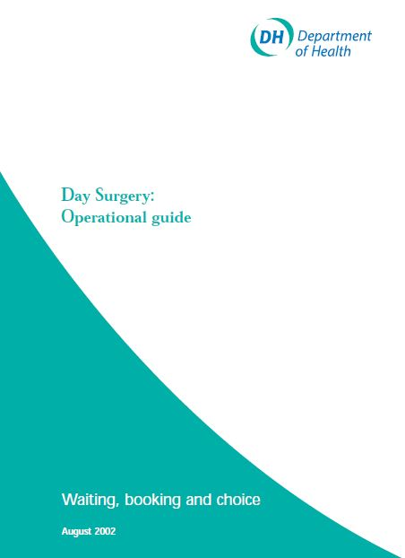
Naughties
2002
Default to Day Surgery
“Patients should only be excluded from day surgery after full pre-operative assessment shows a contraindication”.
Day Surgery:operational guide. DoH, London,2002

Slide 38
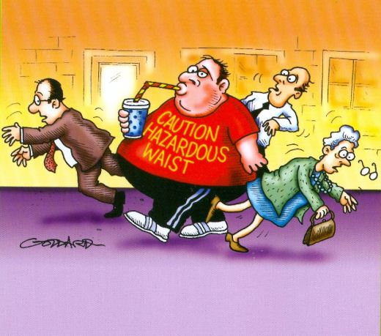
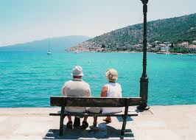
Day Case Criteria
But –
Fatter Population
Older Population
Therefore Expand –
BMI
Age
ASA Status

Slide 39
Patient Selection
 | 1990 | 2019
ASA | 1 and 2 | No limit
Age | 70 | No Limit
BMI | 30 | No limit
IDDM | No | Yes

Slide 40
ASA
Most stable medical conditions can reasonably be managed as a day case
Most patients with unstable medical conditions should not be undergoing elective surgery
Urgent or emergency surgery in these patients may require inpatient stay

Slide 41

AAGBI Guidelines management peri-operative diabetes 2015
“Glycaemic control should be checked at the time of referral for surgery “
HbA1c should be < 69 mmol.mol 1 in the previous three months.
If HbA1c ≥ 69 mmol.mol 1, elective surgery should be delayed while control is improved then proceed with day surgery
Diabetics are usually better at managing their own diabetes than we are!

Slide 42
Elderly
Usually better managed in their own environment

Slide 43
National Audit Office 2019
The average 67 year old admitted to hospital..
5% loss of muscle strength /day
10 days in hospital reduces
  Lung capacity by 12%
  Hip and knee muscle strength by 14%
  life expectancy by 10 years

Slide 44
The Elderly
Admission Rates
% of patients
Sinha et al, 2007

Slide 45
Obesity
“most potential complications of obesity are limited to the intra- and immediate post operative environment and so obese patients can still be managed as a day case”
The Pathway to Success – Management of the Day Surgical Patient.
BADS Publication 2012

Slide 46
Obesity
“even morbidly obese patients can be safely managed in expert hands, with appropriate resources.”
“obese patients benefit from the short duration anaesthetic techniques and early
mobilisation associated with day surgery”
Day case and short stay surgery: 3
Association of Anaesthetists of Great Britain and Ireland
British Association of Day Surgery 2019

Slide 47
Obesity Admission Rates
Davies, Houghton and Montgomery, Anaesthesia 2001

Slide 48
Obesity
Problems occur early (induction/primary recovery)
Everything is more difficult and takes longer
Senior staff required
Additional kit (airway, long instruments, special table etc)

Slide 49
Obesity continued
May not be appropriate for surgery in an isolated site, but can still be day cases through main hospital facilities
Once they are through primary recovery no increased risk of complications from overnight stay
Day surgery arguably reduces risk of DVT/HAI etc

Slide 50
Medical Exclusions
unstable ASA III, ASA IV/V
any poorly controlled abnormality
neonates
ex-prem infants < 60 wks post conceptual age
young sibling of SIDS child

Slide 51
Patient Selection
Is the procedure in the BADs Directory?
Is the patient fit for surgery?
How can we manage them as a day case?

Slide 52
Criteria in 2019
Abandon universal selection criteria
Adopt an inclusion rather than an exclusion philosophy
Apply limitations to the procedure rather than the patient

Slide 53
Day Surgery Pathways
GP referral for procedure
Surgical OPA
Patient Selection
Booking
Pre op assessment
Admission
Surgery
Discharge
Recovery at home

Slide 54
Booking
Booking staff in the DSU
Engage with teams
Attend debrief
Learn together
Dramatic increases in utilisation

Slide 55
Planning the list
“Smart” list order
  Consider recovery times / diabetics first/very young or old
  TKR/UKR/ACL/Scopes

Slide 56
Day Surgery Pathways
GP referral for procedure
Surgical OPA
Patient Selection
Booking
Pre op assessment
Admission
Surgery
Discharge
Recovery at home

Slide 57
Pre operative assessment
Plan appointment at time and place convenient and appropriate for the patient
  Ideally offer a one-stop service immediately after surgical OPC
  Face to face with nurse (occasionally telephone)
  Ideally undertaken by nurses working within the day surgery team
  Anaesthetic review of notes or patient as appropriate

Slide 58
Pre operative assessment
  Patient preparation for day surgery
    Discuss arrangements from admission to discharge home
  Identification of medical concerns and address early
    Medication
    BP/Hb/AF etc
  Optimisation of patient

Slide 59
Day Surgery Pathways
GP referral for procedure
Surgical OPA
Patient Selection
Pre op assessment
Admission
Surgery
Discharge
Recovery at home

Slide 60
Admission
Dedicated day surgery facility best quality environment
Limit fasting and waiting times
  Stagger admission times
  admission area close to theatre
Enable walking to theatre where possible
  Patients and staff prefer it
  Review need for pre-op interventions that prevent walking

Slide 61
Fasting
European Guidelines: 2011
“tea and coffee with milk should be treated as a clear fluid and allowed up to 2 hours pre-operatively”
Perioperative fasting in adults and children: guidelines from
the European Society of Anaesthesiology
Ian Smith, Peter Kranke, Isabelle Murat, Andrew Smith, Geraldine O’Sullivan, Eldar Søreide, Claudia Spies and Bas in’t Veld

Slide 62
Fasting
Association of Paediatric Anaesthetist Guidelines
Children should be allowed free access to water up to 1 hr pre-operatively

Slide 63
Fasting
Free access to water up to time of surgery:
Postoperative nausea and vomiting after unrestricted clear fluids before day surgery
McCracken, Graham C.; Montgomery, Jane
European Journal of Anaesthesiology. 35(5):337-342, May 2018.
Radio 4 Inside Health interview with Mark Porter – Tuesday 26th March

Slide 64
Where?
Dedicated Facilities
for entire pathway if possible
Protected at all cost from inpatient sabotage
Staffed by nurses with day surgery expertise

Slide 65
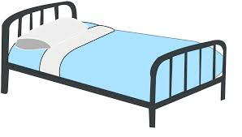
A bed or not a bed?

Slide 66
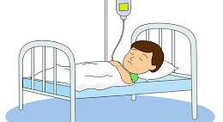
Medical Patients

Slide 67
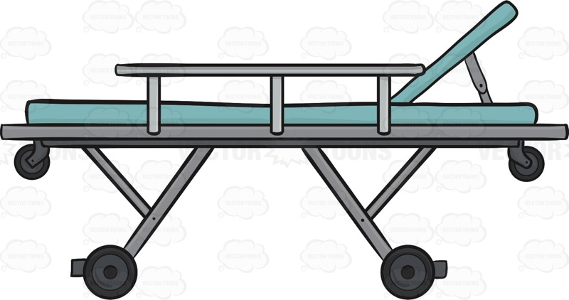
The Solution

Slide 68
Your Day Surgery Unit
Should have…
No Beds
No Showers
Only simple Catering facilities
No capacity to accept an inpatient

Slide 69
Why Dedicated facilities?
National Guidance
The ideal is a self-contained day surgery unit, with its own admission suite, wards, theatre and recovery area, together with administrative facilities. It is also the most cost effective option
Day surgery performed using inpatient wards and inpatient operating theatres is less successful and cannot be recommended. The stay-in rate (unsuccessful discharge of patients home on the day of surgery) rises from 2.4% in a free standing unit to 14% in an inpatient ward

Slide 70
Why Dedicated facilities?
National Guidance
Day surgery should take place within a dedicated unit or area within the main hospital site
All members of the multidisciplinary team should be trained in day surgery practice
Day case beds on wards do not provide the targeted service that is required to achieve good outcomes

Slide 71
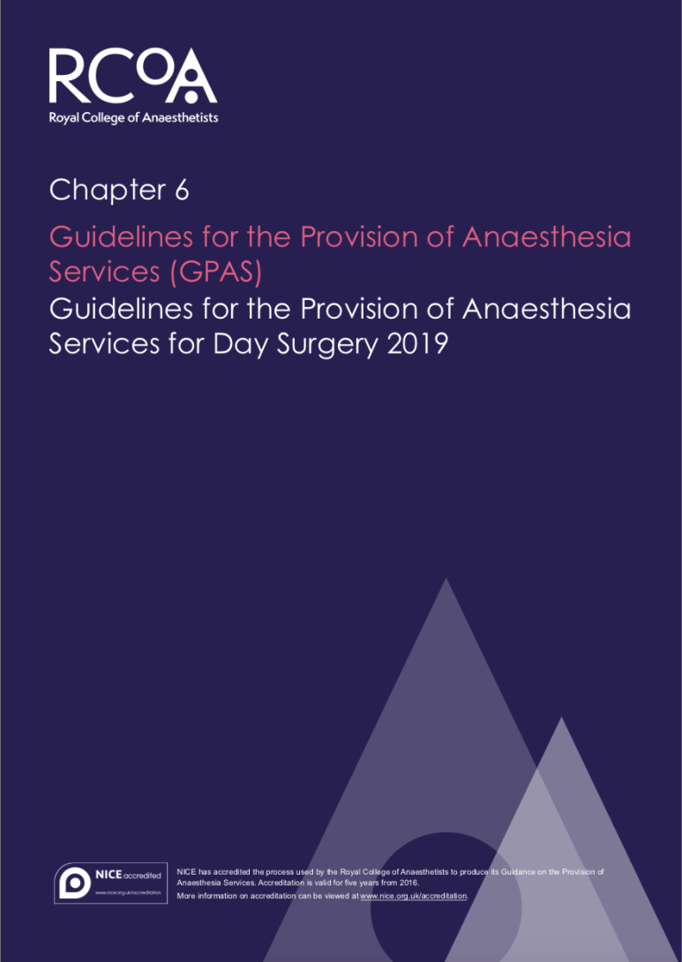
Why Dedicated facilities?
National Guidance
The ideal day surgery facility is a purpose-built, self-contained day surgery unit (DSU), with its own ward, recovery areas and dedicated operating theatre(s)
Dedicated day surgery secondary recovery areas should be provided, which are not part of an inpatient ward area
Day case patients should only be managed through inpatient wards in rare circumstances, as this greatly increases their chance of an unnecessary overnight stay

Slide 72
What do Surgeons Say?
“dedicated day wards and self-contained DSUs separate from the main hospital building led to significant improvements in same day discharges for patients undergoing intended day case surgery"

Slide 73
Royal College of Surgeons
“Integrated day surgery unit should have its own ward in association with the theatres serving it to form a dedicated unit”

Slide 74
Why Dedicated facilities?
Patient experience
Separation from inpatient activity and “mentality” of beds, PJs and “the sick role”
Activity continues even during maximum escalation – fewer cancellations
Everyone else is going home so I will too
Higher chance of successful day surgery discharge
Higher quality outcomes

Slide 75
Why Dedicated Facilities?
Nursing expertise
Nurses not distracted by higher acuity patients
Nurses with expertise in day surgery pathway
Whole team are committed to high quality day surgery outcomes

Slide 76
Why rely on your day surgery patients to drive length of stay reductions in your inpatient population?
There is more risk of inpatient population increasing length of stay of day cases

Slide 77
Surgical Teams Journey
ENT – Airway Emergency
Gynae - TLC
Breast – Breast Care teams
Orthopaedics – Unplanned Admissions
All now acknowledge outcomes improved if managed by DSU team

Slide 78
Day Surgery Pathways
GP referral for procedure
Surgical OPA
Patient Selection
Pre op assessment
Admission
Surgery
Discharge
Recovery at home

Slide 79
Surgery and anaesthesia
Appropriate surgical and anaesthetic technique for rapid recovery
  Remember the most expensive techniques rarely compete with the cost of an overnight stay
Senior staff
Best kit
Any specific discharge criteria specified
Documentation completed in theatre

Slide 80
Recovery
Protocols for pain and PONV with standard management
Pre printed analgesia and anti-emetic prescriptions
Criteria led discharge to second stage

Slide 81
Day Surgery Pathways
GP referral for procedure
Surgical OPA
Patient Selection
Pre op assessment
Admission
Surgery
Discharge
Recovery at home

Slide 82
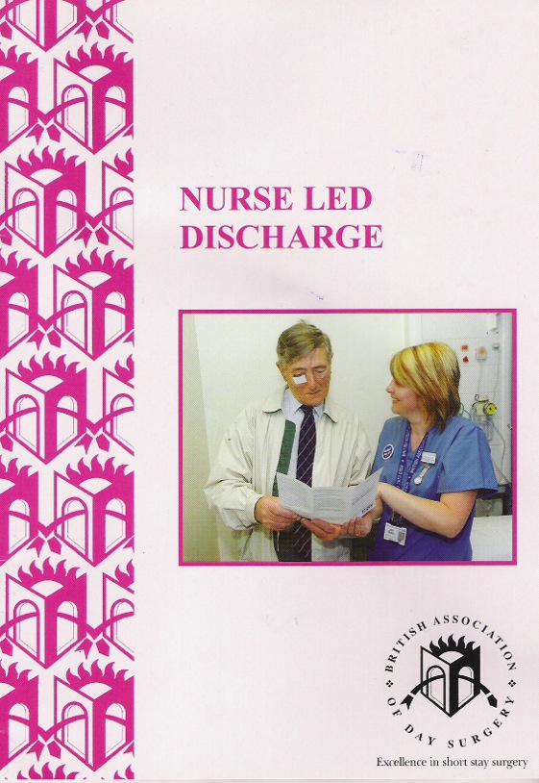
Patient Discharge
Plan from initial referral and at pre op assessment
TTOs, pre-prepared
Nurse led discharge
  Appropriate for any length of stay
  Specify criteria

Slide 83
Day Surgery Pathways
GP referral for procedure
Surgical OPA
Patient Selection
Pre op assessment
Admission
Surgery
Discharge
Recovery at home

Slide 84
Patient support after surgery
Need for transport home and carer afterwards must be explained
Not all patients will need carer for 24 hr
  Depends on surgery and risk of complications
  Patients circumstances
  Availability of support if needed
24 hour access to skilled advice
Notes:
Following most procedures under general anaesthesia, a responsible adult should escort the
patient home and provide support for the first 24 hours after surgery.2 A carer at home may
not be essential if there has been good recovery after brief or non-invasive procedures and
where any post-operative haemorrhage is likely to be obvious and controllable with simple
pressure.37–38

Slide 85
Measuring Outcomes
Day case rates
Unplanned admissions
Postoperative symptoms
Patient satisfaction
hospital IT systems/model hospital etc
Post-op phone calls

Slide 86
Suggested Metrics
Identify key aspects of day surgery pathway
  Are they in place
Identify high volume procedure
  Arthroscopy/Lap Chole/tonsillectomy/hernia
Identify challenging procedure
  THR/hysterectomy/mastectomy/thyroidectomy
Identify emergency procedure
  ORIF Mandible/”Hot” Lap Chole/Ankle ORIF/Ectopic Pregnancy/Torsion

Slide 87
Benchmark
Is ideal day surgery pathway in place
Day Surgery rates for high volume procedure
Day Surgery Rates for Challenging Procedure
Day Surgery Rates for Emergency Procedure
Unplanned admission rates

Slide 88
Analyse “failures”
Identify all patients having the high volume procedure who did not achieve day surgery
What would need to change in the pathway to address this?

Slide 89
Develop new pathways
What changes are needed in your pathway for your challenging procedure to enable it to move to day surgery?
Who are the key players?
How can you implement this?

Slide 90
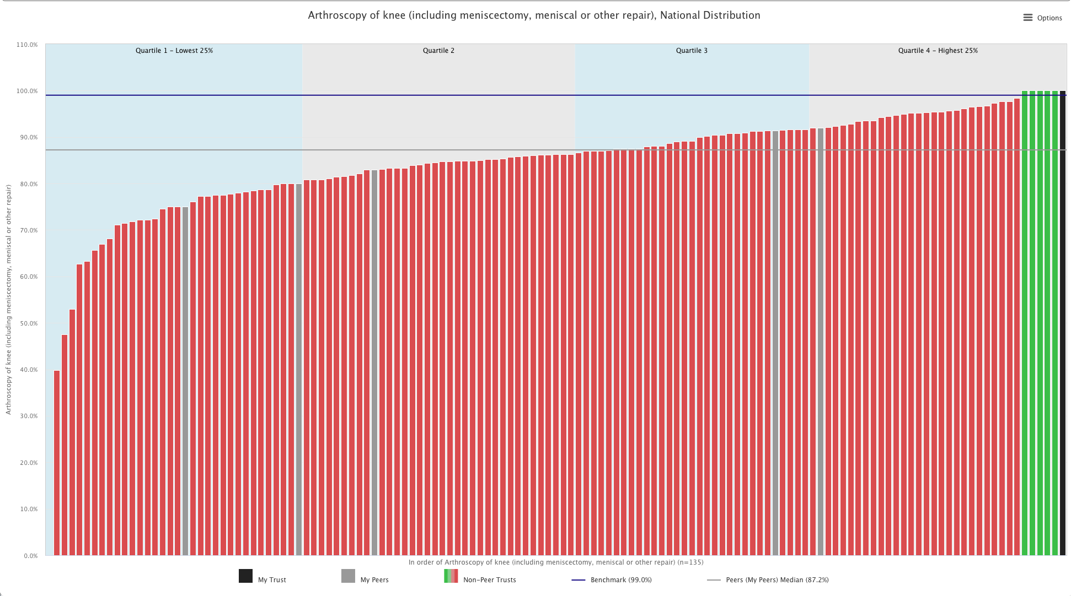
Knee Arthroscopy

Slide 91
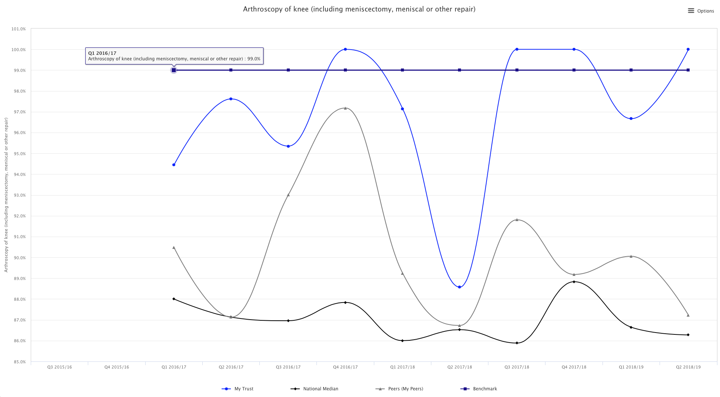
Knee Arthroscopy

Slide 92
Summary of Patient Pathway
Plan pathway at every stage to ensure intended day surgery management
Ensure all appropriate patients are managed as day cases
  Social care rarely an issue
  Medical conditions rarely an issue
  Procedures – embrace the BADS directory
Use dedicated day surgery facilities whenever possible
Evaluate process to ensure high quality
Measure day case rates by procedure against national targets
Monitor day case rates against peers

