Slide 1
Learning from Lived Experience
Sarah Rae
Independent Expert by Experience
November 5th 2021

Slide 2
Safety in Mental Health Settings
Phase 1 project aims (2019 - 20)
To explore the issue of violence and aggression on adult acute care wards and PICU examining quantitative and qualitative incident data
To review current initiatives and approaches towards safety and security, to share learning and to recommend safety improvement interventions
To standardise and improve best practice and make services safer for all who work in and use these services
Phase 1 funded by London MH Transformation Fund
Phase 2 currently by NHS E/I and HEE
Sponsored by the Cavendish Square Group – all of London’s mental health NHS trusts

Slide 3
Safety in Mental Health Settings
Phase 2 (2021-22)
1. Completed a report on service user views on violence and aggression in acute care and PICUs
2. Developed a Trauma Informed Approach position statement
3. Completed a pilot of adoption and implementation of See Think Act Framework (for relational security) with three Trusts and impact assessment report
4. Continuing work with five Trusts on implementing the See Think Act Framework
5. Liaison with national linked programmes, London AHSN patient safety leads, Royal College of Psychiatrists and other safety improvement projects

Slide 4
Service user survey and focus groups - key findings
Importance of improving staff awareness, responsiveness and intervening earlier to service user concerns about personal safety.
The need for staff teams to be more visible and accessible
An improvement in communication and engagement between staff and patients
A shift towards a more collaborative and compassionate culture

Slide 5




PROMISE Programme
PROactive
Management of
Integrated
Services &
Environments

Slide 6


In the Journal of Mental Science for 1862 is reprinted a lecture given in Cambridge by Dr J. Lockhart Robertson on 'The Progress of Psychological Medicine since the Sixteenth Century’.
“In order vividly to see the progress which medical science has made since Dr Caius' time let us look at one of our English county asylums of today. A very good specimen is the Cambridge Asylum at Fulbourn under the able administration of my friend Dr Lawrence.
The first great fact observed is the entire absence of all means of mechanical restraint. Neither belt, strait-jacket, manacle, strong chair, or any other means whatever for restraining the patient, are to be found there”.
‘The Story of a Mental Hospital: Fulbourn 1858-1983’ by David H. Clark
Pause for thought…
https://www.clahrc-eoe.nihr.ac.uk/2016/07/8095/

Slide 7
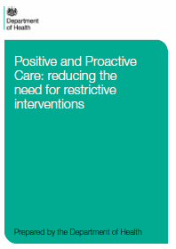
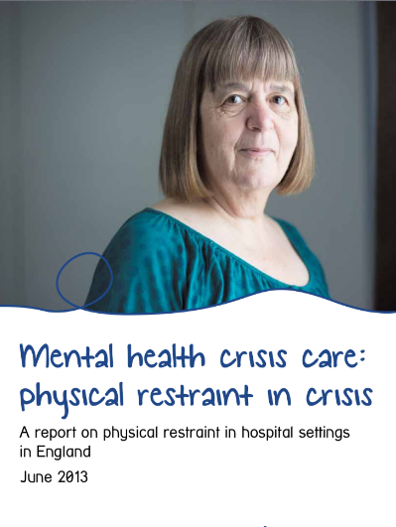
Inception of PROMISE
Meeting of Minds
Initiation of PROMISE
DOH Guidance
Sept 2013
DOH provides a tremendous boost to examine restrictive practice
Mind Report
Highlights inconsistencies from 38 to 3000+ PI incidents
Apr 2014
June 2013
https://www.clahrc-eoe.nihr.ac.uk/2016/07/8095/
Notes:
Cape Town: PROMISE

Slide 8
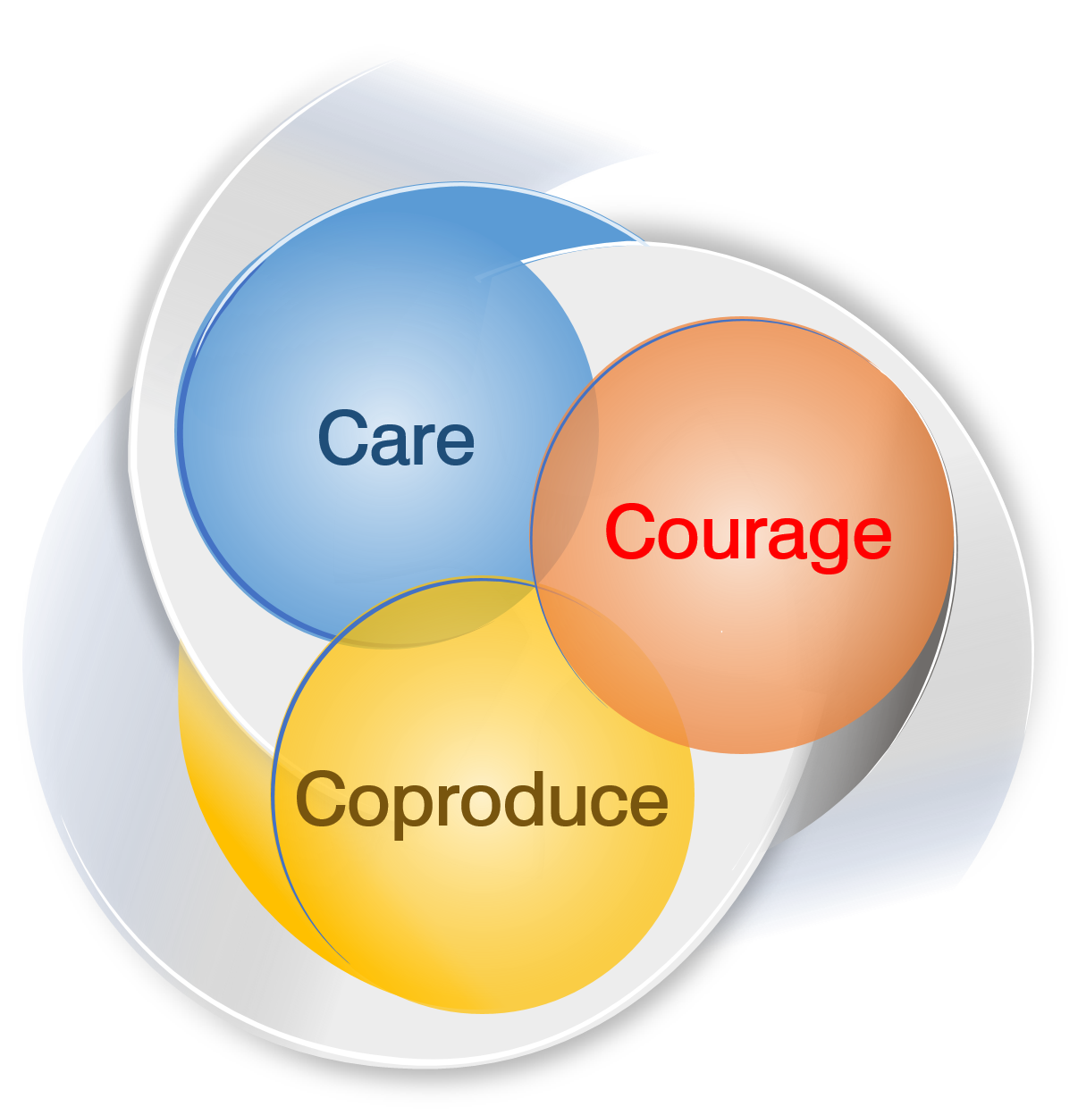
PROMISE values
Value 02
Value 01
Courage to challenge the status quo
Caring response to all distress
Value 03
Coproduce novel solutions
https://www.clahrc-eoe.nihr.ac.uk/2016/07/8095/

Slide 9
2014 data
 | Jan 2014 | Feb 2014 | Mar 2014 | Apr 2014 | May 2014 | Jun 2014 | Jul 2014 | Aug 2014 | Sep 2014 | Oct 2014 | Nov 2014 | Dec 2014 | Total
CAMH North | 0 | 1 | 0 | 0 | 0 | 0 | 0 | 0 | 0 | 0 | 0 | 0 | 1
Cavell Centre - Maple 2 | 0 | 0 | 0 | 0 | 1 | 0 | 0 | 0 | 0 | 0 | 0 | 1 | 2
Cavell Centre - Oak Ward 1 | 6 | 4 | 0 | 1 | 1 | 4 | 4 | 3 | 1 | 0 | 0 | 1 | 25
Cavell Centre - Oak Ward 2 | 1 | 4 | 4 | 1 | 2 | 1 | 0 | 1 | 2 | 5 | 0 | 1 | 22
Cavell Centre - Oak Ward 3 | 1 | 0 | 0 | 1 | 0 | 1 | 0 | 0 | 0 | 0 | 0 | 0 | 3
Cavell Centre - Poplar Ward (PICU) | 0 | 8 | 4 | 2 | 5 | 5 | 2 | 2 | 1 | 0 | 0 | 4 | 33
Community Mental Health - Hunts OP | 0 | 0 | 0 | 0 | 0 | 0 | 0 | 0 | 0 | 0 | 0 | 1 | 1
Darwin Centre for Young People | 47 | 14 | 1 | 14 | 21 | 1 | 0 | 0 | 0 | 1 | 0 | 0 | 99
Darwin Nurseries | 1 | 0 | 0 | 0 | 0 | 0 | 0 | 0 | 0 | 0 | 0 | 0 | 1
Eating Disorder Service | 1 | 0 | 0 | 0 | 0 | 0 | 0 | 0 | 0 | 0 | 0 | 0 | 1
George Mackenzie House | 1 | 2 | 1 | 0 | 2 | 0 | 0 | 0 | 0 | 0 | 0 | 0 | 6
IASS | 2 | 0 | 0 | 0 | 0 | 0 | 0 | 0 | 0 | 0 | 0 | 0 | 2
Learning Disabilities - The Hollies | 0 | 0 | 4 | 1 | 1 | 1 | 0 | 0 | 2 | 4 | 1 | 0 | 14
Mulberry 1 (Formerly Friends Ward) | 0 | 2 | 0 | 0 | 0 | 0 | 0 | 1 | 0 | 0 | 0 | 0 | 3
Mulberry 2 (Formerly Adrian House) | 2 | 2 | 2 | 0 | 0 | 6 | 1 | 0 | 6 | 0 | 2 | 14 | 35
Mulberry 3 formally (Cedars Recovery) | 0 | 0 | 0 | 0 | 0 | 1 | 0 | 0 | 0 | 0 | 0 | 0 | 1
Not applicable | 0 | 0 | 0 | 0 | 0 | 1 | 0 | 0 | 0 | 0 | 0 | 0 | 1
Oak 4 (LVG) | 0 | 2 | 3 | 2 | 0 | 1 | 6 | 0 | 0 | 0 | 2 | 2 | 18
Springbank | 3 | 5 | 2 | 0 | 1 | 0 | 2 | 4 | 8 | 15 | 16 | 1 | 57
The Fens Unit (DSDP Whitemoor Prison) | 1 | 0 | 0 | 0 | 0 | 0 | 0 | 0 | 0 | 0 | 0 | 0 | 1
Willow (Formerly - David Clarke House) | 0 | 0 | 0 | 0 | 0 | 2 | 0 | 0 | 0 | 0 | 0 | 0 | 2
Total | 66 | 44 | 21 | 22 | 34 | 24 | 15 | 11 | 20 | 25 | 21 | 25 | 328
https://www.clahrc-eoe.nihr.ac.uk/2016/07/8095/

Slide 10
Aims of the qualitative study
Improve understanding of the subjective experience of physical restraint for patients and staff on mental health wards within CPFT.
Elicit suggestions from patients and staff on how to reduce restraint.
Explore patient and staff understanding of and views about proactive care.
https://www.clahrc-eoe.nihr.ac.uk/2016/07/8095/

Slide 11
Suggestions: a brief overview
Communication and relationship
  Get to know the patient
  Inform and explain
  Compassion and empathy
  Talking to de-escalate
  Spend more time with patients
  Build therapeutic relationships
  Listen, listen, listen!
  Humanise care
Staffing
  More staff members and more staff time
  Learning from more experienced staff members
  Using and developing staff skills
  Peer support workers
  Staff support from above
Activities and distraction
  Individual or one-to-one activities
  Group activities
  Meaningful and stimulating activities
Environment and space
  Specific ward rooms
  Physical/aesthetic environment
  Take patients off the ward
  Personal space
  Different spaces for different types of patients
  Outside space
  Mixed gender wards
  More space in general
Money and resources
  Money and resources for inpatient care
  Money and resources for community care
Personalised and patient-led care planning
  Patient involvement in care planning
  Personalised care planning
No ‘one size fits all’
https://www.clahrc-eoe.nihr.ac.uk/2016/07/8095/

Slide 12
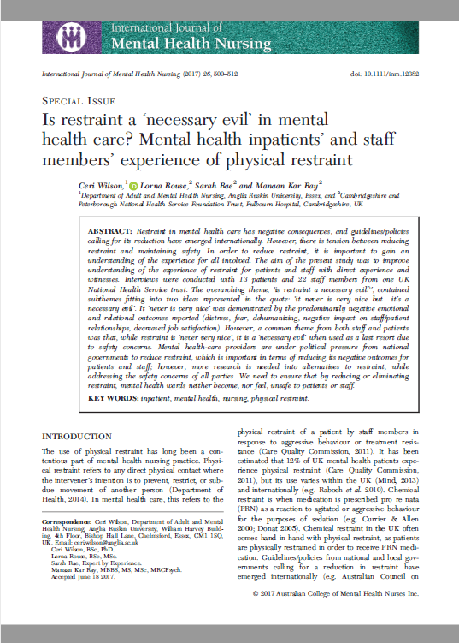
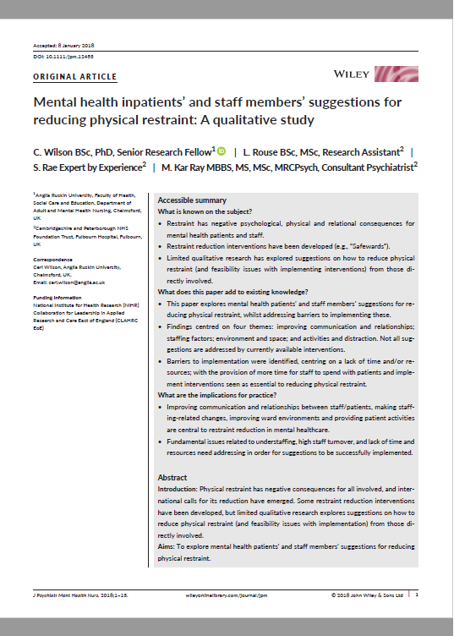
Qualitative study findings
https://www.clahrc-eoe.nihr.ac.uk/2016/07/8095/

Slide 13
A necessary evil?
Staff member 2, witness:
“…it never is very nice but I suppose it’s got to be done… it’s a necessary evil I suppose…”
Patient 2, witness:
“…I don’t think you’re ever going to negate it completely simply by the nature of people’s illness.”
https://www.clahrc-eoe.nihr.ac.uk/2016/07/8095/

Slide 14
Collating frontline initiatives
Over 200 bottom up initiatives listed
Mapping exercise undertaken across all wards
Staff encouraged to innovate to develop new ideas
Key individuals (ward managers, consultants) sent to conferences and learning sets
Shared the stories and the numbers in Acute Quarterly Meetings, seeking their ideas
Key indivKey individuals (Ward Managers, Consultants) sent to conferences and learning sets.
iduals (Ward Managers, Consultants) sent to conferences and learning sets.
https://www.clahrc-eoe.nihr.ac.uk/2016/07/8095/
Your Logo

Slide 15
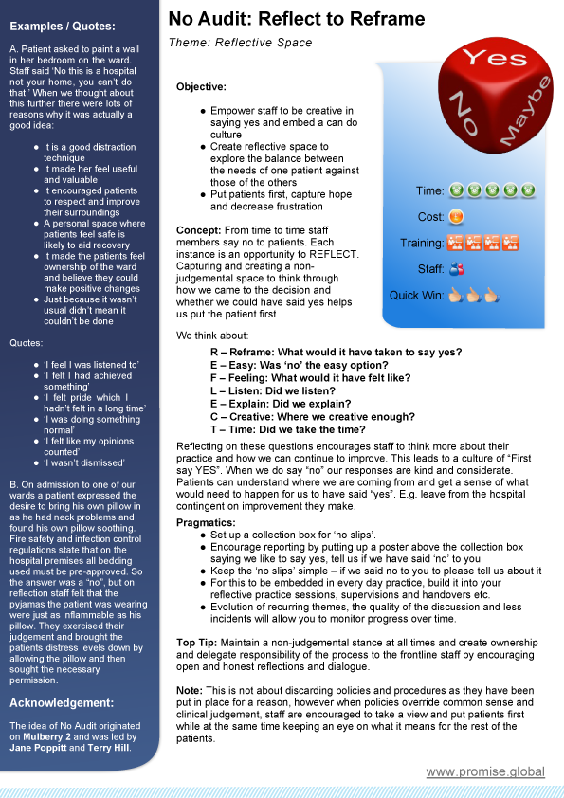
‘No’ Audit - adopting a yes culture
R – Reframe: What would it have taken to say yes?
E – Easy: Was ‘no’ the easy option?
F – Feeling: What would it have felt like?
L – Listen: Did we listen?
E – Explain: Did we explain?
C – Creative: Where we creative enough?
T – Time: Did we take the time?
Yes
No
Yes
Yes
No
No
https://www.clahrc-eoe.nihr.ac.uk/2016/07/8095/
Acknowledgement: Mulberry 2, Fulbourn Hospital, Cambridge

Slide 16
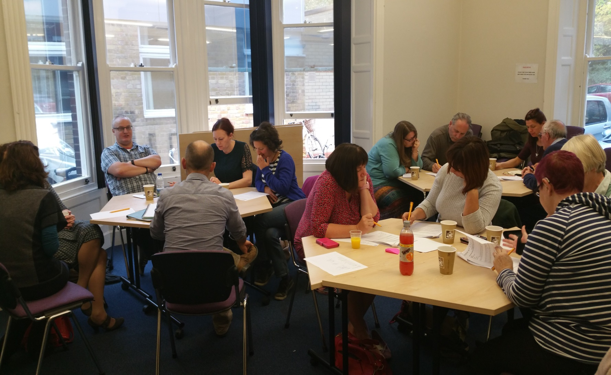
Patient Advisory Group
https://www.clahrc-eoe.nihr.ac.uk/2016/07/8095/

Slide 17

Open door
Diagnosis of PD and engaging with PD team or actively trying to engage
Frequent attenders with GP or ED
Chronic risk where risk behaviour is an
established pattern
Admissions are for two nights (must be a gap of 7 days between admissions)
https://www.clahrc-eoe.nihr.ac.uk/2016/07/8095/

Slide 18
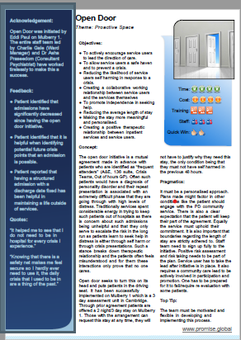
Open door
Aim is to extend periods between admissions
No self harm in preceding 48 hours
Establish a risk sharing partnership
Stick to boundaries and honour commitment
Shared responsibility taken very seriously
https://www.clahrc-eoe.nihr.ac.uk/2016/07/8095/

Slide 19
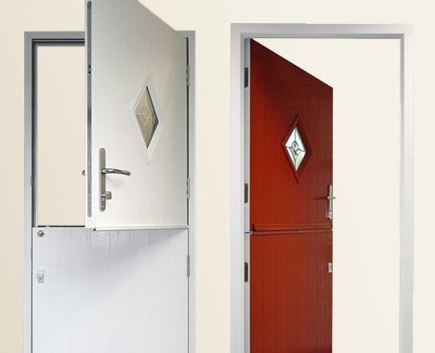
Improving environments
Challenging ‘them and us’
Replacing a stable door
Promoting dignity
Facilitating conversation
Dispensing of symbols of institutionalisation and power imbalance
https://www.clahrc-eoe.nihr.ac.uk/2016/07/8095/

Slide 20
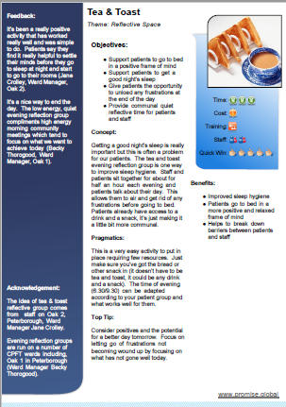
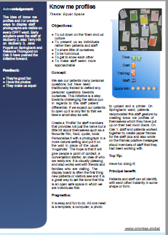
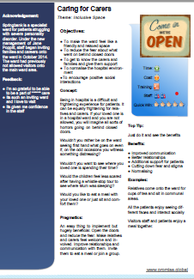
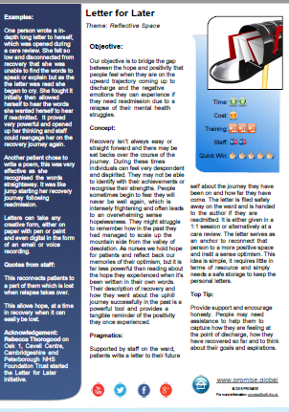
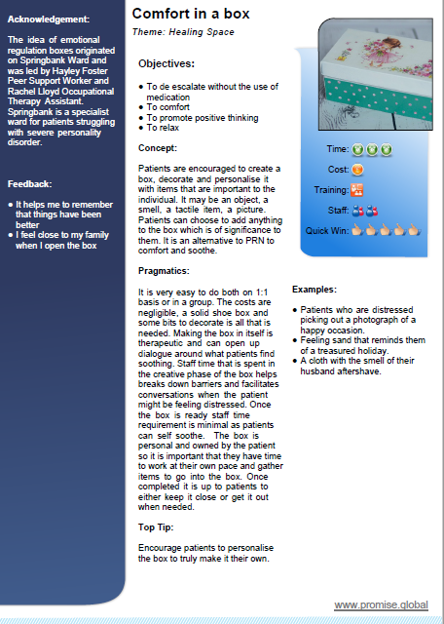
Frontline initiatives continued
Caring for carers
Transforming spaces
Mood and food
Ready steady care
Comfort in a box
https://www.clahrc-eoe.nihr.ac.uk/2016/07/8095/

Slide 21

Report (daily)
01
We manage what we measure, daily reporting on outcomes for safety, clinical effectiveness and patient experience
Reflect (weekly)
02
Doing what counts not just what we count, staying on task by creating a mindful reflective space for staff at least weekly
Review (monthly)
03
Finger on the pulse from board to ward, use the data to track against planned trajectory and proactively identify emerging hot spots
Report
PROGRESS
Reflect
Refresh (annually)
Review
04
Refresh
Annual business plan which lays out trajectory against key measures and how to achieve them with resource layout
PROactive Governance of Recovery Settings and Services
https://www.clahrc-eoe.nihr.ac.uk/2016/07/8095/

Slide 22
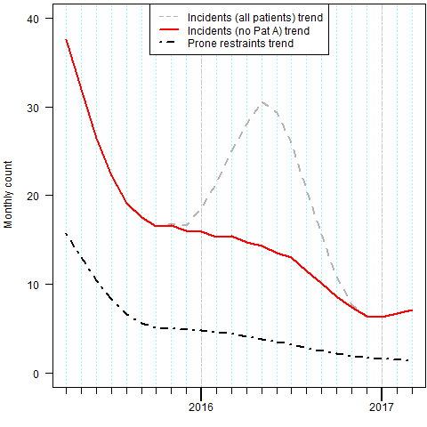
PROMISE results
https://www.clahrc-eoe.nihr.ac.uk/2016/07/8095/

Slide 23
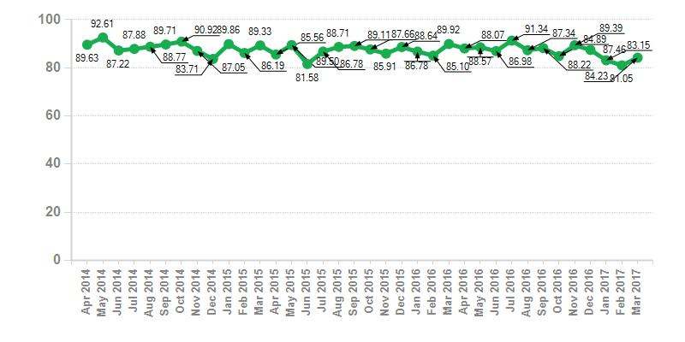
Patient experience scores
https://www.clahrc-eoe.nihr.ac.uk/2016/07/8095/
Notes:
Likely affected by many other factors, however important to map pout the therapeutic day of the patient

Slide 24
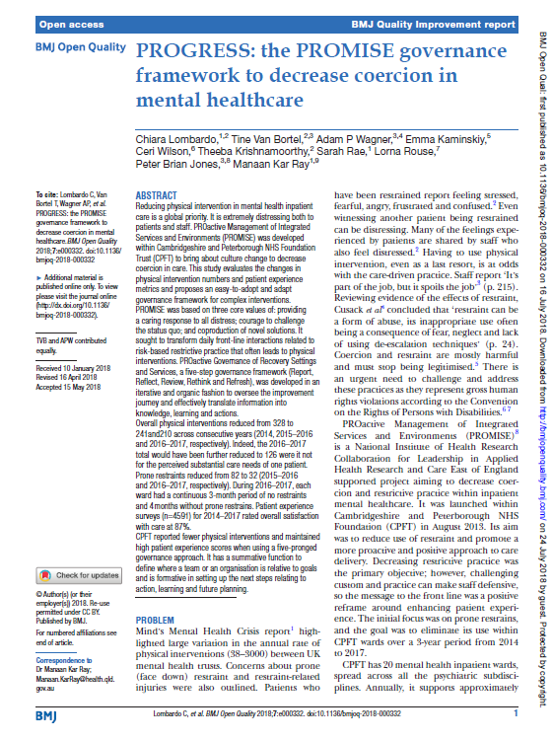
PROGRESS: the PROMISE governance
framework
https://www.clahrc-eoe.nihr.ac.uk/2016/07/8095/

Slide 25
Thank you
Sarah Rae
sarah.rae@rockyroad.org.uk
https://www.clahrc-eoe.nihr.ac.uk/2016/07/8095/

