Slide 1
National Clinical Audit Programme Dawn Chamberlain Director Clinical Improvement, NHS England and Improvement (NHSEI) & Dr Ian Woolhouse Quality Improvement Lead, Healthcare Quality Improvement Partnership (HQIP) 26th November 2021
Notes:
The Clinical Improvement Group has three distinct focuses of work:
Beneficial Changes Network
RightCare
Clinical Audit (from June 2021)
The National Incident Response Board commissioned the Improvement Directorate to capture the innovation and new ways of working from the frontline happening in response to the pandemic and so the Beneficial Changes Network evolved in May 2020.
RightCare started out as the NHS England national commissioning improvement programme to reduce unwarranted variation by benchmarking CCGs and highlighting opportunities for improvement across commissioning care pathways. Various data packs are now provided at Primary Care Network level and also at ICS level for systems to use locally to inform the transformation of care pathways. In addition, patient scenarios and toolkits are developed by the team to support delivery.
Historically Clinical Audit has been seen as a clinical intervention, led by the Medical Directorate at national level, however the Clinical Improvement Director now co-chairs the national forum giving us an opportunity to bring the national recommendations from clinical audit into the integrated improvement work at National and Regional level.
In addition the Clinical Improvement Group leads on a number of Improvement Directorate-wide initiatives:
Coproduction
Social Care integration – first workshop in July 2021
Improvement Hub and repository on the NHS Futures site

Slide 2
NHS England & NHS Improvement Update on Clinical Audit

Slide 3
Update on Clinical Audit
The recommendations from the National Clinical Audits provide expert and invaluable contributions to improvements in clinical practice as well as providing important guidance for changes in NHS Service delivery.
There is a growing desire to ensure the integration and maximum impact of the recommendations emerging from the audits, into overarching National NHSEI Programmes, as well as System and local transformation or clinical improvement programmes.
Following discussion and agreement at the Executive Quality Group Clinical Audit Sub-Group (EQGCASG) (co-chaired by Celia Ingham Clark and Dawn Chamberlain) in June 2021, the Clinical Audit for Improvement Task & Finish Group was established and met throughout August 2021.
A resulting discussion paper was approved by EQGCASG which set out the following vision.

Slide 4
Vision
Prioritisation of Recommendations Clear prioritisation with patient safety at the top of the hierarchy. The Senior Responsible Officer for each national recommendation should be clearly defined.
Benchmarking Data Provide National Clinical Audit benchmarking data through the Model Health System portal as part of the NHSEI move towards integrated single source data.
Quality Improvement NCA recommendations critical in delivering improvements in clinical practice. Regional oversight through the Clinical Networks.
Communications & Engagement Anyone working within a national, regional, system or local health and social care setting should know about how and where to access their relevant National Clinical Audit data and recommendations, as well as having access to best practice information.
Training & Education Clinical Audit awareness and understanding should be routinely included in the education, training, and job planning for doctors, nurses, AHPs, Clinical Audit and Quality Improvement staff across the NHS.
Commissioning NCA needs to be appropriately resourced system-wide and across all sectors.

Slide 5
Maximising the quality improvement potential of the national clinical audit programme
Dr Ian Woolhouse
Quality Improvement Lead HQIP
Nov 2021
Supported by the Health Foundation

Slide 7
Stakeholder feedback
More timely and frequent NCA results feedback
Online results portals more effective than annual reports
Reduce burden of data collection and submission
Reduce the number of performance metrics
Improving quality is dependent on local context
Local capacity for QI work related to NCAs is limited

Slide 8
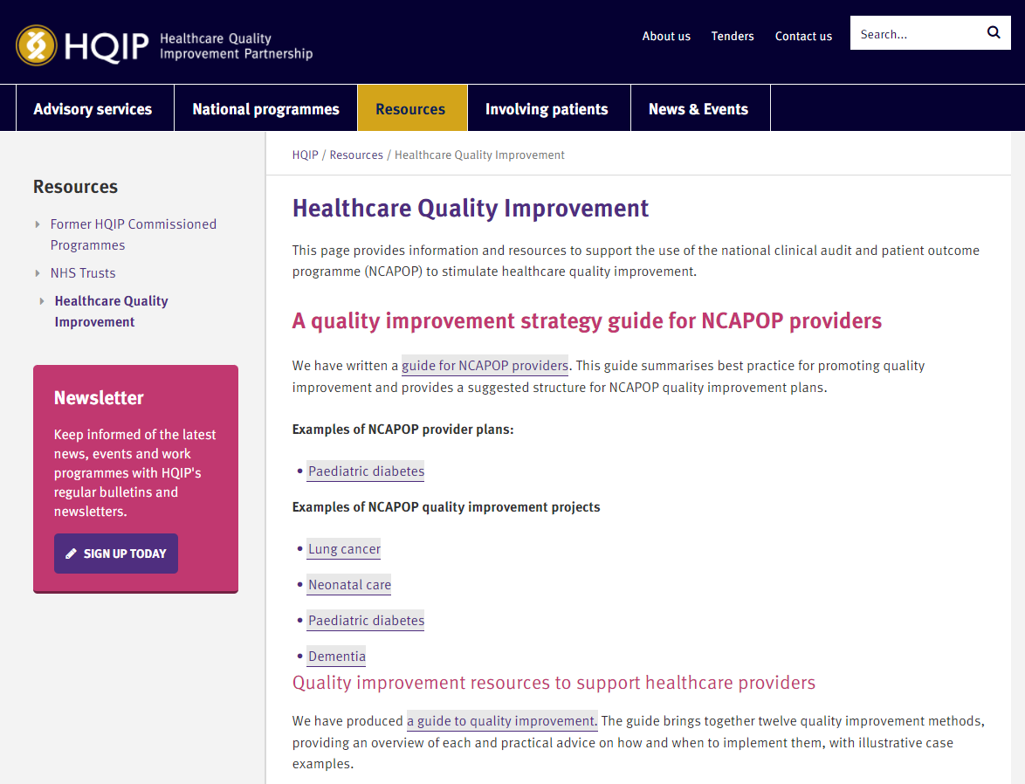

Slide 9
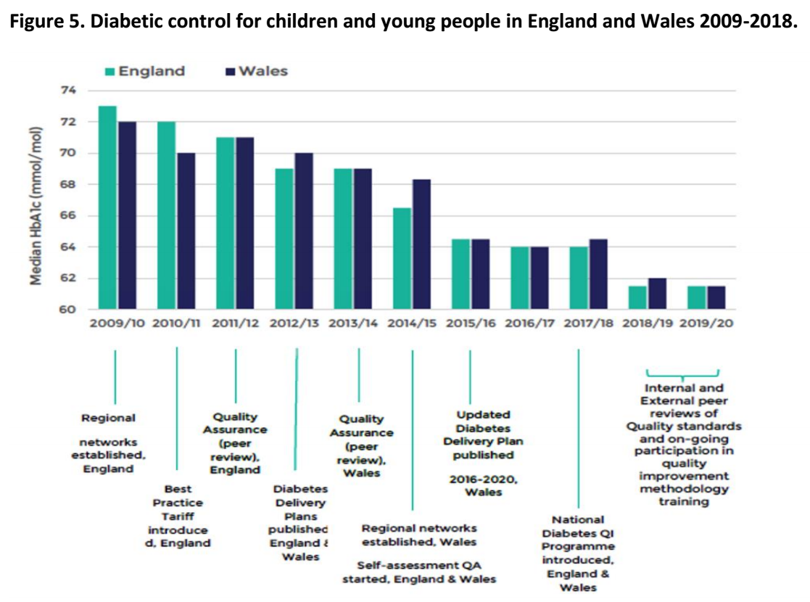

Slide 10
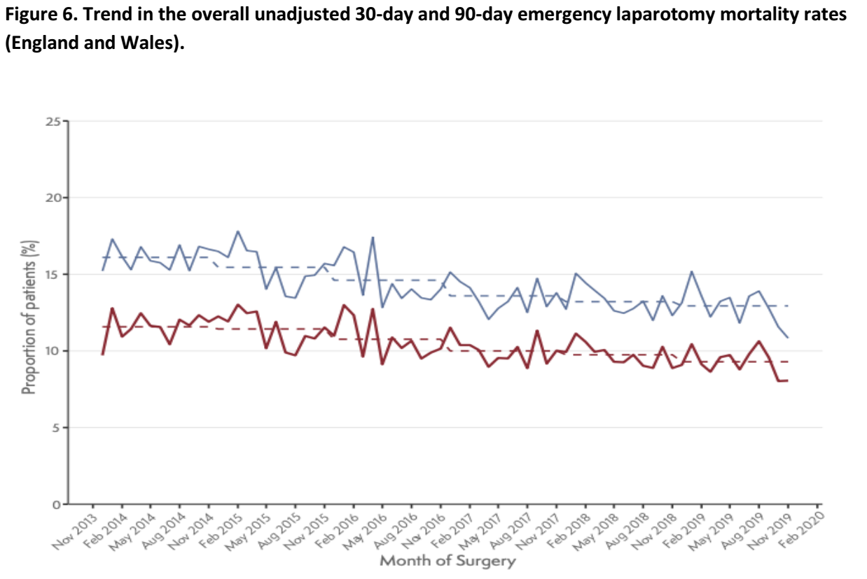

Slide 11
Recommendations
Automated data extraction from routine datasets
Streamline performance metrics (max 10)
Widespread use of near-real time continuous feedback
Short “state of the nation” annual report
Recommendations for the system
Actively share examples of good practice
Better links with national improvement initiatives

Slide 12
Clinical Audit for Improvement

Slide 13
Recommendations from the Task & Finish Group
Enhance the support for the implementation of National Clinical Audit recommendations.
Recognise the need for a more comprehensive approach to stakeholder engagement and communications.
Support the regional clinical networks to have oversight of the implementation of key national clinical audit recommendations in association with regional improvement hubs and others where relevant.
Engage with National Quality Improvement Clinical Audit Network (N-QI-CAN) to support the role of clinical audit managers and frontline staff across England.
Provide training and education for clinical audit implementation that includes events and webinars coordinated at national level.
Create a national knowledge hub for clinical audit that includes key national recommendations as well as best practice case studies and opportunities for shared learning.
Establish an implementation working group to lead on these recommendations that reports into the Executive Quality Group Clinical Audit Sub-Group (EQGCASG).

Slide 14
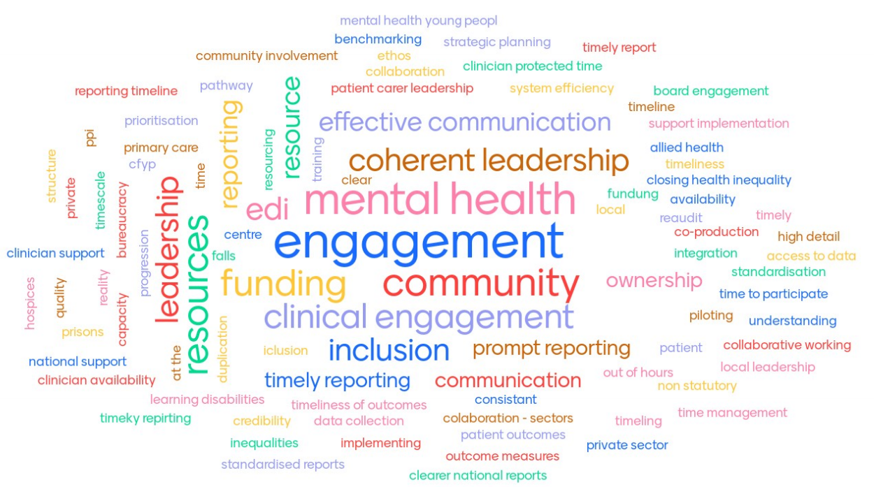
Gaps in the Implementation of NCA

Slide 15
Actions & Next Steps
Implementation Group in place to progress the recommendations from the task & finish group in partnership with HQIP.
Initial actions:
Establish a repository of case studies and community of practice. For example, Improvement Hub - Improvement Hub (future.nhs.uk)
Develop a strategic approach to Clinical Audit training & education offers
Strengthen links with National Quality Improvement Clinical Audit Network (N-QI-CAN) and Clinical Networks to support frontline clinicians and clinical audit managers

Slide 16
Thank you & Introducing Dr Josie O’Heney, National Medical Director’s Clinical Fellow, Healthcare Quality Improvement Partnership

