Slide 1
CQC & Clinical Audit
Graham Cooper
National Professional Advisor for Surgery
Consultant Cardiac Surgeon
1
Notes:
1

Slide 2
Structure
Board including Chief Inspector of Hospitals
Deputy Chief Inspectors
National Professional Advisors
Inspection teams

Slide 3
Surgical Specialties
General Surgery
Paediatric Surgery
Neurosurgery
Orthopaedics
Cardio-thoracic Surgery
Ophthalmology
ENT
Urology
Plastic Surgery

Slide 4
Our current model of regulation
Register
Monitor, inspect and rate
Enforce
Independent voice
We register those who apply to CQC to provide health and adult social care services
We monitor
services, carry out expert
inspections, and judge each service, usually to give an overall rating.
Where we find poor care, we ask providers to improve and can enforce this if necessary
We provide an independent voice on
the state of health and adult social care
in England on issues that matter to the
public, providers and stakeholders
Notes:
In 2013 we introduced fundamental changes to our model of regulation.
We know we still have work to do to deliver this approach consistently and to a high standard.
Over the next five years we will continue to focus on the aspects of our model that people have said make the greatest difference – taking action swiftly when we find poor care and publishing independent expert ratings of quality.
Our core operating model will stay the same and we will ensure we continually improve how we deliver our four main functions.

Slide 5
Inspections
Time consuming
Labour intensive
Expensive
Not seen as relevant by clinicians
Not focused enough for specialist services

Slide 6
We are being ambitious
We’re changing how we regulate to improve care and services for everyone.
Our purpose and role isn’t changing but we’re responding to how services are changing – how we work will be different.
Regulation will be more relevant to how care is delivered, and more flexible to manage risk and uncertainty.
This is our new strategic direction as the health and care environment continues to evolve.
Notes:
We are being ambitious.
The health and social care landscape has changed drastically since 2016, when our previous strategy was published. Changes in the health and social care sector have been accelerated by the pandemic, increasing the needs of those who access health and social care services and placing additional challenges on service providers to meet them.
Our role as the regulator of health and social care in England has also been impacted greatly by the pandemic, affecting our ability to inspect all services and provide the necessary assurance to the public of their safety.
We’re changing how we regulate to improve care for everyone.
What we’ve learned from the past five years puts us in a better position for the future. Our new strategy combines this learning and experience and we’ve developed it with valuable contributions from the public, service providers and all our partners. It means our regulation will be more relevant to the way care is now delivered, more flexible to manage risk and uncertainty, and will enable us to respond in a quicker and more proportionate way as the health and care environment continues to evolve.
This new strategy strengthens our commitment to deliver our purpose: to ensure health and care services provide people with safe, effective, compassionate, high-quality care and to encourage those services to improve. Our strategy is purposefully ambitious, and to implement it we will need to work closely with others to make it a reality. We’ll review this strategy regularly so we can adapt to changes and be prepared for what the future holds.

Slide 7
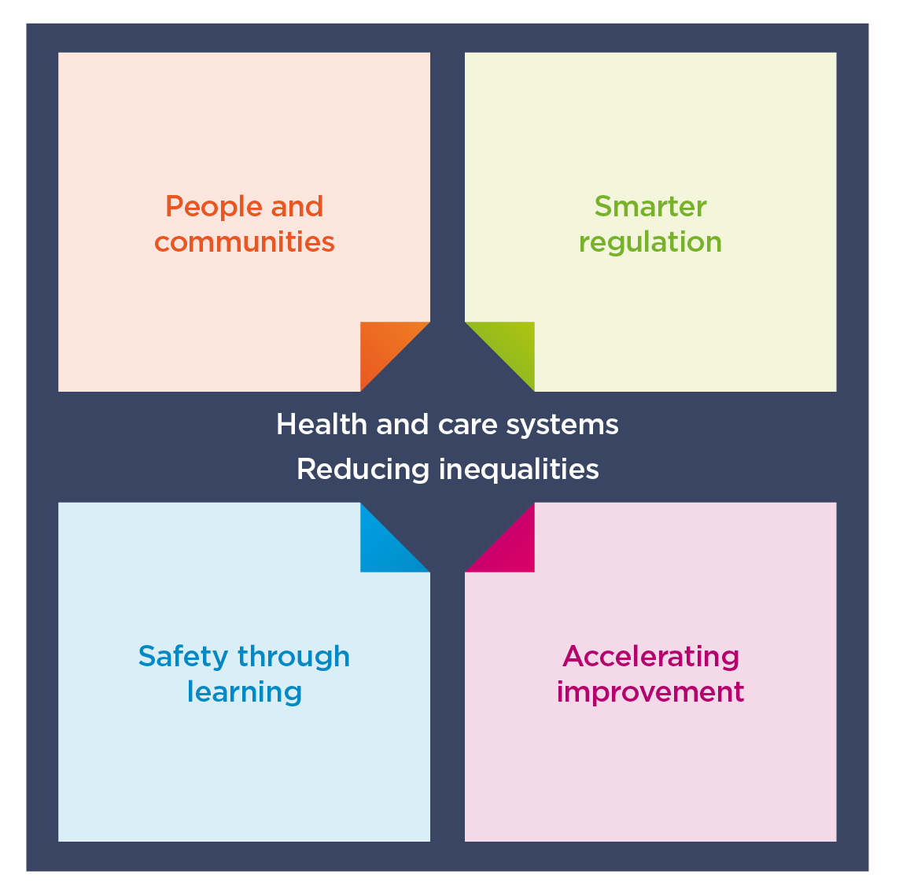
Our strategic themes
Built on four interlinked themes that set out the changes we will make.
We’ll review our strategy regularly so we can be flexible and adapt to changes in health and care.
Assessing local systems
Tackling inequalities in health and care
Notes:
Our strategic themes:
We’ll continue building the underpinning systems and structures, and making changes, to enable our strategy over the next two to three years, but full realisation of the strategy will take longer as we continuously learn and evolve, responding to changes in the world around us.
My Executive Team colleagues will take you through each of the strategic themes;
First, the core ambitions throughout each of the themes;
Assessing local systems and/
Tackling inequalities in health and care
And then onto the four interlinked themes that will determine the changes we will make;
People and communities
Smarter regulation
Safety through learning
Accelerating improvement

Slide 8
Smarter regulation
Smarter, more dynamic and flexible regulation that provides up-to-date and high-quality information and ratings, easier ways of working with us and a more proportionate response
Notes:
Smarter, more dynamic and flexible regulation that provides up-to-date and high-quality information and ratings, easier ways of working with us and a more proportionate response.

Slide 9
Smarter regulation
Site visits are vital in our assessments and essential to observe care – but they’re not the only way to assess quality
Use all our regulatory methods, tools and techniques to support robust and proportionate decision-making
Up-to-date and high-quality information to reflect how people experience care, so ratings will be more dynamic and meaningful
Supportive and constructive relationships with providers to minimise unnecessary workload
Coordinated data sharing to reduce duplication for services in collecting and submitting data to us, and to other organisations
Notes:
We will be smarter in how we regulate. We’ll keep pace with changes in health and care, providing up-to-date, high-quality information and ratings for the public, providers and all our partners.
We’ll regulate in a more dynamic and flexible way so that we can adapt to the future changes that we can anticipate – as well as those we can’t. Smarter use of data means we’ll target our resources where we can have the greatest impact, focusing on risk and where care is poor, to ensure we’re an effective, proportionate and efficient regulator.
Site visits are vital in our assessments and essential to observe care – but they’re not the only way to assess quality. We will use all our regulatory methods, tools and techniques to support robust and proportionate decision-making.
Up-to-date and high-quality information will reflect how people experience care, so ratings will be more dynamic and meaningful.
Supportive and constructive relationships with providers will minimise unnecessary workload.
Coordinated data sharing will reduce duplication for services in collecting and submitting data to us, and to other organisations.

Slide 10
Accelerating improvement
Enabling health and care services and local systems to access support to help improve the quality of care where it’s needed most
Notes:
Enabling health and care services and local systems to access support to help improve the quality of care where it’s needed most.

Slide 11
Accelerating improvement
Identify gaps in improvement support for health and care services, working with others to build on existing partnerships and programmes
Improvement conversations and resources to support services and local systems to decide the best way forward
Encourage innovation, technology-enabled services and research that benefits people
Proportionate approach to regulating new innovations and technology
Build a culture of learning and evaluation in CQC
Notes:
We will do more with what we know to drive improvements across individual services and systems of care. We’ll use our unique position to spotlight the priority areas that need to improve and enable access to support where it’s needed most.
We’ll empower services to help themselves, but we’ll still retain our strong regulatory role so we’ll use our powers to act where we see poor care. The key to this is by collaborating and strengthening our relationships with services, the people who use them, and our partners across health and care.
We will identify gaps in improvement support for health and care services, working with others to build on existing partnerships and programmes – we won’t duplicate what’s already available. W|e’ll do this by facilitating national improvement coalitions with a broad spectrum of partners within both health and adult social care.
Improvement conversations and resources will support services and local systems to decide the best way forward.
We will encourage innovation, technology-enabled services and research that benefits people with a proportionate approach to regulating new innovations and technology.
We will build a culture of learning and evaluation in CQC.

Slide 12
Intelligence!
Surgeons must have a significant input
- determining the quality standards
- acting as Specialist Professional Advisors
- driving improvements
Notes:
Who:
Mix of NHS and independent healthcare providers and professionals
CQC staff – on each table and in room ensuring needs are met etc
Glasgows – registration staff – dealing with logistics etc
Say who you are – introductions to each other on tables/the room
We are expecting the document to publish on Monday 25 January (end date 14 March)
Once the consultation is published, the main route for feedback will be via a web form (available from www.cqc.org.uk/2016strategyconsultation) or by email to strategyconsultation@cqc.org.uk.

Slide 13
Data Sources
HQIP – National Audits
GIRFT
Model Hospital
Notes:
Who:
Mix of NHS and independent healthcare providers and professionals
CQC staff – on each table and in room ensuring needs are met etc
Glasgows – registration staff – dealing with logistics etc
Say who you are – introductions to each other on tables/the room
We are expecting the document to publish on Monday 25 January (end date 14 March)
Once the consultation is published, the main route for feedback will be via a web form (available from www.cqc.org.uk/2016strategyconsultation) or by email to strategyconsultation@cqc.org.uk.

Slide 14
HQIP
National Cardiac Surgery Audit
National Hip Fracture Audit
National Audit Breast Cancer in Older Patients
National Emergency Laparotomy Audit
National Bowel Cancer Audit
National Oesophago-Gastric Cancer Audit
National Prostate Cancer Audit
National Vascular Registry
National Lung Cancer Audit
Notes:
Who:
Mix of NHS and independent healthcare providers and professionals
CQC staff – on each table and in room ensuring needs are met etc
Glasgows – registration staff – dealing with logistics etc
Say who you are – introductions to each other on tables/the room
We are expecting the document to publish on Monday 25 January (end date 14 March)
Once the consultation is published, the main route for feedback will be via a web form (available from www.cqc.org.uk/2016strategyconsultation) or by email to strategyconsultation@cqc.org.uk.

Slide 15
Data Sources
Provide a wide range of metrics
Predominantly process metrics
Length of stay / Readmission
Some clinical
Hip revision rates
GIRFT
Model Hospital
Notes:
Who:
Mix of NHS and independent healthcare providers and professionals
CQC staff – on each table and in room ensuring needs are met etc
Glasgows – registration staff – dealing with logistics etc
Say who you are – introductions to each other on tables/the room
We are expecting the document to publish on Monday 25 January (end date 14 March)
Once the consultation is published, the main route for feedback will be via a web form (available from www.cqc.org.uk/2016strategyconsultation) or by email to strategyconsultation@cqc.org.uk.

Slide 16
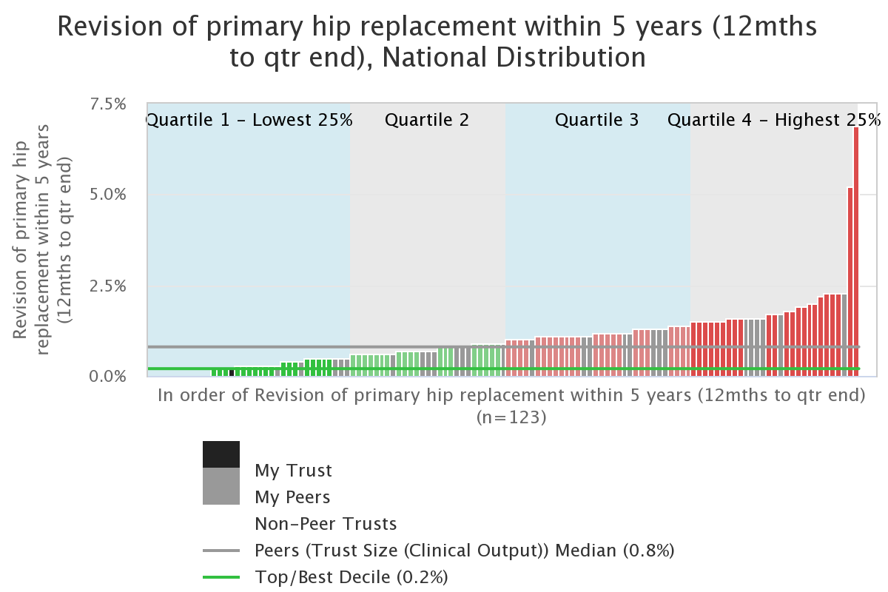
GIRFT

Slide 17
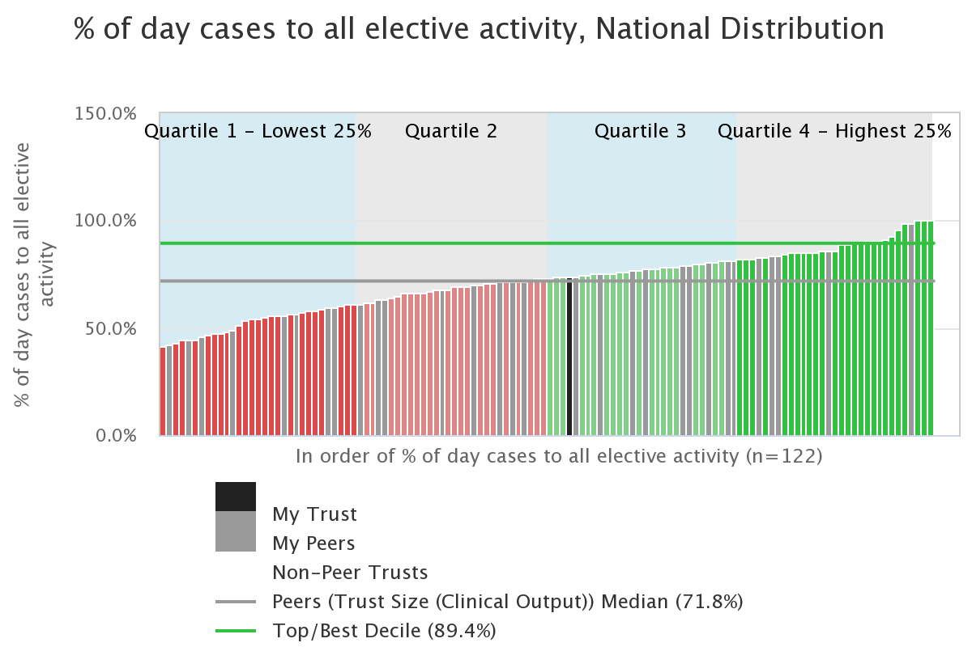
Model Hospital

Slide 18
Sacred Heart Hospital Emergency Laparotomy Audit
 |  | Metric | CQC Key Question | Year 1¹ | Year 2² | National Aggregate (England & Wales) | National Aspirational Standard | Hospital performance
 | 132 cases | Case Ascertainment All eligible patients | Well Led | n/a | 72% | 83%* | 80% | Higher than 70%
Proportion of patients for which each process of care was met | 132 cases | Crude proportion of cases with pre-operative documentation of risk of death | Effective | n/a | 45% | 57% | 80% | Less than 50%
 | 132 cases | Crude proportion of cases with access to theatres within clinically appropriate time frames | Responsive | n/a | 57% | 84% | 80% | Between 50% and 80%
 | 132 cases | Crude proportion of high-risk cases (≥5% predicted mortality) with consultant surgeon and anaesthetist present in theatre | Effective | n/a | n/a | 74% | 80% | Not applicable
 | 132 cases | Crude proportion of highest-risk cases (>10% predicted mortality) admitted to critical care post-operatively | Safe | n/a | 87% | 62% | 80% | Less than 50%
 | 132 cases | Risk adjusted 30-day mortality | Effective | n/a | 3.0%³ | n/a | none
Higher than expected
Positive outlier
(below 99.8% CL)
Negative outlier
(above 99.8% CL)
Key:
Trust
Within expected range
Lower than expected
(below 95% CL)
Higher than expected (above 95% CL)
Anticipated date of next update is mm/yy
Draft context document
1 Dec 13 – Nov 2014
2 Dec 14 – Nov 2015
*England only
³Based on Year 1 and Year 2 data
Notes:
Green = Higher than 70% (case ascertainment) or higher than 80% for all others; Amber = 50-70% (50-69% for case ascertainment); Red = less than 50%. Grey = not applicable

Slide 19
Sacred Heart Hospital National Joint Registry
 | Metric | CQC Key Question | 2014 Report¹ | 2015 Report² | National Aggregate |  | National Aspirational Standard | Comparison to other trusts
800 cases | Number of Consultants | Well Led | 8 9 n None |  |  |  |  | Contextual information
750 cases | Case ascertainment (all joints) | Well Led | 83% | 86% |  | 94% | >95%?**
730 cases | Proportion of patients consent to have personal details included on NJR (all joints)*** | Well Led | 92.5% | 98.3% |  | 93.5% | >95%?**
500 cases | Risk adjusted overall revision rate (for hips & knees) | Effective | 2.6% | 1.8% |  | 80.5% | <4%?**
500 cases | Risk adjusted 5 year revision rate (for hips & knees) | Effective | 2.8% | 2.5% |  | 3% | <2%?**
500 cases | Risk adjusted 90 day mortality (for hips & knees excluding NOF#*) | Effective | 0.1% | 0.1% |  | 0.1% | None**
0 Negative outlier 100
0 Positive outlier 100
0 Better than expected 100
0 Worse than expected 100
0 Within expected range 100
*Neck of femur fracture
** ?Appropriate - Aspirational standards to be discussed with NJR
*** Data may not be available
Negative outlier
(below 99.8% Control limit)
Positive outlier
(above 99.8% CL)
KEY
Trust
Within expected range
1 Jan 14 - Dec 14
2 Jan 15 - Dec 15
Worse than expected (below 95% CL)
Better than expected
(Above 95% CL)

Slide 20
Inspections 5 domains
safe
Well-led
Caring
Responsive
Effective

Slide 21
Safe domain
Safe: Patients are protected from harm and abuse.
Metrics
Evidence from national audits.
Never events
Readmission rates
Notes:
Who:
Mix of NHS and independent healthcare providers and professionals
CQC staff – on each table and in room ensuring needs are met etc
Glasgows – registration staff – dealing with logistics etc
Say who you are – introductions to each other on tables/the room
We are expecting the document to publish on Monday 25 January (end date 14 March)
Once the consultation is published, the main route for feedback will be via a web form (available from www.cqc.org.uk/2016strategyconsultation) or by email to strategyconsultation@cqc.org.uk.

Slide 22
Effective domain
Effective: Timely patient care, treatment and support achieves good outcomes, helps patient to maintain quality of life and is based on the best available evidence
Metrics:
Referral to appointment / treatment, Compliance with 18 week pathway and 31/62 target
Day case activity
Participation in all relevant national audits
Notes:
Who:
Mix of NHS and independent healthcare providers and professionals
CQC staff – on each table and in room ensuring needs are met etc
Glasgows – registration staff – dealing with logistics etc
Say who you are – introductions to each other on tables/the room
We are expecting the document to publish on Monday 25 January (end date 14 March)
Once the consultation is published, the main route for feedback will be via a web form (available from www.cqc.org.uk/2016strategyconsultation) or by email to strategyconsultation@cqc.org.uk.

Slide 23
Well-led domain
Well-led: the leadership, management and governance of the organisation make sure it's providing high-quality care that's based around patients’ individual needs, that it encourages learning and innovation, and that it promotes an open and fair culture
Metrics:
Morbidity and Mortality Meetings
Benchmarking
Active steps for service improvement
GMC Trainee Survey
Notes:
Who:
Mix of NHS and independent healthcare providers and professionals
CQC staff – on each table and in room ensuring needs are met etc
Glasgows – registration staff – dealing with logistics etc
Say who you are – introductions to each other on tables/the room
We are expecting the document to publish on Monday 25 January (end date 14 March)
Once the consultation is published, the main route for feedback will be via a web form (available from www.cqc.org.uk/2016strategyconsultation) or by email to strategyconsultation@cqc.org.uk.

Slide 24
Notes:
By delivering the aims and ambitions in this strategy, we will achieve 12 outcomes:
Our activity is driven by people's experiences of care.
We clearly define quality and safety in line with people’s changing needs and expectations. This definition is used consistently by all people, and at all levels of the health and social care system.
Our ways of working meet people’s needs because they are developed in partnership with them.
We are an effective, proportionate, targeted, and dynamic regulator.
We provide an up-to-date and accurate picture of quality.
It is easy for health and care services, the people who use them and stakeholders to exchange relevant information with us, and the information we provide is accessible, relevant, and useful.
There is improvement in safety cultures across health and care services and local systems that benefit people because of our contribution.
People receive safer care when using and moving between health and social care services because of our contribution.
We have accelerated improvements in the quality of care.
We have encouraged and enabled safe innovation that benefits people or results in more effective and efficient services.
We have contributed to an improvement in people receiving joined-up care.
We have influenced others to reduce inequalities in people’s access, experiences and outcomes when using health and social care services.

Slide 25
graham.cooper@cqc.org.uk
25
Notes:
25

