Slide 1
Developing your role as a Designated Prescribing Practitioner
Dr Andrea Hilton (BPharm (Hons), MSc, PhD, PGCERT, SFHEA, MRPharmS)
Senior Lecturer/Non-medical prescribing programme director
a.hilton@hull.ac.uk

Slide 2
Learning Outcomes
By the end of this mini session you will have:
1) reviewed the role of the Designated Prescribing Practitioner
2) discussed and reflected on integrating the role into day to day practice
3) discussed further the role with a case study

Slide 3
Linking to the previous session
• supporting governance and accountability
• enabling non-medical prescribers (NMPs) to take on this designated practitioner role
• the new Competency Framework for Designated Prescribing Practitioners
• how to evidence competence in the DPP role
• moving forward

Slide 4
Reviewing the role of the Designated Prescribing Practitioner

Slide 5
Before thinking about or actually undertaking the role…..
Notes:
From the DPP framework directly “The expectation of any registered health professional practitioner acting in the DPP role is the ability to demonstrate they meet all competencies within the Competency Framework for all Prescribers.”

Slide 6
Scope of practice defined…in competency framework
“The activities a healthcare professional carries out within their professional role. The healthcare professional must have the required training, knowledge, skills and experience to deliver these activities lawfully, safely and effectively. They must also have appropriate indemnity cover for their prescribing role. Scope of practice may be informed by regulatory standards, the professional body’s position, employer guidance, guidance from other relevant organisations and the individual’s professional judgement”
Health and Care Professions Council (2020) Information on scope of practice. Available from: https://www.hcpc-uk.org/registration/meeting-our-standards/information-on-scope-of-practice/.

Slide 7
Competency statement 9 Prescribing Governance/Improve prescribing practice
Supporting statement 9.6
“Encourages and supports others with their prescribing practice and continuing professional development”…….
“By considering mentoring, leadership and workforce development (for example, becoming a Designated Prescribing Practitioner).”

Slide 8
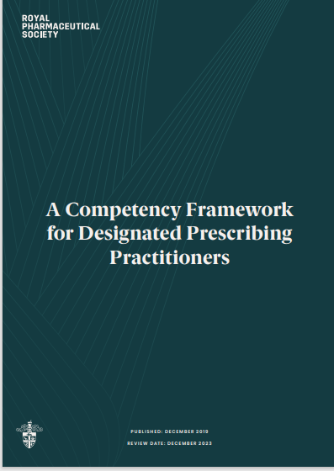

Slide 9
The structure of the competency framework for DPP
The DPP
Personal Characteristics
Professional skills and knowledge
Teaching and training skills
Delivering the role
Working in Partnership
Prioritising patient care
Developing the role
Learning environment and governance
Learning environment
Governance

Slide 10
Reviewing the role of the Designated Prescribing Practitioner
“To oversee, support and assess the competence of non-medical prescribing trainees, in collaboration with academic and workplace partners, during the period of learning in practice”
(A competency framework for designated prescribing practitioners)

Slide 11
Learning in practice (PLP)
Period of learning in practice - since the beginning of non-medical prescribing
“The PLP enables the trainee to put theory into practice; to develop and demonstrate competence as a prescriber under the supervision of an experienced prescribing practitioner.” (A competency framework for designated prescribing practitioners)

Slide 12
Learning in practice (PLP)
Hours in practice – differences NMC and HCPC/GPhC
Use support from your Trust/Organisation
Speak to the academics from the University your potential student is attending.
What information do they have for the DPP, what is the expectation of a DPP?
There should be open communication between a DPP and the University

Slide 13
Integrating the role into day to day practice

Slide 14
Integrating the role into day to day practice
Use the framework
The framework will help DPPs to:
• understand the skills, knowledge, attitudes and behaviours required of someone taking on the role
• self-assess and demonstrate their competence to take on the role
• develop confidence in their ability to take on the role
• target continuing professional development and revalidation

Slide 15
Integrating the role into day to day practice
Think about the structure of the DPP framework
The Designated Prescribing practitioner (YOU prior to undertaking the role)
Delivering the role (YOU delivering the role)
Learning environment and governance

Slide 16
Integrating the role into day to day practice
ACTION: speak to your Trust/Organisation
ACTION: speak to the University
THINK: about the quality of the PLP, overseeing the PLP for that student, support and assessment – competency 1 – 6 (as a starter)

Slide 17
Integrating the role into day to day practice
Think about the logistics of the DPP role
Not only the skills, knowledge, attitudes and behaviours but…..
Time and Support (e.g 1.3, 4.1, 4.2, 6.3, 7.1)
Opportunity to supervise and ASSESS (e.g. 1.4, 3.4, 4.3)
Opportunity (profession specific) to liaise with named practice supervisor (e.g. 4.3, 4.5)
Prioritising patient care (e.g 5.1 – 5.4)
Personal reflection (e.g 6.2)
Commitments to other students you are supervising
Notes:
1.3 Demonstrates a commitment to support trainees
1.4 Displays professional integrity, is objective in supervision and/or assessment
3.4 Has knowledge of a range of methods of assessment and experience of conducting assessment of trainees in clinical practice
4.1 Work with the trainee to establish their baseline knowledge and skills, and jointly create a development plan for meeting learning outcomes
5.1 Ensure that safe and effective patient care remains central to practice through effective clinical supervision
5.2 Ensure patients are informed of and consent to trainee presence at consultations
5.3 Identify and respond appropriately to concerns regarding the trainee’s practice or behaviour
5.4 Act in the interest of patient and public safety when making decisions on trainee competence
6.2 Regularly reflects on their role as a DPP and the potential for improvement
6.3 Identifies when help is required in DPP role and when, and where, to seek support
7.1 Negotiate sufficient time to supporting the trainee throughout their period of learning in practice

Slide 18
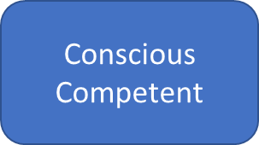
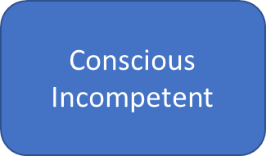
Integrating the role into day to day practice Self-awareness
Unconscious Competent
Unconscious Incompetent
Conscious Incompetent
Conscious Competent
Unconscious Competent
Unconscious Incompetent

Slide 19
Case study

Slide 20
Case Study
Jean has been a registered non-medical prescriber with her regulatory body for the last 36 months, she is an active prescriber in her field. She is an experienced complex case matron (district nurse) but more recently has moved specifically into end of life care. She works a condensed work of Monday-Wednesday.
She has been approached by a specialist end of life practitioner to act as a DPP.
Although they both work for the same organisation, Jean does not particularly know the student and they work in different teams

Slide 21
Case study
Thoughts????
Please post in the chat function

Slide 22
Linking to next session
EXTENDED INTERACTIVE SESSION: Designated Prescribing Practitioners
• the required competencies of an individual taking on the DPP role
• the competencies required in delivering the role
• the learning environment and governance of the period of learning in practice
• using the prescribing competency dimensions for prescribing governance in practice
• governance of non-medical prescribing roles
• interactive discussion around case studies and examples in practice

Slide 23
Learning Outcomes….revisited…
By the end of mini session you will have
• reviewed the role of the Designated Prescribing Practitioner
discussed and reflected on integrating the role into day to day practice
discussed further the role with a case study

Slide 24
Any questions

