Slide 1
Improving the response to emergency admissions for Hip Fracture
Dr Karen Harding
Consultant Orthogeriatrician, NBT

Slide 2
Overview
Our experience of improving hip fracture care at North Bristol NHS Trust
Issues which can arise for hip fracture patients as a result of NBT being a "major trauma unit"
Hip fracture review visits - learning/ideas/common themes emerging from these
Extending outcome data beyond the acute episode
Notes:
What I’m going to cover and why…

Slide 3
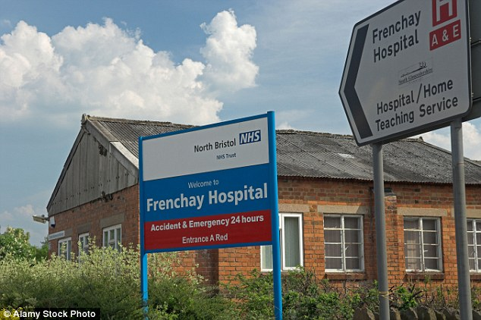
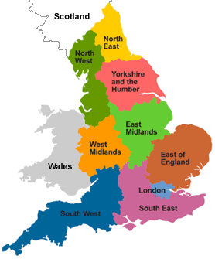
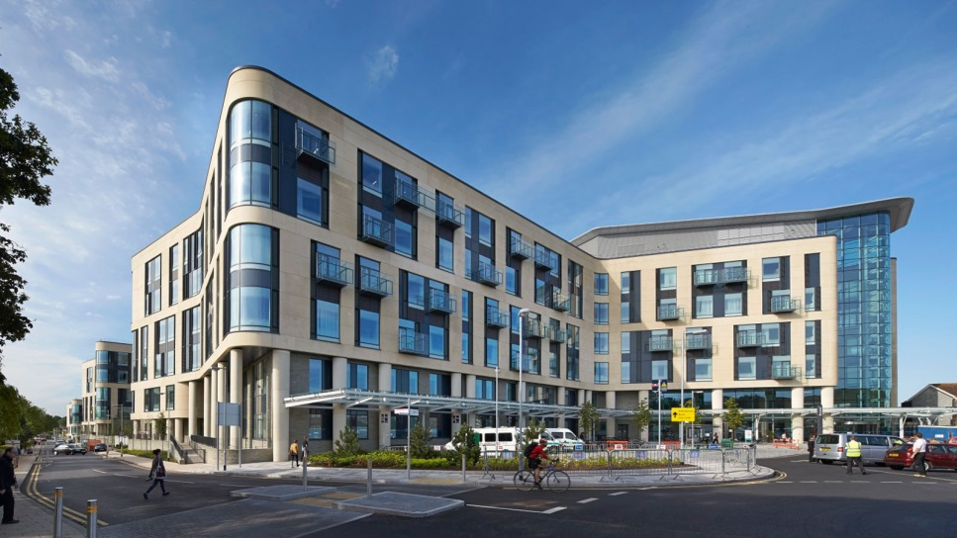
North Bristol NHS Trust
Notes:
2 acute trusts in Bristol admit hip # patients Population ~1 million
NBT serves approximately 500,000 patients and had 2 acute sites until 2014 (ED and trauma sited at Frenchay , MIU Southmead)
Frenchay designated Major Trauma Centre 2012
Moved to new build single site at Southmead 2014 and Frenchay closed – lost ~ 200acute beds
NBT – minimal community hospital beds (x10 Thornbury)
Change in location of ED led to increase ~ 80 hip # patients / year and fewer going to UHB
Weston Hospital ED shut nights and weekends from Summer 2018

Slide 4
Service Evolution
2001 - 2 sessions of liaison / week
2010- in anticipation of hip # BPT I moved to T+O directorate, started a “shared care” model 7 Cons DCC Acute Orthogeriatrics / week 2 band 7 Specialist Nurses (~1.5 WTE) Daily attendance at morning trauma meeting (M-F)
2012 - new Cons colleague = 4 additional DCC sessions
2014 — moved to new hospital on Southmead site
2015 – 2 year fixed term contract to train trust grade OG doctor
2017 — permanent OG staff grade (vacant after August 2020)
Notes:
Liaison sessions - often seeing acutely ill, complex patients who had been seen by multiple different acute med SpRs in between… poor continuity, orthopods poor at engaging with families / setting ceilings of care etc
Our SpN acted like juniors for us
Trauma meeting attendance allowed us to raise the profile of the elderly / frail patients, stop them being bounced off list and engage with anaesthetic colleagues
New hospital - 75% single rooms with 2x 4 bedded bays
Affect on IP falls rate,

Slide 5
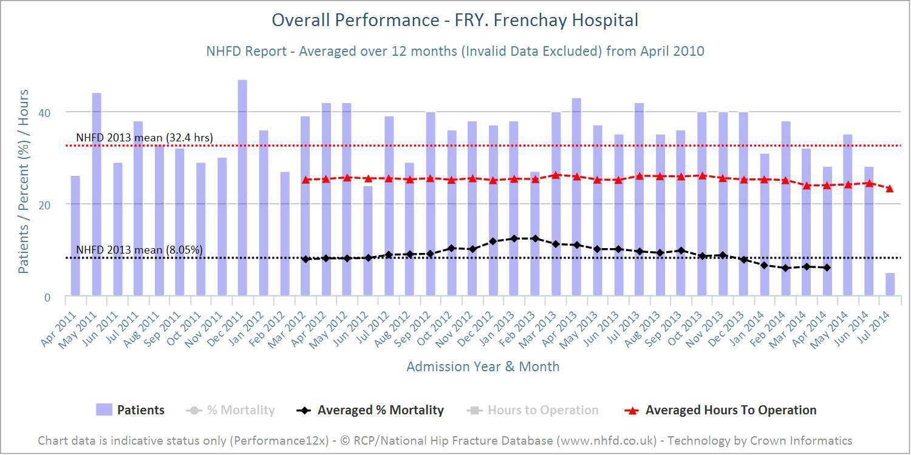
2013 data
Notes:
Mainly to illustrate mortality rate rise …

Slide 6
2013 data - mortality
Data on 454 patients with hip fracture in 2012 - data for the 2013 report
NHFD report for 2012/3 FRY an outlier (more than 2 standard deviations from the mean) for 30 day mortality (55/433 deaths, 12.7% unadjusted ).
National average 30 day mortality for 2013 was 8.02%.
BOA mortality review - early 2013 Implemented changes to admission and improvement process
From early 2013 our 12 month average 30 day mortality improved, below the national average from Jan 2014
Notes:
We were aware of what needed to change – General SAU – hip # not their priority, more trained nurses and very few HCAs (which frail elderly people need input from), poor attention to fluid balance, pressure care, nutrition

Slide 7
2013 data – other measures
In hospital NOFs - Nationally 4.9% FRY in hospital NOFs 8% in 2012, 4.8% 2013 These patients are known to do badly - have around 50% 30 day mortality rate.
A+E to orthopaedic ward in 4 hours – Nationally 47.4% FRY 17%
Surgery within 36 hours – Nationally mean 71.7% (13 to 91%) FRY 80.5%
Non-operative treatment - Nationally 2.3% FRY 0.5%
Pre-operative medical assessment – Nationally 50.5% FRY 84%

Slide 8
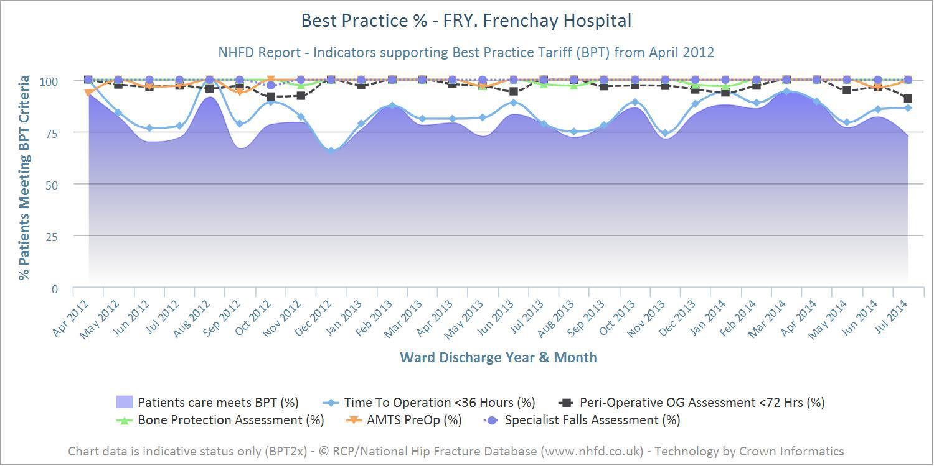
Best Practice Tariff
Nationally in the last quarter of 2013 BPT was 64%
Locally 75-80%. Main limiting factor – time to theatre.
Discharge destination from trust
The preferred pathway = discharged to usual place of residence Nationally 48% went directly home , 18.9% to a rehabilitation unit.
Locally 67% went directly home , 2% to a rehabilitation unit.

Slide 9
2013 data - rehabilitation
Length of stay (LOS)
Mean LOS in acute orthopaedic ward 15.3 days Overall LOS in acute hospital 19.8 days.
Average acute and post acute spell FRY 26 days
Home from home in 30 days
This is a case-mix adjusted outcome Overall 52.7% returned home within 30 days. FRY was one of the 39 out of 182 hospitals that have home from home rates above the upper 99.8% (three SD) limit indicative of particular success in acute care, rehabilitation and discharge planning.
Notes:
We had no provision of rehabilitation hospital beds and community rehab services were in their infancy locally
Ongoing pressure to reduce LOS (which we have done with HaH services) but not necessarily to patients benefit …patients “made safe” at home but physio input often delayed and minimal

Slide 10
Improvement process following 2013 review
Established a “hip fracture unit”, patients admitted directly and priority given to minimising time in ED
Patients had a “named Orthogeriatrician” and regular (minimum weekly) review as well as acute input
Established monthly M+M meetings attended by ED, Anaesthetic, Orthopaedic and Orthogeriatric Consultants
Improvement Projects on: Pain relief - FIB routinely done in ED AKI – redesign of fluid balance charts and medication management peri-operatively Haemaccue and Tx decision in theatre or recovery Ongoing project on use of i.v. iron
Notes:
M+ M - detailed review of all deaths within 30 days
Structured approach - delays to theatre, who operated, post-op review, acute deteriorations / complications etc
ASA grade, expected death?, ceilings of care etc

Slide 11
Evolution of NHFD data
2016 addition of nerve block data to anaesthetic type
2018 new performance indicators: proportion of patients not delirious when tested post-op nutritional assessment – MUST score
Charts / Benchmarks / Dashboards publicly available (FFFAP on RCP website)
2020 femoral shaft fractures added to BPT
Case mix data by site from 2020: ASA grade 1-3 admitted from own home freely mobile missing data
Notes:
Not a static process …

Slide 12
Current key performance indicators (KPI)
Prompt orthogeriatric review (within 72 hours)
Prompt surgery (within 36 hours)
NICE compliant surgery
Prompt mobilisation (out of bed day 1 post-op)
Not delirious post-operation (4AT done within 72 hours of surgery)
Return to previous residence
Notes:
Ongoing monitoring of KPIs, unclear whether BPT will continue

Slide 13
Notes:
KPIs
Mainly to show one affect of Covid - OG nurses used to cover other roles e.g. trauma co-ordination so multiple 4ATs not completed — didn’t actually mean that +++ patients developed delirium

Slide 14
Notes:
NHFD 2020 report (2019 data)
One of 9 trusts that that achieved care >95% confidence level across all 6 KPIs

Slide 15
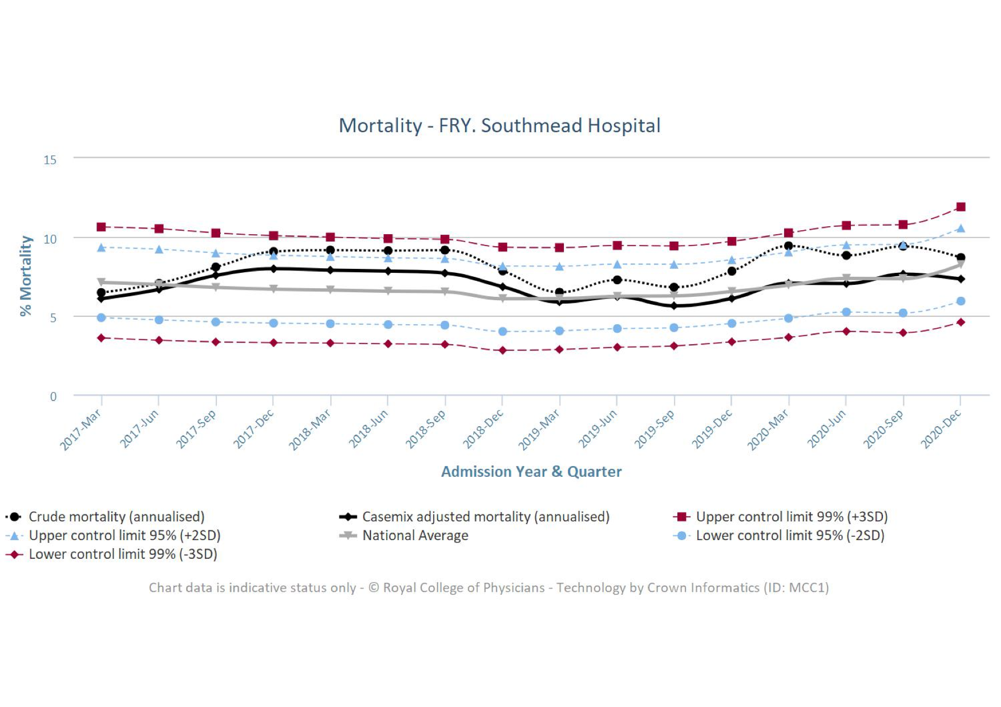
Notes:
Dashed black line is our unadjusted mortality, pale grey line national average
Started to get concerned about our mortality rate again in 2017 (no access to case mix adjustment at the time)

Slide 16
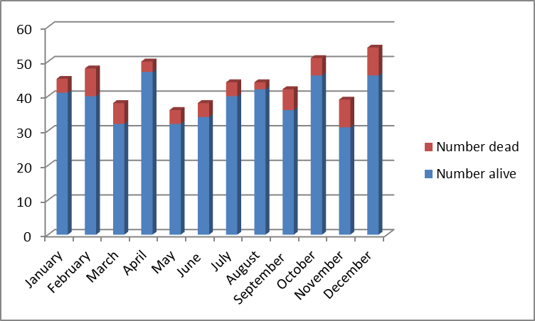
2017 mortality audit
527 #NOF admissions
62 deaths (within 30 days)
1/3 dead within 0-7 days of admission
>80% deaths were expected (either from admission or following an acute deterioration)
No unavoidable deaths
Notes:
8 deaths were in non-operated patients (ie palliated from admission)

Slide 17
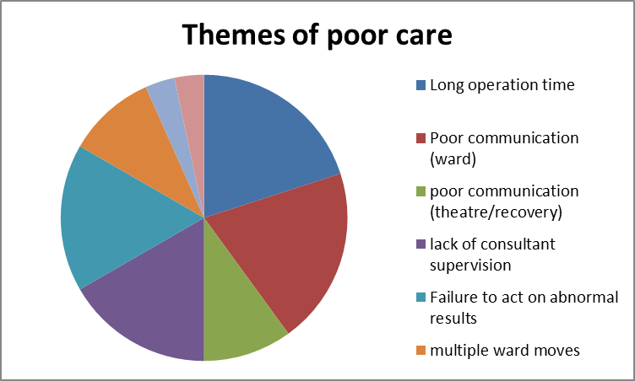
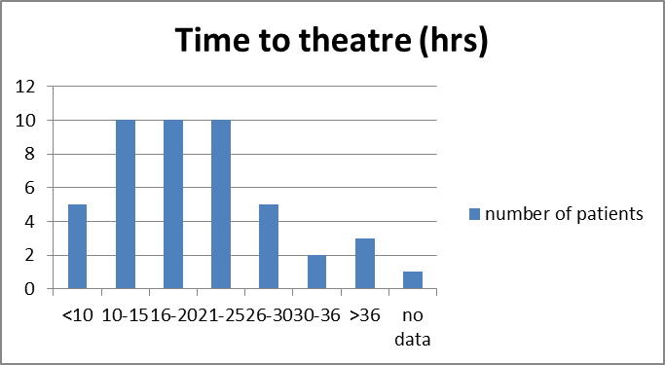
Performance

Slide 18
Recommendations and development opportunities
Avoid delays/long waits for theatre in the most elderly and frail
Avoid long surgery times for very frail, elderly and comorbid patients
Effective communication across the patient pathway
Junior doctor teaching/training
Review of theatre list prioritisation
Review how patients are selected for theatre
Consultant performed operations for the most vulnerable
Improve documentation of : Expected outcomes Changes to Mx from Recovery, Ceilings of care Monitoring required post-op
Re-establish teaching, and front-load at start of rotations

Slide 19
Mortality review
No “obvious” reason for 30 day mortality remaining high
Case-mix adjusted data is reassuring and following our own review and actions has come back to average or below
How much does time to theatre impact an individuals mortality? Evidence that delay to surgery > 24 hrs associated with 9.4% increase in 30 day mortality. Sayers et al, BMC Medicine (2017) 15:62
Increased case load with no increase resources (454 vs 527 = 16% more cases)
Notes:
The association between the day of the week of milestones in the care pathway of patients with hip fracture and 30-day mortality: Findings from a prospective national registry "The National Hip Fracture Database of England and Wales" Sayers et al, BMC Medicine, (2017) 15:62
Sunday surgery (OR, 1.094; 95% CI, 1.043–1.148; P < 0.0001) and a delay to surgery of more than 24-hours (OR, 1.094; 95% CI, 1.059, 1.130; P < 0.0001) were both associated with a 9.4% increase in 30-day mortality.

Slide 20
Major Trauma Challenges
Designated MTC 2012 - major trauma BPT
Multi specialty – orthopaedics, plastics, neurosurgery, cardiothoracic, vascular, general surgery, spinal
Competing priorities e.g. BOAST 4 open # management
High public and hospital profile
Pressure on theatre time from long and complex operations
Mission creep – local units send up more “borderline” cases
Notes:
BOAST 4 - combined OP management
Theatre for debridement within 12 hrs of injury for solitary high energy injury, within 24 hrs for all other low energy fractures

Slide 21
Major Trauma Challenges
Silver trauma – realisation that around 2/3 cases are older patients with relatively low energy injuries and lots of co-morbiditiy
Major trauma BPT commenced April 2019 to engage Geriatricians in care of these patients – require Clinical Frailty Score performed by ST3 or higher grade Geriatrician within 72 hours
Further opportunity for service development - a now requirement to review patients with head injury, orthoplastic and thoracic issues (mainly multiple rib fractures +/- contusion)

Slide 22
BOA Hip Fracture Review Visits
Offered to units with mortality > 2SD above national average on age and case-mix adjusted data
Multi-disciplinary review of the hip fracture patient pathway over 2 day visit
Key findings / recommendations fed back verbally at the end of the visit
Formal written report produced within 2-4 weeks
Designed as a supportive process, highlights areas of good practice as well as focus for improvement

Slide 23
Themes from BOA reviews:
Most units have good insight into problems in the pathway
Issues with split site operating
Provision of an appropriate surgeon to perform THR
Anaesthetic leadership / engagement (with NOF governance / M+M meetings)
Inadequate Orthogeriatrician time / leadership / acuity
Some examples of resistance to change / difficult personalities

Slide 24
Outcome data beyond acute episode
NHFD 120 day follow up is generally poorly completed
Need more detailed information than alive or dead!
What is important to patients? Patient Reported Outcome Measures (PROMs)
Quality of life at different time points – these may reflect quality of acute care and rehabilitation

Slide 25
World Hip Trauma Evaluation Study
The World Hip Trauma Evaluation (WHiTE) was set up to measure outcome in a comprehensive cohort of UK patients with hip fracture. All patients in the cohort are treated under a single comprehensive treatment pathway. A core outcome set, including health-related quality of life, is collected on all the patients.
Participants who temporarily or permanently lack capacity are included
EQ-5D health status is measured in terms of five dimensions: mobility, self-care, usual activities, pain/discomfort, and anxiety/depression
EQ-5D pre-fracture, baseline, 4 weeks, 4 months and 1 year
Costa ML, Griffin XL et al BMJ Open 2016-011679

Slide 26
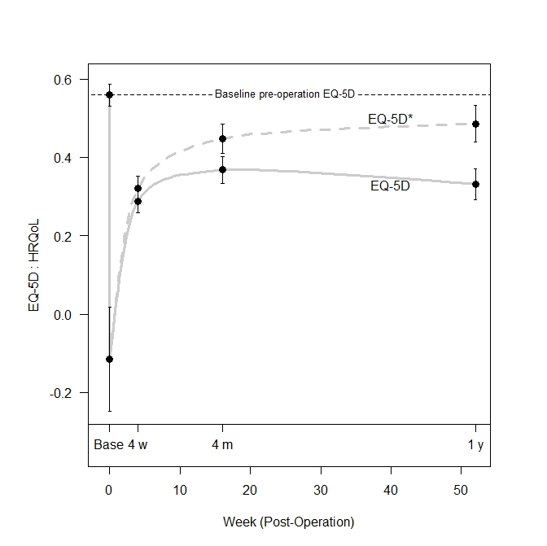
Changes in EQ-5D and EQ-5D* (excluding participant deaths) from baseline (base), and immediate post-operation to 4 weeks (4w), 4 months (4m) and 1 year (1y). Symbols (●) are means with bars representing 95% confidence intervals (CIs) around means.
Notes:
Immediately post-op QoL “worse than being dead”
EQ-5D - little further change after 4 months

Slide 27
Summary
Hip fracture care has improved dramatically over the last 10 years
30 day mortality has reduced from around 10% to 6.5% in spite of increasing age and complexity of patients
Cross specialty multi-disciplinary engagement is crucial
Quality standards and performance measures will continue to evolve

