Slide 1

Hip Fracture Summit 2021
WSFT Hip Fracture Team
A multidisciplinary case presentation, representing our approach
Kasia Bojarska – NHFD Data Officer
Mr Konrad Wronka – Consultant Orthopaedic Surgeon
Dr Mohanraj Suresh – Consultant Trauma Physician
Dr Jonathan Nicholson – Consultant Anaesthetist
Trixie Douglas and Helen Boulton – Nurse Trauma Practitioners
Sheryl Pidgeon – Trauma Ward Manager
Helen Dockerill – Senior Orthopaedic and Trauma Physiotherapist
Notes:
Hello everyone, and thank you very much to the organisers for inviting us back to speak at this summit. We thought we’d do something a little different and take turns to present a case, in the context of the ever changing hip fracture environment, and hope that you find it inspiring, enlightenting and perhaps a little bit amusing!

Slide 2
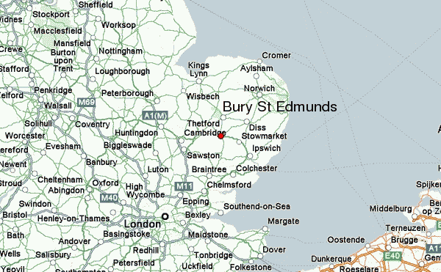
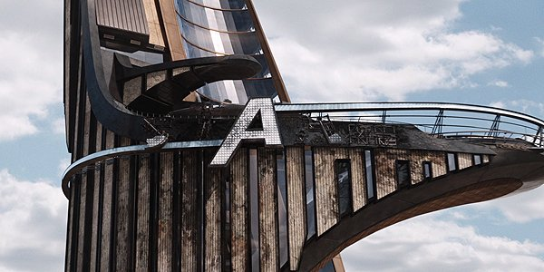
East of England
We’re getting a new hospital!
Notes:
So we are from Bury St Edmunds, smack-bang in the middle of East Anglia, and given the proximity to quite a few other siginificant acute hospitals, you might think (like our Public Health Consultant Associate Medical Director did, who used to work for the DoH, until she came to see us!) why there is a 434-bed hospital here. And we don’t think its because Matt Hancock lives next door.

Slide 3
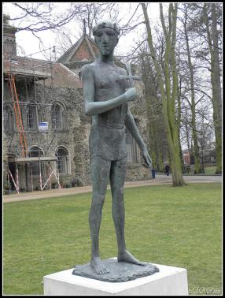
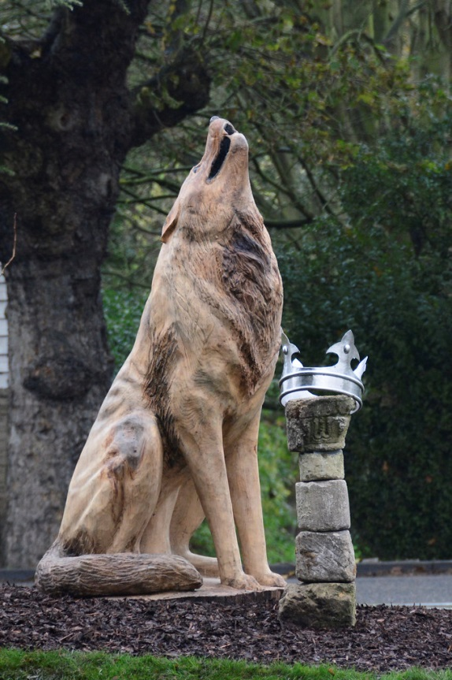
Bury St Edmunds
Edmund The Martyr
King 855-869
Grand heathen army 869
Shot, beat and beheaded him
Head was found by a wolf and re-joined his body
Notes:
Speaking of short reigns, Edmund, King of East Anglia, fought against the marauding Danes. He was captured on the 20th November 869; he refused to give up his Christian faith, so they tied him to a tree, shot him full of arrows so he “bristled like a hedgehog”, then decapitated him. The King’s men came to fetch his body, but couldn’t find his head. Hearing a cry from a nearby wood, where a wolf was protecting the head. The wolf let the men take his head, and when they put it back on his neck, the head magically fused with the body. He was buried in the Abbey. Matt Hancock won’t be, but I’d like to see him bristle.

Slide 4
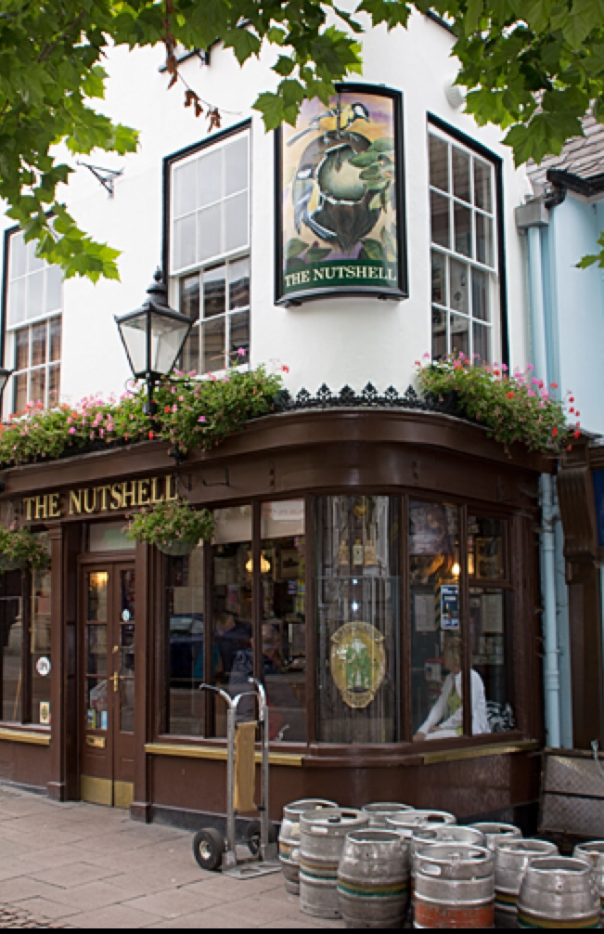
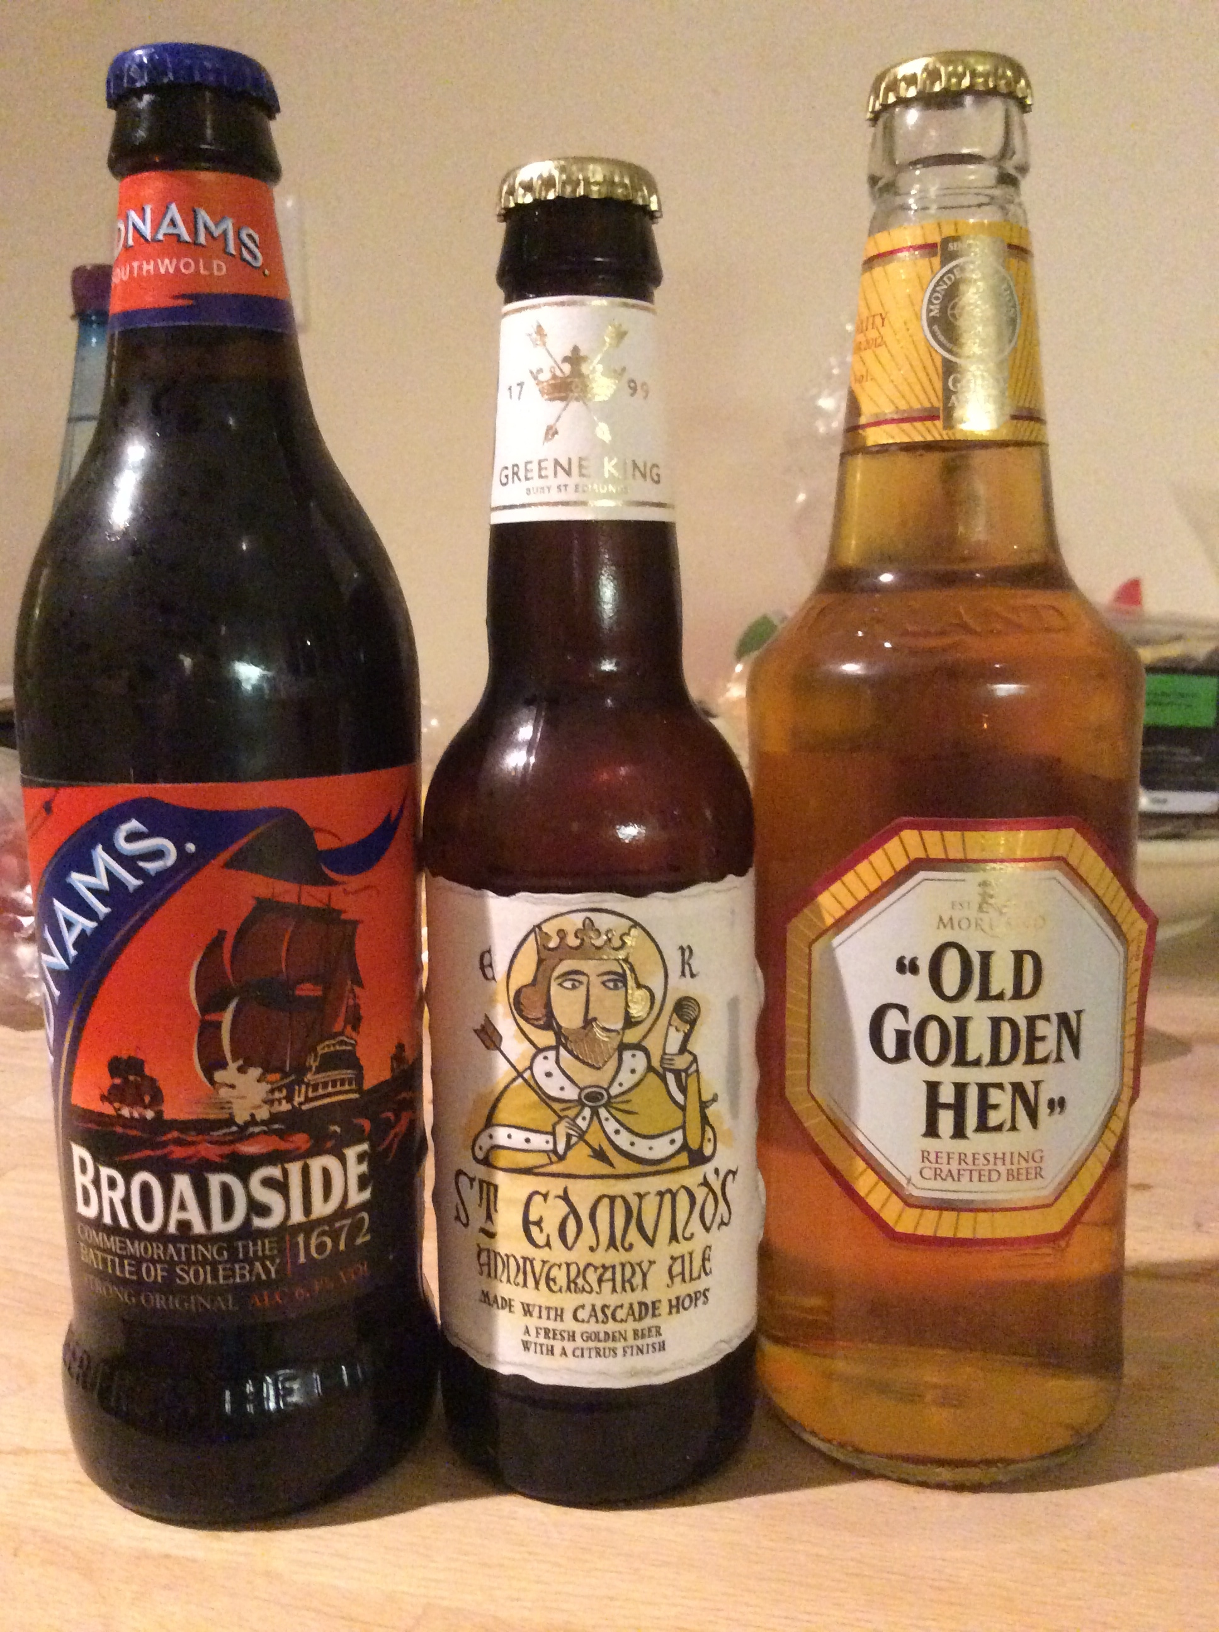
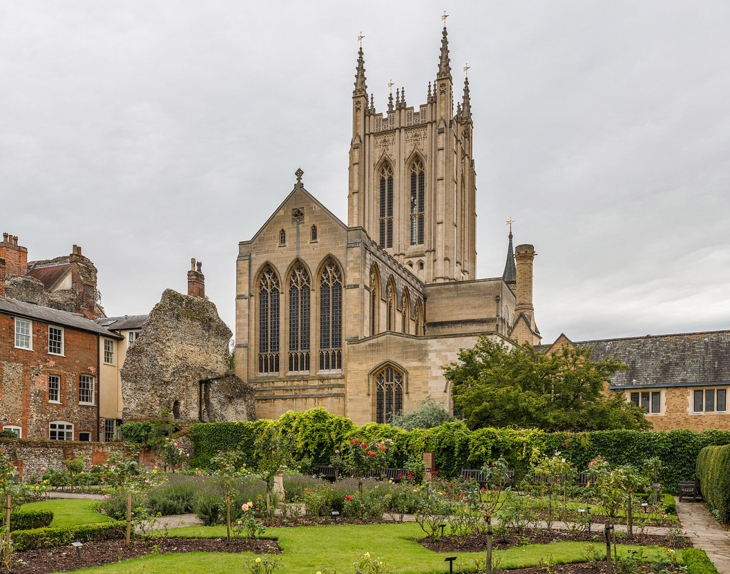
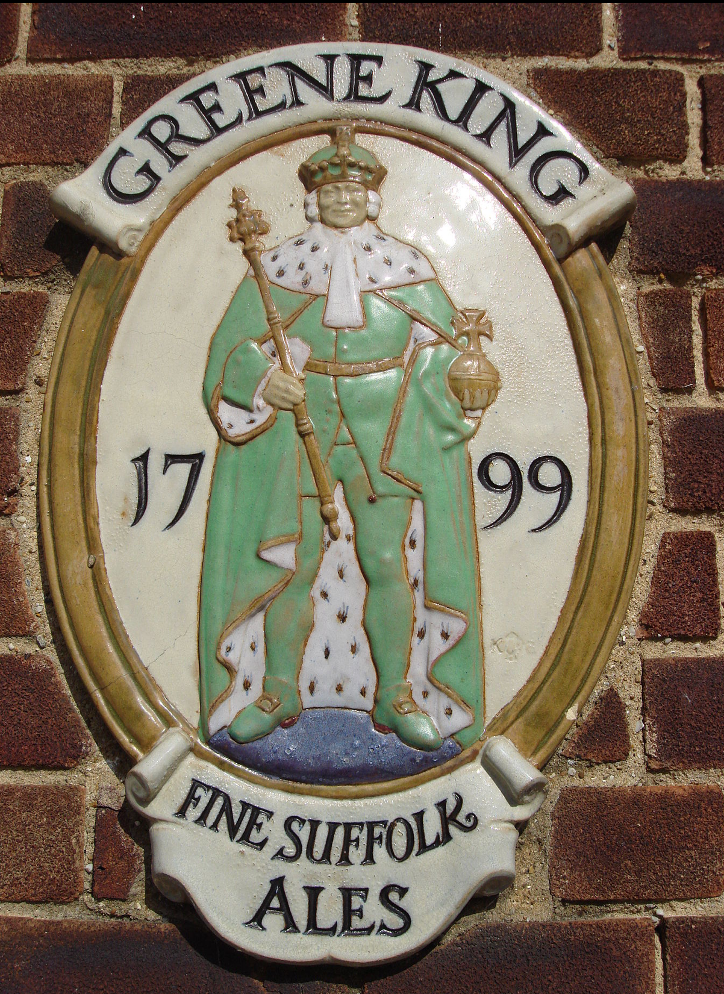
Bury St Edmunds
Notes:
We are now known for our Ales, brewed in town by Greene King, who are known for chemically altering the local water so they can brew for other counties too (well- maybe that’s fairly typical these days) and for the smallest pub in Britain – though in the summer they spilled magnificently out onto the pavement resembling a true Brussels terrace – Matt was very pleased.

Slide 5
West Suffolk Hospital – Hip Fracture Team
Helen B
Trixie
Sheryl
Kasia
Suresh
Jon
Helen D
Konrad
Notes:
So this is us – a happy, hard-working and exuberant hip fracture team! And without further ado, I give you the amazing, the fantastic, please put your hands together for Konrad the Magnificent!!!!

Slide 6
Hip Fracture Summit 2021
Konrad Wronka
Consultant Trauma and Orthopaedics

Slide 7
Aims
Using National Audit to improve Hip Fracture Care Locally
meeting the NHFD Key Performance Indicators
how do you convince your board to give the highest priority to hip fracture patients?
how we have reduced delays in surgical operations
Impact of Covid-19: changing practice

Slide 8
Trauma and Orthopaedic Department
13 Cons (9 O/C)
1 Cons Orthogeriatrician
9 ST trainees
8 F2/GP trainee doctors
2 Trauma Practitioners
ACP
SCP (6 elective)
PT/OT
Data Collection Team NHFD, NJR.
F3 Trauma Ward

Slide 9
Trauma Service
Cons o/c
Mon 8am - Thurs 5pm
Thurs 5pm – Mon 8am
Trauma Meeting 8am
Ward Round
Trauma List (post Covid)
M–F 08:00 – 20:00
Sat 08:00 – 18:00
Orthogeriatric WR:
Mon/Wed/Friday pm
VFC:
Mon/Wed/Fri 7.30-9am
Fracture Clinics – Daily
MTC: Cambridge

Slide 10
Hip Fracture Team
Meet once a fortnight
(minuted)
Review Hip Fracture Service performance
All breaches and issues investigated and discussed/RCA
#NOF discussed at monthly governance meetings
Results disseminated
Lead by example

Slide 11
Patient Journey
SM
87 years old female
Proximal femoral fracture
Sat 12:15pm, 28 Nov - ED
AF, Heart Failure, Chronic kidney disease (eGFR 30) , frailty, HTN, early dementia. 45 kgs
On Apixaban, last dose Sat AM
Family involved, seen anaesthetic team on evening of admission
Aim surgery Sunday PM

Slide 12
Meeting the NHFD Key Performance Indicators
Patient prioritisation
Senior clinician involvement at early stage
Prioritisation of frail and elderly (by clinicians)
Aim of delivering 100% of surgery within 36 hours of admission

Slide 13
Patient Journey
Surgery Sunday
No dedicated trauma list on Sunday…
24h since last dose Apixaban – surgically safe (unless renal failure)
GA
Renal function acceptable and discussion with haematology pre op

Slide 14
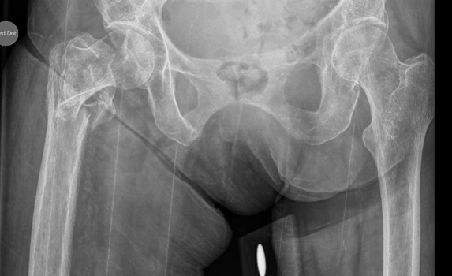
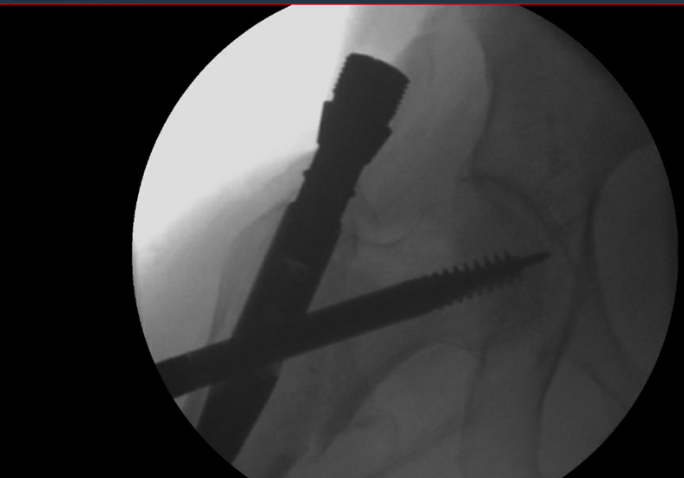
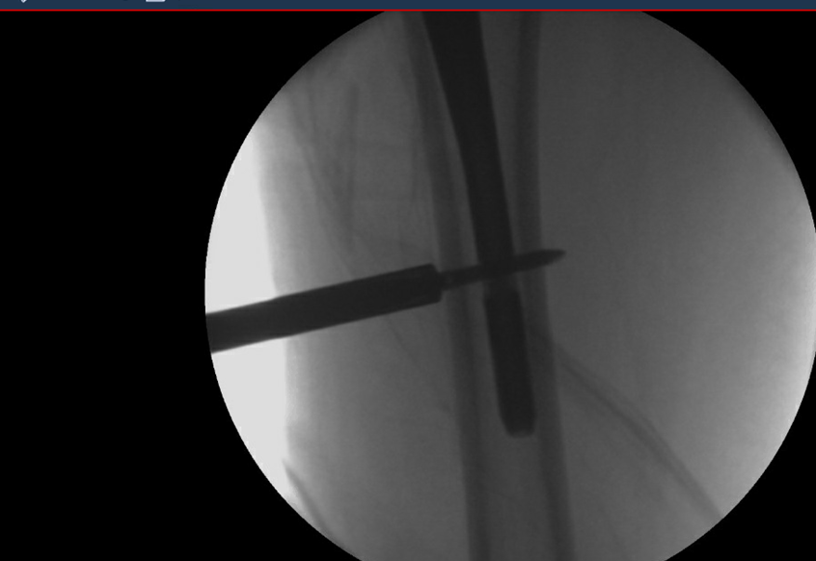

Slide 15
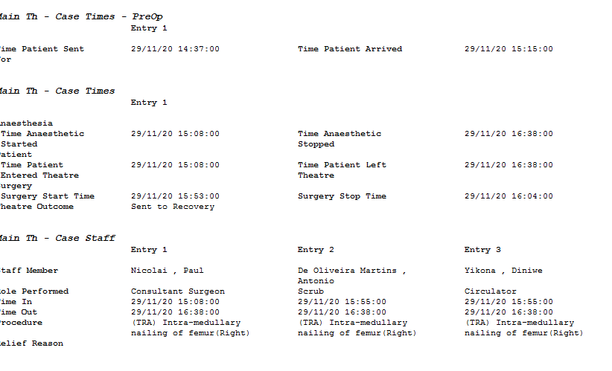
Surgery
Consultant lead
Quick surgery

Slide 16
How we have reduced delays
Evening before plan
Assessment by anaesthetic team evening / night
Golden Patient
Pre operative templating / surgical planning
Theatre meeting with all day plan before list starts
Anticoagulation policy for patient having emergency hip surgery

Slide 17
Best Performing Trust?
Meeting the NHFD benchmarks
Using audit data to monitor care and prompt change
Team work
Evaluating the impact of service change
Ambition

Slide 18
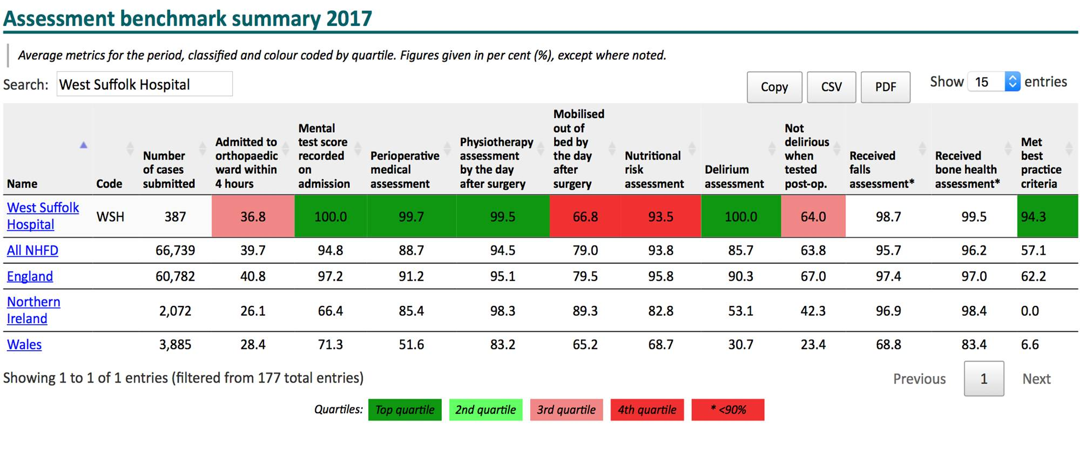
NHFD 2017

Slide 19
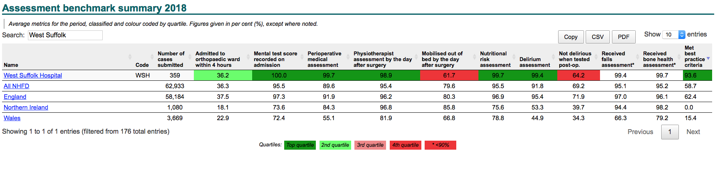
NHFD 2018

Slide 20
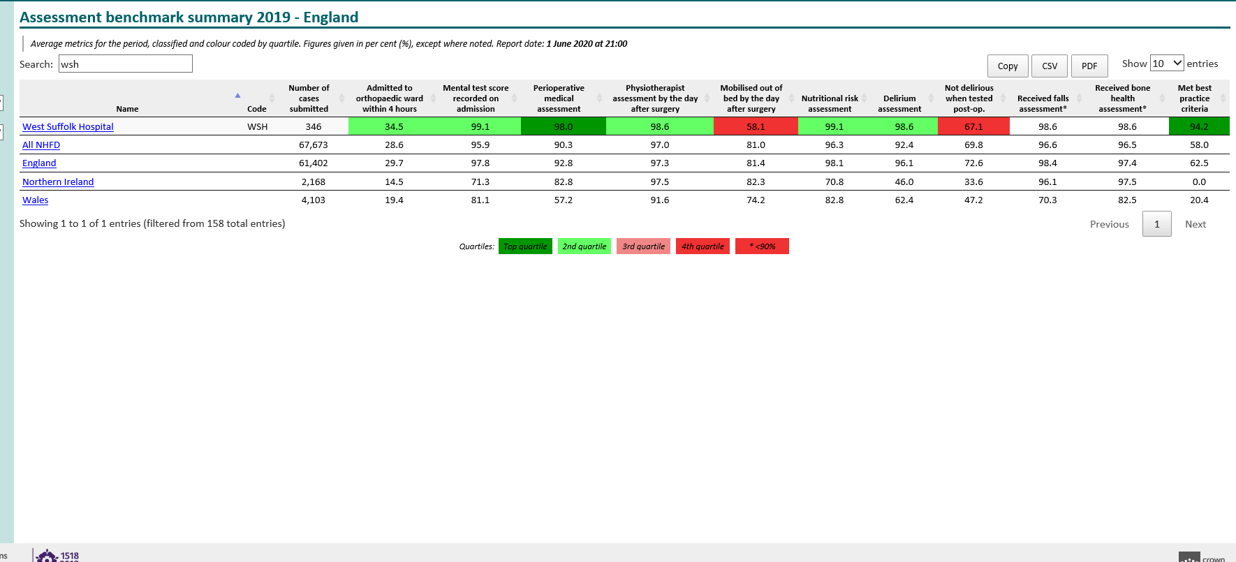
2019

Slide 21
Results – COVID- 19 Times
Fracture of Neck of Femur monthly report
 | 01/01/2020-30/11/2020 | Jan-20 | Feb-20 | Mar-20 | Apr-20 | May-20 | Jun-20 | Jul-20 | Aug-20 | Sep-20 | Oct-20 | Nov-20
Number of #NOFs | 332 | 26 | 29 | 26 | 34 | 25 | 23 | 28 | 28 | 40 | 44 | 29
BPT% (Best Practice Tariff achieved) | 93.37% | 92.31% | 100.00% | 100.00% | 88.24% | 88% | 91.30% | 92.86% | 92.86% | 97.50% | 90.91% | 93.10%
Number of patients lost to BPT | 22 | 2 | 0 | 0 | 4 | 3 | 2 | 2 | 2 | 1 | 4 | 2

Slide 22
How do you convince your board to give the highest priority to hip fracture patients?
Impossible task
Being best – good and bad
Involve Exec team. They are proud of good NHFD too!
Elective surgery cancellations
Support from all consultants in T&O and anaesthetic department

Slide 23
How do you convince your board to give the highest priority to hip fracture patients? – Covid-19
Full day trauma rather than half day 6 days a week started July 2020
Hip Fracture surgery considered high priority and done out of hours
GIRFT Trauma pilot

Slide 24
GIRFT for Trauma review Nov 2020
Excellent overall practice
Recommendations:
  Need 7 days trauma list
  Day 1 mobilisation
  7 day/week orthogeriatrician

Slide 25
Our NHFD results

Slide 26
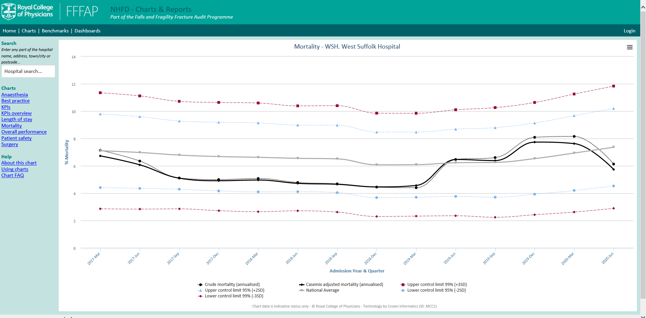

Slide 27
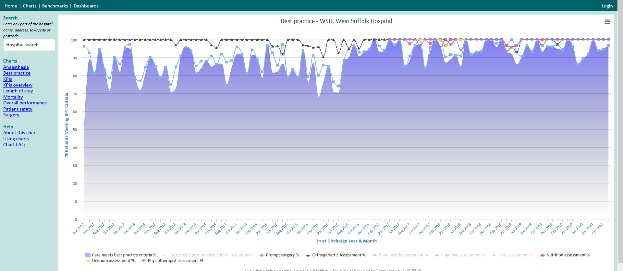
Covid-19
All day trauma list Mon- Sat

Slide 28
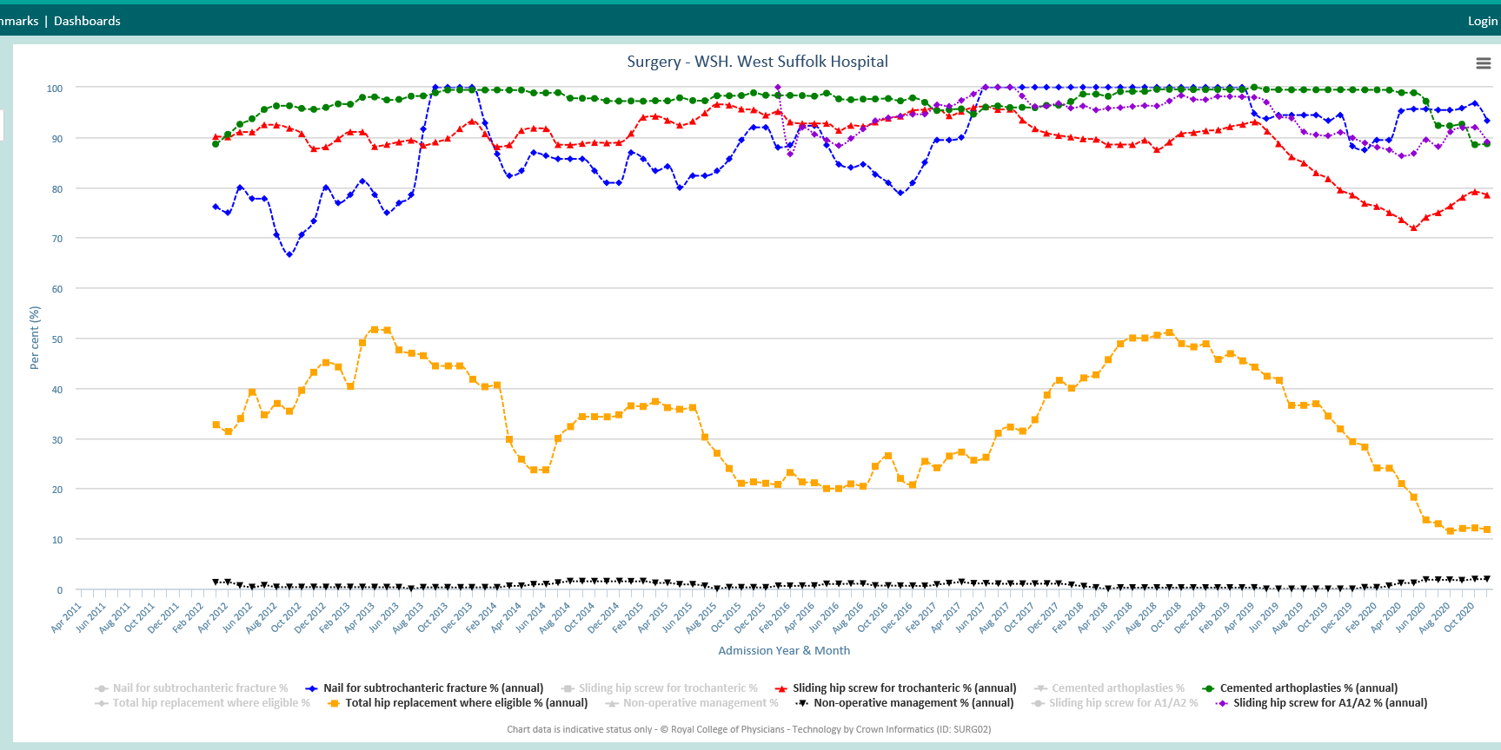

Slide 29
Patient Journey – D1 post op
Attempted physio- low BP
Seen dietician, falls assessment done
Transfusion RBC
Discussion about discharge destination took place

Slide 30
Patient Journey
Stood D2
Sat up D3
Mobilised D5
Complicated recovery by episodes of fast AF, AKI, HAP
Discharged Christmas Eve (4 weeks) - Rehab

Slide 31
WSH Review-Risks We Identified
PT Cover OOH
50% of work comes in OOH
Th Capacity M-F (Sat too)
7 Day working
Cancellations ownership
NOAC’s
Handover Hiatus
Ward staffing
Safe Discharge
Notes:
Other units are seeing where they can get better,
We are already good so small let alone big improvements are ahrd, maybe a role for marginal gains
We have to ffer a 7 day a week service but only have planned trauma lists 5 days a week, with 7day working a realirty for all trauma service providers we have to look at this, but we still share a single list with ALL other speciclaities
Ward staffing is an issue, ortho is heavy lifting these patietns are hard and heavy work, they are some of the most vulnerable patientds in the trust, its not easyu keeping and valiuing our staff and recruiting onto the ward can be an issue\
Discharge to a safe place, social and local authority provided care is becoming increasingly scarce, rehab space is at a premium
Physio OOH not enough of them esp when trying to deal with chests and elective ortho
Demographics, older patients are living longer there are more of them and lots are moving to suffolk
Tariff keeps going down, without a commenserett increase in BPT
Unsure of the role of BPT if we all go onto block contract

Slide 32
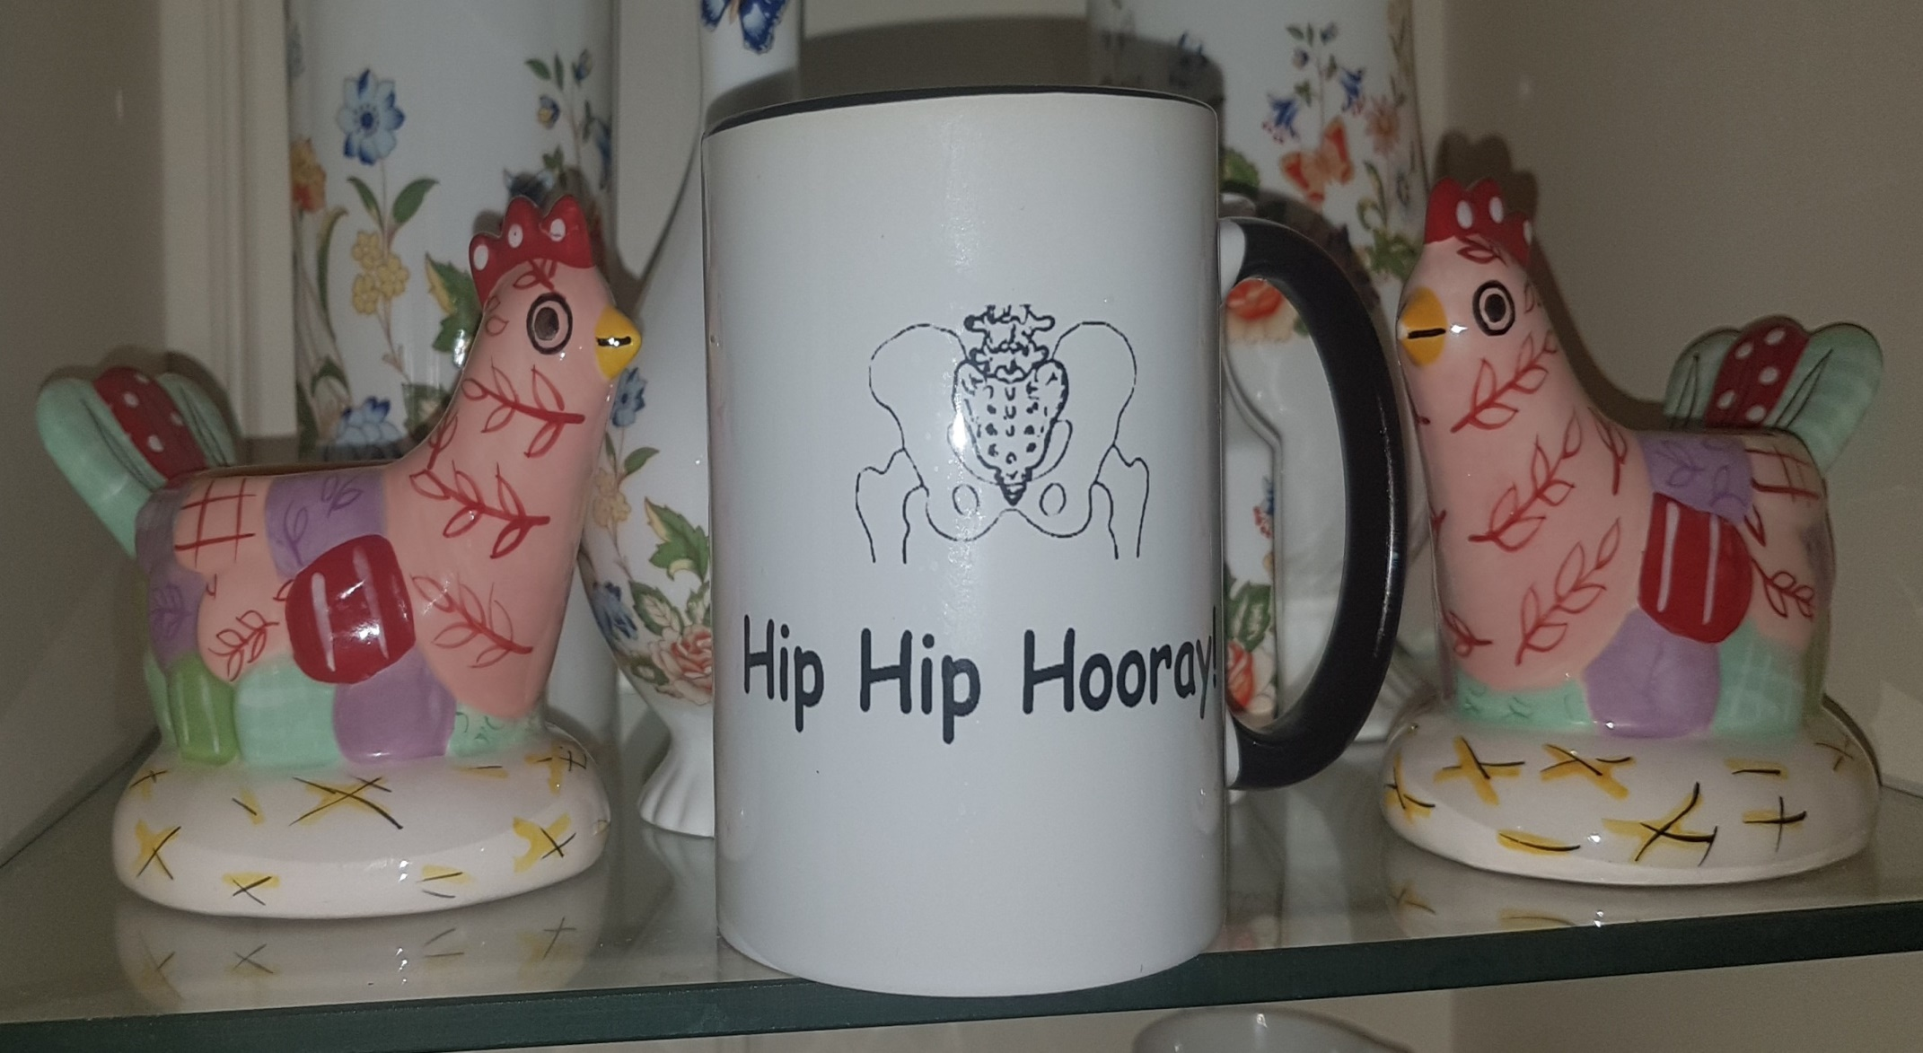
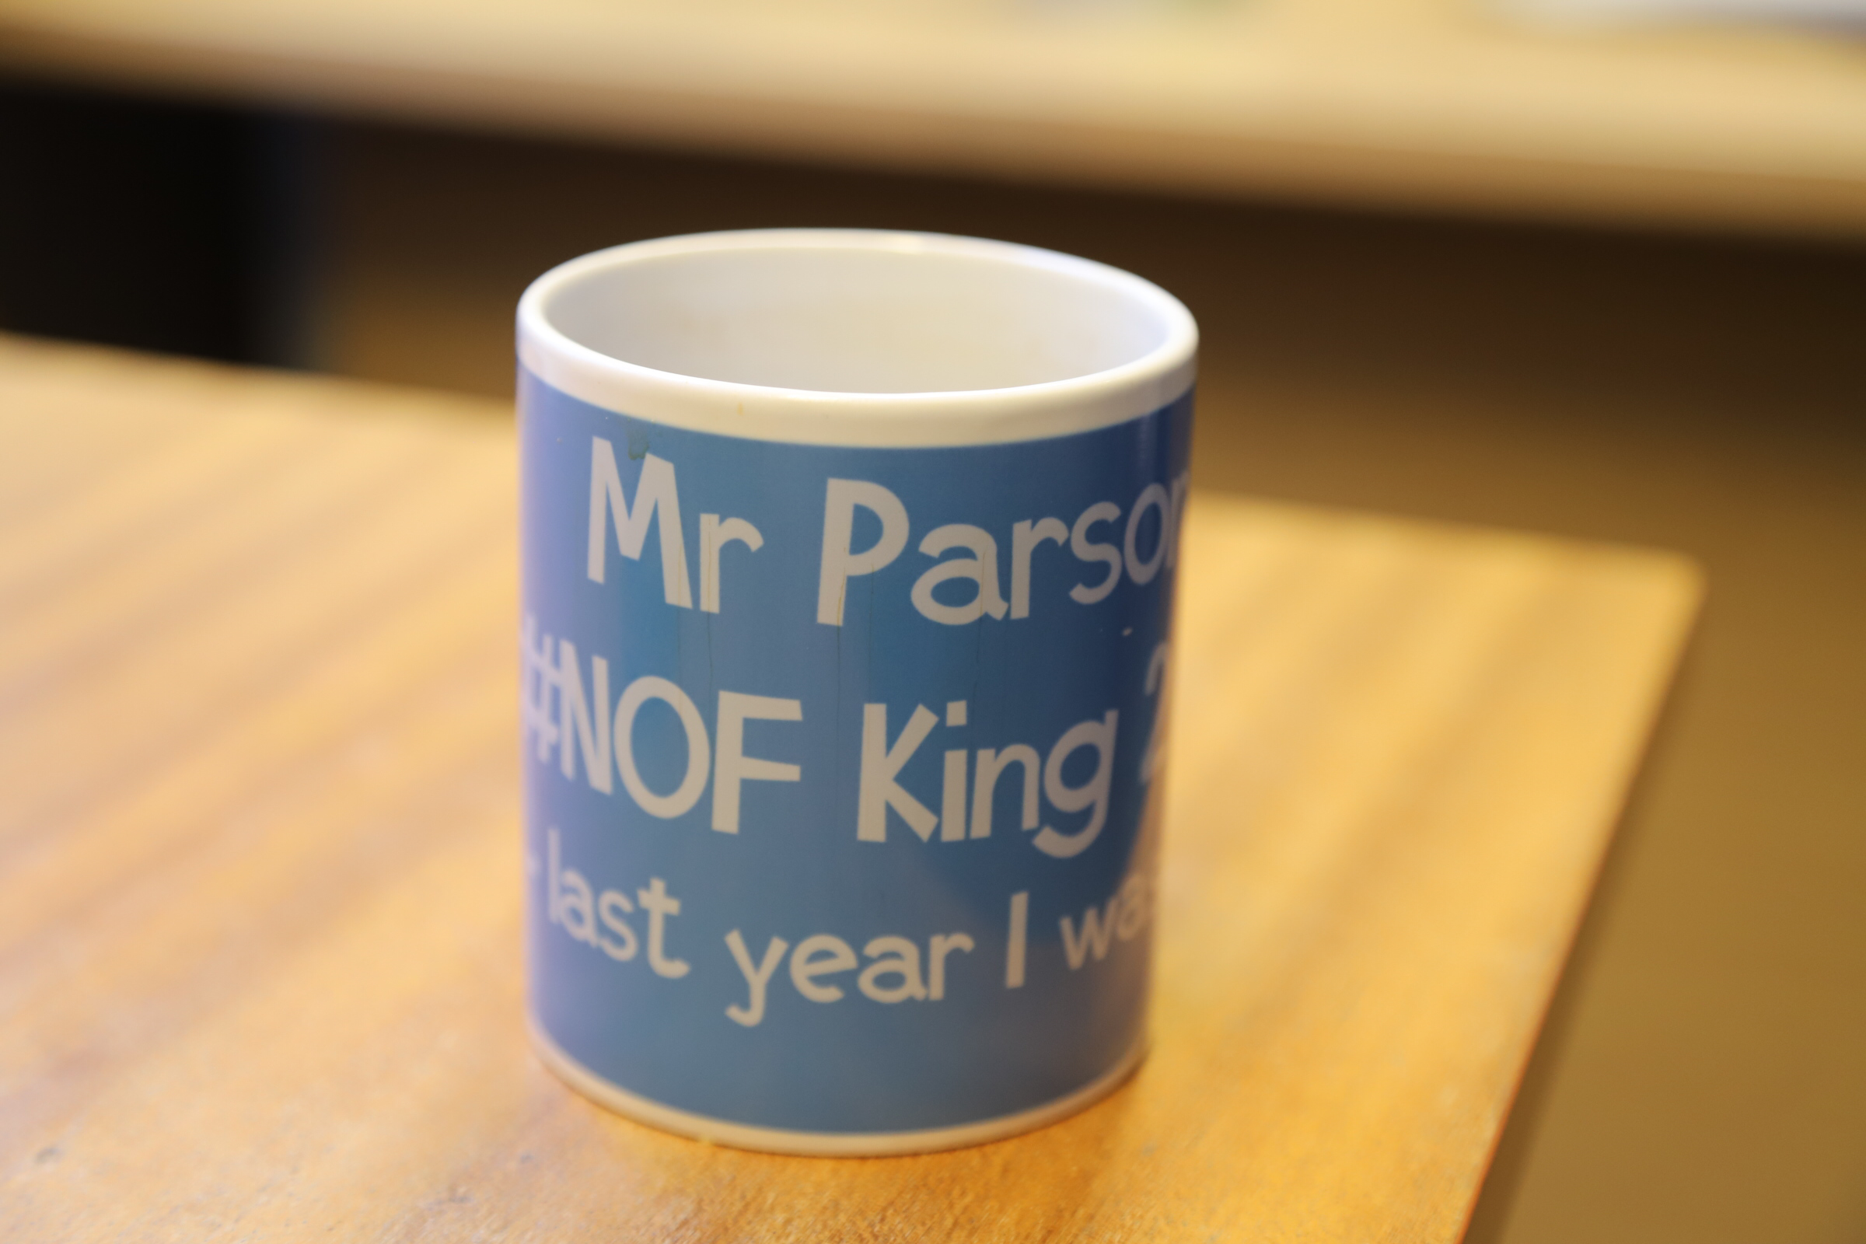
Change – Not Easy
Make it competitive no-one likes being last!
Introduce incentives
Human Factors?
Share your information

Slide 33
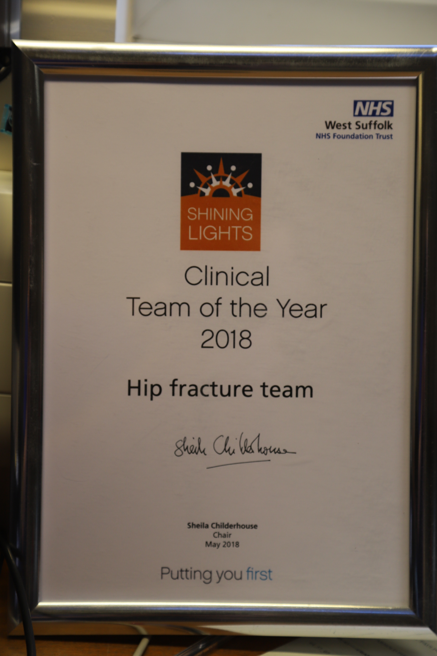
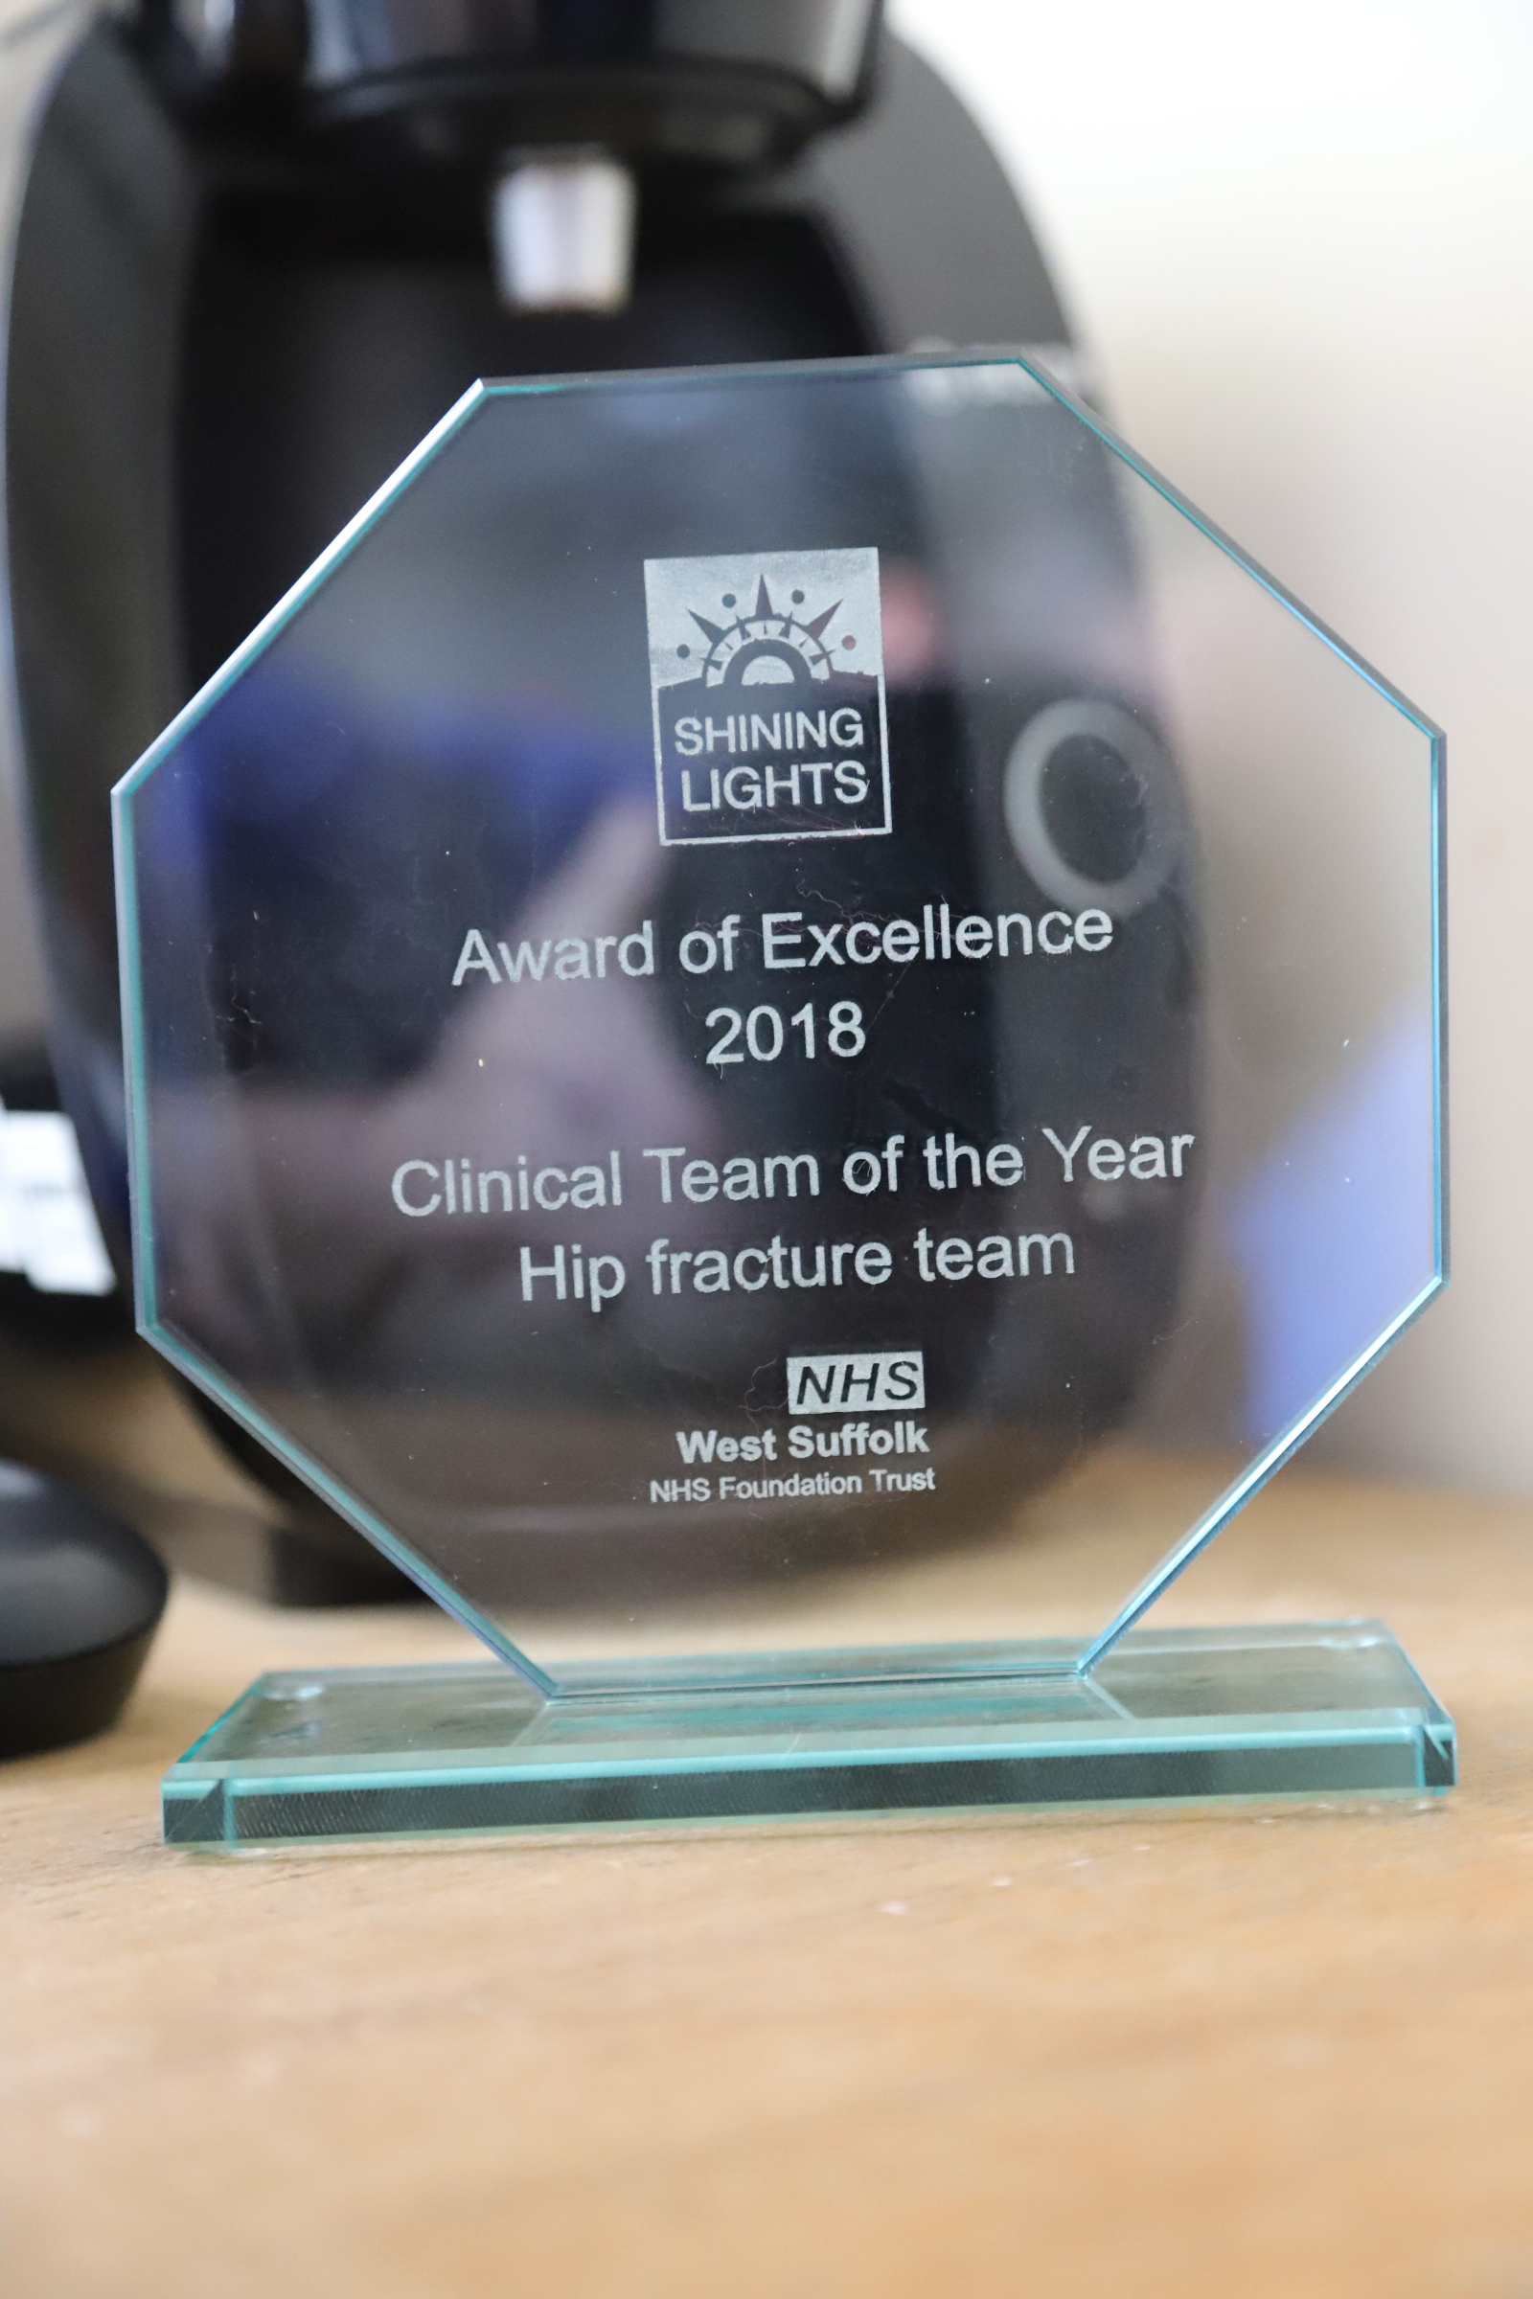
Change – Not Easy

Slide 34
Scaling up
'Golden Patient’
Early Anaesth Review
Th3: 8.15am send (wish)
Prioritization
Consultant Education
Haematology
Weekend Trauma Lists
Longer Trauma List

Slide 35
Marginal Gains
Dietician
Peri operative warming
Fascia iliaca block
Delirium Assessment and Rx
Family information

Slide 36
Challenges
Maintaining Standards
Peri-prosthetic #
Only four people able to do THR
Teaching ?Cons Op
Extending trauma lists

Slide 37
Tips for Improvement
Review NHFD data regularly
Make it personal
Expect challenges
Involve Exec team
Strong Leadership and Core Team
Be clear about your plan
Involve the rest of your department

Slide 38
Trauma Practitioners
Trixie Douglas and Helen Boulton

Slide 39
Our Role
Communicate effectively between the integrated team.
Clerking the patient including diagnostics, investigations, check EPARS, consent and marking
Analgesia – FIB
Prescribe medication and fluids
Set a clear plan with aims and objective’s for the patients journey from admission to discharge

Slide 40
The Patient
Met the patient Monday morning (no practitioner cover over weekends!)
Initiated Fractured Femur and Periprosthetic Femur care pathway (Includes, AMTS, Bone Protection, bloods, Nottingham Prognosis Score, 4AT and medical check list completed).
Checked post-op bloods
Prescribed bone protection; creatinine clearance 15ml/min so Denosumab with Adcal D3, Vitamin D 85 so colecalciferal not prescribed
Falls assessment completed
Nutritional assessment checked
Seen by Orthogeriatrician

Slide 41
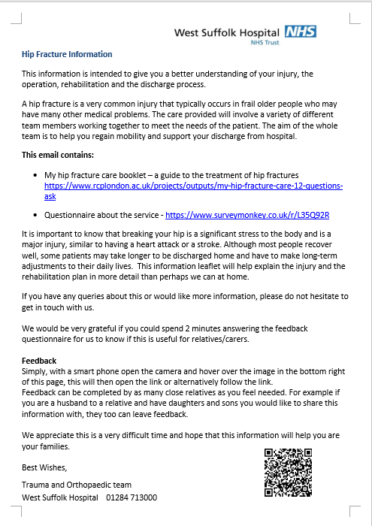
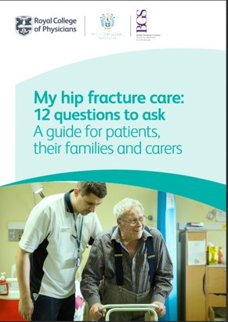
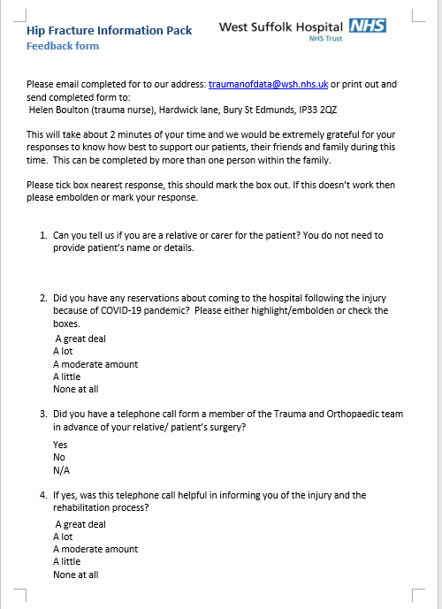
NHFD Leaflet

Slide 42

Sheryl Pidgeon
Ward Manager of F3

Slide 43
Patient’s FIRST
34 bedded ward; inclusive of 4 side rooms.
Strong Leadership.
WM supported by 4 Ward Sisters and a charge nurse. One Sister/CN on duty every day.
Care co-ordinator who organises all complex discharge needs. Discharge plans commence on admission.
Red-Green board rounds held daily inclusive of the MDT.
Trauma Rounds daily-lead by Trauma Consultant and practitioner.
All nurses lead by example e.g. weighing all patients on admission and completing MUST score.
Clear concise communication between patients relatives and the MDT . This improves patient experience and decreases length of stay.

Slide 44
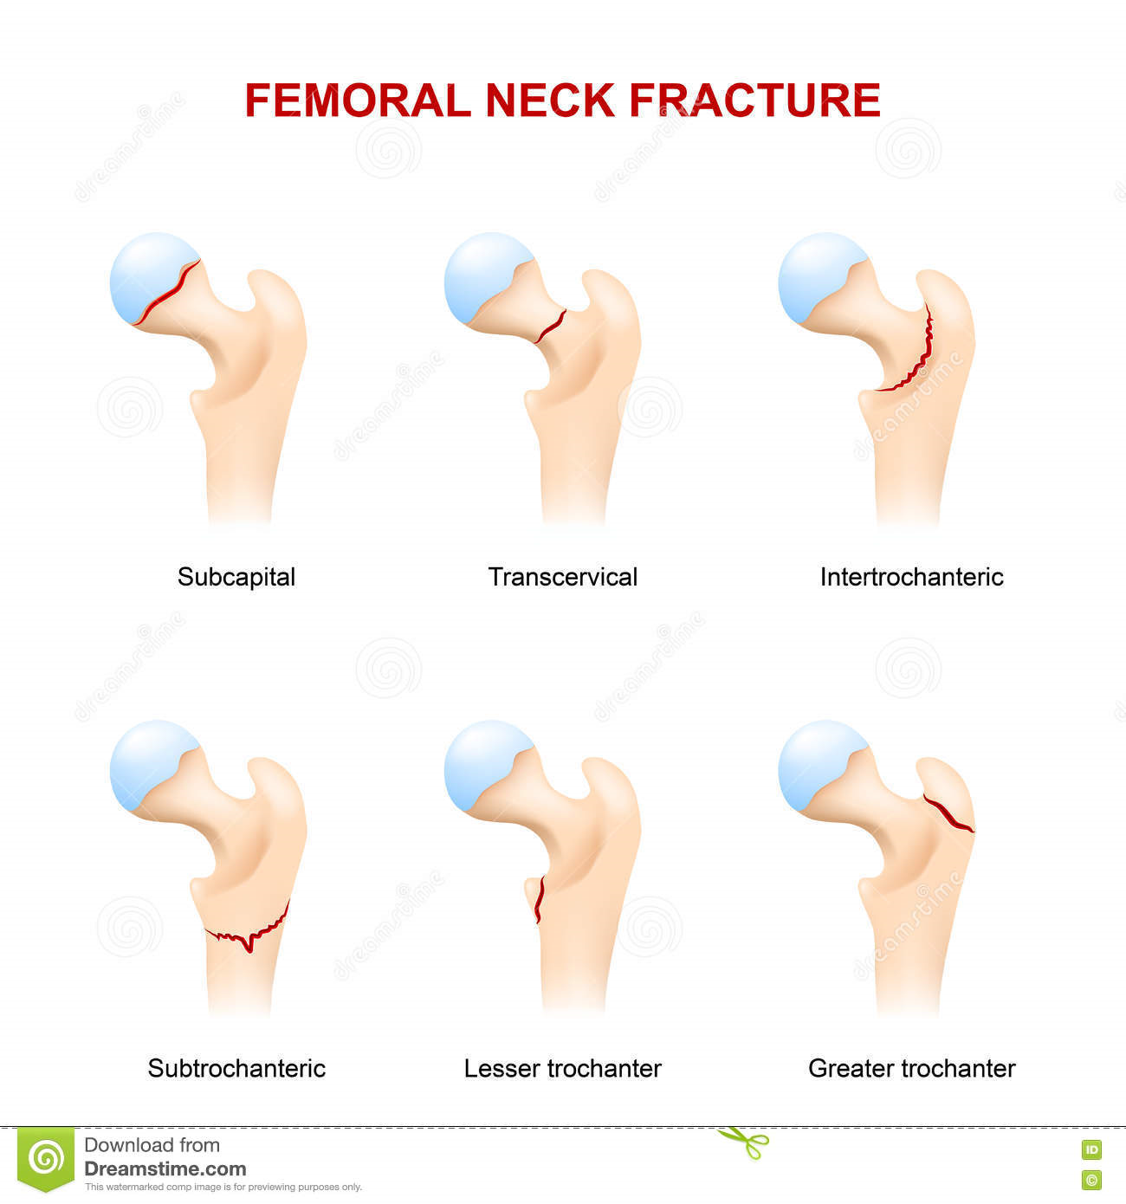
TEAM
Together
Everyone
Achieves
More.

Slide 45
The Anaesthetic Input
Jon Nicholson

Slide 46
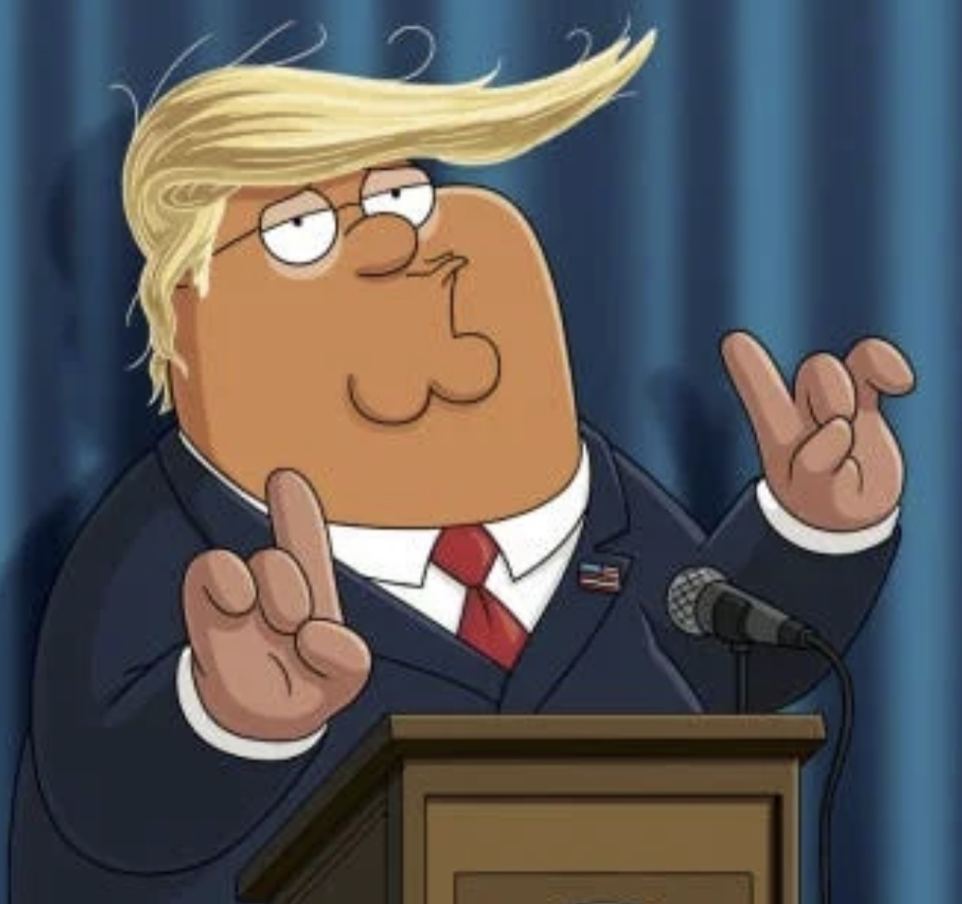
Have I been as involved with the team as I should?

Slide 47
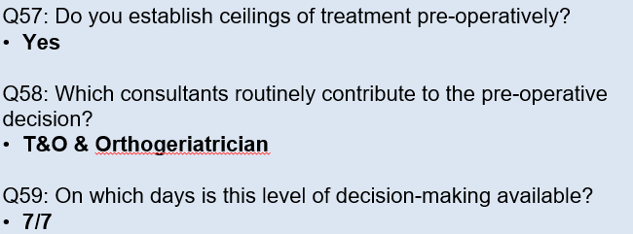
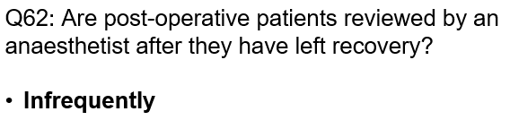
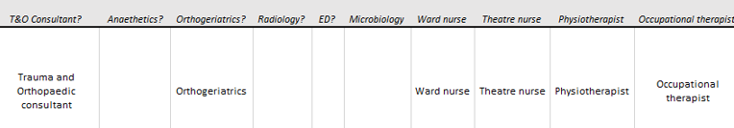
Notes:
Deep dive note – Inconsistency noted that earlier seen that orthogeriatrician not available at weekend

Slide 48
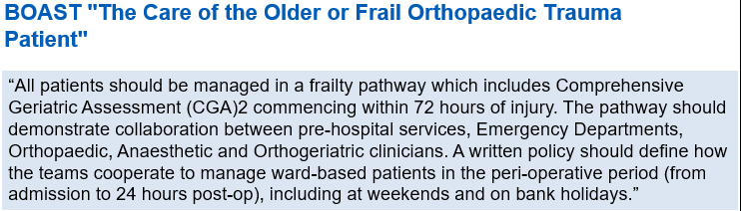
Notes:
Deep dive note – Inconsistency noted that earlier seen that orthogeriatrician not available at weekend

Slide 49
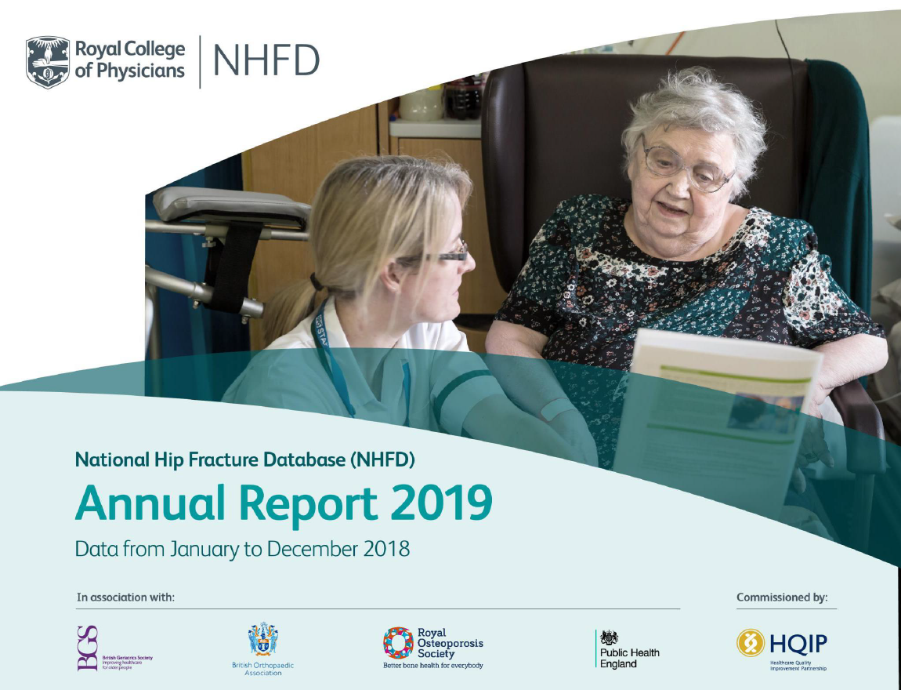
Notes:
If we as anaesthetists think we don’t have to engage with NHFD, then I urge you to think again. This is going to be a self-flagellating confessional talk, so there’s a lot of information, but I want to be brief!

Slide 50
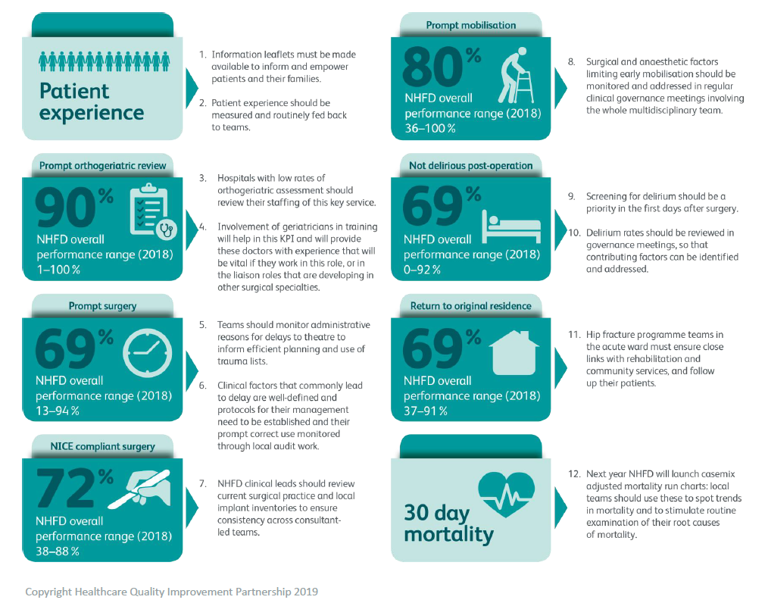
KPI’s
Notes:
I’ve been doing this a while, but have I been pulling my weight? These two infographics are the only ones I have no control over, or rather, responsibility towards (though I could speak up if I see a problem).

Slide 51
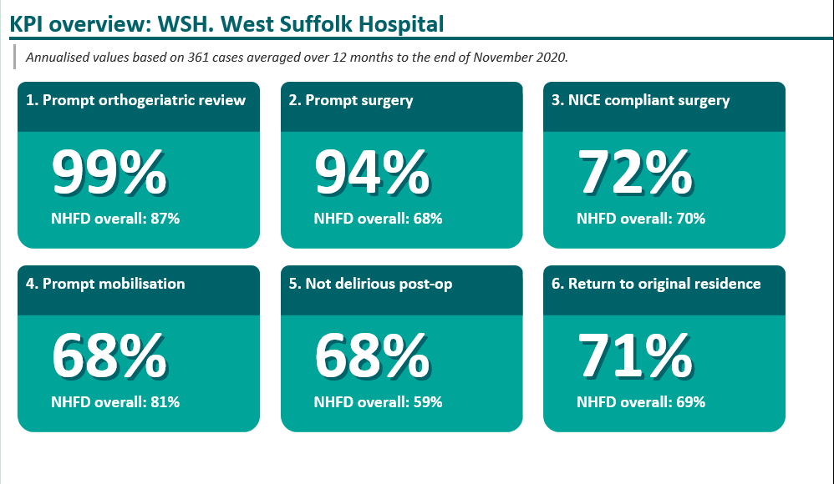
?

Slide 52
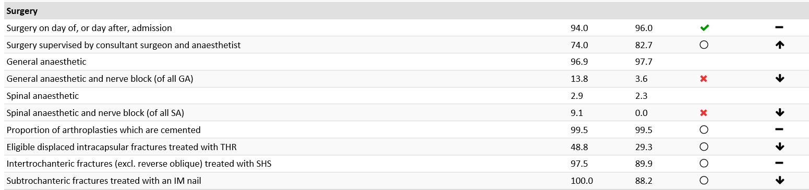
WSH surgical and anaesthetic data

Slide 53
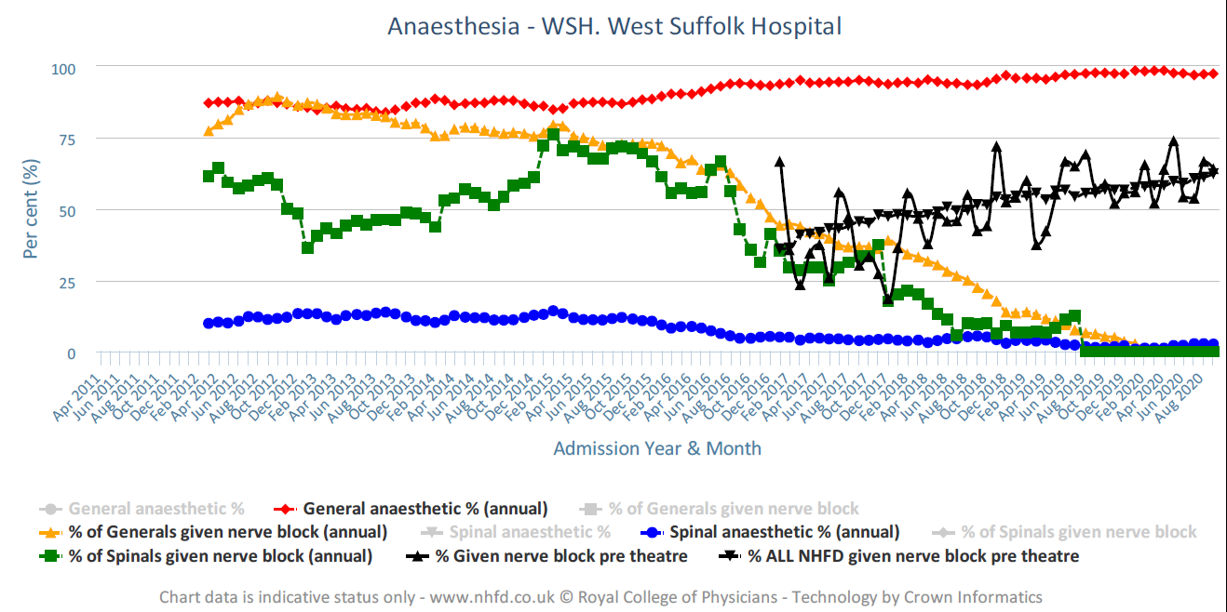
Notes:
Its not that we stopped doing nerve blocks in theatre, but we stopped recording them – transition from paper theatre care pathways to electronic eCare, and no-one thought to put a box for the theatre staff to record an intra-operative nerve block as had been happening on the old paper system. I think the new curve demonstrates the fatigue of the trauma practitioners and data officer in trying to extract the information out of eCare! As well as my failure in noticing the downward trend.

Slide 54
Updated AAGBI guidance 2020 – FFN principles 2018
Part of MDT
Since appt of orthogeriatrician (2011).
Fortnightly meetings now.
Appropriately experienced
Departmental agreement to ‘job-plan’ every trauma list with a consultant (2016). Recent agreement to staff Saturday trauma lists (2020)
Help develop care pathways
Have been doing since appointment. Clinical guidelines, training programme for TP’s doing pre-op FICB, learning about pre-optimisation.
Help facilitate surgery <36hrs
Agree local standards of care
Since having engaged keen consultants doing the lists.
All-day lists will help get anaesthetists into the trauma meetings (I hope).
Train trainees in hip fracture care
Guidelines on peri-operative anaesthetic management since 2016; consultant led-service; COVID response.
Participate in data collection
National – NHFD, ASAP.
Local with audits in various aspects of care.
Regular in-theatre training, supervision, and sign-off for orthopaedic and regional anaesthesia ‘blocks’.
Notes:
The working party endorse the international Fragility Fracture Committee’s principles of anaesthesia for hip fractures
Point 4 – Consultants job-planned to trauma lists. Now that we are doing all day trauma as a side-effect of COVID, I’m hoping this will mean consultants in that theatre all day, and will be attending the morning trauma meetings.
Point 5 - Local audits – pain and analgesia; FICB technique (ED vs ward staff) – led to training ED staff, but they still won’t do it right!); Hb – measurement in theatre (HemoCue vs A/VBG vs lab) and Fe studies – led to getting haematinics done routinely and IV Fe on the ward post-op).

Slide 55
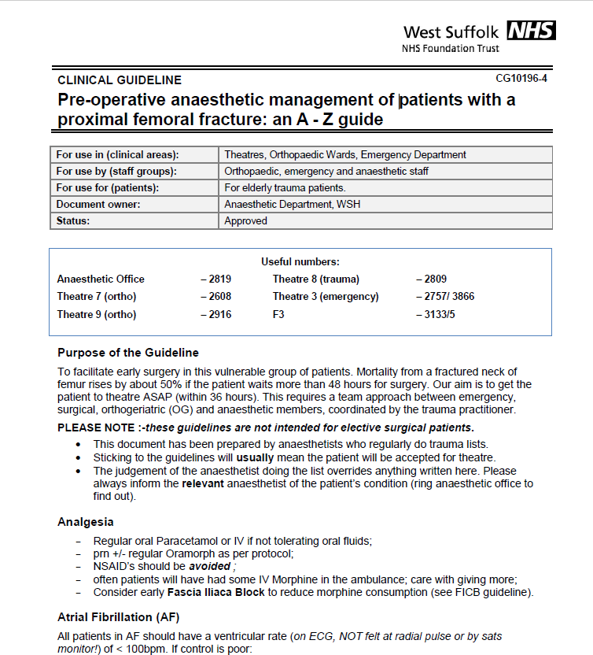
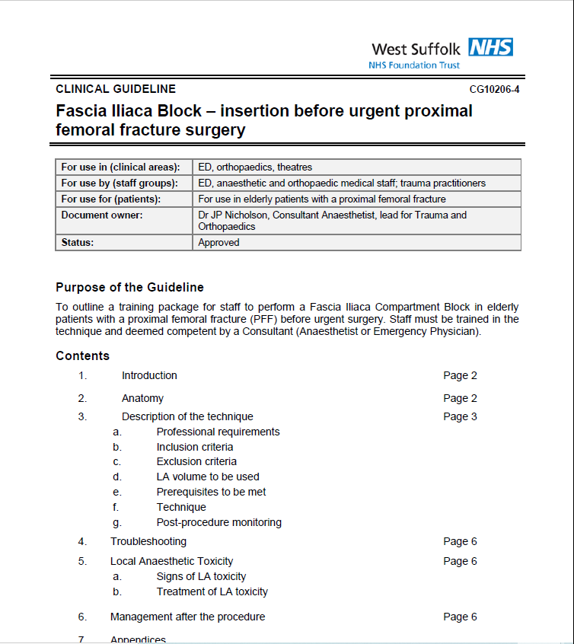
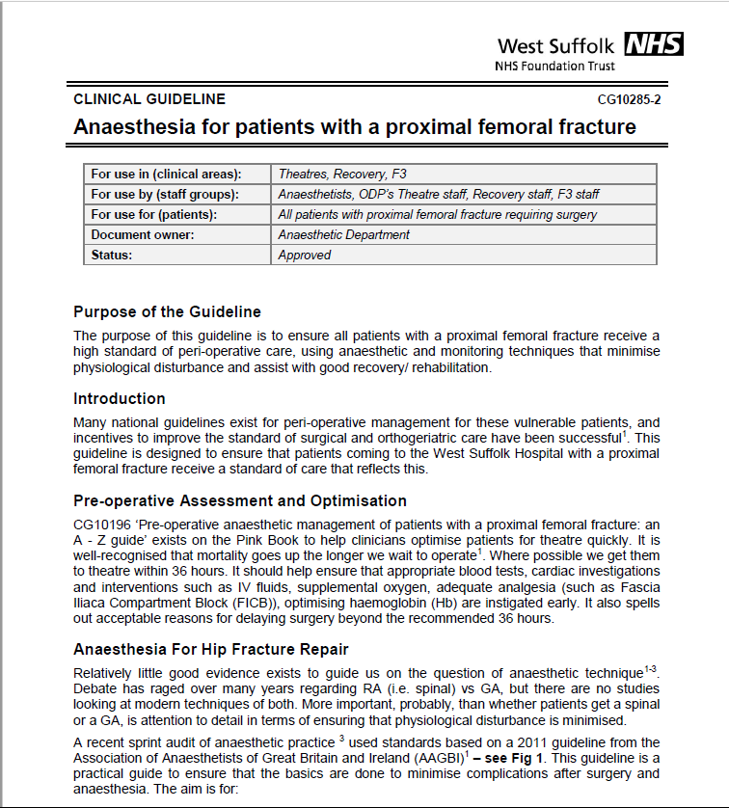
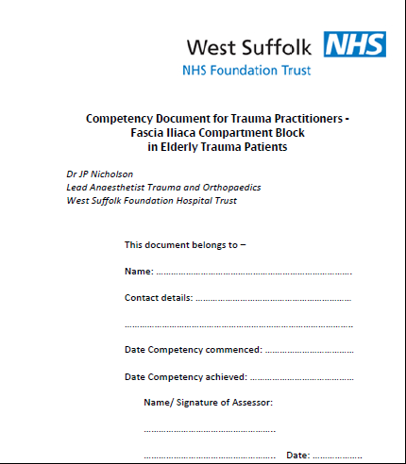
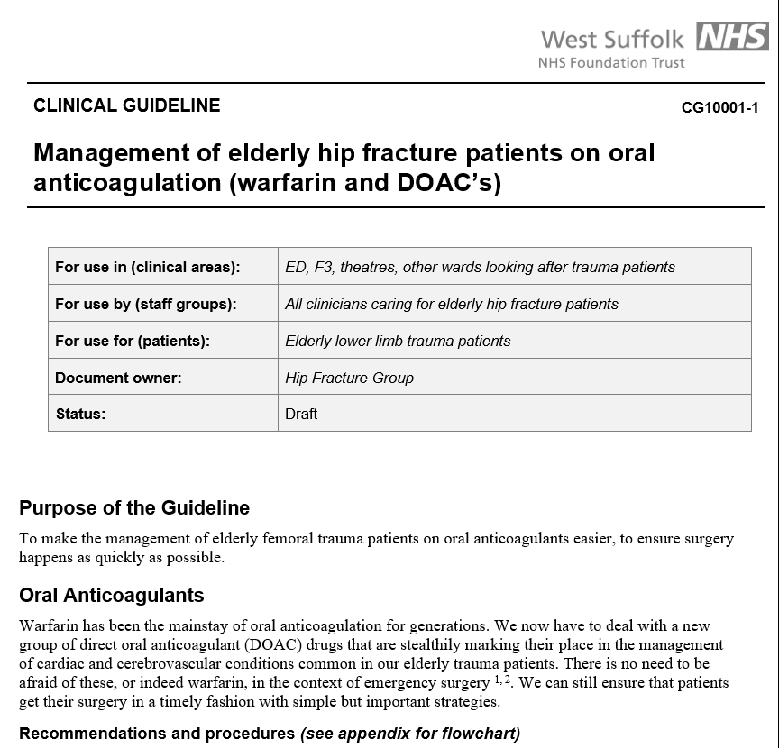

Slide 56
Aims of anaesthesia in hip fracture pathway
Pre-op preparation(“Pre-habilitation”)
  We get involved at admission to enable surgery within 36hrs
    Standardise pre-op assessment, treatment plans for analgesia, IV fluids, common co-morbidities
    Help prioritise daily trauma lists
    Help instigate multidisciplinary pre-op communication/ meetings
Remobilisation
  Day of or after surgery is a KPI
    Pain, hypotension, delirium and anaemia can sabotage this
Re-enablement
  Recommence ADL’s within 2-5 days of surgery
    Depends on attention to pain, BP, bowel & bladder function, nutrition, cognition
Rehabilitation
  Return to pre-admission place of residence
    Anaesthetists should also be part of care beyond recovery, and attend M&M to identify and feedback any anaesthetic issues that might affect rehabilitation

Slide 57
What has been updated and why?
 | 2011 guideline | 2020 guideline
Analgesia | Pre- or post-op PNB may be used to supplement GA or spinal | PNB SHOULD be given in ED AND to supplement GA/ Spinal (>6hrs later) – USG better
DOLS | MCA(2005) – doctor must act in patients best interests and be able to justify action in court | Amendment to MCA(2005) – where pt’s liberty might be deprived, hospital can apply to local authority for legal representation by 3rd party – usu relative.
DNACR | Discussion should be had before surgery, and anaesthetists should be aware of the patient’s wishes | Status re-confirmed at WHO ‘huddle’. Anaesthetists should ascertain and record this, plus ReSPECT
Patient information | Anaes dept should provide written information to patients and relatives | Anaes dept involve should itself in review of multidisciplinary pt info leaflets.
Risk assessment | NHFS described in Appendix 1 | All hospitals use at least NHFS, a frailty score and 4AT delirium score
BCIS | Description of the syndrome. No statistics. | All anaesthetists implement 2015 AAGBI guidance on BCIS (ASAP side project)
Regional Review Networks | HiPeN/HFPN NHFD – recently started collecting anaesthetic data | NHFD now offer support to hospitals in England, Wales and NI with 30day mortality above the 95% control limit. Healthcare regions are setting up informal multidisciplinary service review groups.
Notes:
The

Slide 58
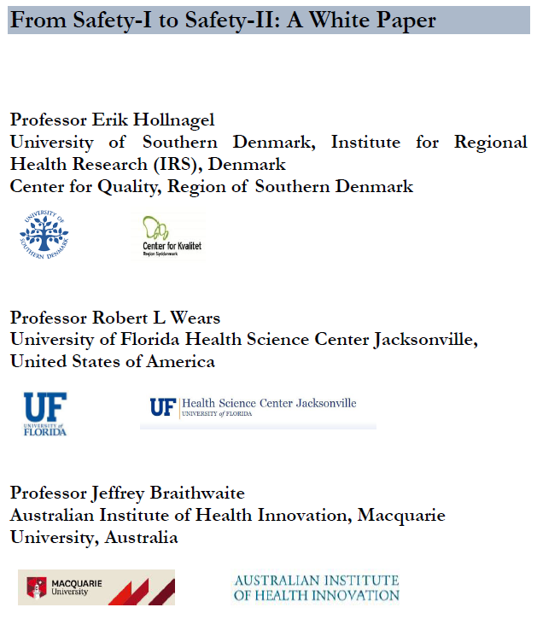
Our patient
Notes:
Safety 1 – where as few things as possible go wrong; its the way most people think of safety as the absence of accidents and incidents (or as an acceptable level of risk). This approach presumes that things go wrong because of identifiable failures or malfunctions of specific components: technology, procedures, the human workers and the organisations in which they are embedded. Humans—acting alone or collectively—are therefore viewed predominantly as a liability or hazard, principally because they are the most variable of these components. It concentrates on the negative, rather than why things pretty much always go right.
Safety 2 – this shifts the focus from trying to prevent things from going wrong to ensuring that as many things as possible go right. It is the system’s ability to succeed under varying conditions. It assumes that everyday performance variability provides adaptability to varying conditions, and is why things go right. The same issues about human flexibility and unpredictable nature that lead to poor performance perhaps provide the reasons for why things go right when conditions are less than ideal, and this behavioural tendency should be looked at, becaseu it will probably lead to better understanding of why things also go wrong. And anyway, it feels better to look at stuff going well than not.
The main point is that our resilience at work is being sorely tested, with increasing demands on our time and energy, and ever increasing complexity of systems. For instance, just our new electronic patient management and theatre record software has created a worrying degree of attention that has taken our focus off the patient.

Slide 59
Anaesthetic input
Pt admitted through ED Sat 28/11/20 12:15
‘Booked’ in theatres (Sat trauma list that day)
Anaesthetic team informed late afternoon – seen by on-call team ?ok to do in the evening?
Assessed by Anaes Reg 19:15
Reviewed by Anaes Cons 21:33 – not safe for that night (DOAC)
Theatre 27 hours after admission
Golden Patient
Notes:
Admitted in the middle of a Sat when we had a good team on. We had started Saturday trauma lists – too many cases to consider adding to the trauma list, but the on-call team did try to get her done that night. However, because she was on a DOAC with poor renal function, it was considered safest to do on Sunday (no trauma list).

Slide 60
Assessment
Risk scoring: NHFS 29 - 30% 30 day † (NB SORT – 20.6% †)
CFS 6 - moderately frail
4AT 6 - possible delirium +/- cognitive impairment
87yo♀- subtrochanteric # for short IM nail
  care home resident (since recent vascular Sx);
  mechanical fall;
  rel. compus mentis / independent (walks unaided)
PHx
  COPD (smoker)
  AF
  CCF
  CKD
  PVD (multiple lower limb procedures)
  recurrent UTI’s
  Prev HTN
Functionally
  Poor ET (<4MET’s); frail, prone to falls
Meds - Bisoprolol, Apixaban, Spironolactone, Bumetanide, Simvastatin
Allergies – NSAID’s, Nitrofurantoin
O/E
  42kg, thin + frail
  Chest clear, RR 22, SpO₂ 94%
  Systolic murmur
  P 96 AF, BP 101/58
Ix
  ECG – AF
  CXR – hyperinflated
  Hb (L)107, MCV (H)101.3, PT/APTT normal
  Haematinics – normal
  G+S – only one (anaes cons asked for 2nd)
  Na⁺ 136, K⁺ 4.6, eGFR *26,
  ECHO (2013) –
    non-dilated LV with severe systolic impairment;
    dilated RV with severe systolic dysfunction;
    mod AR; mild MS; severe MR; severe TR; mild PR;
    severe PASP elevation; bi-atrial dilatation.
Reported as “Obs within normal limits” by admitting junior doctor
  Hb (L)107, MCV (H)101.3, PT/APTT normal
  Haematinics – normal
Notes:
How does an anaesthetic pre-op assessment differ from a medical clerking? I keep saying to my trainees – the aim of the pre-op visit is to see how I can safely get this patient through the surgery, rather than finding reasons not to anaesthetise them.
She had already had 2 clerking’s by ED and junior ward doctors, with different aims and focus – get her tot the next stage in the pathway that doesn’t involve them anymore. The Obs taken at admission will be viewed differently by doctors with different roles.
So, first, we need to know what the injury has done to the patient, and how the surgeon plans to further injure her. Then what degree of physiological reserve she has to tolerate both insults. This depends on her comorbidities, her current physiological response, how her meds impact on it. The more hip fracture patients have been studied over the recent decades, the more we pick up on perhaps little things that have a big impact. We now include Fe studies as routine bloods, which wouldn’t have happened without local data because our parochiality precludes using outside evidence (well, particularly for the transfusion committee!!!)
But the one thing we as anaesthetists haven’t yet embraced is risk scoring these patients.

Slide 61
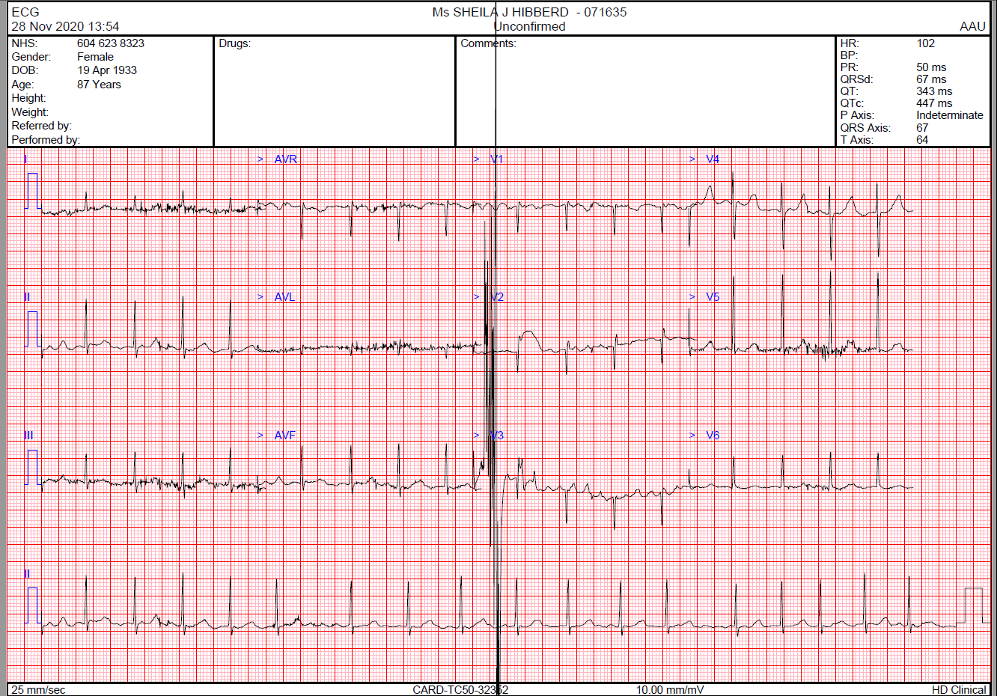

Slide 62
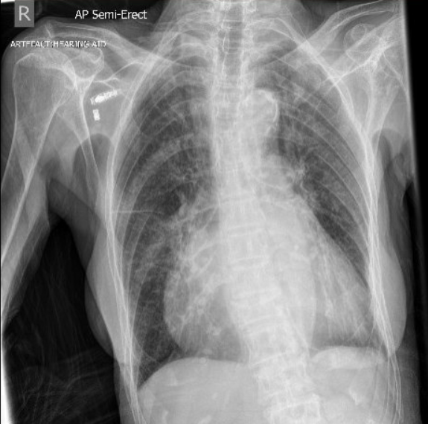

Slide 63
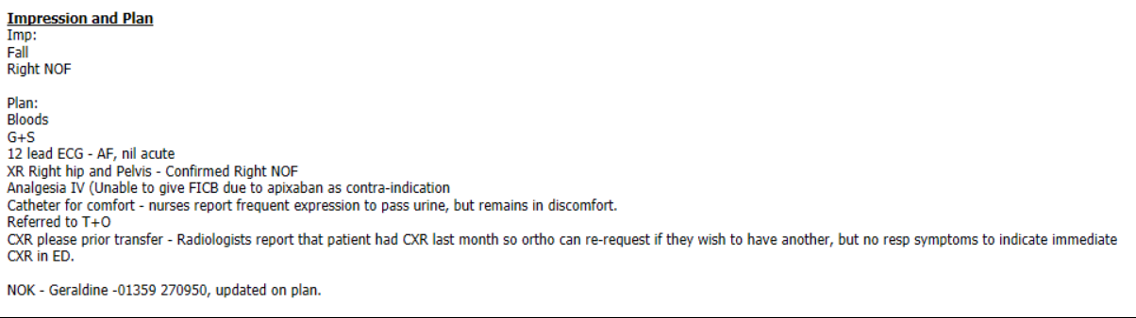
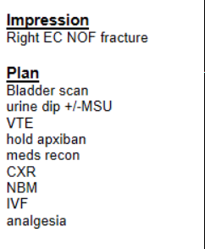
Plans – ED and junior clerking
Notes:
So the particular plan documented is a unilateral view of the patient based on the environment that doctor works in, and is only contextually relevant to getting the patient to the next stage

Slide 64
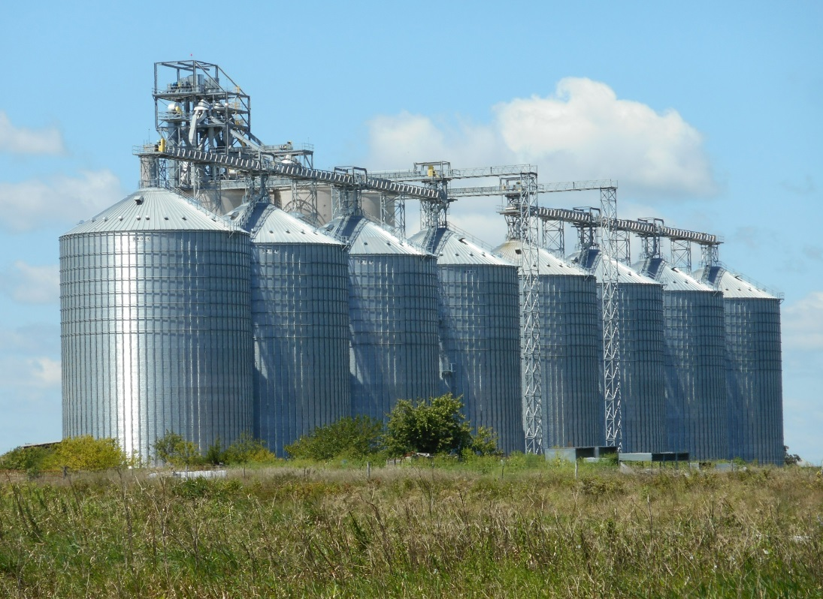
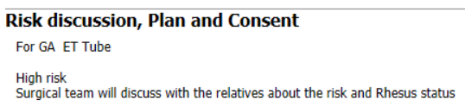
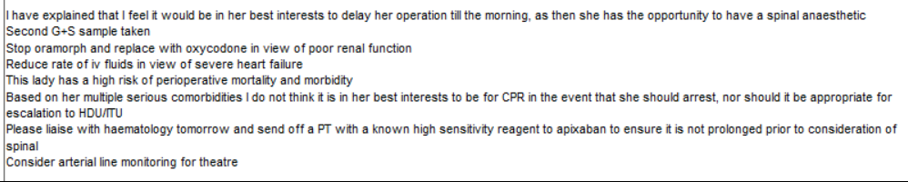
Anaesthetic plans
Notes:
And we are as guilty of this as the admitting junior doctors.
What we need is a standardised plan, with input from the most senior relevant clinicians at the earliest opportunity, to ensure the best chance for that patient to get up and out of hospital ASAP, from the moment the patient hits the hospital.
What we have at the moment still, is silo care – largely independent plans from well-meaning but uncollaborative clinicians. It’s wasted time and energy. The major advantage of doing it together with the most senior people involved, under a structured care plan is that all staff understand what the other’s roles are, and will learn from each other, so that it gets better next time, to the patient’s benefit.

Slide 65
Pre-surgical management
Analgesia
  Pre-hospital – 1g Paracetamol IV; Morphine 4mg IV divided doses
  ED – Morphine 3mg IV
  NOF ward – Morphine 5mg PO
  No FICB because of Apixaban
IV fluid
  NaCl 125ml/hr - on ward only; no more pre-op
Oxygen
  Once SpO2 fell to 84%
I would have done a FICB
  Pain scores were high at rest until surgery
  Apixaban C/I in our guideline
Oxycodone not morphine in renal failure
Fluid resuscitation issues are common in these patients
  Prescriptive – EC vs IC??
Notes:
She should have been prescribed prn Oxycodone. I need to add analgesia to my guideline.
FICB – because the guideline I wrote in 2012 (when we were afraid of DOAC’s) was for nurse practitioners, I had to be very conservative with indications and contraindications.
IV fluids – we had tried to set up stroke volume measurement and individualised fluid resuscitation, but our trauma assessment room was often poached (side-room) and we just didn’t have enough staff.
How many people would have been bold enough to go to theatre at 8pm – 12 hours after last dose of Apixaban?

Slide 66
The Anaesthetic
Notes:
2 points to make:
Delirium prevention:
- No age-related MAC, and no BIS used – both implicated in potentially reducing delirium.
- N2O and low-dose Sevo not a bad combination
Propofol-based anaesthesia may be better
Maintaining MAP above 70 throughout is a sensible idea – for renal perfusion as well as delirium reduction

Slide 67
The Anaesthetic
Consultant anaesthetist and surgeon
  Both with senior trainees
AAGBI standard monitoring plus arterial line (awake)
GA ETT
  High fentanyl (200μg total), low Propofol (20mg)
  Sevo and N₂O
  Metaraminol infusion – maintained into Recovery
  Tranexamic Acid (500mg)
  Teicoplanin 400mg, Gentamicin 120mg
Post-op analgesia – Paracetamol 500mg qds, Oxycodone 2.5mg QDS + 2hrly PRN
I like spinals, but I don’t know anyone who would have been that brave in this case.
I would have done a FICB for post-op analgesia
I like the metaraminol infusion
Currently we lack non-invasive stroke volume ‘measurement’
We do have BIS monitoring now
Notes:
Hb management immediately peri-operatively is difficult. We know anaemia prevents early mobilisation to a degree, but keeping Hb higher than the Haematology-declared limits is a problem. They have just caught up with me! My colleagues don’t necessarily agree with me that perhaps this patient shouldn’t have left recovery with an Hb less than 100g/l, but they don’t see what happens Day3 on the ward, and it’s hard when even on the ward, they don’t always get transfused. Besides, we give a lot of IV Fe when required.
Non-invasive cardiac output monitoring is an interesting issue. These are relatively short cases, and like other emergencies the physiology changes very quickly intraoperatively, so it can be difficult to interpret the numbers. I have used various technologies, and not been convinced that it helps more than good clinical experience, and close attention to detail, but I think more and more we will be having to justify clinical decisions in theatre that may have an impact on early post-op metrics of outcome such as mobilisation, and discharge.
BIS has been very useful in these patients, I think. I routinely attach it before induction now, whether or not I use TIVA (which I generally do).

Slide 68
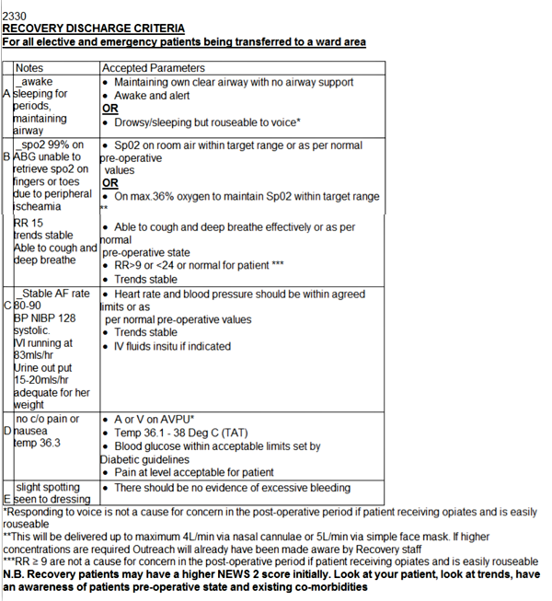
Recovery/PACU
SV FM 6L/min O₂ + Guedel airway
  Coughing when awake
Analgesia – Oxycodone once
Metaraminol weaned to MAP 65
  Over 3 hours
Extended stay
  could still go back to ward, but potentially overnight
ABG’s
  mild metabolic acidosis resolved with fluid boluses and weaning vasopressor
  Hb 92g/L before discharge (6 ½ hrs)
    Nadir Day 1 – 78g/L - transfused
Discharge criteria met & anaes happy

Slide 69
Our case – could we have done anything differently?
Pre-op:
  Assessed in ED, sorted IV fluids (+/- NICOM) + analgesia
    FICB USG
    Change morphine to Oxycodone (prn only) before surgery
  Another ECHO – possible we may have had ITU consultant trained??
  Risk scoring known about and discussed with patient/ relatives
Intra-op:
  BIS monitoring
  Less Fentanyl; Propofol (+/- Alf or Remi)
  FICB for post-op analgesia
  Other drugs to help reduce opioid need/ Delirium prophylaxis – Clonidine, Ketamine, Magnesium??
Post-op:
  Transfusion in recovery?
  Kept overnight anyway?

Slide 70

Standardisation

Slide 71
COVID response
Initial fear was that all should be done under spinal
Anaesthetists and theatre staff went onto 12 hour emergency rotas
  Keep operating overnight
  Keep trauma list 10-12 hours during the day
Staff attrition rate became too high
Now?
  Still assume all trauma and emergency patients are COVID +ve
  We have agreed a 10-hour trauma list on Saturdays
  All-day trauma list during the week, with ‘golden patient’ assessed by outgoing night anaesthetic registrar. **
Notes:
** Though when we were trying to restart elective work in October/ November, when staff were short, management would amalgamate trauma and elective lists during the day, which meant that night staff were even busier.

Slide 72
My Dad always said “The first rule in theatre is to always leave the customer wanting more.”
He was a great actor, but a terrible anaesthetist.

Slide 73
Physiotherapy
Helen Dockerill

Slide 74
Physiotherapy and Occupational Therapy
Review all day 1 post-operative patients as a priority on the ward
Aim to ascertain their pre-admission mobility/ function/ cognition
Sensation and lower limb motor power assessment
Chest assessment as indicated
Lying/standing blood pressure within the initial assessment if possible
Mobility assessment
Notes:
Therapy team responsible for input across both elective and trauma orthopaedics
Understand a patient’s previous function level so important in understanding the patient and how best to approach them, allow earlier identification of any post-op confusion

Slide 75
Patient Journey
Day 1 post-operative assessment
  Sensation
  Motor function
  Observations – low blood pressure 92/57
Day 1 post-operative afternoon review
  Low Bp 86/55
  Low Hb 78 - due blood transfusion
  Appeared confused
Notes:
92/57
86/55, Hb
Allows review of cognition, ability to follow instructions carryover between sessions

Slide 76
Day 2 Assessment
  Sat edge of the bed with assistance two
  Attempted stand to a stand aid with max assistance of two
  Declined further attempt
Day 3 Assessment
  Transferred to chair with stand aid
  Has continued to work and progressed to transferring with frame and two
  Some anxiety, fear of falling limiting input

Slide 77
Aim of post-op day 1 assessment
  To transfer to a chair
Factors affecting this
  Cognition
  Pain
  Blood pressure – postural hypotension
Recent audit to identify and examine our day 1 mobilisation rates

Slide 78
Aim to be seen daily Monday to Friday (post-op day 1 seen as priority at weekend)
Early discharge planning
Highlight concerns/ difficulties at daily red-to-green meeting
Postural hypotension highlighted immediately to ward doctors
Work with nursing staff towards encouraging mobility as patient progresses with their post-op recovery

Slide 79
Discharge individualised depending on each patient
This patient was discharged back to her care home
Referred on to community services for further progression and falls assessment
Notes:
Pathway 1 –D2A, increase current care package, CAB, placement, return to previous care home

Slide 80
Dr Mohanraj Suresh
Trauma Physician

Slide 81
Role of Orthogeriatric department.
Oversee comprehensive geriatric assessment.
Medical liaison for orthopaedic patients.
Develop the team to provide holistic geriatric care.
After care.

Slide 82
Outside the box
Do not waste on skills which others are able to do.
Do a lot in my office than in the ward – electronic patient record system.
Set up escalation process when crisis happens.
Spend more time in theatres and emergency department.
Provide bone health clinics along with rheumatology. More outpatient activity.

Slide 83
What are we good at ?
Addressing delirium – PINCH ME. Issues with bowel care and dehydration.
Educate juniors to look at basic care.
Pain relief - basic and reduced opiates.
Iliofascial nerve block.
Cardiac investigation - orthopaedic department owns 24 ecg machine / carotid hyersenstivity testing.

Slide 85
What are we good at ?
Addressing delirium – PINCH ME. Issues with bowel care and dehydration.
Educate juniors to look at basic care.
Pain relief - basic and reduced opiates.
Iliofascial nerve block.
Cardiac investigation - orthopaedic department owns 24 ecg machine / carotid hyersenstivity testing.

Slide 86
Management level
Continuity of service.
Working with other specialties in medicine – show case orthogeriatric work.
Liaison with community teams - FFFLS
Being a mischief-maker.
Establish credibility.
Reflect on our performance regularly.

Slide 87
What is next?
Learning echocardiogram
Establish a level two care along with ITU – perioperative unit.
Early supported discharge and ortho specific rehabilitation unit.

Slide 88
Summary

Slide 89
What can we say?
While we are proud of how well we are doing, there is always room for improvement
Discussing cases done well is as useful as traditional M&M
Standardisation is vital
Engagement of key (and engaged!) clinical staff at the front door is very important
Better outcomes require everyone to work together

Slide 90







This Photo by Unknown Author is licensed under CC BY-SA-NC
This Photo by Unknown Author is licensed under CC BY-SA

