Slide 1
IV Therapy and Vascular Access Devices – a National and International Update
Sue Rowlands
IV Resource Team Lead
Royal Wolverhampton NHS Trust

Slide 2
I’v Got News For You…..

Slide 3
Old News
Dec 2019 – Wuhan health authorities identified a cluster of cases of unusual pneumonia
Jan 31 2020 – First identified case in UK
Mar 6th 2020 – I was speaking at a conference in the De Vere Centre
Mar 7th 2020 – First case identified in Wolverhampton (ICCU)
Mar 20th 2020 - > 3200 cases in UK
Mar 23rd 2020 – social distancing commenced in UK

Slide 4
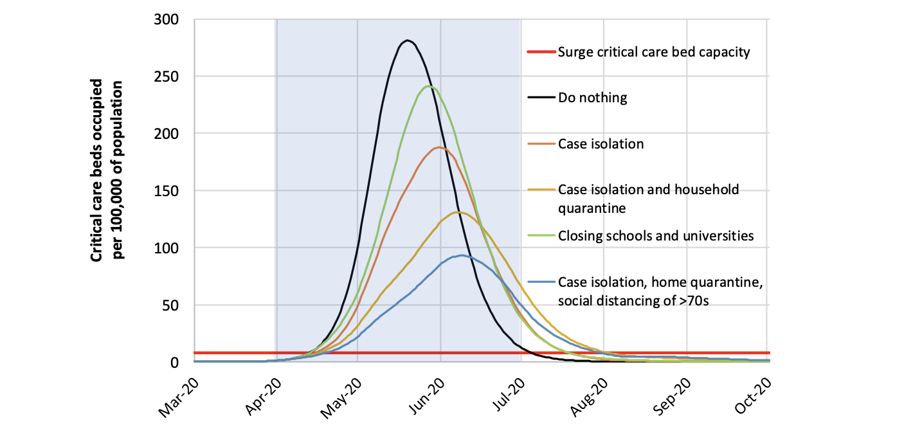
Various Epidemiological Models

Slide 5
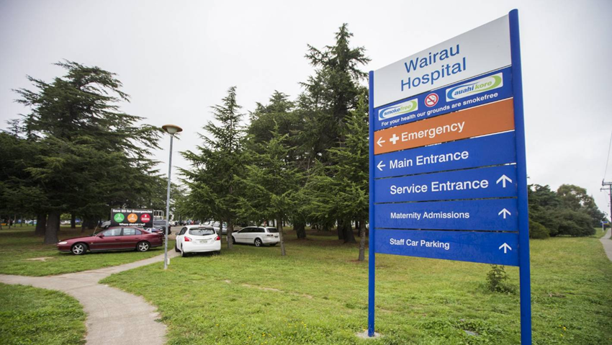
Personal Pandemic Predictor –
Hospital Car Parks
January 2020
Staff parking areas over-crowded
Queues for visitor car parks
Hospital roadways stop-start

Slide 6

Late March 2020
Spacious
Birdsong
Place of rest
Breakout room for staff support
Staff resilience and loyalty
“Clap for Carers”
Reflection of high pandemic numbers

Slide 7


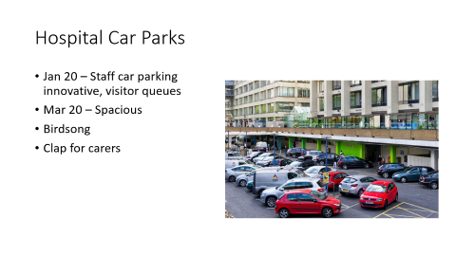
2021 – Car Park Evolution
Still relatively quiet – COVID-19 still here
Outdoor restrooms
Drive through COVID swabbing
Pacemaker checks
Spirometry

Slide 8
“So much has changed in such a short time and credit should be given to everyone for adapting so quickly.”
Jennifer Burch, 2021

Slide 9
Where are we NOW?....
NHS facing massive challenges
COVID-19 still an issue
Massive backlog / waiting lists
Staff leaving/ retirement/ burn out/ isolation
New recruits – international/ inexperienced
Supply issues
Cut costs
Environmental awareness

Slide 10
Regroup and focus
Preserve resources – physical and time
Reduce waste – physical and time
Optimise care delivery and patient safety

Slide 11
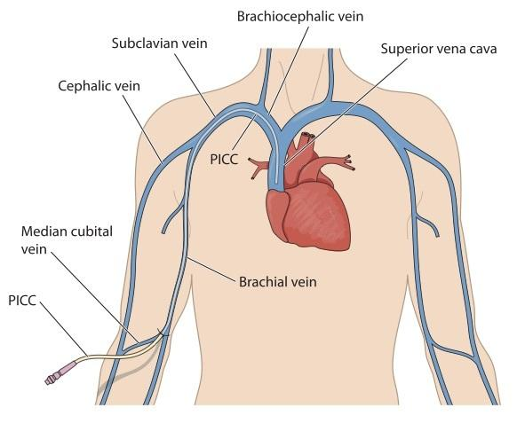
How ? – From a vascular access perspective
Variety of devices available include
Peripheral cannulae
Mini – midline – up to 15cm – dwell time 28 days max (non-vesicant medication only)
Midline – 20 cm - higher quality PVC (non-vesicant medication only)
Peripherally inserted central catheter (PICC)
Multi lumen central line
Tunnelled central line (Hickman)
Ports

Slide 12
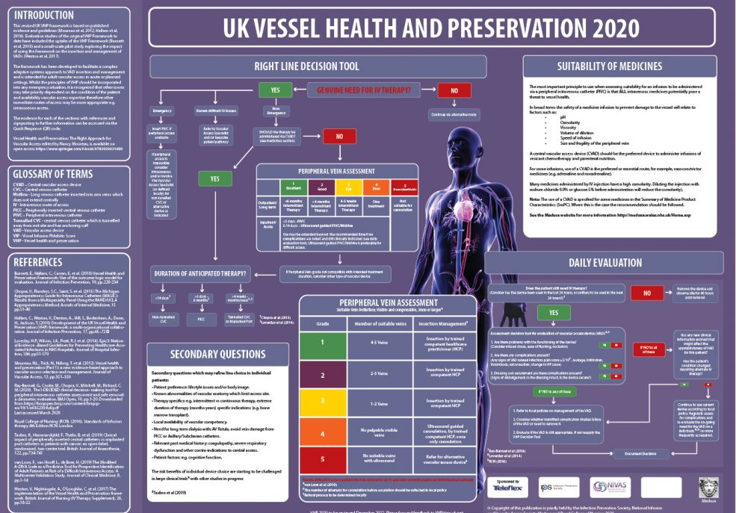
Device choice – Vessel Health and Preservation Framework (hallam et al. 2020)

Slide 13
1. Avoid unnecessary PVC insertion
Costly in time and resources (Gledstone-Brown and McHugh, 2018, cited in Oliver 2021)
Leads to patient distress
Can lead to bacteraemias – require ongoing care and observation
Hawkins et al (2018 - cited in Oliver 2021)) demonstrated a reduction of 9.8% in numbers inserted and 12.8% increase in the numbers actually used by asking clinicians to only insert PVCs if they felt they would be >80% chance of being used within the next 24 hours
Requires education and difficult but necessary culture shift

Slide 14
2. Improved vascular access for acutely ill
GAVeCeLT – Pittiruti et al – vascular access guidelines (April 2020)
Advocated the use of mini midlines and midlines for non-vesicant medication and additionally blood sampling
Save resources and need for replacement as with PVCs
Mini midlines (<15cm) quicker to insert
(?? Can swop via a guidewire to a PICC if necessary)
Risks:
Occlusion of axillary veins with CPAP hood underarm strapping
Increased chance of line malpositioning/ infiltration with shorter mini midlines

Slide 15
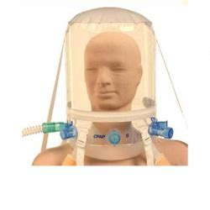
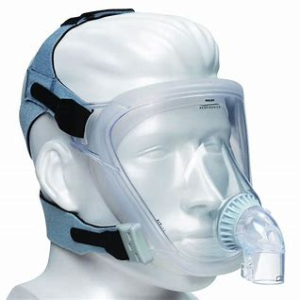
Choice of CPAP Administration

Slide 16
Improved vascular access for acutely ill - contd
Advantages of PICCs for critically ill requiring PN, inotropic support, vascular monitoring
Reduced risk of pulmonary complications
Less need for supine patient position
Preferable for patients receiving CPAP as neck remains free
Easier to change line dressings
Less risk of site contamination if tracheostomy in situ
Leave the subclavian and femoral veins free for ECMO

Slide 17
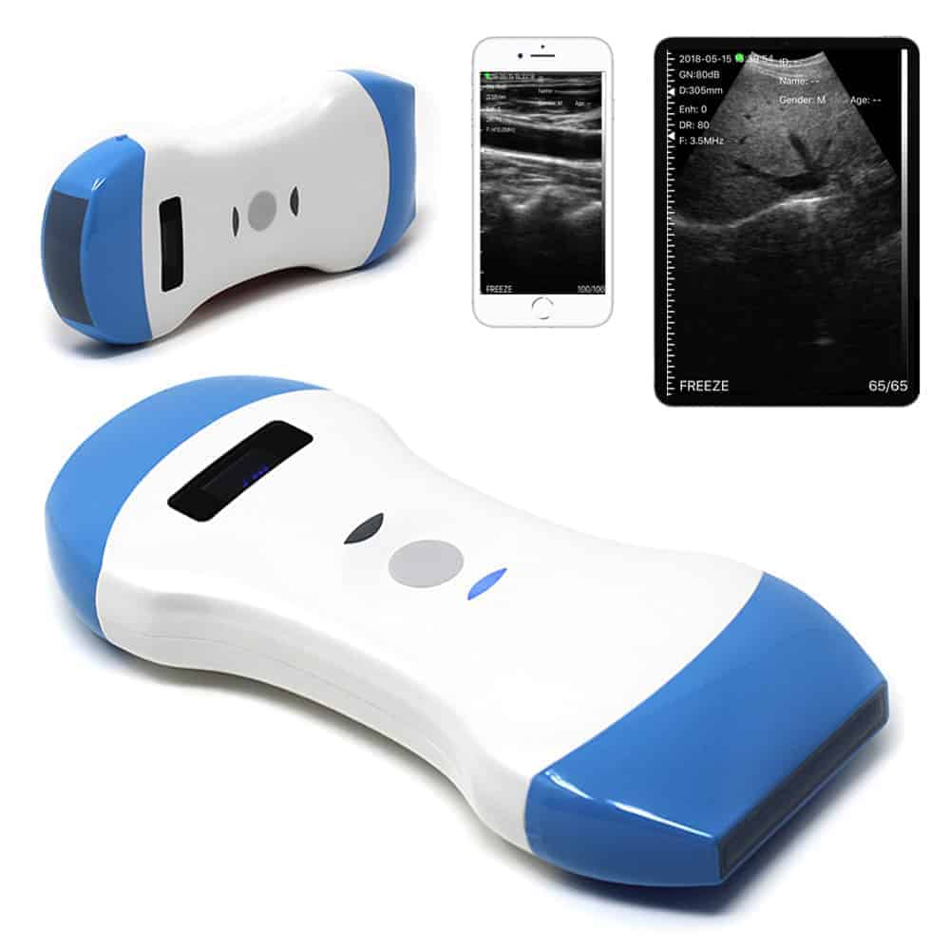
Improved vascular access for acutely ill– general points
Urged the need for specialized vascular access services
Wireless U/S – ease of cleaning
Intra-cavitary ECG – reduce need for radiology
Use securacaths to reduce risk of line dislodgement esp. with proning
(Full PPE including double gloving and masking)

Slide 18
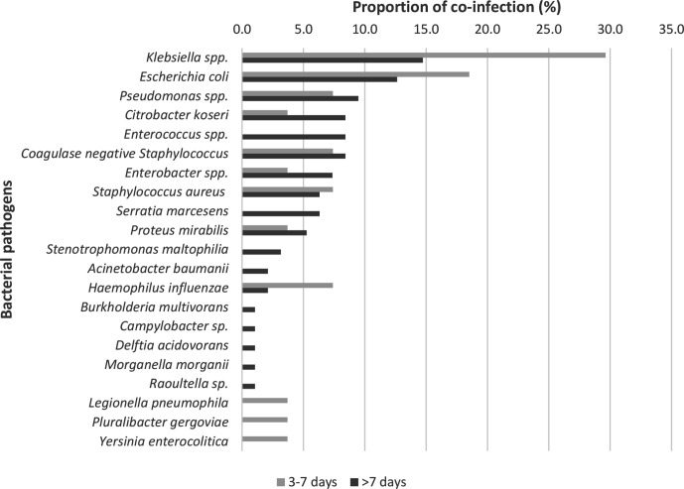
Increased rate of secondary infections for ICCU Covid-19 patients
Study by Baskaran et. al, 2021– 7 UK ICCUs
254 cases – 139 clin significant
Showed increased numbers of klebsiella and E Coli secondary infections – increased resistance and associated mortality
Potential causes – unnecessary early empirical antimicrobial use/ nosocomial issues associated with prolonged ICCU stay (procalcitonin levels vital)

Slide 19
Nosocomial issues
Initial confusion re PPE
Double gloving – reduced hand hygiene
Shorter sleeved gowns ? preferable
Inexperienced and relocated staff
Proning

Slide 20
challenges of proning
Precarious procedure for unstable patients
Hub cap usage
Drainage of oral secretions on to insertion sites
Mouthcare – chlorhexidine gel
Proning checklist

Slide 21
4. Optimise Device insertion and care – UK Device Related Infection Prevention Practice (DRIPPs) Collaborative
Why?
Aware of ongoing issues relating to device related bacteraemias – urinary catheters and vascular access devices
Aim – to improve patient safety and save lives
Benefits of specialist collaboration

Slide 22
DRIPPs - Collaboration of specialist practitioners:
IPS – Infection Prevention Society
ACA – Association of Continence Advice
ASAP – Association for Safe Aseptic Practice
BAUN – British Association of Urology Nurses
NIVAS – National Infusion and Vascular Access Society
BD – Becton Dickinson

Slide 23
DRIPPs – IV workstream
Initial meeting identified issues – split over 3 years
Delayed via the pandemic – moved forwards via MS Teams
First priorities –
Vascular access device care bundles
Vascular access pathway
Standardised line related bacteraemia identification tool and report template

Slide 24
Vascular Access Device Pathway Poster
Guidance from insertion, administration of medicines to removal
Evidence-based statements
Referenced with national and international guidance

Slide 25
Revision of the VAD HII (Care Bundles)
Liaised with NHS E/I for permission to revise and update
Used evidence-based statements
Reflect same wording as VAD pathway

Slide 26
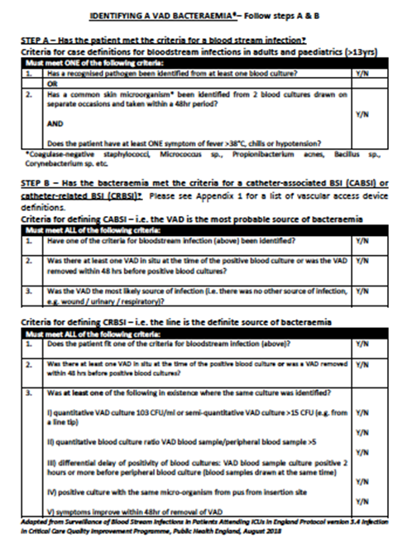
Surveillance guidelines
Not intended to replace National surveillance guidelines
Intended to be simple for use by single wards or trustwide
Includes
  Standardized criteria for VAD related BSI – checklist approach
  Sample report template for feedback
  VAD definitions standardised

Slide 27

DRIPPs Website
A DRIPP website went live in January 2021
  Resources page and enables feedback on the draft documents
  Events page
The website visits >6,000

Slide 28
Next Phase
Trialling surveillance tool
Developments of further resources relating to device maintenance / complications / education
Preparing case studies for addition to website
Launching event planned for later this year

Slide 29
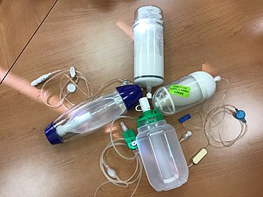
4. Increase patient discharge via Outpatient Parenteral Antimicrobial Therapy (OPAT) services
Reliable vascular access vital to prevent repeat cannulation often via ED
Innovations – use of elastomeric pumps could broaden patient acceptance onto service and reduce community administration times/ ease self administration - ?? Financial savings
Improves antimicrobial stewardship

Slide 30
5. Reduce the need for hospital attendance especially for high risk groups
Some UK Centre's extended the time between flushing ports during the pandemic
Reduces risk of cross infection with COVID-19
Extended duration between clinics – preservation of healthcare time and funds
PICCs and Hickmans - ? Consider patient/ carer involvement
Leads to improved patient quality of life

Slide 31
Infusion Nurses Society Standards (USA, revised 2021)
Detailed and extensive version of the RCN standards for infusion
66 standards covering vascular access care – from competency assessment to pain relief during procedures
Standard 41 - Flushing and locking
Point H.5. – “There is insufficient evidence to recommend the optimal frequency, solution, or volume to maintain the patency of implanted vascular access ports not accessed for infusion
c) Extending flushing to every 3 months with 10ml 0.9% sodium chloride and 3 or 5 ml of heparin (100 units/mL)was found to be safe and effective in maintaining patency.”

Slide 32
Conclusions
To save resources we must –
Need for vascular access teams unprecedented
Improved vascular access improves care and speeds recovery
Cross site working enables promotion of good practice and continuity of care
Avoid the unnecessary
Optimise appropriate vascular access insertion and care
Save hospital based resources – consider alternative approaches
“# No Going Back”

Slide 33
Thank you

Slide 34
References
J.; ; Lim, W SI
Baskaran et al. ‘Co-infection in critically ill patients with Covid-19: an observational cohort study from England’ Journal of medical microbiology, Apr. 2021 Vol.70(4) aan McKeever, Tricia M ; Beed, Martin ; Lim, Wei Shen
Burch, J. “Providing gastrointestinal nurse education during the pandemic”, British Journal of Nursing vol. 30 (19) p 1146-1148 Oct. 2021
Infusion Nurses Society Standards, 2021
Oliver, G. “Can ‘just in case’ PIVC placement still be justified?’ British Journal of Nursing vol. 30 (19) S3 Oct. 2021
Pittiruti, M.; Pinelli, F.; Guiseppina Annetta, M.; Bertoglio, s.; Biffi, R.; Biondi, S.; Brescia, F.; buonato, M.; Capozzoli, G.; Cotogni, P.; Deganello, E.; Dolcetti, L.; Elli, S.; Giustivi, D.; Iacobone, E.; LaGrea, A.; Lampertyi, M.; Maspero, G.; Scopolettuolo, G.; Vailati, D.; Vezzali, D. “Considerations on the use of vascular access devices in patients with COVID-19 (and some practical recommendations)”. April 2020 GAVeCeLT

