Slide 1
Medical Examiner Implementation and the role in Learning from Deaths
Dr Jason Shannon
Lead Medical Examiner for Wales
Notes:
Thanks Chris, Suzy and good afternoon everyone.
Fully appreciating that most of you don’t work in Wales I wanted to make sure this presentation is relevant to you in England. Chris has kindly outlined the main high level points about the ME service and its role in the NHS in Wales. The legislation is largely non-devolved but the NHS required to deliver it is fully devolved.
Therefore rather than trying to tell you about everything in 20 minutes or so, I am going to pose 5 important questions which I feel are key for any ME service to consider and then I will explain what we have done thus far in meeting those challenges and what the future plans are going forward as we head towards a statutory system.
Finally before I begin, it is not my place to dictate or even advise others on how their services work – that is for them. IT does not mean that just because others do things differently it is somehow wrong – this was about what was right for us. I will only refer today the processes in Wales in the context of 5 specific questions and challenges. You may decide the one or more of the questions are not particularly relevant and the answers therefore not helpful. I hope that will not be the case and overall I am optimistic that we can share some experiences which will be of value to others.

Slide 2
Programme content
Ensuring learning from the mortality review process, incidents and investigations leads to sustainable improvements in quality or safety
Developing the role of the Medical Examiner
Extending medical examiner scrutiny to all non-coronial deaths wherever they occur
Learning from Covid-19
Our experience in Wales
Notes:
These are not the only questions we need to consider but just the five I wanted to base this presentation on.
I’ve highlighted the important key words.
Go through these

Slide 3
Ensuring learning from the mortality review process, incidents and investigations leads to sustainable improvements in quality or safety
Do medical examiners have a role?
Independence
Host organisations
Boundaries between roles in the wider process
Clarity about what they will and won’t do as part of this process
Competency
Public perception is important
Notes:
These are not the only questions we need to consider but just the five I wanted to base this presentation on.
I’ve highlighted the important key words.
Go through these

Slide 4
Why were Medical Examiners suggested?

Slide 5
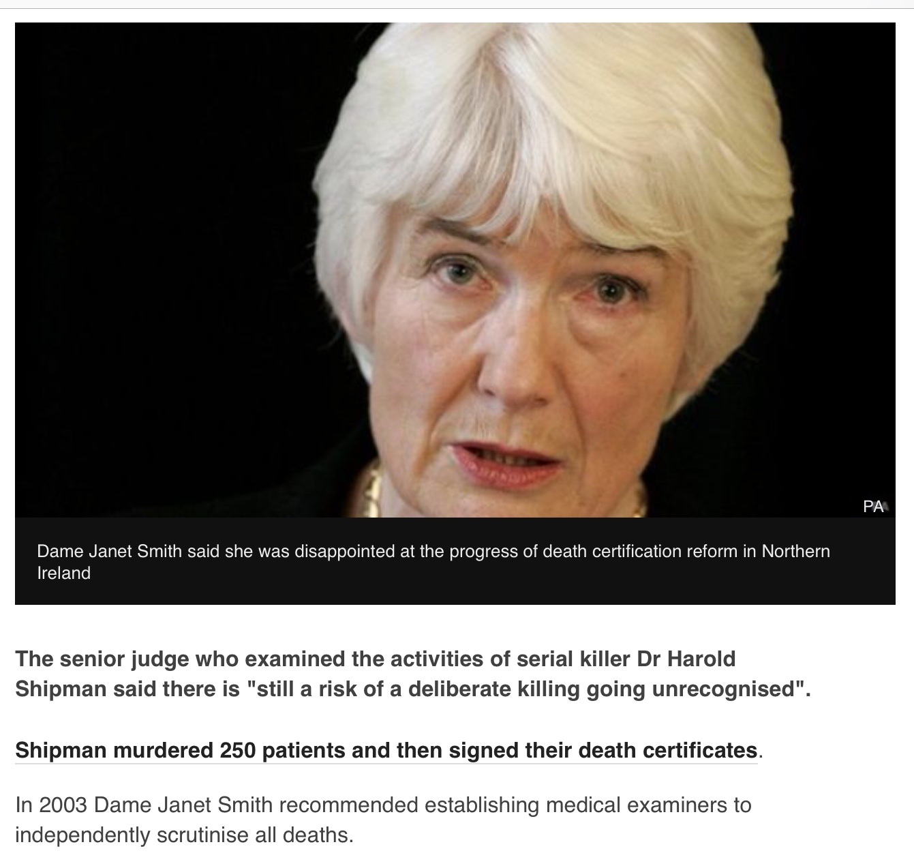

Slide 6
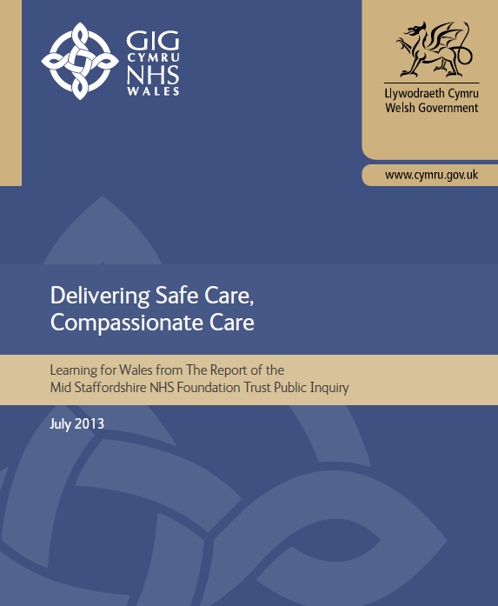
The Wales response to the Francis Report
The Chief Medical Officer has mandated all acute hospitals to set up a consistent, standardised system for reviewing all in-hospital deaths to detect potential harm.
Our aim is to have a consistent process, with reporting and learning on findings shared in a transparent way .
Notes:
As mentioned, the requirement to review all deaths in hospital at least was made clear following the Francis report. Even then, it was expected that consistency and standardisation would apply and that such a system would be connected to learning and improvement.

Slide 7
Role of the Medical Examiner
What did the person die from?
Does the death need to be referred to the coroner?
Are there any clinical governance concerns?
Proportionate scrutiny of the relevant clinical record
Interaction with the attending practitioner
Interaction with the bereaved
Accurate death certification
Compliance with Notification Regulations (2019)
Detection and passing on of concerns
Notes:
These are not the only questions we need to consider but just the five I wanted to base this presentation on.
I’ve highlighted the important key words.
Go through these

Slide 8
Developing the role of the Medical Examiner
How do we maximise the INDEPENDENCE of the processes of scrutiny?
How do we know that our ME and MEO staff are confident and COMPETENT in their roles?
How do we ensure that health care providers are given CONSISTENT information upon which to base their learning from deaths and other Quality Improvement work?
Notes:
These are not the only questions we need to consider but just the five I wanted to base this presentation on.
I’ve highlighted the important key words.
Go through these

Slide 9
What the Medical Examiner service isn’t
Investigation
Inspection
Service improvement
Counselling

Slide 10
Why is independence important?
275. Independent medical examiners It is of considerable importance that independent medical examiners are independent of the organisation whose patients’ deaths are being scrutinised.
276. Sufficient numbers of independent medical examiners need to be appointed and resourced to ensure that they can give proper attention to the workload.
Notes:
Why does independence matter? Put simply it matters to the public as a whole and this has been recognised as I’m sure William will no doubt be able to confirm and remind us that it was the Mid Staffs conclusion list which mentions the importance of independence of medical examiners. In fact in recommendations 275 and 276 it is mentioned 4 times!!!!
It also makes reference to the requirement for sufficient resourcing of the work which makes sense if the objectives of the service are to be met

Slide 11
How do we maximise the independence of the processes of scrutiny?
Primary legislation
Joint decision by Health Boards and Welsh Government to host a single Medical Examiner Service
Options in Wales
Joint Health Board committee
Welsh Health Collaborative
Public Health Wales
NHS Wales Shared Services
Notes:
Legislation in the form of the Coroners and Justice Act makes provision for independent medical examiners.
In Wales it was relatively straightforward to achieve a consensus that, subject to legal acceptance, the service would be delivered via a single NHS entity “on behalf of health boards”.
We had options including establishing a new health board committee. The collaborative is a more strategic group rather than one responsible for operational service delivery and public health already had well defined roles elsewhere which may have made hosting the ME service challenging. Who could have known how busy they would turn out to be in 2020.
Shared services were chosen on the basis that they already had some experience of employing doctors, and that their experience of achieving operations at scale in other areas essential to NHS Wales functioning would be well directed to the challenge of establishing a new service.

Slide 12
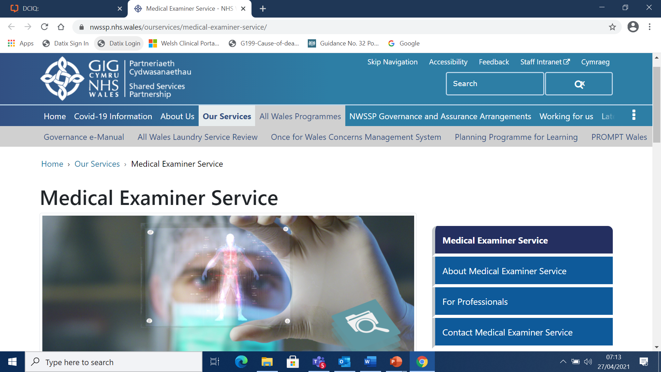
Notes:
Don’t need to dwell on this too much

Slide 13
Maximising independence
ME and MEO staff NHS Wales Shared Services employed
Minimise / eliminate of conflicts of interest
Coroners on appointments panels
Medical Examiners in Wales unable to wear two hats simultaneously
Early stages
Independent of care provided
Not clinically working at the same hospital
Late phase
Not clinically appointed in the same health board
Move work around Wales digitally to the ME on duty that day
Notes:
Medical examiners in Wales are not appointed by Health Boards (or the few number of Trusts we still have). They are also not appointed as consultants or GPs but, as Alan has indicated, as Medical Examiners in their own right by Shared Services. We are clear that on the day they attend our hub sites to carry out their duties, they must be MEs and not mix their duties. The reverse is also true that when back at their hospital sites, they should avoid involving themselves in ME duties but pass any requests on to the MEO to whom the case has been assigned. This is to avoid accusation of conflicts of interest and matters being discussed which are not recorded or covered by ME governance through Shared Services.
Whilst in the early phase, the fullest independent model is not in place for all deaths, it is the model we are progressing towards so that digital work can be transferred across Wales, whether the whole or part of the process, as is required for the best outcome for the bereaved. This might for example include some of our MEO staff undertaking conversations with the bereaved in their first language of Welsh but could also include asking a ME or officer with a specific background to consider the whole or part of a case.

Slide 14
Principles of the Welsh Medical Examiner Service – a service the public can trust
Maximise independence
From care provided
From hospital providing care
From employing care provider
Consistency to assist those responsible for further investigation
Governance and process
Competency
Ongoing internal CPD training
Avoidance of isolated practice
Sustainable
Adherence to Good Practice Guidance from the National Medical Examiner
Sufficiently sized
7 day working
Appraisal and Revalidation Framework
From Health Board
Service for a nation
Principles for the service
Notes:
We have established some key principles for the service in Wales and again, whilst there are others I could share, these are likely to be amongst the most important for all of us responsible for the establishment and functioning of a medical examiner service.
I would advise that we look at independence from the point of view of a bereaved family. Perception is reality for them and the future credibility of the system is dependent upon retaining public confidence in it. In turn this is dependent upon a consistent service run by high calibre people with the necessary skills and attributes who actions can be concluded to be objective and independent. We need to know that our staff are not only trained but have ongoing support throughout their further development in their careers as ME’s and MEO’s.
As we head towards a statutory system, we need to ensure the service doesn’t fall over once an MCCD cannot be issued without either a ME or a coroner agreeing. It will serve the bereaved poorly.
Finally we should all recognise that the GPG provides the basis upon which we should establish and run our services

Slide 15
How do we know that our ME and MEO staff are confident and competent in their roles? The Welsh Experience
E-learning and face to face training
Recruitment
Submission of workbooks based on scrutiny of redacted records
Scenario-based questions
Coroners involved in appointments
Support via virtual MDT twice daily
CPD programme
Competency framework
“Be aware of the Mortality Review programme in Wales and how the medical examiners service links with this”
Quality Assurance scheme
Notes:
Alan mentioned having a trained workforce fully equipped with the skills.
No one clinical specialty can lay claim to being best placed to carry out ME duties
Indeed it is from the richness and diversity.
We have appointed several general practitioners into the service in Wales and in all four of our hub sites. Our interview process involved reviewing a returned case-book based on review of redacted health records to gain a sense of their understanding of the role of the medical examiner and officer roles beyond what they have done previously either in their clinical roles or their previous involvement in processes around death certification. As previously mentioned, we had coroner involvement in the appointments specifically of our ME staff.
Alan has mentioned in the question and answer section that there is much greater benefit in having clinicians from a range of specialty backgrounds and that has been very much our experience in Wales. Every medical examiner and officer has been able to learn new things by working together through our twice daily MDT meetings where they can bring problem areas for consideration by all on the call, often multiple MEs and MEOs. This might be about formulation of a cause, whether a death meets the Notification Regulations threshold or how best to approach the bereaved with a complex issue to allow them to have as much control over the process.
We already have a comprehensive programme of CPD activity delivered from those within the service and from external speakers which can form a portfolio of ongoing training in line with the competency frameworks we have established. We are beginning to look at the beginnings of a quality assurance scheme, mainly in the first instance to allow our staff to understand where their development needs exist for the purposes of PDR and appraisal processes.

Slide 16
How do we ensure that health care providers are given consistent information upon which to base their learning from deaths and other Quality Improvement work? The Welsh Experience
Mortality Review programme in Wales
Once for Wales digital system
Single Welsh governance and competency frameworks
Local flexibility to dovetail into care provider systems
Arrangements for reporting any death where concerns are detected including positive experiences
Thematic reporting e.g service, departments, wards
Quality and Safety committee attendance
Notes:
The MR programme started nearly a decade ago under the 1,000 Lives strategy and in response to the Mid Staffs report.
We quickly adopted a commercial module adapted for hosting the ME service as part of the wider mortality review process which has the potential for connectivity with health care providers in the future but equally important for us allows accurate and detailed recording of information for providing individual reports to the Health Board patient safety teams and to coroners.
By providing a single governance framework our staff have the confidence that the processes are not hampered by unwarranted variation leading to the potential for waste and harm but which also allows local flexibility to dovetail in to bereavement, registration and coroner services without compromising the principles outlined earlier.
We are keen to report positive experiences, particularly during this challenging time for NHS staff. We have also been able to determining “service themes” for the wider board level consideration further supported by our representation on Quality and Safety committees.

Slide 18
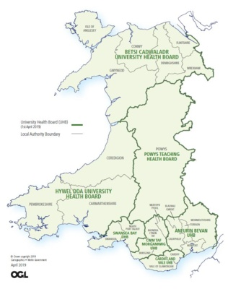
Region | Approx Total Deaths scrutinised per Year
North Wales (BCUHB) | 7,000
Mid & West Wales (HDUHB/SBUHB) | 7,500
South Wales Central (PTHB/CTMUHB) | 6,000
South Wales East (C&VUHB/ABUHB) | 9,000
Total | 29,500
Medical Examiners now work on an all Wales basis
MEOs will continue to be locally based at Hub sites
Notes:
Wales has 7 health boards responsible for acute and non-acute services with an integrated care provider model. We wanted to avoid the perception particularly by certifying and attending medical staff that “health boards have their own medical examiners” but equally have had to be pragmatic about avoiding creating a new layer of artificial boundaries.
Each hub site will deal with between 7 and 9K deaths allowing our largest hub site to be staffed by 9 MEOs which is a solid basis for business continuity.

Slide 19
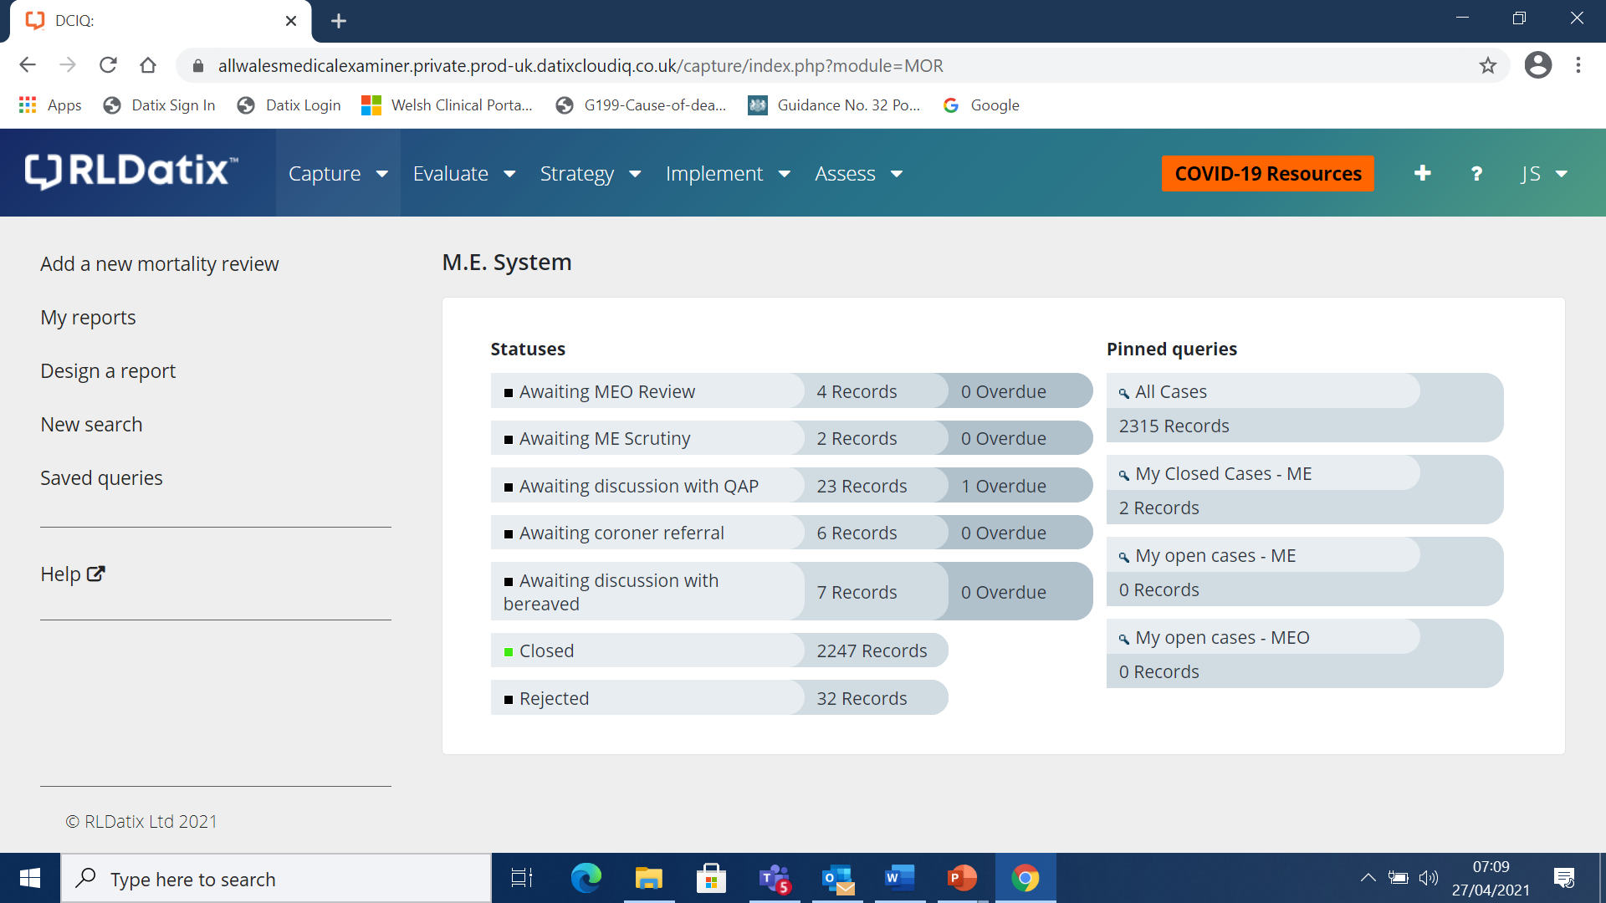
Daily Dashboard of the Welsh ME Service
Notes:
We can see hour to hour what is happening across the country. This allows us to prioritise cases according to the needs of the bereaved and ensure that our processes don’t threaten the statutory 5-day registration period.
More generally we can generate run rates and interrogate for local purposes. In time, for example, we could detect a high rate of concerns in a stroke or cardiac unit, confident that the variance is not a consequence of our function.

Slide 20
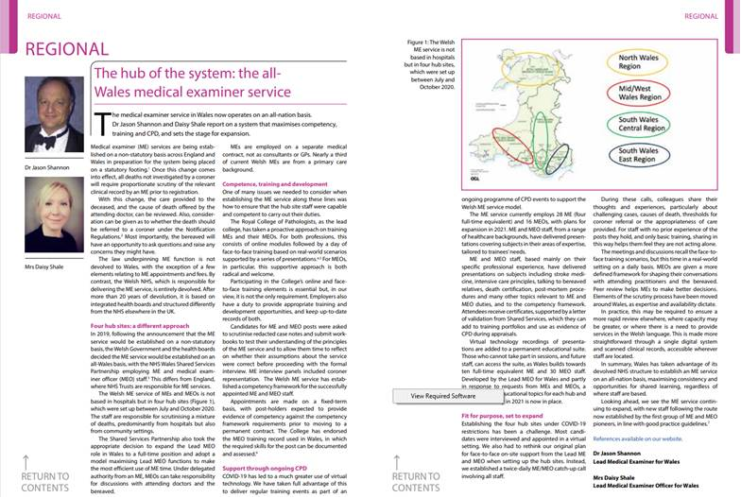
Notes:
Further information specifically about the virtual MDT and CPD programmes are available in the April edition of the rcpath bulletin and both Daisy, the Lead MEO for Wales and I, are more than happy to receive further feedback and questions on this.

Slide 21
MES role in QA and QI
SCRUTINISE
IMPROVEMENT
DETECTION
WELSH MEDICAL EXAMINER SERVICE
HEALTH BOARDS / CARE PROVIDERS / CORONERS
LEARNING
INVESTIGATION
HEALTH BOARDS / CARE PROVIDERS
For Medical Examiners - If its not BLUE it ain’t YOU!!
Notes:
Once of the challenges is ensuring ME’s don’t overstep their remit to scrutinise and detect and into the realms of investigation. We are clear that they have no role in health board investigations in the same way that they should not interfere with the judicial decision making of a coroner.
That said, the service is part of an important quality improvement cycle to feed into care providers improvement systems in a consistent way.

Slide 22
Medical Examiner and Welsh Mortality Review
Coroner
Consideration of Stage 2 Processes
Scrutiny of relevant clinical record of last illness
PTR/SI etc
Stage 1 / UMR – last admission only
Interaction with attending practitioner and the bereaved
Stage 2
Case Closure
MCCD issued / NFA

Slide 23
Learning from Covid-19
Death Certification
Weight of contribution of Covid in deaths
Infections acquired in hospital
Understanding of co-morbidity burden and contribution
Opportunity to enhance engagement with bereaved at a challenging time
Remote scrutiny of scanned records
Notes:
These are not the only questions we need to consider but just the five I wanted to base this presentation on.
I’ve highlighted the important key words.
Go through these

Slide 24
Extending medical examiner scrutiny to all non-coronial deaths wherever they occur
All deaths not investigated by a coroner
Non-statutory implementation
Statutory expected in 2022
Challenges with role out into non-acute sector
Notes:
These are not the only questions we need to consider but just the five I wanted to base this presentation on.
I’ve highlighted the important key words.
Go through these

Slide 25
Extending medical examiner scrutiny to all non-coronial deaths wherever they occur. The Welsh Experience
Not a secondary care service
GPs are employed in ME positions
NHS Wales Shared Services host GP digital services
Data sharing agreements
Piecemeal by agreement
Wider engagement with GPC Wales
Notes:
These are not the only questions we need to consider but just the five I wanted to base this presentation on.
I’ve highlighted the important key words.
Go through these

Slide 26
Does it work?
Consistency allows meaningful interpretation about concerns detection rates for care providers
Health Boards acknowledge the richness of both data and narratives as well as case selection for further reviews
Attending doctors value the support particularly with the application of Notification Regulations and MCCD formulation
Coroners have given a vote of confidence by seeking scrutiny to assist with judicial decision making
Families have provided positive feedback following their experience
Adds to surveillance of Covid-19 acquired in hospitals
Notes:
Certainly health boards are already welcoming our assumption of the stage 1 MR process and applying consistent criteria. This was particularly so with deaths from covid where the disease was likely acquired during hospital admission. The numbers matter but the stories matter even more.
Doctors appreciate the support in an area that historically there has been a vacuum into which various people have stepped over the years, often without training and governance.
Coroners have voted by seeking advice and also considering ME reports in their initial judicial decision making about individual deaths.
Lastly, but most importantly is what families tell us…….

Slide 27
Future plans in Wales
Whole Nation service based on independence and consistency
Patient, departmental, hospital, health board and national level reporting
Acute alerting to clinical Executive Directors
Business Intelligence tools
Artificial Intelligence application?
Notes:
These are not the only questions we need to consider but just the five I wanted to base this presentation on.
I’ve highlighted the important key words.
Go through these

Slide 28
‘I just want to tell you that the work you’re doing is so valuable. When my dad died the hospital gave me the paperwork and said “that’s it pal”.
The registrars told me there was a new service and it was causing a bit of a delay but I want you to know that the delay to me is worthwhile.
You’ve closed the loop and answered any questions that I had that I wouldn’t have been able to ask anyone else and would have eaten away at me probably forever’.
Notes:
This is just one of many comments we have received as Alan referred to in his opening presentation

Slide 29
Diolch yn fawr / Thank you
Notes:
Say thank you in Welsh
There are many many other things I could share with you about the service in Wales
but it was important to focus on those I felt would be of most assistance to colleagues elsewhere who are facing similar challenges

