Slide 1

‘To Infinity and Beyond’
My Chief Nurse Journey
“
Leadership is an opportunity to serve. It is not a trumpet call to self-importance.” – J Donald Walters
Professor Nancy Fontaine
Chief Nurse
Nancy.Fontaine@nnuh.nhs.uk
@DrNancyFontaine

Slide 2

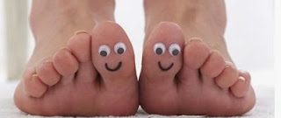




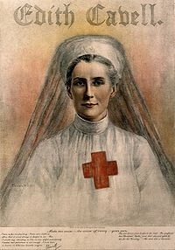
The Early Years

Slide 3
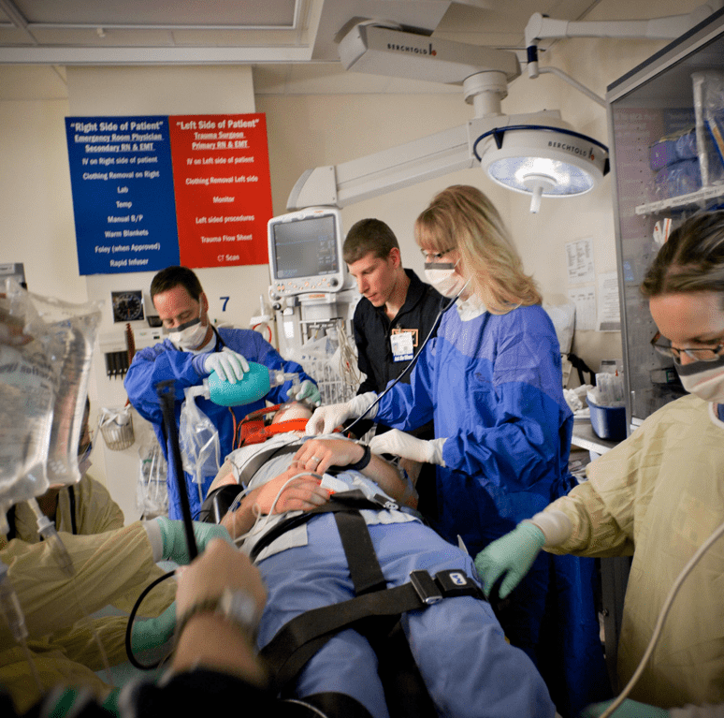





This Photo by Unknown Author is licensed under CC BY-SA
Notes:
Notes for Nancy:
We’ve been sold a myth in traditional leadership models, that idea of heroic leadership
..which is no longer just outdated, but also now dysfunctional and counter-productive, we need to realise that we have been numbing authenticity in the workplace

Slide 4

‘We do not learn from experience, we learn from reflecting on experience’
John Dewey (1859)
Beware the GREEN
‘Three healthcare assistants who abused elderly patients at Whipps Cross University Hospital in east London hospital have been sentenced.’
Have Continual Professional Curiosity
HBR: Strategies for Learning from Failure
Amy C. Edmondson (2011)

Slide 5

From Crisis Management to Board Assurance
5 Ways to Adapt and Lead In a Crisis
Seek credible information
Focus on the positive
Get grounded & prioritise
Transparency & Explanation
Be present, visible & available

Slide 6

‘Your first and foremost job as a leader is to take charge of your own energy and then help to orchestrate the energy of those around you.’
Peter F. Drucker
Commit – Connect - Communicate

Slide 7
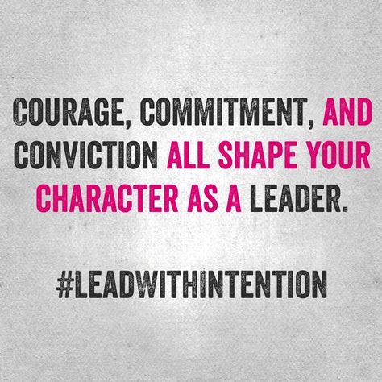
Being Courageous
“Courage is what it takes to stand up and speak; courage is also what it takes to sit down and listen.”
Winston Churchill

Slide 8


Benevolence, kindness & positivity leadership habits that inspire people, cement relationships & enhance belief & reputation
A teaching hospital in Norfolk has been rated "inadequate" by inspectors because of a "bullying culture", a report has said.
…goes into special measures
….has been put into special measures after it was rated "inadequate" by the health watchdog.

Slide 9

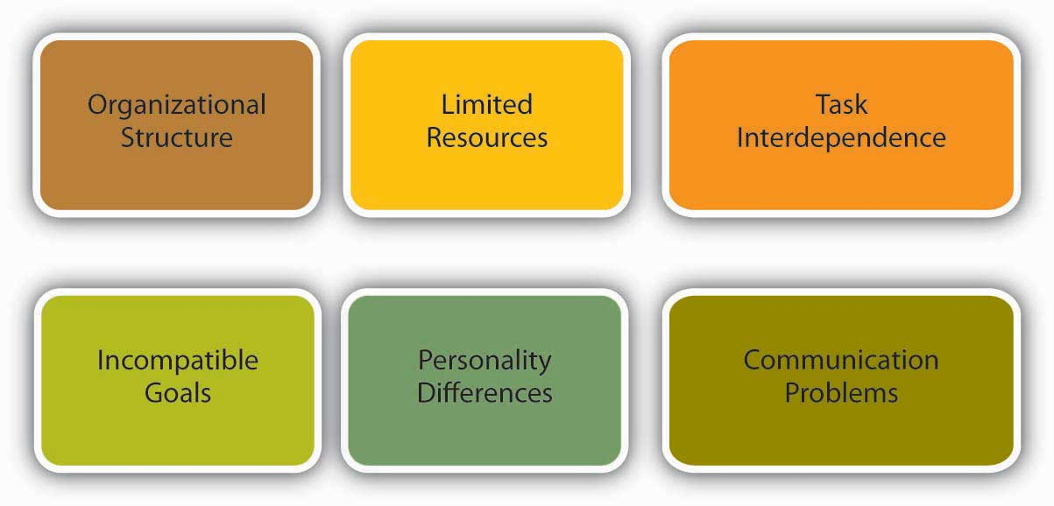
Art of diplomacy
Choose your battles
Beware the judgemental view
Know your data

Slide 10
Vulnerability is not weakness. That myth is profoundly dangerous.
Brené Brown, Sociologist, 2014
Being Authentic & show your true self

Slide 11
My challenge to each of you.
Express your vulnerability with your colleagues, allow yourself to be ‘deeply seen, vulnerably seen’
Attend - listen with fascination and authenticity, give your time in a complete way
See through their eyes and take intelligent action
Enable collective leadership, create a community of leaders

Slide 12
Leadership is not so much about technique and methods as it is about opening the heart. Leadership is about inspiration—of oneself and of others. Great leadership is about human experiences, not processes. Leadership is not a formula or a program, it is a human activity that comes from the heart and considers the hearts of others with kindness. It is an attitude, not a routine.

Slide 13


Slide 14
References
Blakey, J 2016 The Trusted Executive
Brown, B. 2014 The Power of Vulnerability
Brené Brown: The power of vulnerability | TED Talk
Drucker, P 2007 The Effective Executive
Newton, R 2019 Authentic Gravitas; Who Stands Out & Why
West, M 2021 Compassionate Leadership; sustaining Wisdom, Humanity & Presence in Health & Social
Compassionate and inclusive leadership | The King's Fund (kingsfund.org.uk)

