Slide 1
Measuring and Improving Experience of care
Clare Enston
Head of Insight and Feedback
@clareenston

Slide 2
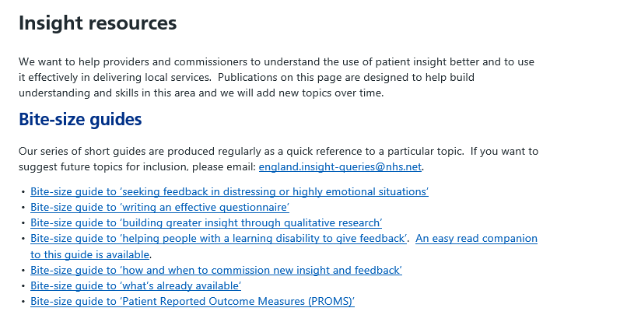
Insight and Feedback team
  https://www.england.nhs.uk/ourwork/insight/insight-resources/
To contact us with a question or to join our NHS Insight Network:
england.insight-queries@nhs.net

Slide 3


Slide 4

Why is patient/user insight important?
“The confidence that individuals have in their beliefs depends mostly on the quality of the story they can tell about what they see, even if they see little. We often fail to allow for the possibility that evidence that should be critical to our judgement is missing – what we see is all there is”
Daniel Kahneman
Thinking, Fast and Slow

Slide 5

Any service needs to understand the people it serves by hearing from them

Slide 6
Less descriptive
More descriptive
Insight &
Feedback
Surveys
GP Patient Survey
Inpatient Survey
Cancer Patient Experience Survey
NHS Staff Survey
PROMs
In depth interviews
Experience Based
Co-Design
Friends & Family Test
Feedback tools
(kiosks, SMS, apps)
Examples include:
Hospedia
Synapta
Feedback apps
Focus groups
& patient forums
NHS Trusts
CCGs
Healthwatch
Patient organisations
Less generalisable More generalisable
Complaints
Online reviews
& ratings
NHS.uk
Care Opinion
IWantGreatCare
Care Connect
Patient stories
HealthTalkOnline
Patient Voices
Social media
listening
Salesforce
Polecat
Healthberry
Public
Meetings
NHS Trusts
CCGs
Matrix of insight methods from Measuring patient experience: evidence scan Health Foundation, June 2013

Slide 7
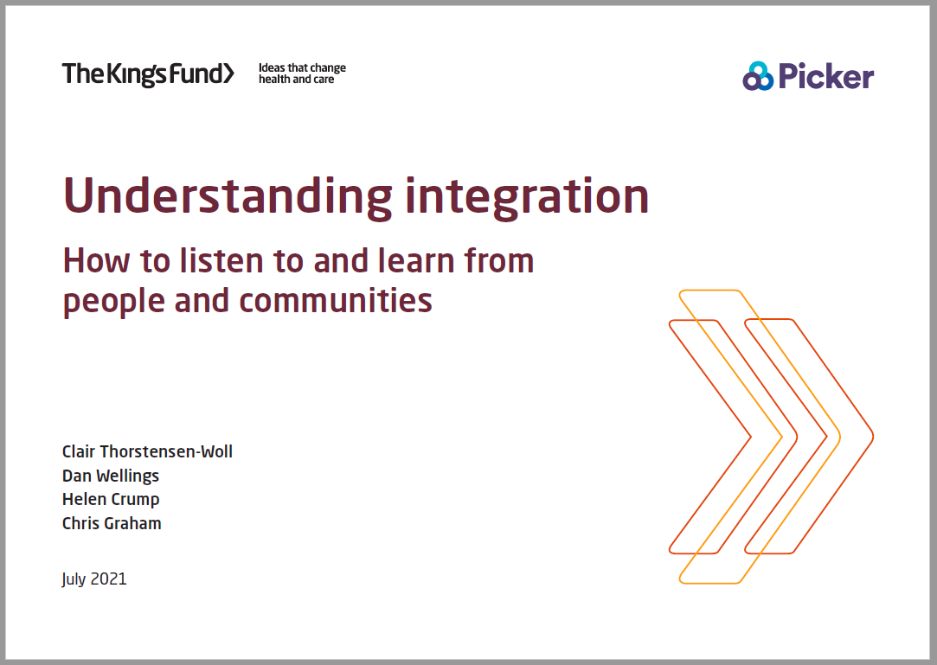
Understanding integration: how to listen to and learn from people and communities | The King's Fund (kingsfund.org.uk)

Slide 8
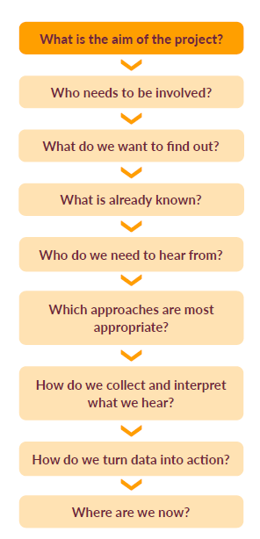
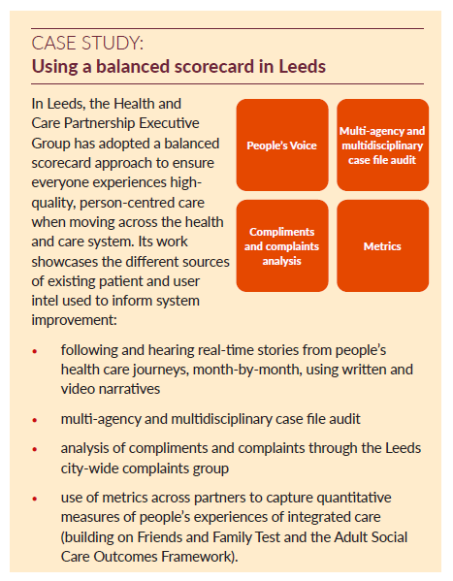



Slide 9
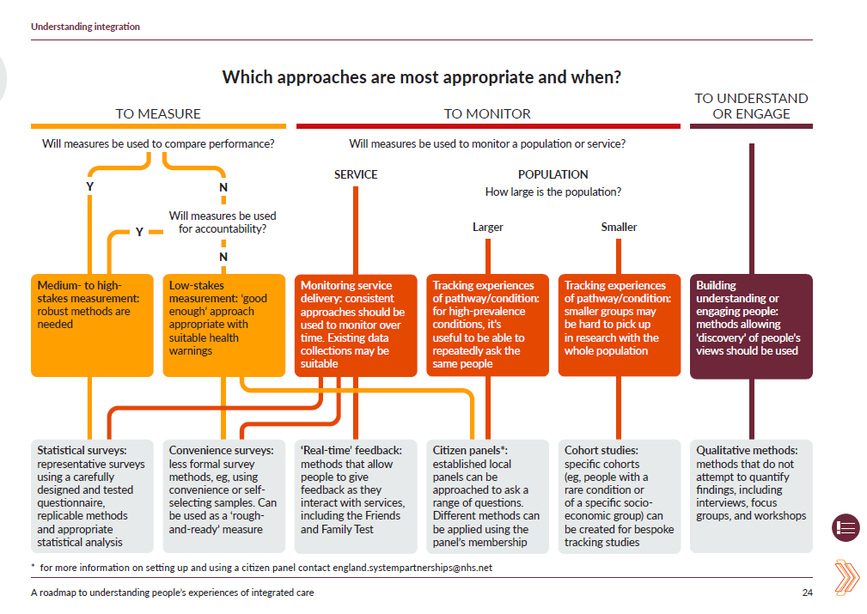

Slide 10


Making more of what patients say

Slide 11

Type of feedback – positive/negative/neutral
Topic
Moment feedback is given or asked for
Care setting
Authorship and anonymity
My state of health
NHS Empathy
www.england.nhs.net

Slide 13


Slide 14

A range of research reports have demonstrated clear links between levels of engagement
and a range of outcomes for trusts including:
  patient satisfaction, patient mortality,
  trust performance ratings,
  staff absenteeism and turnover.
The more engaged a workforce is, the better the outcomes for patients; the difference between an average and good trust as measured by engagement scores in the staff survey is equivalent to around a 5% decrease in absenteeism or turnover, or about a 4% decrease in mortality.
West, M. A., & Dawson, J. F. (2012). Employee engagement and NHS performance. Paper commissioned for The King’s Fund review Leadership and engagement for improvement in the NHS. http://www.kingsfund.org.uk/document.rm?id=9545

Slide 15
Staff engagement was one of the areas of the 2020 NHS Staff Survey where the overall indicator remained broadly stable (at seven out of ten).

Slide 16
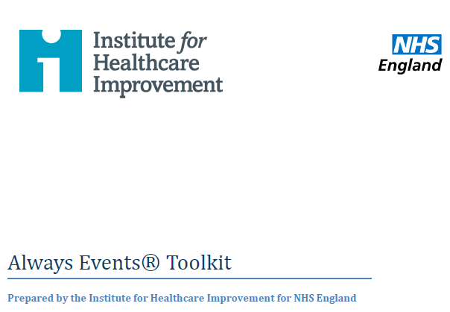




Slide 17
A few thoughts on how to work with different sources…
Listen for what you can learn rather than dismissing a source
What do you get from different methods?
What story do they tell together?
The data is only ever as good as the person listening to it

Slide 18
Thank you
To contact us with a question or to join our NHS Insight Network:
england.insight-queries@nhs.net

