Slide 1
Patient perspectives and patient engagement in prehabilitation programmes
Ceinwen Giles
Founding Director
Shine Cancer Support
November 2021

Slide 2
Overview
Personal perspective
Patient perspectives on prehabilitation
Engaging patients in prehabilitation
Notes:
Speak both as a cancer survivor and as a Director at Shine Cancer Support

Slide 3
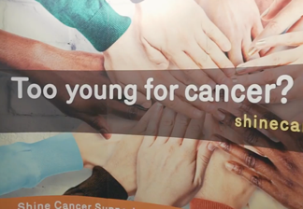
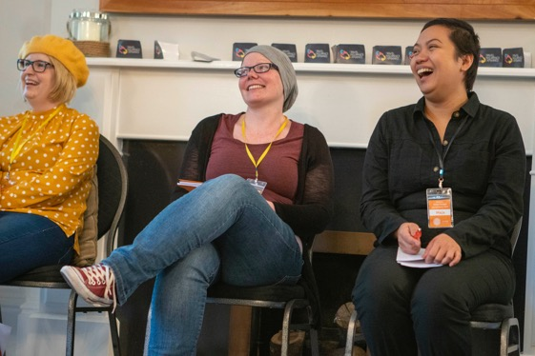
About Shine
Shine Cancer Support (reg. charity no 1146902) is the only charity in the United Kingdom that is exclusively focused on supporting people in their 20s, 30s and 40s who have had a cancer diagnosis.
Our vision is that every adult in the UK diagnosed with cancer in their 20s, 30s or 40s can access the help and support that they need in a way that suits their lifestyle, and that they are a part of a confident, supportive, and empowered community of young adults with cancer.
Notes:
Ceinwen

Slide 4
My life in exercise

Slide 5
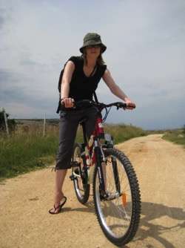
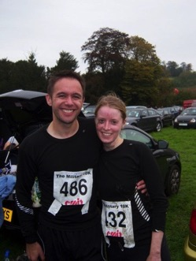
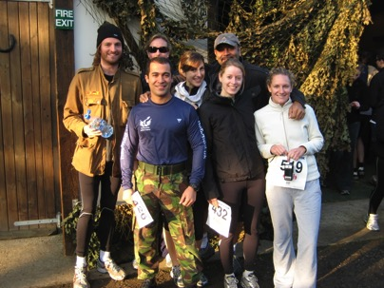
Life before diagnosis
Notes:
Work and very fit – did British Military Fitness (back when it was hard!) three times a week and regularly competed 10km runs, particularly mud runs. I have also been a vegetarian since I was 17.

Slide 6
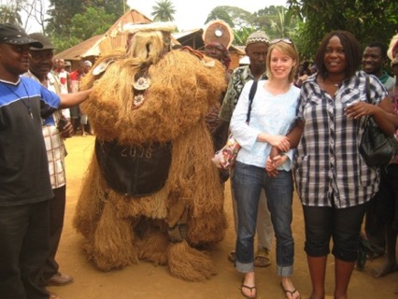
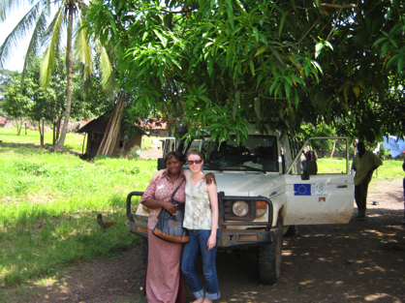
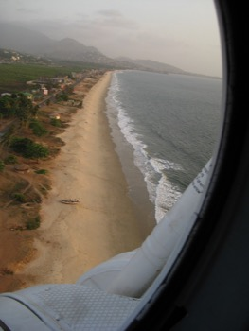
Life before diagnosis
Notes:
I am the kind of person who takes my running shoes everywhere and I used to go running in Sierra Leone when I worked there – it was really hot and I often got sunburned. The locals also thought I was nuts.

Slide 7
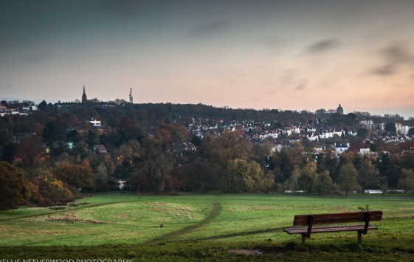
Life before diagnosis
Notes:
Added this slide because it shows the top of Parliament Hill. In 2009, I became pregnant with my daughter but did BMF in the first trimester – including piggybacking someone up this hill!

Slide 8
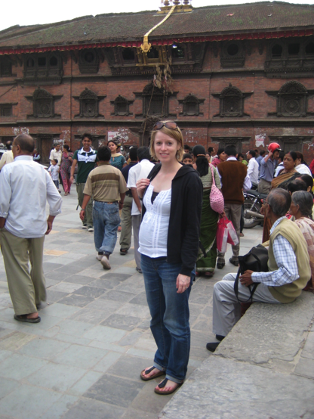
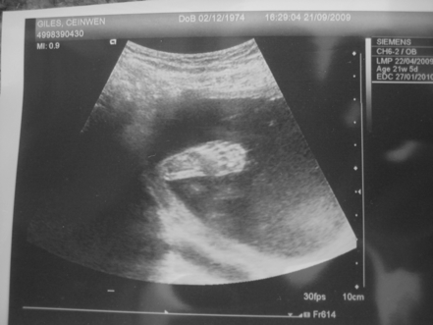
Notes:
As I became more pregnant I became less active as I had some hip problems that caused pain – still travelled a lot (e.g. Kathmandu when I was 7 months pregnant) and walked as much as possible.

Slide 9
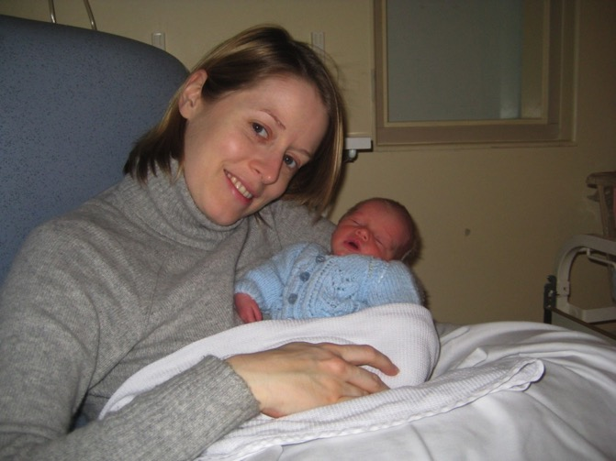
Notes:
At the end of Dec 2009, I became really ill and was told I needed to have my baby by emergency c-section. She was taken into the NiCU as she was 6 weeks early – I was very unwell. I had fevers, nights sweats and swollen glands but most of this was taken as pregnancy complications. I was in the hospital for three weeks and then managed to get home with my daughter – but a few days later went back in as I was in terrible pain and very weak.

Slide 10
Diagnosis….
Very weak, unable to walk or eat.
Stage IV diffuse large b-cell lymphoma “with significant liver and bone marrow involvement”.
Notes:
Initially doctors didn’t know what was wrong with me and I spent another three weeks in hospital so weak I couldn’t get up and brush my teeth – a lot of theories were considered but it was eventually found that I had DLBCL. It’s an older man’s cancer and it was very advanced. I was told that if I even if I survived chemotherapy, I had a 40% of survival over 2 years. I was devastated.

Slide 11
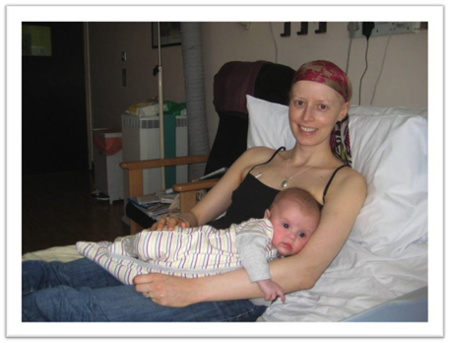
Treatment….
Treatment was part of a Phase II clinic trial
Six months as an in-patient – largely lying in bed!
Used visualisation of Parliament Hill to cope with spinal injections
No real diet or exercise advice
Notes:
I was also devastated to learn that the best treatment for me required staying in the hospital as an inpatient for six months. I was asked to speak about whether I did any exercise during treatment – at first, just being able to take a shower was a real accomplishment. Weirdly the chemo made me feel BETTER – and a few weeks after treatment, I started doing loops of the ward with my IV because I wasn’t allowed outside. As part of the treatment, I also had to have chemo injected into my spine and this is actually where I think my experience with the pain of exercise helped. I hated the injections but I’d try to use the visualisation technqiues I used as a runner to get through them. I used to picture myself running up parliament hill and think that by the time I got to the top, the injection would be over (though I frequently had to go back to the bottom and do it again because the injections didn’t go to plan). I did just meet someone who did the GNR while doing this treatment – but I think she is a rare and wonderful bird.

Slide 12
Remission
Got out of the hospital six months after I went in.
Muscle wastage, fatigue, aches & pains
Started trying to get fit again…everyone told me to take it ”easy”.

Slide 13
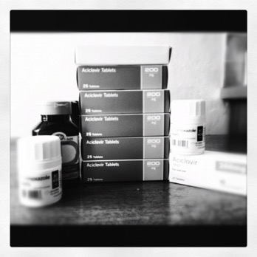
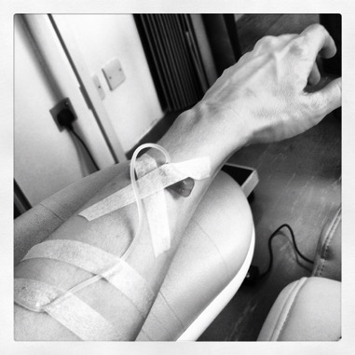
Ill again….
Notes:
Unfortunately – this wasn’t the end and a year after I finished treatment, I contracted meningitis. I spent another month in the hospital and then four months recovering. I was lucky in that it wasn’t the kind “where you lose your arms and legs” but it was awful and by the end of that I felt pretty spiritually and physically broken.

Slide 14
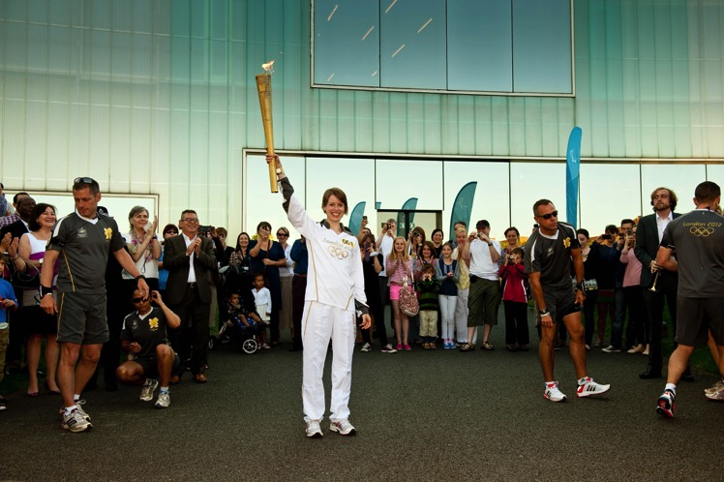
It’s not a sad ending!
Notes:
I got to be a torch bearer in the London Olympics – and given how my times have declined this was definitely the closest I’ll ever be to being in the Olympics!

Slide 15
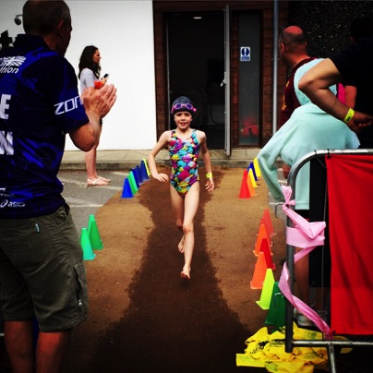
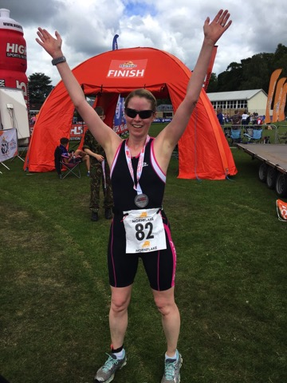
My running times have never been what they were…
Notes:
In 2017, I started to come to terms with the fact that my running times were never going to be what they were. Not only did I come out of treatment weaker and with health problems, I’m also older! So I decided to try a triathlon and found one in Henley that had a kid’s race as well – so my daughter did it too.

Slide 16
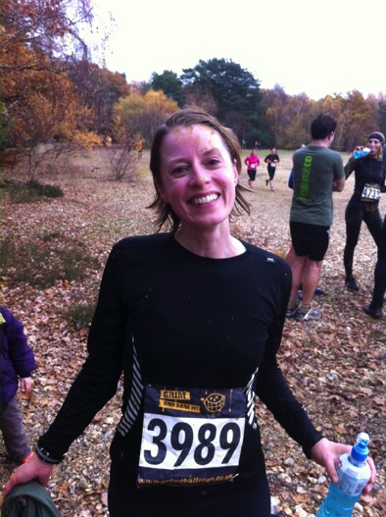
I’m in a good place but…
Reasonable, good quality advice on diet was hard to find.
Finding exercise specialists who understood my goals, and were supportive, was difficult (may have improved now….)
Notes:
In 2013, I did my first long-distance race again – the 11km Grim Challenge. For me this was a massive achievement. I still suffer from fatigue and receive treatment for my immune system every month. Being able to train and complete a race (and beat a few of my non-cancer friends!) was a big deal.

Slide 17
What patients think…
Notes:
Added this slide because it shows the top of Parliament Hill. In 2009, I became pregnant with my daughter but did BMF in the first trimester – including piggybacking someone up this hill!

Slide 18
Prehabilitation Principles
Notes:
In 2019, I reviewed new Macmillan Principles for Prehabilitation for the BMJ with an expert in the social determinants of health (who happens to be husband). Many people felt our review was saying that prehabilitaiton wasn’t useful or would be too difficult for people; we were accused of being paternalistic and out of touch with patient needs BUT….

Slide 19
We asked patients what they thought….
Notes:
We had actually asked current cancer patients what they thought about the idea of prehabilitation in a Shine Facebook group. Responses were very wide ranging.

Slide 20
We asked patients what they thought….
Generally, many people saw merit in the idea of prehabilitation
Many people were worried that prehab would take away from rehab (though it doesn’t need to be an either/or)
Some people felt that they wouldn’t have been able to cope with it before treatment
Short length of time between diagnosis and treatment
Physical ill health prior to the start of treatment, making things like exercise difficult.
The thought of major changes to lifestyle can be scary!
Those who had experienced prehabilitation before surgery felt strongly that it had been useful.
Notes:
We had actually asked current cancer patients what they thought about the idea of prehabilitation in a Shine Facebook group. Responses were very wide ranging.

Slide 21
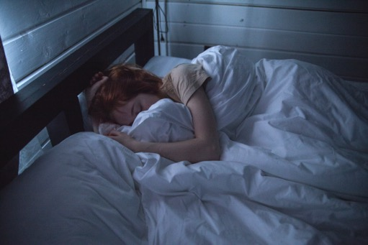
Patients do want information
Shine survey (2019) of young adults with cancer found that:
79% said additional information and support on physical activity would have been useful.
74% said additional information and support on diet would have been useful.
5% wanted support to quit smoking
At the same time:
48% were doing less exercise due to fatigue
Notes:
We had actually asked current cancer patients what they thought about the idea of prehabilitation in a Shine Facebook group. Responses were very wide ranging.

Slide 22
Where do we go from here?
Ideally, prehabilitation will be the first of many steps to maintaining or improving diet and fitness.
Link prehabilitation to rehabilitation so that patients can improve their diet and fitness before and after treatment.
Prehab needs to be approached in a way that is non-confrontational, and supportive.
Consider how peer support can be worked into prehabilitation programmes
Take into account where patients are now – and what treatment they are having.
Remember that “exercise” sounds scary to a lot of people!

Slide 23
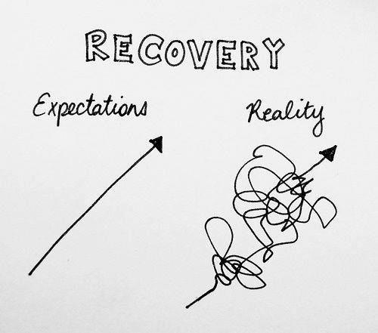
A final thought
Notes:
The reason I’m telling you this is that a lot of the people you meet will experience set backs – so often we think that cancer is a choice between dying and running the London marathon but for a lot of people cancer is a series of events – we often say that cancer is the gift that keeps on giving. This doesn’t fit that well with how society works and I think as prehab specialists it will be important to remember that the people you support will have ups and downs – they may have relapses, more surgery, recurrences; good prehabilitation will be about empowering people to develop skills that can help them not just with immediate surgery but can also make them better equipped to cope with what may come their way.

Slide 24
Questions? www.shinecancersupport.org ceinwen@shinecancersupport.org

