Slide 1
Workforce development and considerations to inform the planning and delivery of prehabilitation services
June Davis
Allied Health Professional Advisor
Macmillan Cancer Support
5th November 2021

Slide 2
Workforce
Allied Health Professionals
Anaesthetists
Exercise physiologists
GPs
Clinical Nurse Specialists
Oncologists
Primary care nurses
Public health teams
Psychologists
Support workers (cancer support workers, allied health support workers)
Surgeons
Fitness instructors

Slide 3
Right skills from the right people at the right time
Screening
Assessment
Delivery of interventions
Escalation

Slide 4
Screening
Registered health and care professionals or by unregistered professionals through delegated authority
Screening and monitoring of universal interventions may be self - managed

Slide 5
Assessment
Undertaken by registered professionals for targeted and specialist interventions

Slide 6
Delivery of interventions
Targeted interventions can be delivered by registered health and care professionals or by unregistered professionals under delegated authority

Slide 7
Universal interventions
Exercise
Health Conversations, Making Every Contact Count, Supported self-management
Nutrition
Food choices and access
Health eating guidance, Health Conversations, Making Every Contact Count, Supported self-management
Psychological support and behaviour change
Effective compassionate communication, information giving and general psychological support
Health Conversations, Making Every Contact Count, Supported self-management
All health and care professionals and the wider workforce including fitness professionals

Slide 8
Universal interventions
One You is an NHS resource which can help people get healthier and feel better with free tips, tools and support. NHS Choices https://www.nhs.uk/oneyou/
Moving Medicine includes resources for health and care professionals and patients with the aim of encouraging behaviour change. https://movingmedicine.ac.uk/
Fitter better sooner resources will provide patients with the information needed to become fitter and better prepared for surgery.
Preparing for surgery – Fitter Better Sooner | The Royal College of Anaesthetists (rcoa.ac.uk)
Moving healthcare professionals programme
free e-learning

Slide 9
A response to the pandemic
SafeFit is a clinical trial for anyone in the UK with suspicion of or confirmed diagnosis of cancer.
Cancer exercise specialists offer advice, support and resources to maintain and improve physical and mental well-being.

Slide 10
Right skills from the right people at the right time - SafeFit
Screening – registered healthcare professionals
Assessment - registered healthcare professionals
Delivery of interventions – Cancer exercise specialists
Escalation to clinical trial team

Slide 11
Nutrition interventions | Description | AHP workforce to support interventions
Targeted | Dietetic Counselling Assess readiness to change Reasons and goals for nutritional recommendations Motivate the patient Therapeutic dietary advice | Dietitians, Nutrition Support Teams, Intestinal Failure Units
Specialist | Artificial Nutrition Support Enteral or parenteral nutrition

Slide 12
Exercise interventions | Description | Workforce to support interventions
Targeted | Referral/support for appropriate reconditioning and/or prehabilitation exercise programmes including Healthy Conversations. Group exercise or one-to-one support in local community gym setting run by cancer exercise specialists such as Move More106 –aiming to increase frequency, intensity and duration of exercise incrementally to get as near as possible to 150 minutes of moderate intensity. Interval training, supervised and structured exercise | Physiotherapists Specialised exercise physiologists Rehabilitation support workers Trained cancer exercise professionals
Specialist | Fully supervised exercise intervention (aerobic/endurance/strength) for those very inactive/sedentary/co-morbidities, contemplative/low self-efficacy or treatment related indication (e.g. major surgery). | Physiotherapists

Slide 13
Psychological Support and Behaviour Change interventions | Description | Workforce to support interventions
Targeted | Psychological techniques such as problem solving. Counselling and specific psychological interventions such as anxiety management and solution-focused therapy, delivered according to an explicit theoretical framework. | Dietitians Occupational therapists Physiotherapists Speech and language therapists Health psychologists Clinical nurse specialists, Chemotherapy nurses
Specialist | Specialist psychological and psychiatric interventions such as psychotherapy, including cognitive behavioural therapy (CBT). | Occupational therapists Clinical nurse specialists Health psychologists

Slide 14
What is the HEE Star?
Two functions:
To provide a simple, coherent framework to facilitate and guide local conversations with provider systems to better understand and define their workforce transformation requirements; and
To create a single 'go to' directory for providers and systems to access and explore the range of workforce transformation solutions available to help address the workforce requirements identified - including tools, training materials, case studies and other interventions, realising the potential of workforce transformation investments.
Notes:
The HEE Star is based on the premise that change happens, project by project and in no other way.
What providers and wider systems can often struggle with, is seeing the wood for the trees – creating the capacity and keeping a focus on one challenge at a time.
The Star model is a framework to structure workforce conversations focussing on one enabler of change at a time to identify projects for sustainable change.
It has 2 functions:
As a simple, coherent framework to facilitate and guide local conversations with provider systems to better understand and define their workforce transformation requirements
As a single 'go to' directory for providers and systems to access and explore the range of workforce transformation solutions available to help address the workforce requirements identified - including tools, training materials, case studies and other interventions, realising the potential of workforce transformation investments.
The HEE Star is based on the premise that change happens, project by project and in no other way.

Slide 15
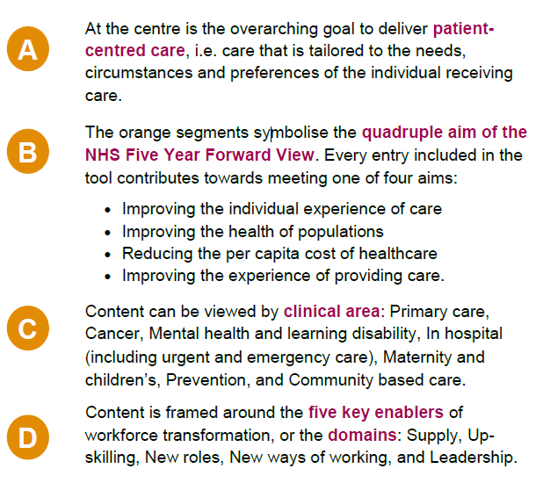
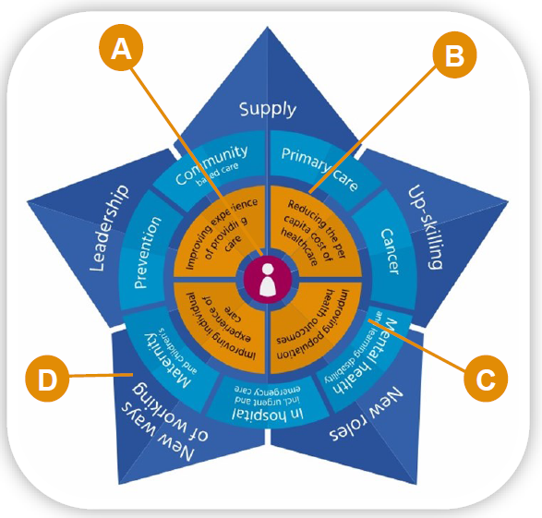
What does the Star look like?
Access the Star at www.hee.nhs.uk/transformation
Notes:
As a directory of workforce transformation solutions, the STAR can be accessed on-line and is an interactive tool. I want to give you a quick overview…..
The five points of the Star depict the 5 key enablers of change, of transformation – Supply, Up-skilling, New roles, new ways of working and Leadership – more on those in a minute….
The second rim of segments, reflect the system priorities – allowing ease of navigation of workforce solutions specific to certain specialties, as well as ones which are whole system wide.
For example, if you click on mental health and supply – all of the workforce interventions that fit that requirement will appear.
The four orange segments represent the quadruple aim – improving patient experience; improving staff experience; improving population health & reducing cost. These are the outcomes we are ultimately chasing that need to be considered when we make decisions about our workforce transformation programmes.
And of course, the Patient in the centre.

Slide 16
Key enablers of workforce transformation
Supply
Up-skilling
New roles
New ways of working
Leadership
Identifying current and future workforce availability in terms of skills, capabilities and numbers, in order to identify the appropriate workforce interventions.
To improve the aptitude for work of (a person) by additional training *
the aim of which is to create:
A competent workforce working to its maximum potential
An agile workforce that may be flexibly deployed
A capable workforce with future-facing knowledge and skills
*Collins English Dictionary, 2014
Health and care roles designed to meet a defined workforce requirement, warranting a new job title; the likely ingredients including additionality to the workforce, a formal education and training requirement (whether that be vocational or academic), an agreed scope within the established Career Framework, and national recognition (although not necessarily regulatory) by clinical governing bodies.
Emphasis on developing an integrated workforce culture that empowers it to break through system barriers to deliver a practical response, resonating with STP needs, to person-centred care.
The support of individuals, organisations and systems in their leadership development – ranging from individual behaviours and skills, to organisational development of systems through partnerships.
Notes:
The five key enablers of workforce change are shown here.
The importance of having agreed definitions for each enabler is to maintain the integrity of the common language – when we talk about new roles, we all know what we mean in this context and do not confuse with a different way of working or enhancing someone’s competencies.
For example:
Supply focusses on workforce information, data, planning; recruitment, supply and demand, education and placements
Upskilling – on competencies, skills, skill mix, capacity, training and development
New roles – on the role, team culture, supervision, mentorship, monitoring and evaluating
NWOW – on integration, multi discp teams, digital technology, innovative practice, the millennials
Leadership – on system leadership, talent management, reward and recognition, culture change

Slide 17
The PRosPer Project (The P(prehabilitation), R (rehabilitation) osPer (personalised care) project

Slide 18
Project overview and outputs
Project overview
HEE and Macmillan identified a need for the development of education and development offers for healthcare professionals and the wider workforce about personalised care with a focus on prehabilitation and rehabilitation in people with cancer
Project commenced Spring 2020, to be completed late 2022
Project outputs will be available to all across the UK
PRosPeR steering group, subject matter experts and reviewers
Project outputs
E-learning developed in collaboration with E-Learning for Health
PRosPer - e-Learning for Healthcare (e-lfh.org.uk)
Face to face/virtual workshops/best practice webinars
Optional accredited Masters module
How to guide?

Slide 19
Concept of Personas
Persona 1
Requires a foundation level of knowledge related to personalised care, prehabilitation and rehabilitation working and /or Cancer
Persona 2
Has knowledge in personalised care and either Cancer or Prehabilitation/Rehabilitation but not necessarily both
Persona 3
Has knowledge of personalised care, cancer and prehabilitation and rehabilitation
Persona 4
Clinical leads, commissioners, managers with strategic decision making responsibility

Slide 20
Prehabilitation workforce matrix
Persona/Workforce roles
 | Exercise |  |  | Nutrition |  |  | Psychological support
Level of patient need | Screening | Assessment | Delivery | Screening | Assessment | Delivery | Screening | Assessment | Delivery
Universal
Targeted
Specialist
Include setting and supervision
Competence – Knowledge/skills/expertise for each persona
Education and training - to support development and maintenance of competence

Slide 22
PRosPer Modules
Personalised care and support
Cancer Prehabilitation
Cancer Rehabilitation and symptom management
Service redesign and workforce development

Slide 23
Persona 4 toolkit
Examples of types of P4 professionals
Leads for strategy, policy, service delivery and commissioning
Clinical leads with strategic decision-making responsibility
Notes:
Cancer services manager needs to develop a prehab and rehab service.
Would assess their own learning needs from P1-3 persona levels and then may need specific project management, business case, commissioning, quality and service improvement support

Slide 24
Ethos of the education pathway model
Individual learners identify their individual learning path through the four persona’s
P1
P2
P4
P3

Slide 25
Persona 2 content outline
Module 1 – Principles of self-management, Behaviour Change, Self-efficacy and Patient Activation
Module 2 - Prehabilitation
Module 3 - Rehabilitation Management of Cancer Symptoms Across the Cancer Pathway (3x symptom cluster modules)

Slide 26
P2 Module 1: Personalised Care
Build on Introduction to Prehabilitation, Rehabilitation & Personalised Care (Persona1, Module 1):
Behaviour change
Patient activation
Promoting self-efficacy
PROMS/ePROMS
Motivational interviewing
Health coaching

Slide 27
P2 Module 2: Prehabilitation
Build on P1 Prehabilitation content to cover:
Screening & identifying levels of intervention (Universal/Targeted/Specialist)
Difference between screening and assessment.
Implementation strategies for prehabilitation interventions to minimise cancer treatment side effects
Targeted healthy lifestyles interventions
Case studies

Slide 28
P2 Module 3: Rehabilitation
3x modules – approx. 30 mins learning per module
Fatigue, breathlessness, worry, fear & anxiety/psychological support/depression/sleep problems, communication, cognitive function.
Pain, mobility, physical function, neuropathy, hemiplegia/paraplegia, lymphoedema, skin & soft tissue management, bladder, bowel & sexual function.
Nutrition, weight management, swallowing, body image, nausea & vomiting, diarrhoea, taste changes.
Notes:
This is three modules of content set out in symptom clusters with a short introduction that cross cuts them all

Slide 29
Service redesign & workforce
May be cross-cutting across all personas & has synergy with P4 toolkit.
Data collection
Clinical outcome measurement
Cost effectiveness measures
Presenting the impact and outcomes of prehabilitation and rehabilitation
Workforce development, competency etc

Slide 30
Persona 3 Outline
E-learning + optional academic BSc/MSc credits
3x modules of content
Self-directed, reflective learning approach
Options for structure:
Option A
Work through the whole patient pathway for 3 tumour types/sites
(e.g. breast, head & neck, lung)
Option B
Each module could focus on a different time of need/ stage in the pathway
(e.g. diagnosis/prehab, during & after treatment, palliative care)
Notes:
With P3 we think learners will benefit from being facilitated to learn for themselves by answering questions or problems and making the responses relevant to their profession and scope of practice.

Slide 31
Persona 4 – How to guide?
Strategic development of cancer prehabilitation and rehabilitation
Measuring the outcomes and impact of prehabilitation and rehabilitation
To signpost to established prehab and rehab services
To provide a variety of models to support service innovation
Not an e-learning module

Slide 32
Strategic development of cancer prehabilitation and rehabilitation
Indicative content may include reference to
The importance of local and regional population needs​
Developing the evidence
Links to organisation and system wide priorities
Health economics and data capture
Stakeholder engagement

Slide 33
Measuring the outcomes and impact of prehabilitation and rehabilitation
Indicative content may include reference to
Data collection
Clinical outcomes measurement
Cost effectiveness measures
Presenting the impact of prehabilitation and
rehabilitation measures

Slide 34
Next steps and future plans
Persona 1 x 2 modules (personalised care and support and prehabilitation) now launched
https://www.e-lfh.org.uk/programmes/prosper/
Persona 2 and Persona 3 content
P4 toolkit
Service redesign and workforce development module –across all Persona
Accessibility of PRosPer through platforms in each nation of the UK

Slide 35
Thank you for listening jfdavis@macmillan.org.uk @junedavis44

Slide 36
Group questions
What components do you have in place to support local delivery of prehabilitation?
How can you promote sustainability of prehabilitation services locally?

