Slide 1
The lived experience of having an eating disorder
Katharine Lazenby
Snr People Participation Lead
Expert by experience
katharine.lazenby1@nhs.net

Slide 2
overview
Brief outline of my personal experience of eating disorders
'Anorexia is an illness of contradictions'
Reflections on the importance of early intervention, and the barriers that prevent sufferers getting the support they need at an early stage.
The impact of hospitalisation
Reflections on recovery
The power of creativity
How to help someone who is struggling
Looking beyond the surface
Discovering a life worth fighting for
All photography by Katharine Lazenby

Slide 3
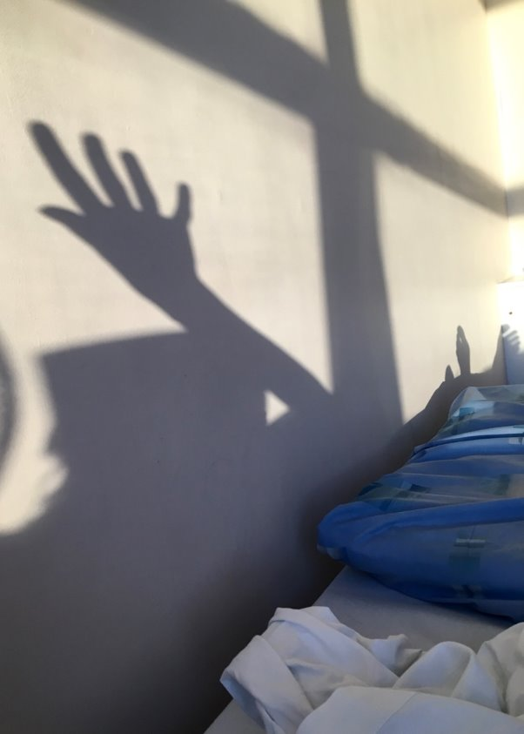
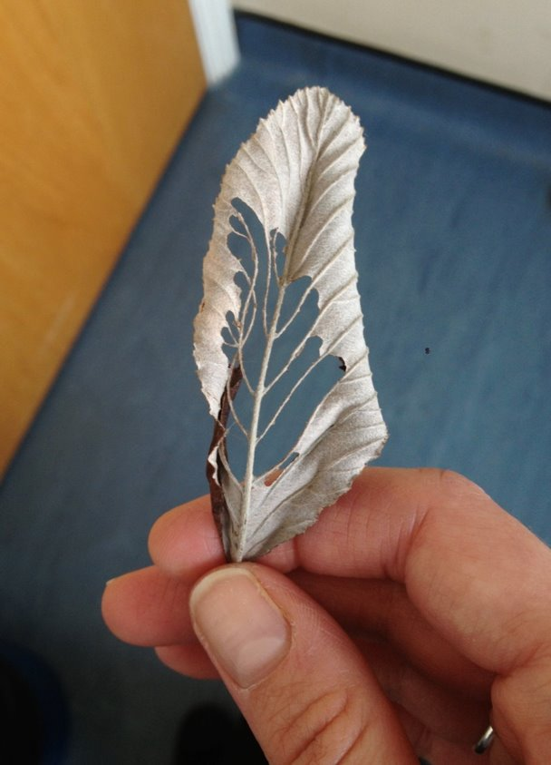
A brief History

Slide 4
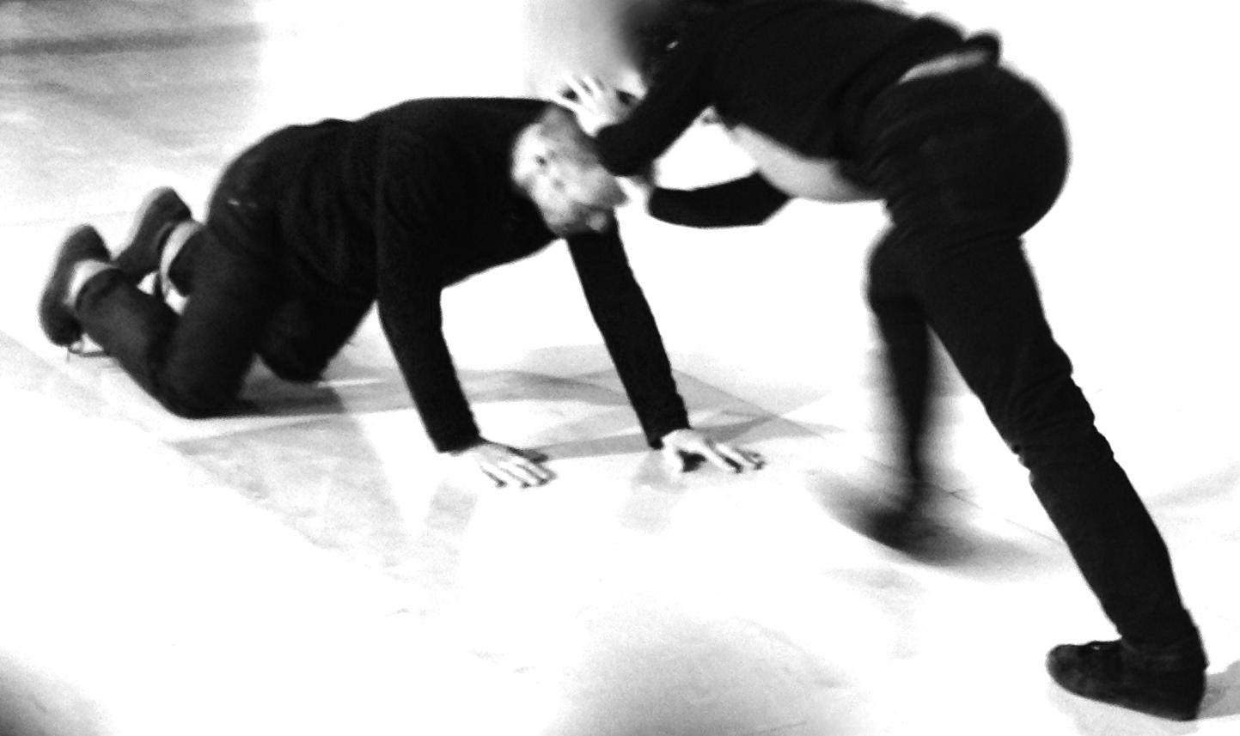
Anorexia is an illness
of contradictions

Slide 5
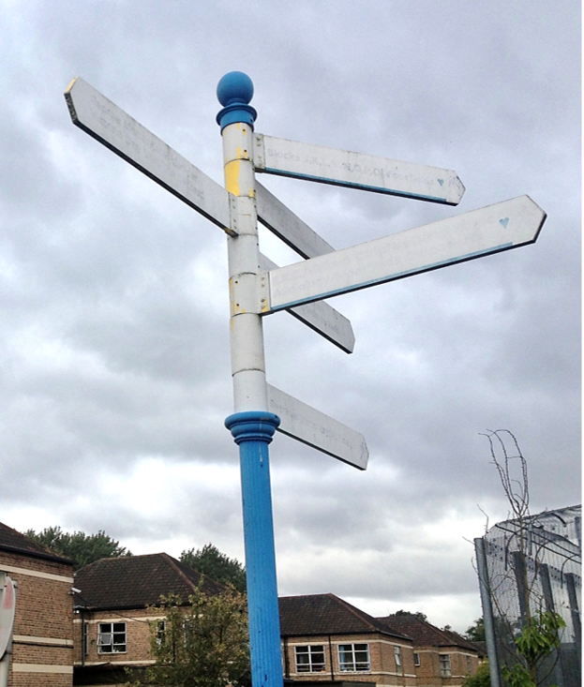
Why is Early intervention important?
Avoid further deterioration in health
Minimise impact of the eating disorder
Avert need for more extreme, intensive and disruptive forms of treatment
Increased likelihood the eating disorder will not yet have become an inseparable part of their identity
Existing recommended therapies are more effective at an early stage

Slide 6
Barriers to Early intervention
Eating disorders take time to develop
Stigma
Normalisation of disordered eating
Systemic issues within care pathways leading to delays to treatment
Poor detection of eating disorders – lack of knowledge
Measuring eligibility for support according to weight/BMI
Inclusion/exclusion criteria across services
Lack of affordable local services
Personal resistances, fear and barriers...

Slide 7
Barriers to seeking support
Not recognising the seriousness of the problem
Shame, fear of judgment
Fear of losing control
Fear/ambivalence about treatment and recovery
Stereotypes and stigma
Normalisation of disordered eating
Believing 'I am not ill enough', feeling of fraudulence
Fear of being turned away from services

Slide 8
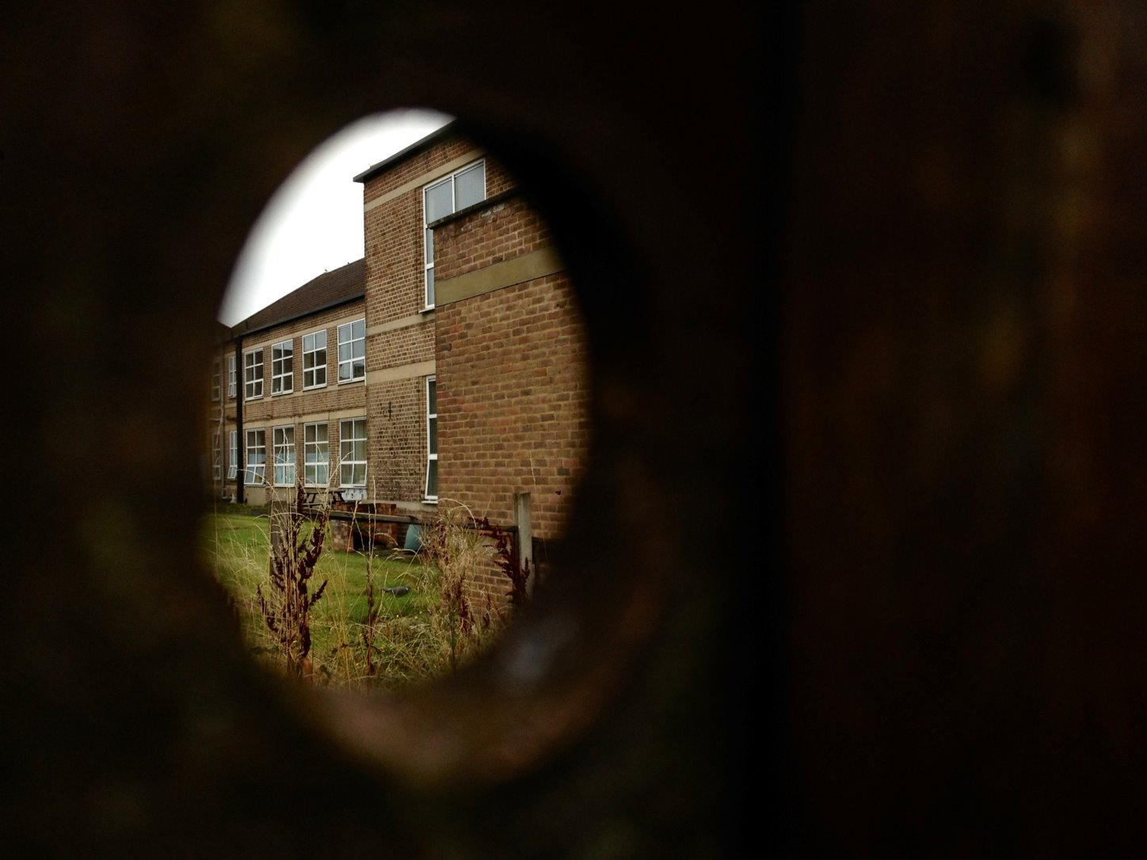

Slide 9
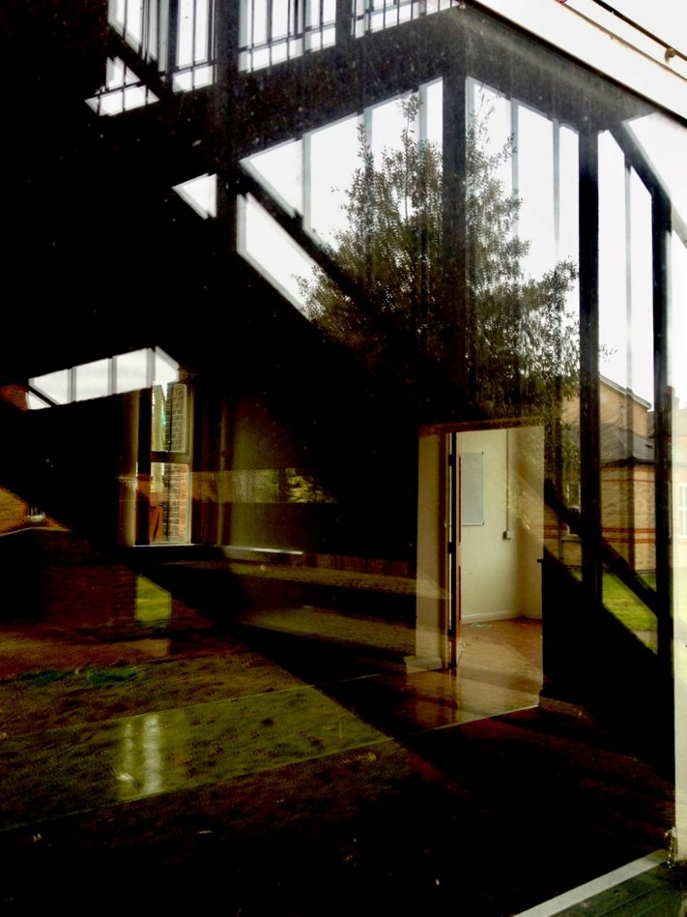
My experiences of inpatient Treatment
Inpatient care saved my life
It also exacerbated and compounded my problems
Institutionalisation
'Recovery' = compliance rather than empowerment
The legacy: more wounds to heal, more challenges to manage

Slide 10
Iatrogenic trauma
Exposure to others' distress
Being sectioned
Being a patient first, person second, losing sense of self
Force-feeding via nasogastric tube
Exacerbation of self-harm
Bullying
Learning weight loss tricks from patients – and staff.
Competitiveness and comparison between patients
Not being able to be alone when this felt needed
Patient deaths and crises
Loss of freedom – lack of fresh air
Locked doors
Loss of control over one's life and environment

Slide 11
Iatrogenic trauma contd.
Isolation
Disconnection from outside world
Institutionalisation and dependence
Conflict, aggressive oppression by staff
Losing friends
Separation from family
Guilt and shame, especially with relapse and readmission
Life standing still, arrested development
Relationships jeopardised – impact on family
Attempting to heal and cling on to hope in spaces which embody despair and lack inspiration or meaningful stimulation.

Slide 12
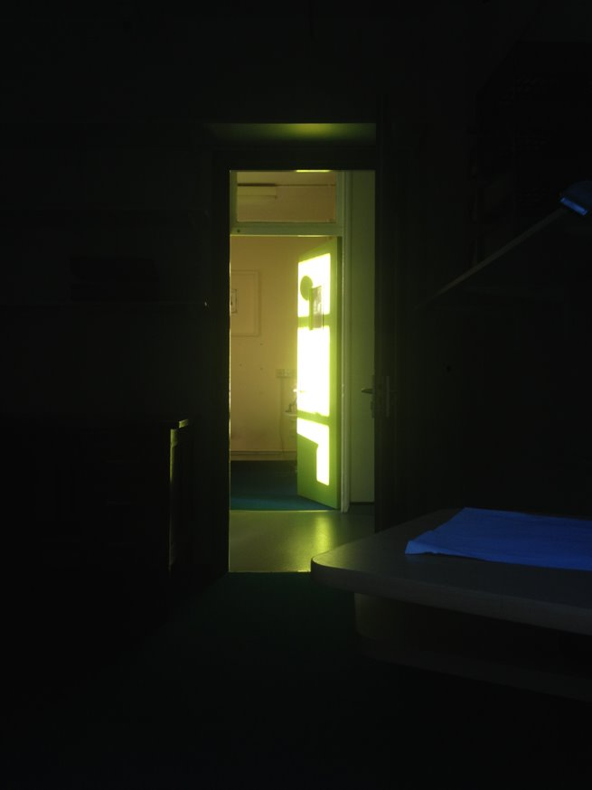
Extreme environments provoke extreme behaviour

Slide 13
Unit
Here mothers and housewives shed forty years,
swaddle themselves in Winnie the Pooh.
Padding down corridors in thick socks,
unsteady legs take tentative steps,
learning to walk or just marking time.
A nurse waits with outstretched arms
to catch us when we fall.
We sit in aggressive silence.
Lips sealed to stopper the flow of words.
Language is insufficient, feelings are formless.
So we act up, lash out, spill milk like tears.
Here tantrums delayed for decades reduce adults
to crumpled heaps,
rattling the bars of the playpen and screaming for release.
Rules, so they tell us, are crutches, stabilisers, stitches.
We are propped up by 'boundaries':
locked gates of routine,
allocated doses of fresh air and freedom.
Here we are schooled to unlearn old tricks -
our table manners leave a lot to be desired.
Pockets are checked for biscuits,
Sleeves for pieces of toast.
Butter fingers let sauce slip.
We are spoon-fed,
or eat under instruction,
like so, like so, like so:
knives are for cutting not scraping
butter belongs on the bread not the plate
the salad dressing is part of the salad
sandwiches shouldn’t be pulled apart or worried to bits
pick up more than one pea with your fork
scrape the plate clean
be mindful of the time
Bitter pills are swallowed at bedtime.
With hot mugs cupped close to the chest,
rising heat soothes worn faces and dries salt on cheeks.
Sleep is restless,
the dark corridor is paced at night.
In the blackout, the beam of a torch scans humid rooms,
checking that we have not drowned.
We retreat to corners and dark cupboards,
draw knees to our chest,
curl heads into crooked elbows.
Searching for the comfort of an absent embrace,
we long for our original selves,
uncontaminated and pregnant with possibility.
by Katharine Lazenby

Slide 14
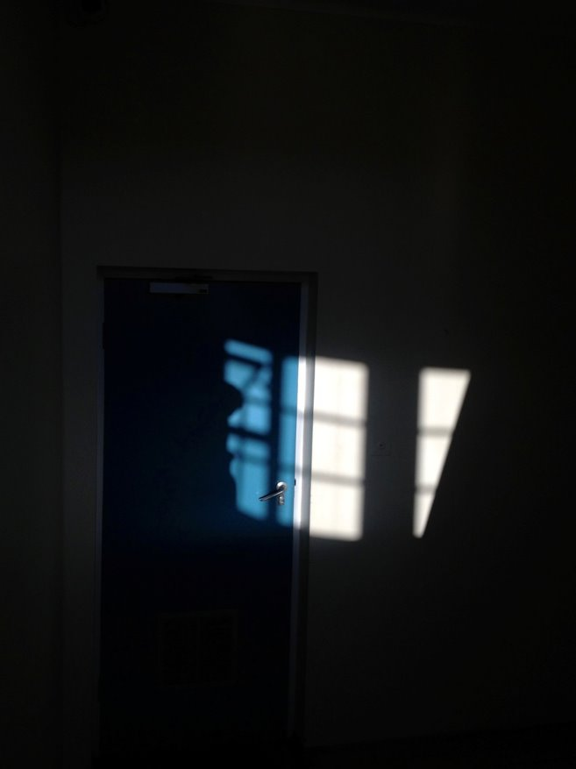
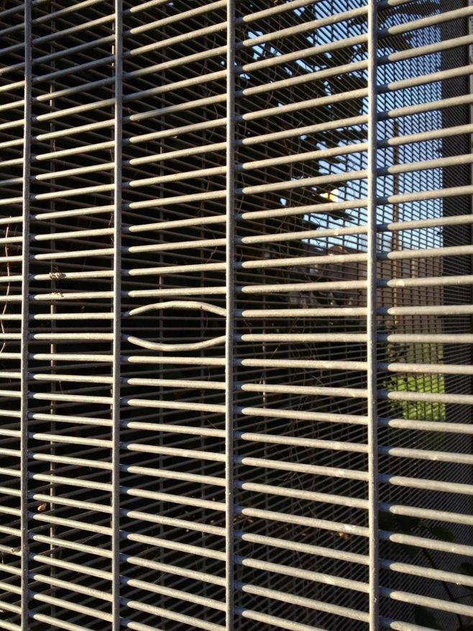
Survival – the power of creativity

Slide 15
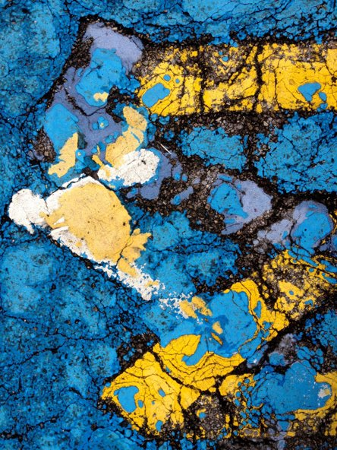
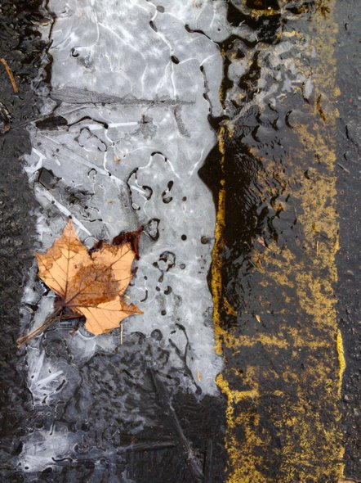
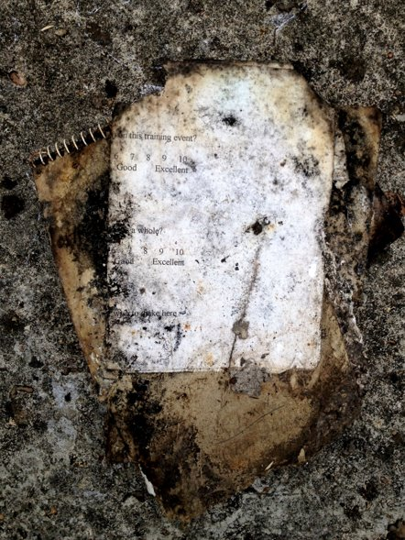
Terra incognita

Slide 16
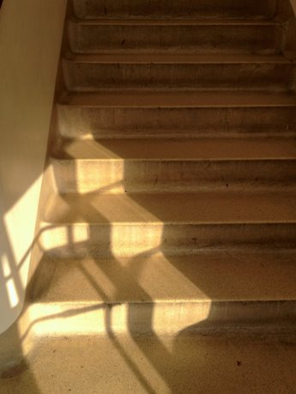
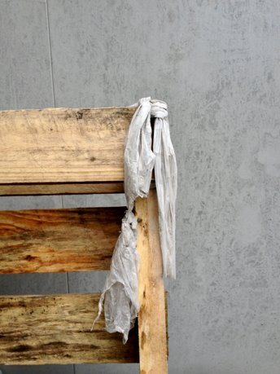
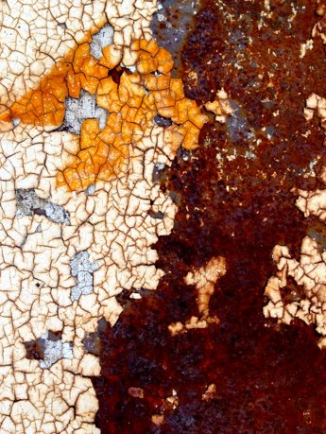
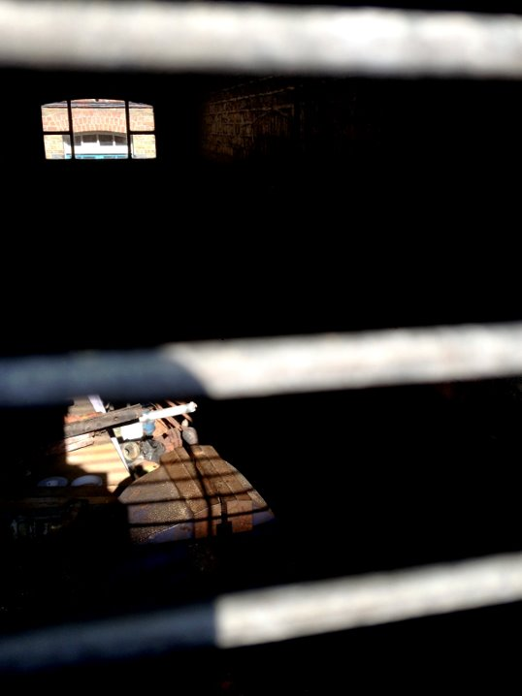
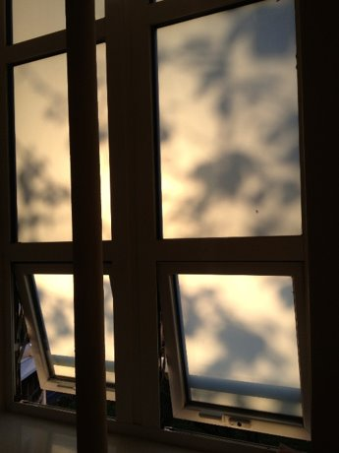

Slide 17
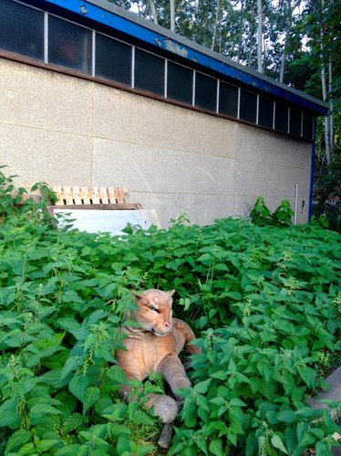
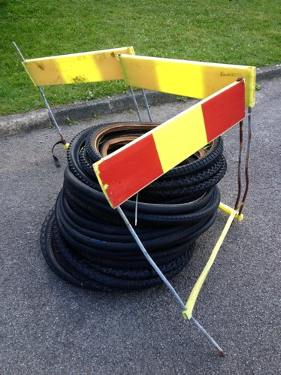
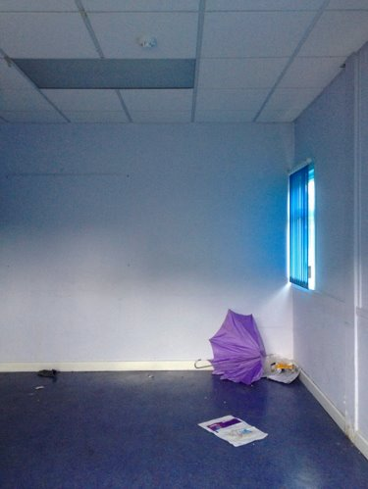
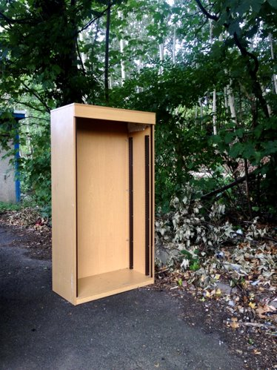
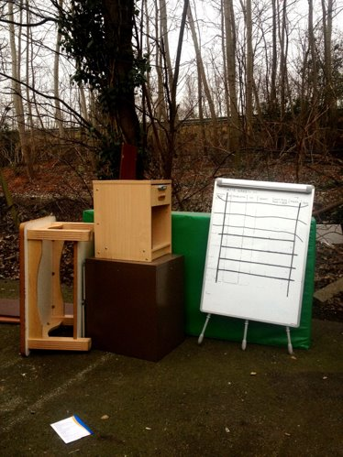
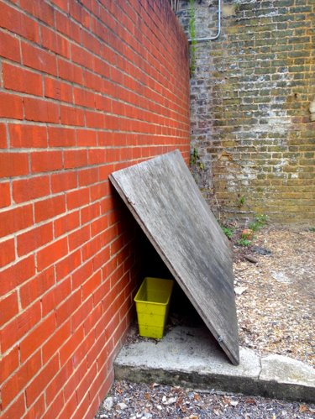

Slide 18
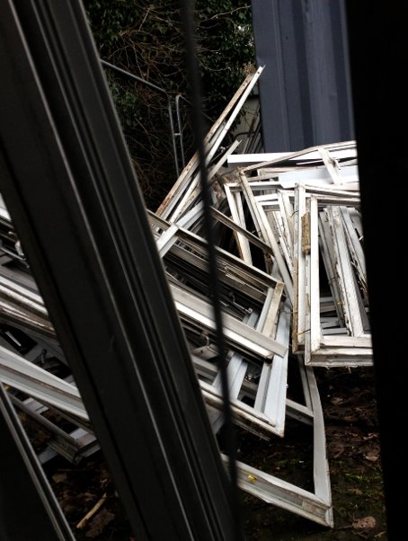
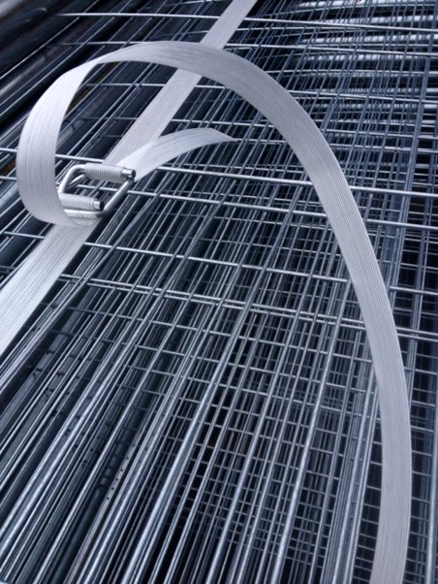
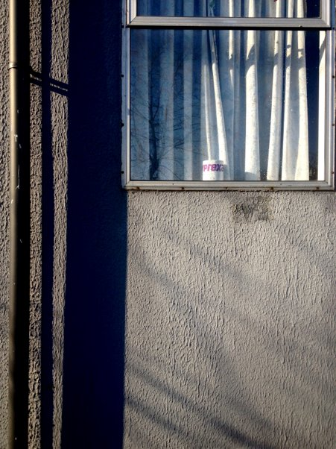

Slide 19
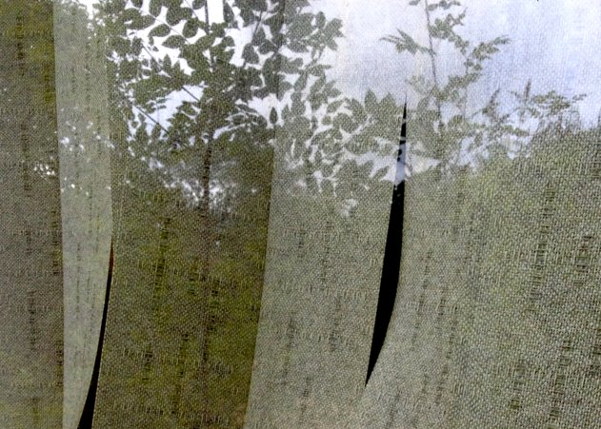
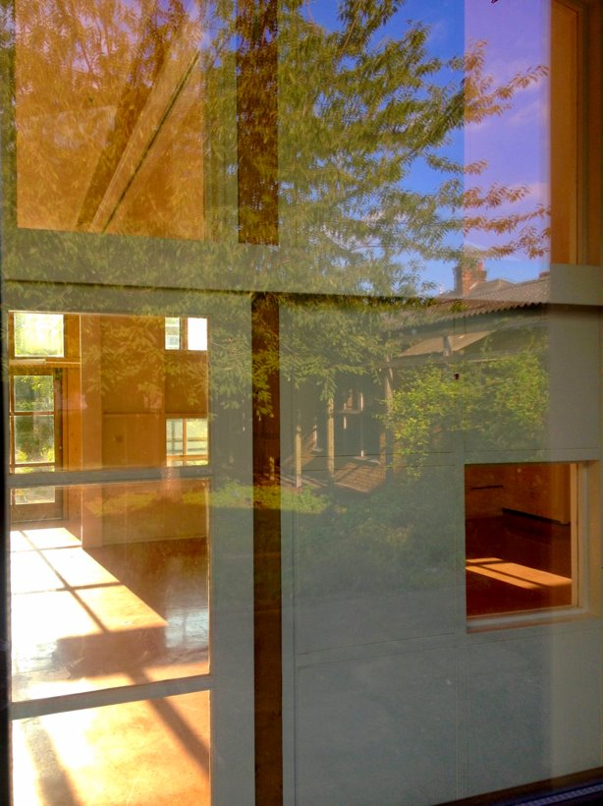
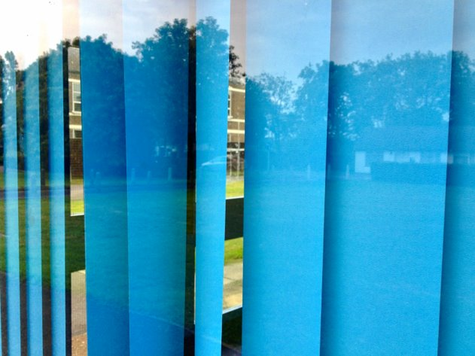

Slide 20
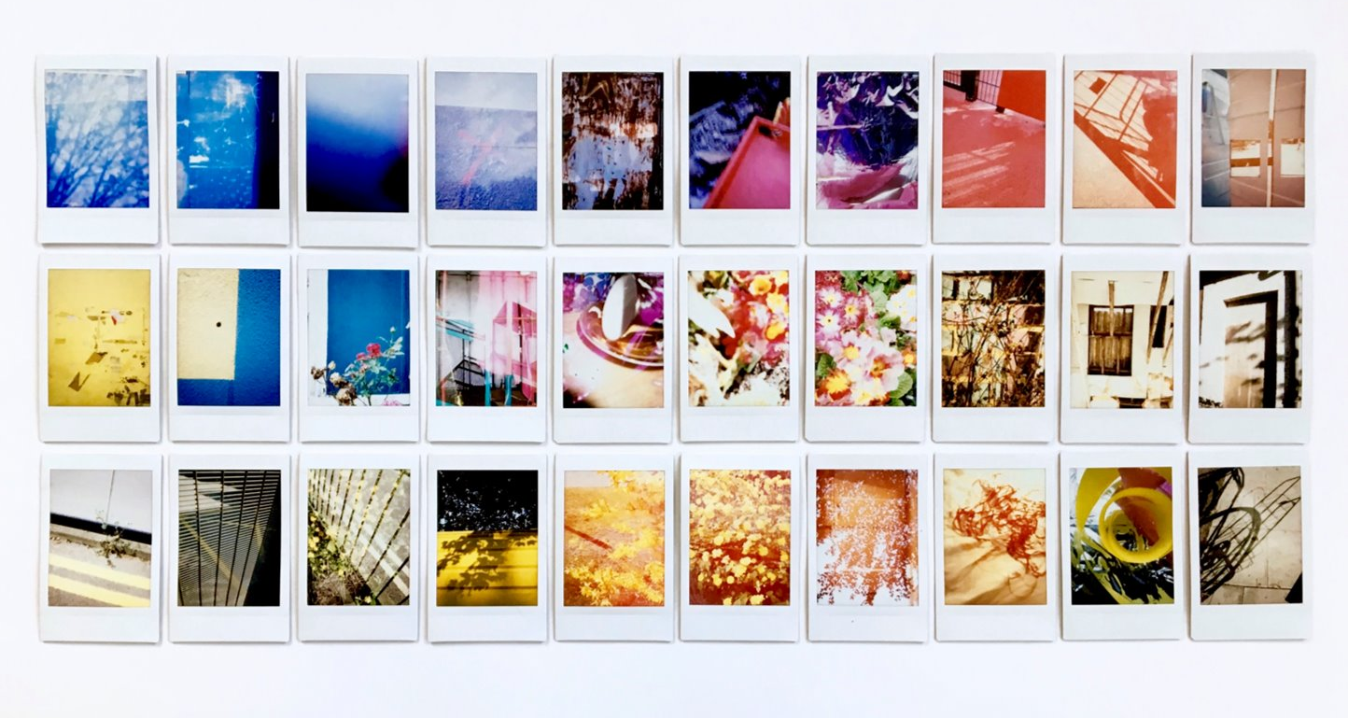
"Helped are those who create anything at all, for they shall relive the thrill of their own conception"
Alice Walker

Slide 21
"NO PERSON TRYING TO TAKE RESPONSIBILITY FOR HER OR HIS IDENTITY SHOULD HAVE TO BE SO ALONE. THERE MUST BE THOSE AMONG WHOM WE CAN SIT DOWN AND WEEP, AND STILL BE COUNTED AS WARRIORS"
Adrienne Rich

Slide 22
What can you do to help?
Have the conversation! You do not need to be an 'expert'
Acknowledge distress regardless of weight or physical 'severity'
Validate the issue. Confirm we deserve help
Listen with compassion and don't make assumptions
Support us and our carers, don't leave us waiting with nothing
Look beyond the surface to understand us better

Slide 23
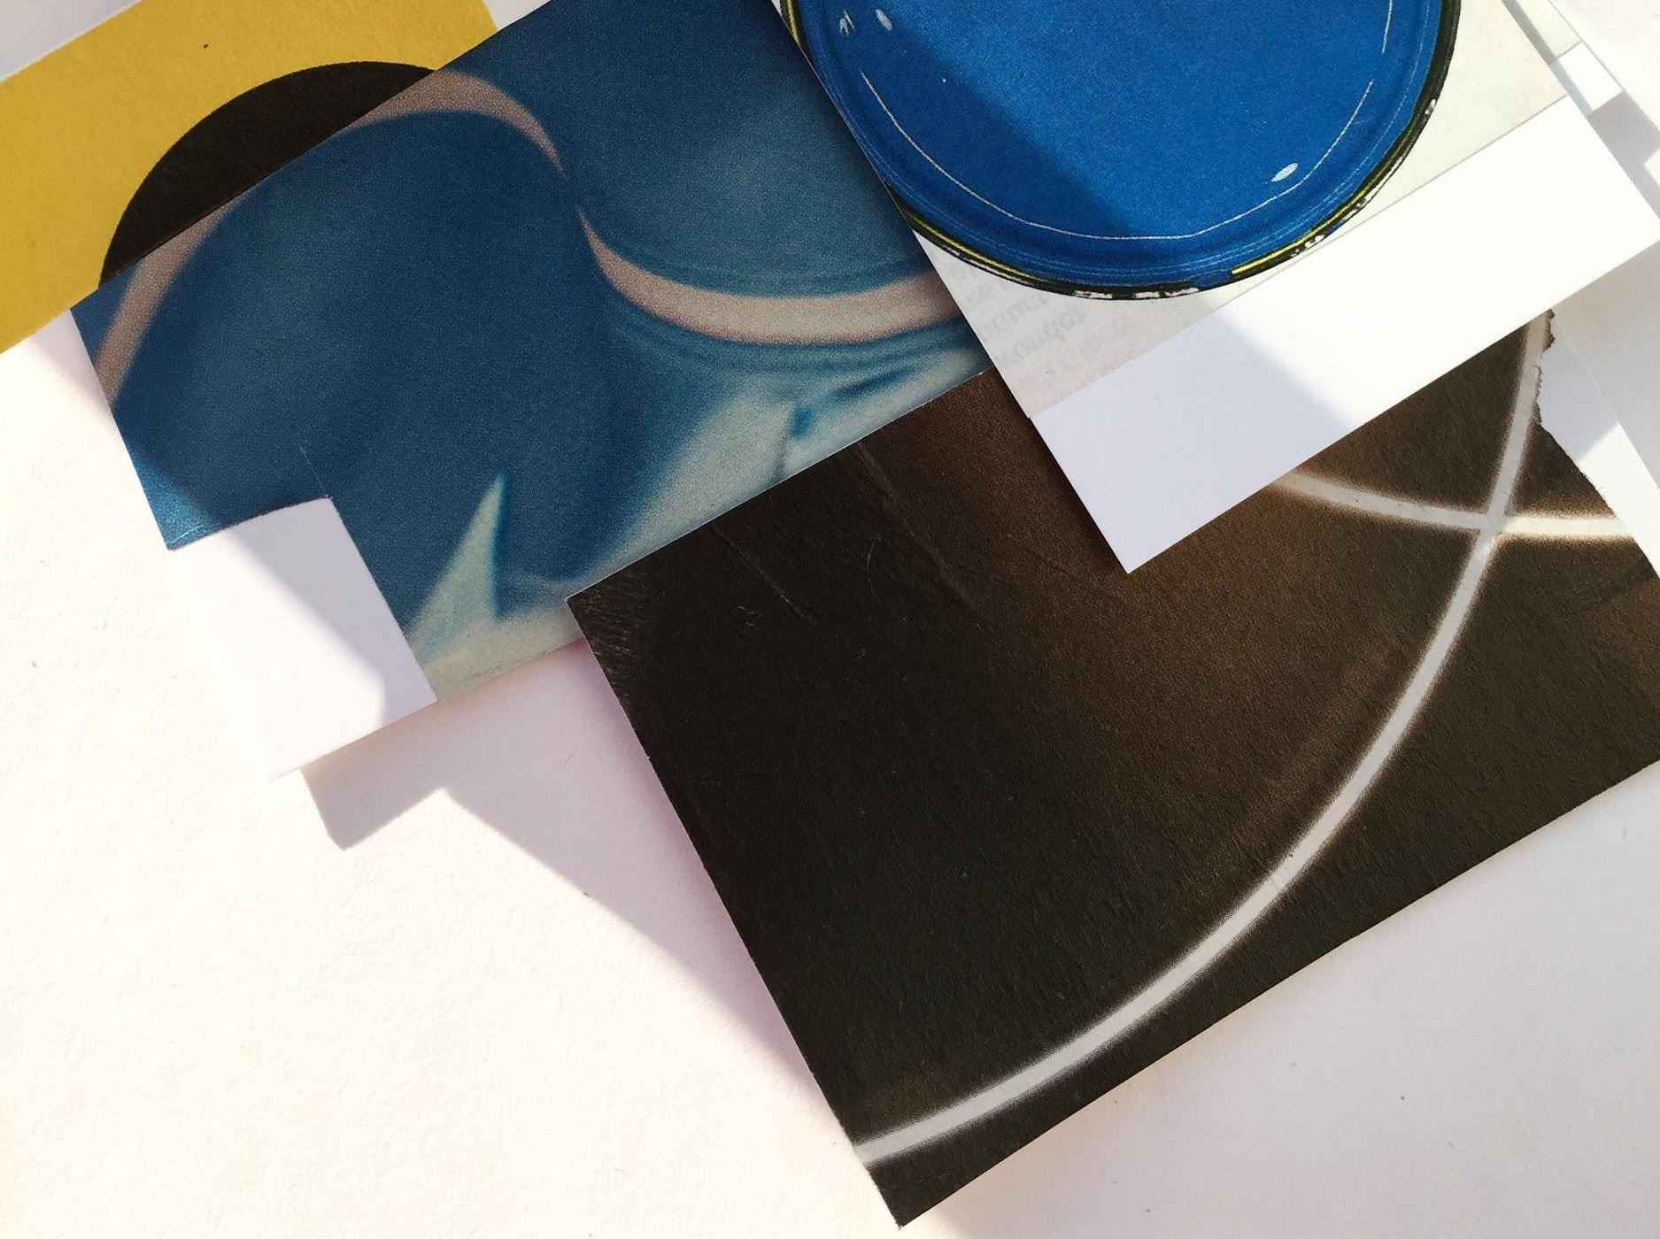
"WE NEED TO STOP JUST PULLING PEOPLE OUT OF THE RIVER.
WE NEED TO GO UPSTREAM AND FIND OUT WHY THEY'RE FALLING IN."
Desmond Tutu

Slide 24
I don’t want to spend time preparing or eating food that I could instead be using to work
Your brain needs calories,
it needs fuel in order to
work and study...
A balanced life includes
time for work, rest
and play
We all need a break
sometimes...
An overwhelming drive to perform, perfectionism
Subjugation of needs
Lack of self-care
High anxiety, fear of failure
Pressure to meet others’ expectations
Low self-worth, low self-esteem

Slide 25
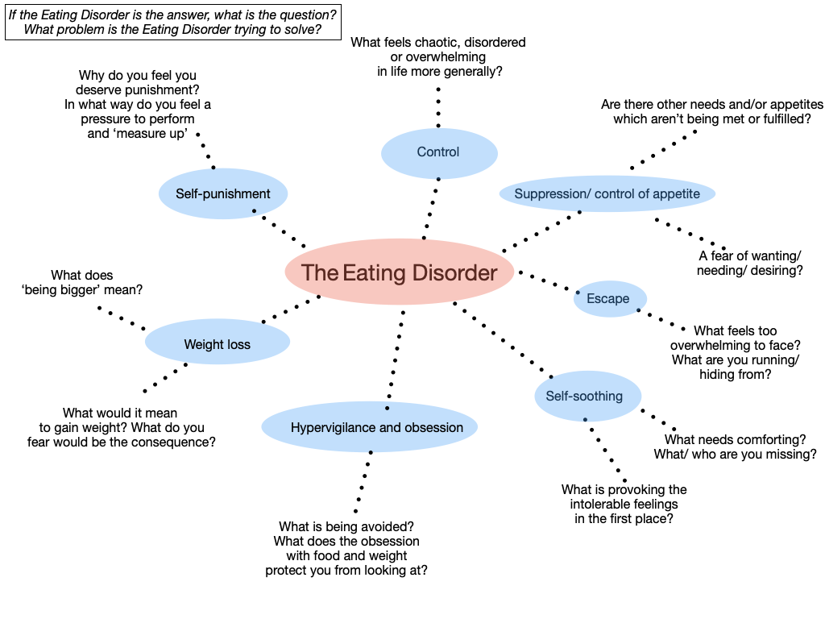

Slide 26
Meet the person where they are in their journey
Recovery is not a linear process
Level the power/authority imbalance
Check your bias, assumptions & judgments
Tailor support to fit
the individual, not
the other way round
Step-by-step approach
Working with
not doing to
Recognise your potential to trigger
Flexible and person-centred
Supporting the individual:
best practice
Self awareness
Every recovery is different
See the person not just the ED
Respect difference,
be inclusive
Be mindful
of the pros and cons
of diagnosis
Compassionate
and sensitive
Recovery from the ED may require ‘recovery’ in other areas of the
person’s life
What’s happened to you?
Not
What’s wrong with you?
Don’t fixate on the external at the cost of caring for the internal
Active listening

Slide 27
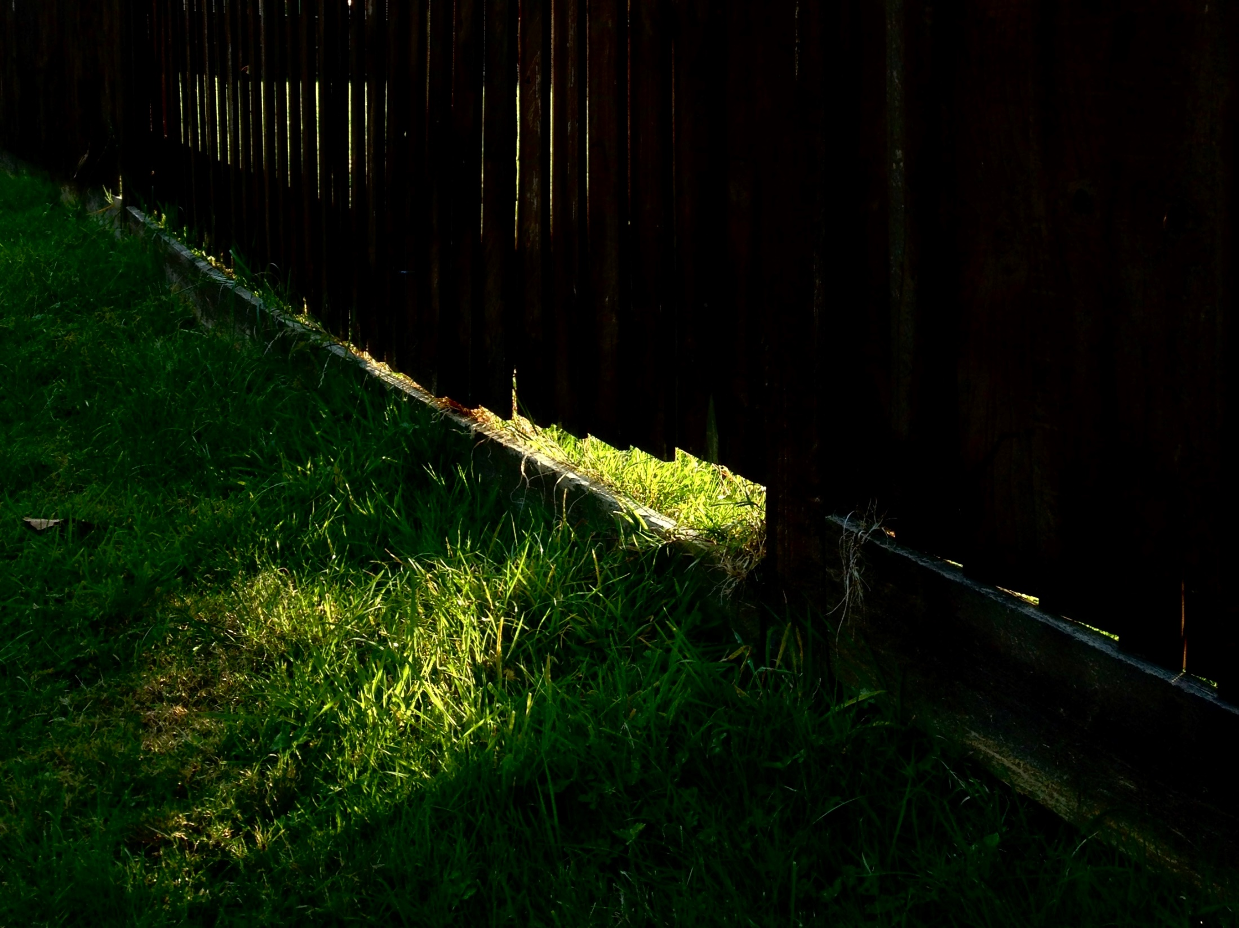

Slide 28
Barriers to Recovery
Preoccupation with food and weight offers a powerful distraction
Denial/struggle to recognise reality
Lack of support/right support
Feeling pressured to change
Unprocessed trauma
Fear
Safety in familiarity
Recovery is painful and extremely difficult
"I'm scared of being rejected if my body changes"
"I'm not that sick, why can't I just stay as I am?"
"Who am I without my eating disorder?"

Slide 29
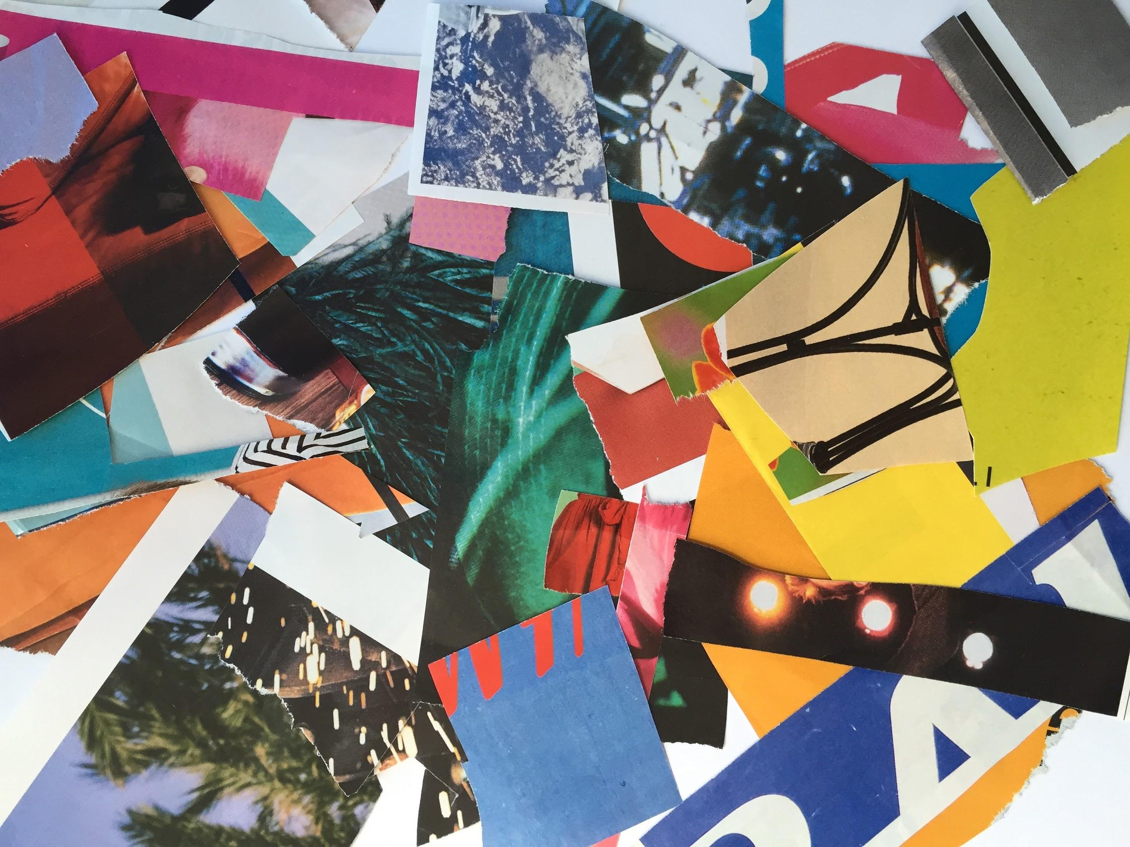
Recovery is "a deeply personal, unique process of changing one’s attitudes, values, feelings, goals, skills and/or roles. It is a way of living a satisfying, hopeful, and contributing life even with limitations caused by the illness. Recovery involves the development of new meaning and purpose in one’s life as one grows beyond the catastrophic effects of mental illness. Recovery from mental illness involves much more than recovery from the illness itself."
Bill Anthony
"Healing is never complete - that’s the job of living"
Indigo Daya

Slide 30
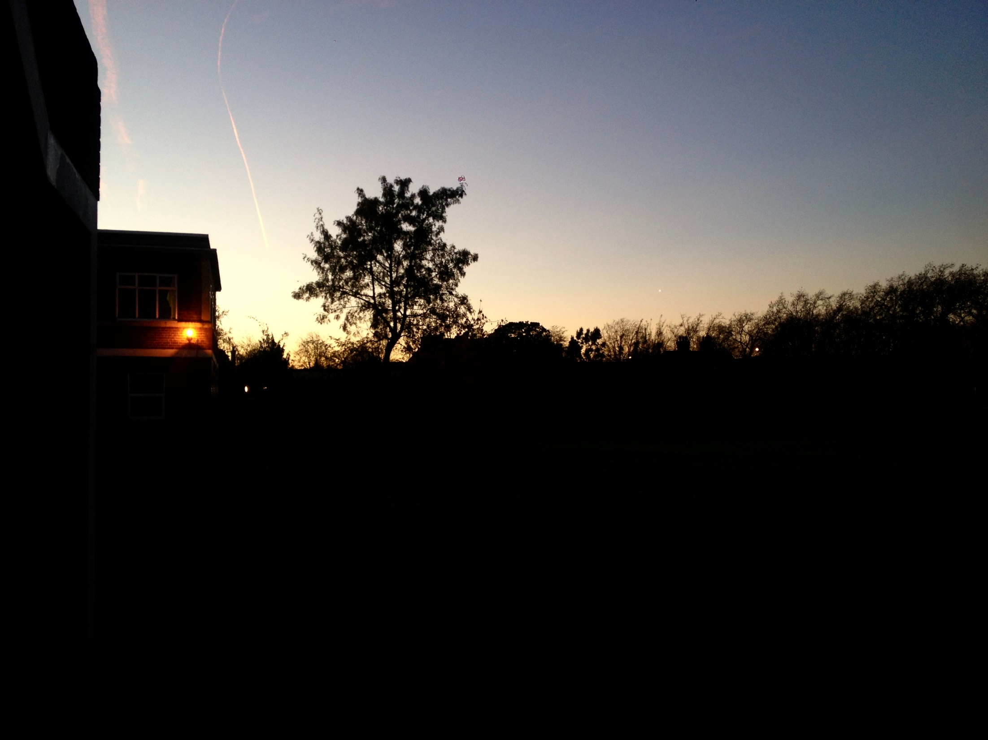
"You can’t organise a recovery around a vacuum…around nothingness.
We need to organise our recovery around something, something that has meaning and purpose, something that gives us a sense that I can begin to move."
Pat Deegan

Slide 31
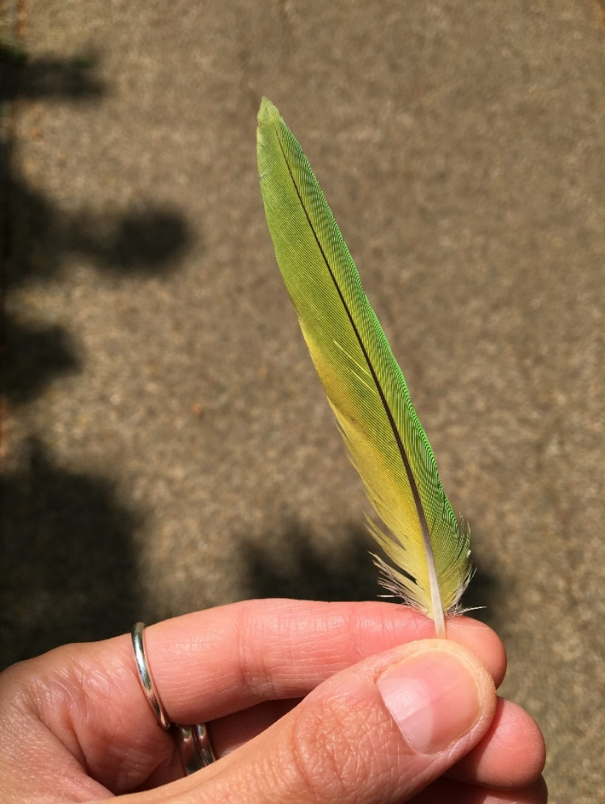
Discovering a life worth fighting for
Creativity & completing my BA in Fine Art
Holidays & travelling abroad independently
Building a healthier relationship with movement and exercise
Living independently in my own home
Relationships, meeting the love of my life
Becoming a teacher & mental health trainer
Volunteering
Recognising my identity as an Expert by Experience – overcoming shame
Finding and using my voice

