Slide 1
From DoLS to Liberty Protection Safeguards: Managing the Interim
December 2021
Alex Ruck Keene
Barrister, 39 Essex Chambers
Wellcome Research Fellow and Visiting Professor King’s College London
Visiting Senior Lecturer, Institute of Psychiatry, Psychology and Neuroscience, King’s College London
Research Affiliate, Essex Autonomy Project, University of Essex
alex.ruckkeene@39essex.com
@capacitylaw

Slide 2
What should we be doing at the moment?
Confidence as to legal framework – the meaning of deprivation of liberty
Confidence as to how to take steps to authorise deprivation of liberty: inside and outside the scope of DoLS
Applying the frameworks under COVID-19
Applying LPS thinking

Slide 3
Restraint
Where a person lacks capacity to consent to it, restraint is lawful if (1) it in their best interests; and (2) necessary and proportionate to the risk of harm that they would suffer otherwise (s.6 MCA 2005)
Not risk of harm to others – that is common law if immediate or potentially the MHA 1983
NB, just because you can lawfully use restraint does not mean you should

Slide 4
What is a deprivation of liberty?
Article 5 ECHR:
Objective element: confinement to restricted space for non-negligible period of time –
Subjective element: either cannot or will not give valid consent
Imputable to the state

Slide 5
The objective element
Birmingham City Council v D [2017] EWCA Civ 1695
Meaning of freedom to leave
A Local Authority v AB [2020] EWCOP 39 and Re AEL [2021] EWCOP 9
Continuous supervision and control, the ‘true powers of control’ and the ‘policy of caution’

Slide 6
The subjective element (1)
The information relevant to the decision: A PCT v LDV [2013] EWHC 272 (Fam) (capacity to consent to admission as informal patient to psychiatric hospital)
If you are to say a person has capacity to consent to what would otherwise be a deprivation of their liberty, they must be given and be able to understand, retain, use and weigh the information relating to the restrictions upon them

Slide 7
The subjective element (2)
16 and 17 year olds: Re D [2019] UKSC 42
Where 16/17 year old confined and cannot consent, parents cannot seek to consent on their behalf
I.e. apply ‘acid test’, ask whether young person can consent, and then, if they cannot, they are deprived of their liberty
=> Application under MHA (where relevant) or court order will be required
https://www.mentalcapacitylawandpolicy.org.uk/deprivation-of-liberty-and-16-17-year-olds-shedinar/

Slide 8
What is a deprivation of liberty? Imputability to the state
Re D [2019] UKSC 42
it is clear that the first sentence of article 5 imposes a positive obligation on the State to protect a person from interferences with liberty carried out by private persons, at least if it knew or ought to have known of this

Slide 9
The medical treatment carve-out (1)
Life-saving treatment: the scope of the Article 5 carve-out
R (LF) v HM Senior Coroner for Inner London South [2017] EWCA Civ 31 (nb SC refused permission)
Re D [2019] UKSC 42
“the situation where a person is taken into (in that case) an intensive care unit for the purpose of life-saving treatment and is unable to give their consent to their consequent loss of liberty, does not result in a deprivation of liberty for article 5 purposes so long as the loss of liberty is due to the need to provide care for them on an urgent basis because of their serious medical condition, is necessary and unavoidable, and results from circumstances beyond the state’s control”

Slide 10
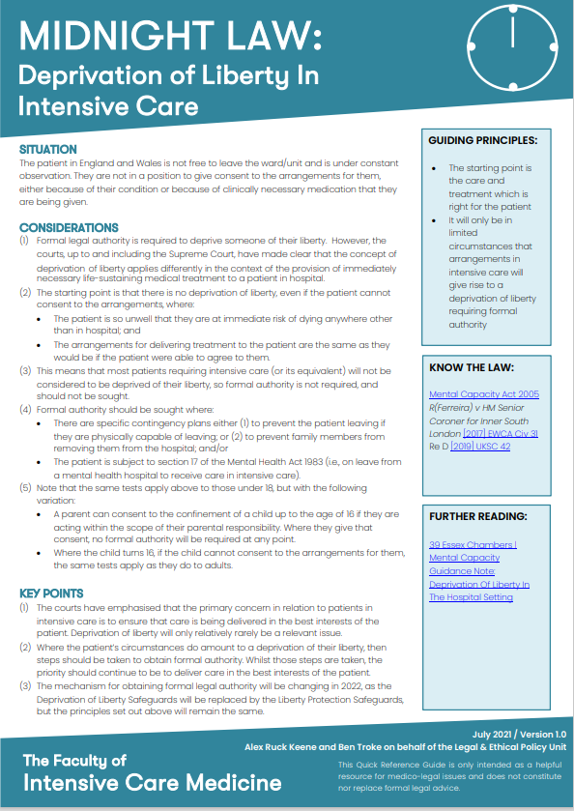
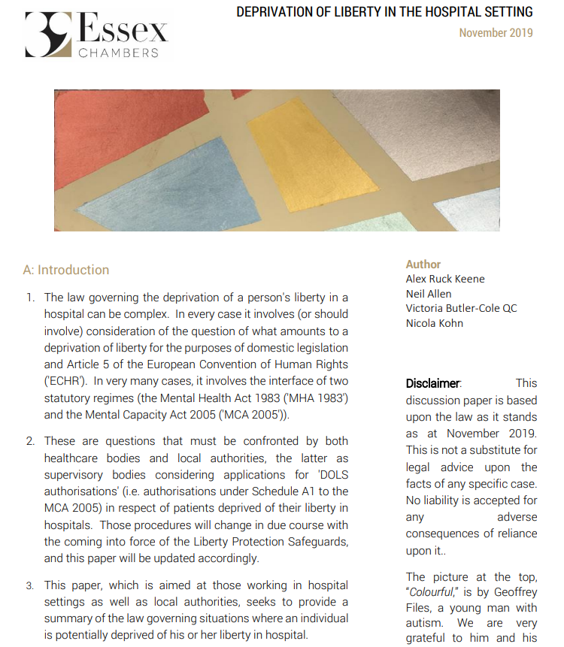
The medical treatment carve-out (2)
How far does the carve-out extend?
Microsoft Word - Midnight Law Deprivation of Liberty in ICU July 2021.docx (ficm.ac.uk)
http://www.39essex.com/mental-capacity-guidance-note-deprivation-liberty-hospital-setting/

Slide 11
The consequences: damages
Distinction between substantive and procedural breaches of Article 5:
LB Haringey v Emile [2020] MHLO (CC): contested case: £143,000 for 8 years failure to authorise causing harm
Essex County Council v RF [2015] EWCOP 1 (where DJ Mort approved an award of £60,000 plus costs of between £50,000 and £64,000 and repayment of £23,000 in care home fees where the local authority’s conduct - depriving P of his liberty in a care home for 13 months - had been “reprehensible”)
Cf
Bostridge v Oxleas NHS Foundation [2015] EWCA Civ 79 (where the Court of Appeal held that a patient unlawfully detained in a mental hospital for over a year was only entitled to nominal damages as the NHS Trust could have lawfully detained him under the MHA 1983)
Burden of proof on detaining body to show no harm caused

Slide 12
DoLs pitfalls at present
YC, Re [2021] EWCOP 34: cutting and pasting…
Be prepared for the court to call upon your assessor: DP v LB Hillingdon [2020] EWCOP 45
Section 21A challenges are there for a purpose: DL v London Borough of Enfield [2019] EWCOP B1

Slide 13
“Community DoL”
Re X (Deprivation of Liberty) [2014] EWCOP 25 and [2014] EWCOP 37
The process for judicial authorisation of deprivation of liberty falling outside DOLS because of nature of placement (or age)
The ‘irreducible minimum’ for compliance with Article 5(1)(e) ECHR
COPDOL11, Practice Direction (PD11A) and model order
https://www.39essex.com/judicial-deprivation-liberty-authorisations/
Telling the truth to the court: LB Barnet v JDO & Ors [2019] EWCOP 47

Slide 14
Applying DoLS at present
DOLS statistics for 2020-21 (England – Wales not available)
3% drop compared to average growth rate of 14% for previous years since Cheshire West
137,515 urgent authorisation applications, and 117,220 applications for standard authorisations
79,880 were in nursing homes, 71,885 were in care homes, 66,375 were in acute hospitals, and 5,685 were in mental health hospitals. 26,685 did not contain information on the detaining authority.
Of applications which were not granted, approximately 60% were due to change in circumstances
Roughly as many applications were completed in the year as were made
10,000 fewer cases not completed at year end
Average length of time for completed applications 148 days.
Proportion of standard applications completed within the statutory timeframe of 21 days was 24% in 2020-21
A major acute hospital problem: 59,360 not granted and 3,140 granted…
How are you doing?

Slide 15
Assessments
DHSC emergency MCA/DOLS guidance now withdrawn but it never changed the law:
It is, and has always been lawful to assess remotely (unlike the MHA)
It is for you to decide whether you have enough evidence
If you can’t access the person meaningfully, do you have any other evidence upon which you can draw to make the determination?
In all cases, need to be clear as to the basis upon which you have reached your conclusion
And if adopted the ‘least worst’ approach more likely to mean that will have to keep under review
If you are not seeing them in person to consider their capacity are you complying with s.1(3) MCA 2005?
Making use of older material
Vaccination requirements from 11 November (in England, not Wales): the Health and Social Care Act 2008 (Regulated Activities) (Amendment) (Coronavirus) Regulations 2021

Slide 16
Digging deeper into consent
Advance consent in the palliative and hospice context – DHSC (and Law Commission) consistently held it’s appropriate: how to record?
And also consent to planned operations and post-operative delirium where foreseeable consequence

Slide 17
Applying LPS thinking
NB not the LPS itself – the MC(A)2019 is not in force, so you can’t e.g. rely upon s.4B ‘emergency’ deprivation of liberty absent court order
But you can start to apply LPS thinking – above all:
Front-loading thinking – will still require fresh assessment from BIA but should already be capturing consideration of confinement, capacity and deprivation of liberty at the point of care planning: good care planning practice already and integral to LPS in due course
Making sure you capture information about the confinement as part of the information relevant to the capacity test: LDV
Focusing on necessity and proportionality as part of the DoLS “best interests plus” test

Slide 18
Beginning to think about the LPS
Categories not relevant to DoLS but who will be relevant to LPS
CHC v social care funding
Self-funders vs CHC/LA-funded individuals in care homes
Assisting children’s services get up to speed with the MCA: crucial post Re D [2019] UKSC 42:

Slide 19
‘Community DoL’
Renewed focus required on community DoL applications – the only way to get authority to deprive someone of their liberty in the community (and very good preparation for LPS thinking)
Section 4B – when application made, authority from the outset where necessary to provide life-sustaining treatment or reasonably believe necessary to prevent a serious deterioration in condition

Slide 20
Beginning to prepare for LPS
Local impact assessments
Sharing expertise
Planning to share personnel
Identifying sources of advocacy
Above all, strengthening knowledge of the MCA

Slide 21
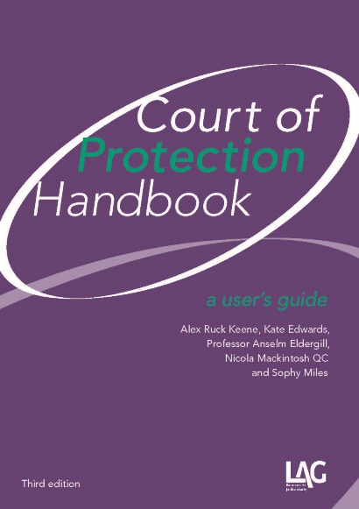
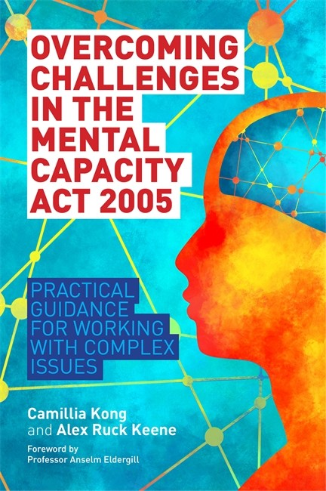
Keeping yourself up-to-date
http://www.39essex.com/resources-and-training/mental-capacity-law/
www.mentalhealthlaw.co.uk
http://www.scie.org.uk/mca-directory/
https://www.mentalcapacitylawandpolicy.org.uk/resources-2/liberty-protection-safeguards-resources/
https://lpslaw.co.uk
www.courtofprotectionhandbook.com
@capacitylaw Evaluations!

