Slide 1
LPS: the person at the heart
Rachel Griffiths

Slide 2
Risk of losing the person within the system Ways to make sure the person is central to LPS How can we know we’re getting it right?
What we
will
cover

Slide 3
Necessary and proportionate deprivation of liberty of someone lacking capacity is lawful if: person is of ‘unsound mind’ and process laid out in law and person informed promptly of reasons and the person is told of their right to challenge (and helped to exercise it)
ECHR and LPS: Protection for universal human rights

Slide 4
Trying to balance autonomy and protection… fear of law and systems and process

Slide 5
Will LPS prevent the problems linked to DoLS?
Government policy objectives:
New simplified legal framework…clear to all
Improved outcomes for people and their family/unpaid carers
Ensure the MCA works as intended by placing the person at the heart of decision making
Provide authorisation in a cost-effective manner.

Slide 6
How can we use LPS to improve life for the person at their heart?
Look past the bureaucracy to enable LPS to strengthen the empowering ethos of the MCA
Create care around the wishes and feelings of the person
Make sure we ‘hear the voice’ of the person
Consult those who know them best to find out what they would want

Slide 7
‘improved outcomes’: not just safety, quality of life, more freedom
Great widening of scope compared with DoLS
People aged 16 and 17
Those living in the community: often younger than those in residential care
Essential to ‘hear the voice’ of the person
Missing skills can often be learned: Dave can be taught to have capacity to engage in sexual relations, Amina can learn to choose her own foods

Slide 8
LPS part of the MCA: a deeper purpose
•The MCA protect rights enshrined in human rights law (ECHR and HRA)
Human rights law is founded in philosophical principals:
Prevention of misuse of power by states to oppress or punish those lacking power
Recognition that ‘human rights are for everyone’ (Lady Hale)
Adds legal weight to the importance of enhancing individual autonomy and happiness

Slide 9
Best interests is a process founded in the MCA principles
39 Essex Chambers: ‘where it is possible to identify a course of action that the person would have taken had they had capacity, then any departure from that course of action must be justified by the health and social professionals involved. The greater the departure, the more compelling must be the reason for so doing.’ Guidance Note, 2019

Slide 10
Best interests checklist MCA s.4, code ch. 5
Excerpts from checklist:
Might the person regain capacity in time?
What is the decision?
Are we clear whose decision this is?
What are ALL the available options?
What does the person want, what are their relevant past wishes, feelings, their culture?
Appropriate consultation, inc. relatives/friends?
Difficult decisions need a balance sheet for options: sometimes ‘least worst’ option
Least restrictive (of rights and freedoms) that meets the need

Slide 11
Recording a best interests decision
Go through the checklist, show that you’ve considered each factor – say briefly if it’s irrelevant, it shows you’ve thought. Remember to consider if other factors exist for this individual.
Wherever you can, illuminate the process by quoting the person and/or those who know them best
Be truthful if it’s difficult, or if you feel that this decision is sub-optimal due to constraints and circumstances
Ensure the decision is transparently arrived at. If the outcome leads to uproar among relatives/friends or causes unexpected upset to P, be prepared to revisit the process: we won’t always get it right.

Slide 12
What matters to someone: not one-size-fits-all
Johann, from central Europe, brought to the care home his alpenstock and a large wall-picture of mountains
When anyone visits her, Pammy takes her clothes off the hangers and puts them in her bag; she drags staff by the hand to the door
Myra no longer uses words, but cries when she sees dogs because she so misses her pet
Emrys has a learning disability and no speech, but brought a box of Welsh rugby shirts and posters to his supported living house

Slide 13
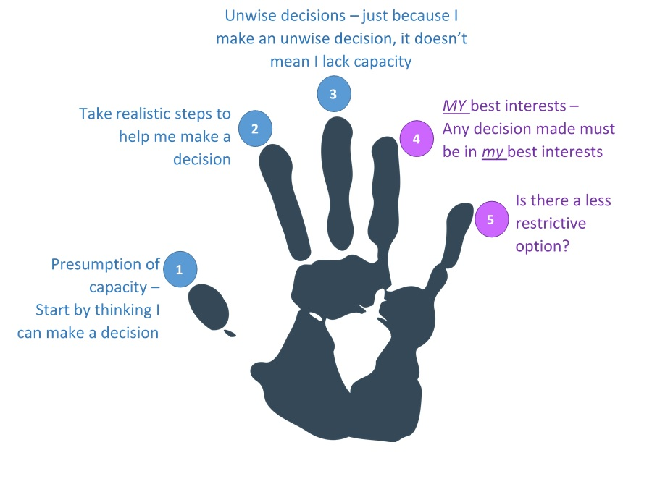
MCA requires it: ss.4(4) and 4(6)(a)-(c) demand that we find out P‘s wishes and feelings beliefs and values, now and in the past; anything else they might think important
Judges increasingly stress the importance of P’s wishes and feelings
OPCAT requires that the UK’s NPM (including CQC) must hear the voice of the detained person* – this has been signalled for action by all the NPM members in each annual report since 2009. *OPCAT Article 20(d)
CRPD makes the person’s wishes the central factor irrespective of capacity
Why the person’s voice is crucial (1)

Slide 14
People with lived experience of the MCA don’t always find the same things important as professionals do (Article 8 more than Article 5?)
It’s their lives, not ours
We can’t presume to get it right if we don’t ask, whether in words or by observation of what makes them happy or sad – and do our best to align care with their wishes and feelings
Hence DoLS / LPS must look past ‘process’ to the effect on the person
Why the person’s voice is crucial (2)

Slide 15
Legacy of DoLS
Bright sparks of hope:
Best interests assessor and DoLS mental health assessor - drivers for improving general rigorousness of understanding
CQC has made MCA and liberty KLOEs, and inspects against them routinely
DoLS like LPS focus on necessity and proportionality to force us back to best interests, and to questions of enhancing capacity

Slide 16
What might good practice look like?
Back to the basics: LPS ensures we recognise when rights at risk
Mental Capacity Act (MCA) Principles give a scaffolding for creating good care
Best interests decisions can only reflect the available options – now cruelly limited for all
Enable learning of living skills
Find person-centred and creative solutions for the tiny issues

Slide 17
What do people want?
The shorthand for it might be: Article 8 Rights to live as they choose, as far as possible.
People tell us the most important thing in their lives is to be heard, to be recognised as individuals, in a way that implies that their wishes and feelings are central to how they live.
Really important to people in settings that are their homes.

Slide 18
Risks of LPS process changes from DoLS
authorisations can last up to 3 years (DoLS 1 year)
a lesser role for AMCPs than BIAs, as person’s voice only heard if objecting
devolves much of the process to providers (NHS trusts, CCGs, perhaps care homes) and the intention is to halve the number of challenges to 0.5%
IMCA is advisory but not a right; no RPR (even paid)

Slide 19
Not always easy to recognise objection
Objection is the trigger for referral to an Approved Mental Capacity Professional to visit, and hear the person

Slide 20
Spurs to improvement: DoLS vs. LPS
Reputation of DoLS at rock-bottom
Widening of scope means far more professionals will work within LPS
New refreshed code of practice, setting LPS firmly within DoLS
Advantages of novelty, a better name, and chance to refresh knowledge of the wider MCA

Slide 21
What can we do better?
LPS offer a great opportunity…
To be clear about what we want to know, and clarify who will oversee new, varied responsible bodies
to stress human rights-based decision-making from the start of care planning
To find better ways to audit the processes in a way that explicitly links people’s rights with respect for their wishes and feelings.

Slide 22
Some great quotes 1 Lady Hale
The purpose of the best interests test is to consider matters from the patient's point of view. That is not to say that his wishes must prevail, any more than those of a fully capable patient must prevail. We cannot always have what we want. [2013] UKSC 67]
People with disabilities, both mental and physical, have the same human rights as the rest of the human race. [2014] UKSC 19

Slide 23
Some great quotes 2 Mr Justice Peter Jackson
A conclusion that a person lacks decision-making capacity is not an ‘off-switch’ for his rights and freedoms
I am quite sure that it would not be in Mr B's best interests to take away his little remaining independence and dignity in order to replace it with a future for which he understandably has no appetite, and which could only be achieved after a traumatic and uncertain struggle that he and no one else would have to endure
[2015] EWCOP 60

Slide 24
Person-centred audit: contentment and challenge
Audit how happy or content people are when their rights are protected by this scheme: include ‘negatives’ – depression, silence
We will not always get it right, and people change: if a plan leads to uproar from people or their relatives, be prepared to look what has been missed or what has changed
Remember that a central plank of Article 5 is the right to challenge: be proud to highlight and support this right

Slide 25
Embed LPS clearly right now in the wider MCA
Ensure that ‘necessary and proportionate’ is always our starting-point in care planning
Record evidence of ‘mental disorder’
Be more aware of objection in all its forms
Put Article 8 rights at the heart of decision-making and record wishes and feelings
Audit what elements of MCA practice can we strengthen now: assessment of capacity, how to work out best interests

Slide 26
LPS part of MCA part of human rights law

