Slide 1
10 Years of Spectrum
Looking back with pride, Looking forward with ambition.
NHS Complaints Summit
December 2021
Offender health and Complaints
Early reflections from the Pilot 2021/22
Sue Thornley, Head of Healthcare HMP Kirkham
Agnes Wozna, Patient Experience Lead Spectrum

Slide 2

Who we are
Spectrum Community Health CIC- offender health, community substance misuse and integrated sexual health services
Sue Thornley Agnes Wozna

Slide 3

Why we were chosen for the pilot
Versatile settings: offender health (all genders and different category prisons) integrated sexual health and community substance misuse;
Offender health within secure settings presents itself with challenges beyond acute or community;
Prior to the Pilot, Spectrum had reviewed Complaints Policy and aligned to the NHS Complaints Standards;
We want the gold standard for our patients and staff;

Slide 4
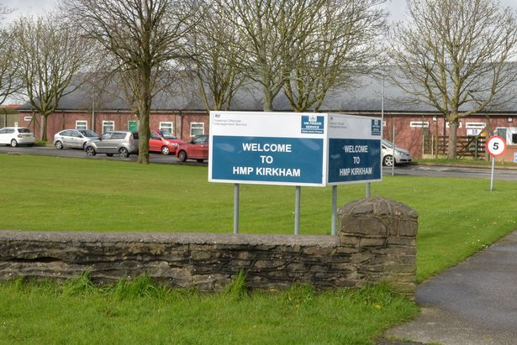
Our experience of implementing the standards, model procedure and guidance
HMP Kirkham:
Why we said yes
What is going well
What has been a struggle

Slide 5

Our experience of implementing the standards, model procedure and guidance
Support from Senior Leaders and PHSO colleagues
Interim Complaints Policy not far from the new model procedure
Two sites chosen- different regions and cat
HMP Kirkham- proactive, patient centred,
Staff engagement-
Patient day to day engagement impacted by prison category, size of population, vacancies, Covid outbreaks
Staff training- concern vs complaint, all hands on board

Slide 6
Our experience of implementing the standards, model procedure and guidance
Training- useful but time consuming
Two sites chosen but one troubled with staff shortages, vacancies and unable to start as planned
Culture change around how we perceive complaints and concerns

Slide 7
what have we learned and how have things improved in our organisation
Early resolution aligns to initial face to face contact
Time is what we need and time is the biggest struggle
In house training
Engagement with clinical colleagues
Firefighting but the passion is there
Evaluation- do we ask patients about their satisfaction post response
Focused on lessons learnt

Slide 8

Next steps
Continue with evaluation and process at HMP Kirkham
Support the other site to commence as soon as possible
Rolling out in-house complaints training for all services
Patient centred complaints procedure to feed into new patient engagement strategy

Slide 9

Thank you for listening.
Any Questions?
Agnieszka.wozna@spectrum-cic.nhs.uk
@wozna_ag

