Slide 1
Non medical prescribing in End Of Life Care and Symptoms
Dr Edith Israel
Clinical lead and Chief Consultant in Palliative medicine, The London Clinic, Nye Bevans NHS Executive Leadership Academy fellow

Slide 2
Objectives
Nurse prescribing for symptom control: current issues
Empowering nurses to prescribe in end of life care
Managing pain at the end of life
Controlled drugs and non medical/nurse prescribing
The use of drugs beyond their medical licence
Improving non medical prescribing practice at the end of life

Slide 3
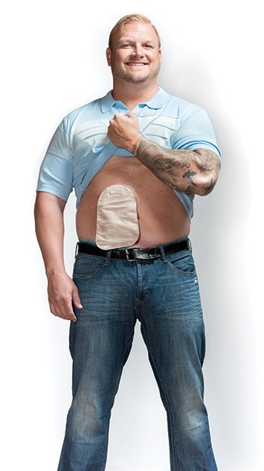
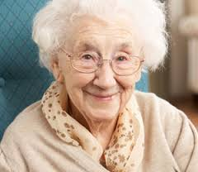
Which one of these patients is an EOL patient?
18 y.o Erika Morales
Feisty teenager, loves surfing
Cystic fibrosis
Well known to Royal Brompton Hosp (RBH)
Been in & out RBH most of 2017
Liver failure + resistant infections
Jehovah’s witness (not for transplant)
82 y.o. Maevis Bell
NH Resident
Dementia 5yrs ago
‘Quite happy’
Son + daughter visit regularly
Recurrent hospital admissions –infections, falls, UTI, aspiration LRTI
Now barely E +D
47 y.o John Shepherd -accountant
Father of 2
Metastatic colorectal cancer since 2011
Now awaiting immunotherapy trial at Royal Marsden
Notes:
Lung transplantation is the only definitive treatment in patients with cystic fibrosis, BUT IT IS STILL NOT A CURE
?End stage dementia- ? E + D less, Worsening cognitive impairment, recurrent infections.

Slide 4
Who is considered to be an EoL Patient?
‘Patients who are approaching the end of life, are likely to die in the next 6- 12 months…’
National definition & CQC definitionhttps://www.nhs.uk/conditions/end-of-life-care/what-it-involves-and-when-it-starts/
Notes:
As I go through the definition of EOL patient, I would like you to think about how many or what proportion of patients within your practice fit the definition of EOL patient

Slide 5
Who is considered to be an EoL Patient?
This includes people whose death is imminent, as well as people who:
have an advanced incurable illness, such as cancer, dementia or motor neurone disease
are generally frail and have co-existing conditions that mean they are expected to die within 12 months
have existing conditions if they are at risk of dying from a sudden crisis in their condition
have a life-threatening acute condition caused by a sudden catastrophic event, such as an accident or stroke
National definition & CQC definitionhttps://www.nhs.uk/conditions/end-of-life-care/what-it-involves-and-when-it-starts/

Slide 6
Would you be surprised if the patient were to die in the next 6-12 months?
Notes:
Prof Paddie stone BMC August 2017: How accurate is the ‘Surprise Question’ at identifying patients at the end of life? A systematic review and meta-analysis
-22 papers
-25,718 predictions of survival made in response to the SQ.
-Pooled accuracy level was 74.8% (95% CI 68.6–80.5). There was a negligible difference in timescale of the SQ. Doctors appeared to be more accurate than nurses at recognising people in the last year of life (c-statistic = 0.735 vs. 0.688), and the SQ seemed more accurate in an oncology setting 76.1% (95% CI 69.7–86.3).

Slide 7
Controlled drugs in End of Life and use of drugs beyond product license
• Frequently used controlled drugs used at end of life include: Morphine, Oxycodone, Fentanyl, Alfentanyl, Diamorphine, Midazolam – Others of note: Pregabalin, Methadone, Ketamine
NB: Medicinal cannabis – specialist register
• Legal aspects of prescribing unlicensed medications
• Prescribing off-label
Notes:
DISCUSS

Slide 8
Principles of N-MP post Shipman/Gosport report
Hand writing requirements
• Signature on collection of CD prescriptions
Registers /record keeping requirements
30 day supply
28 day validity
Government response to the recommendations of the Shipman Inquiry's fifth report and to the Ayling, Neale and Kerr/Haslam inquiries - GOV.UK (www.gov.uk)

Slide 9
Principles of N-MP post Shipman/Gosport report
• Accountable Office Role:
– Information Sharing & co-operation between bodies
– Inspection
– Monitoring prescribing of CDs
– Requirement to report incidents to AO
– Sharing lessons learnt
Notes:
DISCUSS

Slide 10
Principles of N-MP post Shipman/Gosport report
REPORTING INCIDENTS, NEAR MISSES AND CONCERNS INVOLVING CDs
Record Keeping and Stock Discrepancies
Clinical Governance and Professional Practice
Fraud & Possible Criminal Issues
Notes:
DISCUSS

Slide 11
Principles of N-MP post Shipman/Gosport report
Controlled Drugs Accountable Officer’s national update (22 September 2020) - Watch this video on Vimeo: https://vimeo.com/464953934
This is a good video if you have time to view it, that addresses governance in health and social care – it is the controlled drugs accountable officers annual update ( Sept 20), the AA is also a pharmacist and lawyer. Start the video from minute 2 to avoid usual teams meeting gaffs

Slide 12
Issues for Non Medical Prescribers
Royal College of Pharmaceutical competencies
• Role and remit
• Competency
• Job description/professional indemnity
• Local policies/formulary
• Legal & best practice requirements
• The patient/patient group
Notes:
DISCUSS

Slide 13
Issues for Non Medical Prescribers
Newly qualified NMPs
Off licence drug
Confidence, pressure, family pressure to prescribe/or not
Specialist initiated treatment protocols
Difficult to manage symptoms
Notes:
DISCUSS

Slide 14
Mixing medicines that include controlled drugs
National guideline –Care of Dying Adult, NICE 2016, Local guidelines
Regular v PRN v Syringe Driver
Combining medicines in a syringe driver/Recognition of incompatibility
Only prescribes medicines that are unlicensed, ‘off-label’, or outside standard practice if satisfied that an alternative licensed medicine would not meet the patient's clinical needs.
Notes:
DISCUSS
14

Slide 15
The use of anticipatory prescribing
) REACH A SHARED DECISION
1) ASSESS PATIENT & symptoms
Document findings & clear decision making process
2) CONSIDER OPTIONS –risk and benefits
3) REACH A SHARED DECISION –work with pt/carer and seniors I.e. consultant in pall care
4) PRESCRIBE –risk and benefits, national guideline
5) MONITOR & REVIEW
Notes:
^{DISCUSS}

Slide 16
Prescribing CD -Tips
Checks the patient/carer’s understanding of and commitment to the patient’s management, monitoring and follow-up.
Establishes and maintains a plan for reviewing the patient’s treatment.
Ensures that the effectiveness of treatment and potential unwanted effects are monitored.
Detects and reports suspected adverse drug reactions using appropriate reporting systems.
Adapts the management plan in response to on-going monitoring and review of the patient’s condition and preferences.

Slide 18
Disposal of CDs
Only small amounts of CDs should be destroyed at ward/department level.
Destruction should be documented in CDRB
Destruction must be witnessed by a second person.
The liquid contents of opened or partly used ampoules should be placed into a black lidded burn bin.
This applies also to discontinued or partly used PCA/epidural or solutions in syringe drivers.
Used patches should be folded and placed in a black lidded burn bin.
Oral CDs dispensed but refused by a patient should be placed in a black lidded burn bin with some liquid soap

Slide 19
Pain at the End of Life
Is patient currently taking strong opioid?
Yes
No
Is pain controlled on strong opioid?
Does patient have uncontrolled pain?
Assessment
No
Yes
Yes
ASSESS CAUSE
Consider alternative causes of pain including:
urinary retention
constipation
No
NO
If patient cannot take oral meds:
Convert regular 24 hour dose of oral opioid to sub-cutaneous (sc) syringe driver
Oral-to sc conversion ratio for Morphine and Oxycodone is 2:1 (i.e. to get dose for sc route, divide oral dose by 2)
Prescribe prn analgesia – 1/6th of 24 hour dose
e.g. syringe driver with 30mg morphine over 24 hours equates to 5mg sc morphine prn
Transdermal patches (e.g. Fentanyl) should continue
PRN analgesia is often Oxycodone in these cases
Yes
Prescribe regular/prn analgesia as appropriate:
Morphine is the usual first-line opioid for patients with pain at the end of life. Caution is advised with the following risk factors:
RENAL IMPAIRMENT FRAILTY MORPHINE INTOLERANCE
Treatment options are:
Convert oral dose to sc and reassess
Increase dose by 25-50%
Switch to alternative opioid
Does your patient have any of these risk factors?
Suggested Treatment
No
Yes
Suggestion for regular analgesia:
Morphine sulphate 10-15mg over 24 hours sc via syringe driver
Suggestion for prn:
Morphine sulphate 2.5-5mg sc
Suggestion for regular analgesia:
Oxycodone 2.5-5mg over 24 hours via syringe driver
Suggestion for prn:
Oxycodone 1.25mg sc
Notes:
discuss

Slide 20
Watch for Side effects and Toxicity!
SIDE EFFECTS
TOXICITY
Nausea
Vomiting
Constipation
Sedation/drowsiness
Vivid dreams
Visual hallucinations
Myoclonic jerks
Coma (reduced GCS)
Respiratory depression
Pinpoint pupil
Myoclonic jerks
Visual hallucinations
Confusion
Treat underlying cause, consider opioid switch/withdrawl, consider naloxone ↓RR
Check for precipitant
i.e. dehydration, renal failure, infection, drug interactions…

Slide 22
Nausea & Vomiting

Slide 23
Nausea and vomiting

Slide 24
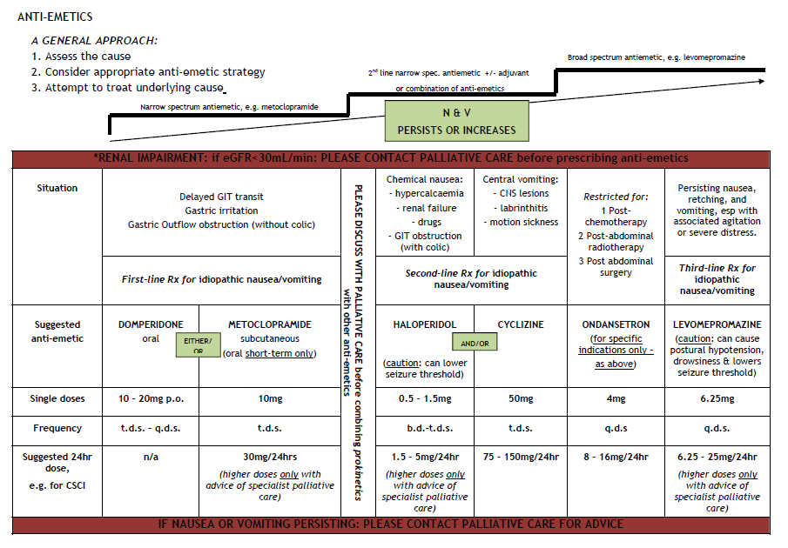
Approaches to Managing Nausea & Vomiting
D2
D2
H1/muscarinic
5HT3
D2/H1/muscarinic/5HT

Slide 25
Respiratory secretions

Slide 26
Respiratory Tract Secretions at the End of Life
Present
Absent
ASSESS CAUSE
Possible causes include:
Retained saliva/nasopharyngeal secretions or vomit;
Infective secretions, e.g. purulent sputum;
Positive fluid balance, e.g. due to excess parenteral fluids or nutrition
Assessment
Saliva and/or
retained secretions
Retained VOMIT
Infective secretions,
e.g. CAP/HAP
Non-drug management:
Positioning
Reassurance and explanation of causes for family
Avoid suctioning
Consider suctioning
Consider single dose of broad spectrum IV antibiotic
Suggested Treatment
Consider a peripherally-acting anti-muscarinic, e.g.
Glycopyrronium 0.6-1.2mg over 24 hours sc via syringe driver
START
ANTI-EMETIC (see GUIDE)
REASSESS CAUSE
Glycopyrronium/Hyoscine hydrobromide 0.2-0.4mg sc prn OR Hyoscine Butylbromide 20mg sc

Slide 27
Agitation and anxiety

Slide 28
End of Life - Terminal Agitation/Restlessness in Adults
(Prognosis of hours to days)
Present
Absent
Assessment
ASSESS CAUSE
Consider treating potentially reversible risk factors where appropriate e.g.
urinary retention,
constipation,
uncontrolled pain,
opiate toxicity,
known biochemical abnormality,
hypoxia,
hypoglycaemia,
sepsis
Once potential reversible factors considered
Midazolam 2.5-5mg sc prn
+/- Lorazepam 0.5mg -1mg SL
Midazolam 2.5-5mg sc prn
Consider need for syringe driver with Midazolam 5-10mg over 24 hours sc (reduce dose if frail or have renal impairment)
Suggested Treatment
Persistent restlessness NOT responding to prn midazolam
Persistent restlessness responding to prn midazolam
Persistent restlessness NOT responding to prn midazolam
REASSESS CAUSE
Increase Midazolam in syringe driver according to prn dosage used in last 24 hours, to a maximum of 30mg over 24 hours
REASSESS CAUSE
If symptoms have not responded to 30mg Midazolam over 24 hours sc then please contact Palliative Care urgently for further advice.

Slide 29
References
Department of Health Faculty of pain medicine https://www.gov.uk/government/publications/information-about-controlled-drugs-regulations
Care Quality Commission https://www.cqc.org.uk/guidance-providers/controlled-drugs/controlled-drugs
NICE 2016 https://www.nice.org.uk/guidance/ng46/evidence/full-guideline-pdf-2427186353
Faculty of pain management http://www.fpm.ac.uk/faculty-of-pain-medicine/opiodaware
Royal Pharmaceutical Society (2016) A Competency Framework for all prescribers
Schneider & Dickman, A (2016). The syringe Driver, Continuous subcutaneous infusions in palliative care. 4th Edition. Oxford university press. www.nmc.org.uk/standards-profiency-nurse-and-midwife-prescribers

Slide 30
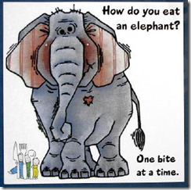
To Take Away (TTA)
Practice safe prescribing
Practice, practice, practice and document!
“Since so many people were in the same boat, I appreciated the reminder that eating an elephant can only be done one way: one bite at a time. Trying to gulp it down in one sitting is asking for severe indigestion. We know intellectually that the best way to accomplish something big is to approach it in smaller pieces
How to eat an elephant –The Introverted Entrepreneur

Slide 31
WHO CAN PRESCRIBE WHAT?
Nurse and pharmacist independent prescribing changes announced - GOV.UK (www.gov.uk)
This is a really good link to clarify who can prescribe what – use the drop down box for independent non medical prescribers

Slide 32
Any questions?

