Slide 1

Developing and ensuring competence in practice
Presentation by:
Paul Jebb OStJ MA BSc(Hons) DipHE RN

Slide 2
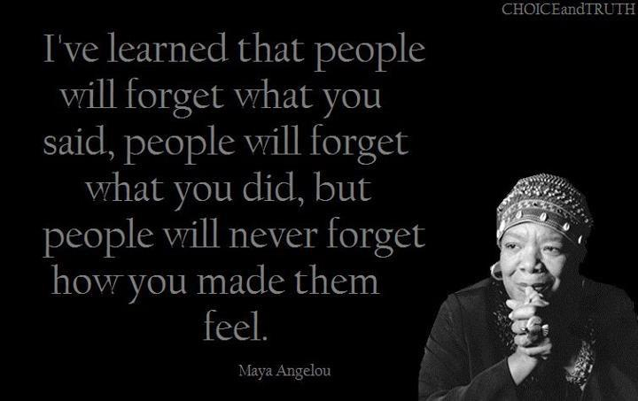

Slide 3
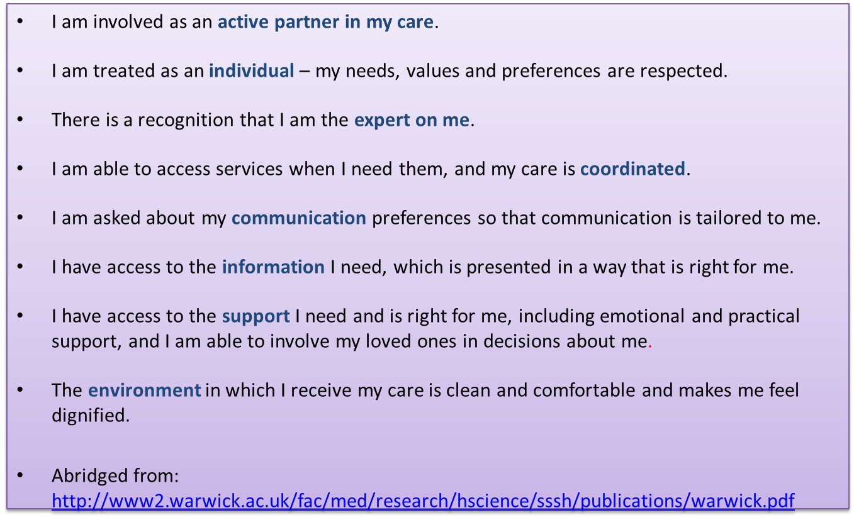
What makes a good experience?

Slide 4
Service excellence
‘Put emotional experience at heart of the healing process, not as an add-on’
  Fred Lee ‘If Disney Ran Your Hospital’ (2005)

Slide 5
The Challenge
Moving beyond marginal improvements in experience
Improving faster for the most vulnerable
Improving consistency
Engaging staff and influencing work climate
Achieving right balance between local and national.

Slide 6
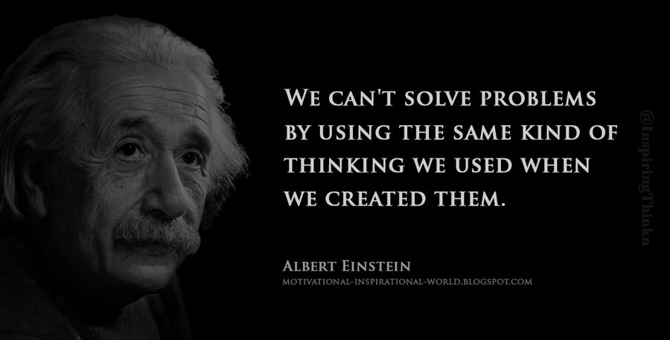
Be the eyes and ears…

Slide 7
6Cs - Values essential to compassionate care
Care
Compassion
Competence
Care is our core business and that of our organisations; and the care we deliver helps the individual person and improves the health of the whole community.
Caring defines us and our work. People receiving care expect it to be right for them consistently throughout every stage of their life.
Compassion is how care is given through relationships based on empathy, respect and dignity.
It can also be described as intelligent kindness and is central to how people perceive their care.
Competence means all those in caring roles mist have the ability to understand an individual’s health and social needs.
It is also about having the expertise, clinical and technical knowledge to deliver effective care and treatments based on research and evidence.
Communication
Courage
Commitment
Communication is central to successful caring relationships and to effective team working. Listening is as important as what we say. It is essential for ‘No decision without me’.
Communication is the key to a good workplace with benefits for those in our care and staff alike.
Courage enables us to do the right thing for the people we care for, to speak up when we have concerns.
It means we have the personal strength and vision to innovate and to embrace new ways of working.
A commitment to our patients and populations is a cornerstone of what we do. We need to build on our commitment to improve the care and experience of our patients.
We need to take action to make this vision and strategy a reality for all and meet the health and social care challenges ahead.

Slide 8

Positioning all staff as leaders…
Meeting the challenges of today;
And influencing the health and care landscape of the future

Slide 9


Social Media

Slide 10

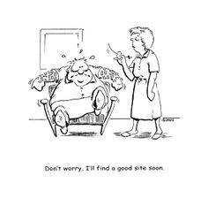


Maintain Competence

Slide 11
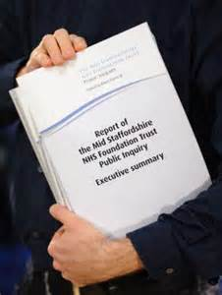
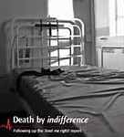
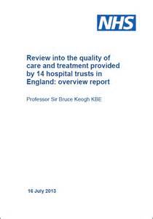
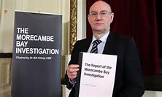

Keep Learning…

Slide 12


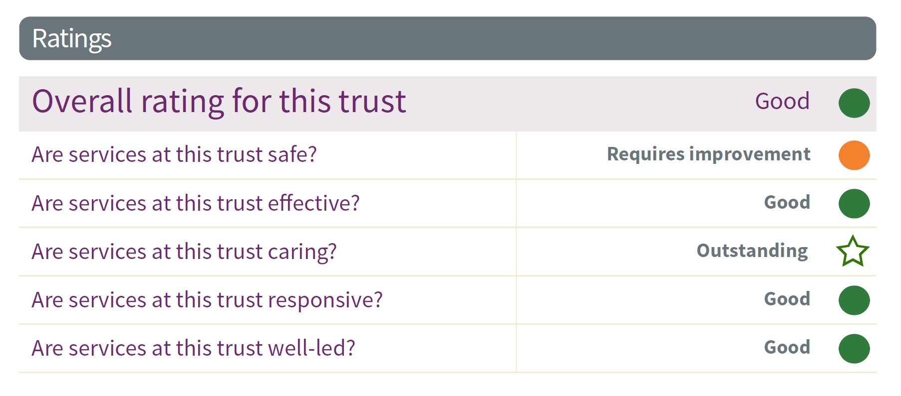
Celebrate the Good Stuff!

Slide 13
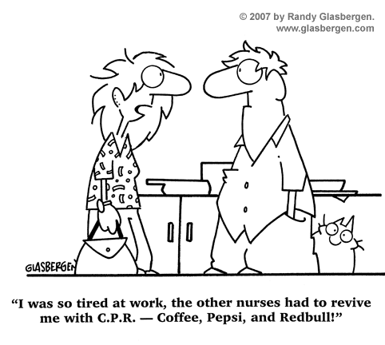
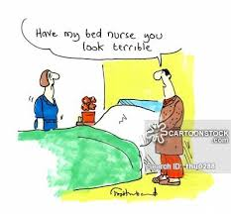

Look After Yourself
Happy Staff make Happy Patients

Slide 14
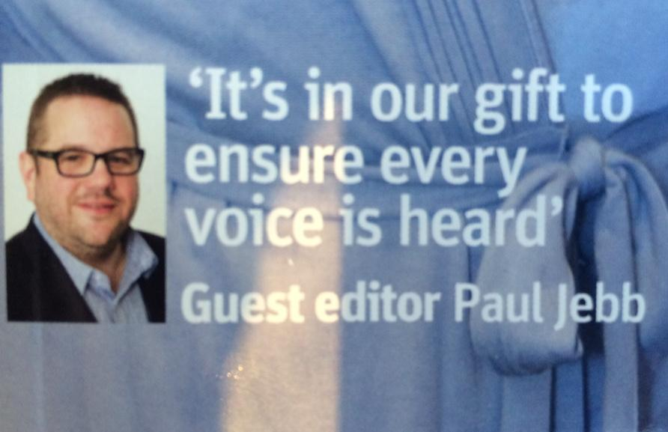

Slide 15
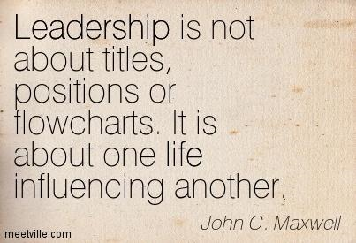

Developing You
Coaching
Mentoring
Role modelling
Everyone across the NHS is in leadership
Theory of followship

Slide 16
What’s Next…
Top up to be an RN – what field will you chose? Can you APEL? Think about your field of practice and how you gain specific competencies
Consolidate your theory and put it into practice – learn new skills according to organisation policies
Develop your leadership skills – FNF courses an ideal opportunity
Think about the skills you have and how you develop them
Understand your values, who are your role models
Get a mentor and coach to help you develop
Collect for your revalidation

Slide 17
Be The Voice & Step up….
Introducing the nursing associate - YouTube

Slide 18

Its in our gift…..

