Slide 1
Jeanette Dickson President The Royal College of Radiologists December 2021
Improving radiology reporting and escalation: where are we now?

Slide 2
Declarations
I am not a radiologist but I do spend a lot of time with them
As a referrer, I work with two different PACs and three different alerting systems

Slide 3
Topics to cover
What is a report?
What is an alert?
Where are we now?
Where are we going?
What help do we need?

Slide 4
A perfect world
Correct imaging test requested by referrer whose contact details are available and question asked
Images immediately acquired
Images immediately reported in written form and question answered
All findings communicated to referrer immediately
Immediate response instituted for patient benefit

Slide 5
Reality
Insufficient reporting capacity means the report is often generated long after the patient leaves the department
Improvements in imaging technology mean more questions can be asked / more answers given
The number of referrers has increased
Continuity of the referral team has been disrupted

Slide 6
RCR standards
First produced 2008
Fifth iteration
“Actionable” report
Expert medical opinion

Slide 7
RCR standards (2)
Actionable report – access to previous imaging, clinical history, laboratory investigations, patient correspondence
Report for the referrer, but about the patient
Process to follow when findings unexpected
Mention made of training curriculum, scope of practice, lifelong learning

Slide 8
RCR standards (3)
First produced 2008
Response to National Patient Safety Notice (NPSA 16)
Description of responsibilities for all

Slide 9
RCR Standards (4)
Emphasis on communication between clinicians
Alerting systems for “critical” , “unexpected” and “urgent” findings
Employer responsibilities outlined: the system brought into play
Challenges remarkably similar – continuity of care, multiple site working

Slide 10
RCR audit 2016
Audit of all UK Healthcare organisations to determine compliance with published standards on communication of critical, urgent and unexpected findings
Wide variation in practice, most not fully compliant
Most using electronic systems but a small minority only using electronic tracking to ensure reports have been read and acted upon
RCR, Clinical Radiology Audit Committee: Clin Radiol. 2016 Mar;71(3):265-70

Slide 11
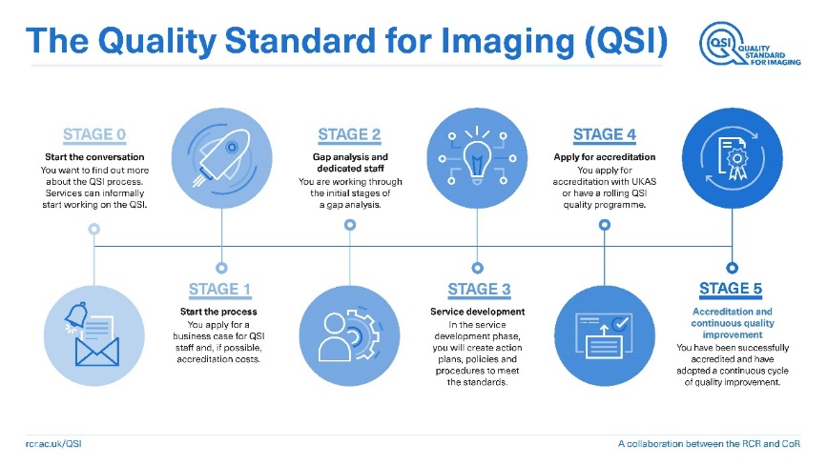
Quality Standard for Imaging (QSI)
Collaboration with CoR
Refined to focus on outcomes to benefit patients and service delivery
Relaunched 2021

Slide 12
QSI (2)
All healthcare organisations must have systems ensuring communication if radiology reports to referrers and MDTs in a timely fashion
All healthcare organisations must have systems to manage communication of unexpected findings and potential medical emergencies

Slide 13
Where does that get us?
Recognition of the pivotal role imaging plays in the patient pathway
Quality or report (and referral)
Timeliness of report
Need for failsafe alerting system
Need for referrers to hand off imaging requests

Slide 14
And?
Problem recognised and accepted so surely can be addressed and answered?

Slide 15
Are we alone?
European Society of Radiology: 2012
Communicating critical radiological findings enables urgent or appropriate action to be taken
Good communication helps improve patient safety
Clear departmental protocols become familiar to referrers within the organisation
Referrers should be aware of their responsibility to read and act on radiological reports
European Society of Radiology. Insights Imaging. 2012 Feb; 3(1): 1–3

Slide 16
Are we alone? (2)
No – all healthcare systems face the same challenges
All have struggled with them
But some have better infrastructure to manage them

Slide 17
Healthcare Safety Investigation Branch
Same problems - 2019
New “broom”
Challenge to work together – an acknowledgement that radiology cannot solve these problems alone

Slide 18
HSIB recommendations (1)
The RCR charged with collaborating on:
Standardised process and definitions for acting on abnormal findings across multiple specialties to be developed
Healthcare organisations to develop a fail-safe system aiming to make delayed / missed diagnosis due to notification failure a never event
Standard result notification process via a digital platform or paper-based approach, including an alert system to prioritise actions
The system should define responsibility for communicating results to patients

Slide 19
HSIB recommendations (2)
NHSE/I patient safety team to ensure providers are aware of the safety recommendations
Providers need to act on key findings regarding risk controls
NHSX to develop a way to digitally notify patients of report findings in collaboration with RCR – which should be tested and evaluated
CQC to incorporate findings in the core service framework to mitigate risk of findings not being acted on

Slide 20
PHSO report - 2020
IT failings as a patient safety issue
Role of the system as well as individuals

Slide 21
PHSO recommendations
Implement what you have already identified as necessary
Digital infrastructure is a patient safety issue
Ensure sufficient time in job plans for reflection and learning
Use PHSO information to update RCR guidance

Slide 22
HSIB response: Methodology
Academy agreed to host multi-specialty task and finish group
Open acknowledgement from all sectors that this is a shared responsibility
Benefit to timely patient care

Slide 23
HSIB response: Partners
RCR – patient safety and professional practice
SCoR – professional and lead representatives
RCEM, RCGP, RCPCH, RCPL, RCSEng and AoMRC – those making requests and wishing to receive results in a timely fashion
NHSD – theme of IT connectivity to enable timely alerting and escalation to benefit patient safety

Slide 24
HSIB response: Outputs
Lay and patient input on validity of outputs
Cross specialty agreement on what needs to be urgently alerted – headings of “cancer”, “critical” and “addendum”
Focus of impact on changes in patient management

Slide 25
HSIB response: Outcomes
Document in final draft form
Stakeholder consultation
Launch shortly
Highlighting the need for a systems approach – both personal and digital - shared across referrer and reporter

Slide 26
The future
Adoption of cross specialty guidance locally
Implementation of local systems to deliver this guidance
Upgrading of IT to enable delivery of joined up service
Use of AI in workflow, triage, alerting and audit

Slide 27
Aim
Adoption of definitions universally – better standardisation, clear message to industry and research partners, platform for audit / QI
No more reports highlighting missed diagnoses

Slide 28
Acknowledgements
William Ramsden – Vice President, Clinical Radiology, RCR
Teik Choon See – Patient Safety Advisor, RCR and other members of the short-life working group

Slide 29
Questions

