Slide 1
LPS Virtual Conference
Hayley Moore, Interim Head of Inspection for Adult Social Care
03 December 2021

Slide 2
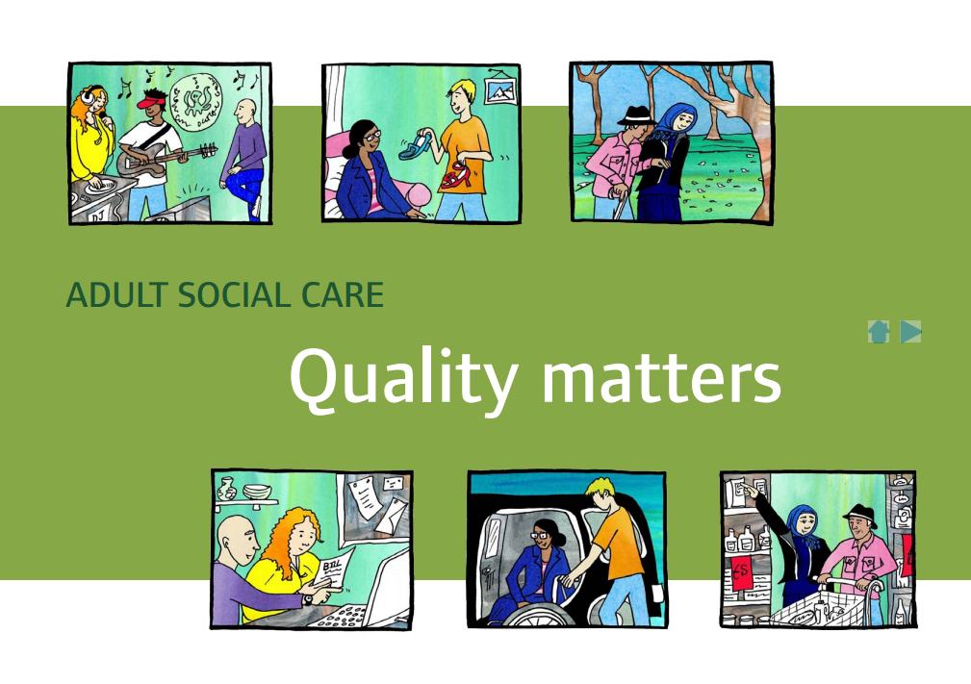

Our role and purpose
The Care Quality Commission is the independent regulator of health and adult social care in England
We make sure health and social care services provide people with safe, effective, compassionate, high-quality care and we encourage care services to improve

Slide 3
Present - How do CQC apply DoLS?
We monitor use of the Mental Capacity Act in all health and care services in England.
We monitor the use of the Deprivation of Liberty Safeguards (also known as DoLS) in all care homes and hospitals in England.
We receive notifications from providers about the outcome of DoLS applications.
We check on the use of DoLS by visiting the places where they are used.

Slide 4
What are we finding on inspection?
Notifications – Notifications from adult social care services and hospitals fell sharply during the early months of the Covid-19 pandemic
However, providers and local authorities were largely able to maintain overall levels of DoLS activity compared with 2019/20.
Challenges posed by Covid – good examples of providers thinking creatively to support social distancing and isolation in the least restrictive way possible
However, concerns that providers’ focus shifted away from DoLS towards managing COVID-19 restrictions, causing increased isolation, and negatively affecting wellbeing and family relationships
MCA/DoLS training - Better training is needed to improve staff knowledge and understanding of DoLS and the MCA, and their importance in protecting people’s human rights.

Slide 5

LPS and CQC’s role
  CQC and Ofsted will be the monitoring bodies for LPS in England
  Regulations and Codes of Practice will set out the details of how monitoring bodies will discharge the statutory LPS functions
  A public consultation on draft Regulations and Codes of Practice will precede LPS implementation
  We will monitor DoLS and LPS together for the first year of implementation
  Responsible bodies will provide regular notifications to CQC
  Monitoring bodies in England and Wales will work together on LPS

Slide 6
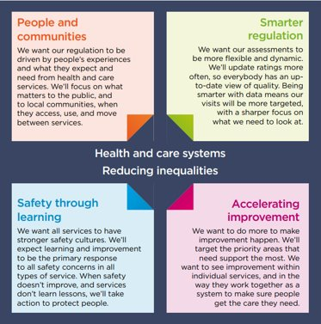
LPS and CQC’s future strategy
  Our monitoring of LPS will focus on the experiences of those subject to safeguards, their families and carers
  We will use quality data to develop a risk-based monitoring and reporting model
  We will work with all system partners, including responsible bodies to protect and safeguard people subject to LPS and drive improvements
  Through our annual reporting we tell the public the impact LPS is having on people, and advise on necessary changes and improvements

