Slide 1
MBRRACE-UK Perinatal Mortality Surveillance for Births in 2019 Saving Babies Lives conference - 9th December 2021
Professor Elizabeth S Draper

Slide 2
MBRRACE-UK

Slide 3
MBRRACE-UK Perinatal mortality rates
Surveillance of all…
stillbirths (from 24⁺⁰ weeks gestation)
neonatal deaths (from 20⁺⁰ weeks gestation)
late fetal losses (22⁺⁰ to 23⁺⁶ weeks gestation)
https://www.nhsx.nhs.uk/key-tools-and-info/data-saves-lives/improving-health-and-care-services-for-everyone/improving-the-care-of-mothers-and-babies/

Slide 4
Data for denominators and validation
NIMATS births
NIMATS deaths
NIMATS inpatient data
NRS births
NRS deaths
ISD – SMR02
PDS births
2019: 716,825 UK births
ONS births
ONS deaths
PDS births
ONS births
ONS deaths
PDS births
States of Guernsey births
States of Guernsey deaths
States of Jersey births
States of Jersey deaths

Slide 5
Main report overview
Perinatal mortality rates in the UK: 2019
Mortality rates by gestational age
Effect of deprivation on perinatal mortality
Effect of ethnicity on perinatal mortality
Effect of mother’s age on perinatal mortality
Multidimensional effects of ethnicity, deprivation and mother’s age on perinatal mortality
Perinatal mortality rates for Trusts and Health Boards
Causes of perinatal death
Timeliness of notification of perinatal deaths
Deprivation
Maternal age
Ethnicity

Slide 6
1,158
neonatal
deaths
2,399 stillbirths
716,825 births
1,436
neonatal
deaths
3,286 stillbirths
781,932 births

Slide 7
6.04 per
1000 total births
4.96 per
1000 total births
4.20 per
1000 total births
3.35 per
1000 total births
1.84 per
1000 live births
1.62 per
1000 live births

Slide 8
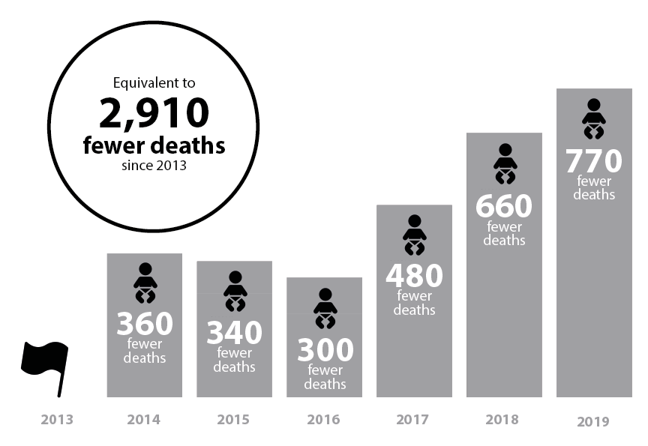

Slide 9
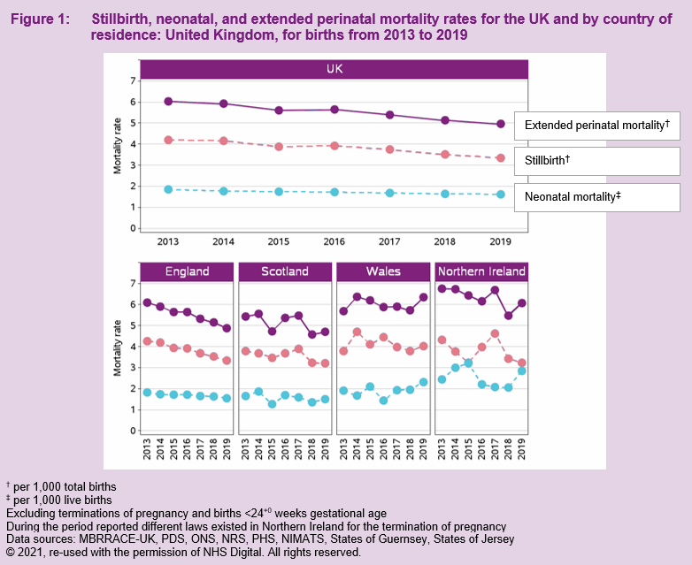

Slide 10
Recommendations
New
Enhance current programmes in order to accelerate the reduction of SBs & NNDs to meet national targets, with an emphasis on reducing rates of preterm birth, particularly the most extreme preterm group
Recommendation requiring improved implementation
Develop public health initiatives to address issues linked to high risk populations. (MBRRACE-UK 2020)

Slide 11
Mortality rates by gestational age
What did we look at?
Rates of SB, NND and extended perinatal death for births that occurred from 2015 to 2019 at ≥ 22⁺⁰ weeks GA (excl. TOPs) in the UK, by gestational age.
Trends in rates of SB, NND and extended perinatal death for births that occurred from 2015 to 2019 at ≥ 22⁺⁰ weeks GA (excl. TOPs) in the UK, by gestational age.

Slide 12
10%
7%
10%
19%

Slide 13
12%

Slide 14
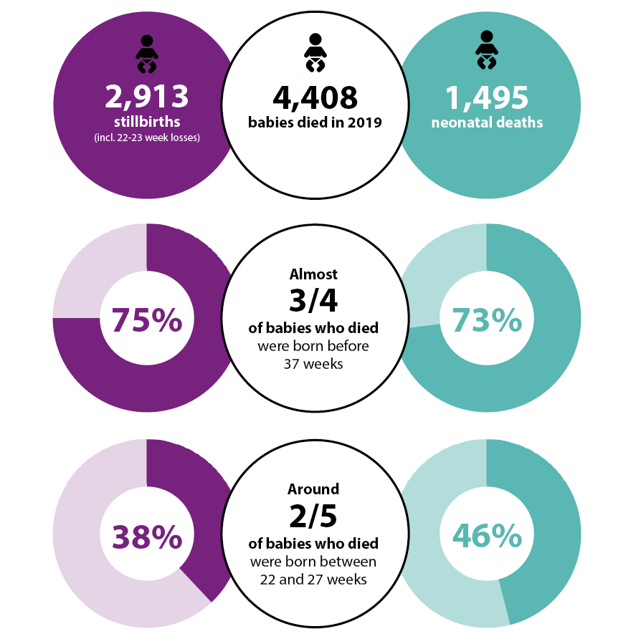
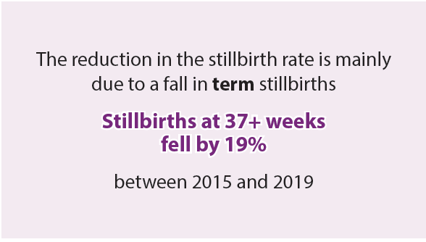
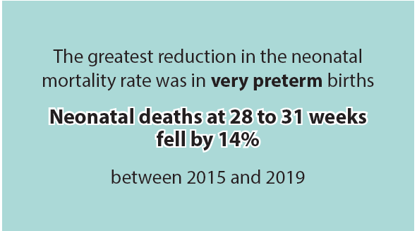
Notes:
So in summary….

Slide 15
Recommendations
New
Continue to develop innovative new programmes of research into reducing preterm birth.
To ensure standardised reporting of deaths before 24⁺⁰ weeks, use the MBRRACE-UK guidance for the assessment of signs of life in births before 24⁺⁰ weeks gestational age
Recommendation requiring improved implementation
Ensure that healthcare providers have implemented national initiatives to reduce SB / NNDs & are monitoring their impact on reducing preterm birth (MBRRACE-UK 2020).

Slide 16
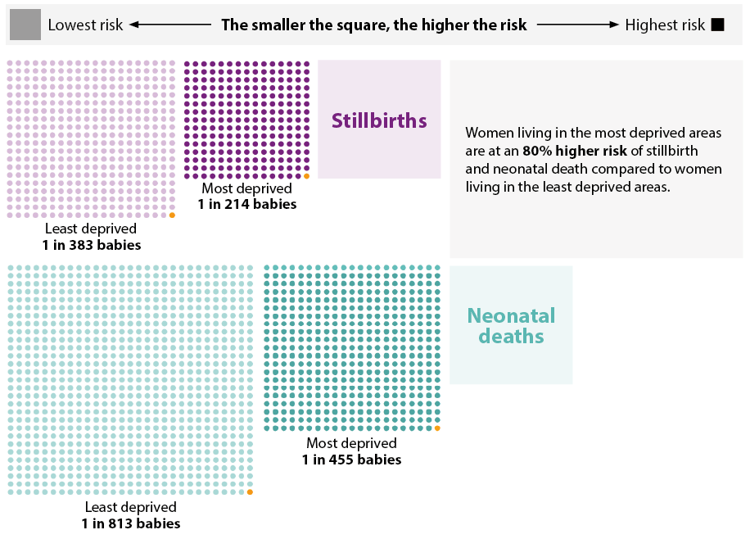
Effect of deprivation on perinatal mortality
Most deprived
4.67 per 1000 births
1 in 214 babies
2x
higher risk of stillbirth
for women living in the most deprived areas compared to those from the least deprived areas
Least deprived
2.33 per 1000 births
1 in 429 babies
Most deprived
2.07 per 1000 live births
1 in 483 babies
Least deprived
1.20 per 1000 live births
1 in 833 babies

Slide 17
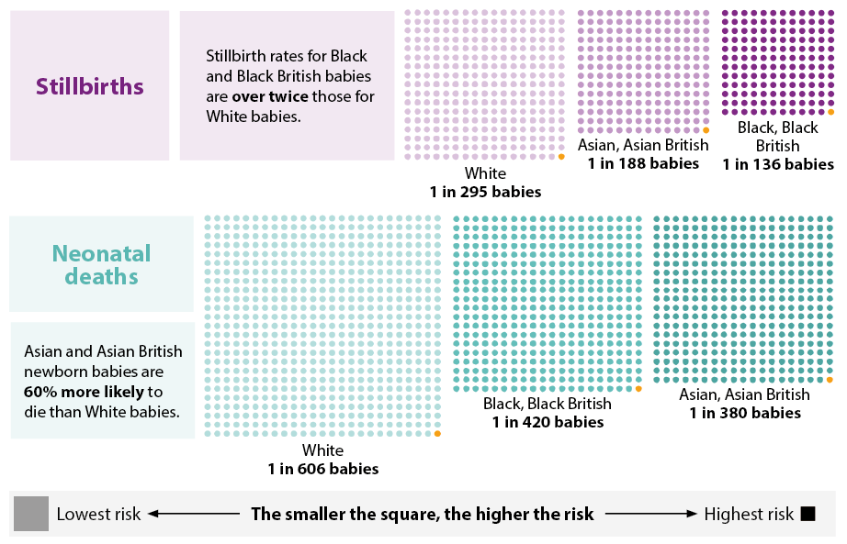
Effect of
ethnicity on
perinatal mortality
Black, Black British
7.23 per 1000 births
1 in 139 babies
Asian / Asian British
5.05 per 1000 births
1 in 198 babies
White
3.22 per 1000 births
1 in 310 babies
Black, Black British
2.32 per 1000 births
1 in 431 babies
Asian, Asian British
2.57 per 1000 births
1 in 389 babies
White
1.62 per 1000 births
1 in 617 babies

Slide 18
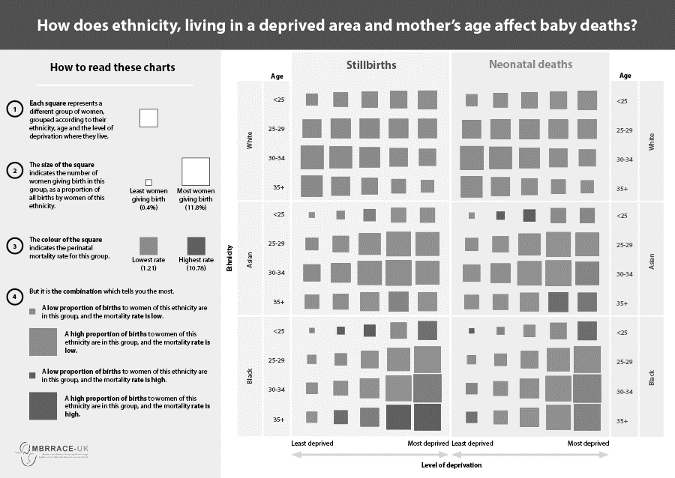

Slide 19
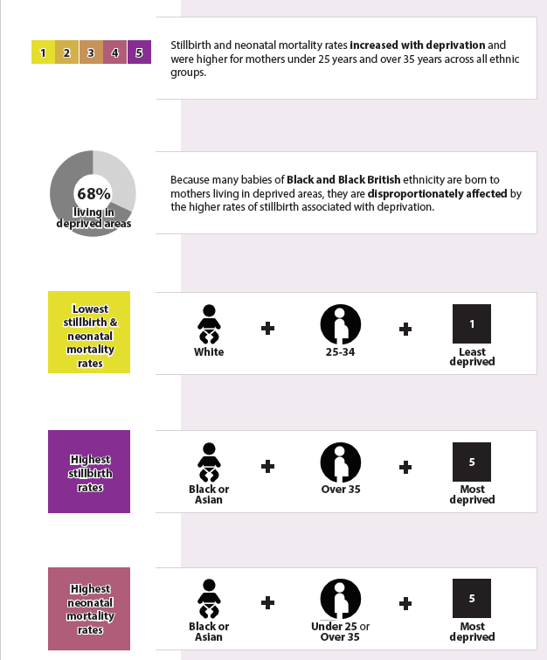
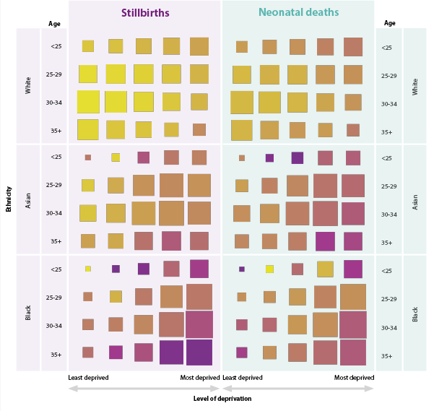

Slide 20
New Recommendations
Initiate a research programme to inform the development of effective interventions to address health inequalities and reduce stillbirth and neonatal mortality rates.
Develop focused initiatives to reduce stillbirths and neonatal deaths among groups of mothers at the highest risk, informed by the multidimensional effects of ethnicity, deprivation and mother’s age

Slide 21
Mortality rates for Trusts and Health Boards
To account for the wide variation in case-mix, Trusts and Health Boards were classified hierarchically into five mutually exclusive comparator groups, based on their level of service provision:
Level 3 NICU and neonatal surgery;
Level 3 NICU;
4,000 or more births per annum at 24 weeks or later;
2,000-3,999 births per annum at 24 weeks or later;
Under 2,000 births per annum at 24 weeks or later.

Slide 22
How mortality rates are reported
Trusts/Health Boards & Neonatal Networks mortality rates are:
Stabilised to allow for
Random variation
Takes into account the lack of data
“How much evidence is there that the mortality rate of any organisation is different from the national rate?”
Adjusted to allow for
Differences in risk in the populations wrt: ethnicity, deprivation, mother’s age, sex of child, multiplicity, gestation at delivery (NNDs only)

Slide 23
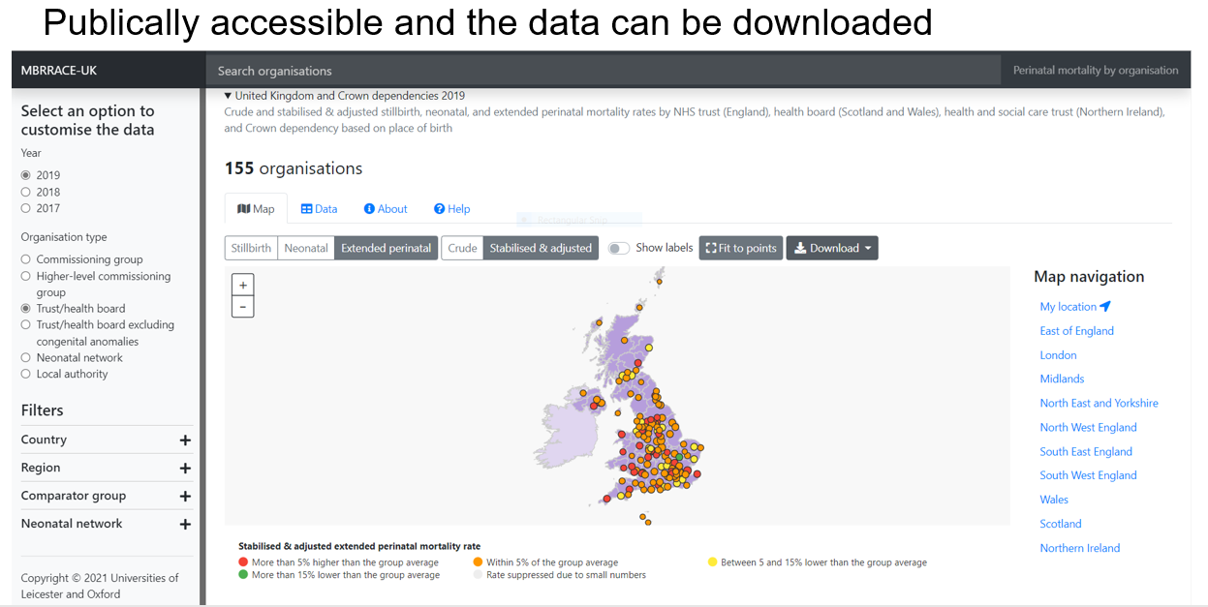
New interactive online maps

Slide 24
New interactive online maps

Slide 25
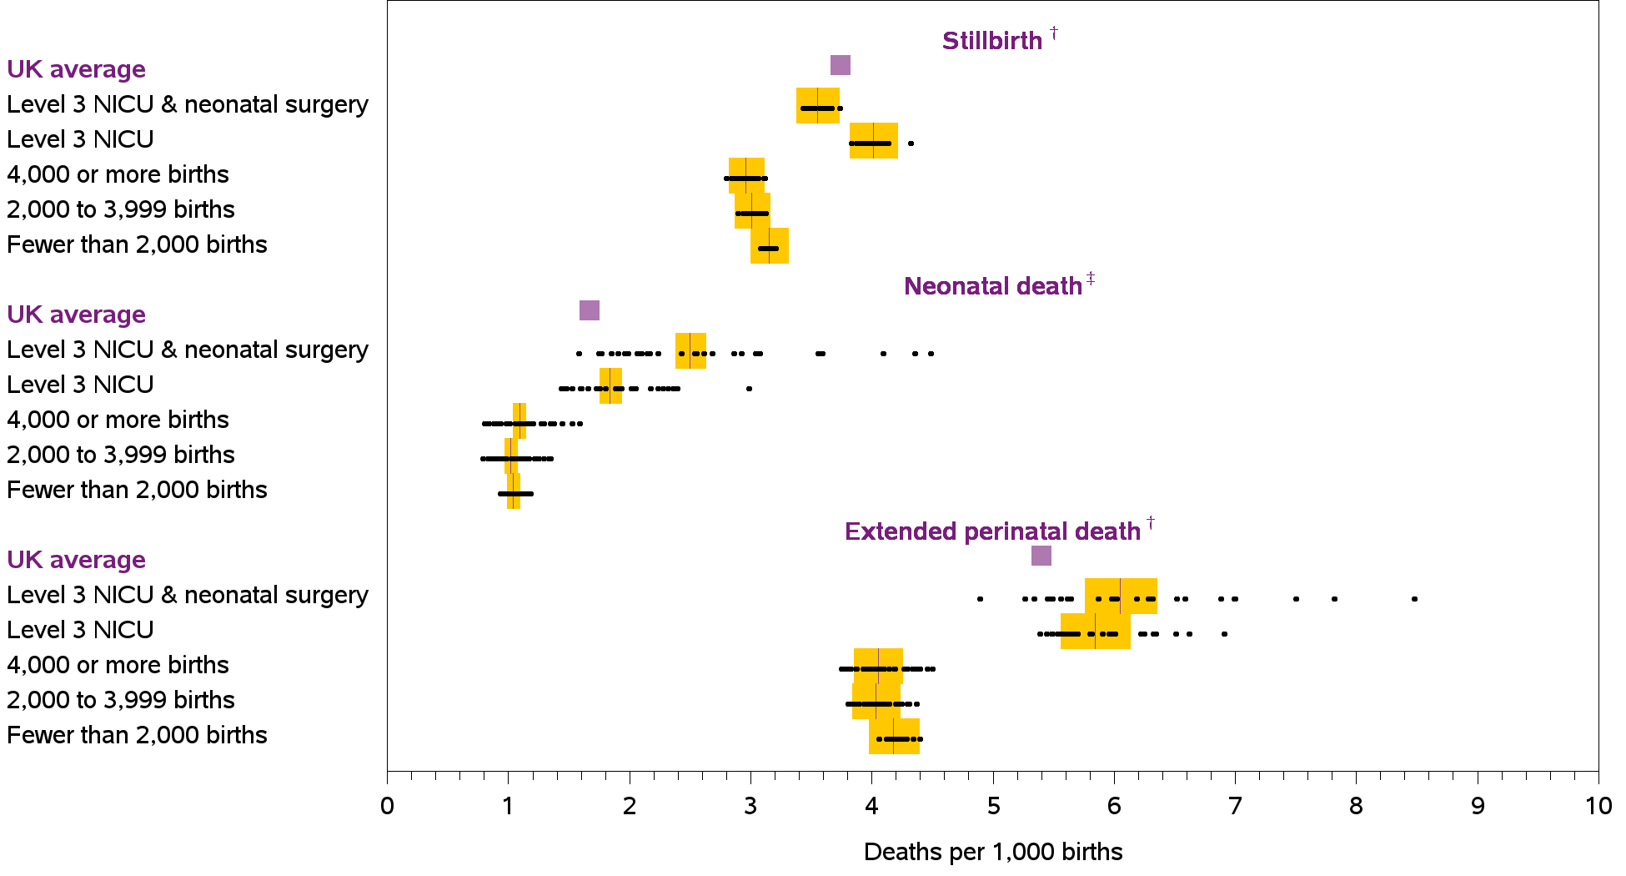
Stabilised & adjusted mortality by Trust or Health Board

Slide 26
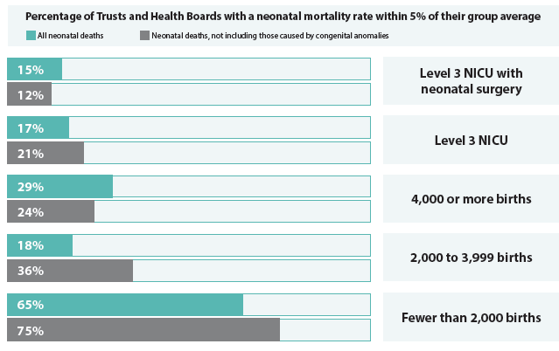
Variation in SB & NND rates between Trusts & HBs
Little variation in SB rates
Wide variation in NND rates – even after exclusion of congenital anomalies.
Mainly focused in Level 3 NICUs
Need to determined reasons….
Local population characteristics
Quality of care provision

Slide 27
Recommendations
New
Use the newly-developed MBRRACE-UK interactive maps and tables to compare stabilised and adjusted mortality rates between organisations
Recommendation requiring improved implementation
Use the MBRRACE-UK real-time data monitoring tool as part of regular mortality meetings to help identify why an organisation’s stabilised & adjusted mortality rate falls into the red or amber band.
Investigate potential modifiable factors in the treatment of neonates when an organisation’s stabilised and adjusted neonatal mortality rate falls into the red or amber bands after exclusion of deaths due to congenital anomalies. Ensure that this encompasses both local population characteristics and quality of care provision

Slide 28
Learning from Standardised Reviews When Babies Die - 2021

Slide 29
Implementation of the PMRT
National PMRT - launched early 2018 ---- over 14,000 reviews have been started.
All Trusts & Health Boards across England, Wales and Scotland had registered to use the PMRT within 4 months of the launch. Implemented in Northern Ireland in late 2019.
Third annual report coincides with the first year of the SARs-CoV-2 global pandemic from March 2020 to February 2021 – 3,981 completed reviews
Full report available to download: https://www.npeu.ox.ac.uk/pmrt/reports

Slide 30
Multi-disciplinary Review
Better quality local reviews are carried out when a multi-disciplinary group conducts the review compared with a review by only one or two members of staff.
Each participant involved in a review session should be recorded in the PMRT.
The minimum composition for the perinatal mortality review group is set out in the Guidance for using the PMRT:
Stillbirths and late miscarriages:
Two midwives and two obstetricians
Neonatal deaths:
Two midwives, two obstetricians, two neonatal nurses and two neonatologists

Slide 31
Multi-disciplinary Review
Membership of the review team at the review session with the largest number of participants
* Minimum recommended staff: two midwives and two obstetricians for reviews of stillbirths and late miscarriages, and in addition two neonatal nurses and two neonatologists for neonatal deaths.
from 17%
from 19%
from 27%
33%
from 18%
from 92%
Arrows compared with previous reporting period

Slide 32
Multi-disciplinary Review
External member* of the review group
*Relevant professional who is external to the Trust/Health Board whose role is to provide a ‘fresh pair of eyes’ to the review

Slide 33
Parent Engagement
Parents whose baby has died have the greatest stake in understanding what happened and why their baby died.
Engaging bereaved parents in the review process and including their views and any concerns and questions they have about their care enhances the process of review and ensures that from the outset that the review addresses any questions or concerns they have about their care.

Slide 34
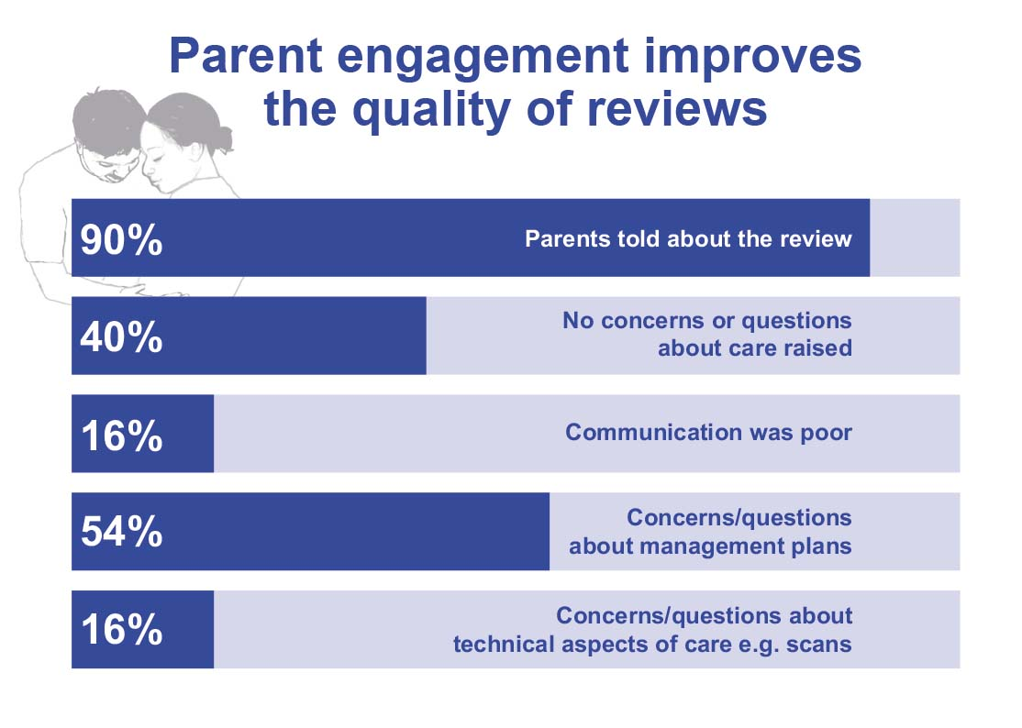
Parent Engagement Improves the Quality of Review
from 84%
from 78%

Slide 35
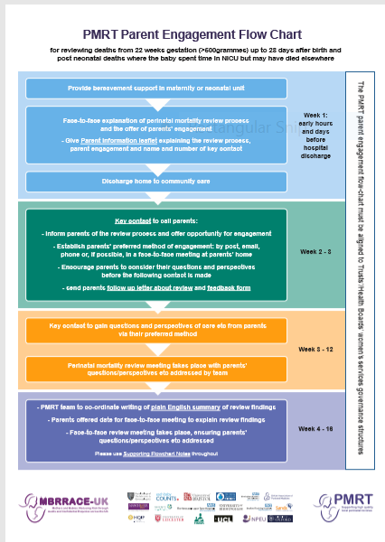
Engaging Parents in Reviews
All of these reviews were carried out after the release of the PMRT Parent Engagement Resources.
At present we have no information about how many Trusts/Health Boards are using the pathway or resources to help with parent engagement.
Please let us know if you are using the resources and if you find them useful.
https://www.npeu.ox.ac.uk/pmrt/parent-engagement-materials

Slide 36
Issues with Care Identified
At least one issue with care was identified in 19/20 reviews with an average of 4 issues per review
Late miscarriages - 95% identified at least one issue, average 3 issues
Stillbirths - 96% identified at least one issue , average 4 issues
Neonatal deaths - 97% identified at least one issue, average 5 issues

Slide 37
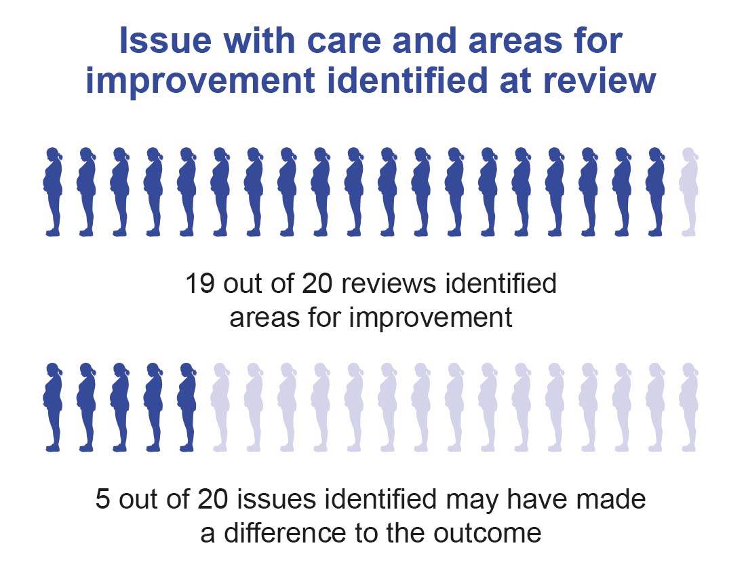
Issues with Care Identified
Of the issues raised about 5 in every 20 may have made a difference to the outcome

Slide 38
Impact of the SARS-CoV-2 global pandemic on care
The five most common issues relating to the impact of the SARS-CoV-2 global pandemic on care*:
*Questions introduced in July 2020

Slide 39
Action plans in response to issues….
Action plans needs to be strong*
No
Improvement from 2019
Strong actions are system changes which remove the reliance on individuals to choose the correct action. They use standardisation and permanent physical or digital designs to eliminate human error and are sometime referred to as ‘forcing’ actions
Veterans Affairs, Root Cause Analysis Tools. USA 2015

Slide 40
Examples of action strength
Weak
“Distribute communication to maternity staff regarding the necessity for intrapartum antibiotics in preterm labour and the importance of this.”
This is a reminder for individual action without any controls
Intermediate
“Major review which led to a new staffing model and a newly appointed Lead for Triage and Induction.”
A new system in place but as yet still requires individuals to act without any controls
Strong
“Process for assessing need for aspirin developed and implemented via electronic patient record (EPR).”
A system level electronic design to reduce/eliminate human error

Slide 41
Recommendations
1. Provide adequate resourcing of multidisciplinary PMRT review teams, including administrative support and ensure the involvement of independent external members in the team.
Action: Trusts & Health Boards, regional network support systems & organisations, Service Commissioners
2. Use the PMRT parent engagement materials to support engaging parents and families in the review process, including them being made aware a review is taking place and being given flexible opportunities at different stages to discuss their views, ask questions and express any concerns. Many parents may want to give positive feedback about the care they received.
Action: Trusts & Health Boards, staff caring for bereaved parents, Service Commissioners
3. Use the local PMRT summary reports and this national report as the basis to prioritise resources for key aspects of care and quality improvement activities identified as requiring action.
Action: Trusts & Health Boards, Service Commissioners, regional/network support systems, Governments
4. Improve the quality of recommendations developed as a consequence of reviews by developing actions targeted at system level changes and audit their implementation and impact.
Action: PMRT review teams, governance teams in Trusts & Health Boards, Service Commissioners

Slide 42
Thank you
Trust/Health Board Reporters
Organisations which provide population data:
ONS & NHS Digital (England, Wales & Isle of Man)
NRS & ISD (Scotland)
NIMACH (Northern Ireland)
HSSD (Guernsey)
HIU, PHS (Jersey)
Independent Advisory Group
Stakeholder groups
The Leicester based perinatal team
Programmers and data team in Oxford
Report production team Leicester
Launch meeting organising team
MBRRACE-UK collaborators
Funders – HQIP on behalf of NHS England / DH, Devolved Governments and the Crown Dependencies

Slide 43
MBRRACE-UK/PMRT collaboration
MBRRACE-UK
Jenny Kurinczuk
Elizabeth Draper
Marian Knight
Alan Fenton
Charlotte Bevan
Thomas Boby
Peter Brocklehurst
Sara Kenyon
Bradley Manktelow
Janet Scott
Lucy Smith
Peter Smith
Derek Tuffnell
Sarah Prince
Scott Redpath
Miguel Neves
Each Baby Counts, RCOG
Gemma Goodyear
British Association of Perinatal
Medicine
Karen Luyt
PARENTS study team
Dimitrios Siassakos
Claire Storey
Alex Heazell
Royal College of Midwives
Zeeneth Uddin
Chair of the DH/Sands group
Tracey Johnston

